Slide 1
World History
The Age of Exploration

Slide 2
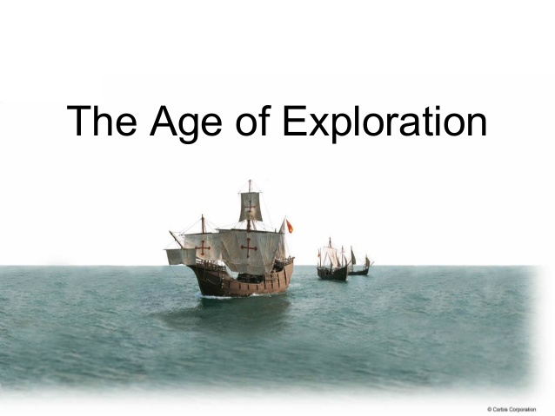

Slide 3
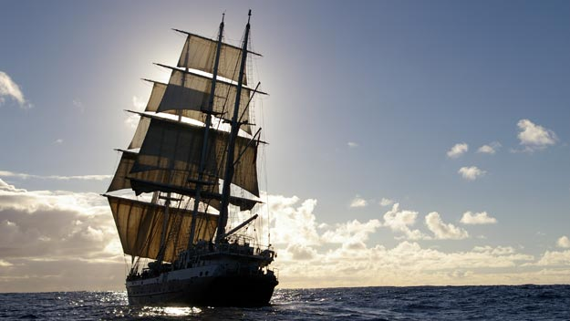
Age of Exploration: Is it good or bad?
Intro Video
https://www.youtube.com/watch?v=I_3L5zoX7Us&feature=youtu.be

Slide 4
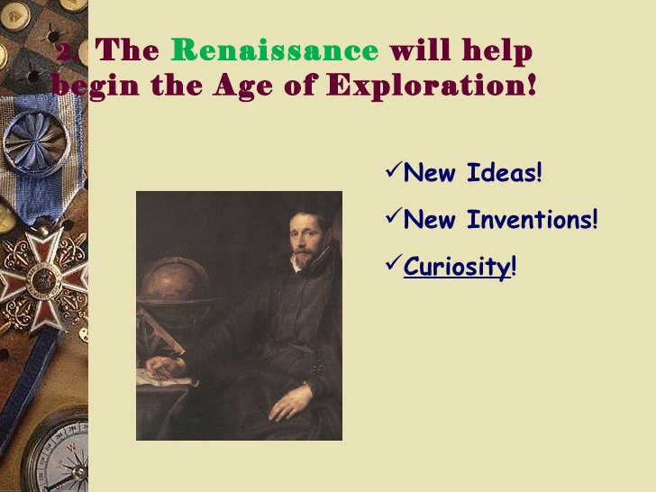

Slide 5
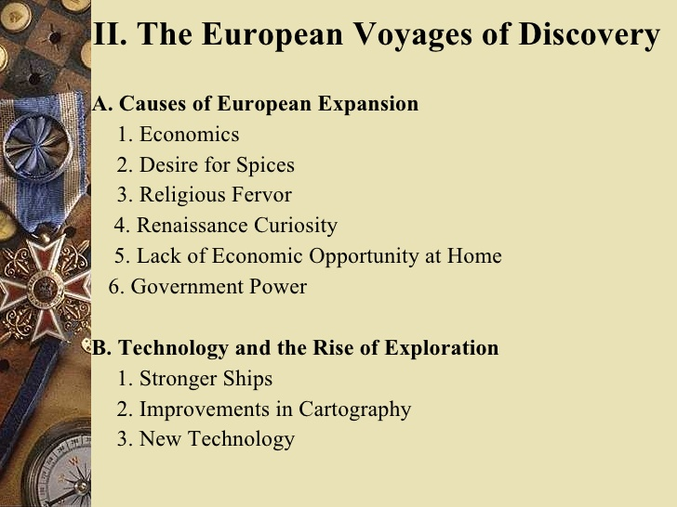

Slide 6

The Age of Exploration

Slide 7


Slide 8
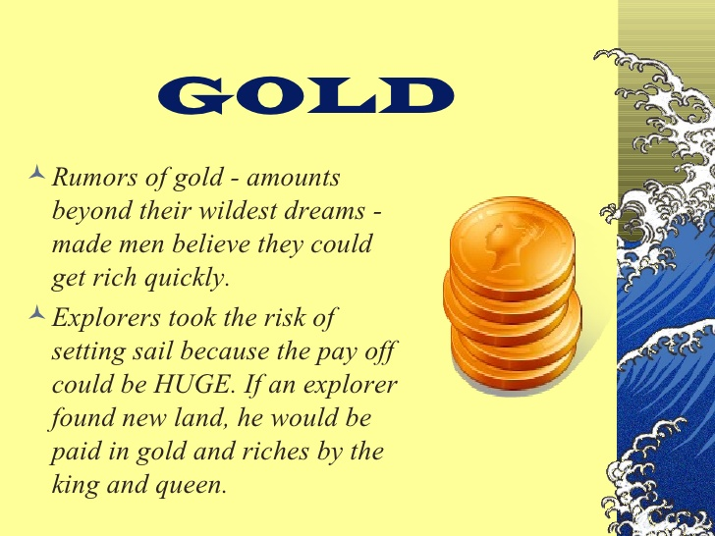

Slide 9
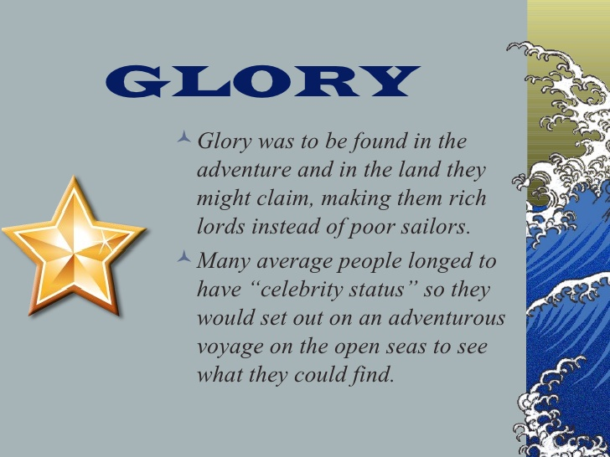

Slide 10
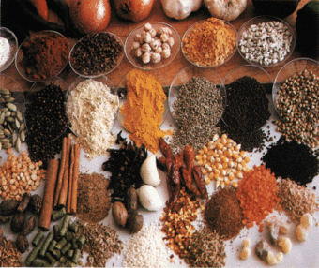
It’s All About The Spices

Slide 11
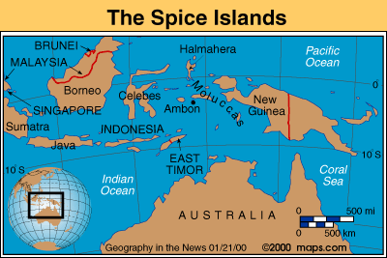
Spice Islands
Why spices?
They were used to preserve food
Flavor meat
Make medicines
Make perfumes

Slide 12
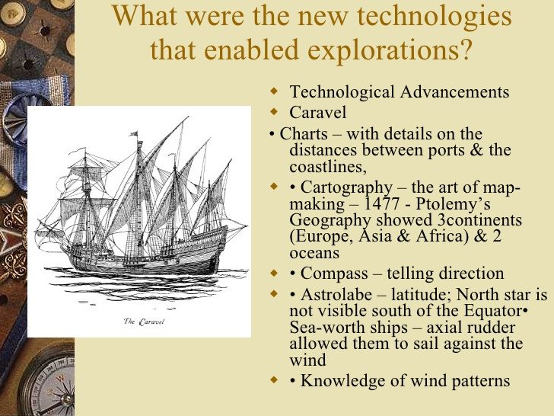

Slide 13
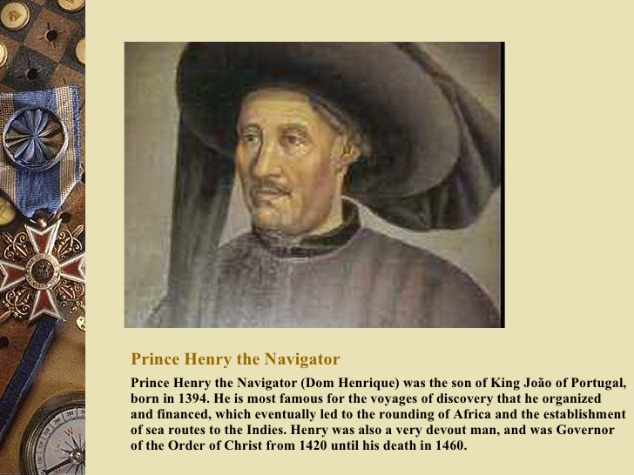

Slide 14
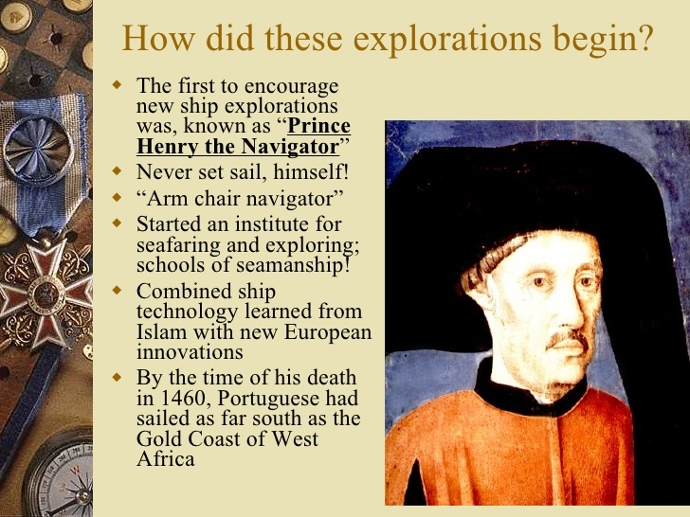

Slide 15
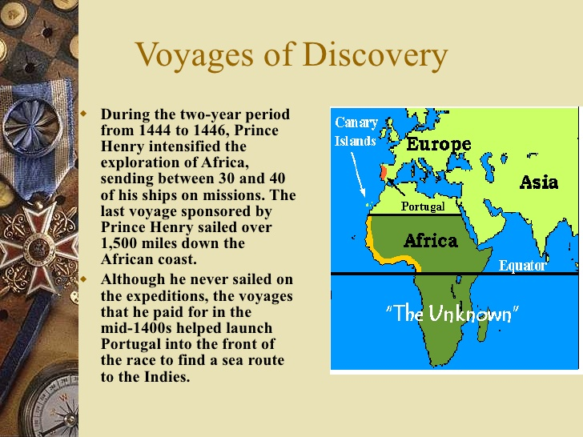

Slide 16
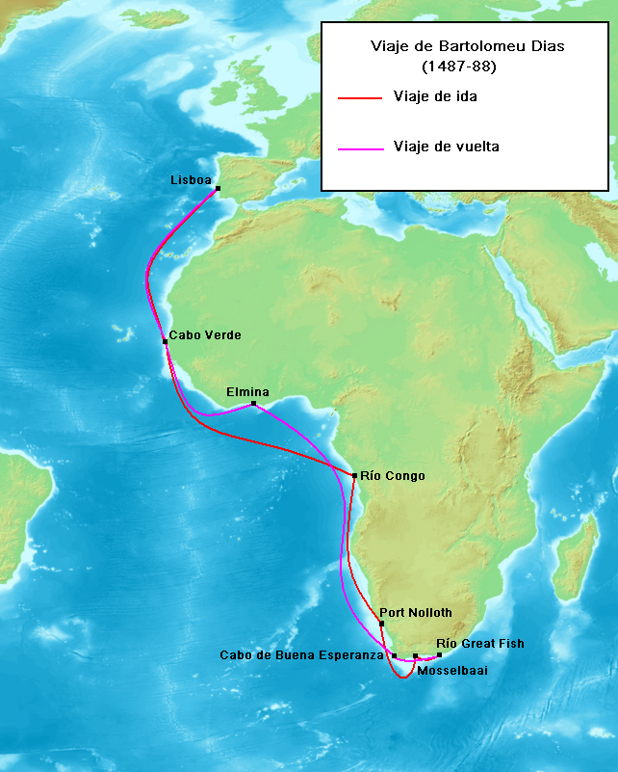
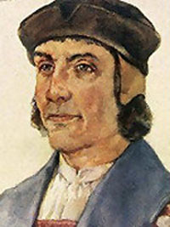
Dias rounds the tip of Africa

Slide 17
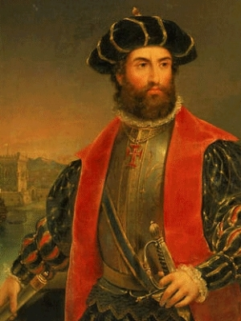
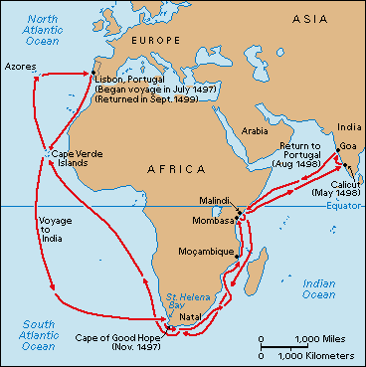
Da Gama Goes to India

Slide 18
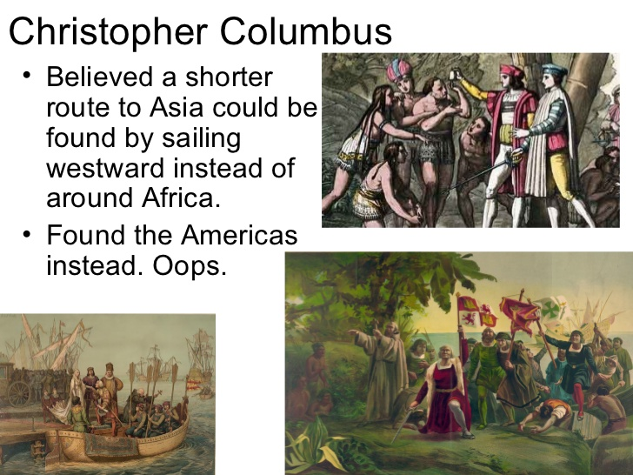
Columbus

Slide 19
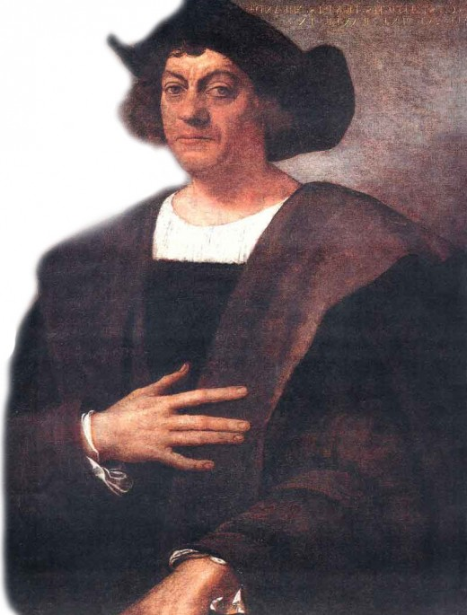
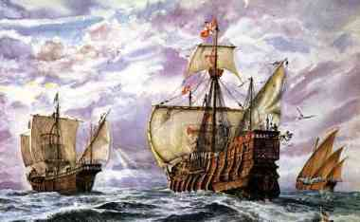
Christopher Columbus
Good guy or not so good guy?

Slide 20
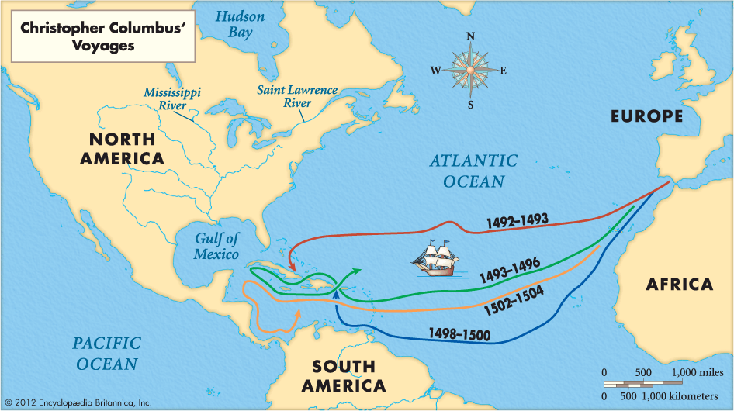
The Voyages of Columbus
Columbus on trial 5 min: https://www.youtube.com/watch?v=GD3dgiDreGc&feature=youtu.be
Should we still celebrate Columbus Day?
Crash Course Columbus, DeGama Zheng He:
https://www.khanacademy.org/partner-content/crash-course1/crash-course-world-history/road-trip-conquest-trade/v/crash-course-world-history-21

Slide 21
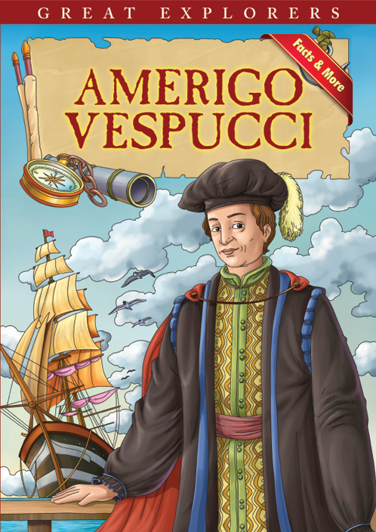
Italian explorer Amerigo Vespucci
On May 10, 1497, he embarked on his first voyage. On his third and most successful voyage, he discovered present-day Rio de Janeiro and Rio de la Plata. Believing he had discovered a new continent, he called South America the New World. In 1507,America was named after him.

Slide 22
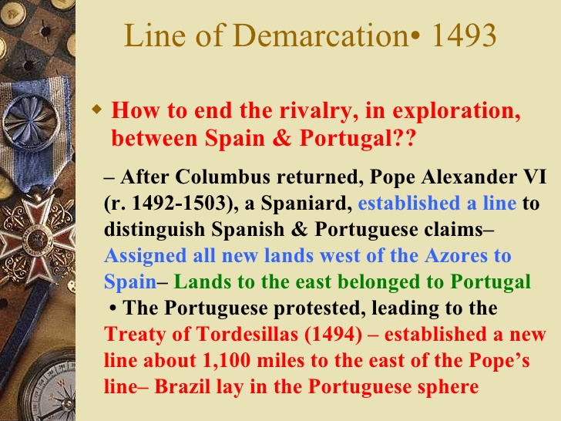

Slide 23
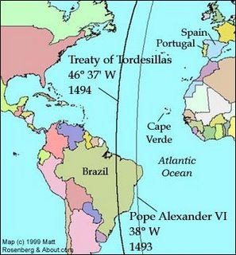
Treaty of Tordesillas divides the New World between Spain and Portugal

Slide 24
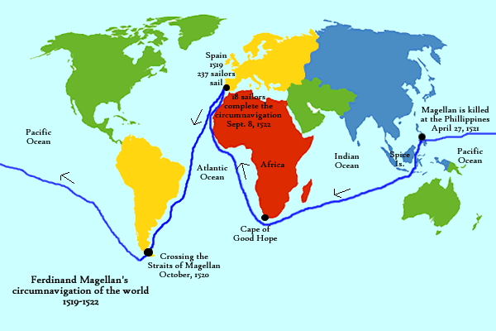
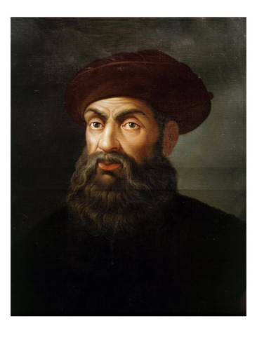
Magellan Circumnavigates the Globe
(actually 19 of his crew does, he dies along the way)

Slide 25
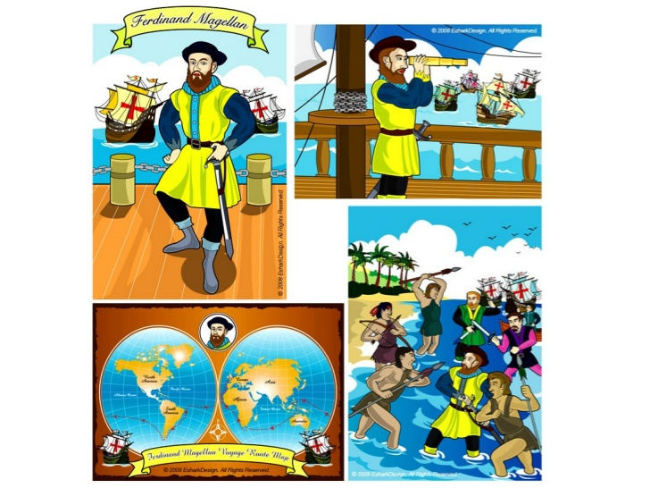
Magellan

Slide 26
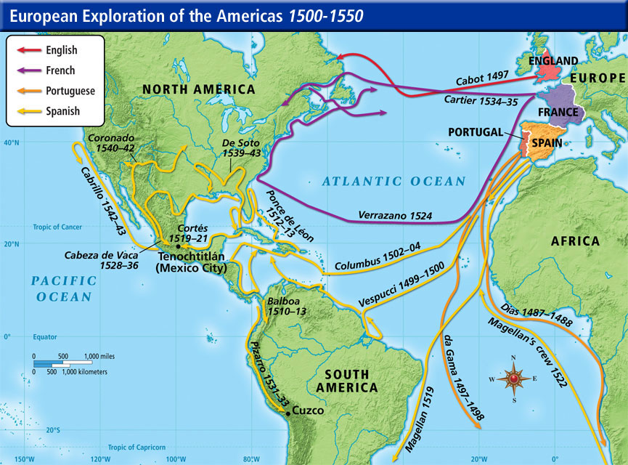
Age of Exploration

Slide 27
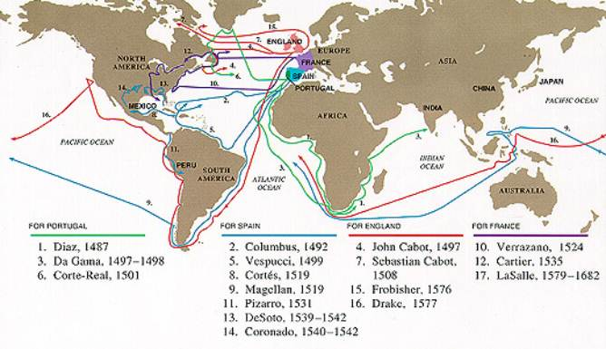
Who Went Where

Slide 28
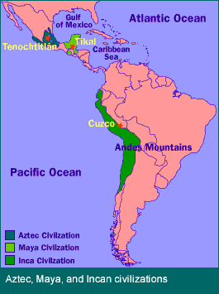
South American Empires

Slide 29
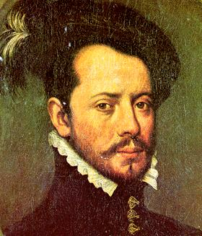
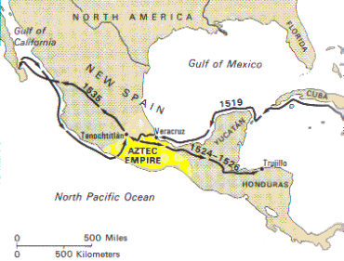
Cortez Conquers the Aztecs
Superior weapon, divisions among Indians and disease helped Spanish win

Slide 30
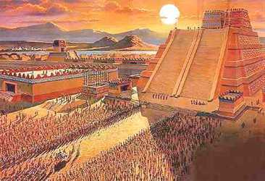
Aztec Empire
Aztec Death Whistle:
https://www.youtube.com/watch?v=I9QuO09z-SI
Keith Meso America in 17 minutes: https://www.youtube.com/watch?v=o5_DKwuP97w

Slide 31
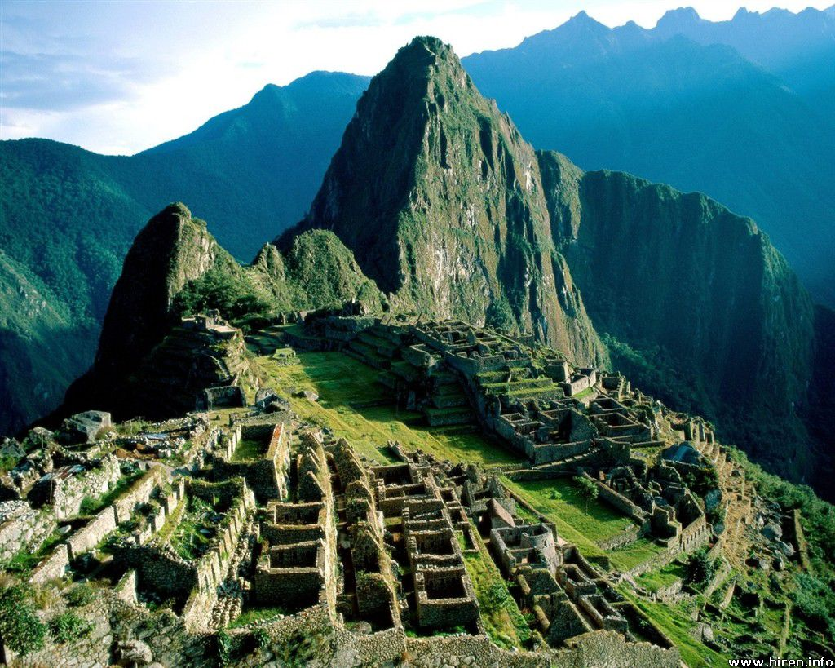
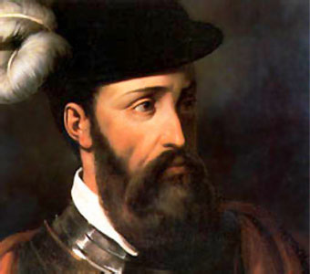
Pizarro Conquers the Incas

Slide 32
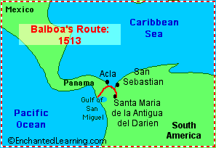
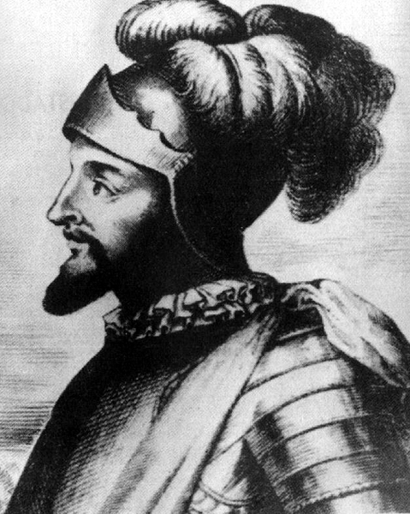
Balboa

Slide 33
French, Dutch and English Explorers
John Cabot: navigator and explorer. His 1497 discovery of the coast of North America under the commission of Henry VII of England is the earliest known European exploration of coastal North America
Sir Francis Drake: First Englishman to circumnavigated the globe from 1577-1580
Henry Hudson: made two unsuccessful sailing voyages in search of an ice-free passage to Asia and explored Canada
Jacques Cartier: His exploration of the St. Lawrence River allowed France to lay claim to lands that would become Canada.

Slide 34
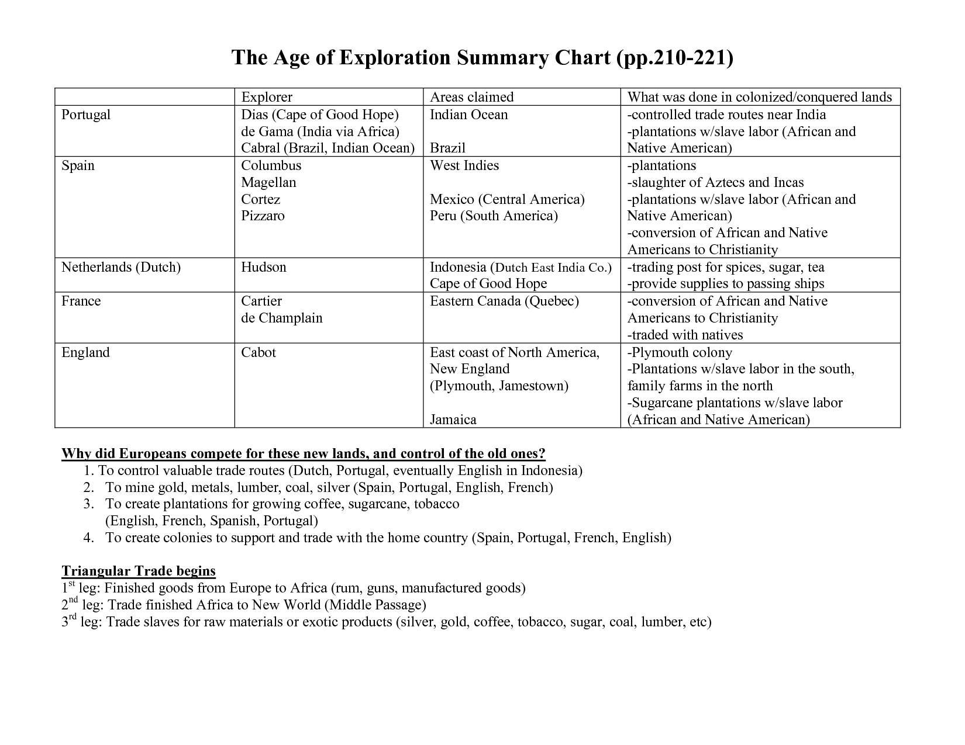
Age of Exploration Summary Chart

Slide 35
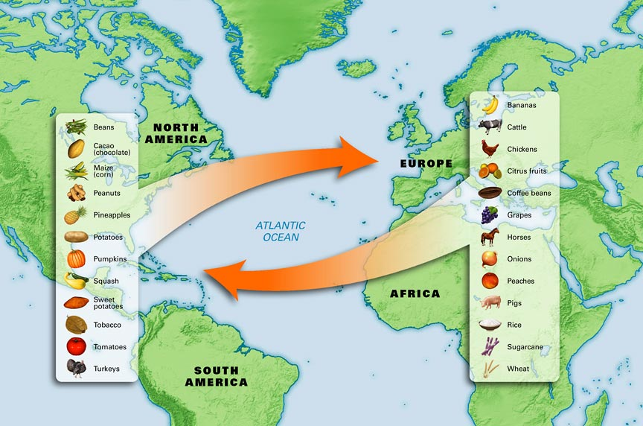
Columbian Exchange

Slide 36
Causes of the Columbian Exchange
European exploration of the world
Quest for God, Gold and Glory
Empire building
Discovery of the Americas
Colonization of the Americas by Spain, Portugal
Introduction of European cultures, goods, people, and diseases to the Americas

Slide 37
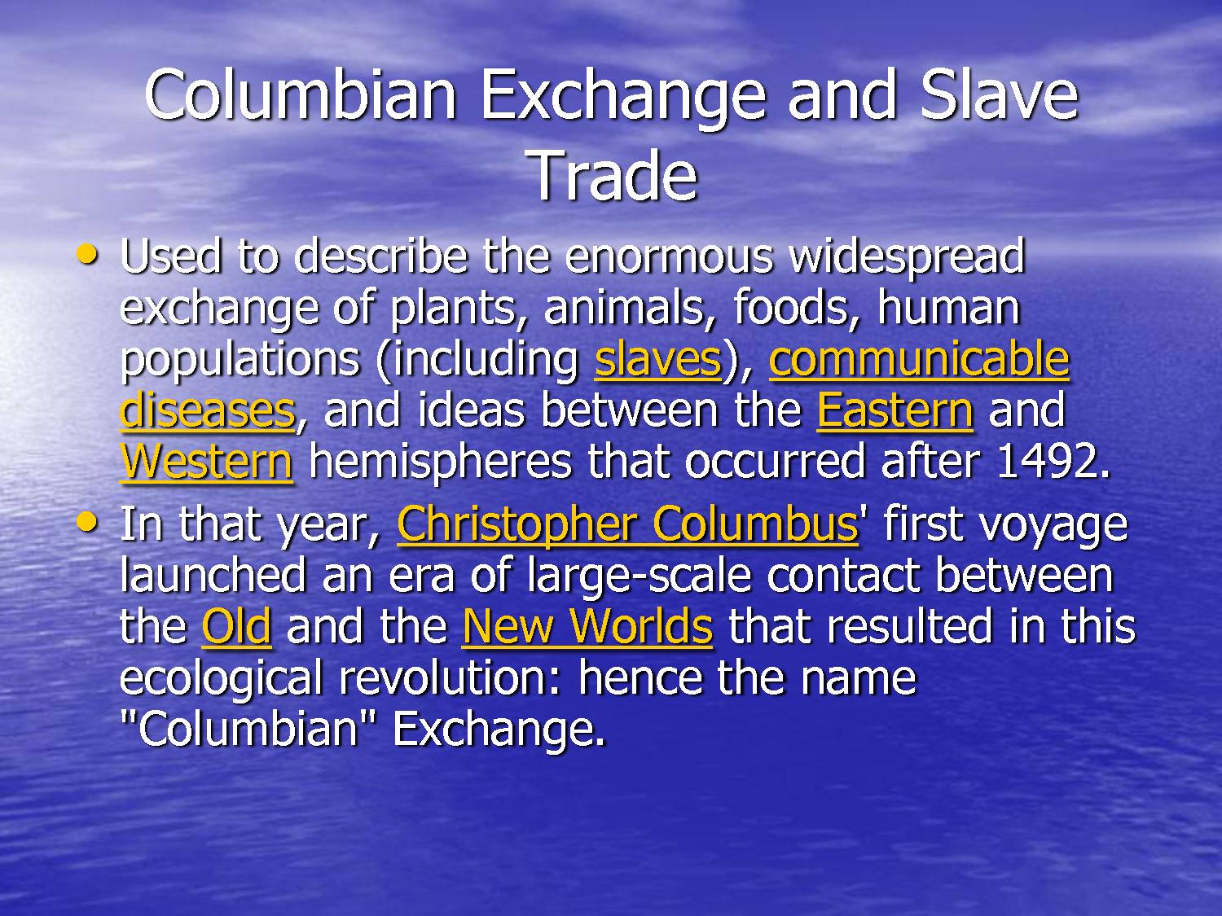
Columbian Exchange

Slide 38
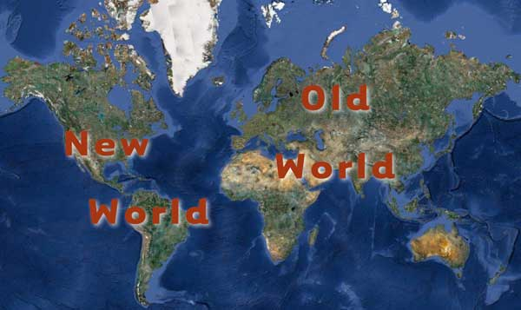
Old and New Worlds

Slide 39
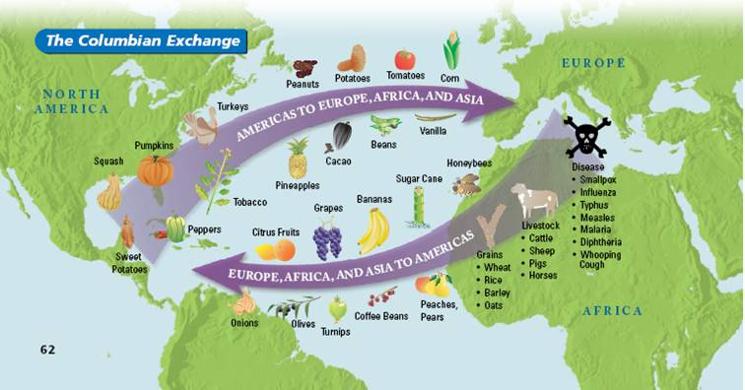
Columbian Exchange

Slide 40
Part of the Columbian Exchange
Sugar
At one time sugar was a luxury item that few Europeans could afford. Then in 1493 Columbus brought sugar cane plants to the Caribbean and it thrived. Prices fell and would come to be added to another treat from the Americas ….Chocolate!!!
Tulips
Tulipmania in the 1630’s in the Netherlands. People paid thousands for bulbs. Just as fast as the price soared it crashed
Columbian Exchange Crash Course: https://www.youtube.com/watch?v=HQPA5oNpfM4

Slide 41
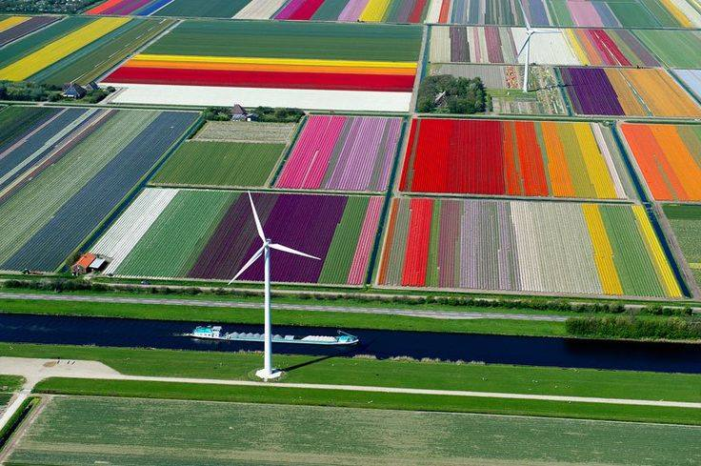
Growing Tulips Today

Slide 42
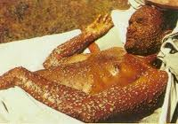
Effects of Disease in the Americas
In terms of death tolls, smallpox killed the greatest number of Indians, followed by measles, influenza, and bubonic plague. The most deadly European disease was smallpox, a disease almost unknown in today's world but common prior to the twentieth century.
The great impact of disease on the Native population of America is an important part of the story of European exploration. Some experts believe that as much as 90 percent of the American Indian population may have died from illnesses introduced to America by Europeans.

Slide 43

The Affects Today

Slide 44
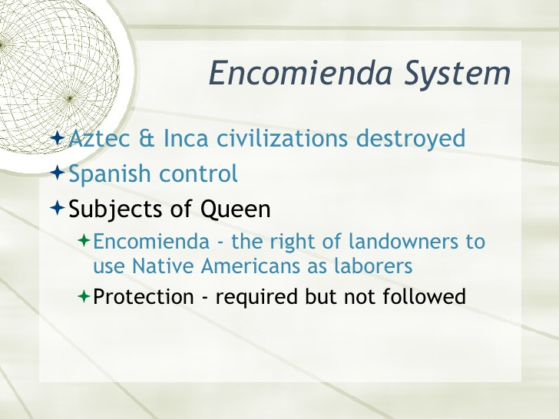

Slide 45
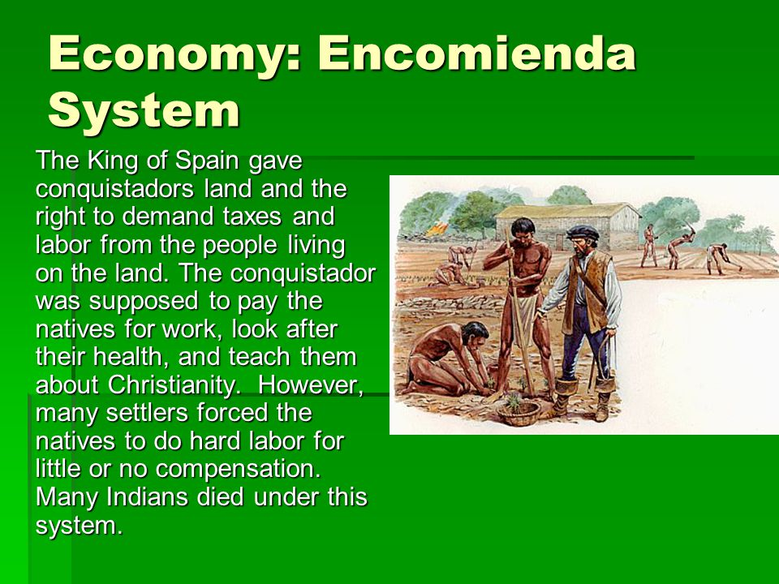
Encomienda System

Slide 46
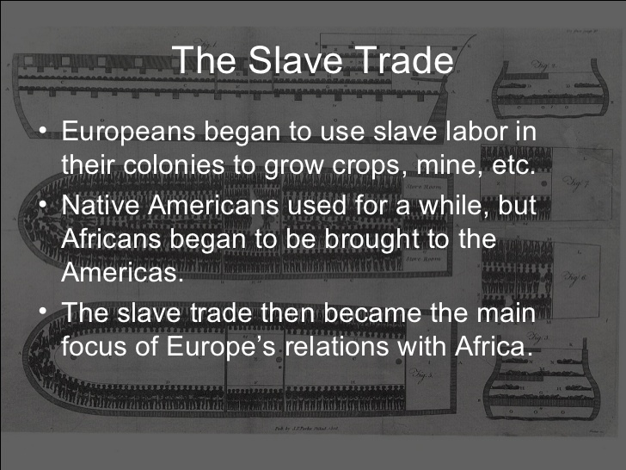
Slave Trade

Slide 47
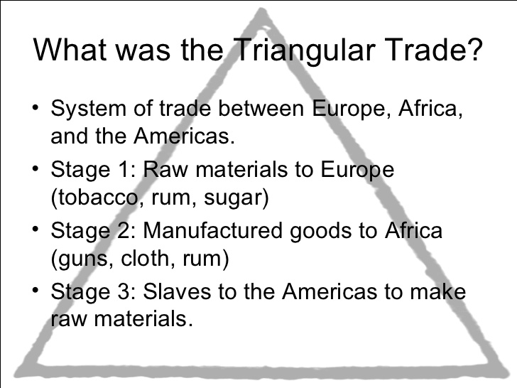
Triangular Trade

Slide 48
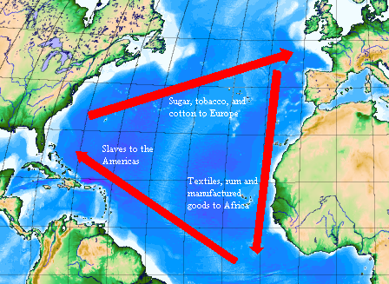
Triangular Trade

Slide 49
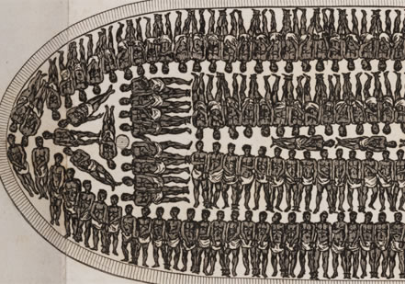
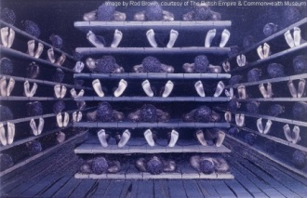
The Middle Passage

Slide 50
The Middle Passage
After kidnapping potential slaves, merchants forced them to walk in slave caravans to the European coastal forts, sometimes as far as 1,000 miles. Shackled and underfed, only half the people survived these death marches. Those too sick or weary to keep up were often killed or left to die. Those who reached the coastal forts were put into underground dungeons where they would stay -- sometimes for as long as a year -- until they were boarded on ships.
Just as horrifying as these death marches was the Middle Passage, as it was called -- the transport of slaves across the Atlantic. On the first leg of their trip, slave traders delivered goods from European ports to West African ones. On the "middle" leg, ship captains loaded their then-empty holds with slaves and transported them to the Americas and the Caribbean.
A typical Atlantic crossing took 60-90 days but some lasted up to four months Upon arrival, captains sold the slaves and purchased raw materials to be brought back to Europe on the last leg of the trip. Roughly 54,000 voyages were made by Europeans to buy and sell slaves. Over the centuries, between one and two million persons died in the crossing
Crash Course: Atlantic Slave Trade: https://www.youtube.com/watch?v=dnV_MTFEGIY
Animated history of slave trade, hit pause to stop on a ship and get info
http://www.slate.com/articles/life/the_history_of_american_slavery/2015/06/animated_interactive_of_the_history_of_the_atlantic_slave_trade.html

Slide 51

Commercial Revolution

Slide 52
The Commercial Revolution
The Price Revolution: Inflation hits Europe because, as the population grows so does demand for goods and services and there was a shortage. Also tones of gold and silver came in from the Americas and much was used to make money
Growth of Capitalism: Expanded trade spurred the growth of capitalism the investment of money to make a profit.
New Business Methods: Joint Stock Companies were trading companies in which shares are sold to investors to finance business ventures. Allowing people to pool large amounts of capital needed for overseas ventures
Bypassing Guilds: The growing demand for goods led merchants to by pass guilds and came up with the “Putting Out System” merchants would give wool to peasants to weave into thread and then give the thread to other peasants to make the thread into cloth etc.

Slide 53
$ Mercantilism $
Mercantilism is aimed at strengthening their national economies. They believed that a nation’s real wealth was measured in its gold and silver treasure and a nation must export more than it imports
Role of Colonies: Colonies are important to mercantilism because they exist for the benefit of the parent country. They provide resources and raw materials not available in Europe. Colonies also serve as a market to sell its manufactured goods too. European colonies passed strict laws regulating trade of colonies
Increasing National Wealth: Governments wanted to increase their wealth by imposed national currencies and established standard weights and measures and sold monopolies to large producers as well as big overseas trading companies and imposed tariffs or taxes on imported goods to protect local industries from foreign competition by increasing the prices of imported goods
Impact on European Society: further divided the classes and increased the middle class

Slide 54


Balance of Trade: The difference in the value between what a nation imports and exports over a period of time
Favorable Balance of Trade: You Export (sell) than you import (buy). Negative Balance of Trade: you Import more than you export

Slide 55

True Size of Africa

Slide 56


Slide 57


