Slide 1
APHUGE Models to Know
Geopolitics:
Cultural landscape:
Gender Equity Ravensteins Model of Migration: Epidemiological Model:
Von Thunen Model, DTM, Thomas Malthus:

Slide 2
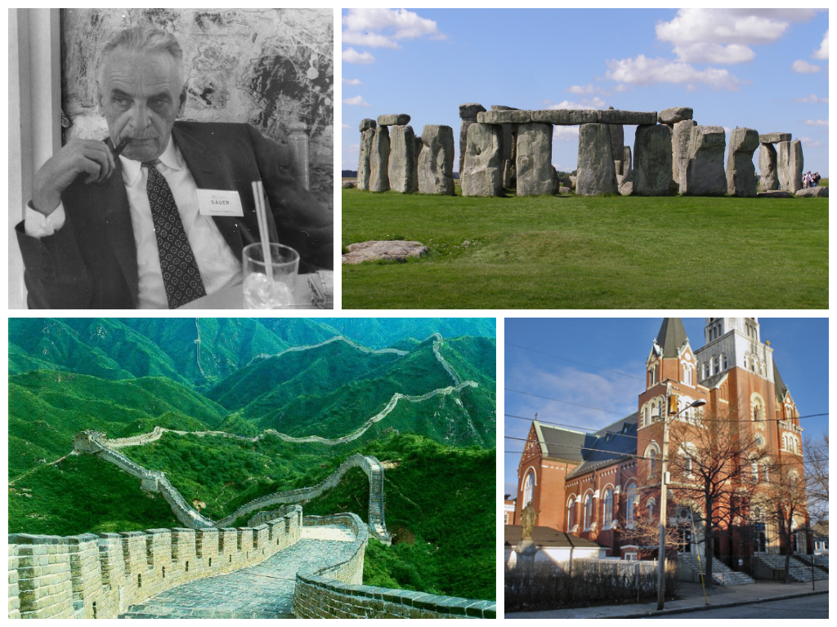
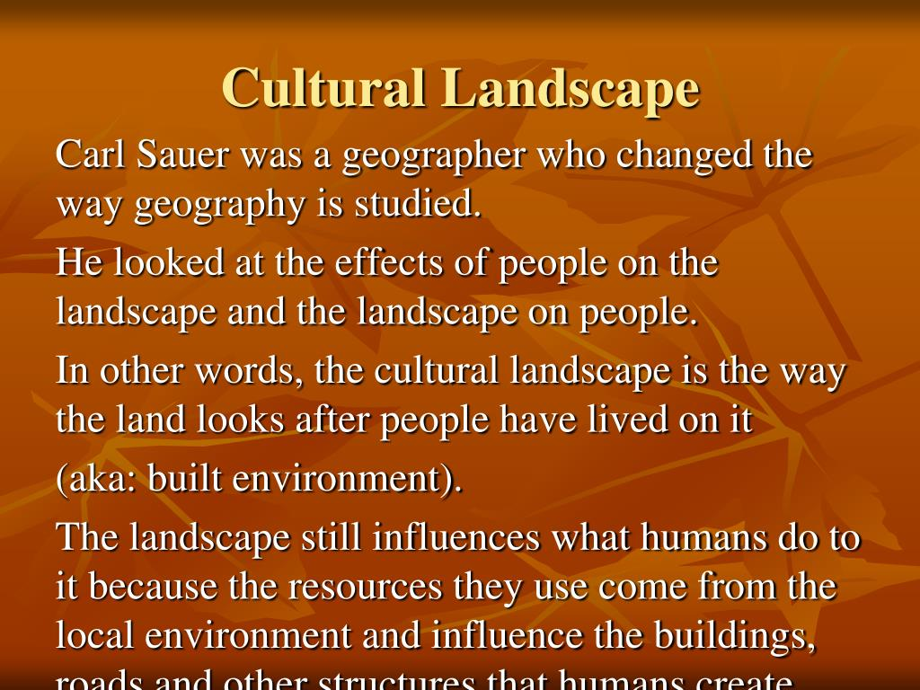
Cultural Landscape

Slide 3
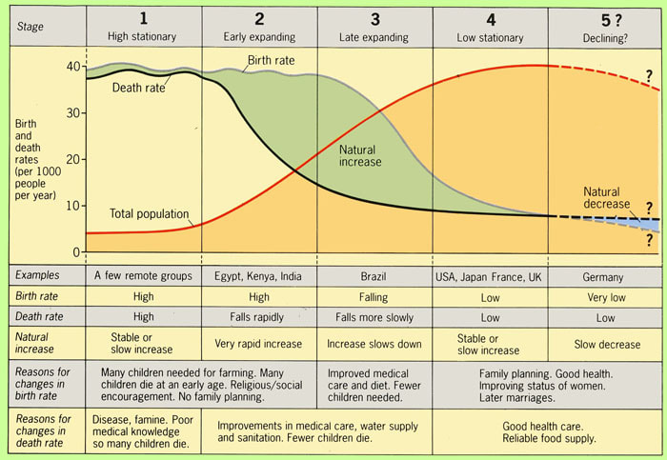
DTM and Why

Slide 4
Gotta Knows about the DTM Stages
Stage 1: Slow population growth, when the birth rate and death rates are both high. Most of the world before the Industrial Revolution was stage 1. Because Pandemics, wars, and weather catastrophes had big effects of population
Stage 2: The population increases greatly as the death rates (especially with children) drops due to improvements in medical care but birth rates stay high so population growth occurs at a fast pace. Many of the least developed countries today are in this stage
Stage 3: The population growth slows because of a falling birth rate due to improvements in economic conditions, status of women and access to contraception. Population continues to grow but at a slower rate. More developed countries (MDC’s) are in this stage today
Stage 4: The rate of natural increase is low or decreasing because of low death rates and low birth rates with a stable population rates. There is a higher levels of education, stronger economies, improved health care, more women in the workforce and a fertility rate of approximately 2 children per women. Mode developed countries are in this stage
Stage 5: There appears to be an emerging 5th state represented by man European countries and Japan. That have achieved this stage of have sub replacement birth rates and the population of elderly is greater than the youthful population.

Slide 5
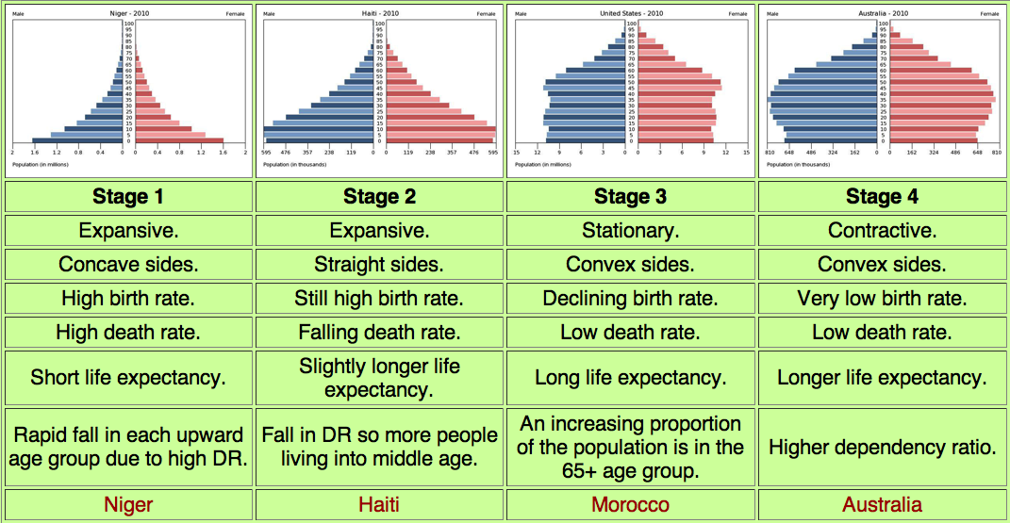
Comparing Stages looking at Pyramids

Slide 6
Epidemiological Transition Model Stages: The predictable stages in disease and life expectancy that countries experience as they develop. / They correspond with the stages of the DTM
Stage | Description | Effects on Population
1. Pestilence and Famine | Parasitic or infectious diseases, accidents, animal attacks, or human conflicts cause most deaths | A high death rate and low life expectancy
2. Receding Pandemics | The number of pandemics (widespread diseases that affect large populations) declines as a result of improved sanitation, nutrition, and medicine | A decreasing death rate and increasing life expectancy
3. Degenerative and Human Created Diseases | Infectious and parasitic diseases continue to decrease, but diseases associated with aging, such as heart disease and types of cancer – increase as people live | Death rate stabilizes at a low level and life expectancy increases
4. Delayed Degenerative Diseases | Stage 4 is an extension of Stage 3, but the age – related diseases are put off as medical procedures delay the onset of these diseases through advanced procedures. Diseases such as Alzheimer's and dementia increases | Death rate reaches its lowest level and life expectancy reaches a peak
5. Reemerging of Infectious and Parasitic Diseases | Infectious and parasitic diseases increases as some bacteria and parasites become resistant to antibiotics and vaccines | Life expectancy decreases

Slide 7
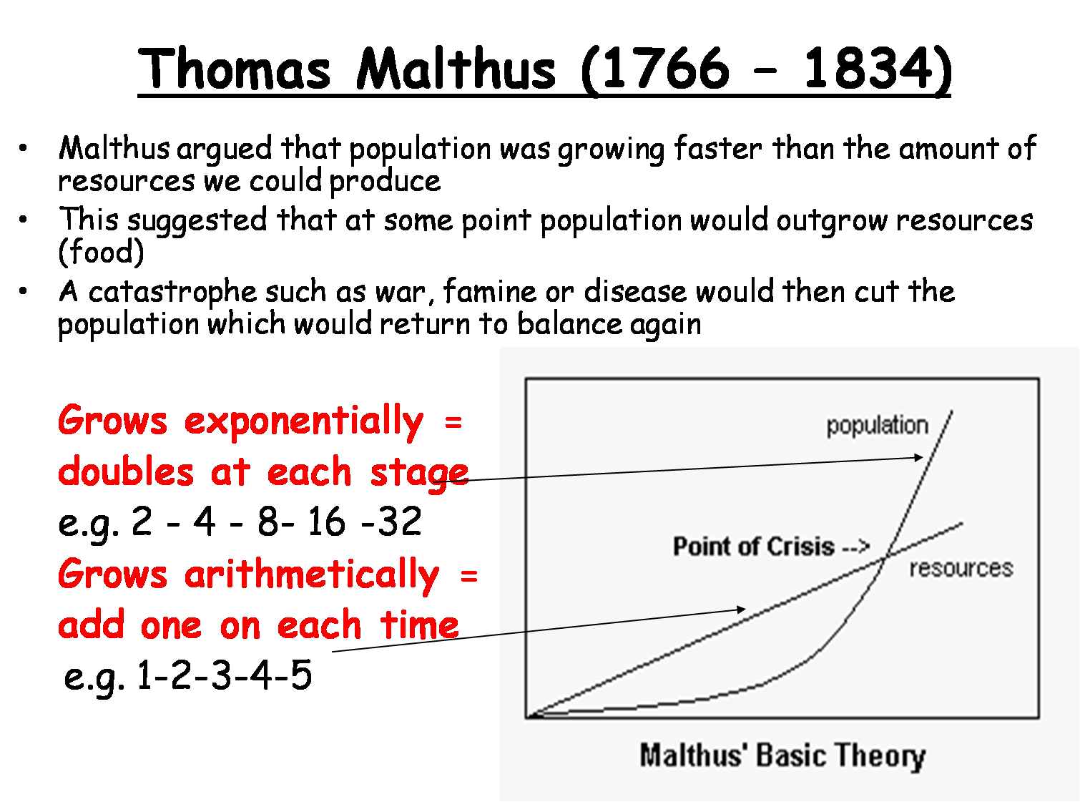
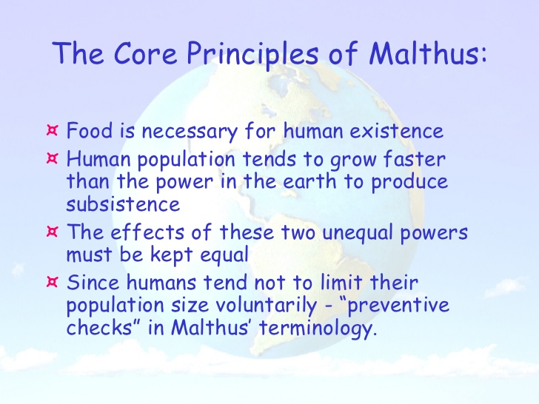
Thomas Malthus: Coined the term over population. In An Essay on the Principle of Population (1798) Stating Earth’s population was growing much more rapidly than the Earth’s food supply. Food shortages and chaos inevitable. Possible checks on population growth: War, poverty, pestilence (epidemics), or famine. Crash Course Malthus 13 min: https://www.youtube.com/watch?v=QAkW_i0bDpQ

Slide 8
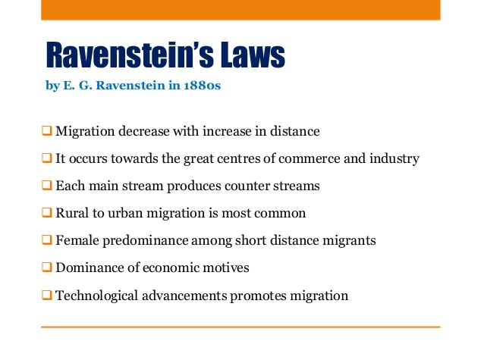

Slide 9
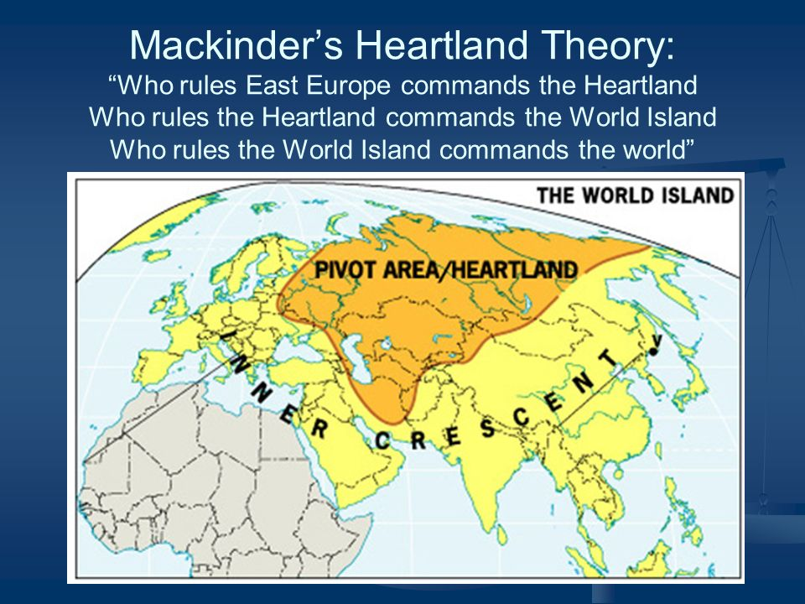

Slide 10
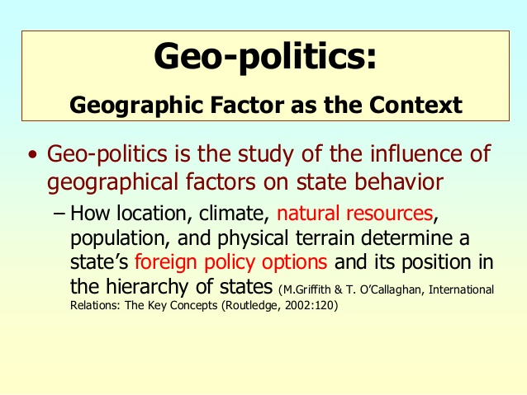
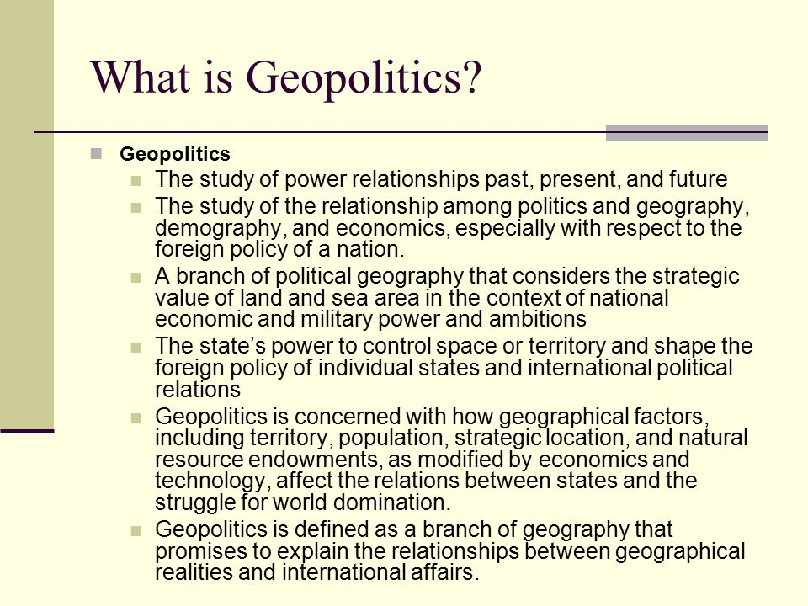
Geo Politics

Slide 11
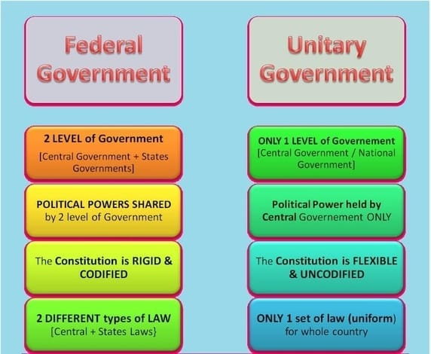
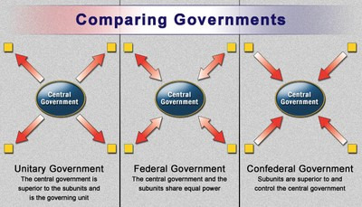
Governments

Slide 12
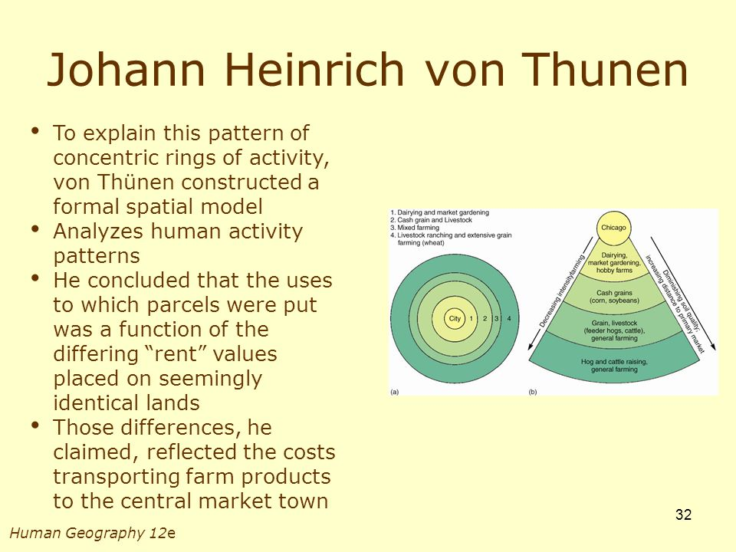
Von Thunen Model: is used to help explain the importance of proximity to market in the choice of crops on commercial farms. The farmer needs to compare two costs, the cost of the land and the cost of transporting products to market
First Ring: market oriented gardens and milk producers were located in the first ring out from cities, These products are expensive to deliver and must reach market quickly because they are perishable
Second Ring: the next ring out from cities contained wood lots, where timber was cut for construction and fuel: closeness to market is important for this commodity because of its weight
Third Ring: The next ring was used for various crops and for pasture; the specific commodity was rotated from one year to the next
Fourth Ring: the outer most ring was devoted exclusively to animal grazing, which requires lots of space

Slide 13
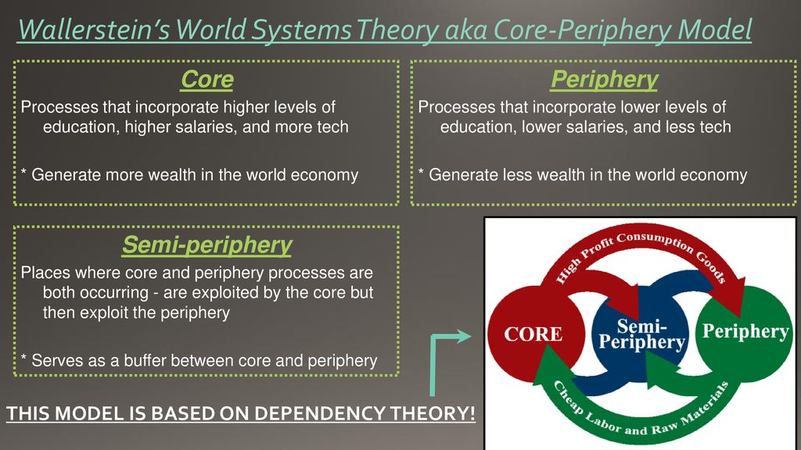
Wallerstein’s World Systems Theory / Core periphery Theory
Core periphery theory 3 min cartoon
https://www.youtube.com/watch?v=oVGdECND9Fs
A limitation of the three-tiered structure of Wallerstein’s world systems theory.
The model sorts countries into one of three categories: core, semi-periphery, or periphery. Once assigned to a category, countries have little opportunity for advancement into a higher category.

Slide 14
Wallerstein’s World Systems Theory
Category | Characteristics | Examples
Core | Includes the economically advantaged area of the world & the center of world businesses & finances; headquarters of most large multinational companies are located in core countries Focuses on higher skill, capital intensive production Promotes capital accumulation Dominates periphery and semi-periphery economically ad politically, & by paying low wages & exploiting weak environmental laws Benefits greatly from international trade | United States, United Kingdom Japan Australia Germany
Semi-Periphery | Includes the middle income countries Sometimes known as the emerging economics Provides the core with manufactured goods and services that the core once provided for itself, but no longer does | India, Taiwan, South Korea, Mexico South Africa Brazil, China
Periphery | Includes the least developed countries Has a high percentage of jobs in low skill, labor intensive production and extraction of raw materials Provides the core and semi-periphery with inexpensive raw materials, labor, & agricultural production Receives jobs but few profits from manufacturing Often have weak laws protecting workers and the environment | Afghanistan Zimbabwe Peru Kenya

Slide 15
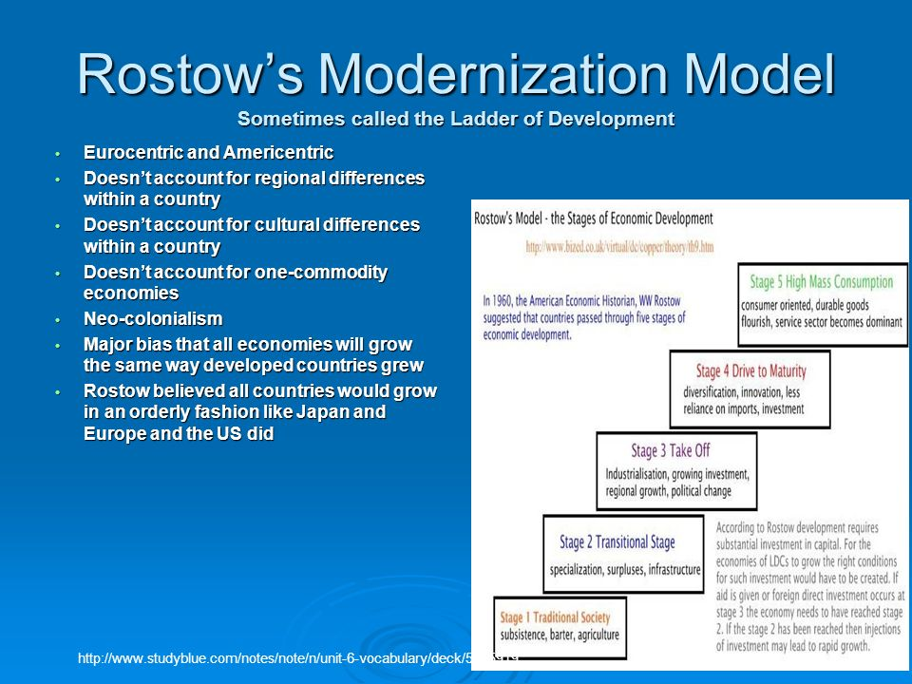

Slide 16
Economic Activities Classification
Economic Activity | Definition | Examples
Primary | Extraction of natural resources Dominated the economy until the Civil War | Farming, mining, forestry, fishing
Secondary | Processing of raw materials into finished goods by manufacturing Significant labor growth in 1840’s to 1960’s | Steel manufacturing, furniture production, food processing, building
Tertiary | Provision of services Most people in the US labor force today | Retail, restaurants, tourism, police, and fire provision. sanitation, advertising
Quaternary | Information and knowledge processing | Education, data processing, research and development, banking and finance, medical, entertainment
Quinary | Highest-level decision making | Top-level government officials and business executives, research scientists, financial consultants

Slide 17
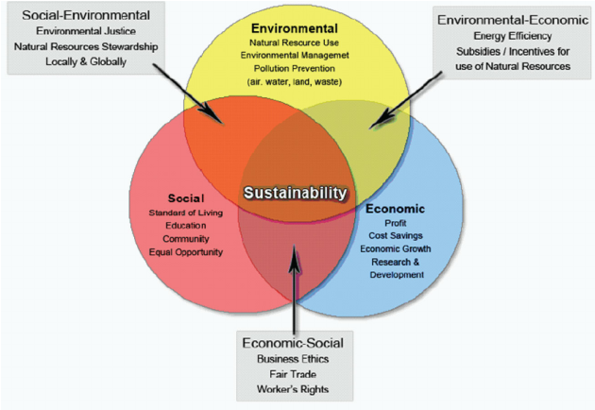
Sustainability Issues
Sustainable development is development that meets the needs of the present without compromising the ability of future generations to meet their own needs
Sustainability addresses issues of…
natural resource depletion, mass consumption costs, pollution, climate change, human health, and social & economic equity
In industry and agriculture, more women are taking on responsibilities in the workforce.
the challenge = laws that protect them and treat them equally
■ Ecotourism - A form of tourism pursued by many ecologically concerned people, who visit regions with pristine ecosystems without damaging the economic system, intended as a low-impact and often small-scale alternative to standard commercial mass tourism

Slide 18
Rostow’s Stages of Economic Growth
Stage | Characteristics | Examples
Traditional Society | Depends upon primary sector activities (farming, fishing, hunting,) subsistence Uses limited technology Carries out local or regional trading Enjoys limited socio-economic mobility | English colonies in North America in 17th century Medieval Europe, Not country is at this state today
2. Pre-Condition for Take off | Improves infrastructure (roads, electrical grid, water systems) etc Improves farming techniques & shifts toward commercial agriculture Exports agricultural and raw materials (international trade) Diffuse technology more widely Starts individual socio-economic mobility | United States in early 19th century Nigeria today Afghanistan today
3. Take Off | Open to major technological innovations Starts industrialization & primary sector begins to shrink Spreads entrepreneurial mentality Begins to urbanize Initiates self sustaining growth | United States mid 19th century Japan, late 19th century Bangladesh today
4. Drive to Maturity | Creates new industries while strengthening existing ones Improves energy, transportation, & communication systems Sees economic growth greater than population growth Invests in social infrastructure (schools, hospitals etc) | U.S. late 19th century, Germany early 20th century Brazil today
5. High Mass Consumption | Spends money on nonessential goods ( consumerism) Purchases of high order goods become common Desires to create an egalitarian society Supports a strong tertiary sector | US early 1920’s to present Japan mid 1950’s to present

Slide 19
Cities Terms:
Megalopolis is an entire region that has become highly urbanized in North America, Examples: Boston-New York-Philadelphia, Baltimore – Washington D.C. urban mass along the western seaboard and the Los Angeles – Orange County - San Diego – Tijuana megalopolis in Southern Ca., Sao Paulo – Rio de Janeiro in Brazil and the Tokyo-Osaka in Japan
Megacities are an increasingly a phenomenon of the developing world, where high population growth and migration have caused some urban areas to explode in population since World War II. All megacities are plagued by chaotic, unplanned growth, terrible pollution and widespread poverty and many with squatter settlements that cluster on hillsides and near waterways,
World Cities are centers of economic, cultural or political activity and thus have an includes felt across the globe.
Top Tier Word Cities include the economic and cultural power houses of New York, London, and
Tokyo
Second Tier World Cities include seats of government such as Moscow, Paris, Washington D.C. and
Brussels Belgium, Centers of popular culture such as Los Angeles, and Mumbai India; and centers
of industry such as Mexico City and Sao Paulo Brazil,
Gateway City: Airport or seaport that serves as the entry point to a country by being the primary arrival and departure point
Metropolitan Area: Within the US, an urban rea consisting of one or more whole county units, usually containing several urbanized areas, or suburbs ant all act together as a coherent economic whole

