Slide 1
Egypt – Mesopotamia Notes
World History

Slide 2
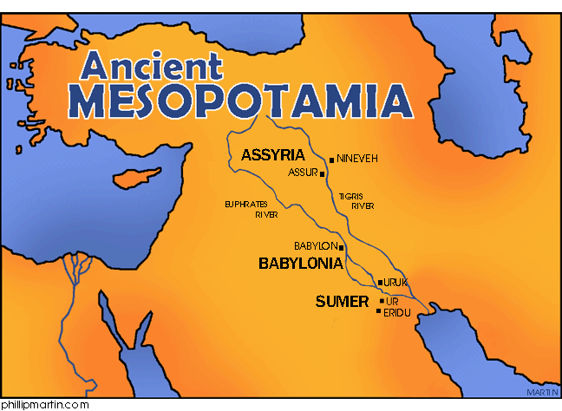
  Land Between the Rivers
Fertile Crescent: a region of rich farmland that curves from the Mediterranean to the Persian Gulf
Mesopotamia means between two rivers and was located between the Tigris and Euphrates Rivers where Iraq is today
The Tigris and Euphrates would also flood leaving silt behind which would enrich the soil but also devastated the area

Slide 3
  First Cities / Sumerian Government
3200 BC first Sumerian cities emerge in southern Mesopotamia
Had few natural resources so structures were built with mud bricks
Each city-state ruler was responsible for maintaining city walls and irrigation systems and were considered agents of the gods but not gods themselves
Over time they cities and land it controlled formed city states which are political unit with its own government

Slide 4
Sumerian Society was a social hierarchy or system of ranks / Religion
Ruler / Ruling Family: Led armies, maintained city walls, irrigation systems and considered agents or chosen by gods to lead
Priests: who’s jobs were to keep the gods happy with prayers and offerings
Scribes collected taxes and kept records’
Middle Class made up of minor priests, merchants and artisans
Peasant Farmers made up the majority of the population
Slaves: most owned slaves captured in wars or paying off debts
Women: had some legal rights, could engage in business and own property
Polytheistic they believed in many gods, built pyramid temples called Ziggurats to the main god, and believed the afterlife was a grim dark place which there was no escape

Slide 5
Advances in Learning
Sumerians invented the earliest known form of writing called cuneiform using a reed pen to make wedge shaped marks on clay tables
Scribes had to go through years of schooling to acquire their skills
Additional Advances: Math system based on the number 60 (we use 60 minutes in an hour. Circle dived into 360 degrees, geometry need for building, first wheel, plow, use of bronze, sewers, cataloged medical knowledge, cylinder seals, Epic of Gilgamesh (Sumerian hero and world ending flood)

Slide 6
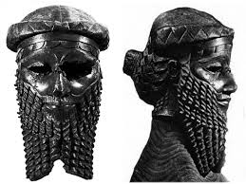
  The First Empire Builders
Invasion and conquest was a prominent feature in the history of the ancient Middle East
2300 BC Sargon conquered Sumer building the first empire
His empire falls after his death and many more conquers follow

Slide 7
Hammurabi the Law Giver
1790 BC Hammurabi of Babylon brought much of Mesopotamia under his control
Develops a set of laws known as the Code of Hammurabi
This was the first attempt by a ruler to Codify or arrange and set down in writing all of the laws that would govern a state.
One section deals with Criminal law deals with offenses against others such as robbery, assault or murder
Hammurabi's Code was very cruel by today’s standards
By setting specific punishments for offenses he limited personal vengeance and encouraged social order
Civil law laws deals with private rights and matters such as business contracts, property inheritances, taxes, marriage and divorce
He took many steps to keep his empire unified including a common religion

Slide 8
His Other Accomplishments:
United an empire
Improved irrigation
Organized a well trained army
Encouraged religious unity

Slide 9
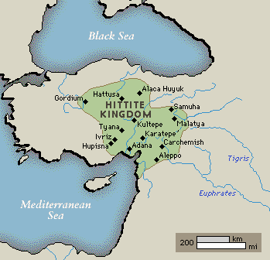
  Warfare and The Secret of Ironworking
By forcing people to move elsewhere invaders helped spread ideas while others brought new skills
Hittites had learned how to extract Iron from ore 1400 BC
Kept this technology a secret until empire collapse 1200 BC

Slide 10
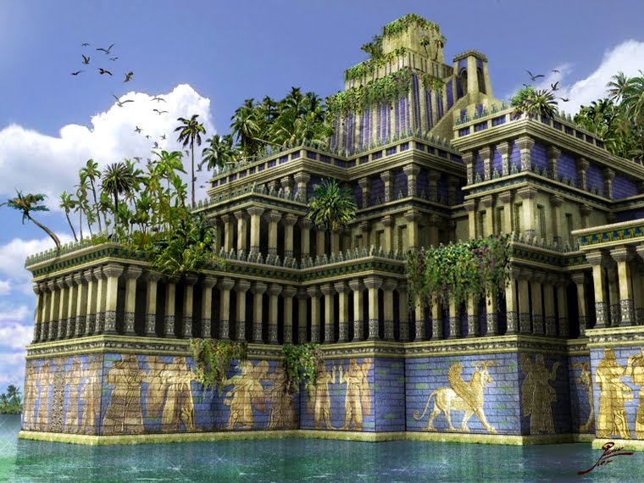
  Babylon Revived
Chaldean leader Nebuchadnezzar revived power of Babylon
Built a large empire from the Persian Gulf to the Mediterranean Sea
He built “The Hanging Gardens of Babylon”
He pushed the frontiers of LEARNING! Into other areas especially astronomy

Slide 11
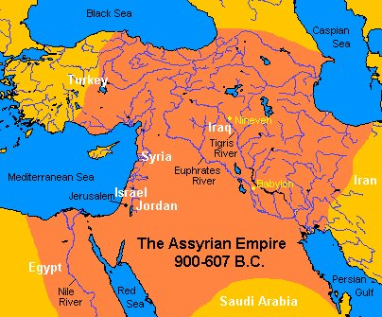
Assyrian Warriors
Lived on upper Tigris & began expanding by 1100 BC
Reputation as most feared warriors in history
Warfare was central to their culture but did have a well order society with extensive laws
King Assurbanipal founded one of the first libraries

Slide 12
  Uniting Many People
539 BC Babylon falls to the Persian armies of Cyrus the Great
In general the Persian armies of Cyrus the Great pursued a policy of toleration or acceptance of people they conquered
Unification of empire accomplished under Darius (522-486 BC)
Divided Persian empire into provinces with each headed by a governor called a satrap
Created a standing army
Darius also adapted laws from the people he conquered and drew up a single code of laws
Built and repaired roads to make communication easier. Set up a type of pony express system for mail

Slide 13
  Economic Life
He improved trade and set a common set of Weights and Measures
He encouraged the use of Money introduced by the Lydian's
However most people used the Barter Economy to exchange one set of goods for another
the Money Economy where goods and services are paid for through the exchange of some token of an agreed upon value, by using a single Persian coinage Darius could link all of his subjects together

Slide 14
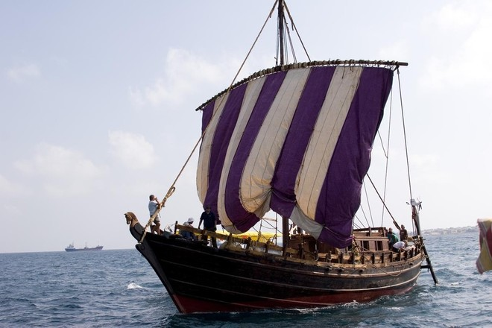
Phoenician Sea Traders, Manufacturing and Alphabet,
famous sailors and sea traders
Carriers of Civilization
Phoenicians were great traders and set up colonies or territories settled and ruled by people from another land
Phoenicians were the “Purple People:
They had their own alphabet that had symbols that represented spoken sounds and was quick, flexible

Slide 15
THE ROOTS OF JUDAISM
Israelites or Hebrews recorded events in the Torah their most sacred text
Abraham migrates to Canaan (Palestine)
He considered the founder of the Israelite nation
Famine forced many to migrate to Egypt where they became enslaved
Moses led them out of Egypt on an great exodus but died before they reached Canaan
1,000 BC Israelites set up a kingdom called Israel.
King David united the Israelite tribes into a single nation
David’s son, Solomon turned Jerusalem into an impressive capital and tired to increase Israel’s influence with other empires

Slide 16
Division and Conquest
Solomon’s building projects required high taxes & forced labor causing revolts to erupt
The kingdom split into Israel in the north and Judah in the south
Israelites could not fight off invaders and in 722 BC fell to the Assyrians then Nebuchadnezzar came and destroyed the temple and forced many Israelites into exile in Babylon and this period was called the Babylonian Captivity and the Israelites became known as the Jews
Years later Darius would conquer Babylon and free the Jews from captivity

Slide 17
  The Chosen People / Law and Morality
They Israelites differed from other around them because they were monotheistic or believed on only one true God
Israelite society was patriarchal in that fathers and husbands held great legal and moral authority over their families
Women had few rights
At the heart of Judaism are the 10 Commandments which are a set of laws the Jews believe God gave them through Moses
First four stress religious duties toward God like keeping the Sabbath a holy day for rest and worship
Rest set out rules for conduct towards other people

Slide 18
  An Ethical Worldview / Looking Ahead
In Jewish history spiritual leaders emerged to interpret God’s will called prophets
They preached a strong code of Ethics or moral standards of behavior
Judaism 14 min:
https://www.youtube.com/watch?v=0TPaqTSuurs
Thousands of years ago many Jews left their homeland, this scattering of people was called Diaspora
The Jews still maintained their identity, lived in close knit communities and obey their religious laws and traditions helping them survive centuries of persecution and influencing both Christianity and Islam

Slide 19
Geography of the Nile Valley
Nile/Egypt region is a very fertile area
Farmers grew wheat and flax which is a plant whose fibers were used for clothing
  TWO REGIONS OF
  ANCIENT EGYPT
  UPPER EGYPT: which stretched from the first CATARACT or waterfall of the Nile northward to within 100 miles of the Mediterranean
In 3100 BC MENES, king of UPPER EGYPT united the two regions and used the Nile to link the two regions and also used the river as a trade route

Slide 20
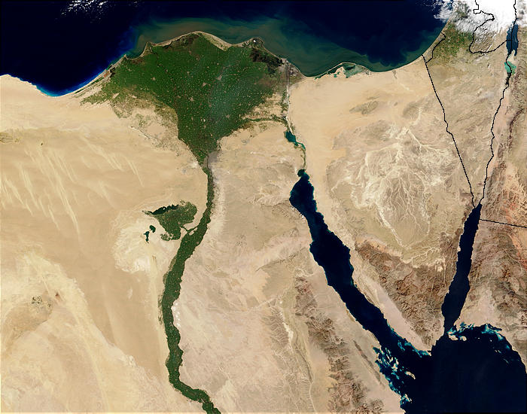
Yearly Flooding of the Nile
Nile comes from the highland lakes of Ethiopia
Every year the spring rains in this region send this water down into the Nile flooding and the soaking the region with and Silt or soil
People built dikes or earthen dams, reservoirs, and irrigation ditches to channel the rising river and store for the dry season

Slide 21
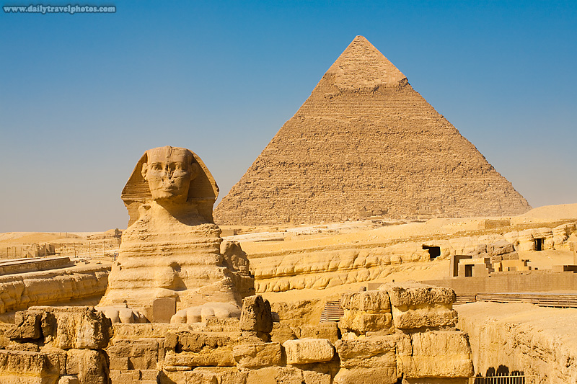
Three Main Periods of Ancient Egypt
Old Kingdom -2700–2200 BCE
Middle Kingdom - 2050-1800 BCE
New Kingdom –1550-1100 BCE
Power passed from one Dynasty , or ruling family to another

Slide 22
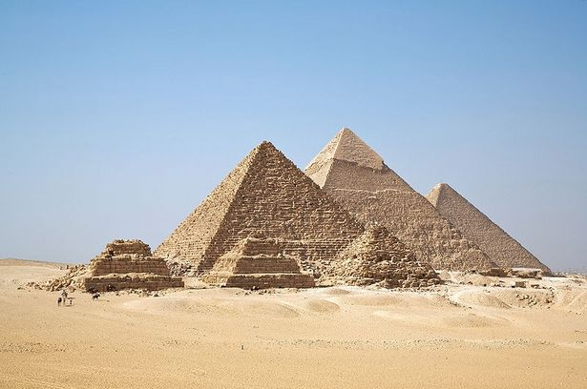
  The Old Kingdom (2700 – 2200 BC)
  Pharaohs organized a strong centralized state
  Egyptians believed the pharaoh had a divine right to rule because he was a GOD so he had absolute power and owned and ruled all of the kingdom
  Known as the Age of the Pyramids
  Pyramids were tombs for Pharaoh's
Built without iron tools or WHEELED VEHECLES and were often started as soon a pharaoh
Pyramids suggests strength of Egypt

Slide 23
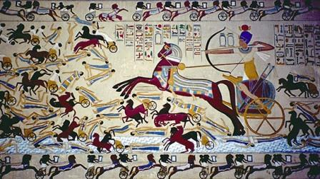
  The Middle Kingdom (2050 – 1800BC)
  A turbulent period
  Egyptians suffer crop shortages
  Nile did not rise regularly
  Egyptian armies occupied part of Nubia
  Traders had contact with people around the Middle East and island Crete
  The Hykos invaded in 1700 BC
  Egyptians were impressed with their horse drawn war chariots and the Hykos were impressed by the Egyptians civilization and adopted many customs, beliefs and names
Egyptian rulers drove out the Hyksos after100 years and
set up the New Kingdom

Slide 24
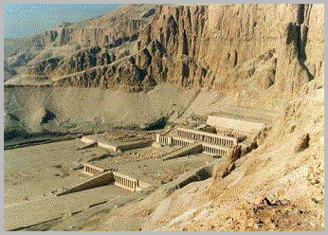
  New Kingdom (1550 – 110 BC)
  Powerful pharaohs build a large empire bringing Egyptians into greater contact with more regions & peoples
  Queen Hatshepsut: ruled between 1503 – 1482; She encouraged trade with many eastern Mediterranean lands and along the Red Sea. First female to rule in her own name
  Ramses II: most powerful ruler who ruled between 1290 – 1224; He increased the empires size, built temples and monuments boasting of his conquests;
Egyptian power begins to decline after Ramses death

Slide 25
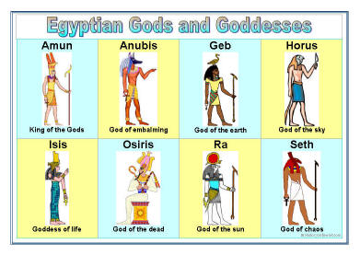
  Egyptian Religion
Egyptian belief in eternal life had a profound effect on their civilization
They are Polytheistic
- Chief god was Amon Re:
the sun god
  Isis: _Goddess of the life
  Osiris: Ruled over the Underworld and was god of the Nile
Aton: a minor god whose symbol was the sun disk

Slide 26
Religious Rebel
  In 1380 BC Akhenaton devoted his life to the worship of Aton who was a minor god
  The pharaoh took the name Akhenaton which means he who serves Aton
  His wife was the beautiful Nefertiti
  Scholars disagree: did the pharaoh try to introduce a new religion based or the worship of a single god or did he just want to raise Aton to the highest place among the gods
  Many resisted this revolutionary change and after Akhenaton’s death the old gods were restored

Slide 27
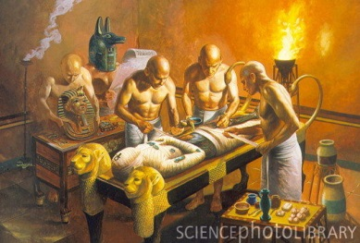
Mummification
The preservation of the dead
Process took months to complete
At first a privilege for rulers and nobles but later even common people could be mummified

Slide 28
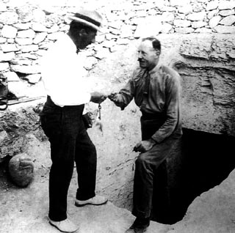
  Evidence of the Tomb of Tutankhamen
  (King Tut)
Buried in the Valley of the kings
Most royal tombs had been stripped of their treasures by looters
In 1922 archaeologist Howard Carter unearthed the tomb of Tutankhamen which had remained untouched for more than 3,000 years
King Tut was 19 years old when he died

Slide 29
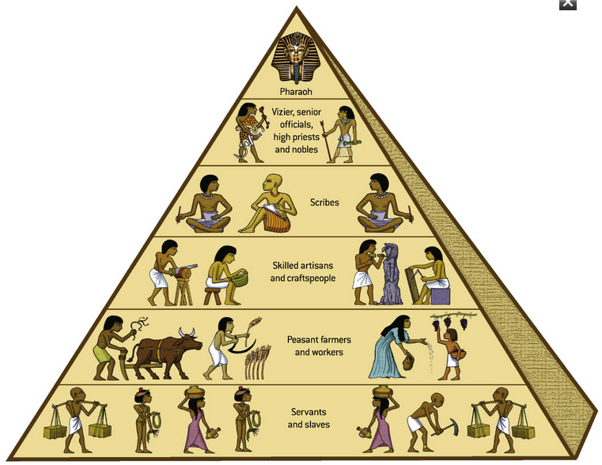
Egyptian Society
At the top of society is the Pharaoh and his family
High Priest & Priestesses
Nobles who fought the wars
Merchants, scribes and artisans who provided services for the rich and powerful

Slide 30
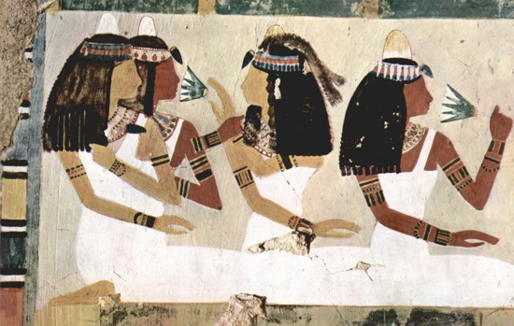
Women
Enjoyed a higher status & greater independence than women elsewhere
They could inherit property, make business deals, buy and sell goods, go to court and obtain divorce, manufacture goods, manage farming estates, serve as doctors and enter the priesthood
They were not confined to the home
They could not be scribes or hold government jobs

Slide 31
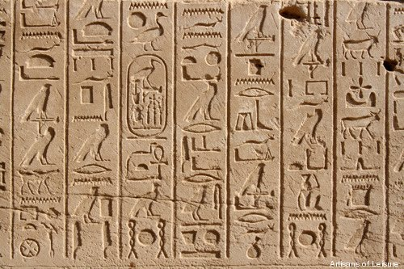
  Egyptian Learning /Written Records
Reading and writing were very important
Besides reading and writing they had to
Have skills in _
They developed a form of picture writing called hieroglyphics
As language became more complex they added ideographs or pictures that symbolized an idea or action
Over time they developed demotic a simpler form of writing for everyday use
They wrote on a paper like material made from papyrus and wrote with reed pens and ink

Slide 32
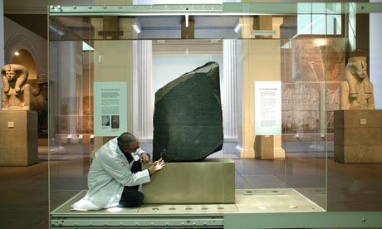
The Rosetta Stone
Jean Champollion discovered the Rosetta Stone which helped him to decipher or decode the ancient hieroglyphics
The stone was flat and black with the same message carved in three forms, Hieroglyphics, demotic and Greek
So by comparing the three he could decode the hieroglyphics symbols

Slide 33
  Advances in Medicine, Science, Art and Literature
Physicians became skilled at observing symptoms, diagnoses, finding cures, surgery, medicines
Priests and astronomers studied the heavens charting movements of plants and mapping constellations thus developing a calendar
geometry was used to survey the land and build pyramids and temples and irrigations systems
Paintings, statues, poems, literature, temples, pyramids, tombs give us much information of daily life, trade, farming, religious ceremonies and battles
Paintings style of Frontalism remained unchanged for thousands of years

Slide 34
IMPORTANT PEOPLE YOU SHOULD KNOW
Ruler or Conquerors | Contribution to Civilization
1. Menes | United upper and lower Egypt
2. Akhenaton | Worshipped the minor god Aton
3. Hatshepsut | First woman to rule Egypt in her own name
4. Ramses II
5. Sargon | First Empire in History
6. Hammurabi | First law Code / known to be harsh
7. Hittites | iron
8. Assurbanipal | First library
9. Nebuchadnezzar | Hanging gardens of Babylon, increased learning
10.Darius | United the Persians
11. Phoenicians | Carriers if civilization, alphabet based on sound, made trading easier
12. Assyrians | Known as the most feared warriors in history
13. Hebrews | First to believe in monotheism
14. Solomon | Ruler Jerusalem during its height in power
15.David | United the tribes of Israel

