Slide 2
The Old Regime
In 1789 France was till clinging to the outdated social system of the Middle Ages where everyone belonged to one of three classes
First Estate: the Clergy
Second Estate: the nobility
Third Estate: majority of the population

Slide 3
The Third Estate
The Third Estate was made up of 98% of the French population
This diverse group was made up of several smaller groups
Top Group was the bourgeoisie or middle class which included bankers, merchants, manufacturers, official royal bureaucracy, lawyers, doctors, journalists professors and skilled artisans
Biggest Group with 9 out of 10 people in France was the rural peasants with some being landowners who hire laborers to work for them or day laborers
Poorest Group: urban workers such as apprentices, journeymen, industry workers in printing or servants, stable hands, porters, construction workers or street sellers and the many urban unemployed who were forced to turn to begging or crime

Slide 4
Discontent
All members of the Third Estate resented the privileges enjoyed by their social betters
“What They Resented”
Wealthy bourgeois could buy political offices and titles but best jobs were reserved for nobles
Urban Workers earned miserable wages so even the smallest rise in bread prices could threaten hunger or starvation
Peasants were burdened by taxes on everything. They may be technically free but many owned fees and service dating back to medieval times even old rules about only nobles may hunt
People in towns began learning of Enlightenment ideas which led them to question the inequalities,
why should the first estates have such privileges at the expense of the of the majority

Slide 5
Causes of French Revolution
Monarchy: absolute rule, debt from previous kings, heavy spending on court and wars, failure to make reforms
French Society: Third estate burden with taxes, overall discontent of third estate
Economic issues: France’s heavy debt, high interest rates, low wages
Enlightenment Ideas: the spread of Enlightenment ideas or freedom, equality
Poor harvests: poor harvests drive up the price of food, risks of starvation for some
Failure of reforms: failure to take Necker advice, not taxing all estates, taxes and tariffs inside France
Origins of FR History ch. 4 min: http://www.history.com/topics/french-revolution/videos/origins-of-the-french-revolution

Slide 6
Tennis Court Oath
Since only propertied men most of the Third Estate was made up of
+ middle class officials
+ Lawyers
+ writers
They were familiar with the writings of Voltaire and Rousseau and came prepared to solve the finical crisis and insist on:
All three Estates meet in May 1789
First Problem: the issue of voting
In the past each group had one vote so under this system
the First and Second estates would always out vote the Third Estates two to one The Third Estate wanted all Estates to meet in a single body with votes counted by head
The Third estate claiming they represent the people of France called themselves the National Assembly and invited delegates from the other estates to help them write a constitution. Describing the basic rules and allows of government

Slide 7
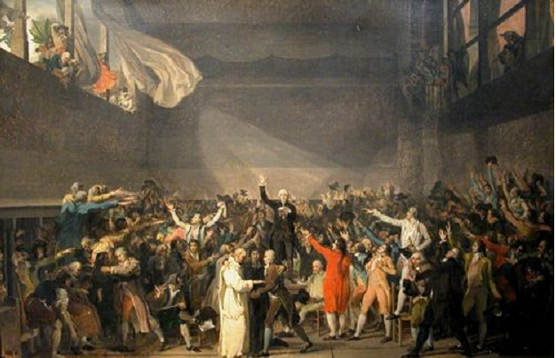
Tennis Court Oath
The National Assembly found themselves locked out to the meeting all and met across the street at an indoor tennis court and too the famous Tennis Court Oath vowing to never separate and continue meeting until they establish a just and sound constitution

Slide 8
Storming the Bastille
On July 14th on the streets of Paris rumors of royal troops coming to occupy the capital sent over 800 Parisians to gather in font of the Bastille, a grim medieval fortress used as a prison
The crowd demanded weapons and gun powder they believed was stored there
The commander of the Bastille refused to open the doors but then opened fire on the crowd.
A battle followed with the crowd breaking into the Bastille and killing the commander and the five guards and released the handful of prisoners but found no weapons
The storming of the Bastille became a symbol of the French Revolution because it was seen as a blow to tyranny and is still celebrated today on July 14th, Bastille Day and is a national holiday

Slide 9
Setting the Scene
The Four Phases of the Revolutionary era
1. (1789-1791) moderate phase of the National Assembly
2. (1792-1793) turned France into a constitutional monarchy
3. (1793-1794) a phase of escalating violence led to the Reign of Terror
4. (1793-1794) periods of reaction against extremism
known as the Directory
(1799-1815) Age of Napoleon
This section is about the moderate start

Slide 10
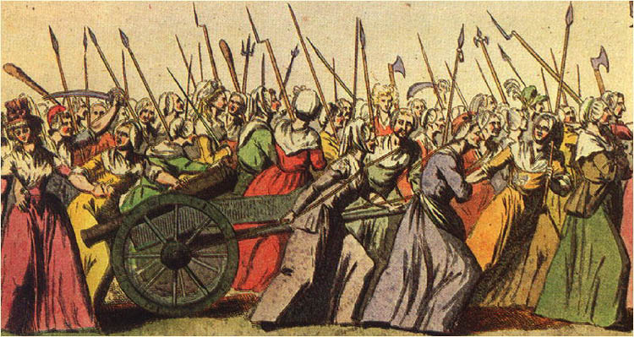
Women March on Versailles
October 5 thousands of women streamed from Paris to Versailles protesting the price of bread
Much of the protest was aimed at Marie Antoinette for being frivolous and extravagant plus the rumor of her saying “Let them eat cake” which she did not say but it fueled rumors of her
The women refused to leave until Louis came back with them to Paris so the royal family did move back to Paris

Slide 11
Declaration of the Rights of Man
In the first step toward writing a constitution the Assembly issued the Declaration of the Rights of Man and the Citizen, a Bill of Rights
It was modeled in part after the Declaration of Independence
It proclaimed:
all men were born and remain free and equal in rights
they enjoyed natural rights to liberty, property, security, and resistance to oppression
constitutions existed to protect the natural rights of the citizen
male citizens were equal before the law
Frenchmen had an equal right to hold public office
freedom of religion
taxes to be levied according to ability to pay
Its principles captured the French Revolution’s slogan
Louis XVI was slow to accept the reforms causing Parisians to grow suspicious

Slide 12
Reorganizing the Church
The Assembly votes to put the French Catholic Church under state control
Under the Civil Constitution of the Clergy issued in 1790
clergy became elected, salaried officials
ended papal authority over the French Church
dissolved convents and monasteries
Reaction was swift and angry with many clergy refusing to accept the Civil Constitution, peasants rejected it and a huge gulf opened between the revolutionaries in Paris and the peasantry in the provinces

Slide 13
Constitution of 1791
The National Assembly produced a constitution in 1791 which was the first constitution
1. set up a limited monarchy
2. a new Legislative Assembly that had power to make laws, collect
taxes, and decide on issues of war and peace
3. lawmakers would elected by tax paying male citizens
4. replaced provinces with 83 departments
5. abolished old provincial courts
6. reformed laws
7. protected private property
8. supported free trade
9. compensated nobles for the land seized by peasants
10. abolished guilds
11. forbade urban workers to unionized
To moderate reformers it completed the revolution, reflected Enlightenment goals and means and leisure to serve in government end church interference and ensured and it put power in the hands of men with the

Slide 14
Internal Divisions
In Paris and other urban areas working class men and women called sans-culottes (without short britches) pushed for more radical action, they demanded a Republic or government ruled not by a monarch but by elected representatives
Within the Legislative Assembly several hostile factions competed for power
The sans culottes found support among the more radical Jacobins, a revolutionary political club who were mostly middle class lawyers or intellectuals
Opposing the radicals were moderate reformers and political officials who wanted no more reforms at all

Slide 15
The French Republic
In Paris radicals took control of the Assembly
They called for the election of a new legislative body called the National Convention
Suffrage or the right to vote was to be extended to all male citizens not just property owners
The more radical body voted to abolish the monarchy and to declare France a republic
A new constitution was drawn up erasing all traces of the old order
They seized lands of nobility and abolished

Slide 16
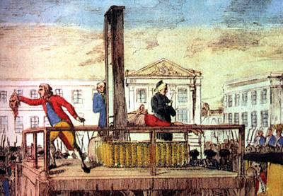
The Convention Defends the Republic
The Republic put Louis XVI on trial and sentenced him to death on January 1793 shocking European monarchs
Marie Antoinette was also executed. Their son, Louis XVII died of unknown causes
History of guillotine 3:16: http://www.history.com/topics/french-revolution/videos/coroners-report-guillotine?m=528e394da93ae&s=undefined&f=1&free=false

Slide 17
Robespierre
Maximilien Robespierre was a lawyer and politician who quickly rose to leader of the Committee of Public Safety
Among Jacobins he earned the nickname incorruptible his enemies called him a tyrant
He embraced Rousseau’s idea of the general will as a source of all legitimate law
He promoted religious toleration
He wanted to abolish slavery
He believed that France could achieve a republic of virtue only through the use of terror which he defined as nothing more than prompt, severe and inflexible justice
Robesppierre 4 min: http://www.history.com/topics/french-revolution/videos/robespierre-and-the-reign-of-terror?m=528e394da93ae&s=undefined&f=1&free=false

Slide 18
The Reign of Terror
Maximilien Robespierre was a lawyer and politician who quickly rose to leader of the Committee of Public Safety
the Committee of Public Safety Goal was to keep the revolution going
Within a year the Reign of Terror consumed its own members including Robespierre who was arrested and executed the next day
Robesppierre 4 min: http://www.history.com/topics/french-revolution/videos/robespierre-and-the-reign-of-terror?m=528e394da93ae&s=undefined&f=1&free=false

Slide 19
Reaction and the Directory
In reaction to the Terror the revolution entered a third phase
Moderates produced another constitution, the Constitution of 1795, the third since 1789.
The Constitution of 1795 set up a five man directory and a two house legislature elected by male citizens who own property
The middle class professionals of the bourgeoisie was the dominant force in this state of the French Revolution
The Directory held power from 1795 to 1799
The Directory faced growing discontent
War with Prussia and Spain had ended but war with Austria and Great Britain continued
Corrupt leaders lined their pockets and failed to solve problems
price of bread increased stirring sans-culottes to riot
Many émigrés returned to France and were welcomed by devout Catholics who were angry over actions used against the Church
In 1797 elections supporters of a constitutional monarchy won the majority of seats in the legislature
Politicians turned to Napoleon Bonaparte

Slide 20
Changes in Daily Life
Many changes came from this 10 year long French Revolution
dislodged the old social order
Overthrew the monarchy
Brought the Catholic Church under state power
new symbols like red liberty caps confirmed liberty and equality for all male citizens
the new title citizen applied to people of all social classes
titles were eliminated
elaborate fashions gave way to more practical clothes
revolutionary names went to children like Constitution, Republic or August 10th

Slide 21
Nationalism
Revolution and war gave the French people a strong sense of national identity
loyalty had shifted from the king to the nation
Nationalism, a strong feeling of pride in and devotion to ones country spread throughout France
https://www.opened.io/video/the-french-revolution-sung-to-tune-of-bad-romance-by-lady/113892?isAlreadyAdded=false&isEditMode=false

Slide 22
THE AGE OF NAPOLEON BEGINS
From 1799 to 1815 Napoleon would dominate France and Europe
A hero to some, an evil force to others, he gave his name to the final phase The Age of Napoleon
Napoleon Bonaparte was born in Corsica
his family were minor nobles with little money
at age 9 he was sent to France for a military career
When the revolution broke out he was a 20 year old lieutenant and eager to make a name for himself
He favored the Jacobins and republican rule but found the conflicting ideas of the revolution confusing
3 min cartoon overview: http://www.history.com/topics/french-revolution/videos/napoleon?m=528e394da93ae&s=undefined&f=1&free=false

Slide 23
Early Successes
During the French Revolution Napoleon rose through the ranks quickly winning numerous dazzling victories and managing to hide stories of some of his losses
Success fueled his ambition and by 1799 he moved from victorious general to political leader by helping overthrow a weak Directory and setting up a three man governing board called the Consulate
Another constitution was drawn up and Napoleon took the title of First Consul
In 1802 he named himself Consul for Life
The rise of napoleon History channel 2 min http://www.history.com/topics/french-revolution/videos/the-rise-of-napoleon?m=528e394da93ae&s=undefined&f=1&free=false

Slide 24
Reforms
To restore economic prosperity he
controlled prices
encouraged new industry
built roads and canals
To endure well trained officials and military officers he set up a system of public schools.
He made peace with the Catholic Church in the Concordat of 1801
The state still kept the Church under state control but recognize religious freedom
Napoleon had the support of all the classes
He encouraged émigrés to return provided they took an oath of loyalty
Peasants supported him because he recognized their right to lands they had bought from the Church and nobles.
Middle class supported him because of the economic reforms reforms and the restoration of order, plus he made jobs open to all of talent

Slide 25
Napoleonic Code
The Napoleonic Code was one of his most lasting reforms
It included:
Enlightenment principles such as equality for all citizens before the law
religious toleration
advancement based on merit
Women lost rights under the Napoleonic Code

Slide 26
The Grand Empire
Napoleon created a vast empire
He annexed or added outright some areas to France such as Netherlands, Belgian, parts of Italy and Germany
He abolished the Holy Roman Empire, and created a 38 member Confederation of the Rhine under French protection
He cut Prussian territory in half turning part of Poland into the Grand Duchy of Warsaw
Much of Europe he controlled through forceful diplomacy
He forced alliances on European powers
Napoleon’s success boosted the spirit of nationalism

Slide 27
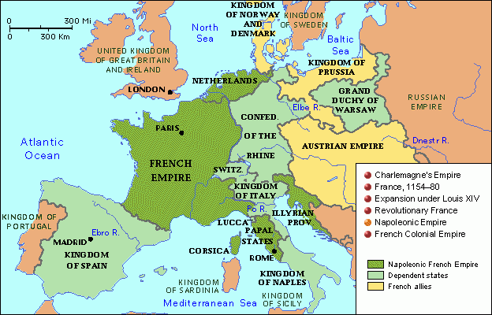
Napoleon’s Empire

Slide 28
France Versus Britain
Britain alone remained outside Napoleon’s empire
Britain relied on sea power to stop Napoleons drive
In 1805 Napoleon prepared to invade England but at the Battle of Trafalgar near Spain a British admiral named Horatio Nelson defeated the French fleet
With invasion ruled out Napoleon decided to strike a Britain’s commerce
He waged economic warfare called the Continental System by which he closed European ports to British goods
Britain responded with its own blockade or shutting off ports to keep people or supplies from moving in or out of European ports
Both sides seized neutral ships suspected of trading with the other
British attacks on American ships would eventually trigger the War of 1812
Napoleon’s Continental System failed to bring Britain to its knees
Trade restriction created a scarcity of goods in Europe sending prices soaring and intensified resentment against French power

Slide 29
Challenges to Napoleon’s Empire
Under Napoleon’s armies the ideas of the revolution and the Napoleonic Code spread across Europe
New reforms such as
installing new governments that abolished titles of nobility
ending Church privileges
opening careers to men of talent
ending serfdom and manorial dues
reduced trade barriers
stimulated industry

Slide 30
Impact of Nationalism
While nationalism spurred on French armies it also worked against them too
Even though many Europeans welcomed the ideas of the French Revolution they still saw Napoleon and his armies as foreign oppressors
They resented the Continental System
They resented the effort to impose French culture
Throughout Europe nationalism unleashed revolts against the French

Slide 31
Resistance in Spain
Resistance to France forced the need for large numbers of Napoleon’s troops
In 1808 Napoleon
replaced the king of Spain with his brother Joseph Bonaparte.
sought to undermine the Spanish Catholic Church
When the Spanish people resisted French forces responded with brutal force which further inflamed Spanish nationalism and efforts to drive the French out intensified
Spanish patriots conducted guerilla warfare or hit and run raids against the French (in Spanish guerrilla means little war)
The numerous attacks kept large numbers of French soldiers in Spain when they were need elsewhere
Then the British sent an army under Duke of Wellington to help the Spanish fight France

Slide 32
Defeat in Russia
Concerns of Czar Alexander I of Russia
Napoleon’s alliance with the Austrian royal family
economic effects of the Continental System
Napoleon had enlarged the Grand Duchy of Warsaw that bordered Russia
These concerns caused the Czar to withdraw from the Continental System
In 1812 Napoleon responded by invading Russia
Trying to avoid battles with Napoleon, Russia retreated using the “scorched earth ” policy by destroying anything that could be used by Napoleon’s army leaving the French hungry and cold as the Russian winter came
When Napoleon entered Moscow he realized he could not feed and supply his army through the long Russian winter so in October he turned to make the 1,000 mile trip
Only 10,000 of the original 400,000 men survived
“General Winter and General Famine”, rather than Russian bullets have conquered the Grand Army”
Napoleon rushed home to Paris to raise a new force
History Channel invasion of Russia 5 min: http://www.history.com/topics/french-revolution/videos/napoleon-invades-russia?m=528e394da93ae&s=undefined&f=1&free=false

Slide 33
Battle of Waterloo
Napoleon will rule only for 100 days
The allies reassembled their troops and the armies met near the town of Waterloo in Belgium
British and Prussian forces crushed the French in a day long battle
Again Napoleon was forced into exile and go to St Helena on the island in South Atlantic and this time he would not return
History Channel death of Nap. 4 min: http://www.history.com/topics/french-revolution/videos/the-death-of-napoleon?m=528e394da93ae&s=undefined&f=1&free=false

Slide 34
Legacy of Napoleon
Napoleon died in 1821 but historians have long debated his legacy
Some of this changes / impacts in France
Napoleonic Code
A centralized state with a constitution
Elections were expanded
Many more citizens had right to property and access to education
The French also lost many rights promised to them
Changes / impacts in Europe
spread ideas of the revolution
while he failed to build a French Empire he did spark nationalist feelings across Europe
the abolition of the Holy Roman Empire would lead to the creation of a Germany
sold the US the Louisiana Territory and doubling the size of the US

Slide 35
Congress of Vienna / Gathering of Leaders
Diplomats and heads of sate sat down at the Congress of Vienna
to restore the stability and order in Europe
The Congress met for 10 months
While many enjoyed the entertainment of it hosted by Francis I of Austria the real was done by Prince Clemens von Metternich of Austria, Czar Alexander of Russia and Lord Robert Castlereagh of Britain, France was represented by Prince Charles Tallyrand

Slide 36
Goals of the Congress
The chief goal was to create a lasting peace by establishing a balance of power and protecting the system of monarchy
2. The Congress redrew the map of Europe
To keep France contained they surrounded it with
stronger countries
3. promoted the principle of legitimacy, restoring hereditary monarchs that the French Revolution or Napoleon unseated
The Congress failed to foresee how powerful the new force of Nationalism was and redrew the new boundaries without concern for national cultures.

Slide 37
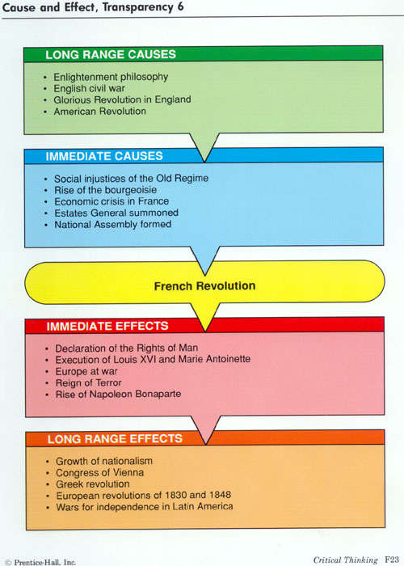
Cause and effect of French Revolution

