Slide 1
AP Human Geography Unit II / Population and Migration

Slide 2
Did you know?

Slide 3
Population - Demography
Demography: The study of the Characteristics of human population
Demographers look statistically at how people are distributed spatially by age, gender, occupation, fertility, health, etc.
The distribution of the worlds population is in one word “uneven”
Demographers ask:
1) where people are (concentration/ density)
2) where populations are growing

Slide 4
A little information about World Population
80% of pop. Lives within 500 Mi. of an ocean
World inhabitants live on only 10% of the land
90% of pop. Lives North of the Equator
65% lives between 20°N and 60 ° N latitude
TED Talk population growth 10min: https://www.ted.com/talks/hans_rosling_on_global_population_growth
Humans are NOT uniformly distributed across the Earth • We can understand the nature of its distribution by studying their concentration and density
• Concentration –
2/3 of Earth’s population is concentrated in 4 regions: • East Asia • South Asia • Europe • Southeast Asia
23 countries = 75% of world population (172)
10 Countries have pops. Greater than 100M
China, India, United States, Indonesia, Brazil

Slide 5
Population Growth

Slide 6
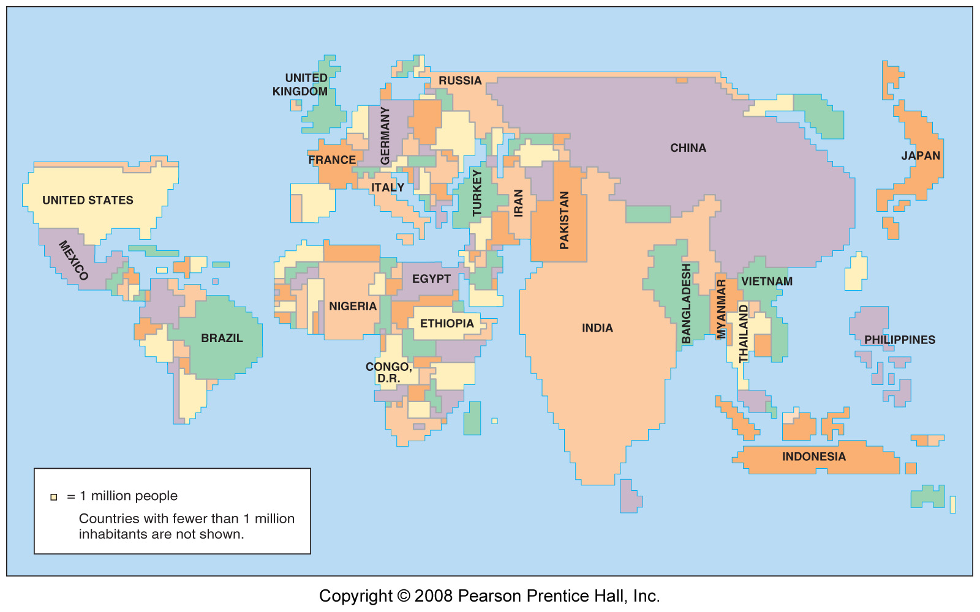
Population Cartogram (population displayed by size of population rather than land area. For example Canada is the 2nd largest country in land area but ranks only 37th in population so it appears small of the map, Conversely, Bangladesh ranks only 92nd in land area but is 8th in population so it appears large. (Countries over 50 million are labeled)

Slide 7
Population
population distributions tells us where individuals or groups live on the Earth’s surface
historically people congregate in places where food can be grown
there are four main areas of population density in the world (five depending on what text you read)
East Asia
South Asia
Europe
North America
* The three Asia population concentrations together comprise more than half of the world’s total population, but together they live on less that 10% of the Earth’s land area (the same held true 2,000 years ago)
Demography is the scientific study of population
Density: numerical measure of the relationship between the number of people and some other unit of interest (typically space)
Concentration: The spread of something over a given area
EX: The area Australia and Continental US are about the same, but the population is radically different (21 million to 300 million). So the density of population in Australia is far lower than the density of population of continental USA. However, the continental USA has almost 60 million people spread throughout rural area. Australia, has it's population concentrated in a few urban areas, and a very small percentage spread through very vast rural regions. So Australia may have a higher concentration of people than the USA even though the density is lower

Slide 8
Factors that Shape Distribution
Accessibility
Topography
Soil Fertility
Climate
Weather
Water
Political History
Economic History

Slide 10
East Asia
Nearly ¼ op world’s population live here
Region bordering the Pacific Ocean, includes eastern China, islands of Japan, Korean peninsula and island of Taiwan

Slide 11
China
The People’s Republic of China is the world’s most populous country and the 4th leading country in land area
It population is clustered near the Pacific Coast areas and in several fertile river valleys that extend inland
Much of China’s interior is sparsely inhabited mountains and deserts.
Nearly ½ of the people live in rural areas where they work as famers.

Slide 12
Japan and Korea
In Japan and Korea population is not distrusted evenly either
More that a third of the people live in three metropolitan areas.
Tokyo and Osaka in Japan and Seoul in South Korea that cover less than 3% of the two countries land area
In contrast to China, more than a 1/3 of all Japanese and Koreans live in urban areas and work in industrial or service jobs

Slide 13
South Asia
Nearly 1/4th of world population lives in South Asia, which includes India, Pakistan, Bangladesh, and Sri Lanka
The largest concentration of people live along a 900 mile corridor from Lahore, Pakistan, through India and Bangladesh to the Bay of Bengal.
Much of the population is concentration along the plains of the Indus and Ganges Rivers
Another concentration is near India’s 2 long coastlines, the Arabian Sea to the west and the Bay of Bengal to the east
Most people in South Asia are farmers living in rural areas
The region contains 21 urban areas

Slide 14
Southeast Asia
600 million people live in South east Asia, mostly on a series of islands that live between the Indian and Pacific Oceans,]Indonesia, which consists of 13,677 islands, is the world’s fourth most populous country. The largest population concentration is on the island of Java with more than 100 million people
Several islands that belong to the Philippines contain high population concentrations, and population is also clustered along several river valley's and deltas at the southeastern of the Asian mainland known as Indochina.
The Southeast Asia concentration is characterized by a high percentage of people working as farmers in rural areas
High concentration of rural farmers

Slide 15
Europe
Combining the populations of Eastern and Western Europe and the European portion of Russia, forms the world’s third largest population cluster, 1/9th of the world’s population
The region includes 4 dozen countries, ranging from Monaco, with 0.7 sq. miles) and population of 33,000 to Russian the world’s larges country in land area when its Asian part is included.
In contrast to the 3 Asian concentrations, ¾ of Europe’s inhabitants live in cities, and fewer than 5% are farmers
The higher population concentrations in Europe are near the major rivers and coalfields of German and Belgium as well as capital cities
A dense network of roads and trains link settlements
The search for more resources was a major incentive for European explorer and colonize other parts of the world
Today Europeans turn many of these resources into manufactured products

Slide 16
Ecumene, or portion of the earth’s surface that has permanent human settlement has expanded to cover most of the earth’s land area.

Slide 17
Why are some land areas not part of the ecumene?
Dry Lands: Areas too dry for farming cover approximately 20% of Earth’s land surface. They lack sufficient water to grow crops that could feed a large population. While some people live here by raising animals that are adapted to the climate. These lands can contain natural resources like petroleum
Wet lands: lands that receive high levels of precipitation, located primarily near the equator, are often inhospitable for humans. The combination of rain and heat rapidly depletes nutrients from the soil hindering agriculture
Cold Lands: Much of land near the Poles is perpetually covered with ice or the ground is permanently frozen (permafrost), thus unsuitable for planting crops and most animals and few humans live there
High Lands: the highest mountains in threw old are steep, snow covered and sparsely settled. Some high altitude plateaus and mountain regions are more densely populated such as those at low latitudes (near the equator)

Slide 18
Population Distribution – Why it Matters
Population grows at different rates in different places
Overpopulation - occurs when there are too many people for the amount of available resources
Problems result when an area exceeds its carrying capacity the number of people an area can support given the quantity of food, habitat, water and together life infrastructure present.
On a local scale, overpopulation currently threatens some regions much more than others, but the number of overpopulated regions continues to grow
On a global scale most geographers agree that the world’s resources will become overtaxed in the future

Slide 19
Density or Concentration
Arithmetic Density: The total number of objects in an area and is commonly used to compare the distribution of population in different countries. AKA Density Remember that a large population does NOT necessarily lead to a high density. -Arithmetic density involves two measures: the number of people and the land area. FOR EXAMPLE: China! China the most populous country in the world with approximately 1.3 billion actually does not have the highest density!
Also, high population density is unrelated to poverty. FOR EXAMPLE: The Netherlands, one of the world's wealthiest countries, has an arithmetic density of approximately 475 persons per square kilometer (1230 persons per square mile). One of the poorest countries, Mali, has an arithmetic density of only 9 persons per square kilometer (24 persons per square mile)
Concentration: The extent of a feature's spread over space. If the objects in an area are close together, they are clustered; if relatively far apart, they are dispersed. To compare the level of concentration most clearly, two areas need to have the same number of objects and the same size area. Geographers use concentration to describe changes in distribution. FOR EXAMPLE: the distribution of people across the United States is increasingly dispersed. The total number of people living in the United States is growing slowly - less that 1 percent per year - and the land area is essentially unchanged. But the population distribution is changing from relatively clustered in the Northeast to more evenly dispersed across the country.
Remember, concentration is not the same as density. Two neighborhoods can have the same density of housing but different concentrations. In a dispersed neighborhood each house has a large private yard, whereas in a clustered neighborhood the houses are close together and the open space is shared as a community park.

Slide 20
Density: is the number of things—which could be people, animals, plants, or objects—in a certain area. The frequency something occurs
Arithmetic density: Number of people in an area, commonly used to compare distribution of population in different countries. (# people / sq. kilometer / mile. also known as real density, is very simply the total number of people divided by the total land area
Physiological density: Number of persons per unit of area suitable for agriculture. (how many mouths to feed vs how much land can be used for farmland) A higher physiological density suggests that the available agricultural land is being used by more and may reach its output limit sooner than a country that has a lower physiological density. Could mean a country has difﬁculty growing enough food.
Agricultural density: Number of farmers per unit area of farmland. Could mean that a country has inefﬁcient agriculture.
Housing density-: Number of dwelling units per unit of area -- may mean people live in overcrowded housing

Slide 21
Density Maps

Slide 22
Population Composition
A “composite” is something made of different parts.
• Populations of different places are composed of different ethnicities, sexes, ages, etc. No two places have identical compositions.
• Sometimes these characteristics are called “demographics”.
• (Notice how that sounds similar to demography)".

Slide 23
Developing Countries

Slide 24
Developed Countries

Slide 25
Dependency Ratio
Potential Workforce:
Demographers consider people ages 15 – 64 the Potential Workforce, the group expected to be the society’s labor force.
Everyone else – people under 15 or over 64 – are the dependent population, because they are considered too young or too old to work full time.
Dividing the potential work force by the dependent population results I the dependency ratio. Since many people who are 15 to 64 do not work for pay, and since many people under 15 and over 64 do, this number is only an estimate

Slide 26
Measuring Population: Population increases rapidly in places were more people are born than die, and it declines in places were deaths outnumber births. Populations also increase and decrease when people move in and out
Geographers /
Demographers most frequently measure population change in a country through 3 measures
Crude Birth Rate (CBR)
Crude Death Rate (CDR)
Natural Increase Rate (NIR)
Natural means excluding migration
Crude means looking at society as a whole

Slide 29
Total Fertility Rate (TFR) the average number of births in a society. The TFR is the average number of children a woman will have throughout her child bearing years (roughly 15 through 49), SO CBR is a picture of a given year while TFR attempts to predict the future behavior of women. The TFR for the world is 2.5 but varies between developed and developing countries

Slide 30
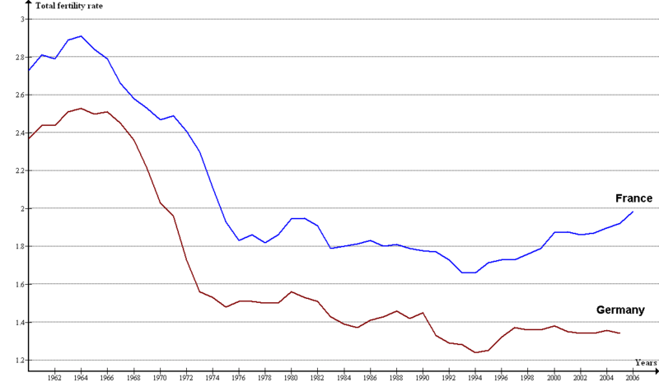
Total Fertility Rate - the average number of children a women will have in her childbearing years. This rate varies from just over 1 (Japan, Italy) to around 7 (Niger, Mali). The U.S. rate is about 2.
England & Wales
2.1 is generally regarded as the replacement rate (the rate at which a population neither grows nor shrinks) in the developed world. In less developed countries this rate should be higher to account for so many children not reaching childbearing age.

Slide 31
Infant Mortality Rate (IMR): The annual number of deaths of infants under 1 year of age, compared with total live births. IMR is usually expressed as the number of deaths among infants per 1,000. Generally a reflection of a country’s health care system

Slide 32
Growth Rate and Doubling Time

Slide 33
World Death Rates
Infectious diseases
HIV/AIDS
SARS
Degenerative diseases
Obesity
Tobacco use
Epidemiological transition
Communicable diseases/pathogens in less developed countries
Degenerative diseases in more developed countries (obesity, heart disease, diabetes, cancer)

Slide 34
Life Expectancy
Life Expectancy: is the average number of years an individual can be expected to live, given current social, economic, and medical conditions.
Life expectancy at birth is the average number of years a newborn infant can expect to live
Average number of years a newborn infant can expect to live at current mortality levels
W. Europe = late 70’s
Sub Saharan Africa = 40’s
Health Care and access to Medical Services can influence Life Expectancy

Slide 35
Demographic Transition Models

Slide 36
Demographic Transition Model: Model that shows changes in natural increase, fertility, and mortality rates. This process has several stages

Slide 37
DTM Stages

Slide 38
DTM STAGES

Slide 39
Effects on Population Growth
Policy Implications:
As countries move from stage to stage, they face different challenges, A country in Stage 2 or 3, with a relativity high percentage of young people, often lacks the resources to educate all children.
A country in Stage 4 or 5. with a relatively high percentage of old people, often faces problems funding healthcare. However, since the elderly can vote while children cannot, the elderly often have more influence on governmental policy than do children
Demographic Balancing Equation
Natural increase is only part of a country’s total population change. Migration also plays a part. To calculate a country’s total population change, the number of Immigrants, people who moved into the country, and the number of emigrants, people who moved out of the country, must be added to the equations. This is known as the Demographic Balancing Equation;
Total Population Change = Births – Deaths + Immigrants _ Emigrants

Slide 40
Characteristics of the DTM Stages
Factor | 1. High Stationary | 2. Early Expanding | 3. Late Expanding | 4. Low Stationary | 5. Declining
Birth Rates | High, but fluctuating as need for farm labor changes | High, but fluctuating to reflect desires for bit families | Declining as urbanization decreases the need for child labor | Low but enough to keep the population stable | So low it falls below the death rate
Death Rate | High, but fluctuating to reflect diseases and poor sanitation | Rapidly declining as nutrition, sanitation and medicine improve | Declining but not as fast as in previous stage | Low and stable | Low, sometimes increasing as the population ages
Population Change | Very low growth because births and deaths are both high | Rapid growth as death rates fall faster than birth rates | Rapid but slowing growth as birth rates decline | Very low growth because births and deaths are both low | Very low decline as births fall below deaths
Examples Today | Scattered isolated groups | Mali South Sudan | Mexico Turkey Indonesia | United States China | Japan Germany
Population Structure | Very Young | Very Young | Young, with rising life expectancy | Balanced with more aging | Very old

Slide 41
Epidemiological Transition Model Stages: The predictable stages in disease and life expectancy that countries experience as they develop. / They correspond with the stages of the DTM (Haiti / Cholera 9 min: https://www.youtube.com/watch?v=PwSnc-TauGk cholera is an infectious and often fatal bacterial disease of the small intestine, typically contracted from infected water supplies and causing severe vomiting and diarrhea.
Stage | Description | Effects on Population
1. Pestilence and Famine | Parasitic or infectious diseases, accidents, animal attacks, or human conflicts cause most deaths | A high death rate and low life expectancy (the plague)
2. Receding Pandemics | The number of pandemics (widespread diseases that affect large populations) declines as a result of improved sanitation, nutrition, and medicine | A decreasing death rate and increasing life expectancy (cholera in London) (today sub-Sahara Africa, India)
3. Degenerative and Human Created Diseases | Infectious and parasitic diseases continue to decrease, but diseases associated with aging, such as heart disease and types of cancer – increase as people live longer | Death rate stabilizes at a low level and life expectancy increases (Heart attacks, cancers) Today Europe
4. Delayed Degenerative Diseases | Stage 4 is an extension of Stage 3, but the age – related diseases are put off as medical procedures delay the onset of these diseases through advanced procedures. Diseases such as Alzheimer's and dementia increases (look at diets) | Death rate reaches its lowest level and life expectancy reaches a pea (obesity) Today ( US
5. Reemerging of Infectious and Parasitic Diseases | Infectious and parasitic diseases increases as some bacteria and parasites become resistant to antibiotics and vaccines, DDT resistant mosquitos, Increased travel can help spread disease. | Life expectancy decreases (aids) (avian flu)

Slide 43
Reading a Pyramid
Most pyramids follow the same fundamental structure, however, as with most types of graphics, the format can vary
The vertical axis shows age groups, known as cohorts, They are often listed in the middle, but are sometimes shown on the left or right side
Pyramids usually show the male population on the left and the female population on the right
The values of the horizontal axis may be percentages or absolute members of males and females
Pyramids are most commonly constructed at a country scale, but they can also be constructed for cities, states, or multi-country regions

Slide 44
Reading a population pyramid

Slide 45
Reading a Population Pyramid

Slide 46
Reading a Population Pyramid
Determining Population Trends
If a population has a wide base and tapers upward, the region’s population is growing. The population pyramid for the African nation of Niger is an example. Notice that the 3 longest bars are at the bottom of the pyramid and represent ages 0-14. As these children age, there will be more people in the older categories. There will also likely be a greater number of children born as these people reach childbearing ages
The pyramid is symmetrical or balanced indicating a balance of males and females until age 65.
The changes in the size of bars from 1 cohort to the next are gradual, there are no sudden bulges indicating war, natural disaster, epidemics etc.

Slide 47
Reading a Population Pyramid

Slide 48
Comparing Pyramids / Developed vs Developing

Slide 49
Developing vs Developed

Slide 50
Reading a Pyramid
The Impact of War
The clearest effect of war on population is that people are killed, Often half or more of deaths in war time are civilians, and the deaths affect people of all ages. However, the loss of fighting-age people, traditionally males between the ages of18-40, of often noticeable
During war men and women are often separated thus delaying family until after the war. Bars of the pyramid represent children born during the conflict are significant and referred to as a birth deficit
Post WWII German shows loss of life of both males and females in the 20-40 cohorts with a greater loss of men than women. The birth deficit during war in the 0-4 cohort

Slide 51
Causes of Industrial Revolution

Slide 52
Effects of the Industrial Revolution

Slide 53
Percent if Population under 15: About one-third of world population is under 15, but the percentage by country varies from over 40% in most of Africa and some Asian countries, to under 20% in much of Europe

Slide 54
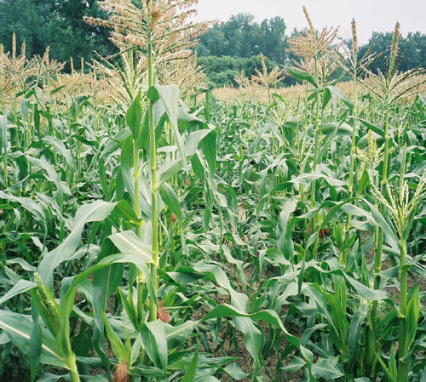
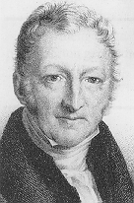
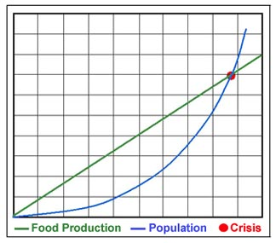
Thomas Malthus on Population
An Essay on the Principle of Population (1798)
AKA the Cycle of Misery
Earth’s population was growing much more rapidly than the Earth’s food supply .
Assumptions
Populations grow geometrically / exponentially. (characterized by or being an extremely rapid increase as in size or extent))
Food supply grows arithmetically.
Food shortages and chaos inevitable.
Population will keep increasing until it runs out of food and cant support itself
Bangladish
Crash Course Malthus 13 min: https://www.youtube.com/watch?v=QAkW_i0bDpQ

Slide 55
Malthus Critics and Neo Malthusians

Slide 56
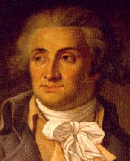
Jean Antoine Condorcet
(1743 – 1794)
predicted that innovation, resulting in increased wealth, and choice would provide food and resources in the future and lead to fewer children per family
believed that society was perfectible

Slide 57
Ester Boserup
20th century Danish economist
Argued that, "The power of ingenuity would always outmatch that of demand“
People would deal with higher population by using more intensive agricultural methods
Larger population could stimulate economic growth and therefore produce more food. Population growth could generate more customers and more ideas for improving technology

Slide 58
S Curve

Slide 59
J Curve
J-shaped growth curve A curve on a graph that records the situation in which, in a new environment, the population density of an organism increases rapidly in an exponential or logarithmic form, but then stops abruptly as environmental resistance (e.g. seasonality) or some other factor (e.g. the end of the breeding ...

Slide 60
Videos
Chapter 2 Key Issue 1 - Population 5 min: https://www.youtube.com/watch?v=1yb3RKsvkBI
Chapter 2 Key Issue 2 – Why Population is increasing 12 min: https://www.youtube.com/watch?v=wnEXB_YPyEM
Chapter 2 Key Issue 3 – Why does Population change among regions 13 min: https://www.youtube.com/watch?v=h2h9tuPzeOw
Chapter 2 Key Issue 4- Why do some regions face health threats 16 min: https://www.youtube.com/watch?v=Z2_p95lOaHk
World Population growth 6 min : https://www.youtube.com/watch?v=khFjdmp9sZk
Population, Sustainability, and Malthus: Crash Course World History 215
https://www.youtube.com/watch?v=QAkW_i0bDpQ
Chapter 3 Key Issue 1 – Migration where migrants distributed 15 min: https://www.youtube.com/watch?v=o7SBG6acQ5A
Chapter 3 Key Issue 2 – Migration Where do people migrate within a country 9 min: https://www.youtube.com/watch?v=mr1eb1_BQz8
Chapter 3 Key Issue 3 - Migration Why do People Migrate 9 min: https://www.youtube.com/watch?v=050O2YTMc2o
NOVA A World in the Balance Peoples Paradox: 1:18 : https://www.youtube.com/watch?v=bMLVGKIWA1c&feature=youtu.be
Migration 1:28 : https://www.youtube.com/watch?v=t3YdAcMENbk

