Slide 1
Chapter 30 / Post World War I
World History

Slide 2
Postwar Issues / Underlying Problems
While Great Britain and France appeared strong
After WWI they faced grave problems such as:
1. Finding jobs for returning vets
2. Rebuilding war damaged lands
3. Huge debts
4. Economic problems fed social unrest & made radical ideas more popular
5. Peace settlements dissatisfied many Europeans
6. Europe lacked strong leaders

Slide 3
Recovery and Depression A Dangerous Imbalance
During the 1920’s, Europe made a shaky recovery and the US emerges as the world’s leading economic power
Both American and world economy was overproducing and goods and farm products exceed demands causing prices to drop and surpluses of goods (supply and demand)

Slide 4
Crash and Collapse
  Investors in the Stock Exchange began purchasing stocks through Margin buying or paying part of the cost and borrowing he rest from brokers
  Because of uncertainty in the economy, many brokers called these loans due but investors who could not repay were forced to sell their stocks
  A financial panic set in as many tried to sell their stocks causing the stock market to crash and triggering the Great Depression
  Banks closed, business and factories closed and millions were unemployed

Slide 5
  Causes of Depression in US
Uneven distribution of income (1/2 lived at or below minimum level of income and could not afford goods- more production than consumption
Easy credit causing dept. and people to buy stocks on margin, farm loans for land, machines, seed
Unbalanced foreign trade: high tariffs on foreign goods so nations were unable to sell goods in Us were then unable to buy US goods plus many nations retaliated against tariffs by cutting purchase of US goods
Mechanization: new plants were built and turned out more goods than ever but employed fewer people

Slide 6
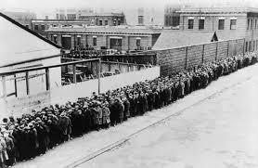
Global Impact
  The depression was a world wide depression
  Many people lost faith in the ability of democratic governments to solve problems
Misery and hopelessness create fertile ground for extremist who promised radical solutions

Slide 7
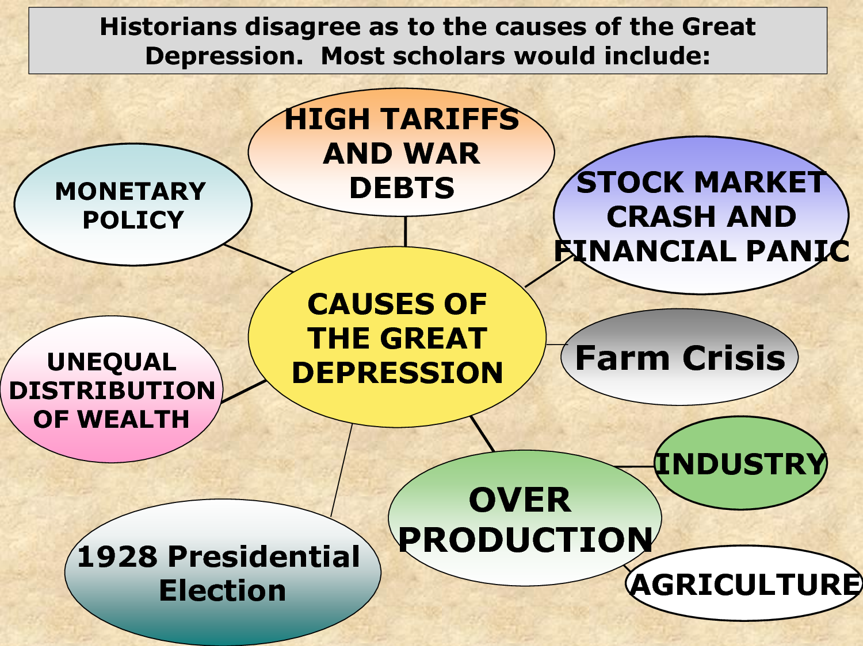
Causes of the Great Depression

Slide 8
Cause and Effect of the Great Depression
Cause and Effect of the Great Depression
Long Term Causes | Immediate Causes
Worldwide interrelationship of government and economies Huge War Debts American loans to Europe Widespread use of credit Overproduction of goods Industrial wages rise as farm earnings fall | New York stock market crash Farms unable to repay loans Banks demand repayment of loans American loans to other countries dry up Without capital, businesses and factories fail
World Economic Depression
Immediate Effects | Long Term Effects
Vast unemployment and misery Protective tariffs imposed Loss of faith in capitalism and democracy Authoritarian leaders emerge | Rise of fascism and Nazism Governments experiment with social programs People lame scapegoats World War II begins
Connections to Today
Governments monitoring of or control of national economies, banks, credit and stock markets Continuation of social programs Monitoring of worldwide economic developments by international agencies

Slide 9
New Deal
  Franklin D. Roosevelt became president and introduced The New Deal a massive package of economic and social programs
regulating stock market
protected bank deposits
government created jobs
gave aid to farmers
Social Security provided old age pensions
The New Deal did not end the depression but did ease the suffering of many

Slide 10
Smith and Keynes / Two Different Views
Adam Smith founded what is known as classical economics. The key doctrine of classical economics is that a laissez-faire attitude by government toward the marketplace will allow the “invisible hand” to guide everyone in their economic endeavors, create the greatest good for the greatest number of people, and generate economic growth
John Maynard Keynes, a British economist and financial genius examined capitalism and came up with some extremely influential views
John Maynard Keyes believed that there was only one way out, and that was for the government to start spending in order to put money into private-sector pockets and get demand for goods and services up and running again. , President Franklin D. Roosevelt gave this remedy a try when he started a massive public works program to employ a portion of the idle workforce. However, the United States entry into World War II rendered this a less than pure experiment in government spending. The war effort boosted production to extremely high levels (to make guns, ammunition, planes, trucks, and other materiel) while simultaneously taking millions of men out of the civilian workforce and into uniform.
The validity and desirability of Keynes's prescription for a sluggish economy—using government spending to prime the pump—are still debated today.

Slide 11
Karl Marx
Marx believed that once the capitalist (the guy with the money and the organizational skills to build a factory) has set up the means of production, all value is created by the labor involved in producing whatever is being produced. In Marx's view, presented in his 1867 tome Das Kapital (Capital), a capitalist's profits come from exploiting labor—that is, from underpaying workers for the value that they are actually creating. For this reason, Marx couldn't abide the notion of a profit-oriented organization.
This situation of management exploiting labor underlies the class struggle that Marx saw at the heart of capitalism, and he predicted that that struggle would ultimately destroy capitalism. To Marx, class struggle is not only inherent in the system—because of the tension between capitalists and workers—but also intensifies over time. The struggle intensifies as businesses eventually become larger and larger, due to the inherent efficiency of large outfits and their ability to withstand the cyclical crises that plague the system. Ultimately, in Marx's view, society moves to a two-class system of a few wealthy capitalists and a mass of underpaid, underprivileged workers.
Marx predicted the fall of capitalism and movement of society toward communism, in which “the people” (that is, the workers) own the means of production and thus have no need to exploit labor for profit. Clearly, Marx's thinking had a tremendous impact on many societies, particularly on the USSR (Union of Soviet Socialist Republics) in the twentieth century.
Sharing in the growth of the economy. In a very real sense, they are sharing in the profits.
https://www.youtube.com/watch?v=B3u4EFTwprM&list=PLBDA2E52FB1EF80C9&index=33

Slide 12
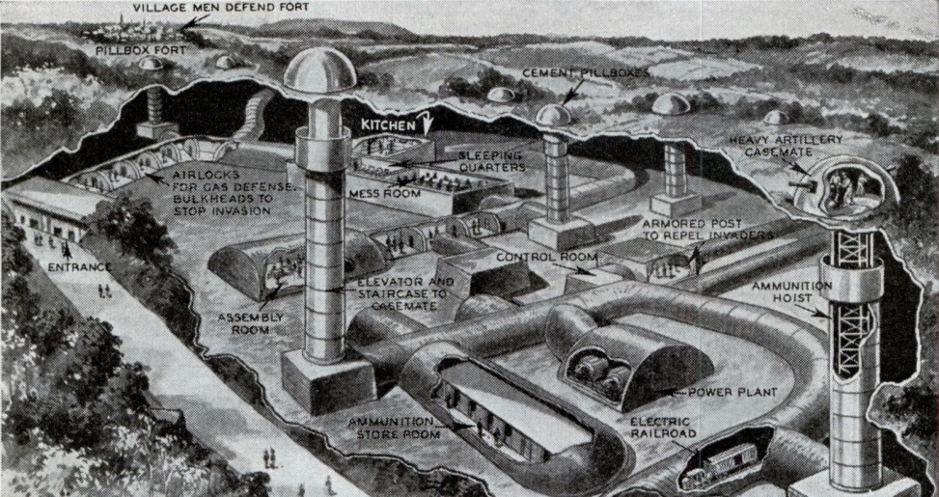
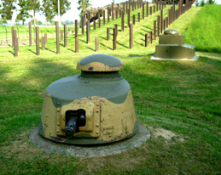
Maginot Line

Slide 13
China After World War I
  Anger over Treaty of Versailles because it gave German territories in Asia to Japan and not China even though it was on the allies side which was a signal to China they were seen as a weak nation
  May Fourth Movement: protests and strikes by people demanding change
  Long March: Led by Mao Zedong in 1934 was a 6,000 mile journey made by Communist Chinese to escape Nationalist troops. The Long March marked the emergence of Mao Zedong (1893-1976) as the undisputed leader of the Chinese Communists.
  Long march cartoon 2 min: https://www.youtube.com/watch?v=V_OpoNhEFQY

Slide 14
India
  India & after WWI: Indians angry because many fought for the British and hoped their sacrifices would win them some freedoms which it did not
  Amritsar Massacre: 1919 was an event in which British troops fired on a large crowd of peaceful, unarmed Indian protesters, killing some 400 people, it led to a campaign of protests led by Gandhi
  Mohandas Gandhi believed that nonviolent resistance is the best way to achieve change in a society where others hold all the power. He believed in two concepts:
  1. Ahimsa or nonviolence toward living things
  2. Civil Disobedience or a refusal to obey unjust laws
Salt March: took place from March to April 1930 in India, was an act of civil disobedience led by Mohandas Gandhi (1869-1948) to protest British monopoly on salt and rule in India.
SM 5min cartoon: https://www.youtube.com/watch?v=G1_Dm1ZjRAM

Slide 15
The Middle East
  The Ottoman Empire broke up with the country of Turkey being created
  Persia became Iran and ruled by Reza Shah
  French and British Mandates: France gains control of Syria and Lebanon and Britain gained control of Iraq and Palestine and Trans Jordan. Jewish immigration increases angering Arabs.
  Roots of Arab-Israeli Conflict: In the late 1800 Jews from Europe began to establish small colonies trying to rebuild a Jewish state in their ancient homeland.. Arab nationalist also developed and wanted an independent Arab state. After WWI Ended British and French mandates were setup making both groups unhappy. Still thousands of foreign born Jews and Arabs moved into Palestine with violence breaking out. In 1947 the UN issued a plan to divide Palestine between Jews and Arabs. The Jews accepted the plan while the Arabs felt it was unfair. The conflict continues today
  Africa: Nationalist feelings grow, Anger over Treaty of Versailles because no Africans were a part of the negotiations, Europoean countries just gave German colonies to other countries as mandates rather than granting them independence
  Many Africans organized and worked for Independence

Slide 16
Japanese Imperialism
  * Economic Challenges:
  Japan’s rapid shift from agricultural nation to a more urban industrial country the economy struggled
  After WWI factories began to shut down
  Tariffs on foreign goods increased tariffs on Japanese goods
  Social Changes:
  More urban people embraced western ideas and culture however more conservative people, including the military, resented these changes and believed in traditional beliefs
Military Influences:
  Economic crisis make many Japanese lose faith in their government
  US bans Japanese immigration offending Japanese and made them question their support of the west and support for military increased

Slide 17
Japanese Imperialism
Japanese Aggression : Japans military gained power, widening the gap between the military and civilian government. Without civilian controls the military became more aggressive towards other countries
  Taking over the government: slowly the Japanese military began taking over the government
  Manchurian Incident: 1931 Using an explosion on a Japanese controlled Southern Manchurian railroad as an excuse, Japanese military forces conquered Manchuria and set up a puppet government
  Nanjing Massacre: 1937 the murder of as many as 300,00 men women and children by Japanese troops
Japanese Alliances
  Anti Comintern Pact:
Greater East Asia Co-Prosperity Sphere

Slide 18
Events in Japan
1929 The Great Depression hits Japan
1931 Japan takes control of Manchuria, China
1933 Japan withdraws from the League of Nations
1934 Japan announces it will no longer submit to limits on its navy
1936 Japan signs agreement with Germany
1937 Japanese troops kill hundreds of thousands of civilians in Nanjing China
1940 Japan attempts to expand its power in Asia by proposing an economic alliances of Asian nations

Slide 19
Stalin’s Soviet Union
  Communism under Stalin: Instead of reducing government power he turned the Soviet Union into a Totalitarian State
  The Five Years Plan: The goal was to turn the USSR from an agrarian society into an industrialized powerful country. It focuses on centralized planning done by the state.
  Collectivization and Famine: the state took all the small individually owned farms and combined them into large mechanized farms. There was much resistances to this with many sent to Gulags (labor camps) and many left to starve
  Political Purges: fearing that many were plotting against him Stalin sent thousands of military officers and people to gulags (Soviet labor or concentration camps, or detention sites created fro military or political purposes to confine, civilians) or executed them
  Totalitarian rule: By using schools, propaganda, renaming streets after him he promoted a cult of personality and ruthlessly removed any opposition

Slide 20
The Rise of Mussolini
  In 1919 Italian nationalists were outraged by the Paris Peace Treaties
  They had expected to gain territory on the Adriatic but the lands went to the new Yugoslavia
  Many peasants were inspired by the Russian Revolution and began seizing land, and workers went on strike or seized factories and taxes rose
The government split into feuding factions and seemed powerless to end the crisis

Slide 21
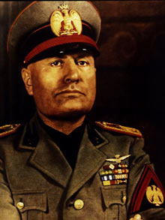
A Leader Emerges
  Benito Mussolini was a nationalist and in 1919 he organized veterans and other unhappy Italians into the Fascist Party taking the name from a Latin word meaning a bundle of sticks wrapped around an ax symbolizing the authority of ancient Rome
He promised to end corruption, to replace turmoil with order and revive the greatness of Rome

Slide 22
Seizing Power
  Mussolini organized his supporters into Black Shirts combat squads who use terror and intimidation against all who opposed them
  They ousted many elected officials in the north with the support of many who had lost faith in the government
Thousands marched on Rome and to avoid civil war King Victor Emmanuel asked Mussolini to form a government and serve as Prime Minister

Slide 23
Mussolini’s Italy
  Il Duce or The Leader
  Benito Mussolini
1. Suppressed rival parties, imprisoned critics
2. Muzzled or silenced the press
3. Rigged elections
4. Replaced elected officials with Fascist supporters
5. He brought the economy under state control by having representatives of business, labor, government and Fascist party controlling industry, agriculture and trade
6. The state not the individual is what is important
7 Shaping the young was a major

Slide 24
What is Fascism?
  Fascism is an authoritarian government that is NOT Communism
extreme nationalism
strong powerful ruler
glorified action, violence and discipline and loyalty to the state
Anti enlightenment, anti democratic,
aggressive expansionism
Totalitarian leaders

Slide 25
Totalitarian Rule
  Features of Totalitarian States
single party dictatorship
use of police spies and terror of enforce the will of the state
strict censorship of government monopoly of the media
use of schools and media to indoctrinate and mobilize citizens
unquestioning obedience to a single leader
State control of economy

Slide 26
The Appeal
  Given its restrictions of individual freedom why did fascism appeal to many Italians?
It promised a strong stable government ending political feuding that paralyzed democracy
Intense nationalism, revived national pride

Slide 27
HITLER AND THE RISE OF NAZI GERMANY
  After WWI Germany was on the brink of chaos
German leaders drafted a new constitution in the city of Weimer setting up a parliamentary system led by a Chancellor or prime minister
Germany faced severe problems
There were numerous factions vying for power

Slide 28
$ Inflation $
  When German fell behind in reparation payments France seized the coal rich Ruhr Valley causing many Germans to resist by refusing to work
  The government printed huge quantities of money causing massive inflation with most citizen’s salaries not keeping up
With the help of US, GB and Frances the reparation payments were reduced and France with drew from the Ruhr area

Slide 29
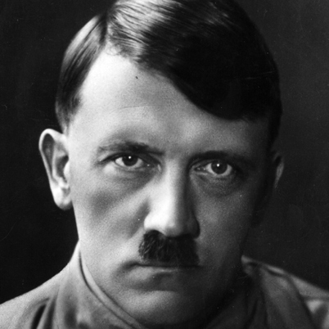
Adolf Hitler
  He was born in Austria 1889
  Moved to Germany and fought in WWI with the German Army
  Like many he despised the Weimar Government and joined a small group of right wing extremists called the National Socialist German Workers or Nazi party.
He organized his supporters into fighting squads called Storm Troopers

Slide 30
Mein Kamph
  After a failed attempt to overthrow the government he was jailed and while in jail he wrote Mein Kamph or My Struggle where he expressed his extreme nationalism, racism and anti-Semitism and how he belonged to a superior or master race
  He viewed Jews not as members of a religion but as a race and claimed that Germany lost the war because it was betrayed by a conspiracy of Marxist Jews and corrupt politicians and business leaders
  He urged Germans to united to form One Nation to gain Lebensraum or Living Space
To achieve greatness Germany needed a strong leader or Fuhrer

Slide 31
Road to Power
  After serving a Year in prison Hitler returns to an enthusiastic following
  Germans were frustrated with the Great Depression and the high unemployment rate so the Nazi membership grew to almost a million
  He promoted an end to Reparations, creating jobs and defying the Treaty of Versailles by rearming Germany
  With support from the conservatives Hitler wins election to become Chancellor through legal and democratic means
Within a year he suspended civil rights, destroyed opposing parties, Germany becomes a one party state where Hitler demands unquestioning obedience

Slide 32
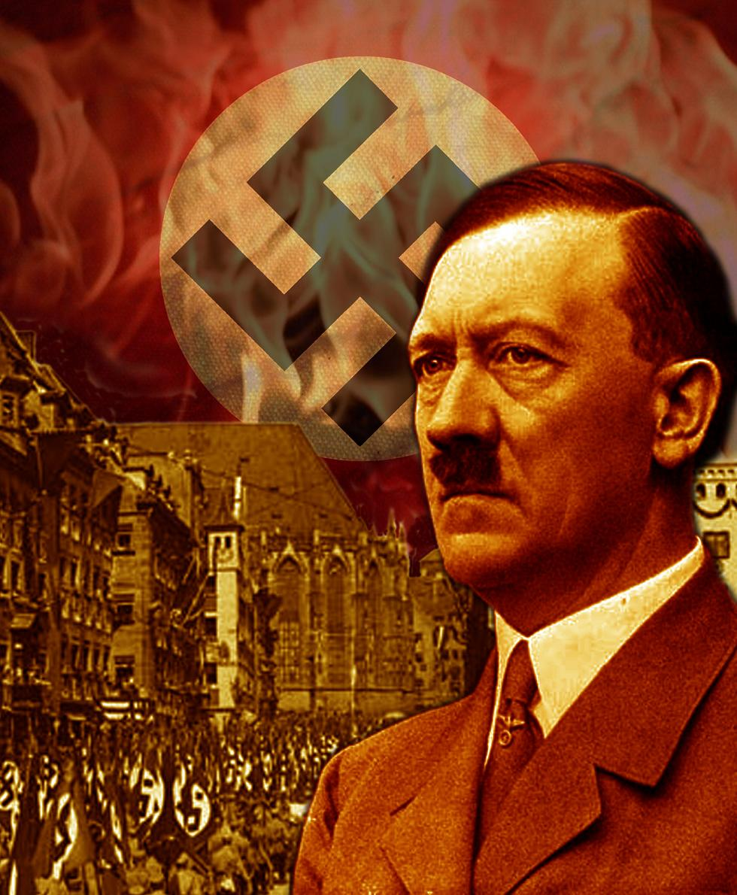
Hitler’s Third Reich (empire)
  Hitler appeals to German nationalism and Germany’s First Reich or Empire with the medieval Holy Roman Empire, the Second Reich forged by Bismarck and now his Third Reich were the German master race would dominate Europe for 1,000 years
  Hitler repudiated, or rejected the hated Treaty of Versailles scheming to unite Germany and Austria

Slide 33
A Totalitarian State
  To achieve his goals he organized an efficient and brutal system of terror, repression and totalitarian rule controlling all areas of German life from government to religion to education
  The black uniformed SS troops enforced his will and his secret police, or Gestapo rooted out opposition
Many cheered his accomplishments ending unemployment and reviving German power

Slide 34
Economic Policy
  To combat the Great Depression, Hitler launched large Public Works programs
  People were put to work building highways, housing, replanting forests and producing military hardware, against the Treaty of Versailles
  Placed both business and labor under control of the government
  Few objected to the loss of freedom because their standard of living increased
Propaganda highlighted the improvements for workers

Slide 35
Social Policy/ Purging German Culture
  Nazis indoctrinated young people with their passionate speeches and propaganda and asking young people to pledge absolute loyalty to Germany
Women’s roles were limited and rewarded them for having more children an dismissed from many jobs and turned away from
  Arts: Wanting to purge or purify German culture they denounced modern art and glorified German myths along with banning or burning many books
Churches: Hitler despised Christianity and sought to replace religion with his creed and combined Protestant sects into one and closed Catholic schools and muzzled their clergy.

Slide 36
Campaign Against the Jews Begins
  In his fanatical Anti Semitism Hitler set out to drive Jews from Germany. He placed sever restrictions on Jews when he instituted the Nuremberg Laws Which Include:
  * that Jews can’t marry non-Jews
  *Jews cannot attend or teach at German schools or
  universities
  * Jews cannot hold government jobs
  * Jews cannot practice medicine or law
  * Jews cannot publish books
  * Germans must boycott Jewish business
  * Jews may not fly the German or Reich flag
  * Jews may not employ German females in their household staff
  * Violators may be put in prison, put in labor camps and fined
  Night of Broken Glass called Kristallnacht when Nazi led mobs attacked Jewish communities all over Germany
Aftermath: Hitler continued his campaign against Jews sending thousands to concentration camps or detention centers for civilians considered enemies of the state

Slide 37
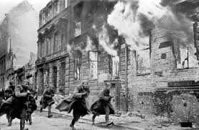
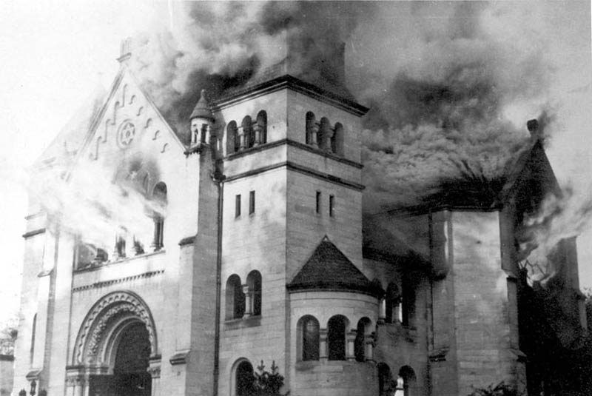
Night of Broken Glass or Kristallnacht

Slide 38
The Russian Revolution
National groups wanted self-rule | Growing social unrest A widening gap between the haves and have not’s | Disasters on the battlefield Weak leadership of Czar Nicholas II | Shortages of food and fuel

Slide 39
Communist Dictatorship in the Soviet Union
POLITICAL | ECONOMIC | SOCIAL | CULTURAL | MILITARY
One party only Dictatorship with absolute power Cult of the dictator | Government makes all decisions Collectivization of agriculture No private ownership of property Central control of industry State sets prices and provides needs of production | Attempt to regulate every aspect of life Propaganda as tool of social control Feeds extreme nationalism Atheism becomes official party policy New central role for women Elite ruling class of party members | Art serves government goals Conformity of style (social realism) | Secret police silences dissent wit torture, exile, death; Army used to enforce will of state

Slide 40
Communist Rule
Benefits
Free education for all
Free medical care
Day care for children
Inexpensive housing
Women equal under law
Drawbacks
Government regulated every aspect of citizens lives
Surveillance by secret police
Censorship
Relentless propaganda
Religious persecution
Low standard of living

Slide 41
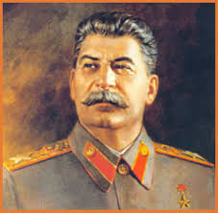
After World War I Totalitarian governments took root in Russia, Italy and Germany
Soviet Union: Joseph Stalin
Goal: To create a model Communist state and to transform the Soviet Union into a great industrial power.
Action: Massive campaigns to collectivize agriculture and industrialize the nation plus eliminate private property. The Five Year Plan
Government: Centralized Totalitarian government that maintains complete control over its citizens with no individual rights and government suppression of all opposition state ownership of property.

Slide 42
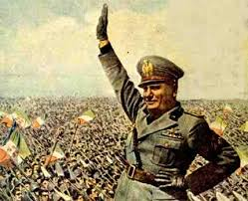
Italy: Benito Mussolini
Goal: to make Italy a world power
Action: extreme nationalism, strong centralized government, against communism, March on Rome, Rome-Berlin-Axis Pact, invasion of Ethiopia
Government: Fascism, consists of strong centralized government lead by a powerful dictator. Il Duce or the leader. Private property with strong government controls

Slide 43
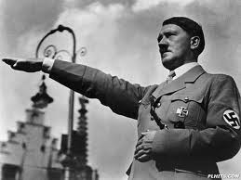
Germany: Adolf Hitler
Goal: To unite the German “master race” into an empire destine to rule the world
Action: Extreme nationalism, established the Their Reich, pulled out of League of Nations, built up military, sent troops into Rhineland, set up the Rome-Berlin Axis Pact, Hitler write Mein Kampf,
Government: Nazism, a political movement based on extreme nationalism and racism, Third Reich

Slide 44
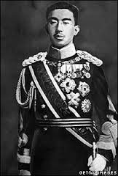
Japan
Goal: Needed more “living space” for growing population
Action: nationalism, militaristic expansion, invasion of Manchuria, pulled out of League of Nations
Government: Has an emperor but real power in hands of military

