Slide 1
Renaissance and Reformation Notes
World History

Slide 2
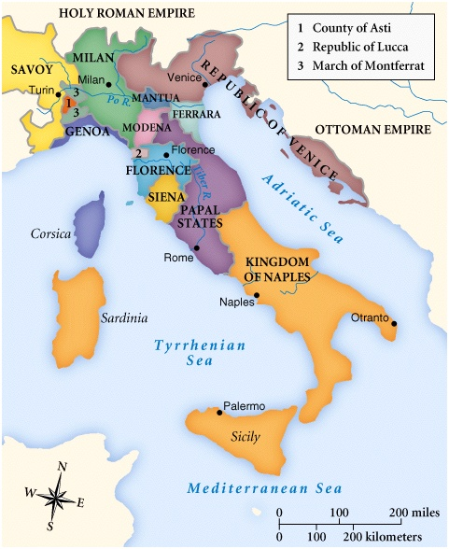
The Renaissance / Setting the Scene
A new age had dawned in Western Europe called the Renaissance, meaning Rebirth
It began in the 1300”s and peaked in the 1500”s
The Renaissance was characterized by creativity, interest in learning, and a desire to explore the human experience. Spurred by renewed interest in the culture of ancient Rome, the Renaissance began in the independent and prosperous cities of Italy. At the heart of the Renaissance was a set of ideas known as humanism

Slide 3
Why Italy?
The Renaissance began in Italy and then spread north to the rest of Europe
Renaissance was marked by a new interest in culture of ancient Rome
It was logical for this reawakening to start there because of ancient Roman remains were visible reminders of Rome
Visible reminders of Rome’s grandeur was architectural remains, statues, coins, inscriptions
Italy’s city states survived the Middle Ages
Prosperous manufacturing/trading Northern city-states include:
Florence Milan
Venice Genoa
Central Italy city-state
1. Rome
Southern city-state
1. Naples
A wealthy, powerful merchant class further promoted the cultural rebirth
These merchants exerted both political and economic leadership and helped shaped the Renaissance They stressed education and individual achievement and spent lavishly to support the arts

Slide 4
Florence and The Medici’s
The city of Florence came to symbolize the Renaissance.
It produced a large number of gifted poets, artists, architects, scholars and scientists
In the 1400’s the Medici family organized a very successful banking business as well as several other business and were one of the richest merchants and bankers in Europe.
In 1434 Cosomo de ’Medici gained control of the Florentine government and the family ruled Florence for many years
Lorenzo the Magnificent was a clever politician and a generous patron or financial supporter of the arts
Many artists and philosophers came to the Medici palace and practiced their crafts sketching Roman statues in the Medici gardens

Slide 5
What Was the Renaissance and
A New Worldview
The Renaissance was a time of relativity and change in the areas of political, social, economics, and cultural as well as how people viewed themselves and the world
With a reawakened interest of classical Greece and Rome creative minds felt this was a rebirth from the disorder and disunity of the medieval world. Although, it was not a complete break, many ideas, beliefs and philosophies carried over
Renaissance produced new attitudes toward and culture & learning such as
+ explore a variety of human experiences
+ emphasis on human achievement
+ ideal person has talent in many areas

Slide 6
Humanism
Renaissance supported the spirit of adventure and curiosity
The intellectual movement, Humanism, was at the heart of the Renaissance
Based on the study of classical culture, it focused on worldly rather than religious issues
Most humanist scholars were pious Christians who hoped to use wisdom of the ancients to increase their understanding of their own times
Humanist Believe
You should seek fulfillment in daily life
Individual had dignity and worth
Challenged long accepted traditions and institutions
Ideal person should participate in
a. politics d. sports
b. literature e. art
c. music
The Renaissance’s most glorious expression was its paintings, sculptors and architecture
Wealthy patrons played a major role, such a the church who supported the work of hundreds of artists

Slide 7
Humanist Concerns
How Renaissance art reflected humanist concerns
Look to the past/look to antiquity
Imitate culture of ancient Greece and Rome
Interest in man’s emotion
Emphasis on man’s talents
Humanized God
Classical nudes from antiquity
Religious themes still dominate
History Channel / Humanism 120: http://www.history.com/topics/enlightenment/videos/humanism-triggers-the-renaissance?m=528e394da93ae&s=undefined&f=1&free=false

Slide 8
Changing Art
Medieval Art
praised God’s greatness
Christianity all important
purpose of life preparing for heaven
didn’t care about subjects, being life like/flat looking
body is the house of sin
artists did not sign works
the story is what’s important
Renaissance Art
admired man’s talents
Christ important but new interest emerge
life on earth important
body form very life like/natural
body is seen as beautiful
artist’s signed works wanted recognition

Slide 9
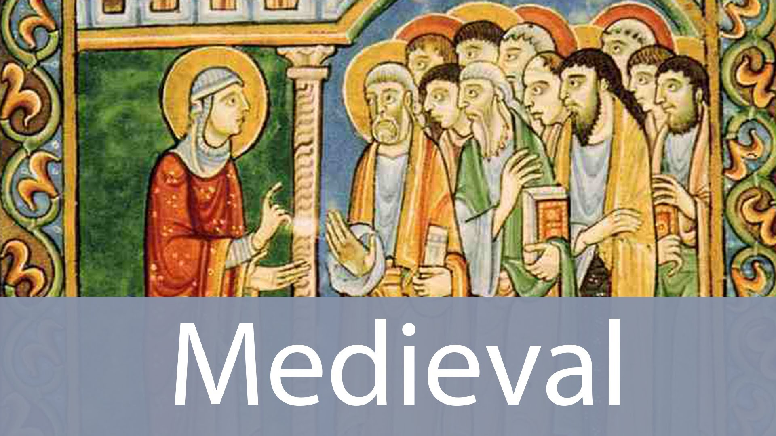
Medieval Art

Slide 10

New Techniques
Renaissance painters developed new techniques for representing both humans and landscapes in a realistic way
Perspective: making distant objects smaller that those close to the viewer
Appeared 3 dimensional
Painters used shading to make objects look round and real
A few women did manage to overcome lack of education & training to become professional painters

Slide 11
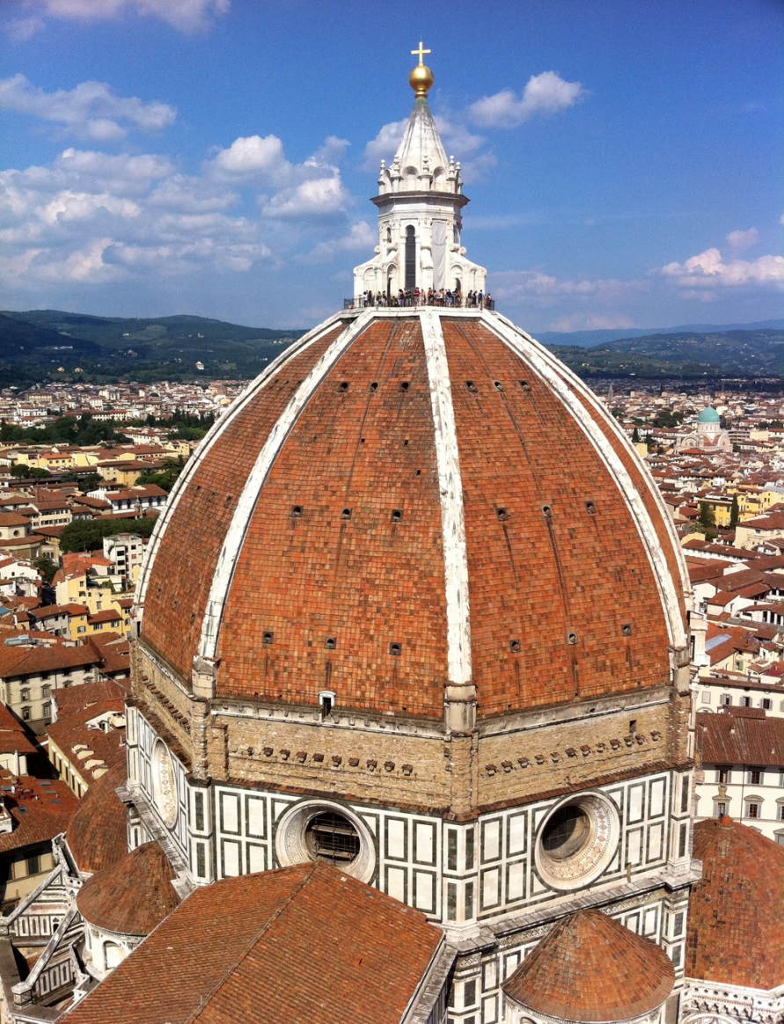
Architecture
Rejection of Middle Age Gothic Style
Adopted columns, arches, domes of the Greeks and Romans
Filippo Brunellechi created the dome for the Florence Cathedral

Slide 12
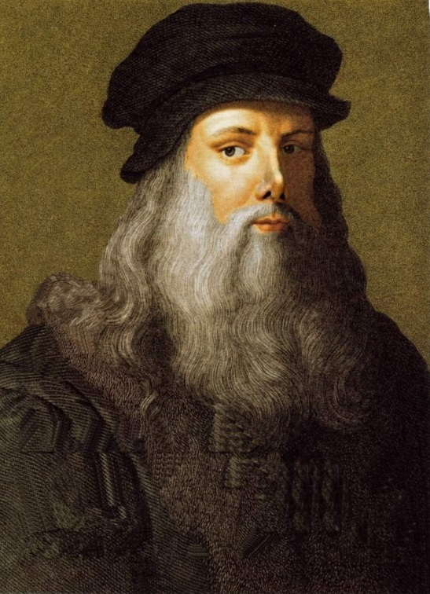
Leonardo da Vinci
Born 1452
Had an exploring mind and endless curiosity
Painter - scientist - inventor
Famous Paintings:
Mona Lisa : a portrait of a woman with a mysterious smile
The Last Supper The last dinner Jesus has with his apostles
Some other inventions, ideas, interests
Botany anatomy
Optics music
Architecture engineering
Flying machines parachutes
Under sea boats

Slide 13
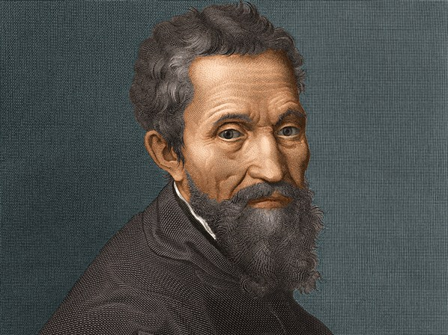
Michelangelo
Sculptor, painter, engineer, architect, and poet
Famous Works of Art:
La Pieta: Mary cradling her dead son Jesus
Sistine Chapel :ceiling and back wall
David Statue of shepherd who killed the giant Goliath
St Peter’s Basilica the dome for St Peter’s Cathedral in Rome

Slide 14
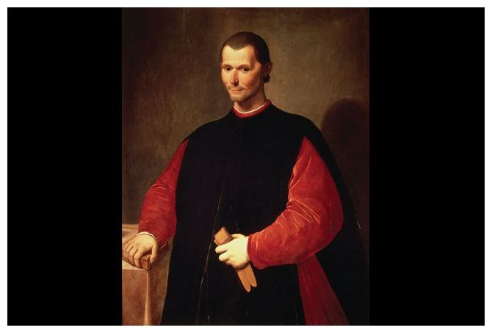
Niccolo Machiavelli
He had served as diplomat and observed kings and princes in foreign courts and studied ancient Roman history
He wrote The Prince in 1513 which was a book on how rulers can gain and maintain power
He based his book on real rulers, such as the Medici’s in a time of ruthless power politics
He stressed that the ends justified the means
He urged rulers to use whatever methods were necessary to achieve their goals
Getting results was more important that keeping promises
Felt he was and enemy of oppression and corruption
Machiavellian means use of deceit in politics
Is it better to be feared or loved as a ruler?

Slide 15
THE RENAISSANCE
MOVES NORTH
Unlike Italy, northern Europe recovered slowly from the Black Death
Only after 1450 did it enjoy the economic growth that Italy had
Northern Renaissance began in prosperous cities of Flanders, a region that included parts of present day northern France, Belgium and Netherlands
100 years later Spain, France, Germany England enjoyed theirs

Slide 16
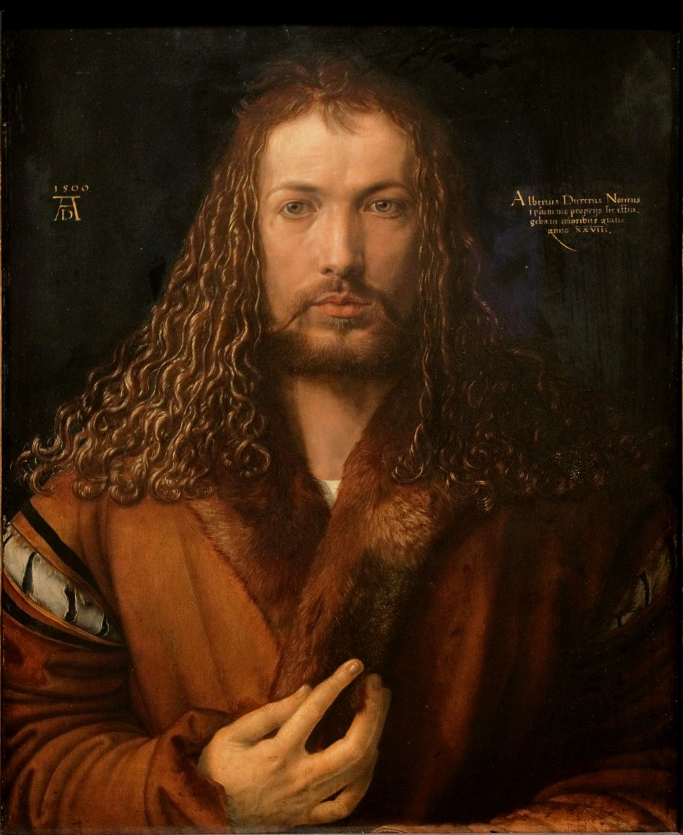
A “ German Leonardo” Durer
Albrecht Durer studied the techniques of Italian masters
He employed these methods in paintings and engraving, when artists etch a design on a metal plate with acid then use the plate to make prints
Durer’s engravings portrayed the religious upheaval of his age
Because of his wide range of interests he was sometimes called German Leonardo

Slide 17
Flemish Painters
In the 1400’s Jan and Hubert van Eyke portrayed townspeople & religious scenes with rich realistic details
They also developed oil paint
This produced strong colors and a hard surface that could survive the centuries
1500’s Pieter Bruegel used vibrant colors to portray lively scenes of daily life rather than religious or classical themes
1600”s Peter Paul Rubens blended realistic tradition of Flemish painters with classical themes and artistic freedom of Italian Renaissance with many painting portray pagan figures from the classical past

Slide 18
Northern Humanists/ Erasmus
Stressed education and classical learning
But also emphasized religious themes
They believed that the revival of ancient learning should be used to bring about religious and moral reform
Dutch author, priest and Humanists Erasmus
Used his knowledge of classical languages to produce a new Greek edition of the New Testament
Called for a translation of Bible into the vernacular or everyday language of ordinary people.
As a priest he was disturbed by the corruption in the church and called for reform
Wrote The Praise of Folly using humor to expose the ignorant and immoral behavior of many people of his day, including clergy

Slide 19
Authors
Thomas More
English humanists
Pressed for social reforms
Thomas Moore wrote Utopia which describes an ideal society in which men and women live in peace and harmony
No one idle, all are educated and justice is used to end crime rather than eliminate the criminal
Utopia : any ideal society
More and Erasmus wrote mostly in Latin
Northern growing middle class demanded new works in the vernacular, especially dramatic tales and comedies
Northern Humanists/ ErasmusStressed education and classical learning
But also emphasized religious themes
They believed that the revival of ancient learning should be used to bring about religious and moral reform
Dutch author, priest and Humanists Erasmus
Used his knowledge of classical languages to produce a new Greek edition of the New Testament
Called for a translation of Bible into the vernacular or everyday language of ordinary people.
As a priest he was disturbed by the corruption in the church and called for reform
Wrote The Praise of Folly using humor to expose the ignorant and immoral behavior of many people of his day, including clergy

Slide 20
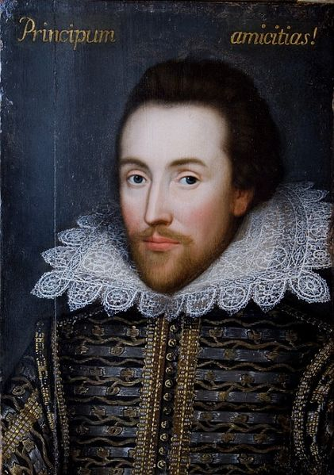
Shakespeare
He’s the Man!
English play write
Wrote 37 plays between 1590 and 1613 that are stilled performed around the world
Some works you may have heard of:
Romeo and Juliet: two teens fall victim of family feud
Twelfth Night: follies of young people in love
Richard III: power struggles for English throne
Enriched English language by more that 17,000 words words

Slide 21

Words and sayings created by Shakespeare

Slide 22
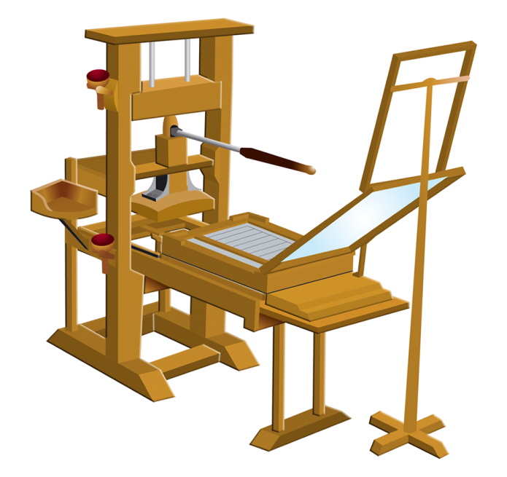
The Printing Revolution
1456 Johann Gutenberg of Germany developed the first Printing Press and printing inks in the West
Helping this was the methods making paper had reached Europe from China in about 1300
With more and more printed books more available, cheaper, and easier to produce more people learned to read and easier to spread information
History channel history of printing press 4 min: http://www.history.com/topics/middle-ages/videos/mankind-the-story-of-all-of-us-the-printing-press

Slide 23
Setting the Scene - Abuses in the Church
Setting the Scene
During the Renaissance the church came under increasing fire from all levels of society accusing the clergy of corruption and worldliness
These renewed calls for reform would unleash forces that would shatter Christian unity
This movement is know as the Protestant Reformation. (Protestant-to protest)
Abuses in the Church
Starting in the Middle Ages the Church became more caught up in worldly affairs
Popes competed with princes for political power
Church fought wars to protect Papal States
The Church was a great patron of the arts
To finance these projects, the Church increased fees for such services as marriages and baptisms
Indulgence was a lessening of time a soul would have to spend in purgatory, a place where souls too impure to enter heaven atoned for sins committed during their lifetimes.
In late 1400’s the Church began giving indulgences in exchange for money gifts to the church
Many Christians (especially northern Europeans) protested this practice

Slide 24
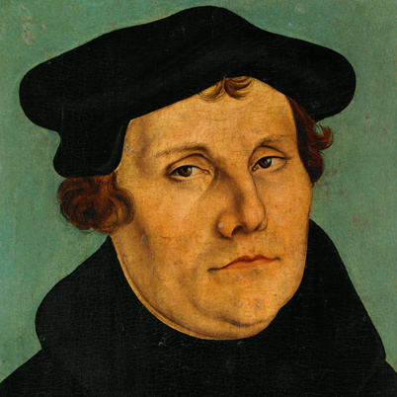
Luther’s Protest
By 1517 protest against Church abuses became a full scale revolt triggered by a German monk and professor of theology named Martin Luther
As a young man he tried to lead a holy life but believed he was doomed to eternal damnation
He grew disillusioned with Church corruption and worldliness
Keith Hughes 7 min: https://www.youtube.com/watch?v=__X5Z9IztrM

Slide 25
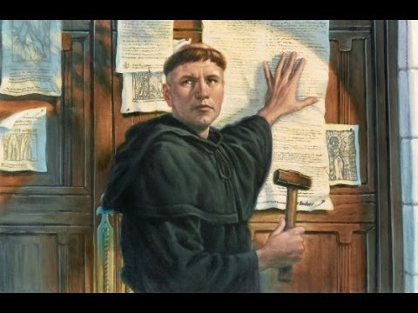
The 95 Theses
In 1517 a priest outside Whittenberg offered indulgences to any Christian who contributed money for the rebuilding of the Cathedral of St. Pewter in Rome
The priest said that if indulgences were purchased it assure entry into heaven for the purchaser and their dead relatives too
Luther was outraged and drew up the 95 Theses or arguments against the Church such as
indulgences had no basis in the Bible
The pope had no authority to release souls from purgatory
Christians could be saved only through faith
Luther posted this lists on the door of the Wittenberg’s All Saints Church

Slide 26
Luther Versus the Church
Copies of Luther’s 95 These were printed and distributed throughout Europe
The Church called on Luther to recant or give up his views but Luther refused and instead developed an even more radical new doctrine
Luther urged Christians to reject the authority of Rome
In 1521 the pope excommunicated Luther
The Holy Roman Emperor ordered him to give up his writings but he would not so Charles declared Luther an outlaw
Luther had many supporters who hid him and thousands hailed him a hero accepting his teachings and renounced the authority of the pope

Slide 27
Luther’s Teachings
At the heart of Luther’s beliefs were 7 teachings
rejection of Church doctrine that good deeds were necessary for salvation that Salvation was through faith alone
Bible is sole source of religious teachings and denied other authorities
such as church council or pope
Rejected idea that priests and the church hierarchy special powers instead there was priesthood of all believers. All Christians have equal access to God through faith and the Bible
Luther rejected 5 of 7 sacraments because he says the Bible doesn’t mention them
He banned indulgences, confession, pilgrimages and prayers to saints
He simplified the elaborate ritual of the mass and emphasized the sermon
He permitted clergy to marry
These and other changes were adopted by the Lutheran churches set up by Luther’s followers

Slide 28
Spread of Lutheran Ideas / Widespread Support /The Peasant’s Revolt
Luther’s ideas caught on in Germany and Scandinavia
The Printing Press help spread his ideas
by 1530 Lutherans were using a new name Protestants for those who protest papal (the pope’s) authority
Why did people support Protestantism?
1. His reforms were the answer to Church corruption
2. German princes embraced it because they saw it as a way to throw off rule of both the Catholic Church and the Holy Roman Empire
3. A chance for German princes to seize Church lands
4. Germans supported Luther because of feelings of national loyalty
5. Peasants like Lutheranism because they hoped to gain his support of social and economic change
1523 Peasant’s Revolt in Germany when rebels called for and end to serfdom and other changes
Luther denounced the revolt because he favored, social order and respect for political authority

Slide 29
The Peace of Augsburg
During 1530’S and 1540’s Holy Roman emperor Charles V tried to force Lutheran prices back into the Catholic Church
Finally after a number of brief wars Charles and the prices reached a settlement called the Peace of Augsburg in 1555
It allowed each prince to decide which religion would be followed in his lands
Northern German states chose Protestantism and southern remained largely Catholic

Slide 30
Calvin’s Teachings
Calvin’s Teachings
Two other reforms were
  Ulrich Zwingli
  John Calvin
Zwingli, a priest and admirer of Erasmus lived in the Swiss city of Zurich
John Calvin rejected elaborate church rituals and stressed the importance of the Bible
Calvin was born in France
Trained as a priests and lawyer
In 1536 he published Institutes of the Christian Religion which set forth his religious beliefs and how a church should be run
He believed
salvation gained through faith alone
Bible was only source of religious truth
Predestination or the idea that God determined long ago who would gain salvation
Two kinds of people saints and sinners
Calvinists tried to live like saints but believed only those who were saved could live Christian lives
In 1541 Protestant city state of Geneva in Switzerland asked Calvin to lead their community
Calvin set up a theocracy or government run by church leaders
His followers in Geneva saw themselves as a new chosen people entrusted By God to build a truly Christian society
Stressed:
hard work 4. honesty
discipline 5. morality
Thrift
Faced harsh penalties for offences such as
Fighting laughing in church
swearing dancing
They frowned on
theaters
Elaborate dress
They believed in: Religious education for girls and boys

Slide 31
Spread of Calvinism
Reformers from all over Europe visited Geneva and then returned home to spread Calvin’s ideas
By late 1500’s Calvinism had taken root in Germany, France, Netherlands, England, and Scotland
This new challenge to the Roman Catholic Church set off bloody wars of religion across Europe
In Germany, Calvinists faced opposition from Catholics and Lutherans
In France wars raged between French Calvinists called Huguenots and Catholics
In Netherlands Calvinists organized the Dutch Reformed Church
In Scotland a Calvinists preacher named John Knox led a religious rebellion and overthrew their Catholic queen and set up the Scottish Presbyterian Church

Slide 32
Radical Reformers
Throughout Europe, Catholic monarchs and Catholic Church fought back against the Protestant challenge but also sought reforms in the Church
As the Reformation spread hundreds of new Protestant sects sprang up
Anabaptists rejected infant baptism arguing infants are too young to understand what it means to accept the Christian faith and only adults should be baptized,
Some wanted to abolish private property
Some called for religious toleration and separation of church and state
Today Baptists, Quakers, Mennonites and Amish can all trace their ancestry to the Anabaptist

Slide 33
Seeking an Annulment
In England the break from the Catholic Church came from Henry VIII for political reasons
He wanted to end papal control over the
At first Henry VIII stood firm against the Protestant Reformation even receiving the title Defender of the faith from the pope
The issue that set Henry against the Church was his desire to end his marriage to Catherine because he did not have a male heir
Their only child was a girl named Mary
Henry felt England stability depended on a male heir
He wanted to marry Anne Boleyn
While Catholic law does not permit a divorce it Henry asked for an annulment or cancel his marriage
The pope refused not wanting to offend the Holy Roman emperor Charles V who was Catherine’s nephew
History channel cartoon HenryVIII 3 min: http://www.history.com/topics/middle-ages/videos/henry-viii?m=528e394da93ae&s=undefined&f=1&free=false

Slide 34
Break with Rome
Angry he could not gain a divorce Henry takes over the English Church
Acting through Parliament he enacted laws that took the Church away from the pope’s control and place it under Henry’s rule
In 1534 the Act of Supremacy made Henry the only supreme head on Earth of the New Church of England or Anglican Church
Many Catholics refused the accept the Act of Supremacy and were executed for treason
Sir Thomas More , the great English humanist was executed and later canonized or recognized as a saint by the Catholic Church
Henry appointed Thomas Crammer as archbishop who annulled the king’s marriage.
Henry married Anne who gave him a daughter named Elizabeth
Henry married 4 more times and had only one son
Song: https://www.youtube.com/watch?v=3EGzHsye71c&list=RDrZy6XilXDZQ&index=2

Slide 35
The Church of England
Between 1536 and 1540 Henry seized many convents and monasteries
Then granting these lands to nobles and other high ranking officials thus securing their support for the Anglican Church or the new Church of England
Henry was not Protestant so aside from the break with the Catholic Church the only other change was use of the English Bible

Slide 36
Religious Turmoil
When Henry died his 10 year old son Edward inherited the throne
His advisors were Protestant
Parliament passed laws that brought the Protestant reforms to England
Thomas Crammer drew up the Book of Common Prayer that imposed a moderate form of Protestant service while keeping many Catholic doctrine
Uprisings were suppressed
Edward died and his half sister Mary becomes queen
She was determined to return England to the Catholicism
Hundreds of Protestants were burned at the stake
The Elizabethan Settlement
Mary died in 1558 and Elizabeth became queen
She passes a series of reforms called the Elizabethan Settlement aimed at making a compromise or acceptable middle ground between Protestants and Catholics practices.
The Church of England
preserved much Catholic ceremony and ritual
kept a hierarchy of bishops
queen reaffirmed that the Monarch was the head of the Anglican Church
she restored a version of the Book of Common Prayer
accepted moderate Protestant Doctrine
allowed English to replace Latin in church services
Elizabeth tried to restore unity to England
While keeping many Catholic traditions she made England a Protestant nation
Upon her death England faced new religious storms

Slide 37
The Catholic Reformation
As the Protestant Reformation swept across northern Europe reform movements took place within the Catholic Church
The Catholic Reformation was led by Pope Paul III during the 1530’s and 1540’s
He set out to revise moral authority of the Church, stop the spread of Protestantism, end corruption within the papacy and appointed reformers to key posts

Slide 38
The Catholic Reformation Council of Trent
Council of Trent
In 1545 the pope called the Council Of Trent to establish the direction that reforms should take
Met for almost 20 years
They decided
Salvation comes through faith and good works
The Bible, while a major source of religious truth is not the only source
Took steps to end abuses in the Church
Proved penalties for worldliness and corruption
Established schools to create a better clergy who could challenge Protestant teachings
The Catholic Reformation
As the Protestant Reformation swept across northern Europe reform movements took place within the Catholic Church
The Catholic Reformation was led by Pope Paul III during the 1530’s and 1540’s
He set out to revise moral authority of the Church, stop the spread of Protestantism, end corruption within the papacy and appointed reformers to key posts

Slide 39
The Inquisition
Pope Paul strengthened the Inquisition
It was a Church court that used secret testimony, torture, and execution to root out heresy
It prepared the Index of Forbidden Books considered too immoral or irreligious for Catholics to read including books by Luther and Calvin

Slide 40
The Inquisition Widespread Persecution
The Inquisition
Pope Paul strengthened the Inquisition
It was a Church court that used secret testimony, torture, and execution to root out heresy
It prepared the Index of Forbidden Books considered too immoral or irreligious for Catholics to read including books by Luther and Calvin
Widespread Persecution
Rome was a far more devout city than it had been
Reforms did slow Protestant reformation
Europe remained divided between Catholics in the south and Protestants in the north
Both Catholics and Protestants fostered intolerance and persecution with both attacking and killing each other as well as radical sects like the Anabaptists

Slide 41
Witch Hunts
Religious fervor contributed to a wave of witch hunting
Those accused of being witches or agents of the devil were usually women but some were men
Between 1450 and 1750 tens of thousands of women and men were victims of witch hunts
Why?
Most people believed in magic / spirits
saw close line between magic and heresy
in times of trouble people often look for scapegoats or those whom they can blame their problems on
Victims mostly outcasts
Most victims of witch hunts died in German states

Slide 42
Jews and the Reformation
The Reformation brought hard times for Jews in Europe
At first Italy allowed Jews to remain but would eventually force them to live in ghetto’s, separate portions of cities
During the Reformation restrictions increased
Luther, disappointed Jews had not converted ordered them expelled from Christian lands
And their synagogues and books to be burned
Other German princes ordered them expelled or confined to ghettos or requiring them to wear a yellow badges
HRE Charles V supported toleration but banned Jews from Spanish Colonies
Many Jews migrated to Poland and Lithuania , Also Dutch Calvinist allowed Jewish families driven out of Portugal and Spain to settle in the Netherlands
These religious wars in Europe will last until the mid 1600”s
Issues of religion begin to give way to issues of national power

Slide 43
A Revolutionary Theory
1543 Copernicus published On the Revolutions of the Heavenly Spheres
He proposed a heliocentric or sun centered model of the universe, meaning the sun is the center of the universe
Most experts rejected this theory
At the time all scientific knowledge and many religious teachings were based on arguments by classical thinkers
They felt that if Ptolemy's reasoning was wrong so might be the whole system of knowledge
Both Brache and Kepler provided evidence to support Copernicus’s theory
Kepler’s calculations supported Copernicus’s heliocentric view and also proved that the planets moved in an oval shaped orbit called an ellipse

Slide 44
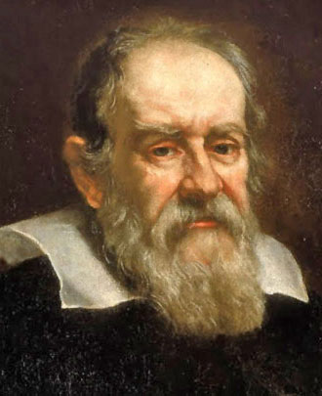
Galileo
Galileo assembled an astronomical telescope
He realized that Copernicus was correct that the earth moved around the sun
The Church condemned him because his ideas challenged the Christian teachings
1633 Galileo was tried before the Inquisition and threatened with death unless he withdrew his heresies
Galileo agreed to state publicly that he was incorrect but did not believe that
History channel 333: http://www.history.com/topics/enlightenment/videos/beyond-the-big-bang-galileo-galilei?m=528e394da93ae&s=undefined&f=1&free=false

Slide 45
Scientific Method /
A Step by Step Process
Early 1600’s a new approach to sickened emerged
It depended upon observation and experimentation
This new approach required scientists to collect and accurately measure data
To explain data scientist used reasoning to propose a logical hypothesis or possible explanation
Seven steps of the Scientific Method
State the problem
Gather information on the problem
Form a hypothesis or educated guess
Experiment to test the hypothesis
Record and analyze
State a conclusion
Repeat the steps
This step by step process of discovery was known as the Scientific Method
History channel 254: http://www.history.com/topics/enlightenment/videos/mankind-the-story-of-all-of-us-scientific-revolution?m=528e394da93ae&s=undefined&f=1&free=false

Slide 46
Bacon and Descartes
Both Bacon and Descartes incorporated scientific thought into philosophy
Bacon, an English philosopher claimed that idea based solely on tradition or unproven facts should be discarded completely
He felt truth can only be found by using the scientific method and stressed experimentation and observation
Descartes believed that truth must be reached through reason
He wrote Discourse on Method
He believed he had found only unshakable and self evident truth in the statement “I think, therefore I am”

Slide 47
Newton Ties It All Together
Newton spent 20 years perfecting his theory and used mathematics to show that a single force keeps the planets in their orbits around the sun and that is gravity
He wrote Mathematical Principles of Natural philosophy
He argued that nature follows uniform laws and all motion in the universe can be measured and described mathematically
Newton also developed an important new branch of mathematics called calculus
History channel 433: http://www.history.com/topics/enlightenment/videos/beyond-the-big-bang-sir-isaac-newtons-law-of-gravity

Slide 48
Other Scientific Advances
Alchemist believed is was possible to turn lead into gold
1600’s Robert Boyle distinguished between individual elements and chemical compounds
He defined that air could not be a basic element because it was a mixture of several gasses and he defined an element as a material that cannot be broken down into simpler parts by chemical means
He is called the founder of modern chemistry
Galen wrote was a Roman who formulated his theories on human anatomy by dissecting dogs ad apes but many of his findings were not accurate
1543 Andreas Vesalius wrote the first the first accurate study of the human body
1600’s William Harvey described circulation of blood
Anthony van Leeuwenhoek perfected the microscope and saw cells and micro-organisms

Slide 49
The Thirty Years War (1618-1648) in a nutshell
The Thirty Years' War was a series of wars principally fought in Central Europe, involving most of the countries of Europe. It was one of the longest and most destructive conflicts in European history, and one of the longest continuous wars in modern history.
Initially, The Holy Roman Empire fights with German states and Bohemia for religious control and to force their return to the Roman Catholic Church. Religion was a motivation for the war as Protestant and Catholic states battled it out even though they all were inside the Holy Roman Empire. Changing the relative balance of power within the Empire was at issue. Gradually, it developed into a more general political conflict involving most of the great powers of Europe. In this general phase the war became less specifically religious and more about political reasons
Murder, torture then famine and disease led to a severe depopulation of the German states,
The Treaty of Westphalia ends the war with France gaining territory, the Hapsburgs losing territory and the Netherlands and Swiss Federation gaining independence. Germany was divided into more than 360 kingdoms

Slide 50
The Results of the Peace of Westphalia1648
The First Modern Peace Treaty Marking the beginning of the modern state
France will gain the territory of Alsace and Lorraine
France becomes a dominate power
Sweden receives land from the empire
Dutch republic becomes independent
Recognizes the independence of the Swiss Confederacy
Spain and German states were weakened
Hapsburg power would decline
Relevance of the Holy Roman Empire declines
The ruler of a land would determine the religion
Calvinism was added as an approved religion
The war would reduce the German population in some parts by half causing education and agriculture to stop, making it difficult to rebuild and prevented religious unity
Would lead to the rise of Prussia
There was a decline in religion being the reason for war
The beginning of the nation based on diplomacy and warfare

Slide 51
