Slide 1
Ancient Rome and the Rise of Christianity Notes
World History

Slide 2
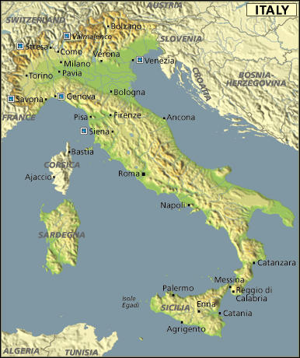
Geography of Italy
The Italian peninsula looks like a boot jutting into the Mediterranean Sea and Rome is located in the center
Its location helped the Romans expand to lands around the Mediterranean

Slide 3
The Roman Republic
Romans drove out the Etruscan ruler in Tarquin the Proud in 509 BCE
This date marks the founding of the Roman state
Romans set up a new government called a republic
They felt this would keep any one individual from getting too powerful

Slide 4
The Government Takes Shape
In the early republic the most powerful governing body was the Senate
Its 300 members were all Patricians Or members of the landholding upper class
Each year the senators elected two Consuls, whose jobs was to supervise the business of government and armies
The consuls could only serve 1 year
By limiting their time in office and making them responsible to the senate, Rome had a system of checks and balances
In the event of war the senate would choose a dictator or ruler who has complete control over a government.
The dictator could rule for 6 months

Slide 5
Plebeians Demand Equality
At first all government officials were patricians
Plebeians, who made up the bulk of the population had little influence and were not happy
1st breakthrough was in 450BC when the Twelve Tablets of Law were placed in the Forum so all may know the laws
Plebeians could now appeal judgments
Later, they gained the right to elect their own officials called Tribunes to protect their interests
Tribunes could veto those laws that they felt were harmful to plebeians
Slowly plebeians forced the senate to give them more of a voice in the government
More than 2,000 years later the framers of the US Constitution would adapt such Roman ideas as the senate the veto and checks on political power

Slide 6
Citizen Soldiers / Conquered Lands
By 270 BC Rome controlled most of the Italian peninsula
Rome’s success was due to its skillful diplomacy and its well trained army
The basic unit was a legion who fought for free & furnished their own army
Conquered peoples had to
1. Had to acknowledge Roman leadership
2. Pay taxes
3. Supply soldiers to the Roman army
In return, Rome letting them keep their own customs and even gave some full citizen ship.
As a result, most conquered lands remained loyal to Rome

Slide 7
Protection and Unification
To protect its conquests, Rome posted soldiers throughout he land
It built a network of roads to link distant territories
As trade and travel increased, local peoples incorporated Latin into their languages and adopted many Roman customs and beliefs
Italy began to unite under Roman rule
Roman roads, forum Engineering an Empire 9min
https://www.youtube.com/watch?v=W1phqEmyxGY

Slide 8
Wars with Carthage
Rome’s conquests brought it in contacts with Carthage
Carthage was a city state on the northern coast of Africa And ruled over an empire stretching across N. Africa & W. Mediterranean
Between 264-146 BCE Rome fought three wars against Carthage called the Punic Wars from Punicus, the Latin word for Phoenician
First Punic War: was largely a naval battle over the Straits of Mesina. Rome defeated Carthage and won Sicily, Corsica and Sardinia
Second Punic War : The Carthaginians sought revenge. The Carthaginian general Hannibal led his army, including war elephants across the Pyrenees, through France and over the Alps into Italy. This cost him nearly half of his army. He did surprise the Romans and for 15 years Hannibal and his army moved across Italy. The Carthaginians failed to capture Rome . Rome sent an army to attack Carthage and defeated Carthage
Third Punic War: Rome saw Carthage as a rival and wanted revenge for Hannibal’s destruction so Rome completely destroyed Carthage. Survivors were killed or sold into slavery; they poured salt into the earth

Slide 9
Social and Economic Effects
The many conquest brought many riches into Rome
A new class of wealthy Romans emerged who built huge estates driving many small farmers out of work
As Rome conquered more and more land they forced the captured people to work as slaves
Widespread use of slave labor hurt small farmers
Huge quantities of grain forced the prices down forcing many farmers into debt and forced to sell their land
These landless farmers flocked to Rome looking for jobs
There they joined a growing class of unemployed causing a gap between rich and poor and angry mobs began to riot

Slide 10
Attempts at Reform
Two patrician brothers named Tiberius and Gaius Gracchus were the first to attempt reforms
Tiberius was elected Tribune called on the state to distribute land to poor landless farmers
Ten years later his brother Gaius was also elected Tribune and sought even wider reforms, including the use of public funds to buy grain to feed the poor
Both Gracchus brothers angered the senate so much that they and thousands of their followers were killed

Slide 11
Decline of the Republic
Unable to resolves its problems Rome was plunged into civil war
At issue was who should hold power, the senate or popular political leaders
This turmoil sparked slave uprisings and revolts among Rome’s allies
Old legions of Roman citizen soldiers became professional armies loyal to their generals and not Rome

Slide 12
Julius Caesar’s Rise to Power
An ambitious military leader Julius Caesar comes to dominate Roman politics
The First Triumvirate - a group of three persons with equal power
1. Gen. Pompey
2. Marcus Crassus
3. Julius Caesar
After Crassus’ death Pompey and the Senate order Caesar to leave his legions and return home, Caesar defied the order and crossed the Rubicon River and headed to Rome sparking a civil war across Rome
Caesar crushed Pompey
“Veni, vidi, vici”—I came, I saw, I conquered
Upon returning to Rome, Caesar forced the senate to make him dictator but kept the senate and other features of the republic but in fact he was the absolute ruler
Caesar’s reforms:
Gave jobs to unemployed with public works projects
reorganized the government of the provinces
granted citizenship to more people
Most lasting reform was the Julian Calendar

Slide 13
Assassination and Civil Wars
A group of senators led by Brutus and Cassius feared Caesar would make himself king, assassinated him
Caesar’s death plunged Rome into a new civil war
Second Triumvirate: Mark Antony, Caesars chief general and Octavian, Caesar’s grand nephew and Marcus Lepidus divide up the empire
Octavian forced Lepidus to retire
After Antony married Cleopatra, Octavian declares war on Antony in Rome’s name
Octavian defeats Antony’s army a the naval battle at Actium
Antony & Cleopatra commit suicide to avoid capture
Octavian becomes undisputed ruler of Rome

Slide 14
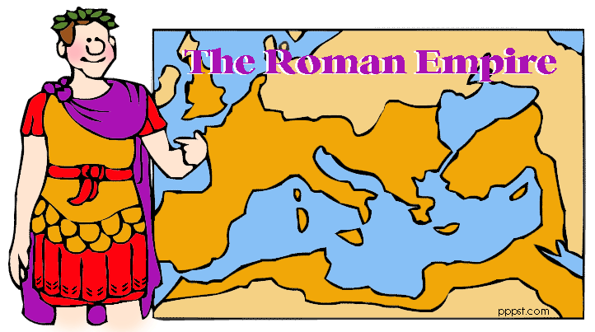
Rome Becomes an Empire

Slide 15
Roman Empire /A Stable Government
Octavian takes the title of Augustus Or Exalted One
Augusts exercised absolute power and named his successor just as a king would. This ushers in the Age of the Roman Empire
Augusts did lay the foundation for a stable government
He created a well-trained civil service
High level jobs were open to men of talent
He allowed cities and provinces to Rome self government
Economic reforms:
1. Made the tax system more fair
2. Ordered a census, or population count
3. set up a postal system
4. issued new coins to make trade easier
5. put jobless to work building roads and temples
Augustus government functioned well for 200 years but the main problems kept arising

Slide 16
Bad Emperors and Good Emperors
The Bad Emperors or The Julian Emperors
Tiberius
Caligula: Mentally disturbed, killed by palace guards
Claudius
Nero: Cruel, insane; senate sentenced him to death for treason
The Good Emperors
Nerva
Trajan: increased empire to its greatest size
Hadrian: codified Roman law, built wall across Britain
Pius
Marcus Aurelius: brought empire to height of its economic prosperity

Slide 17
Pax Romana
200-year period of Peace that began with Augustus and ended with Marcus Aurelius was called Pax Romana or Roman Peace
During this time Roman rule brought many regions under their rule to become as large as the continental United States
Roman legions maintained and protected the roads, trade flowed freely
People moved easily within the empire spreading ideas and knowledge
Mr Corwins Rome song: https://www.youtube.com/watch?v=XoK1mRnjPC0

Slide 18
Bread and Circuses
Rich and poor a like enjoyed the spectacular entertainments
Circus Maximus: Chariot Races
Gladiator contests were at the Colosseum
Paid for with taxes, they were a way to pacify the city’s restless mobs and gave grain to the poor
During Pax Romana, the general prosperity hid underlying social and economic problems
Colosseum: Engineering an Empire 10 min: https://www.youtube.com/watch?v=XyVuqsOHxwA

Slide 19
Greco-Roman Civilization
Early on Rome absorbed ideas from the Greeks
Greek art, literature, philosophy and scientific genius represented the height of cultural achievement
Romans adapted Greek and achievements, this blending of Roman, Hellenistic and Greek traditions produced what is known as Greco-Roman Civilization
civilization which trade and travel help spread

Slide 20
Art & Architecture
Largely based on Greek and Etruscan models but also developed their own style
Like Greeks, they stressed realism portraying their subjects exactly as they looked
Some sculptures were more idealistic
Many homes had mosaics or pictures from chips of colored stone or glass
Romans emphasized grandeur
The built immense palaces, temples, and stadiums to show the power and dignity of Rome
Pantheon was a temple to all the Roman gods
Engineering an empire pantheon/Hadrian wall: https://www.youtube.com/watch?v=qC5uecyfK34

Slide 21
Technology & Science
Romans excelled in engineering or the application of science and mathematics to develop useful structures and machines such as roads, bridges, harbors throughout the empire
Aqueducts were bridge like stone structures that brought water from the hills into Roman cities
Ptolemy proposed that the earth was the center of the universe, which was accepted in the western world for nearly 1,5000 years
Galen advanced the frontiers of medical science by insisting on experiments to prove a conclusion and he compiled a medical encyclopedia summarizing what was known a the time and used for 1,000 years

Slide 22
Common Principals of Roman Law
One of the greatest legacy’s from Rome is their commitment to the rule of law and justice
The rule of law fostered unity and stability
Civil law was law that applied to its citizens but many foreigners were not covered
The Law of Nations applied to all people under Roman rule, citizens and noncitizens and later the two systems would merge
As Roman law developed, certain basic principles evolved
1. An accused person is presumed innocent until
proven guilty
2. The accused was allowed to face the accuser and
offer a defense against the charged
3. Guilt had to be established clearer than daylight
through evidence
4. Judges were allowed to interpret the laws and
were expected to make fair decisions

Slide 23
Mystery Religions /Religious Toleration
Within a culturally diverse Roman empire a variety of beliefs coexisted
Some turned to mystery religions that emphasized secret rituals and promised Special rewards
Generally the Romans tolerated other religions as long a citizens showed loyalty by honoring Roman gods and acknowledging the divine spirit of the emperor
Since most people were polytheistic, they were content to add Roman gods as well
By 63BC Rome had conquered Judea where most Jews lived
To avoid violating the Jewish belief in one god Romans excused Jews from worshiping Roman gods

Slide 24
Jesus and His Message/Life of Jesus
A new religion, Christianity is founded by a Jew named Jesus
What we know about the life of Jesus comes from what is written in the Bible
Jesus was born 4 BC in Bethlehem after an angle gold his mother “Mary” that she would give birth to the messiah
Jesus grew up in Nazareth and as a young man worked as a carpenter
At the age of 30, he began preaching
He recruited twelve close followers who became know as his apostles meaning person sent forth
Large crowds gathered to hear his teachings and see him perform miracles of healing. He often used parables or short stories with simple moral lessons

Slide 25
The Message
Jesus’ teaching were firmly rooted in Jewish traditions
He believed in one God, accepted the Ten Commandments and preached the obedience to the laws of Jewish, and teachings of Jewish prophets
He called himself the Son of God
Many people believed he was the messiah who the Jews had predicted
He claimed his mission was the bring spiritual salvation and eternal life to anyone who would believe in him
In the Sermon on the Mount he echoed Jewish ideas of mercy and sympathy for the poor
Emphasized God’s love and taught the need for justice, morality, and service to others
A person’s major responsibilities were love the Lord, and love your neighbor
He emphasized the importance of forgiveness

Slide 26
Death on the cross
While some Jews welcomed Jesus other s regarded him as a dangerous troublemaker
Jewish priests felt he challenged their leadership
To the Roman authorities he was considered a revolutionary
Jesus was betrayed by one of his disciples and was arrested by the Romans
He was tried and condemned to be crucified
Crucifixion was a Roman method of execution in which a person was nailed to or hung on a cross and left to die
His disciples say they saw and talked with Jesus who had risen from the dead, who told them to spread his teachings Then ascended to heaven

Slide 27
Spread of Christianity/Work of Paul
After Jesus’ death, the apostles and other disciples spread his message and helped establish Christian communities
Paul had never seen Jesus in fact he had persecuted Jesus’ followers
One day Paul had a vision in which Jesus spoke to him then immediately converted the new faith an spread the teachings of Jesus
His work set Christianity on the road to becoming a world religion
His letters and teachings are part of the New Testament

Slide 28
Persecution
Rome’s tolerant attitude toward religion did not extend to Christianity
Officials suspected Christians of disloyal to Rome since they would not make sacrifices to the emperor or honor the Roman gods
Rumors spread that they were engaged in evil practices
Many Christians became martyrs or people who suffer or die for their beliefs

Slide 29
Reasons for Christianity’s Appeal
Despite attacks Christianity spreads…Why
1. Jesus welcomed all people especially the humble, poor and oppressed
2. Message of love
3. Equality, human dignity
4. The promise of a better life beyond the grave
The work of Christian missionaries was made easier by the unity of the Roman Empire as they traveled Roman roads
Keith Hughes 12 min: https://www.youtube.com/watch?v=0XceOxLsGzg
Crash Course https://www.youtube.com/watch?v=TG55ErfdaeY&index=11&list=PLBDA2E52FB1EF80C9

Slide 30
Triumph
Persecution of Christians ends in 313 AD when emperor Constantine issued the Edict of Milan
It granted toleration of Christians
Theodosius made Christianity the religion of the empire

Slide 31
Crisis and Reforms / Economic and Social Problems
After the death of Marcus Aurelius in 180, the golden age of Pax Romana ended and political and economic turmoil rocks the empire
During this period emperors were overthrown by others who seized power
At the same time there were social and economic problems
High taxes to support the army and bureaucracy put a heavy burdens on businesspeople and small farmers
Farmland had been over cultivated and lost productivity
Many poor farmers left their land and sought protection from wealthy landholders and though technically free there could not leave the land

Slide 32
Emperor Diocletian
Emperor Diocletian set out to restore order and make empire easier to govern
He divided the empire into two parts
He kept the wealthier eastern part and appointed a co-emperor to rule the western provinces but was answerable to him
Took steps to end the economic decay by
to slow inflation or the rapid rise of prices he fixed prices for goods and services
required men to follow their fathers occupations
Forced farmers to stay on their land

Slide 33
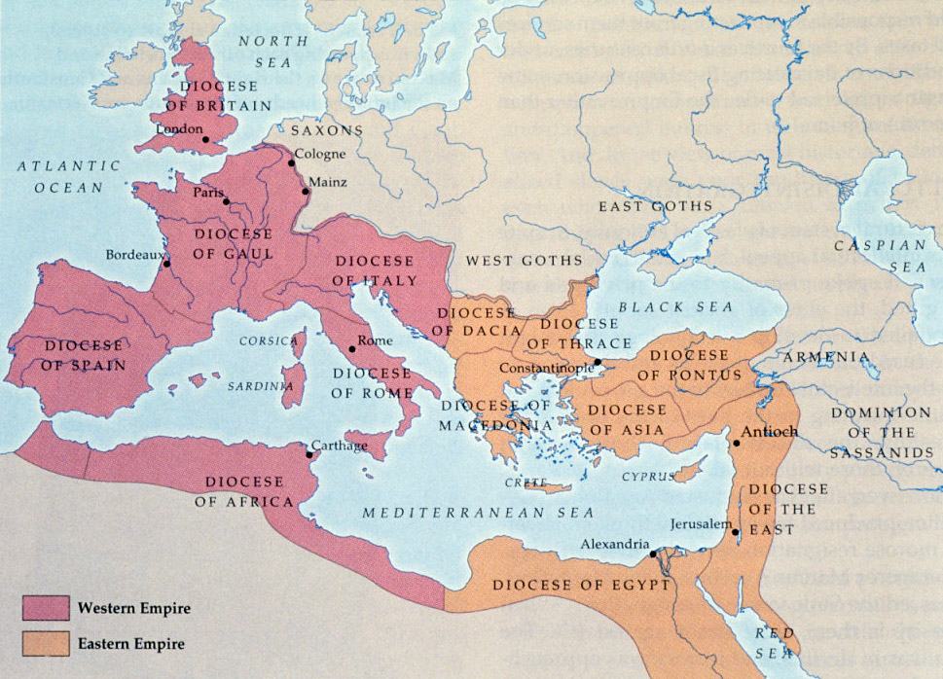
Dividing the empire

Slide 34
Emperor Constantine
In 312 Gen Constantine takes the throne and continues Diocletian’s reforms
Constantine granted toleration to Christians which encouraged its growth
He built a new capital in Constantinople which made the eastern portion of the empire the capital of the Roman Empire
The western portion declined while the Eastern portion prospered

Slide 35
Rome Defeated
For centuries Rome faced attacks from the invasions of Germanic peoples and wars in east Asia forced man to flee to Rome
Under pressure from attacks Rome gave up Britain then France then Spain and finally Rome
In 410 Visigoth general Alaric overran Italy and plundered (to take goods by force) Rome
In 434 Hun leader Attila embarked on a savage conquest across Europe sending many fleeing into the Roman empire
Finally Odoacer, a Germanic leader ousted the emperor in Rome This event was later referred the “Fall of Rome”

Slide 36
The Fall of the Roman Empire

Slide 37
Did Rome Fall?
The fall did not happen in 476, Rome still had an emperor in the eastern empire with came to be known as the Byzantine Empire
The “fall” was a long slow process over hundreds of years
Over centuries German customs and languages replaced much of Roman culture
Roads and cities disappeared a dark age began in the western portion
Christian traditions will give rise to medieval civilization in western Europe

Slide 38
Rome in a Nutshell
Roman Republic | Roman Empire | Decline and Fall | Christianity in Rome
Founded in 509 BCE after last Etruscan king was overthrown Governed by the Senate, elected magistrates and popular assemblies working together During the Republic the Romans conquered Italy, Greece, N. Africa and much of Mediterranean Problems within the government led to the Republics breakdown Julius Caesar, one of the republics last rulers, gained power but was assassinated | Founded in 27 BCE when Augustus became the first emperor The beginning of the empire was marked by peace and prosperity known as Pax Romana The empire continued to expand in both the east and west, surrounding the Mediterranean and becoming the largest empire in the ancient world Emperors gained more power as time passed making important government decisions themselves | Political and economic problems began to threaten the empire’s stability in the late 200 & 300’s Emperors became absolute rulers to try to stop the decline Diocletian divided the empire in half in an effort to prevent its immediate collapse Barbarian invasions and other factors led to the collapse of the Western Empire in 476 CE The Eastern Empire remained strong for several centuries developing into the Byzantine Empire | Based on the teachings of Jesus of Nazareth and spread by his disciples Taught that people should treat others well and seek forgiveness for their sins to achieve salvation Spread throughout the Roman world, especially after Constantine became Christian The Christian church began as small close knit groups and became more complex as time passed

Slide 39
Rome’s Legacy
Engineering and architecture techniques influenced later building practices
Art and literature influenced how people thought and wrote for centuries
Latin developed into the Romance languages and influenced English

