Slide 1
APHUGE: Unit 1 Quick Review

Slide 2
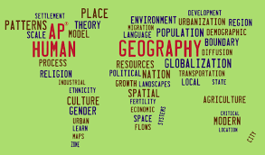
Unit 1: Geography: Its Nature and Perspective

Slide 3
Geography as a field of study
Subfields of Human Geography
    Population – health, births, migration, etc.
    Culture – language, religion, popular music, etc.
    Economics – agriculture, level of development, wealth, etc.
    Urban areas – cities, suburbs, challenges from growth, etc.
    Political - local government, nations, distribution of power, etc.

Slide 4
Place refers a specific point on Earth, distinguished by a particular characteristic. Every place occupies a unique location, or position, on Earth’s surface. Differentiates each location from another, like a fingerprint! Sound, smell, climate, language, damns, pollution, roads, lawns, homes, images you can develop a sense of place from somewhere you’ve never been tv’s, books, movies, people
Site the characteristics at the immediate location.
EX the location of a city, often chose for trade, defense or religion.
EX: Climate, labor force, soil type, human structures, water sources, topography, vegetation, latitude and elevation. The combination of physical features gives each place a distinctive character
EX: Humans have the ability to modify the characteristics of site. Cities like Boston, New York and San Francisco have all added lands to marshes, bays etc to add to their land
Situation a way of describing where a place is based on the physical characteristics of the surrounding area. It is valuable way to indicate location, for two reasons
1. Finding a familiar place: Giving direction
based on current situation of place, It’s
down past the courthouse, on Main St
after the 3rd stoplight
2. Understanding the importance of a place: Situation helps us understand the importance of a location. Some just because they are accessible to other places.
EX: Istanbul is center for trading & distribution of goods between Asia, and Europe along the Bosporus Strait connecting the Mediterranean and Black seas and Russia

Slide 5
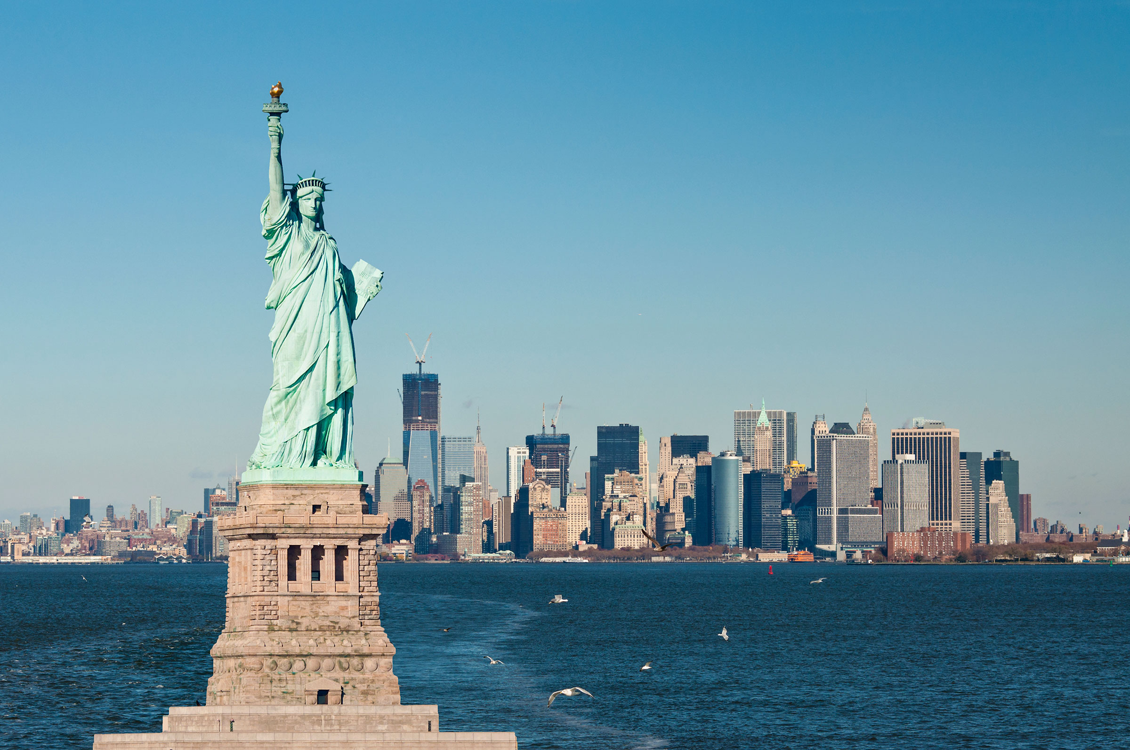
Place refers to all the Human and Physical Attributes in a Location
The attachments we have to a specific location and its characteristics
Often the human and physical attributes in a location give it a sense of place that is different from other places
Human attributes can include elements like religions, languages, political organizations, clothing etc.
What gives Holly Springs a Sense of Place?

Slide 6
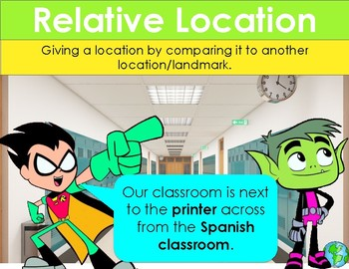
Relative Location
Relative Location refers to the position of a place or entity based on its location with respect to other locations. For example, the location of the US Capitol is located about 38 miles southwest of Baltimore. Relative location can be expressed in terms of distance, travel time, or cost.
Problematic because you have to assume the other person has the same reference points. It can change if the surroundings change

Slide 7
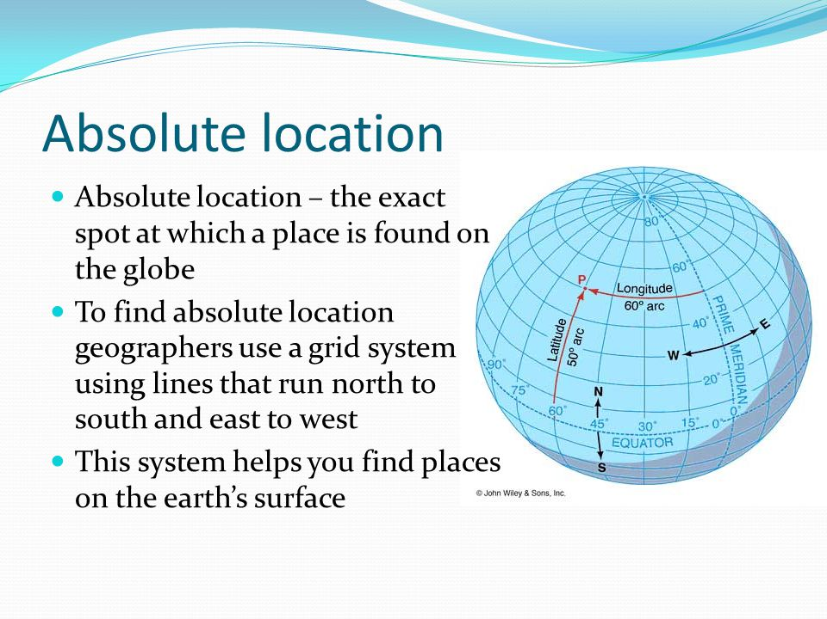
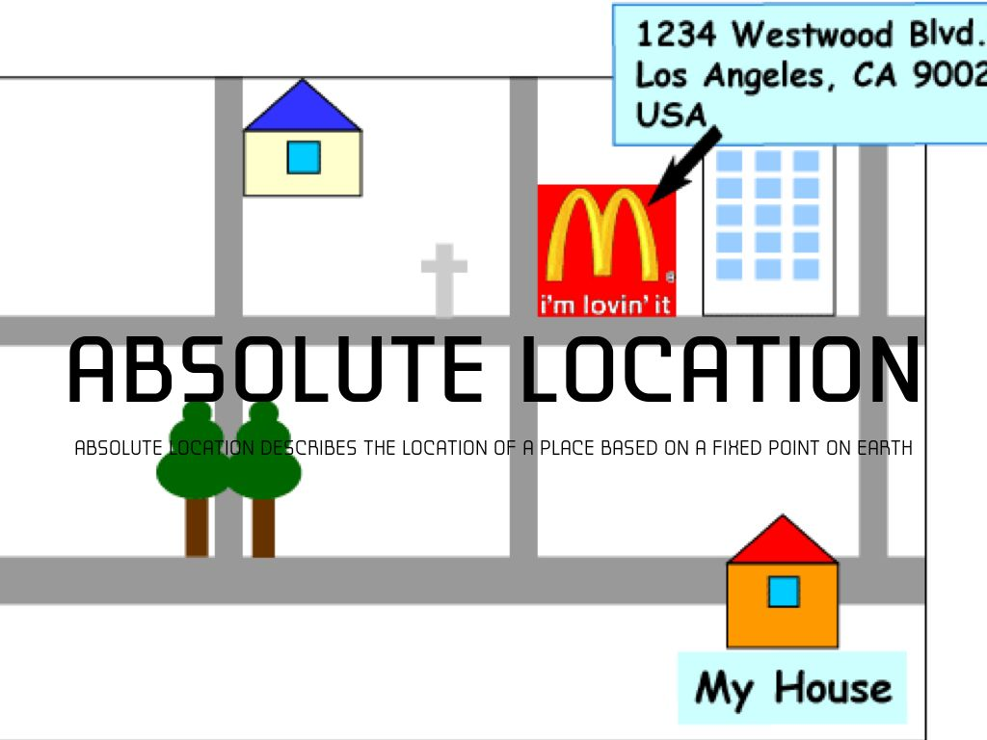
Absolute Location

Slide 8
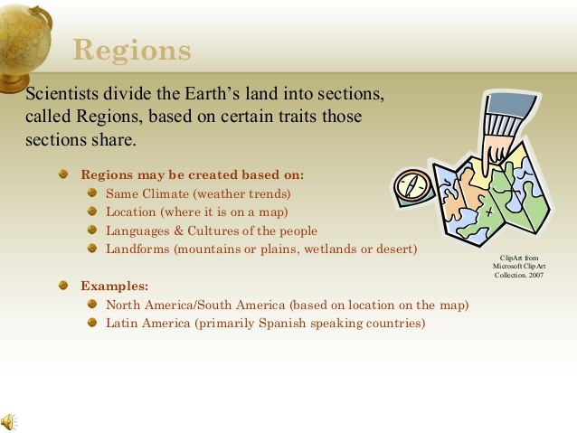

Slide 9
Culture - the body of customary beliefs, material traits, and social forms that together constitute the distinct tradition of a group of people
Culture: What People Care About
Studying a group’s language, religion, values, customs, beliefs, and ethnicity help identify location of a culture and principal means by which cultural values become distributed around the world
Language - Communication
Religion – Beliefs and practices
Ethnicity – Language, Religion, physical traits
Culture: What People Take Care Of
Study the production of material wealth - food, shelter, clothing - but different cultural groups obtain their wealth in different ways world divided into developed and developing countries
characteristics of developed countries (MDC’s) More Developed Countries
characteristics of developing countries (LDC’s) Less developed Countries

Slide 10
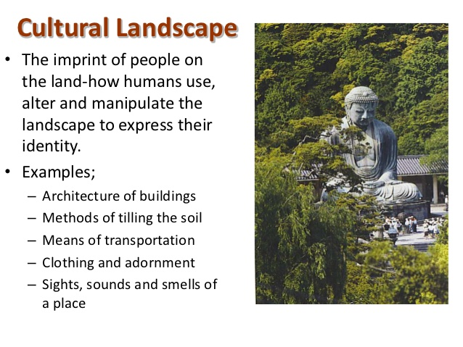
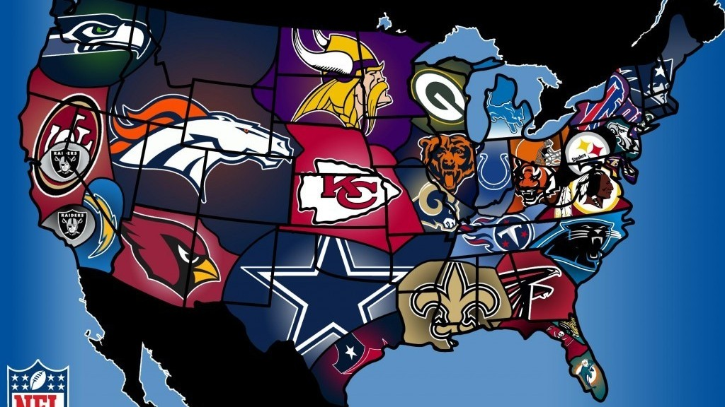
“The physical features, economic features, and cultural features that make up a region are called its cultural landscape.”

Slide 11
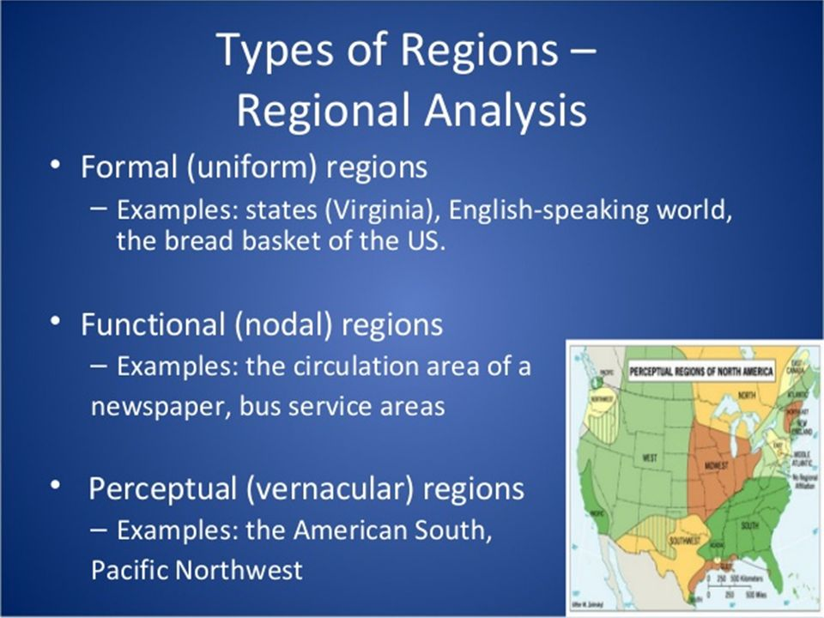
Types of Regions

Slide 12
Regions
Type of Region | Definition | Examples
Formal or uniform | A region with a high level of consistency in a certain cultural or physical attribute | French speaking region of Canada Dairying region or North America Official boundaries demarcating states such as Poland, Thailand or subdivisions like Iowa and Georgia Tropical region or desert region
Functional or nodal | A region with a node or center hub, surrounded by interconnecting linkages. Usually connections relate to trade, communications, transportation | Metropolitan area of Chicago News stations, newspaper delivery, local bus routes, radio stations
Perceptual or vernacular | A region defined by feelings and prejudices that may or may not be true. A construct of one’s mental map | Dixie, Bible Belt, Rust Belt, Hillbilly region, Urban street gang’s turf, China town, Hillbilly region, the Heartland,

Slide 13
Density: is the number of things—which could be people, animals, plants, or objects—in a certain area. The frequency something occurs
Arithmetic density: Number of objects in an area, commonly used to compare distribution of population in different countries. (# people / sq. kilometer / mile, Areas that are urbanized
Physiological density: Number of persons per unit of area suitable for agriculture. Could mean a country has difﬁculty growing enough food. Areas where food isn’t being produced, lets us know how much food is being produced in an area for the people the land supports
Agricultural density: Number of farmers per unit area of farmland. Could mean that a country has inefﬁcient agriculture if it is high density. A low agricultural density like the US means that there is high development, lots of mechanization, you need fewer farmers. Number helps to understand the level of development of a country
Housing density-: Number of dwelling units per unit of area -- may mean people live in overcrowded housing, cities – apartments, suburbs - houses

Slide 14
Pattern / Concentration
Pattern How things are arranged in space
Described by geometric shapes like linear, such as the arrangement of houses along a street or squares of many cities' blocks. Lack of pattern = Random
Concentration: how closely things are related to one another a space. Clustered or Disbursed
Clustered = Agglomerated Dispersed = Scattered

Slide 15
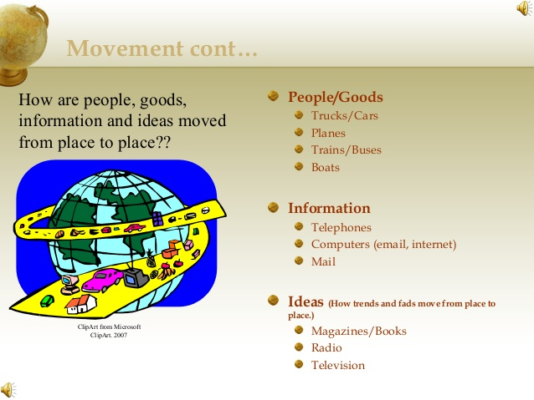

Slide 16
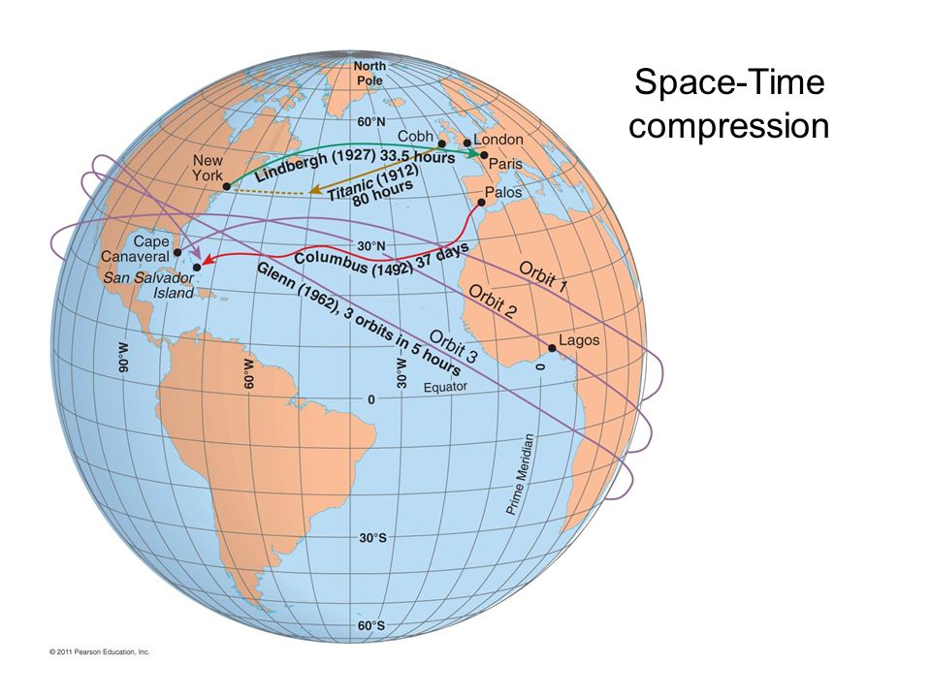
How has the time it takes to travel changed through the years? Why? Mind shift (change in information gathering) 5min: https://www.youtube.com/watch?v=TwtS6Jy3ll8

Slide 17
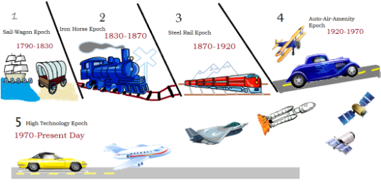
Causes of the World Shrinking

Slide 18
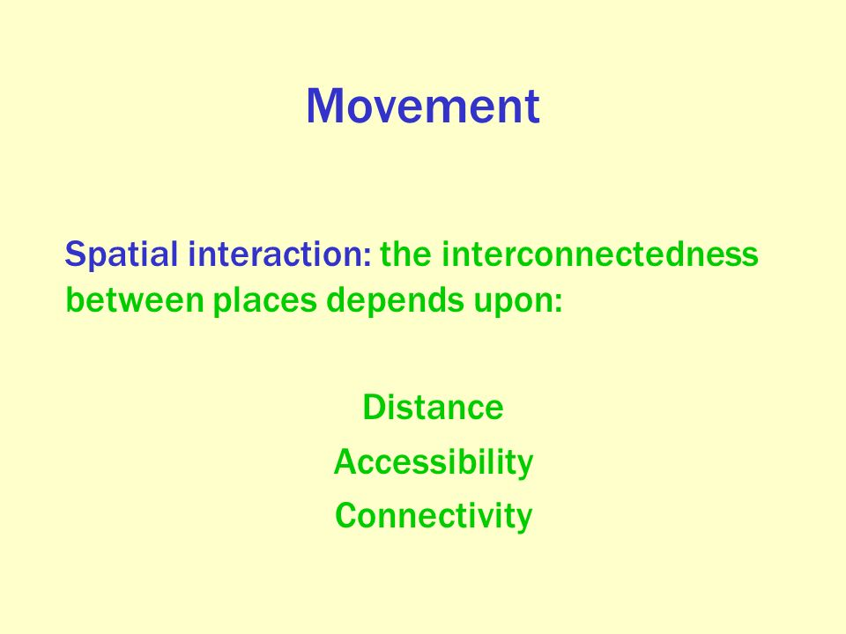
What determines the interaction between places?
Movement: the theme of geography associated with the flow of people, goods, and/or ideas

Slide 19
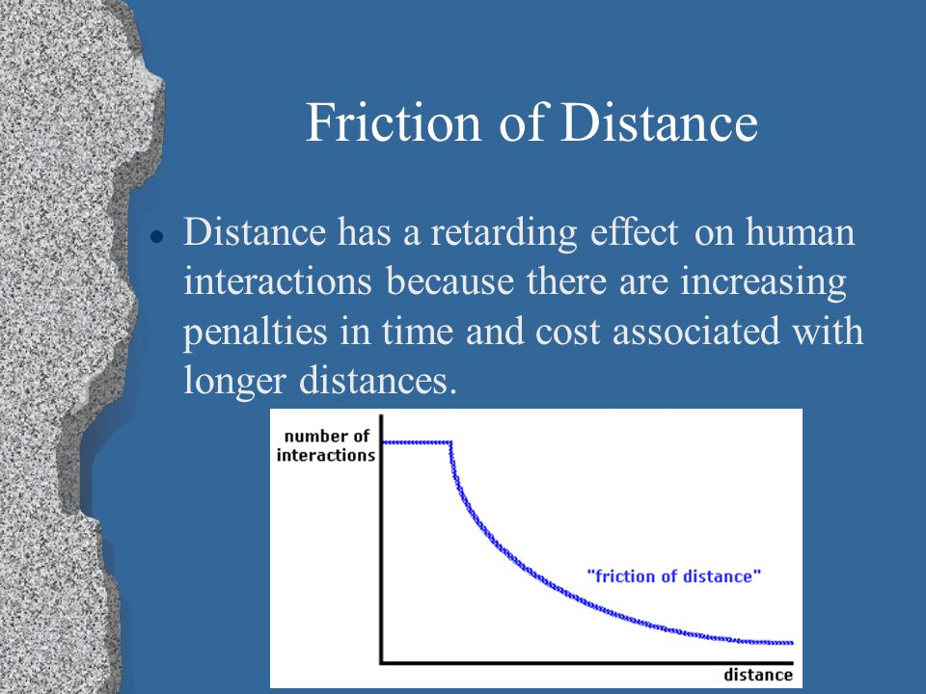
Friction of Distance is based on the notion that distance usually requires some amount of effort, money, and/or energy to overcome. Because of this "friction," spatial interactions will tend to take place more often over shorter distances; quantity of interaction will decline with distance. Elrod video Friction of distance and distance decay: https://www.youtube.com/watch?v=c22DD7rHM-Q

Slide 20
Friction of Distance and Distance Decay
Friction of Distance: The Cause
The impact of distance on interaction
amount of effort, money, and/or energy to overcome.
Distance creates a barrier to interaction. The greater the distance the greater the barrier
Varies from place to place and time to time
The Greater the connection (communication/transportation) lesser the impact of distances
the less connection (communication/transportation) the higher the impact od distance
Distance Decay is the Effect
The result of friction of distance
intensity of some phenomenon decreases as distance from it increases
Over space the interaction becomes less. The Greater the distance the less interaction
Greater the connection (communication/transportation the greater the interaction

Slide 21
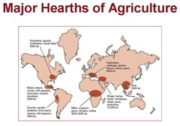
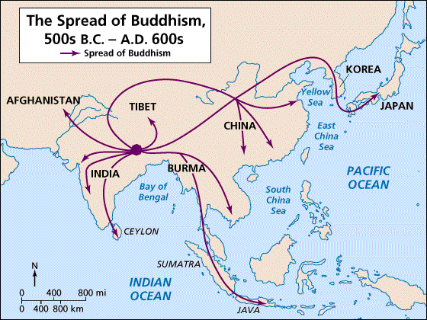
A hearth is the place which an innovation or cultural change originates.

Slide 22
Diffusion
Type of Diffusion | Definition | Examples
Relocation | Physical transfer of an idea, trait, or artifact to a new region | Christianity to the New World by Spaniards; Islam to Indonesia by Muslim traders
Expansion (types of expansion are shown below) Hierarchical Contagious Stimulus | Spread of ideas, traits, or artifact usage to neighboring regions Spread of ideas, etc first to ruler, king, or highest authority and then downward to subjects or less prominent people Idea, trait etc spreads evenly outward from diffusion origin or hearth The spread of a general concept throughout a population | Spread of English in India under British rule so those in prominent positions needed to learn it first Christianity’s spread throughout Europe from monasteries and Roman settlements The development of a written language by Native American groups

Slide 23
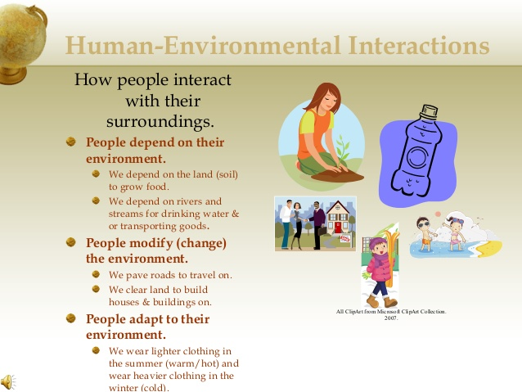

Slide 24
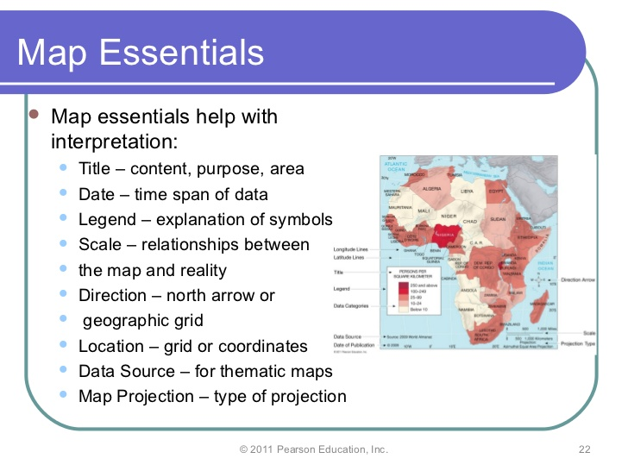
Map Essentials

Slide 25
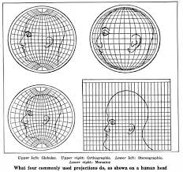
Map Distortions Why all maps are wrong 4 min: https://www.youtube.com/watch?v=kIID5FDi2JQ
Distortion: It is impossible to take the Earth’s round surface and project it onto a flat surface without distortion, or error resulting from the “flattening process
“Projection is the scientific method of transferring location on Earth’s surface to a flat map
Four Properties of Maps
Shape: geometric shapes of objects on the map
Size: relative amount of space taken up on a map by landforms or objects
Distance: the represented distance between objects on the map
Direction: degree of accuracy representing the cardinal directions
Cartographers must decide which properties of maps to distort by thinking about the map’s purpose

Slide 26
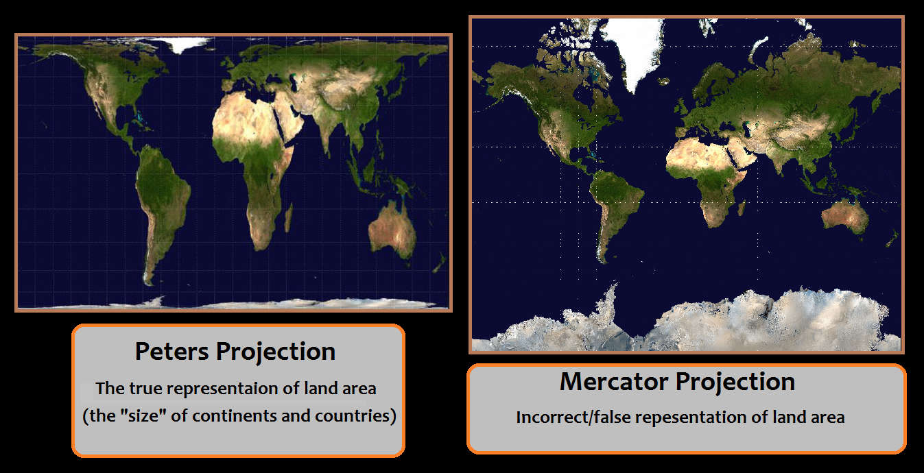
Comparing Maps

Slide 27
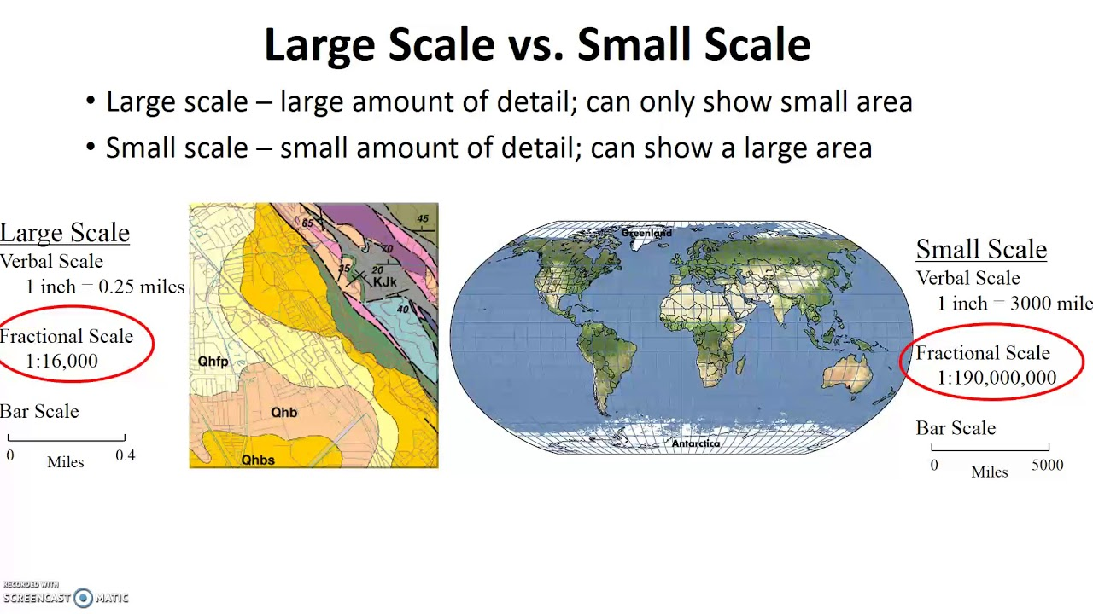
Map Scales,
Small Scale maps are the “Bigger Picture” Maps such as the whole state and Large-Scale Maps are the smaller picture that provides the details of an area such as a city
Large Scale = detail (city blocks, parks)
Small scale = small detail
Small scale is zoomed out, so you see little detail
Large scale is zoomed in, so you see more detail
Small Scale = small amount of detail
Large scale = large amount of detail

Slide 28
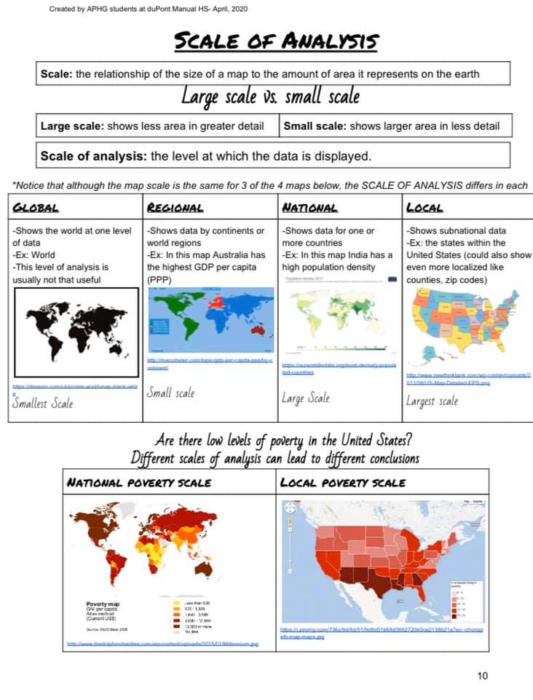

Slide 29
Reference Maps: are designed for people to refer to for general information about places
Political Maps | Show and label human created boundaries and designations such as countries, states, cities and capitals
Physical Maps | Show and label natural features, such as mountains, rivers, and deserts
Road Maps | Show and label highways, streets and alleys
Plat Maps | Show and label property lines and details of land ownership
Locator Maps | Are illustrations used in books and advertisements to show specific locations mentioned in the text

Slide 30
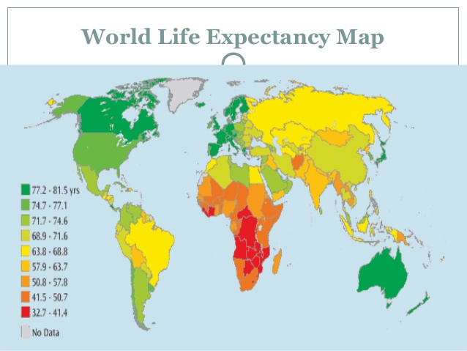
Choropleth Map is a thematic map in which areas are shaded or patterned in proportion to the measurement of the statistical variable being displayed on the map, such as population density per-capita income.

Slide 31
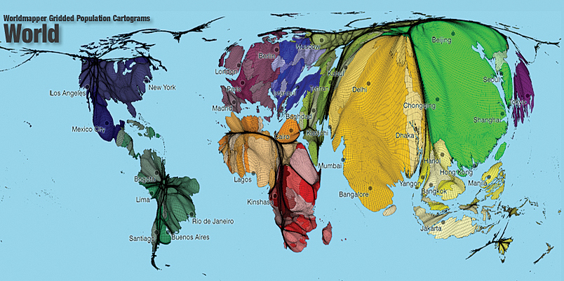
A Cartogram is a map in which some thematic mapping variable – such as travel time, population, or Gross National Product – is substituted for land area or distance. The geometry or space of the map is distorted in order to convey the information of this alternate variable.

Slide 32
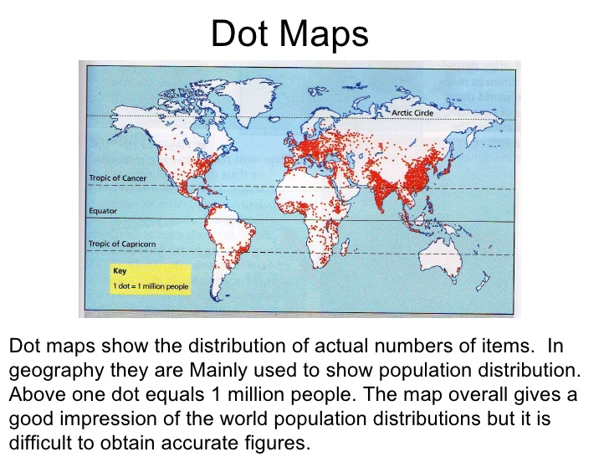
Dot distribution map, or dot density map, is a map type that uses a dot symbol to show the presence of a feature or phenomenon. Dot maps rely on a visual scatter to show spatial pattern

Slide 33
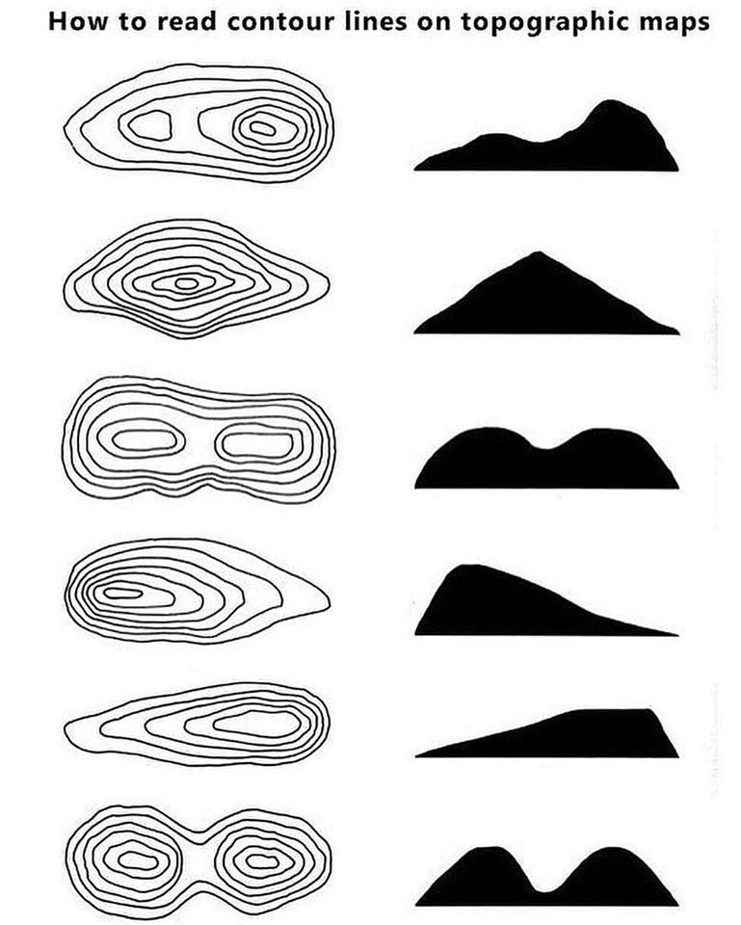
A Topographical Map Looking at Landforms

Slide 34
Geospatial Techniques
Geospatial Techniques
Type | Description | Uses
GPS: Global Positioning System | GPS receivers on the earth’s surface use the locations of multiple satellites to determine and record a receiver’s exact location | Precisely locating borders Navigating ships, aircraft, cars Mapping lines (trails) or points (fire hydrants)
Remote Sensing | The use of cameras or other sensors mounted on aircraft or satellites to collect digital images of the earth’s surface | Determining land cover and use Monitoring environmental changes Assessing spread of spatial phenomena Monitoring the weather
GIS: Geographic Information Systems | Computer system that can store, analyze, and display information from multiple digital maps or geospatial data sets. Allows person to visualize patters, relationships and trends | Analysis of crime data Effects of pollution Transportation/travel time analysis Urban planning

Slide 35
Cultural Ecology
Cultural Ecology: Geographic study of human environment relationships – combing culture and environment
Environmental determinism: A 19th- and early 20th-century approach to the study of geography that argued that the general laws sought by human geographers could be found in the physical sciences. Geography was therefore the study of how the physical environment caused human activities. Physical environment causes social development
Possibilism- The physical environment may limit some human actions, but people have the ability to adjust to their environment (this is a rejection of environmental determinism)
EX: people learn to adjust and grow different crops depending on climate
Why plant grass in a front yard? Why not let it grow? Why mow it? How do your cultural values impact the environment?

Slide 36
Globalization is the process by which businesses or other organizations develop international influence or start operating on an international scale.
Globalization is about the interconnectedness of people and businesses across the world that eventually leads to global cultural, political and economic integration. It is the ability to move and communicate easily with others all over the world in order to conduct business internationally
Some Benefits of Globalization are
more International trade.
more goods & services generally available at lower prices.
higher quality goods & services more generally available.
more wealth in the world.
lower cost of living.
higher standard of living.
Waste Reduction from greater economic efficiency.
Some Disadvantages of Globalization:
Developed countries can stifle development of undeveloped and under-developed countries.
Economic depression in one country can trigger adverse reaction across the globe.
It can increase spread of communicable diseases.
Companies face much greater competition.
Manufacturing jobs can be moved overseas causing many to lost jobs
Heighten economic differences between places
Decline of local cultures and traditions

Slide 37
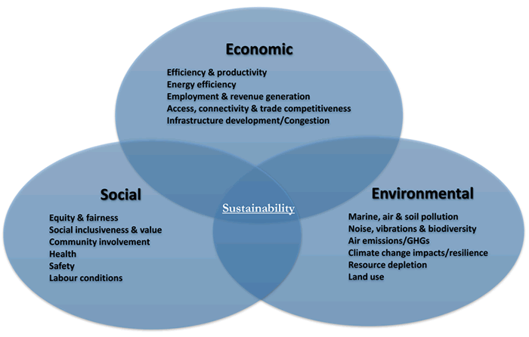
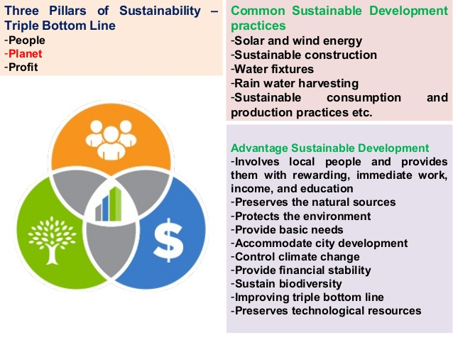
Sustainability is the use of Earth’s resources in ways that ensure their availability in the future. Patterson 17 min https://www.youtube.com/watch?v=6HuKphKJnQk

Slide 38
Quick Summary
Place Specific point on earth disguised by a particular characteristic
Location Position that something occupies
Toponym: Name given to a place on earth
Site: Physical characteristics of a place
Situation: location of a place relative to other places
Regions:
Region: area of the earth defined by one or more distinctive characteristics
Cultural Landscape: A combination of cultural, economic and physical features giving a region character
Regional Studies: an area fashioned from nature by a cultural group
Formal Region (uniform region) area where everyone shares common characteristics
Functional Region (nodal region) area organized around a nodal for focal point
Vernacular Region: area that people believe exist as part of their cultural identity

Slide 39
Connections Between Places
Connection: relationships between people and objects across the barrier of space
Hearth: places from which an innovation originates
Diffusion: process by which a characteristic spreads
Relocation Diffusion: spread by the physical movement of people from one place to another
Example: spread of English language from Europe to North America
Expansion Diffusion: spread in an additive process
Hierarchal Diffusion: spread by certain levels
Example: fashion, soccer, rap music
Contagious Diffusion: rapid, widespread throughout the population
Example: Influenza, ideas on the internet
Stimulus Diffusion: spread of underlying principle
Example: innovative features of the IPhone, McDonalds in India serving veggie burgers

Slide 40
Review Regions of Culture
Culture: a body of beliefs, materiel trails, and social forms that together constitute the distinct traditions of a group or people
Culture is what people care about
Geographers study why customary ideas, beliefs and values of a people produce a distinctive culture in a particular location a place
Language: communication
Religion: beliefs and practices
Ethnicity: language, religion, physical traits
Culture: What people take care of
Material wealth food, clothing, shelter
Developed MDC vs. developing regions LDC

