Slide 1
Unit 2 Migration Condensed Review Power Point

Slide 2

Migration

Slide 3
Spatial Interaction and Friction of Distance
Distance is not the barrier to communication and travel that it once was for most people.
The difficulties we have overcoming these spatial and temporal barriers are commonly referred to as the friction of distance.
The process of coming together and having more contact with each other, even though real distance remains the same, is called space-time compression.
The friction of distance is being reduced through space-time compression, and as a result, spatial interaction is increasing.
Spatial interaction is simply the interaction between two places, whether through communication, economic transaction, migration, or travel.

Slide 4
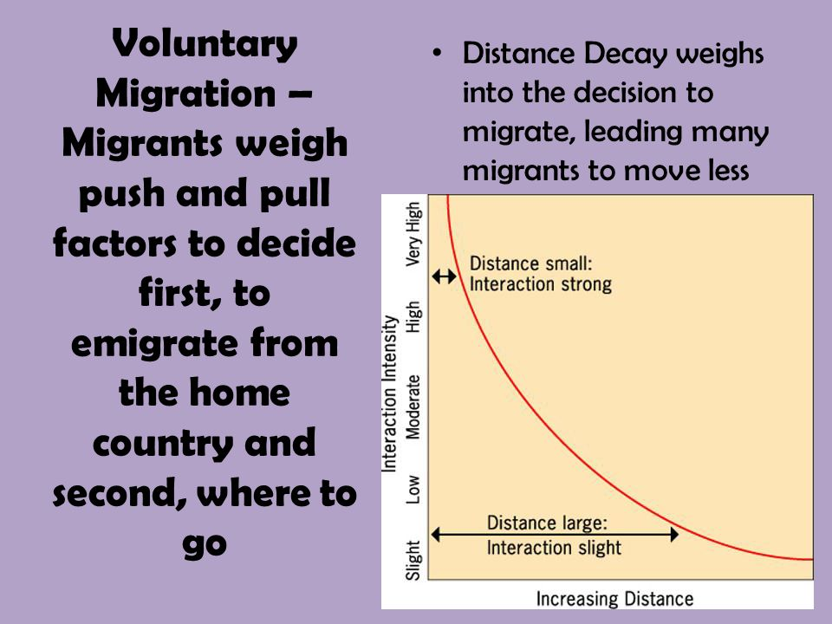
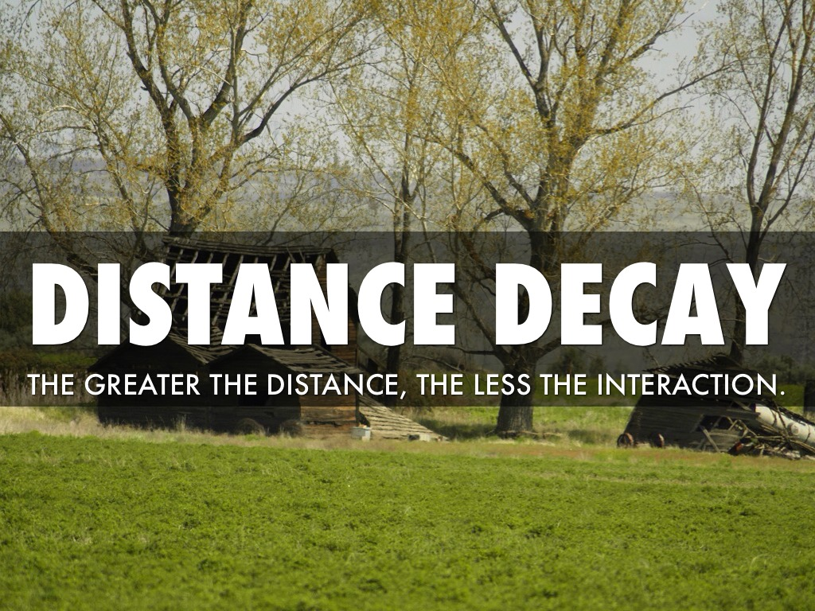
Distance Decay and Migration

Slide 5
Why do People Migrate?
Migration: The permanent or semi-permanent relocation of people from one place to another
Geographers study from where people migrate to where they migrate and why
Three main motivations for Migration
1. Economic Opportunity
2. Cultural Freedom
3. Environmental Comfort

Slide 6
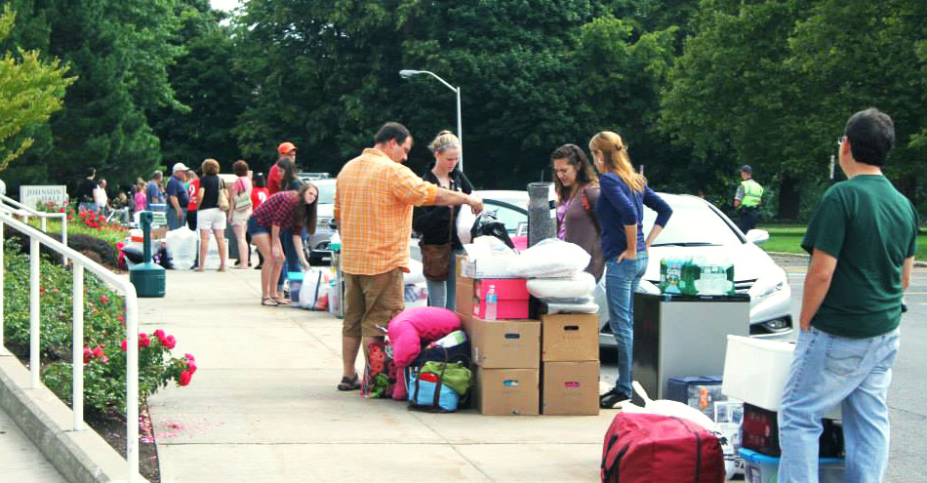
Circulation Migration: types of short-term, repetitive, or cyclical movements that recur on a regular basis, such as monthly or annually.
Examples:
People journeying every weekday from their homes to places of work or education and once a week to shops, places of worship to recreation areas
Circulation of individuals doesn’t involve relocation of residence and is confined to activity of space (an area in which an individual moves about as they pursue regular day to day activities. Area reachable on a typical day, Age Groups, ability to travel, opportunities to travel.
College students
Migrant workers
Seasonal labor

Slide 7
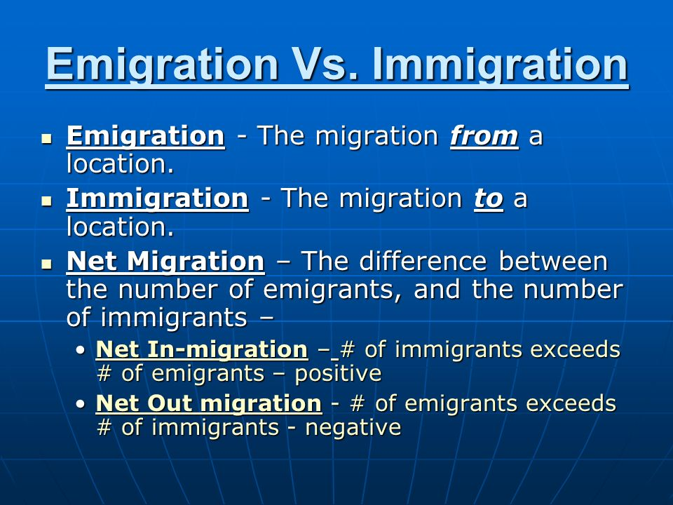

Slide 8
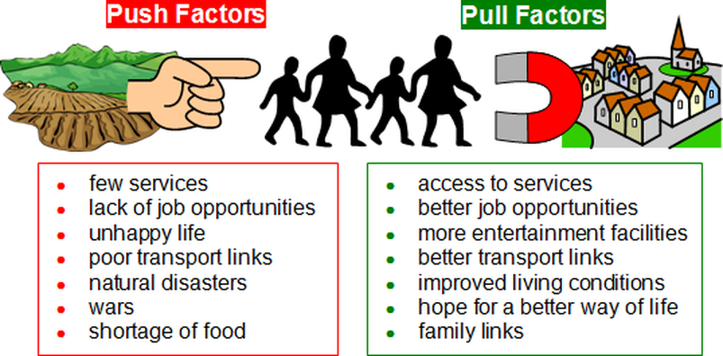
Push Pull Migration: People decide to migrate because of push and pull factors

Slide 9
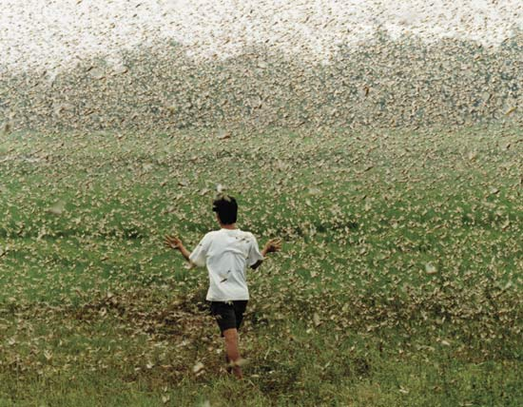
Additional Environmental Push-Pulls
Environmentally attractive places such as
Climates: moving from unpleasant regions that have extreme cold, heat or droughts regions
Attractive places such as Seacoasts, port cities, trade, retirees seeking warm beach locations, entertainment of beach locations,
Mountains, up to middle elevations for entertainment also agricultural regions
Health Reasons: those with asthma, bronchitis, tuberculosis, allergies may move to dry climates like Arizona, Malaria, sleeping sickness, animal diseases that spread to people, fleeing infected areas
Water: The need for water, droughts, decline in glacier melts, or too much water, like floods, hurricanes:
Hurricane Katrina, Hurricanes that hit Puerto Rico and Bahamas produced a Forced Migrations,
Insects

Slide 10
Environmental Push and Pull Factors
Examples of Environmental Push and Pull Factors
Group and Place of Origin | Push Factors | Pull Factors
Farmers from Colorado, Kansas, OKLAHOMA and texas, 1930’s Dust Bowl | A severe drought caused thousands to lose their farms | Farms moved to California hoping to find work
Residents living near the Fukushima Nuclear Power Plant in Japan, 2011 | An earthquake and tsunami damaged nuclear reactors, releasing radioactive materials | Residents near the power plant were resettled to cities around Japan

Slide 11
Economic Push Pulls
Pushes:
Low wages,
low standard of living.
Poor housing,
lack of educational opportunities
shortages of medical services and facilities
Many Countries are experiencing large rural to urban migrations as corporate farming and increased technology have reduced the number of agricultural laborers are needed in rural areas
Economic Push Pulls
Jobs!!:
Examples: Those based on valuable resources such as petroleum, uranium, gold, diamonds also lure factory workers, technicians, scientist, construction workers, restaurant employees public service officials who may move to an areas to support a new area, available natural resources, economic advancement, improved living conditions
United States and Canada gold rushes
Oil boom in North Dakota today
Oil boom Midland Texas
20th century millions of Europeans immigrants arrived in east coast cities like NYC and Boston searching for economic opportunities not available in their homelands.
During the last 40 years thousands of older Americans have moved out of the northeastern states seeking inexpensive retirement living in places like Arizona, NC, and Florida
In the Mid 1990’s thousands of young professional moved to the San Francisco area to take advantage of the high paying jobs in the computer industry.
Many Countries are experiencing large rural to urban migrations for the employment opportunities, entertainment, excitement of cities

Slide 12
Economic Push and Pull
Examples of Economic Push and Pull Factors
Group and Place or Origin | Push Factors | Pull Factors
Factory workers in the U.S. Rust Belt states, beginning in the 1970’s | Unemployment rose among factory workers, particularly in traditional manufacturing states such as Michigan and Pennsylvania | Many factory workers moved to southern states such as Kentucky and Tennessee, as manufacturers opened now factories there
Farming in rural China, beginning around 1950 | Increased use of machines and consolidation of small farms into fewer large farms reduced the number of farmers needed to raise crops | Farmers moved to China’s large cities, increasing the urban population from 64 million in 1950 to 636 million by 2010

Slide 13
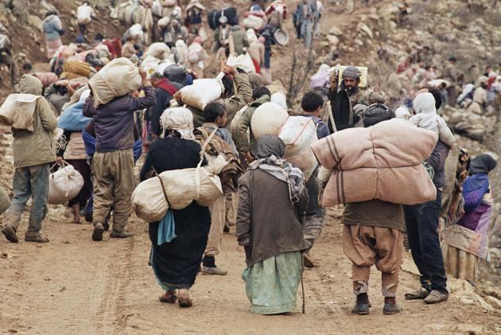
Social/Cultural Push Pull Factors: People will often migrate when they experience discrimination and persecution because of their ethnicity, race, gender or religion: They move to locations where they can practice their culture safely
Examples Of Social/Cultural Factors
Africans brought over to the Americas against their will
Jews Diaspora the dispersion of Jews out of their ancestral homeland (the Land of Israel) and their subsequent settlement in other parts of the globe
After WW2 many Jews from Europe and the Americas and else where relocated to the newly formed state of Israel, a place thy considered their homeland
Refugees being forced from their homes such as:
Palestinians leaving Israel after country was created in 1948
Afghanistan's flee from civil war that began when Soviet Union invaded
Iraqis fleeing Iraq due to war with US and its aftermath and ISIS
Balkan area as a result of fighting between ethnic groups
Internal migration in area of India When India gained its freedom in 1947 migration was based on religion with Muslims migrating to newly created Pakistan and Hindus migrating out of Muslim areas
Pull towards democratic counties in the West and US

Slide 14
Social / Cultural Push and Pull Factors
Examples of Social Push and Pull Factors
Group and Place or Origin | Push Factors | Pull Factors
Mormon Migration 1945 – 1857 | Anti-Mormon violence in Illinois and Missouri resulted in dozens of deaths, including that of leader Joseph Smith | Approximately 70,000 Mormons migrated to the Great Salt Lakes area , a place chosen for its isolation and agricultural opportunities
Hindus and Muslims during and after the partition of India, 1947 – 1957 | Violence resulted in more than 200,00 deaths | More than 14 million people migrated in hopes of finding safety in a new country

Slide 15
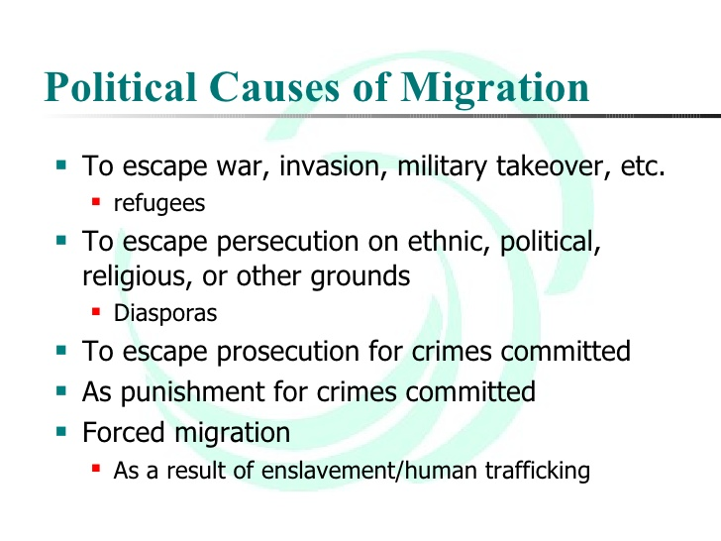
Political Causes of Migration

Slide 16
Political Push and Pull Factors
Examples of Political Push and Pull Factors
Group and Place or Origin | Push Factors | Pull Factors
Anti-communist Cubans after Fidel Castro’s’ communist takeover in 1959 | Opponents of Castro were jailed or killed if they spoke out against Castro’s government | Opponents of Castro fled to the United States, where they received asylum
The Dalai Lama and Tibetan government officials, after China’s takeover of Tibet in 1950 | The Chinese persecuted, arrested, and killed many Tibetans who opposed the takeover | The Dalai Lama and his supporters fled Tibet in 1959 to India, which allowed them to set up a government in exile
Pilgrims who sailed on the Mayflower to America, | fled oppressive governments that had imposed limitations on their religious freedom in Europe | Religious Freedom
Native Americans migration to reservations As the United States expanded westward | they forcibly removed thousands of Native Americans from the lands their ancestors had inhabited for millennia, relocating them to far off reservations

Slide 17
Political Push Pull factors: People who oppose the policies of a government often migrate because they fact persecution, arrest, and discrimination. Such political migrants move to countries that support their political views or will offer asylum, or protection from the danger hey faced in their home country
Syria, Civil war forces loyal to President Bashar al-Assad and those opposed to his rule battle each other - as well as ISIS, this war is a push factor
Rwanda: where members of the majority Hutu ethnic group massacred hundreds of thousands of people, mostly minority Tutsis, from April to July 1994. This is a Push factor
Darfur from ethnic conflicts armed conflict in the Darfur region of Sudan, that began in February 2003 when the Sudan Liberation Movement (SLM) and the Justice and Equality Movement (JEM) rebel groups began fighting the government of Sudan, which they accused of oppressing Darfur's non-Arab population.
Myanmar and the refuges of Muslim Rohingya fleeing their homes in the predominantly Buddhist country. Most have crossed by land into Bangladesh, while others have taken to the sea to reach Indonesia, Malaysia, and Thailand
Balkan area as a result of fighting between ethnic groups
German persecution of Jews
Internally Displaced Persons are technically free to remain in their home country, but do not have place to stay
“Ethnic cleansing” has been defined as the attempt to get rid of (through deportation, displacement or even mass killing) members of an unwanted ethnic group in order to establish an ethnically homogenous geographic area.
Asylum: the protection from danger migrants face in their home country
Refugee: A refugee has a well-founded fear of persecution for reasons of race, religion, nationality, political opinion or membership in a particular social group. Most likely, they cannot return home or are afraid to do so. War and ethnic, tribal and religious violence are leading causes of refugees fleeing their countries
By definition, a refugee is an asylum seeker whose case has been accepted by an asylum country

Slide 18
Country | Why they left | Explanation (1 point)
Syria | Conflict/ War | Internal Civil War, ISIS
 | Religious Ethnic Gender Persecution | Sunni or ISIS vs Shia vs Non Muslim, Arabs vs Kurds, rights or opportunities denied based on gender
 | Lack of infrastructure- as a result of war | Lack of medical care, lack of education, lack of available food as a result of war
Afghanistan | Conflict/ war | Taliban vs NATO (or US) or Taliban vs Afghanistan
 | Religious/Ethnic/Gender Persecution | Taliban Wahhabis persecuting other Sunnis or Shiites/Pashtun dominance over other ethnic groups; rights or opportunities denied based on gender or sexuality
 | Poverty | Food Insecurity, lack of water, little infrastructure, education, or medical care
South Sudan | Conflict/War | Civil war over control over the oil fields. War with Sudan
 | Ethnic/Gender Persecution | Conflict between Ethnic groups Persecution of women
 | Poverty/ Famine | Drought, lack of infrastructure, spread of disease
Myanmar | Religious Persecution | Buddhist vs Muslims, with the buddhist government leading genocide/ethnic cleansing
Somalia | Conflict/War | Between Warlords; warlords or militants vs UN back government
 | Ethnic/Gender Persecution | Militant Wahhabis persecuting other Sunnis, Animists or Christians; conflict based on tribal differences; rights or opportunities denied based on gender or sexuality
 | Poverty/ Famine | Food Insecurity, lack of water, little infrastructure outside of Mogadishu, education or medical care.

Slide 19
Consequence of migration on a receiving country
Adds to available low wage labor pool
Competition with locals for limited jobs
Additional cost on receiving country to provide services (food, housing, education, healthcare)
May result in higher taxes
Increased demand for goods and services (housing, food) that may result in price increases
Increased strain on natural resources (water, energy, food supply)
Refugee camps financially depend on receiving country
May pose costly security risks for receiving country
Strain on local schools for educating immigrating children, supplying ESL teachers
Refugees may provide skills and knowledge (skilled workers among refugees… doctors, scientists, etc)
Replacement population that satisfies the need in countries with an aging population to work decreasing a need to raise taxes on citizens

Slide 20
Demographic Push and Pull Factors
Examples of Demographic Push and Pull Factors
Group and Place or Origin | Push Factors | Pull Factors
Farmers in Europe 1800’s | The population of industrial countries increased, while land became scarce | Europeans migrants came to the United States, in part because the Homestead Act gave them plots of land
Young educated people in less developed countries in Latin America, North Africa, the Middle East, and Asia | Many people unless developed countries live in areas where population is growing very quickly and unemployment | Developed countries in N. America and Europe with again populations need workers for difficult jobs, so they attract immigrants from less developed countries

Slide 21
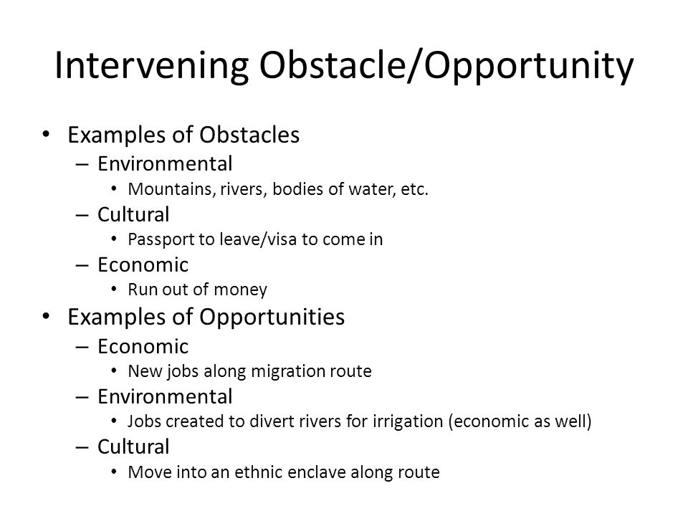

Intervening Obstacles Event or factor that discourages people from migrating from one place to another. and Opportunities: Factors that encourage people to migrate

Slide 22
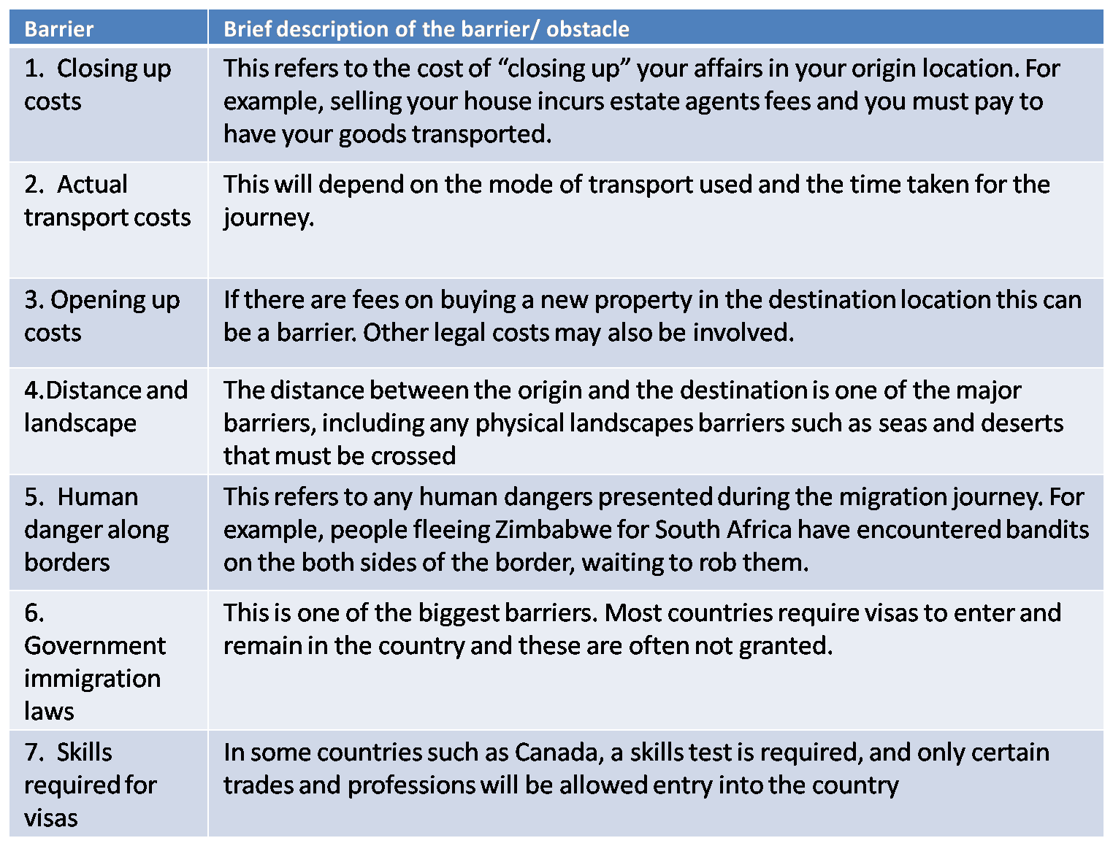
Obstacles to Migration

Slide 23
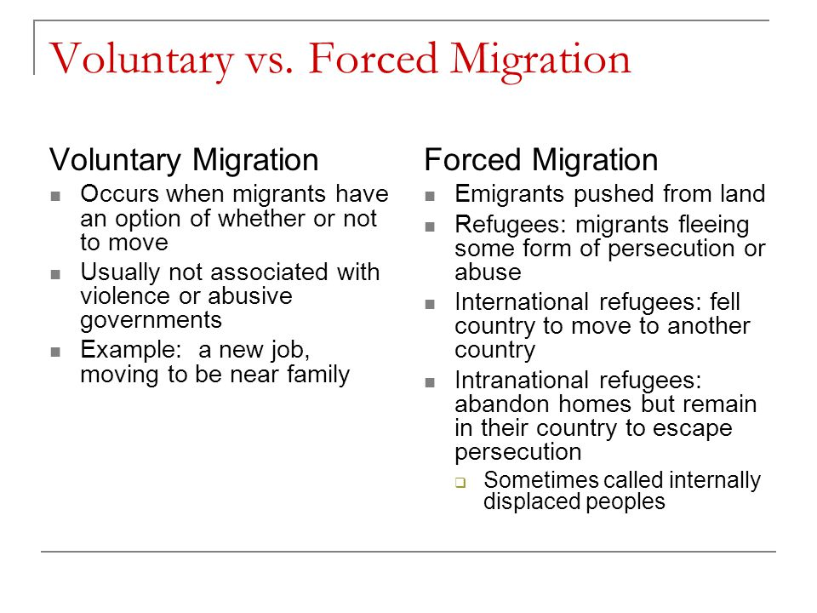
Why do People Migrate?

Slide 24
Types of migration
Migration
International
Voluntary
Forced
Internal
Interregional
Intraregional
Usually economic or environmental
Usually cultural or environmental
Historically rural to urban for jobs
Usually within urban areas from older cities to newer suburbs
Refugees, IDPs, and asylum seekers
Transnational, internal, chain, step, and rural to urban

Slide 25
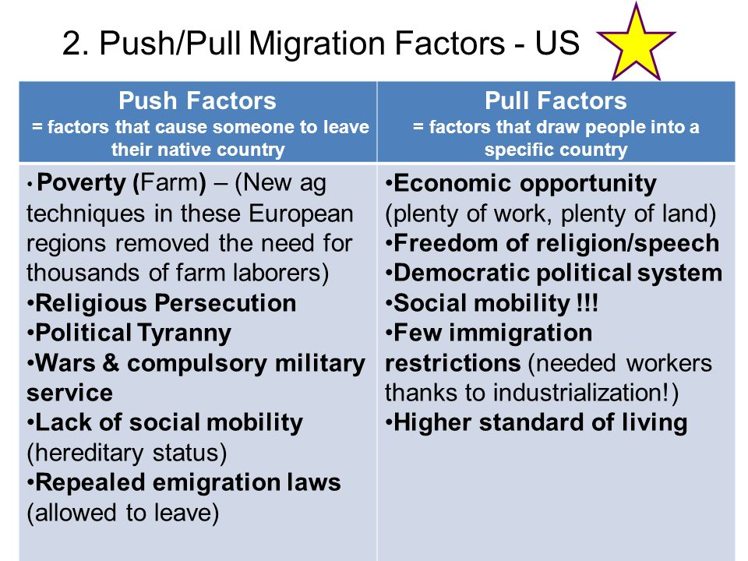
U.S. Push Pull Factors

Slide 26
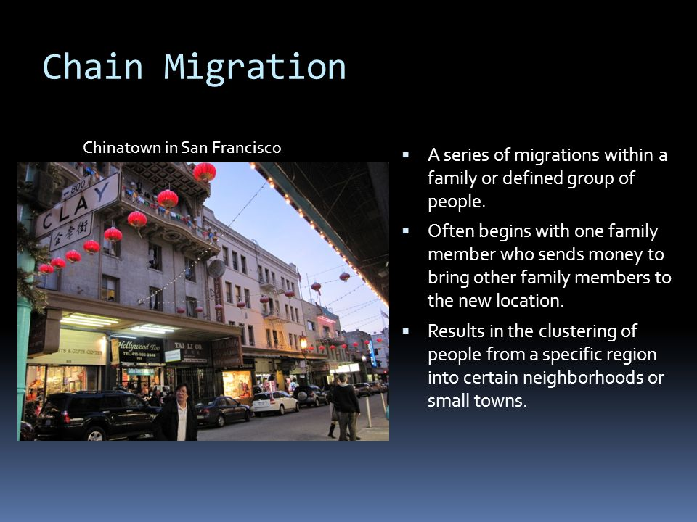
Types of Voluntary Migration – Chain Migration

Slide 27
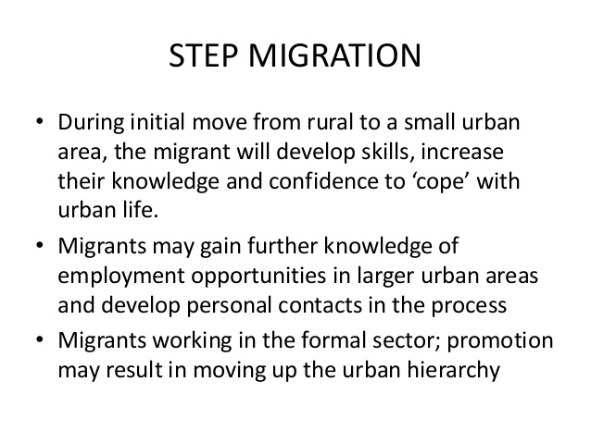
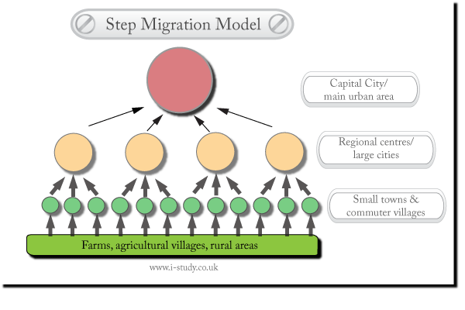
Type of Voluntary Migration - Step Migration:
Migration that follows a path of a series of stages or steps towards a final destination

Slide 28
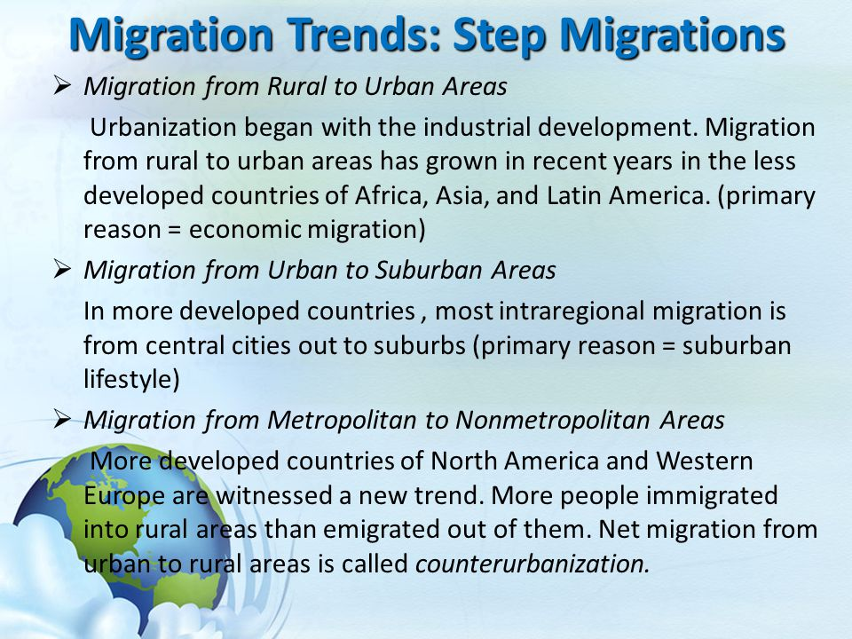

Slide 29
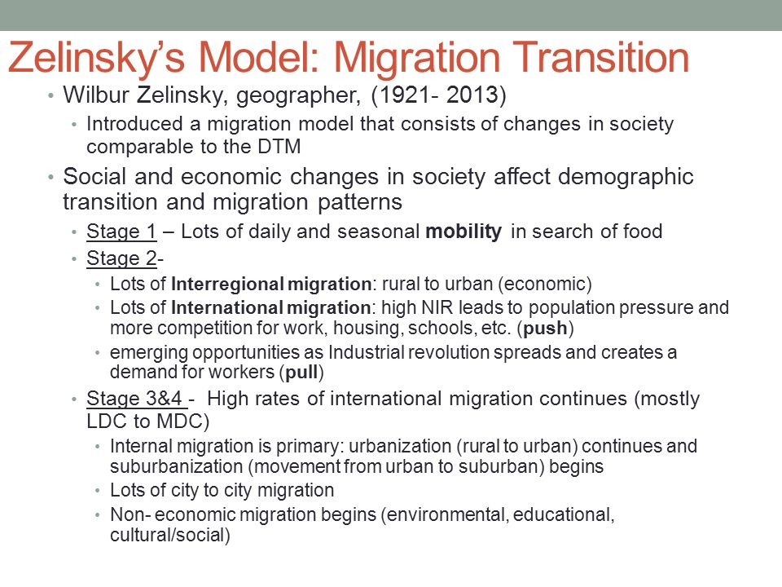

Slide 30
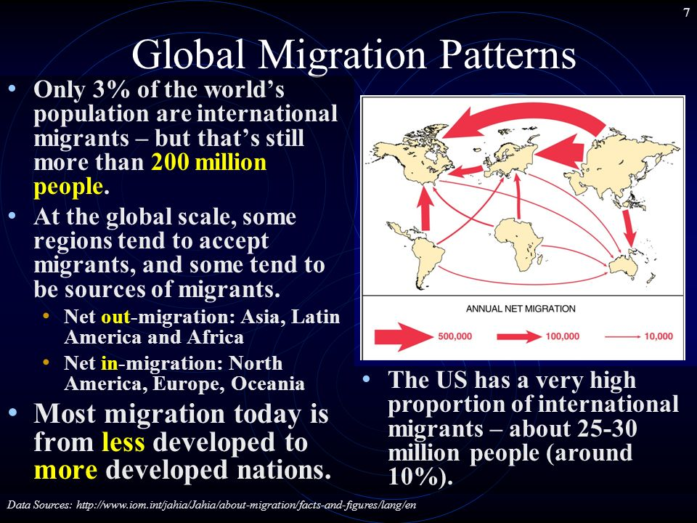

Slide 31
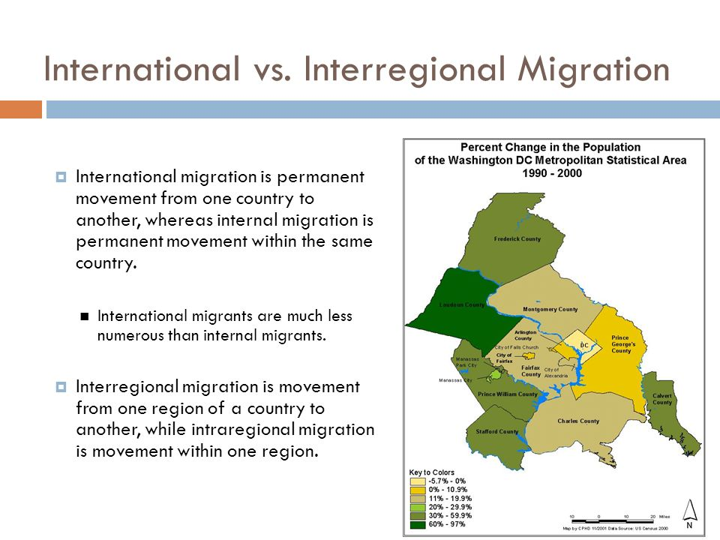

Slide 32
Interregional Migration within the United States
Permanent movement from one region of the country to another
1900-1940: Filling in the Great Plains: The westward movement of the US population with immigrants filling in the Great Plains, Advances in agricultural technology enabled people to cultivate the area. Use of barbed wire reduced dependence on wood fencing, the steel plow to cut thick sod and wind mills and well drilling equipment to pump more water. Also the federal government gave large land grants to the railroad companies permitted settlers to transport their products to the larger concentrations of customers in the East cost cities
1950-2010: Moving South: population centered moved southward for job opportunities and warmer climate..
1790 Hugging the Coast: Virtually all colonies settlements were near the Atlantic Coast
1800-1840 Crossing the Appalachians: With transportation improvements especially canals, the interior was opened up (NY-Great Lakes
1850-1890 Rushing to the Gold in California: Population shifted westward rapidly with the pull to California being the Gold Rush
Rust Belt to Sun Belt: 1906’s-1970’s large numbers of white, middle class Americans moved from older northeastern and midwestern cities to the South and West Coast because northern industrial states like Ohio, Michigan and Pennsylvania, places that were industrial powerhouses with vibrant economies, now had factories closing down and people were losing their jobs. Migrants headed south for job opportunities, favorable climate and affordable cost of living. There were new high-tech industries aerospace jobs. The area became known as the Sun Belt

Slide 33
Intraregional Migration: Permeant migration within one region of the country
Migration from Rural to Urban Areas: Migration from rural to urban areas began in the 1800;s as part of the industrial revolution.
Migration from Urban to Suburban Areas: The major reason for this migration is the Pull of the suburban lifestyle; Detached homes instead of apartments, private yards, safe plays for children to play, garages. Or driveways so you do not have to pay to park your car, more modern schools, recreational facilities.
Migration from Urban to Rural Areas (Counterurbanization) The boundaries where suburbs end and the country begins is not well defined but many are moving into more small town or rural communities for lifestyle reasons. Where they can live on farms, own horses, grow their own food and with modern communication and transportation this is easy to do

Slide 34
Gravity Model of Migration – Migration Selectivity
Geographers use the gravity model to estimate spatial interaction and movement between two places. It is known as the “gravity” model because it resembles Newton’s theory of gravitational pull.
  Essentially, the gravity model predicts that larger places attract more migrants than smaller places.
  It also predicts that closer places attract more migrants than more distant places.
The model can be helpful for predicting migration patterns, but it has limitations. It does not factor in migration selectivity factors
The decision to migrate often fits into a predictable pattern based on age, income, and other socio-economic factors.
Migration Selectivity is the evaluation of how likely someone is to migrate based on personal, social, and economic factors.
Age is the most influential factor. Americans are most likely to move between the ages of 18-30.
Education is also a factor. Typically the more educated people are, the more likely they are to make long-distance moves.

Slide 35
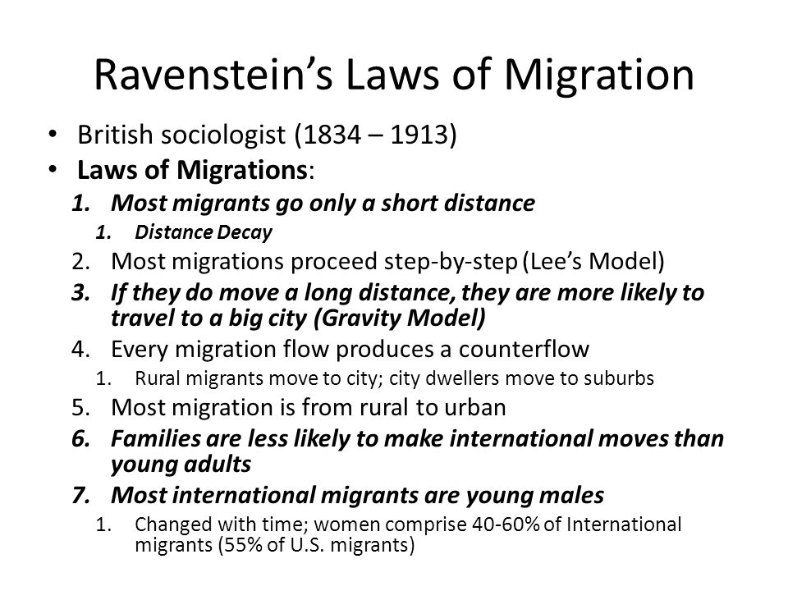
Ravenstein's Laws of Migration: Most migrants move only a short distance. There is a process of absorption, whereby people immediately surrounding a rapidly growing town move into it and the gaps they leave are filled by migrants from more distant areas, and so on until the attractive force [pull factors] is spent.

Slide 36
Ravenstein Revisions
More migrants are female more likely to migrate within their own country while males go longer distances
Most migrants are among the best educated
result: brain drain.
when the most educated people leave their home country
Families are less likely to cross political boarders but is changing
Migration improves economy
#1 reason for migration is the economy
As technology improves so does migration, the obstacles decline, can share information.

Slide 37
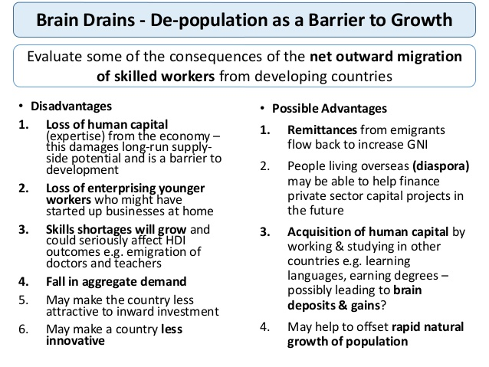
Brain Drain

Slide 38
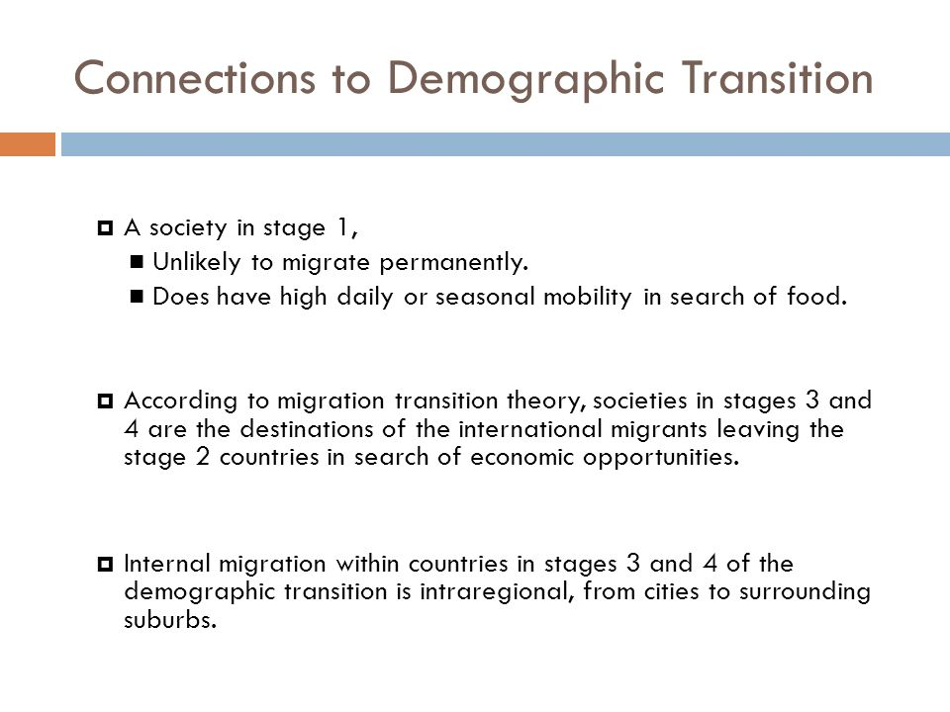

Slide 39
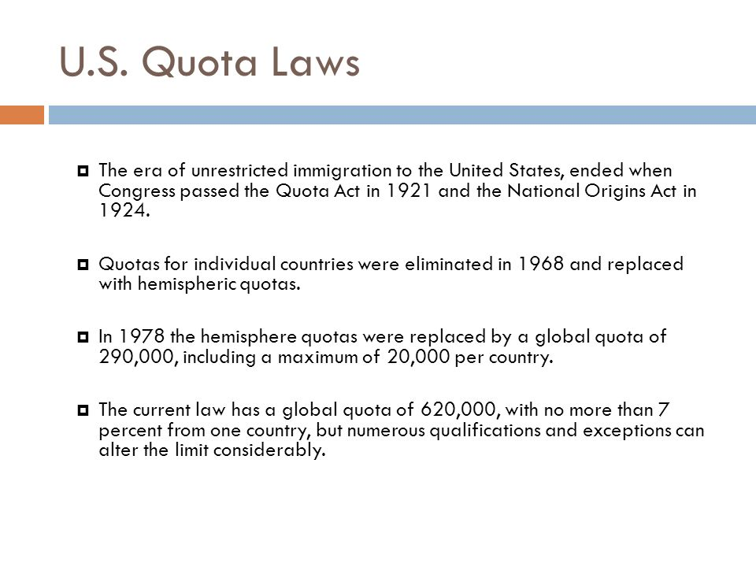

Slide 40

U.S. Attitudes toward Immigrants
Americans have always regarded new arrivals with suspicion but tempered their dislike during the nineteenth century because immigrants helped to settle the frontier and extend U.S. control across the continent.
Opposition to immigration intensified when the majority of immigrants ceased to come from Northern and Western Europe
More recently, hostile citizens in California and other states have voted to deny undocumented immigrants' access to most public services, such as schools, day-care centers, and health clinics.

Slide 41
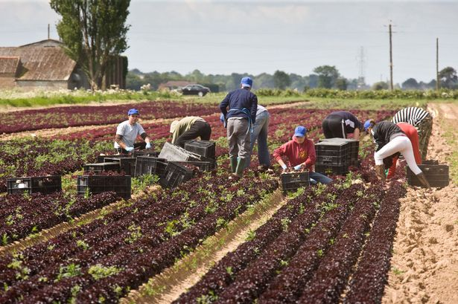
Treatment of Guest Workers in Europe
In Europe, many guest workers suffer from poor social conditions.
Both guest workers and their host countries regard the arrangement as temporary.
In reality, however, many guest workers remain indefinitely, especially if they are joined by other family members.
As a result of lower economic growth rates, Middle Eastern and Western European countries have reduced the number of guest workers in recent years.
Political parties that support restrictions on immigration have gained support in France, Germany, and other European countries, and attacks by local citizens on immigrants have increased.

Slide 42
Migration from Metropolitan to Non-Metropolitan Areas
During the late twentieth century, the more developed countries of North America and Western Europe witnessed a new trend.
More people in these regions immigrated into rural areas than emigrated out of them.
Net migration from urban to rural areas is called counter-urbanization.
Most counter-urbanization represents genuine migration from cities and suburbs to small towns and rural communities.
Like suburbanization, people move from urban to rural areas for lifestyle reasons.
Many migrants from urban to rural areas are retired people.
Counter-urbanization has stopped in the United States because of poor economic conditions in some rural areas.
Future migration trends are unpredictable in more developed countries, because future economic conditions are difficult to forecast.

Slide 43
Quick Summary of Migration
Chapter 3; key issue 1 Why Do People Migrate?
Many people migrate for better job opportunities because generally the better job one has the better one’s quality of life is For fear of prosecution.
Many people leave an area because the land is war torn, are wanted for unfair prosecution, and the crime rate and violence in an are can force people out
Chapter 3; key issue 2 Where Are Migrants Distributed?
Migrants are often distributed by where the most economic opportunities are.
Places such as the United States, Canada, Australia, and Europe (ten years ago) were places of huge economic success.
An example of this is during the American Industrial Revolution, many Europeans moved to the United States for economic opportunities they lacked in Europe.

Slide 44
Quick Summary of Migration
Chapter 3; key issue 3 Why Do Migrants Face Obstacles?
Migrant face obstacles such as Immigration policies of host countries. Such as the United States, the US has a quota that when filled for that year no other people can immigrate in legally.
Cultural problems leaving their own country. Sometimes countries do not want their people to leave for fear of what they may say about the internal integrity of that state. Examples of this include Cuba, North Korea, and West Germany.
Migrant also face physical barriers such as mountains, oceans, and deserts. These however are now not as much as a problem due to the invention and commercialization of the airplane.
Chapter 3; key issue 4 Why Do People Migrate Within a Country?
People may migrate within a country due to political strife in a certain area that they wish to get away from.
AN example of this is Cyprus. In the north there are the Greeks and in the south there are the Turks.
In the middle there are often open conflicts which is why there is a armed gate/wall dividing the to ethnicities.

