Slide 1
Unit 3 Culture
Churchill

Slide 2
Culture: What’s beneath the surface

Slide 3
Culture
Culture is all of a group’s learned behaviors, actions, beliefs, and objects . It is visible force seen in a group’s actions, possessions, and influence on the lands space:
Visible Force Example: in a large city you can see factories, stores, high rise apartments, offices, architecture, land use patterns
Culture is also Invisible force that guides people through shared belief systems, customs, traditions, manners, values, humor/jokes, food preferences

Slide 4
Visual or Material Culture
This type of culture includes concrete human creations called artifacts.
Artifacts reflect values, beliefs, and behaviors.
There are two overarching facets of material culture
➤ Survival Activities
➤ Leisure Activities, the arts, recreation
Visual / Material culture is reflected in a variety of ways, from the way homes are constructed to what equipment is used for construction and arrangement of roadways
Examples; clothing, tools, books, homes, jewelry, pictures, homes

Slide 5
Artifact: The material manifestation of a culture including tools, housing systems, use of land, clothing
Mentifacts – The shared ideas, values, and beliefs of a culture.
Examples include
religion,
language,
viewpoints,
ideas about right or wrong behavior.
Sociofacts: Institutions and links between individuals and groups that unite a culture include:
Examples include:
families,
governments,
education systems,
sports organizations,
religious groups,
any other grouping designed for specific activities.

Slide 6
Invisible or Non-Material Culture
This type of culture consist of abstract concepts of values, beliefs, and behaviors.
Values: culturally defined standards that guide the way people assess goodness and beauty and serve as guidelines for moral living
Beliefs: specific statements that people hold to be true
Behaviors actions that people take
Language
Religion
Ethnicity
Symbols
Gestures
Personal space
Touching
Eye contact

Slide 8
How do generations Pass Down Culture?
Children learn Culture by
Imitation, as when a child learns a language by repeating sounds
Informal instruction, as when a parent reminds a child to say “please and thank you” or in the south Yes sir and no ma’am
Formal instruction: as when a school teaches students history, math or driving a car
Cultural Traits: Culture is an invisible force guiding people through shared belief systems, customs, and traditions. All of these elements, visible and invisible make up the cultural traits that are the building blocks of a culture, or the smallest unit of a culture, they are individual elements of culture, The parts of a watch are traits and all the parts when organized together function as a whole in the watch. and include things like shaking of hands, driving to the right, values, political institutions, land use, food preferences, architecture,

Slide 9
Cultural Hearth
A Cultural Hearth is the area in which a unique culture or a specific trait develops
For Example: Classical Greece is the culture hearth for democracy
Ancient Rome is the cultural hearth of the idea of a republic
First Civilizations such as Nile, Indus River, Mesopotamia, Yellow River
New York City is the cultural heath of rap music
Geographers study how cultures develop in hearths and then diffuse to other places

Slide 10
Taboo: Behaviors heavily discouraged by a culture
Cultural Complex : interrelated traits political parties, a football game, baseball team, (What are some examples of College football Culture?)
Examples from American History
marriage to close relatives,
getting married when pregnant,
marriage between different races,
use of illegal drugs,
same sex marriage,
child marriage
Marriages between Protestants and Catholics
Marriages between different races
Eating insects

Slide 11
Cultural differences in food
Why these specific types of foods? A lot of times it is affected by what’s available in an area
Examples:
The Abipone In in Paraguay eat jaguars, stags and bulls to make them strong and brave and swift. But chickens and tortoises will make them cowardly
Ainu of Japan avoid otters because they are forgetful
Mbum Kpau in Chad women don’t eat chicken or goat during pregnancy with the belief that it reduces labor pains and they avoid meat from antelopes with twisted horns, which could cause them to bear offspring with deformities
Istanbul have diet full of vegetables because the city has many small gardens
Religious Food Taboos (restrictions on behaviors imposed by social customs
Hebrews are restricted from eating animals that do not chew their cud or have cloven feet and fish lacking fins or scales
Kosher refers to a set of intricate biblical laws that detail the types of food that a Jewish person may eat and the ways in which it may be prepared. To be certified Kosher, all ingredients in every product—and the process of preparing the product—must be certified for orthodox kosher-compliance too. Blessed by a rabbi
Muslims don’t eat pork because it is regarded as impure, unhealthy and harmful for humans due to the fats, toxins and bacteria it contains and the way the pig spends its life rolling around in mud and its own excrement.
Hindus don’t eat cows based on scared tradition of reincarnation

Slide 12
Cultural Differences

Slide 13
The boundaries of a region reflect the human imprint on the environment. This is called the cultural landscape or the visual reflection of a culture or the built environment

Slide 14
Cultural Landscapes
Element | Area | Significance
National Park | United States | Land set aside from development reflects the desire to preserve unique environments
Signage | Quebec | Bilingual signs in French and English reflect the desire of French Canadians to retain their heritage
Schools | Pakistan | Gender segregated schools reflect attitudes toward male and female rules
Office Buildings | Shanghai | Massive skyscrapers reflect economic power and a desire to have businesses in a central well known location

Slide 15
Places said to have a strong "sense of place" have a strong identity that is deeply felt by inhabitants and visitors.

Slide 16
Traditional and Post Modern Architecture

Slide 17
Religious Cultural Clothing traits: Religious Traditions: Many devout Muslims and Jews wear modest black clothes

Slide 18
Ethnocentrism

Slide 19
Ethnocentrism

Slide 20
CAUTIONS REGARDING CULTURE AND ATTITUDE
Cultural Relativism – the idea that cultural norms vary from one social group to another and ethical and moral standards are relative to them
Cultural relativism is the principle of regarding the beliefs, values, and practices of a culture from the viewpoint of that culture itself.

Slide 21
Sequent Occupancy and Syncretism
Sequent Occupancy can lead to syncretic traits – this type of cultural blending occurs when one group’s architecture, practices etc are laid on top of the previous culture
EX: visiting a McDonalds while waiting in lie to tour the Coliseum in Rome
Syncretism: a fusion of old and new to create a new cultural trait-this concept is similar to reterritorialization.
The examples below are foreign foods that have been modified to fit American tastes.
Combination of new and old traditions like the combination of the Christian tradition of Easter and the secular idea of the Easter Bunny

Slide 22
Cultural Convergence and Divergence
When cultures collide, they change.
➤ cultural convergence occurs when two cultures adopt each other’s traits and become more alike (examples?)
➤ cultural divergence occurs when two cultures become increasingly different, often when one group moves away from the territory of one culture group
EX: when India unified and the migration of Hindu and Muslims

Slide 23
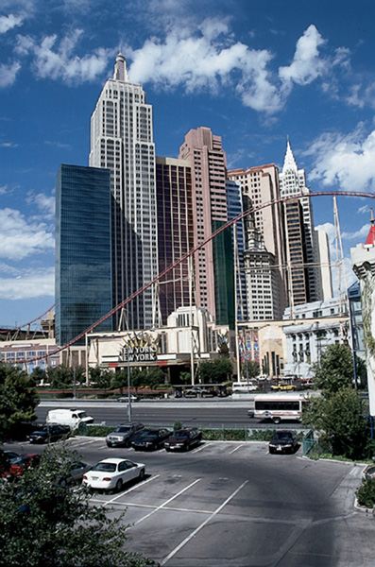
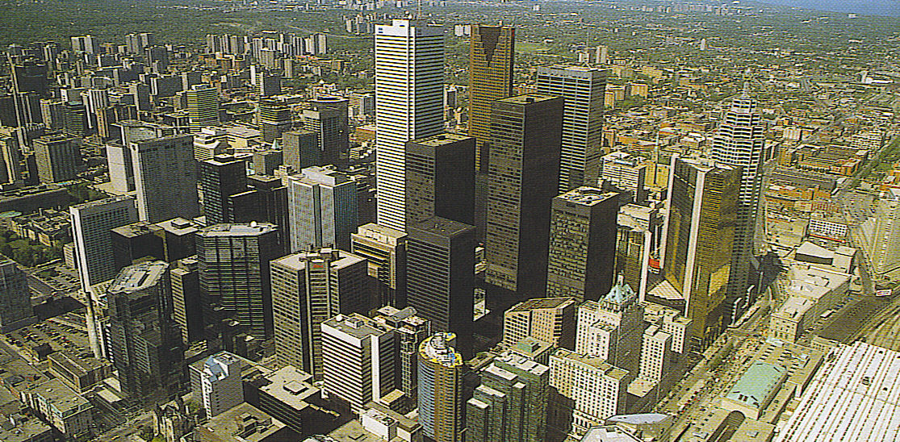
Convergence of Cultural Landscapes:
Borrowing of idealized
landscape images blurs
place distinctiveness.-right Las Vegas, Nevada-below Toronto, Canada

Slide 24
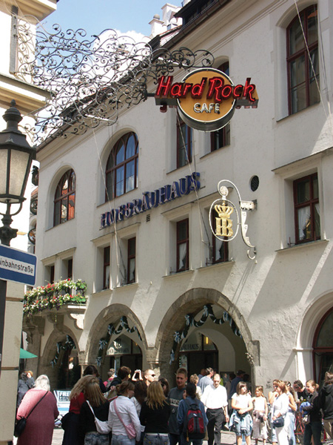
Convergence of Cultural Landscapes:
The widespread distribution of businesses and products creates distinctive landscape stamps around the world.
What are some other examples of businesses that can be found around the world?

Slide 25
Cultural Convergence occurs when two cultures adopt each other’s traits and become more alike

Slide 26
Cultural Divergence is the divide in culture into different directions, usually because the two cultures have become so dissimilar.

Slide 28
Boarders and Barriers
Unless regions are defined by clear features such as a mountain range or a river identifying cultural boarders an be hard, Often a transition zone exists where cultures mi and people exhibit traits of both cultures.
The boarder between the US and Mexico is clearly marked but the people who live in border communities such as El Paso Texas are often fluent in both Spanish and English and have cultural ties to both countries

Slide 29
Cultural Realms are larger areas that include several regions, Cultures within a cultural realm have a few traits that they all share, such as language families, religious traditions, food preferences architecture or shared history

Slide 30
Cultural Diffusion, the spread of culture over wider areas
Relocation Diffusion is the spread of a cultural trait by who migrate and carry their culture traits with them.
Example: Pizza from Italy by immigrants who brought it to the United States in the late 19th century
Larger scale example is the spread of European culture around the world starting in the 1500’s
Sun Never sets on the British Empire
Contagious Diffusion occurs when a cultural trait spreads contiguously outward from its hearth through contact with people
Example is the hearth from blues music from the southern United States as musicians outside the hearth heard the music and began to play it themselves

Slide 31
Hierarchal Diffusion of fashion

Slide 32
Hierarchical / Reverse Hierarchical Diffusion
Hierarchical Diffusion is the spread of culture outward from the most interconnected place or from the centers of wealth and importance, cultural important person, city or social class.
Most popular culture, such a music, fashion, and fads follow the hierarchal path
Example: Cell phones appeared on the market in the 1980’s they were expensive and were most commonly owned by wealthy people in large cities in more developed counties.
Reverse Hierarchical diffusion is when a trait diffuses from the lower class to the higher class
Example: in the US in the 1940s-1960’s people commonly considered tattoos to be a symbol of low social class. Tattoos were associated with 3 types of people, seaport towns of dock workers and sailors, military bases and prisons

Slide 33
Rapid diffusion of popular clothing styles.Individual clothing habits reveal how popular culture can be distributed across the landscape with little regard for distinctive physical features. Instead they reflect
Occupation: a lawyer or business executive tends to wear a dark suit, light shirt or blouse, and necktie or scarf. Whereas a factor worker wears jeans and a work shirt
Income: Women’s clothes, change in fashion from one year to the next.. The color, shape and design of dresses change to imitate pieces created by clothing designers. For social purposes, people with sufficient income may update their wardrobe frequently with the latest fashions
Improved communications have permitted the rapid diffusion of clothing styles from one region of earth to another.

Slide 34
Stimulus Diffusion
Stimulus Diffusion occurs when people in a culture adopt an underlying idea or process from another culture but modify it because they reject on trait of it.
Example: Hindus in India adopted the practice of eating fast food but they rejected eating beef because doing so would violate their Hindu beliefs so they adapted the custom by make vegetarian and other non-beef types of burgers.
500 years ago Europeans adopted the use of lightweight beautifully decorated porcelain dishes that they obtained from China, but they rejected the high cost of importing the dishes so when people in Germany found deposits of the right type of clay to make their own porcelain. They modified the process of obtaining porcelain by making it in Europe
Yoga would be an example

Slide 35
Acculturation and Assimilation
Acculturation occurs when two cultures come into contact with one another and the “weaker” (politically or with less mainstream acceptance) of the two adopts traits from the more dominant culture.
Example: A family migrates here from Denmark settling in a Danish enclave in Iowa. The mother and father gave most of their children common Danish names, and commonly ate Danish foods. Within 3 generations their descendants still ate some of the Danish foods but had common US names
Sometimes acculturation leads to assimilation, when the original traits of the weaker culture are completely replaced by the traits of the more dominant culture and you can no longer distinguish them from the receiving group
This often occurs as ethnic groups become more affluent and leave their ethnic areas. Complete assimilation rarely happens through, often one trait that is retained the longest is religion. For example grandchildren on immigrants from India might not longer speak Hindi but they might still practice their Hindu faith.

Slide 36
Multiculturalism / Nativism
Multiculturalism the coexistence of several cultures in one society, with the ideal of all cultures being valued and worthy of study. A major idea of multiculturalism s that the interaction of cultures enriches the lives of all.
However this can also bring conflicts, as people and groups with difference vales, beliefs and customs often clash. Minority groups often face prejudice and discrimination
Nativism: or anti immigrant, attitude may form among the cultural majority, sometimes bringing violence, or government actions against the immigrant or minority group. Often nativist attitudes are directed toward one particular group, such as opposition in the US to Roman Catholic immigrants in the `1800’s and early 1900’s, nativism reflects a general dislike of people from other countries or xenophobia
Sometimes popular culture can give voice to counter cultures
➤ counter culture groups that rejects the values, norms, and practices of the larger society and replaces them with a new set of culture patterns
➤ counter cultures can be engines of social change
➤ ex: New Wave music brought LBGT counter culture to music videos on MTV

Slide 38
Transculturation
Sometimes transculturation occurs when two cultures of just about equal power or influence meet and exchange ideas or traits without the domination seen in acculturation and assimilation
A well-known example of transculturation is colonialism. When Europeans colonized North America, South America, and other territories, they took with them European values and traditions. For example, many countries in South America speak Spanish today because of the Spanish colonial conquest.
A current example of transculturation in modern day is the proliferation of American cultural values to other areas of the world in various aspects including language, dress, and music. The media has become the modern agent of transculturation since it transmits cultural information through media such as movies and music.

Slide 39
Effects of Globalization on Culture
Critics say that it neglects smaller cultures and that globalization process forces them to assimilate into much more spread western culture
It can create a monculture
For many developing nations, globalization has led to an improvement in standard of living through improved roads and transportation, improved health care, and improved education due to the global expansion of corporations

Slide 40
Commodification

Slide 41
Neolocalism
Neolocalism is a common phenomenon wherein displaced ethnic groups will celebrate their heritages in locations alien to their origins
Neolocalism is a term coined by geographer Wes Flack to describe a renewed interest in preserving and promoting the identity of a community and restoring aspects that make it culturally unique.
Neolocalism, simply meaning "new localism," is a broad term that can be used to describe everything from a local farmer's market supporting regional farming initiatives to grass roots opposition when a large corporation like Walmart attempts to set up shop in a town
Localism describes a range of political philosophies which prioritize the local. ...Localism can also refer to a systematic approach to organizing a national government so that local autonomy is retained rather than following the usual pattern of government and political power becoming centralized over time.

Slide 42
Placelessness: The condition of an environment lacking significant places and the associated attitude of a lack of attachment to place caused by the homogenizing effects of modernity, e.g. commercialism, mass consumption, standard planning

Slide 43
Gender
Gender: Social differences between men and women.
rather than the anatomical, biological differences between the sexes.
What is considered "feminine" or "masculine" vary over time and space
Sex: categories describing reproductive organs present at birth
Identity: “how we make sense of ourselves”
Gendered Space - whether the place is designed for or claimed by men or women
most important: school
As of 2012, 2/3 of women in the world were illiterate

Slide 44
Sex -> Gender

Slide 45
Ethnicity
Ethnicity refers to a group of people who share similar ancestry and cultural traditions of a particular homeland or hearth.

Slide 46
Examples of Ethnicities / Ethnic Groups

Slide 47
Ethnic Enclaves
Ethnic Enclaves are small areas inhabited by particular ethnic groups found in urban areas.
Toponyms can hint at the presence of an ethnic enclave, ex. Polish Hill or Chinatown.

Slide 48
Ethnic Neighborhoods
The neighborhood level of the cultural landscape where clusters of people of the same culture, but surrounded by people of a culture that is dominate in the region
Ethnic Enclaves sometimes reflect the desire of people to remain apart from the larger society
Other times, they reflect a dominate cultures desire to segregate a minority culture. Inside these enclaves are often stores and religious institutions that are supported by the ethnic group, signs in their traditional language, and architecture that reflects the groups place o origin. These enclaves can provide a buffer against discrimination by the dominate culture

Slide 49
Ethnic Geography
Ethnic Geography The study of the multiple movements, diffusion, migrations, and mixings of people of different origins The study of spatial distributions and interactions of ethnic groups Cultural characteristics of ethnic groups and the influences underlying them How the built environment reflects the imprint of various ethnic groups

Slide 50
Where Ethnicities are Distributed in US

Slide 51
Ethnic Islands
small, usually rural and ethnically homogeneous enclaves situated within a larger and more diverse cultural context.
Groups of immigrants acting in concert, Placed enduring marks in the landscape Chain migration:
Assemblage in one area of the relatives, friends, and compatriots of the first arrivals Ethnic Provinces Larger than the distinctive ethnic islands
The African American Southeast – Native American Oklahoma and the Northern Great Plains – Extensive regional units

Slide 52
The Kurds
The Kurds are a group of people who are Sunni Muslim, who speak a language in the Iranian group and have distinctive literature, dress and other cultural traditions
Post WWII the European allies carved up the Ottoman Empire and created an independent state of Kurdistan but the Turks fought to successfully expand their territory to include some of this region.
Today the 30 million Kurds are split among several countries;
14.5 million in eastern Turkey
6 million in western Iran,
5.5 million in northern Iraq
2 million in Syria
1.5 in other countries
To foster the development of Turkish nationalism, the Turks have tried to suppress Kurdish culture by making the Kurdish language illegal until 1991, and banning its use in broadcasts and classrooms.

Slide 53
Apartheid
Apartheid was a system of institutionalized racial segregation that existed in South Africa from 1948 until the early 1990
Video: https://www.youtube.com/watch?v=S7yvnUz2PLE

Slide 54
Latino vs Hispanic
While the two terms are sometimes used interchangeably, "Hispanic" is a narrower term that only refers to persons of Spanish-speaking origin or ancestry, and does not include Brazil because they speak Portuguese
"Latino" is more frequently used to refer generally to anyone of Latin American origin or ancestry, including Brazilians

Slide 55
CAUTIONS REGARDING CULTURE AND ATTITUDE
Xenophobia – fear or hatred of foreigners
Symptoms of Xenophobia:
Being afraid to be near people that are not similar.
Being angry and volatile near others that are different, even if it is just the culture and not the person.
Jumping to conclusions and stereotypes about others seen as different
Inability to trust or create relationships with others that are different.
Gaining pleasure from the maltreatment of others that are different.
Avoidance of areas where dissimilar people congregate in large groups.

Slide 56
Ethnicities and Violence
Disagreements between people of different ethnic identities are also at the heart of many social and political conflicts throughout the world. Over 90% of the world’s countries contain more than one ethnicity, most countries share borders with people of foreign ethnicities, and many otherwise cohesive ethnic groups have been artificially divided by political boundaries.
Places where particularly sharp ethnic boundaries characterize the cultural landscape or where people of various ethnic identity lay claim to the same lands or resources are often marred by political unrest and violence. In recent years the Middle East, the Balkans of Eastern Europe, eastern Africa and Kashmir on the border between India and Pakistan have all experienced devastating ethnic violence.
Ethnic Cleansing is the systematic attempt to remove all people of a particular ethnicity from a country or region either by forced migration or genocide
Genocide is a premeditated effort to kill everyone from a particular ethnic group

Slide 57
Race
A categorization of humans based on skin color and other physical characteristics. ... Belief that race is the primary determinant of human traits and capacities and that racial differences produce an inherent superiority of a particular race

Slide 58
Race → Ethnicity

Slide 59
White Nationalism
The belief that national identity should be built around “white ethnicity”, and that white people should therefore maintain both a demographic majority and dominance of the nation’s culture and public life.
➤ Places the interests of white people over those of other racial groups.
➤ An extremist reaction to multiculturalism WHITE NATIONALISM
Not uniquely American, also found in Europe
Difference between white supremacy and white nationalism?
White supremacy is based on a racist belief that white people are innately superior to people of other races
White Nationalism is about maintaining political and economic dominance

