Slide 1
Religion: the belief in and worship of a god or gods or any such system of belief and worship
Key Issues
Where are religions distributed?
Why do religions have different distributions?
Why do religions organize space in distinctive patterns?
Why do territorial conflicts arise among religious groups?
Superstitions ted ed 5: https://www.youtube.com/watch?v=quOdF1CAPXs
:

Slide 2
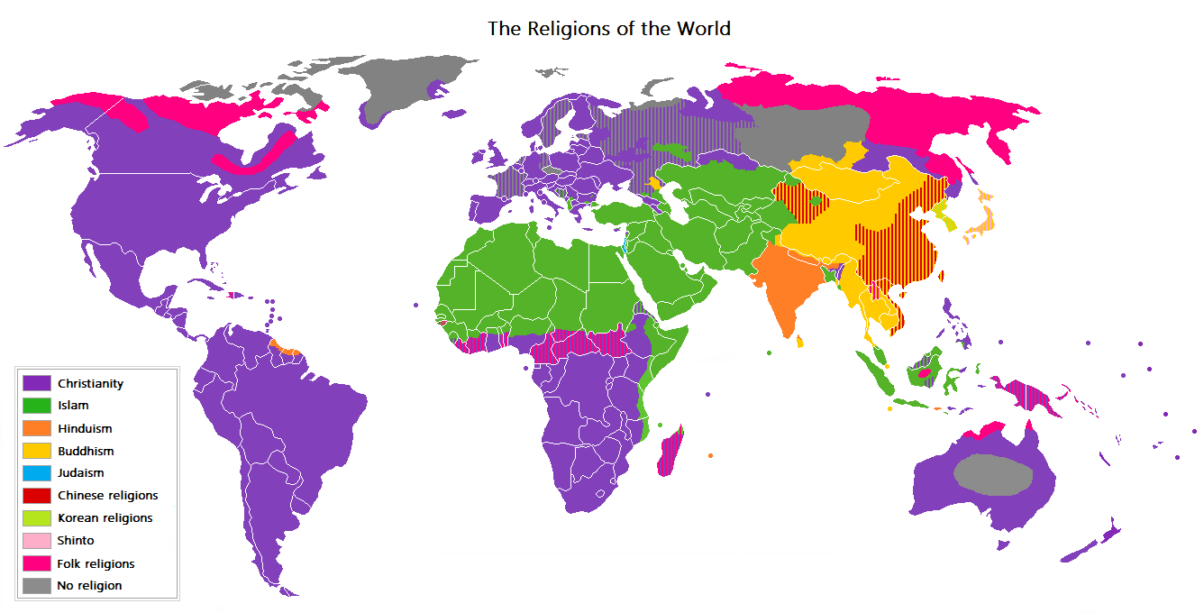
Prevailing World Religions Map
>93% (6.8 billion) of the world claim a religious affiliation
Major Religions (Chronological Order)
Hinduism ~2500 BCE (900 million)
Judaism ~ 2000BCE (14 million)
Christianity 33 CE (2.1 billion)
Islam ~610 CE (1.5 billion)
Sikhism 1469 CE (30 million)
Major Life Philosophies (Chronological Order)
Taoism 550 BCE (20 million)
Buddhism 520 BCE (360 million)
Confucianism ~495 BCE (5-6 million)
Notes:
This map shows the religion practiced by the majority of religious persons in the states of the world. It does not depict non-religious populations. (For example, although recent surveys estimate that 43-54% of French, and 46-85% of Swedes self-identify as atheist, agnostic, or non-spriritual, those nations are depicted as Catholic, and Protestant, respectively.) If the ratio of the largest religious group to the next largest religious group is less than 60:40, then the color of the state is a blend of the colors of the two largest groups. Therefore:
Countries such as Lebanon receive a blend of colors representing the two main religious groups i.e. Christians and Muslims
States consisting of multiple nations, countries, or autonomous regions receive a single color determined by the aggregate of their inhabitants. Thus, Tibet, for example, receives the same color as the People's Republic of China, even though that color does not accurately describe the Vajrayana Buddhist religious affiliation of its inhabitants.
Persons without a religion (atheists) are not counted in determining the majority religion. Because of this, the Netherlands is colored steel-blue (mixed Protestant and Catholic), even though there are more non-religious people than there are Catholics, who constitute the largest religious group[2].
Regions within a state whose predominant religion is different from the plurality religion of the nation-state are not separately indicated. Thus, the southern islands of Mindanao, the Sulu archipelago and parts of Palawan which contain most of the Philippines small 5% to 10% Muslim population are painted Catholic pink. Russia is painted Orthodox purple because its officially small Muslim population who cluster around the Caucasus and Tatarstan at 5% to 6%, according to Russian state figures are not numerous enough to justify a mixed green-pink color.
In Iraq, Shi'ite Muslims are generally estimated to form around 60% to 65% of the population while the large Sunni Muslim minority consists of 35% of the population and Christians only 3% which justifies coloring this state a light green in favor of Shi'ite Islam.
In contrast, Yemen is colored a mix of light and dark green to reflect the fact that no religious group forms 60% of its population; the UNHCR[3] reports that its Shia Zaydi minority forms 45% of the population whereas Sunni Muslims comprise 53% of the population.
It is interesting to note that predominantly Hindu majority India--at 80.5%--according to the 2001 census has the third largest population of Muslims in any country of the world which stands at 13.4% of this state.

Slide 3
Religions are divided into
Branches -a large and fundamental division within a religion –
Catholic, Protestant and Orthodox branches of Christianity.
Sunni, Shi'ite, Sufi Mystic branches of Islam
Mahayana, Theravada branches of Buddhism
Denomination -a division or a within a branch that unites a number of local congregations into a single administrative body-
Protestant Denominations: Baptist, Lutheran, Methodist
Orthodox Denominations: Eastern, Russian, Greek, Coptic
Sect - a small group that has broken away from the established denomination (may be viewed as radical)
- An example of a sect within Catholicism is the Community of the Lady of All Peoples, also know as the Army of Mary. This group's beliefs depart from the official doctrine of the church.

Slide 4
Classifications of Religions
Universalizing (60% adherents) religions that claim applicability to all humans and that seek to transmit their beliefs through missionary work and conversions. And who choose to make some sort of symbolic commitment
Appeal to people everywhere all over the world
Known individual founder (prophet) & specific place of origin
Message diffused widely (missionaries)
Followers distributed widely.
Holidays based on events in founder’s life.
Holy places are associated with the founder
Religious calendar reflects the life of the founder
Group is homogeneous
Ethnic (25% adherents)
Appeals to mainly one group of people living in one place
Strong territorial identification
Strong cultural identification
Become a member at birth or by adoption of a complex lifestyle and cultural identity (conversion)
Unknown source.
Followers highly clustered.
Not just a statement of faith
Holidays based on local climate and agricultural practice
Holy places are associated with the physical environment of the hearth
Religious calendar reflects the seasons
Group is heterogeneous

Slide 5
Religions by the Numbers
58 percent of world’s population practices a universalizing religion.
Christianity: 2.2 billion Christians (31% world total)
Islam: 1.6 billion Muslims (22% world total)
Buddhism: 376 million Buddhists (5.3%)
Bahai: 7 million (.10%) –26% of world’s population practices an ethnic religion
Hinduism: 1 billion people (14%)
Judaism: 14 million (0.20%)
Shinto: 4 million
Traditional Chinese Religions (Taosim, Confucianism): 394 million (5.5%)
15% of the world is secular (non-religious, atheist, agnostic)

Slide 6
ORIGINS OF RELIGIONS
Universalizing religions have precise hearths
➤ Christianity – Bethlehem
➤ Islam - Mecca
➤ Buddhism - rural Himalayan mountains
➤ U.R. hearths are easily traceable because they’re tied to the lives of individuals with well documented biographies
➤ Ethnic religions have anonymous founders, hearths, and dates

Slide 8
Types of Religious
Universalizing religions have precise hearths
Christianity - Bethlehem
Islam - Mecca
Buddhism - rural Himalayan mountains
U.R. hearths are easily traceable because they’re tied to the lives of individuals with well documented biographies
Ethnic religions have anonymous founders, hearths, and dates

Slide 10
Old Testament writings
Hebrew heritage
JUDAISM
CHRISTIANITY
Monotheism
Abraham & Prophets
Jerusalem (Holy City)
SW Asia
Ishmael, son of Abraham
The Prophets
Teachings about Heaven and Hell
ISLAM
Major Monotheistic Religions of the world from SW Asia

Slide 11
Basic Christian Beliefs in Pictures

Slide 12
Christianity History

Slide 13
Christianity Basic Beliefs

Slide 14
Diffusion of Christianity
Hierarchical Diffusion
Emperor Constantine helped diffuse the religion throughout the Roman Empire by embracing Christianity.
Theodosius makes it the religion of the empire
Relocation Diffusion
Missionaries, individuals who help transmit a religion through relocation diffusion, initially diffused the religion along protected sea routes and the excellent Roman roads.
Migration and missionary activity by Europeans since 1500 have extended Christianity all over the world.
Permanent resettlement in the Americas, Australia, and New Zealand

Slide 15
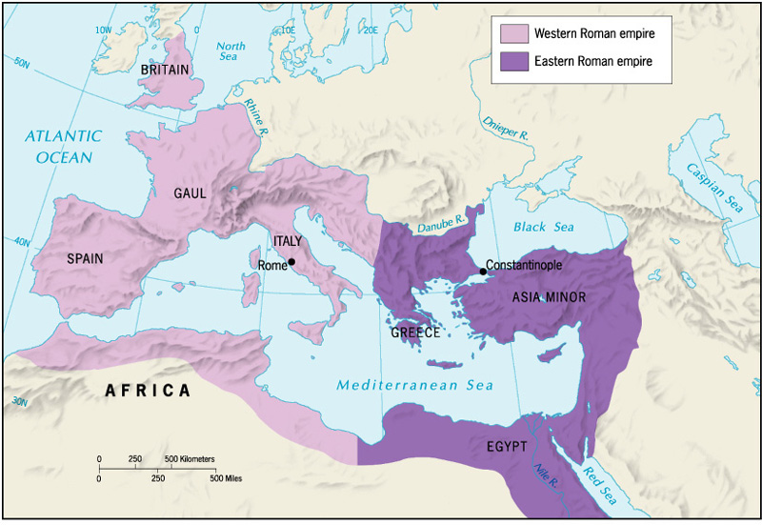
First Split in Christianity, 1054 CE Western Roman empire = Roman Catholicism Eastern Roman empire = Orthodox
Notes:
The East–West Schism is the medieval division of Chalcedonian Christianity into Eastern (Greek) and Western (Latin) branches, which later became commonly known as the Eastern Orthodox Church and the Roman Catholic Church, respectively. The East–West Schism is the larger and more lasting of the two schisms to which the term "Great Schism" is applied (the other being the Western Schism).^{[1]} Relations between East and West had long been embittered by ecclesiastical differences and theological disputes.^{[2][3][4]} Prominent among these were the issues of the source of the Holy Spirit, communion and Papal power (universal jurisdiction.
In 1053, the first step was taken in the process which led to formal schism. Patriarch of Constantinople Michael Cerularius ordered the closure of all Latin churches in Constantinople.^{[9][10][11]}
In 1054, the Papal legate traveled to Constantinople for purposes that included insisting Rome's claim to be the head and mother of the churches.^{[2]} and resulted in a final schism between Easter and Western churches … Catholic (Western) and Orthodox (Eastern).

Slide 17
Protestantism

Slide 18
Roman
Catholic
Orthodox
Hierarchical Organization
Apostolic Succession
Transubstantiation
Purgatory
Separated from RCC over Papal authority and history (who was following original church the closest)
Archbishop of the church is authority.
Branches include: Greek, Russian, Coptic
OT has 7 additional books (The Septuagint)
Pope is the highest authority on earth
All male clergy
Trinity
Deity of Jesus Christ
Old & New Testament
12 Apostles
Communion
Shares same New Testament
No recognition of Papal authority
Multiple denominations
Martin Luther (Augustinian Monk) suggests reform needed in a corrupt practices of RCC (Tetzel’s sale of indulgences)
High Churches use liturgy and procedures akin to RCC.
Low Churches forgo decorations and liturgical pomp
Branches include: Lutheran, Baptist, Non-denominations
95 Thesis Rap
Reformation (CCWH)
Branches of Christianity
Protestant
http://christianityinview.com/comparison.html
Notes:
The Hebrew Bible has 24 books. This list, or "canon," was affirmed at the Councils of Jamnia in A.D. 90 and 118. The Protestant Old Testament includes exactly the same information, but organized into 39 books. For example, the Hebrew Bible has one book of Samuel, while the Protestant Bible has I and II Samuel—same book, but divided into two parts.
In addition to these 39 books, the Catholic Old Testament includes Tobit, Judith, Wisdom of Solomon, Ecclesiasticus (Sirach), Baruch (includes the Letters of Jeremiah), I and II Maccabees, and additions to Daniel and Esther. These books were included in the Septuagint, a Greek translation of a different Hebrew canon. Early church fathers, who relied on the Septuagint (they could read Greek, but not Hebrew), sometimes quoted these books as Scripture. The status of the books continued to be debated throughout the Middle Ages.
At the time of the Reformation, Protestants decided that, because the additional books weren't in the Hebrew Bible, they shouldn't be in the Christian Bible, either (though they were included in early editions of the King James Bible). Catholics, at the Council of Trent (1546), decided to keep the "deutero-canonical" books.
Incidentally, Protestants and Catholics use the same New Testament, the content of which was defined by Athanasius in 367.

Slide 21
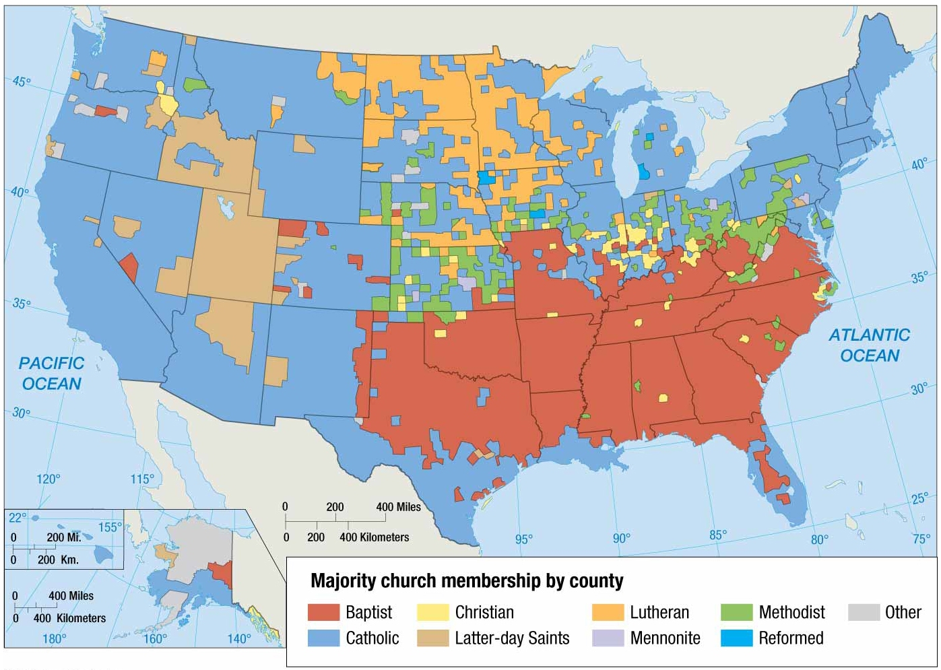
Notes:
FIGURE 6-7 DISTRIBUTION OF CHRISTIANS IN THE UNITED STATES The shaded areas are U.S. counties in which more than 50 percent of church membership is concentrated in either Roman Catholicism or one Protestant denomination. The distinctive distribution of religious groups within the United States results from patterns of migration, especially from Europe in the nineteenth century and from Latin America in recent years.

Slide 22
Regional Patters in the US: The distribution of ethnic and religious groups in the US reflects the historical Patterns:
Congregationalists (form of Protestant church government in which each local religious society is independent and self-governing) are still strong in New England, where their English ancestors settled in the 1600’s.
Baptists and Methodists are most common in the Southeast, where these denominations were spread by traveling preachers in the 1800’s.
Lutherans live mostly I the Midwest, where their German or Scandinavian forbears who immigrated in the late 1800’s could find good farmland.
Many Mormons live in or near Utah, where Mormons settled in the mid 1800’s after religious persecution drove them out of Missouri and Illinois.
Roman Catholics are most common in urban areas in the Northeast and throughout the Southwest
Jews, Muslims and Hindus live most often in urban areas, the traditional home to immigrants

Slide 23
Basic Beliefs of Islam

Slide 24
Basic Ideas of Islam
Islam means surrender or submission to God
The Qur’an is the sacred text of Islam and represents God’s final word
Muhammad is the last of God’s prophets
Other prophets would include Abraham, Moses and Jesus
It teaches that God is all powerful and compassionate and people are responsible for their own actions
It speaks of a final judgment day when people will stand before God to face eternal punishment in hell or eternal bliss in paradise
Muslims believe in the same God as the Jews and Christians which they refer to as the people of the Book.
Qur’an is Gods final word and complete the revelations contained in the Torah and Bible.
Islam is both a religion and a way of life.
The Islamic System of law if called Sharia and it regulates moral conduct, family life, business practices, government and other aspects of Muslim community
All Muslims should follow the Five Pillars of Islam
Because Muslims do not believe in idol worship, they forbade portrayals of God or Muhammad and use arabesques and calligraphy

Slide 25
A Schism in Islam / Who Should Lead
Sunni (from the Arab word for orthodox)
Believe the first four Califs were rightly guided
Believe the caliph should be chosen by leaders of the Muslim community
He should be a pious (religious or devout)Muslim and follow Muhammad’s example
Viewed as a leader and not a religious authority
Claim the Shiites have distorted the meaning of various messages in the Quran
90% of Muslims today are Sunni
Shiites ( from the Arabic word for sectarian sometimes written Shia in English)
Believe that Muhammad’ son in law Ali should have succeeded Muhammad
Believed the true successor to Muhammad were the descendants of Muhammad’s daughter and son in law Fatima and Ali
Claim the Shiites have distorted the meaning of various messages in the Quran
16% of Muslims are Shiites,
Nearly 30% live in Iran
15% in Pakistan
10% Iraq

Slide 26
Sunni
Shia (Shi’ite)
83% of all Muslims are Sunni
More peaceful branch
Held to Muhammad’s choice for succession
10% of all Muslims are Shi’ite
More radical branch
Found mainly in Iran, Pakistan, and Afghanistan
Did not agree with successor to Muhammad
Abraham is the head of Islam through Ishmael
5 pillars
Muhammad is the founder
Mystic Islam branches include: Whirling Dervish, Sufi Mystics
Ibadi (branch of Kharijite) 1.45 mil does not hold that sinful Muslims are unbelievers
Yazdanism blends Kurdish and Sufi doctrines
Black Muslim movements including Nation of Islam
Islamic State (CCWH)
Islam (CCWH)
Branches of Islam
Other
Notes:
The Hebrew Bible has 24 books. This list, or "canon," was affirmed at the Councils of Jamnia in A.D. 90 and 118. The Protestant Old Testament includes exactly the same information, but organized into 39 books. For example, the Hebrew Bible has one book of Samuel, while the Protestant Bible has I and II Samuel—same book, but divided into two parts.
In addition to these 39 books, the Catholic Old Testament includes Tobit, Judith, Wisdom of Solomon, Ecclesiasticus (Sirach), Baruch (includes the Letters of Jeremiah), I and II Maccabees, and additions to Daniel and Esther. These books were included in the Septuagint, a Greek translation of a different Hebrew canon. Early church fathers, who relied on the Septuagint (they could read Greek, but not Hebrew), sometimes quoted these books as Scripture. The status of the books continued to be debated throughout the Middle Ages.
At the time of the Reformation, Protestants decided that, because the additional books weren't in the Hebrew Bible, they shouldn't be in the Christian Bible, either (though they were included in early editions of the King James Bible). Catholics, at the Council of Trent (1546), decided to keep the "deutero-canonical" books.
Incidentally, Protestants and Catholics use the same New Testament, the content of which was defined by Athanasius in 367.

Slide 27
Diffusion of Islam
1.6 billion + adherents
Originated in Saudi Arabia (Mecca and Medina) around AD 600.
Spread originally by Muslim armies to N. Africa, and the Near East.
Sunni (83%) - throughout the Muslim world.
Shiite - Iran (40%), Pakistan (15%), Iraq (10%)
Diffusion from Southwest Asia
Contagious Diffusion by trade & Conquest to Spain, Africa, and mush of Asia
Relocation diffusion throughout the world
Crash Course: https://www.youtube.com/watch?v=TpcbfxtdoI8
Hughes: https://www.youtube.com/watch?v=8S_Tw6jA77E

Slide 28
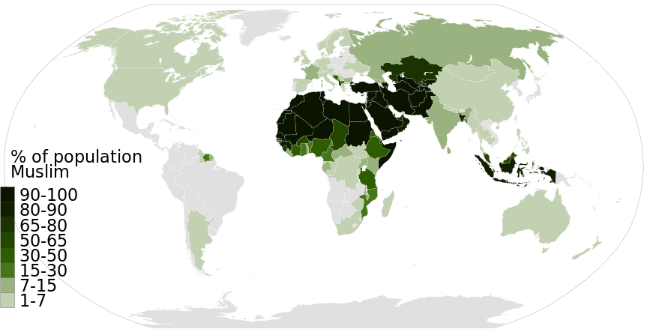
World Muslim population by percentage (Pew Research Center, 2014).

Slide 29
Basic Beliefs Summary

Slide 30
Fundamentalism, Orthodox, Theocracies
Fundamentalism: is an attempt to follow a literal interpretation of a religious faith. Fundamentalists believe that people should live traditional lifestyles similar to those prescribed in the faith’s holy writings, Fundamentalists are more likely that others in their faith to enforce strict standards of dress and personal behavior. Often through laws.
Theocracies: Countries such as Iran, have governments that are run by religious leaders through the use of religious laws.
Orthodox
conforming to what is generally or traditionally accepted as right or true; established and approved
strictly observant.
Purity of faith Christianity, Judaism, Islam, and Hinduism all have orthodox followers.
Orthodoxy" rejects any changes or additions to some "original" tenets or beliefs, only accepting older, traditional ones as "valid." "Fundamentalism" holds to a strict literal interpretation of a particular set of tenets or beliefs, but those tenets/beliefs could be fairly new, they don't have to be old, traditional, or original.

Slide 31
Sikhism
Founded by the Guru Nanak in 1500 CE in Pakistan
God was revealed to Guru Nanak as The One Supreme Being - God is perfect, humans are not
10 Gurus revealed over time taught that people have capacity for continuous improvement and movement toward perfection
Believers are baptized. Men wear turbans and do not cut their hair or beards
A syncretic religion, blending or combining of several traditions, in this case Hinduism and Islam
Heaviest concentration along border of India and Pakistan, south of Kashmir
World numbers: 23 million, mainly South Asia, UK, US

Slide 32
Bahai Beliefs

Slide 33
Baha’i Beliefs

Slide 34
Buddhism Summary

Slide 35
Diffusion of Buddhism from South Asia in present day Nepal: Contagious diffusion as teachings spread throughout East and Southeast Asia, Relocation diffusion throughout the world

Slide 36
Buddhism
Founded and taught by Siddhartha Gautama in the 6th century BCE
After meditating for 49days he became the Buddha after he became “enlightened”
Goal of Life: to achieve nirvana or one with the universe and end the cycle of rebirth or reincarnation through self purification
Belief in the Four Noble Truths and to follow the Eightfold Path to overcome suffering
➤ Diffused relatively slowly from its origin in northeastern India.
➤ Emperor Asoka accredited with much of its diffusion throughout the Magadhan Empire (273 to 232 B.C.).
➤ Missionaries sent to territories neighboring the empire.
➤ Buddhism introduced to China along trade routes in the first century A.D
Hughes: https://www.youtube.com/watch?v=eYKdEnEqfQQ

Slide 38
UNIVERSALIZING RELIGIONS
Religion | Origins | Diffusion | Branches | Cultural Landscape
Buddhism (350 million) | Founded in South Asia in present day Nepal | Contagious: Through the teachings spread out India, to south and east Asia along the silk road | Theravada Mahayana Lamaism | Pagodas Bodhi Trees
Christianity (2 billion | Originated as an offshoot of Judaism in the Semitic Hearth (modern Israel) | Hierarchical: diffusion through conversion of rulers who then forced their followers to adopt the faith. Spread when Roman Empire adopted it, Relocation: monarchs in Europe – expanded with colonial efforts& missionaries Contagious diffusion through the Middle East, Europe and Central Asia | Roman Catholic Protestant Eastern Orthodox | Bible Cathedrals Churches Burial Grounds
Islam (1.2 billion) | Originated in Mecca | Hierarchal: as Islamic empires developed in the middle east Relocation | Sunni Shiite | Quran, Mosque Minarets Five Pillars
Sikhism (20 million) | Founded in Pakistan | Diffused outward toward India |  | Guru Granth Sahib Golden Temple

Slide 39
Religious Hearths and Diffusion
Religion | Hearth | Type of Diffusion
Hinduism | Along Indus River in present day Pakistan | Contagious diffusion across Indian subaccountant Relocation diffusion in resent decades to Europe and the United States
Buddhism | South Asia in present day Nepal | * Contagious diffusion as teachings spread throughout East and Southeast Asia Relocation diffusion throughout the world
Judaism | Eastern Mediterranean and Southwestern Asia | * Relocation diffusion throughout North Africa and Europe forced by the Romans beginning around 70 C.E * Relocation diffusion to the United States and other countries
Christianity | Eastern Mediterranean and Southwestern Asia | Contagious diffusion through the Middle East, Europe, and Central Asia Hierarchical diffusion through conversion of rulers, who then forced their followers to adopt the faith Relocation diffusion throughout the world
Islam | Southwest Asia | Contagious diffusion by trade and conquest to Spain, Africa and much of Asia Relocation diffusion throughout the world

Slide 40
Distribution of Ethnic Religions

Slide 42
Hindism
Hinduism, which claims about 800,000 million practitioners worldwide, is unique among humanity’s major religions in that it cannot be traced to any specific individual or historical event
Scholars believe that Hinduism arose about 3,5000 years ago out of interactions between Aryans and Indus Valley people
Hindu means Indian
Because Hinduism arose from no single person or institution, it is seen an eternal & unchanging in its essence. Believers regard it as having existed forever.
Hinduism originated in the 6th century BCE in the Indus River Valley region and from the Aryan tribes that migrated into this region speaking Indo European languages. They intermingled with the Dravidians who were already living in the area, modified their religious beliefs. The earliest surviving texts were known as the Vedas, written around 1100 BCE. Around 2,000 years ago key texts were composed and rituals were constructed
To Hindus, every person has an essential self or atman which is another name for brahman
The ultimate goal of existence is to end the cycle of reincarnation and achieve Moksha or union with Brahman
To do this one must free themselves from selfish desires that separate them from brahma.
The Hindus believe in reincarnation or the rebirth of the soul in another bodily form which allows people to continue working toward moksha through several lifetimes
Caste System is a social system one is born into and cannot change. Each social caste comes with it’s own duties or dharmas

Slide 44
Jainism
Jainism Believe in no god, only soles, matter and universe which is all eternal, always been, not created. Cleanse soul of karma, free should to join universe
Believe in reincarnation, karma, ahimsa,
Believe in ahimsa: none violence
Moksha: union with the universe, free your soul
Follow the 5 vows to cleanse soul of karma and achieve moksha, None violence, vegetarian/vegans, don’t lie, steal, none possessiveness, don’t be attached to objects
Swastika means good fortune
Hughes: https://www.youtube.com/watch?v=l0LxwiFXOOU

Slide 45
Jainism

Slide 46
Jainism

Slide 47
Judaism

Slide 48
Judaism
At the heart of Judaism are the 10 Commandments which are a set of laws the Jews believe God gave them through Moses
First four stress religious duties toward God like keeping the Sabbath a holy day for rest and worship
Rest set out rules for conduct towards other people
Salvation through belief in God of the Torah
Holy Books: Torah, Talmud, Tanakh (these make up the Law, Prophets, & Writings)
No place of “Hell” or torment for sin
Called: Jews
Place of Worship: Synagogue or Temple
Out of the 14.3 million Jewish people in the world, 43% reside in Israel today. Most Jews have not lived there since 70 CE when the Romans forced to disperse throughout the world, this was known as the diaspora
Other nationalities persecuted them, sometimes forcing them into ghettos (walled off parts of the city, then in WWII the Nazi’s systematically rounded them up and exterminated them
Today, Less than 15% of the world’s 14 million Jews live in Europe compared to 90% a century ago
Second oldest and continuously practiced religion
One of the First monotheistic religions
Abraham migrates to Canaan (Palestine) in about 3000 – 2300BC
He considered the founder of the Israelite nation
Israelites or Hebrews recorded events in the Torah their most sacred text
Famine forced many to migrate to Egypt where they became enslaved
Moses led them out of Egypt on an great exodus but died before they reached Canaan
This exodus is celebrated today with Passover
1,000 BC Israelites set up a kingdom called Israel.
King David united the Israelite tribes into a single nation
David’s son, Solomon turned Jerusalem into an impressive capital and tired to increase Israel’s influence with other empires

Slide 49
Judaism

Slide 50
The Temple Mount is the holiest site in Judaism and is the place to which Jews turn during prayer

Slide 51
TAOISM (DAOISM)

Slide 53
Animism
Animism is an ethnic religious belief
inanimate objects or natural events, such as natural disasters, have spirits and conscious life.
100 million Africans adhere to animism.
Uluru/Ayers Rock is a sacred place for the animist religion associated with the aboriginals in Australia
Tribal or Traditional:
Shamanism – involves community acceptance of a religious leader, healer, or worker of magic, who, through special powers, can intercede w/ & interpret the spirit world

Slide 54
The percentage of animists in sub-Saharan Africa has declined from more than 70 percent in 1900 to around 12 percent in 2010. As recently as 1980, some 200 million Africans—half the population of the region at the time—were classified as animists. Followers of traditional African religions now constitute a clear majority of the population only in Botswana. The rapid decline in animists in Africa has been caused by increases in the numbers of Christians and Muslims

Slide 55
Shintoism

Slide 56
Zoroastrianism
Zoroaster, thinker who founded the religion around 3,500 years ago
The religion became more formally organized around 1,500 years ago in the Persian Empire (Iran) and was the state religion for several empires in Central Asia. The numbers declined after Muslims came to dormmate the region.
There are about 2-3 million today
Rejected Persian gods
Ahura Mazda was a single wise god who was in a constant battle against Ahriman the prince of lies and evil
all individuals will have to chose which side to support
On judgment day all would be judged by their actions. The good would enter paradise and evil dowers would be condemned to eternal suffering
Stress the importance's of good deeds, good thoughts and good words
Zoroastrianism was the first religion to teach dualism, the belief that the world is controlled by two opposing forces, good and evil

Slide 57
Ethnic Religions Shintoism is a blending principals of Buddhism with a local religion of Japan. Taoism teaches that all people should live in harmony with nature. Confucianism focuses more on the worldly life rather than heaven/hell. Maintaining Order in Society Shamanism is ethnic religion that follows a local shaman. Animism belief that objects have a divine spirit
Religion | Origins | Diffusion | Branches | Cultural Landscape
Hinduism (900 million) | Evolved in the Indo-Gangetic Hearth. | Spread east through the Ganges and south through India |  | Vedas Reincarnation Caste System Gandhi Temples Ganges River
Judaism (14 million) | Originated in the Semitic Hearth. | Scattered throughout after Rome destroyed their holy city. | Orthodox Reform Conservative | Torah Talmud Synagogues Six Pointed Star Western Wall

Slide 58
Religious Hearths and Diffusion
Religion | Hearth | Type of Diffusion
Hinduism | Along Indus River in present day Pakistan | Contagious diffusion across Indian subaccountant Relocation diffusion in resent decades to Europe and the United States
Buddhism | South Asia in present day Nepal | * Contagious diffusion as teachings spread throughout East and Southeast Asia Relocation diffusion throughout the world
Judaism | Eastern Mediterranean and Southwestern Asia | * Relocation diffusion throughout North Africa and Europe forced by the Romans beginning around 70 C.E> * Relocation diffusion to the United States and other countries
Christianity | Eastern Mediterranean and Southwestern Asia | Contagious diffusion through the Middle East, Europe, and Central Asia Hierarchical diffusion through conversion of rulers, who then forced their followers to adopt the faith Relocation diffusion throughout the world
Islam | Southwest Asia | Contagious diffusion by trade and conquest to Spain, Africa and much of Asia Relocation diffusion throughout the world

Slide 60
Why do Religions Organize in Distinctive Patterns

Slide 61
Bahá’í Houses of Worship
Dispersed to different continents
Open to adherents of all religions

Slide 62
Muslim Mosques
Space for community assembly
Not viewed as a sanctified place
Attention to cardinal directions is emphasized— e.g., pulpit at end of a courtyard faces Makkah.
Distinctive feature is a minaret, a tower where a man known as a muezzin summons people to worship.
Masjid al-Haram in Mecca is the site of the oldest Mosque
.site of Kaaba
central destination of hajj - pilgrimage

Slide 63
Buddhist Pagodas
Prominent and ornate element on landscape that often includes tall, many sided towers arranged in a series of tiers, balconies, and slanting roofs.
Sometimes contain relics believed to be a portion of Buddha’s body or clothing.
Not designed for congregational worship

Slide 65
Buddhism Scared Places

Slide 66
Treatment of the Dead
Burial: Christian - Jewish - Muslim - Chinese - Bali (Hindu, animism, ancestor worship mix)
Exposed: Zoroastrian - Tibetan Buddhist
Cremate: Hindu

Slide 67
CULTURAL LANDSCAPE
Christian structures
Roman Catholics – cathedral is literally the house of God, so the focal point and large
PROTESTANT STRUCTURES Buildings are merely a place to assemble

Slide 68
ISLAMIC MOSQUES: meaning place of worship and/or gathering, with the pulpit facing towards Mecca or Makkah, Generally having minarets or tall slender towers. The Blue Mosque in Istanbul Turkey.

Slide 69
Jewish Synagogues
The synagogue is the Jewish place of worship, but is also used as a place to study, and often as a community center as well
The word synagogue comes from the Greek word for assembly

Slide 70
Hinduism
Temple usually dedicated to one deity, designed to bring individuals closer to their gods.
It serves as a shrine to one or more gods and as a place for individual reflection and meditation
Most religious functions take place at home.
Sri Ranganathaswamy: Dedicated to Lord Ranganatha (a reclining form of Lord Vishnu), the Sri Ranganathaswamy Temple in Srirangam, India is an important shrine that receives millions of visitors and pilgrims every year. With an area of 156 acres (6,31,000 m²), the Sri Ranganathaswamy Temple is one of the largest religious complexes in the world. The oldest structure of the temple dates back to the 10th century.

Slide 71
Varanasi on the Ganges River
Varanasi on the Ganges River is the holiest city in Hinduism and is over 3,000 years old. As the sun rises each day worshipers come to the ghats (steps) to perform rituals, such as washing themselves, drinking the river water, and making floating offerings. is the holiest city in Hinduism and is over 3,000 years old. As the sun rises each day worshipers come to the ghats (steps) to perform rituals, such as washing themselves, drinking the river water, and making floating offerings.
To die here is to be released from the cycle of life -- from reincarnation and reborn. If possible, Hindus want to die here, and then be burned on one of two funeral ghats -- which are clearly identified by the large piles of firewood.

Slide 72
BUDDHISM
Temple or Pagoda, not designed for congregational worship,
individual prayer or meditation is done in an adjacent temple remote monastery or in a home
Many contain relics that Buddhist believe to be a portion of Buddhas body or clothing

Slide 73
What’s the Difference
RELIGIOUS BOUNDARIES
Interfaith boundaries divide space between two or more religions.
Ex: Nigeria (divided b/w Islam and Christianity)
Islam prevails in the northern region, while Christianity and local religions prevail in the south.
Such division causes power-based tensions for control of the one government.
Intrafaith boundaries divide space within one religion, often among denominations.
Ex: Iraq (divided b/w Sunni and Shiite Islam)
After the fall of the largely Sunni government controlled by Saddam, both Sunnis and Shiites are warring for control of the newly forming political landscape.
Secularism is the movement away from control of life by a religion. Secularist are often associated with being indifferent to religion or rejecting it all together.
Theocracy, is a government run by a religion
Theocracies are most popular in Middle Eastern countries such as: Yemen, Afghanistan, Saudi Arabia (King Abdullah of Saudi Arabia right), Oman, and Iran. African theocracies include: Somalia, Sudan and Mauritania. Each of these theocracies are Islamic states.
The only other theocracy around today is Vatican City

Slide 74
Ethnic Conflicts
ETHNIC CONFLICTS: ARMENIAN GENOCIDE: YOUNG TURKS VS. ARMENIANS 1915-1919 (TURKEY)
Young Turks (Muslims), part of the Ottoman Empire in Turkey, began to exterminate the Armenians (Christians). In the 4 year genocide about 2 million people were killed.
Dutch settlers use the apartheid system to suppress the native African ethnic population. Blacks and colored have to register as a particular race and must live in a designated “homeland”. They are not allowed to protest, many people and those who fight against apartheid are often put in prison and tortured. Sanctions (punishments) are imposed upon the South Africa in 1985 by the United States and Great Britain and by 1994, they begin to dismantle the apartheid system.

Slide 75
MOST FAMOUS RELIGIOUS WARS
Conflict in the Middle East is among the world’s longest standing and most intractable.
Jews, Christians, and Muslims have fought for 2,000 years to control the same small strip of land in the Eastern Mediterranean.
To some extent the hostility among them stems from their similar heritage.
All three groups trace their origins to the area, but the religions have diverged in ways that have made it difficult for them to share the same territory.
What do they believe today about the two state solution?
56% of Palestinians think that Israel's goals in the long run are to extend its borders to cover all the area between the Jordan River and the Mediterranean Sea and expel its Arab citizens. 25% think the goals are to annex the West Bank while denying political rights to the Palestinians. 43% of the Israelis think that the Palestinian aspirations in the long run are to conquer the State of Israel and destroy much of the Jewish population in Israel; 18% think the goals of the Palestinians are to conquer the State of Israel."

