Slide 1
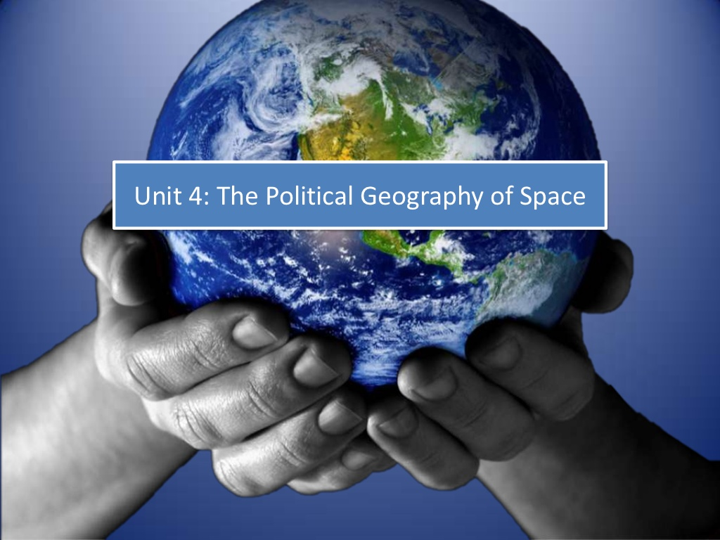

Slide 2
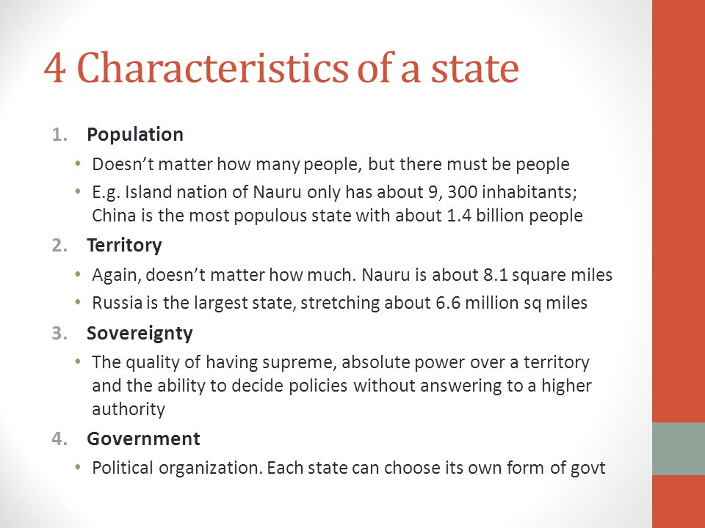
A State ;
Self-Determination - the power of a state to control ones own territory and destiny
When there is a group of people who constitute a nation but do not have autonomy - cannot govern themselves, create their own laws - they are a stateless nation

Slide 3
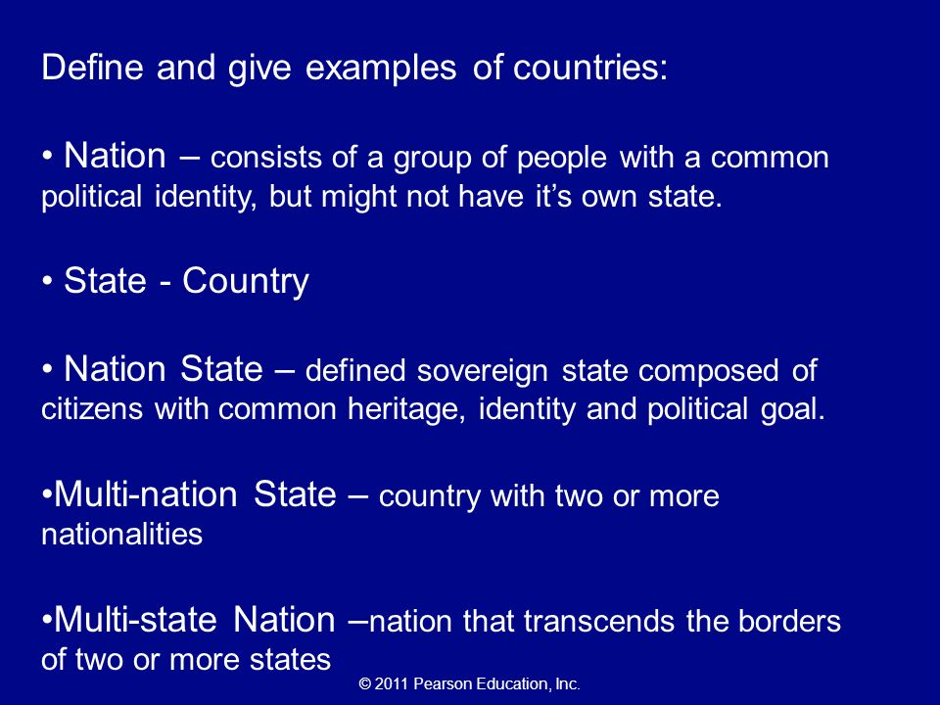

Slide 4
TERMINOLOGY – VARIATIONS ON A THEME
Concept | Description | Example
Multi-national state | A country that contains more than one nation; one nation is usually dominant | Canada French Province of Quebec Inuit in Province of Nunavut
Autonomous region | A defined area within a state that is somewhat independent. | Swedish people in the Åland Islands; Finland won’t let them become independent, but grants autonomy. Also: China does this.
Stateless nation | Special desire to establish their own state | Kurdistan – largest (spread over Turkey, Armenia, IRAQ, IRAN, Azerbaijan and Syria) Palestinians (Gaza Strip and West Bank) Basque (NE Spain and SW France)
Multistate nation | When a nation has a State of its own but stretches across borders of other states. | Hungarians living in Romania, Kurds (who live in multiple states The state of Korea is in North and South Korea, but also China and the US.

Slide 5
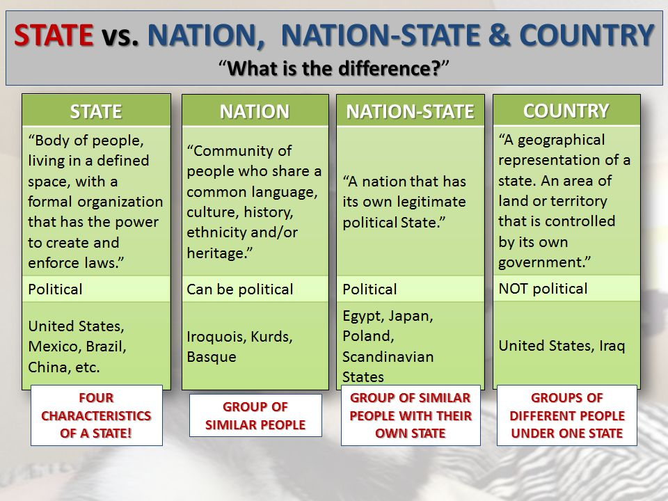

Slide 6
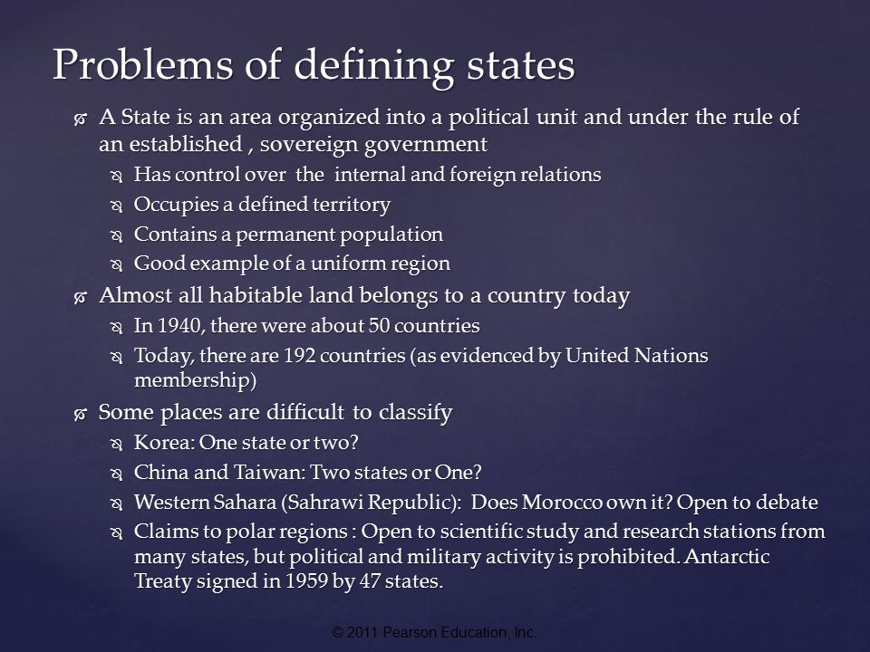

Slide 7
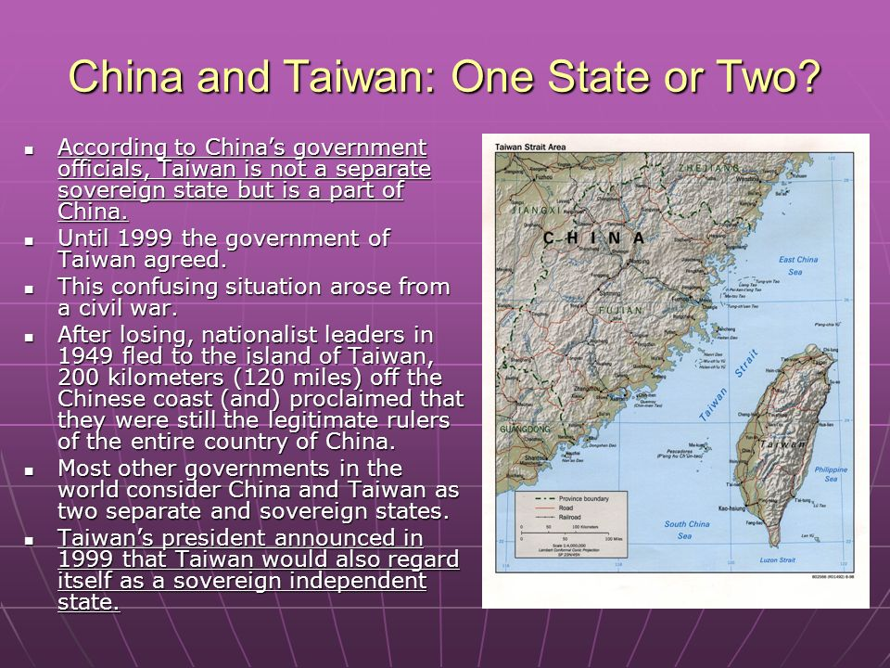
Disputed Territories

Slide 8
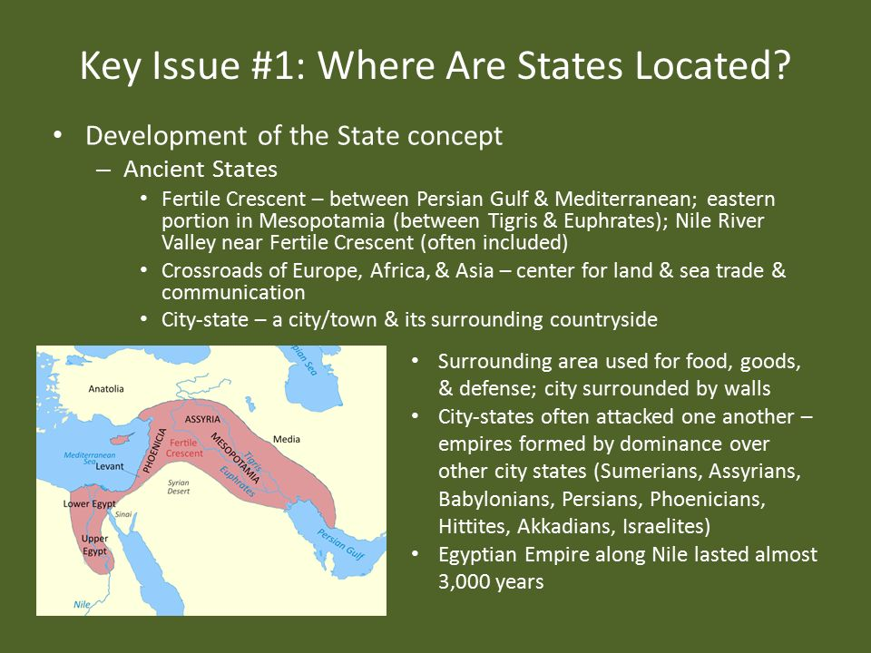

Slide 9
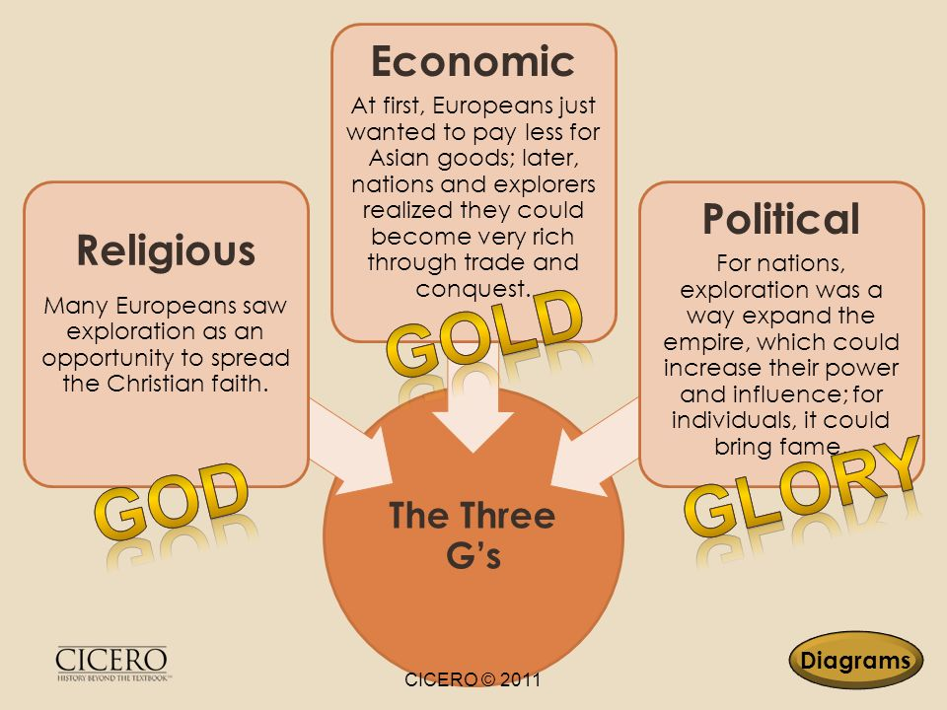
Colonialism
Colonialism: European states came to control much of the world through colonialism, which is the effort by one country to establish settlements and impose its political, economic and cultural principles on such territory.
Colony is a territory legally tied to a sovereign state
European states established colonies elsewhere in the world for three basic reasons
1. European missionaries established colonies to promote Christianity
2. Colonies provided resources that helped the economy of European states
3. European states considered the number of colonies to be an indicator of relative power

Slide 10
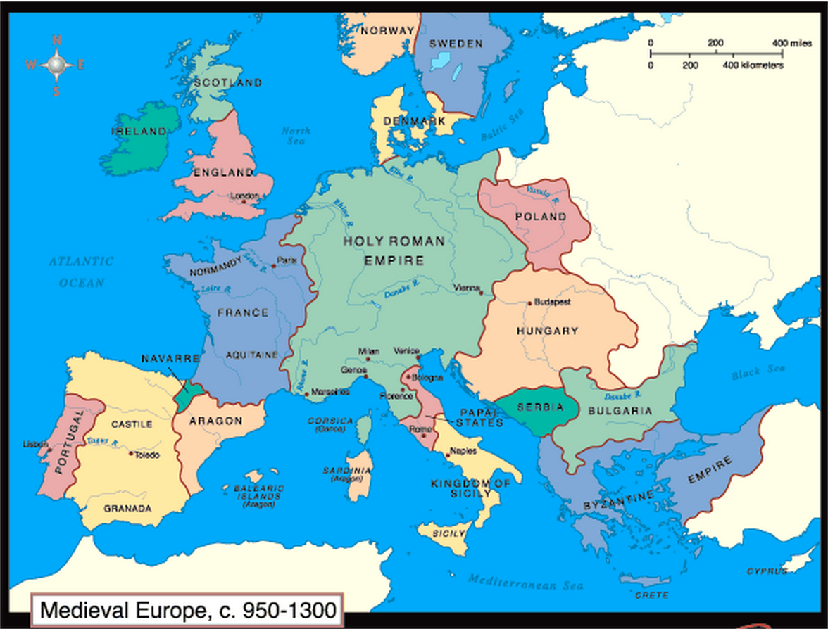
Medieval States
After the fall of the Roman Empire Europe fragmented into a large number of estates owned by competing monarchs, dukes, barons and other nobles, then into a handful of powerful monarchs and emperors emerged around 1100 CE. This consolidation neighboring states formed the basis for the development of modern European states

Slide 11
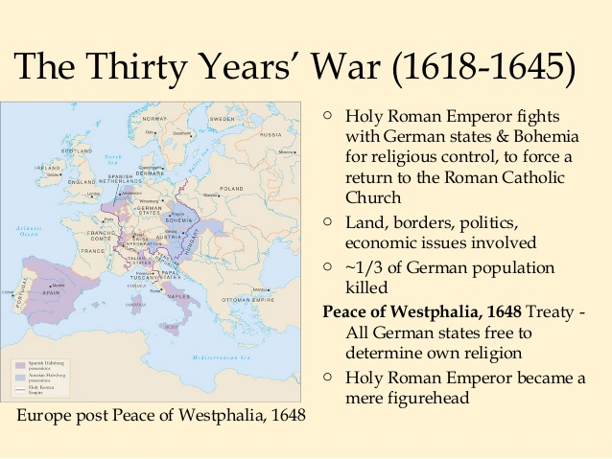
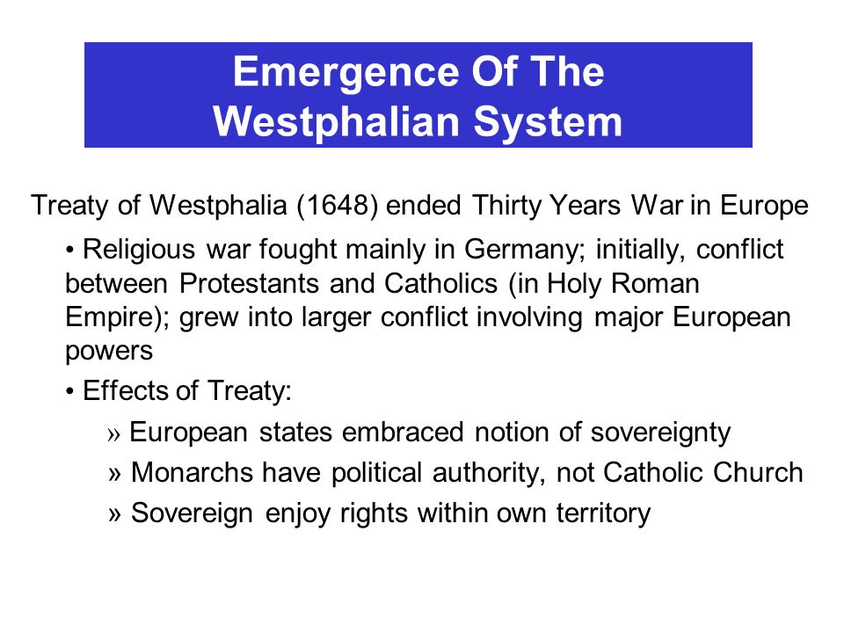
Thirty Years War A war waged in the early seventeenth century that involved France, Spain, Sweden, Denmark, Austria, and numerous states of Germany. The causes of the war were rooted in national rivalries and in conflict between Roman Catholics and Protestants.

Slide 12
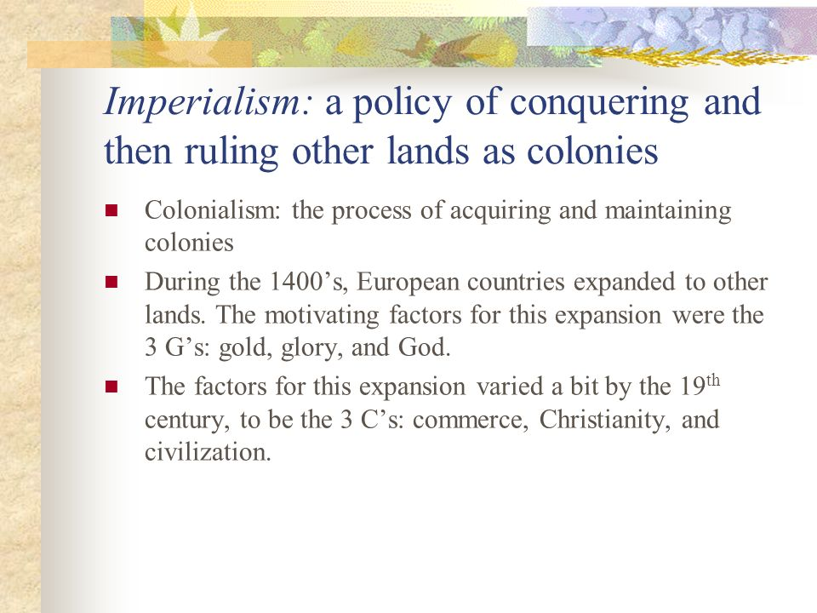
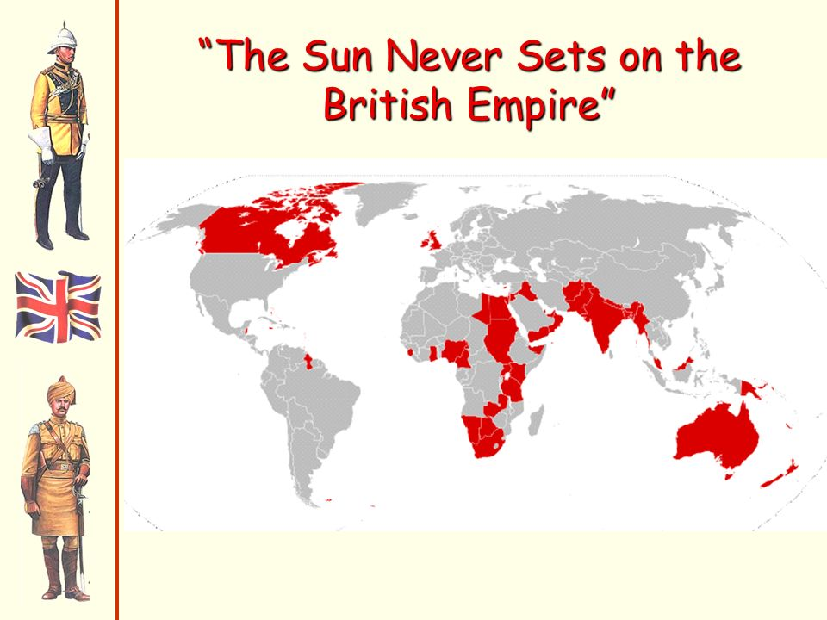

Slide 13
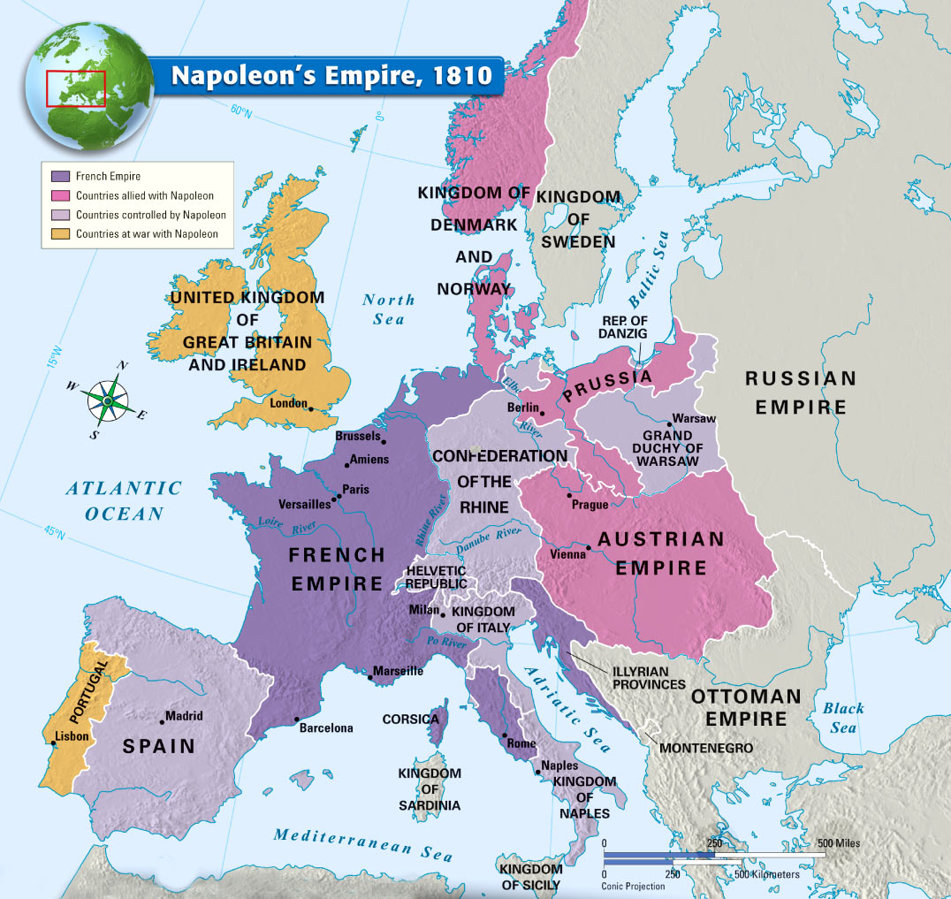
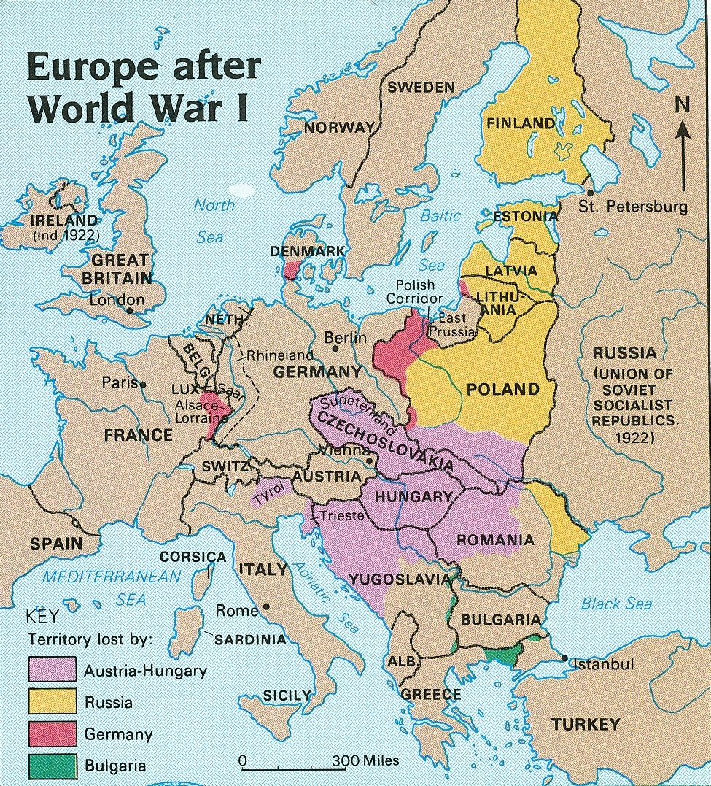
States in 20th Century Europe: Into the 20th century most of Europe was ruled b monarchs and emperors, After WWI leaders of the victorious countries met at the Versailles Peace Conference redrew the map of Europe. The goal was to divide Europe into a collection of nation states using language as the principal criterion for identifying ethnic groups. New states and boundaries were created and adjusted.

Slide 14
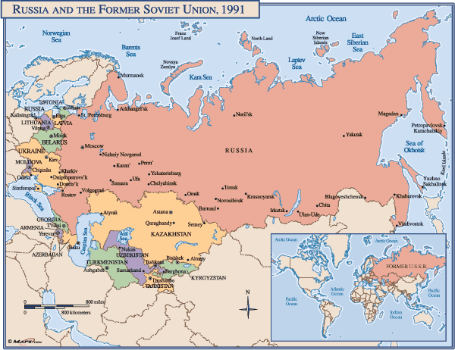
Russia: The largest Multiethnic State: During its existence (1922-1991) both in land area and as the world’s largest multinational state consisting of 15 republics
The breakup resulted in the conversion of the 15 republics into 15 independent states Grouped as:
Russia
Three Baltic states: Estonia, Latvia and Lithuania
Three European states: Belarus, Moldovia, and Ukraine
Five Central Asian States: Kazakhstan, Kyrgyzstan, Tajikistan, Turkmenistan, Uzbekistan
Three Caucasus states: Armenia, Azerbaijan, Georgia
Russia is now the world’s largest multinational state with 81% ethnic Russians and 39 other government officially recognized ethnic groups the remaining 19%. These ethnicities are clustered in 2 principal locations, along the former republics o Azerbaijan and Georgia and between the Volga River and Ural Mountains. Russia has granted autonomy over local government affairs to numerous ethnicities, independence movements are flourishing among several groups

Slide 15
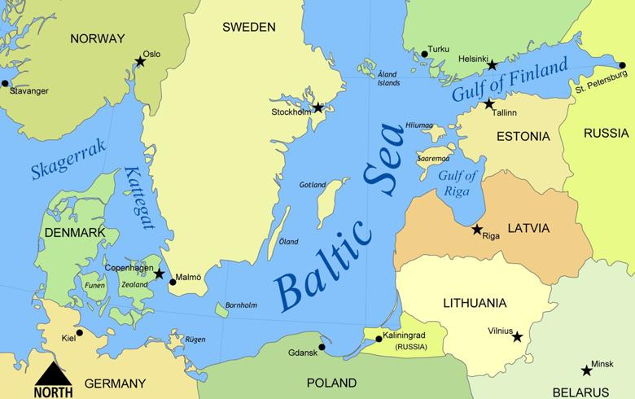
Baltic States of former USSR
Estonia, Latvia and Lithuania are known as the Baltic States for their location on the Baltic Sea. They were independent counties between the end of World War I in 1918 and 1940. when the former USSR annexed them under an agreement with Nazi Germany.
These small neighboring Baltic countries have clear cultural differences and distinct historical traditions.
Most Lithuanians are Roman Catholic and speak a language of the Baltic group as a branch of Indo European language family
Latvians are predominately Lutheran with a substantial Roman Catholic minority
Most Estonians are Protestant (Lutheran) and speak a Uralic language related to Finnish

Slide 16
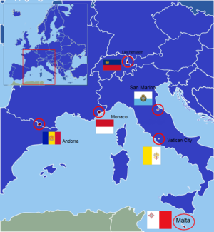
Microstates
A Microstate is a state or territory that is small in both size and population.
Vatican City. Size: 0.17 sq. mi. ( 0.44 km²) Population: 783 (2005 census) ...
Monaco. Size: 0.8 sq. mi. ( 1.96 km²) Population: 35,657 (2006 estimate) ...
Nauru. Size: 8 sq. mi (21 km²) Population: 13,005 (2005 estimate) Location: Western Pacific Ocean. ...
Tuvalu. Size: 9 sq. mi. ( 26 km²) ...
San Marino. Size: 24 sq. mi. ( 61 km²)

Slide 17
Boundary Disputes
Positional or definitional disputes occur when states argue about where the boarder actually is. The United States and Mexico feuded for years over their mutual border even after it was officially set by treaty in 1848. The boundary between Argentina and Chile has been controversial because it follows the crests of the Andes Mountains and the watershed, which do not always coincide,
Territorial Disputes/Locational: arise over the ownership of a region, usually around mutual borders. Conflicts arise if the people of one state want to annex a territory whose population is ethnically related to them. War between Mexico and the United States broke out in areas (such as Teas and California) where many US citizens had settled and yet the Mexican government controlled the land space. This type of expansionism is called irredentism (a movement to unite by people who share a language or other cultural elements but are divided by a national boundary) . A 20th century example is the German invasion of Czechoslovakia and Poland, areas with German minorities
Resource (or allocational) disputes involve disputes involve natural resources – such as mineral deposits, fertile farmland, or rich fishing groups – that lie in border areas, For example, the United States and Canada have feuded over fishing grounds in the Atlantic Ocean. The spark for the Persian Gulf War of 1990-91 was a dispute between Iraq and Kuwait regarding rights to oil
Functional (or Operational) disputes arise when neighboring states cannot agree or policies that apply in border area, An example is the ongoing debate between the US and Mexico regarding the transport of people and goods across their long mutual border. The US has generally wanted stricter controls put on immigration from Mexico, and also has pressured the Mexican government to control drug trafficking across the border

Slide 18
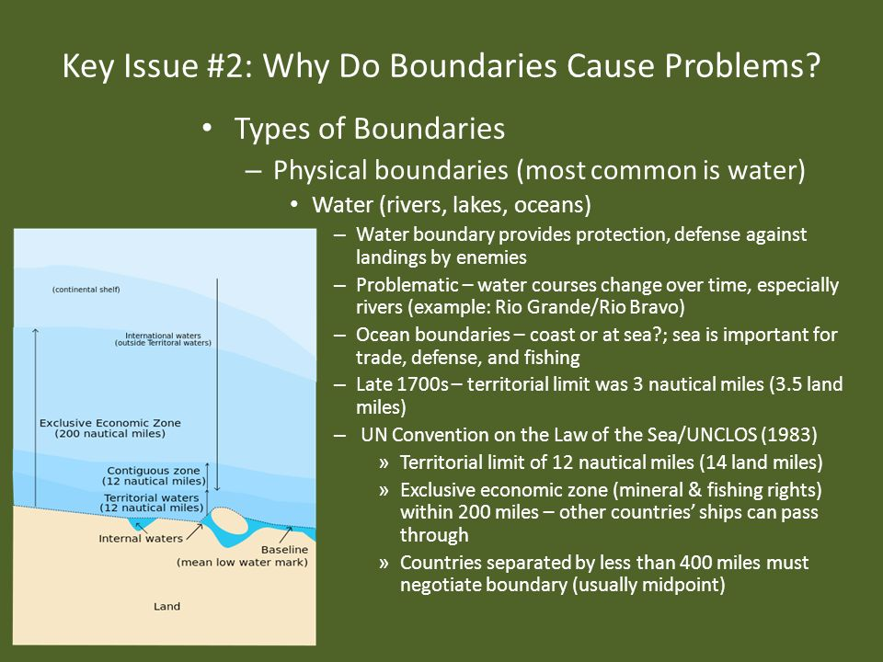
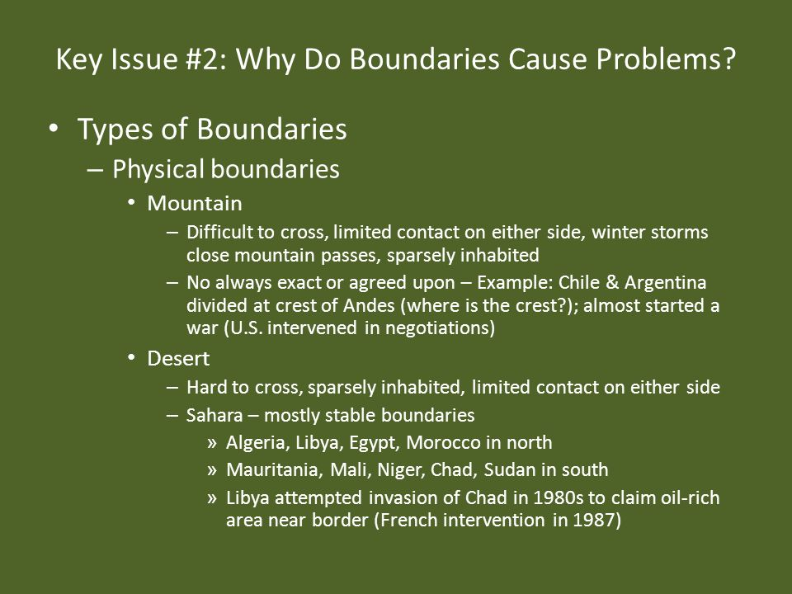

Slide 19
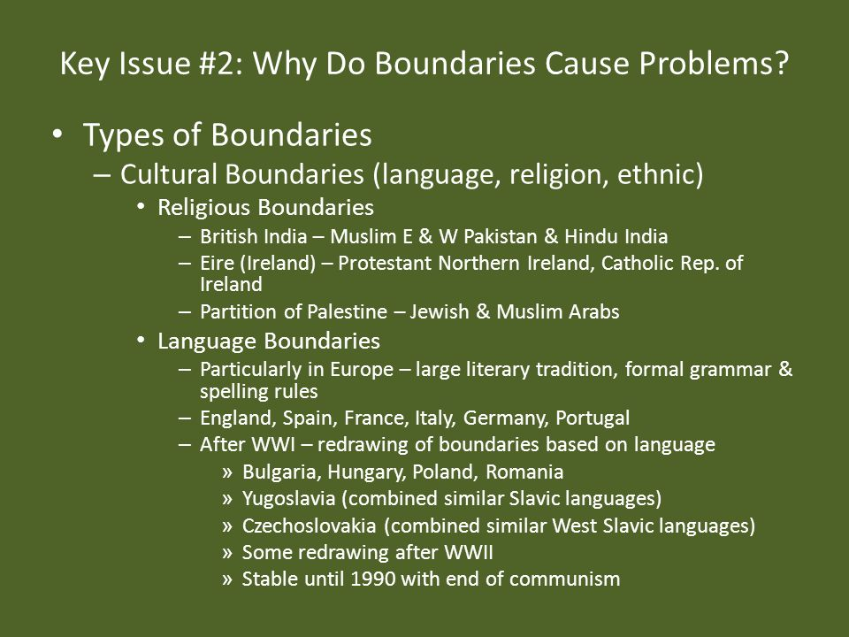
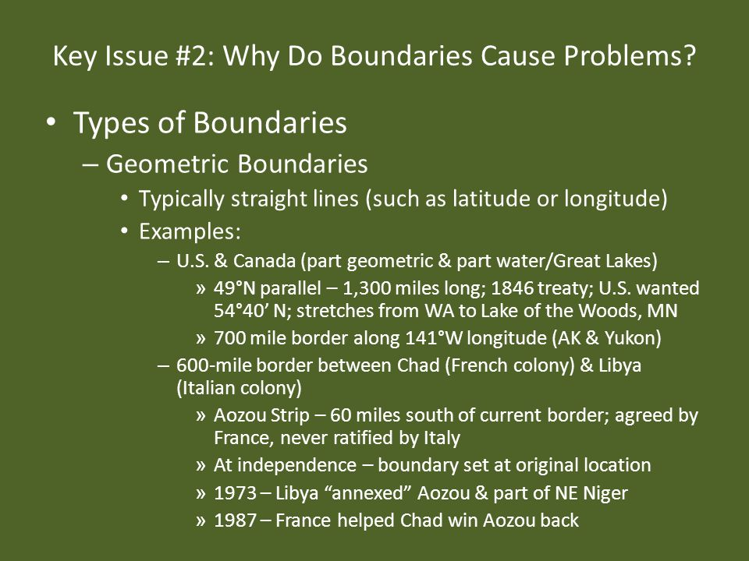

Slide 20
Geometric Boundaries

Slide 21
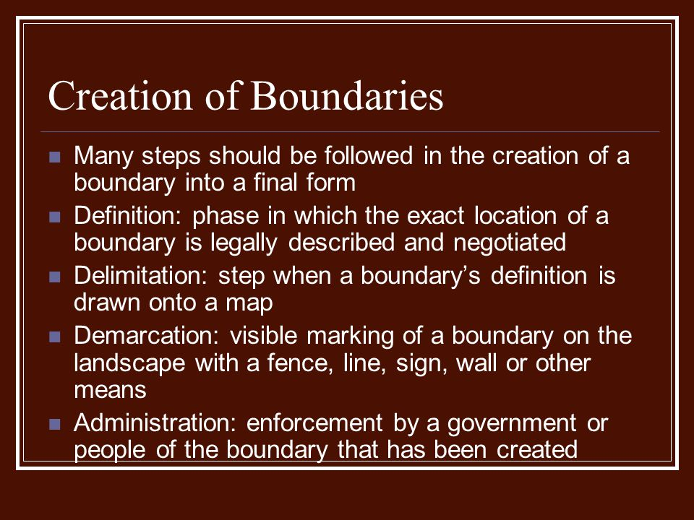
Creation of Boundaries
A defined boundary – legally documented.
Treaty
Homeowners property line.
A delimited boundary:
a line on a map.
A demarcated boundary:
physical objects placed on a landscape

Slide 22
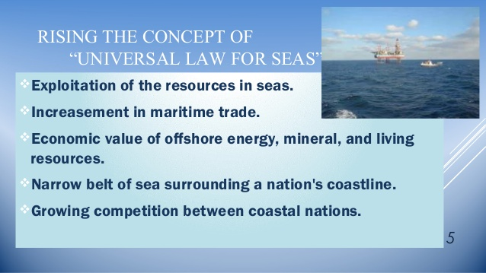
The Law of the Sea
Much of this law is codified in the United Nations Convention on the Law of the Sea, signed Dec. 10, 1982 by 165 countries. The convention, described as a “constitution for the oceans,” represents an attempt to codify international law regarding territorial waters, sea-lanes, and ocean resources.
The law of the sea is a body of customs, treaties, and international agreements by which governments maintain order, productivity, and peaceful relations on the sea. ... The United Nations (UN) held its first Conference on the Law of the Sea (UNCLOS I) in 1956, which resulted in a 1958 Convention
Three types of water boundaries
Territorial Waters: Up to 12 nautical miles from shore (about 14 land miles) a state may set laws regulating passage by ships registered in other states
Contiguous Zone: Between 12 and 24 nautical miles from shore, a state may enforce laws concerning pollution, taxation, customs and immigration
Exclusive Economic Zone: Between 24 and 200 nautical miles, a state has the sole righto the fish and other marine life
Disputes can be taken to the tribunal for the Law of the Sea or to the International Court
  Maritime Boundaries dictate the ownership of oceans and waterways off the coasts
  The UN created the Law of the Sea (UNCLOS)
Each country has the right 12-nautical miles of territorial sea off the coast - no other countries can enter this zone without permission
Countries also have 200-nautical miles of Exclusive Economic Zone (EEZ) - the country will have the right to profit from this area (fishing, drilling, etc.) but other countries can use the water to travel
Anything beyond the 200 miles is part of the high seas - this water does not belong to any one country and is not held to the laws of any one country, but rather is subject to international admiralty law
If the distance between two countries is less than 24 miles this creates a choke point - the countries will establish median lines halfway between both countries waterways

Slide 23
Boundaries Inside States
Federalism: allocates strong power to units of local government within the country
common in Multinational states
Ex. Unites States, Russia, Canada, Brazil, India
Confederal: relating to or denoting a confederation.
Confederalism represents a main form of inter-governmentalism, this being defined as 'any form of interaction between states which takes place on the basis of sovereign independence. The nature of the relationship among the member states constituting a confederation varies considerably.
Unitary System: places most power in the hands of central government officials
Few internal cultural differences
Strong sense of national unity
Small states
Common in European countries

Slide 24
Impacts of a Unitary State
Positive Impacts:
Standardization of laws and their implementation across the country
Patriotism or pride in one’s country is bolstered due to uniformity
Efficiencies are achieved through less duplication or faster countrywide implementation of laws or governmental services across multiped scales
Fewer government or taxation agencies, or fewer scales of government or taxation
The potential for corruption of local government reduced
Creation of a national identity that reduces the potential for devolutionary process
Negative Impacts
Centralization of power can lead to a disconnect with local areas, minority groups, regional political parties or disparate regions
Marginalization of local cultures through standardization of a country level
Central government may not effectively provide services on a subnational scale
Decisions and politics of the central government could become dominated by interests of the politically or culturally dominate group
Central government bogged down by competing local problems OR slow response to local issues (natural disasters, infrastructure public services

Slide 25
Federal and Unitary States:
Trait | Federal | Unitary
Authority of the Government | Shared between the central government and provincial, state, and local governments | Held primary by the central government with very little power given to local governments
Hierarchy of Power | Multiple levels of power; power diffused throughout the hierarchy | No Hierarchy of sovereign powers
Type of Country Where Commonly Used | Multiple ethnic groups with significant minorities | Fewer cultural differences and small minorities

Slide 26
Classifications of Boundaries
Type | Definitions | Examples
Antecedent | A boundary drawn before a large population was present | The boundary between the United States and Canada along the 49th parallel
Subsequent (Ethnographic) | A boundary drawn to accommodate religious, ethnic, linguistic, or economic differences | The boundary between Northern Ireland (part of the United Kingdom) and the Republic of Ireland
Relic | A boundary that no longer exists, but evidence of it still exists on the landscape | The boundary between east and West Germany (states that are now combined)
Superimposed | A boundary drawn by outside powers | The boundary between Mali and Mauritania (very common throughout Africa and Southwest Asia)
Militarized | A boundary that is heavily guarded and discourages crossing movement | The boundary between North Korea and South Korea
Open | A boundary where crossing is unimpeded | The boundaries between countries in Europe that signed the Schengen Agreement

Slide 27
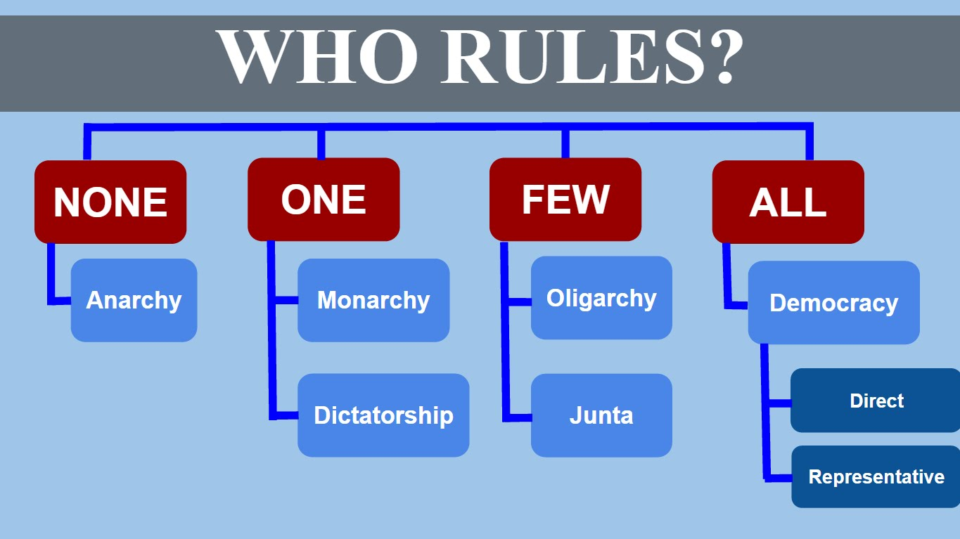
Regime Types Affect Government Effectiveness
Governments based on democratic principles have been more capable of advancing goals of security, peace, and economic prosperity
Democracy: a state in which citizens elect leaders and can run for office
Autocracy: state run according to the interests of a ruler rather than its people
Anocracy: state that is not fully democratic or autocratic, but displays a mix of the two types (Cambodia, Russia, Ukraine, Yugoslavia )
Oligarchy: rule by a few, EX: the rich. Junta: military

Slide 28
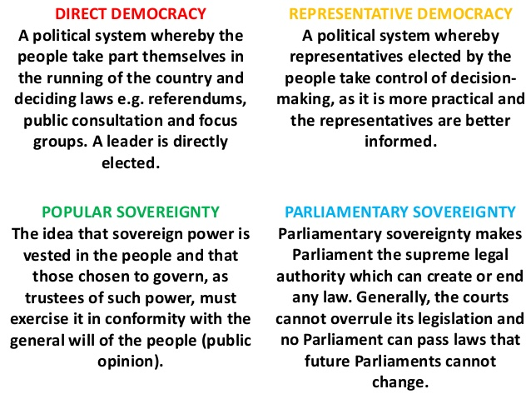

Slide 29
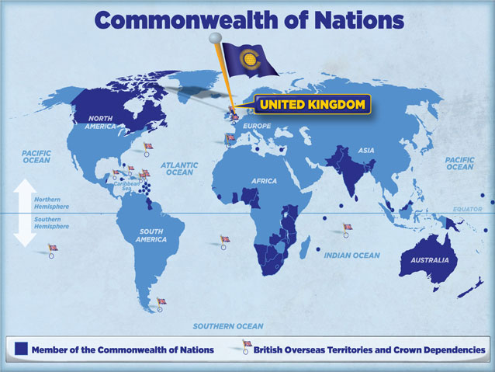
Commonwealth of Nations
The Commonwealth of Nations of 52 sovereign states. Nearly all of them are former British colonies or dependencies of those colonies.
The purpose of the voluntary Commonwealth is for international cooperation and to advance economics, social development, and human rights in member countries. Decisions of the various Commonwealth councils are non-binding
No one government in the Commonwealth exercises power over the others, as is the case in a political union Rather, the Commonwealth is an international organization in which countries with diverse social, political, and economic backgrounds are regarded as equal in status, and cooperate within a framework of common values and goals, Such common values and goals include the promotion of democracy, human rights, good governance, the rule of law, individual liberty, egalitarianism, free trade, multilateralism, and world peace, which are promoted through multilateral projects and meetings, such as the Commonwealth Games, held once every four years.
The symbol of this free association is Queen Elizabeth II, who serves as the Head of the Commonwealth. This position, however, does not imbue her with any political or executive power over any Commonwealth member states; the position is purely symbolic

Slide 30
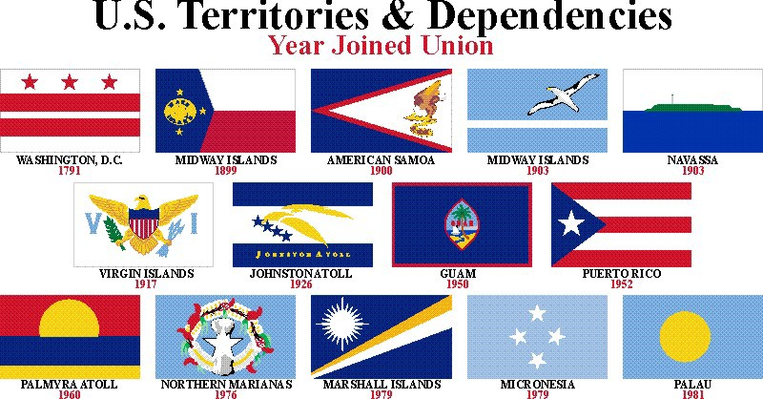
US Territories

Slide 31
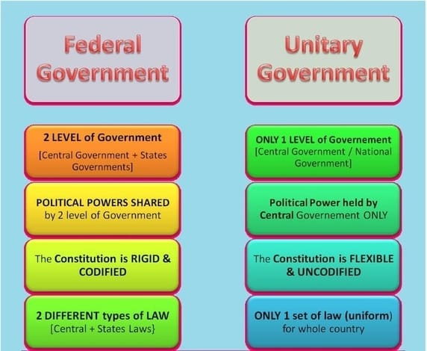
: How is Power Distributed: https://www.youtube.com/watch?v=md2ZHlyYOsc

Slide 32
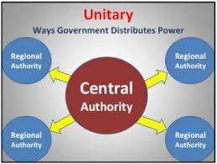
Boundaries Inside States
Unitary System: places most power in the hands of central government officials
Few internal cultural differences
Strong sense of national unity
Small states
Common in European countries
Examples are France, Kenya, Rwanda
N Korea 31 min: https://www.youtube.com/watch?v=IrCQh1usdzE

Slide 33
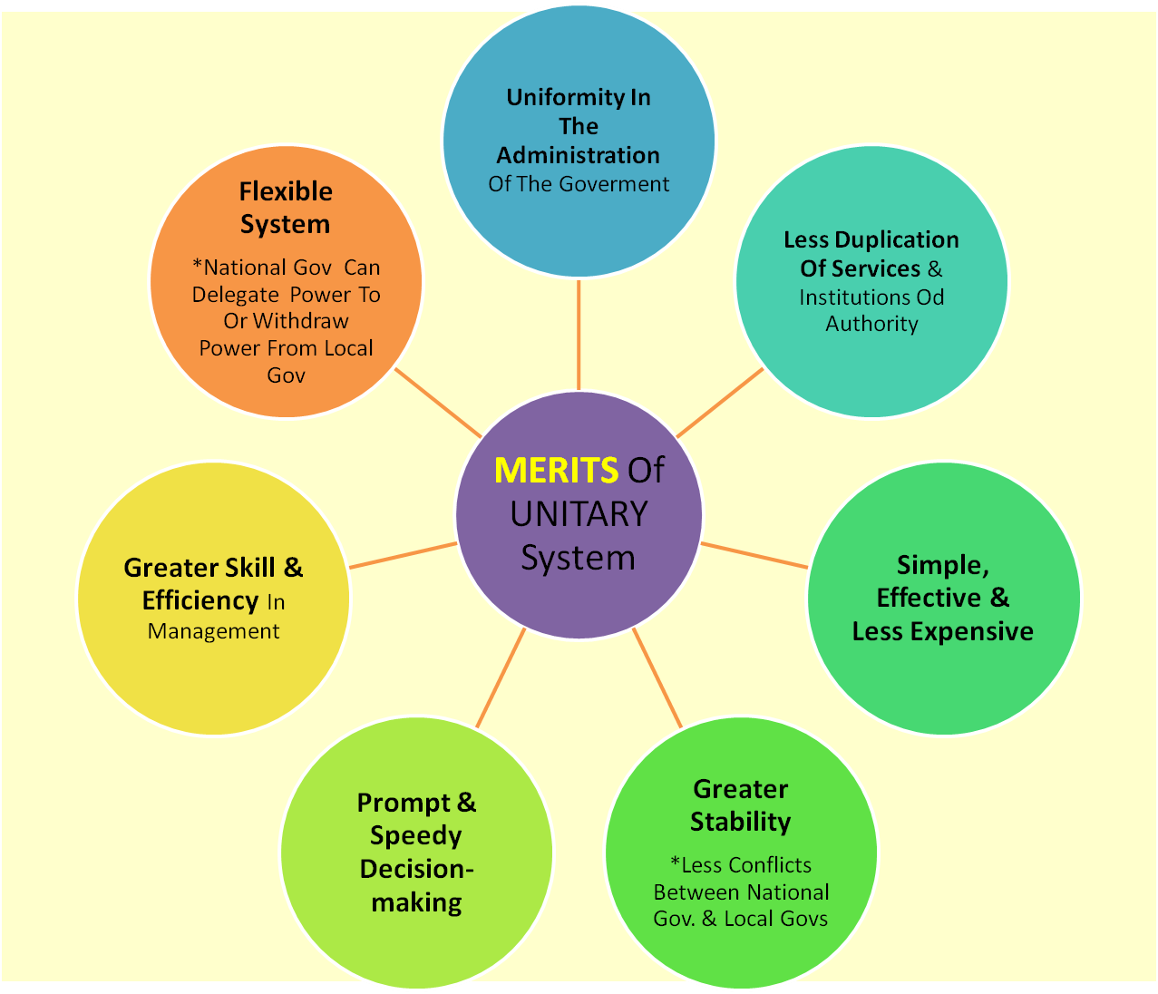
Merits of a Unitary State

Slide 34
Impacts of a Unitary State
Positive Impacts:
Standardization of laws and their implementation across the country
Patriotism or pride in one’s country is bolstered due to uniformity
Efficiencies are achieved through less duplication or faster countrywide implementation of laws or governmental services across multiped scales
Fewer government or taxation agencies, or fewer scales of government or taxation
The potential for corruption of local government reduced
Creation of a national identity that reduces the potential for devolutionary process
Negative Impacts
Centralization of power can lead to a disconnect with local areas, minority groups, regional political parties or disparate regions
Marginalization of local cultures through standardization of a country level
Central government may not effectively provide services on a subnational scale
Decisions and politics of the central government could become dominated by interests of the politically or culturally dominate group
Central government bogged down by competing local problems OR slow response to local issues (natural disasters, infrastructure public services

Slide 35
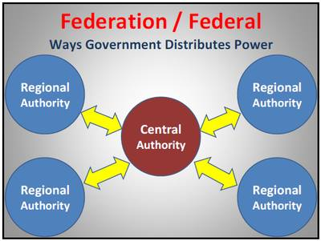
Boundaries inside a state
Federalism: allocates strong power to units of local government within the country
common in Multinational states
Ex. Unites States, Russia, Canada, Brazil, India
Registering a vehicle varies from state to state just as some laws do like death penalty
Catalonia's independence movement, explained https://www.youtube.com/watch?v=__mZkioPp3E

Slide 36
Why some countries are governed as federal states
Identify
Multiple nationalities, ethnicities or cultures
To address devolutionary forces arising from physical, economic or political differences
Larger countries, or territorial control over large or fragmented area
Explain
Diverse states (politically, economically, regionally, culturally) devolve power in order to reduce separatist tendencies or to enhance loyalty to the country
Federal governments are able to maintain national cohesion by bridging physical or cultural barriers or providing means for resolving conflicts between subnational areas
Large countries devolve power to subnational units to more effectively provide governmental services or address local issues
As distance increases from a national capital, people tend to feel better service by decision makers who are closer to home

Slide 37
Federal and Unitary States:
Trait | Federal | Unitary
Authority of the Government | Shared between the central government and provincial, state, and local governments | Held primary by the central government with very little power given to local governments
Hierarchy of Power | Multiple levels of power; power diffused throughout the hierarchy | No Hierarchy of sovereign powers
Type of Country Where Commonly Used | Multiple ethnic groups with significant minorities | Fewer cultural differences and small minorities

Slide 38
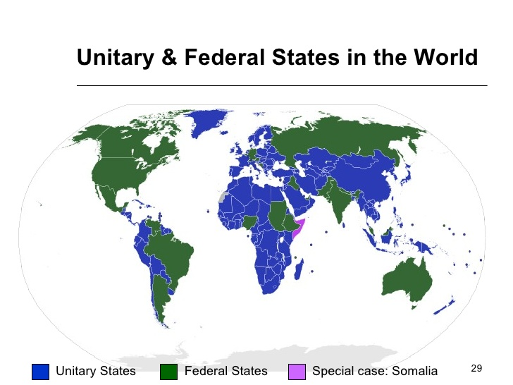
Unitary and Federal States in the World

Slide 39
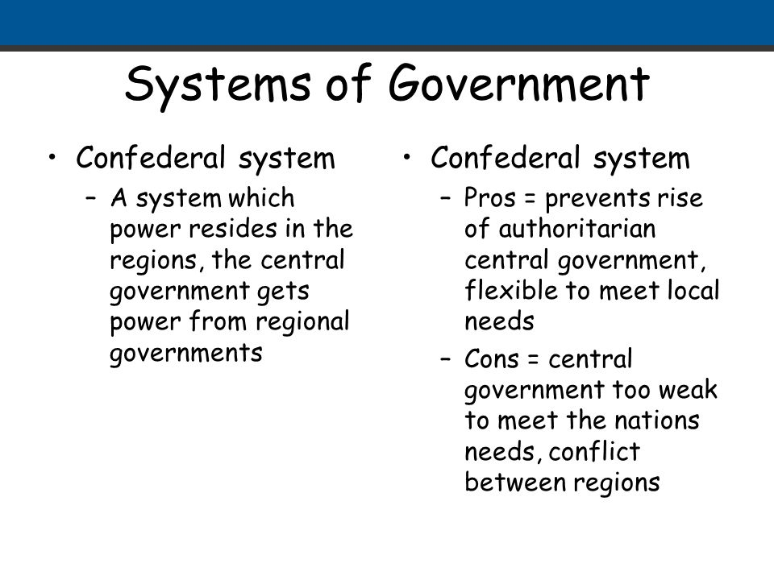
Confederal system
Confederal system spreads power among many sub-units (such as states) and has a weak central government. Most attempts at confederal systems have not been long lasting, although the modern government of Switzerland has very strong sub governments and comes as close to a modern confederation as exists. Examples of failed confederations are the United States Government under the Articles of Confederation (1781-1789) and the Confederate States of America that consisted of the southern states of the United States during the Civil War

Slide 40
How the US elects its executive
The Electoral College (USA) : each state is allotted a number of votes in a Presidential election based on their population
Representation in the House of Representatives is also based on population
# of representatives in the House + 2 Senators = # of Electoral votes your state has
Louisiana has 8, Michigan has 16, California has 55
Which state has the most power?
NPR what is gerrymandering 2 min: https://www.youtube.com/watch?v=ADEflXCXouU
Electoral Geography
In the US, to ensure that districts have close to the same members of people, the Constitution requires the federal government to take a CENSUS every 10 years to determine each state’s number of representatives through reapportionment or changing the numbers of representatives granted to each state so it reflects the state’s population.
State legislatures then redraw district boundaries so that each district contains roughly the same number of people, this is known as redistricting.
In theory, districts are drawn so that each citizen’s vote is equally influential in determining the outcome of legislative and presidential elections…
In practice, because the political party in power redraws districts, they are drawn in a way that makes that party more likely to be re-elected. This process is called gerrymandering.
Gerrymandering: manipulating districts to empower or discriminate against groups of people
Districts are supposed to meet the following criteria:
compactness
Contiguity
equal population
preservation of existing political communities
partisan fairness
racial fairness

Slide 41
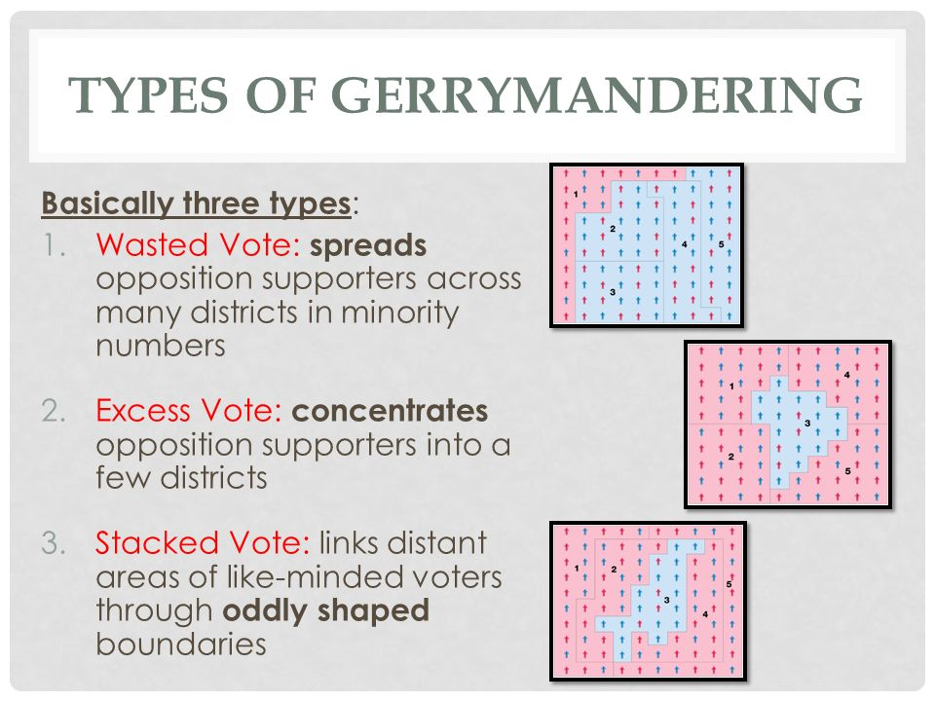
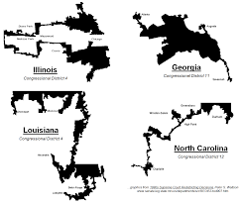

Slide 42
Types of Gerrymandering
Cracking | Dispersing a group into several districts to prevent a majority
Packing | Combing like-minded voters into one district to prevent them from affecting elections in other districts
Stacking | Diluting a minority populated district with majority populations
Hijacking | Redrawing two districts in order to force two elected representatives of the same party to run against each other
Kidnapping | Moving an area where an elected representative has supported to an area where he or she does not have support

Slide 43
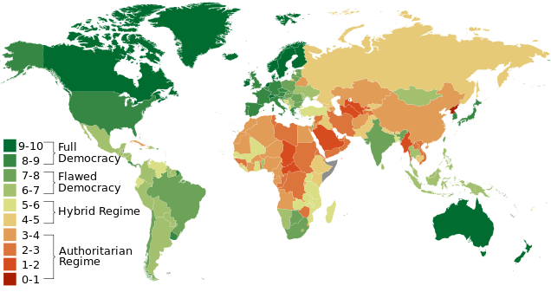
The world has been becoming more democratic
3 reasons why
replacement of out of touch monarchies with more responsive elective groups that broaden individual rights and liberties
widening participation to all citizens through rights to vote and to serve in government
diffusion of democratic governing structures created in Europe and North America to other regions
Examples: Yemen, Egypt, Tunisia, Libya

Slide 44
Network: a set of interconnected entities, sometimes called nodes, without a center or a hierarchy. (Ex. An athletic conference. The world is full of networks in Transportation, communication, trade, social media, beliefs, and values and politics.
Globalization is the integration of markets, states, communication and trade on a worldwide scale. While these forces have brought people and systems closer they have also put a strain on the sovereignty of states. This in turn has led to a race in the creation of special alliances, Globalization has created the necessity for alliances for collective benefits on a global scale. In addition, economic networks between consumers and producers have changed dramatically as a result of Globalization.
Globalization Challenges State Sovereignty. Political borders have become less significant as ideas flow more rapidly among most countries, trade in goods is freer than in the past and even people can travel easily in areas such as Europe. The state
Supranationalism: occurs when multiple countries form an organization to collectively achieve greater benefits for all members. Sometimes, countries sacrifice a degree of sovereignty by accepting the regulations of decisions of the supranationalism organization. These organizations are often formed to create a military alliance, promote trade or combat an environmental problem.
Among the first modern supranational organizations was the League of Nations, founded after WWI.

Slide 45
Economics
Seeking mutually beneficial trade agreements has fostered economic growth for members of states of such economic supranational
The rise of Transnational corporations, companies that conduct business on a global scale has dramatically weakened state sovereignty. In contrast to corporations based in a single country, transnationals have not strong connection to any one place. As a result they can move jobs from one country to another in order to take advantage of lower wages, lower taxes, or weaker laws on worker safety and environmental protection.

Slide 46
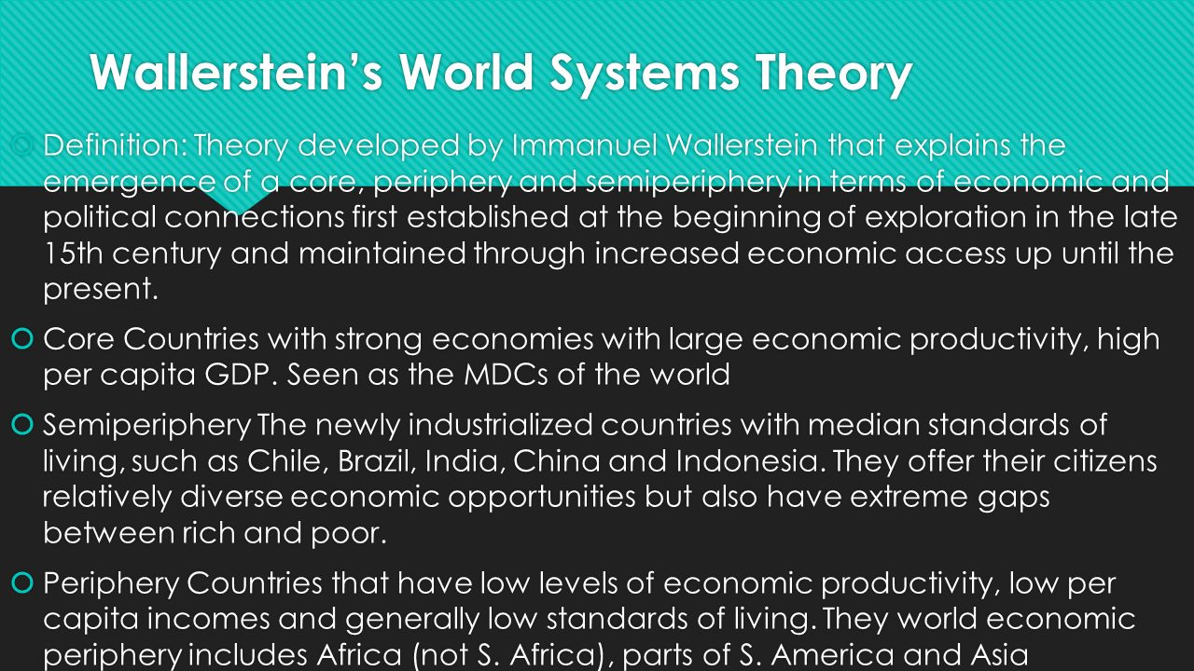
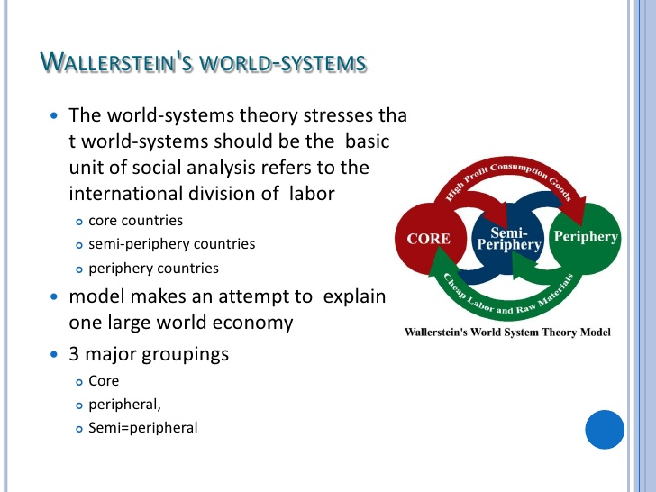

Slide 47
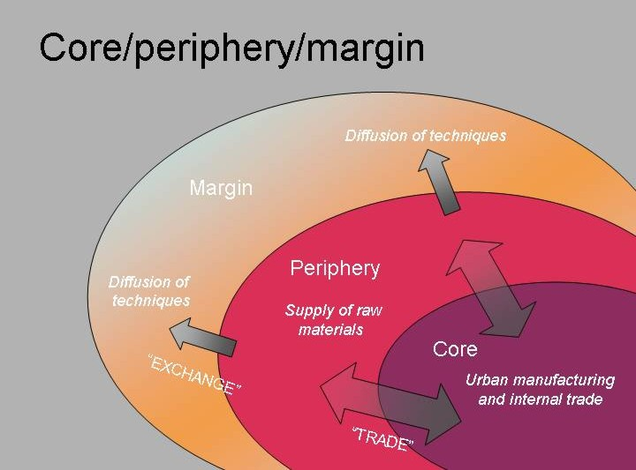
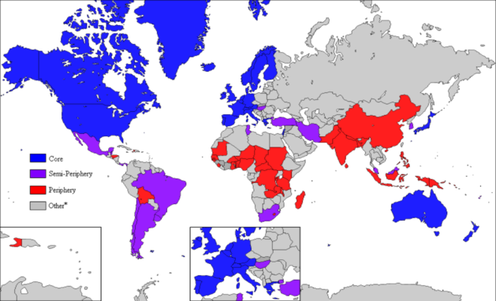

Slide 48
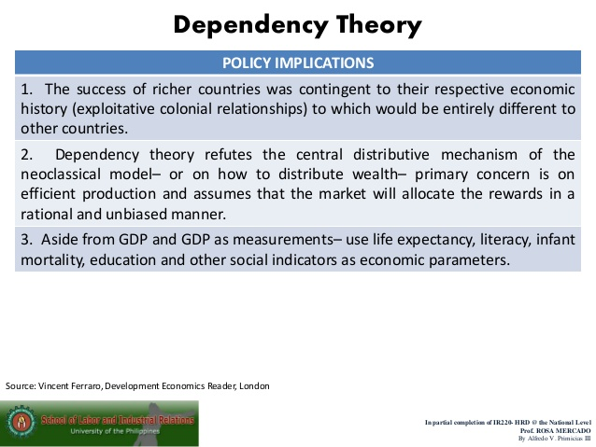
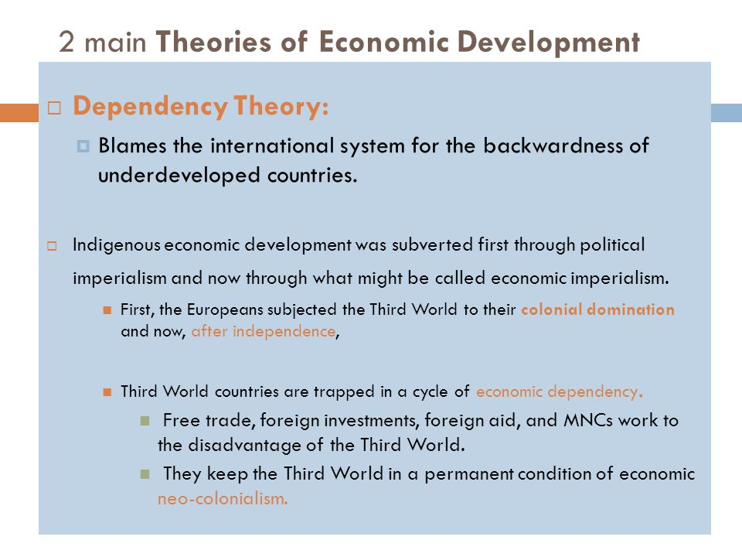

Slide 49
Globalization
Network: a set of interconnected entities, sometimes called nodes, without a center or a hierarchy. (Ex. An athletic conference. The world is full of networks in Transportation, communication, trade, social media, beliefs, and values and politics.
Globalization is the integration of markets, states, communication and trade on a worldwide scale. While these forces have brought people and systems closer they have also put a strain on the sovereignty of states. This in turn has led to a race in the creation of special alliances, Globalization has created the necessity for alliances for collective benefits on a global scale. In addition, economic networks between consumers and producers have changed dramatically as a result of Globalization.
Globalization Challenges State Sovereignty. Political borders have become less significant as ideas flow more rapidly among most countries, trade in goods is freer than in the past and even people can travel easily in areas such as Europe. The state
Supranationalism: occurs when multiple countries form an organization to collectively achieve greater benefits for all members. Sometimes, countries sacrifice a degree of sovereignty by accepting the regulations of decisions of the supranationalism organization. These organizations are often formed to create a military alliance, promote trade or combat an environmental problem.
Among the first modern supranational organizations was the League of Nations, founded after WWI.

Slide 50
Supranationalism: 3 or more states joining together for a common purpose
Purposes Include: More joint power, Economical advancement, Travel and Trade, Regulations
Advantages: Share Resources, Gain more land area, More opportunity, Travel becomes easier, Consistent policies on pollution, travel, laws and etc.
Disadvantages: Sharing resources can lead to conflict, Sovereignty is compromised, Communication barriers, Cultural conflict, Could cost more than what is gained

Slide 51
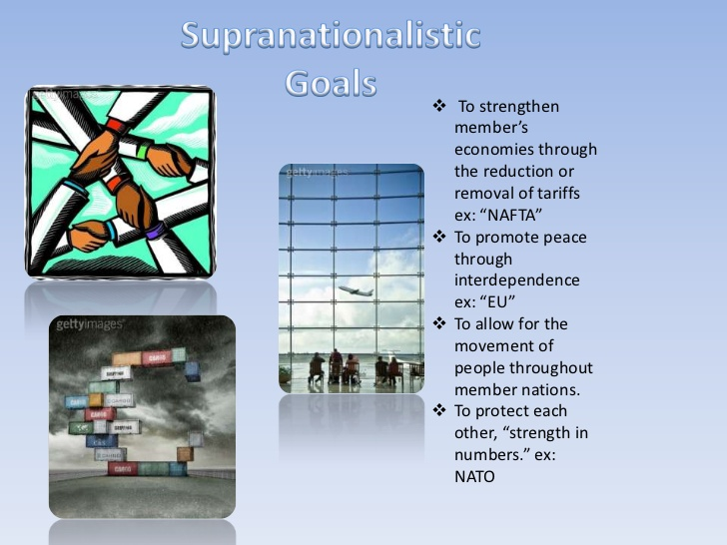
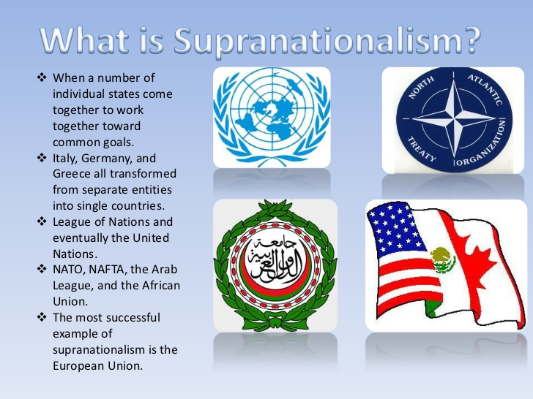
Cooperation between States: Supranationalism- when a state gives up political autonomy to a higher authority in order to accomplish a common objective ex: United Nations, European Union, Arab League, NATO. States cooperate in two different ways: 1. Political and Military Cooperation 2. Economic Cooperation

Slide 52
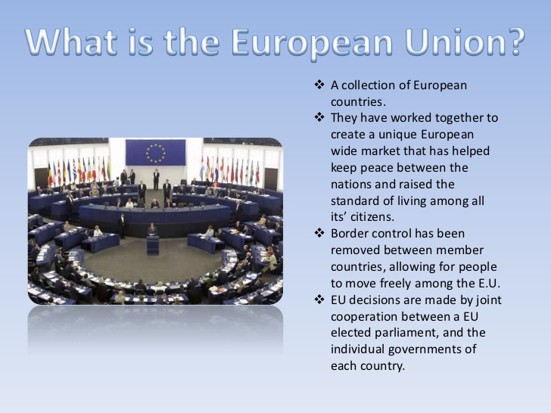
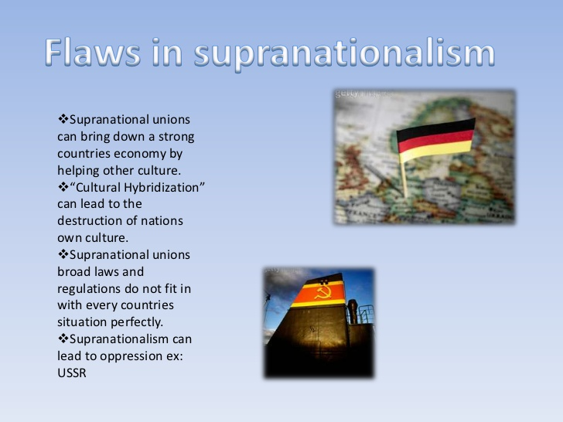

Slide 53
Supranational Organizations
Organization | Members | Mission | Headquarters
United Nations (UN) 1945 | 193 countries | Taking on issues facing humanity such as peace and security | New York City United States
North Atlantic Treaty Organization (NATO) 1949 | United Sates, Canada, Iceland, Western and Central Europe, and Turkey | The mutual defense of member states | Brussels, Belgium
European Union (EU) 1993 | 28 members mostly in Western and Central Europe | The political and economic integration of member states | Brussels, Belgium
North American Free Trade Agreement (NAFTA) 1994) | United States, Canada and Mexico | Free grade among members | Washington D.C. and Mexico City

Slide 54
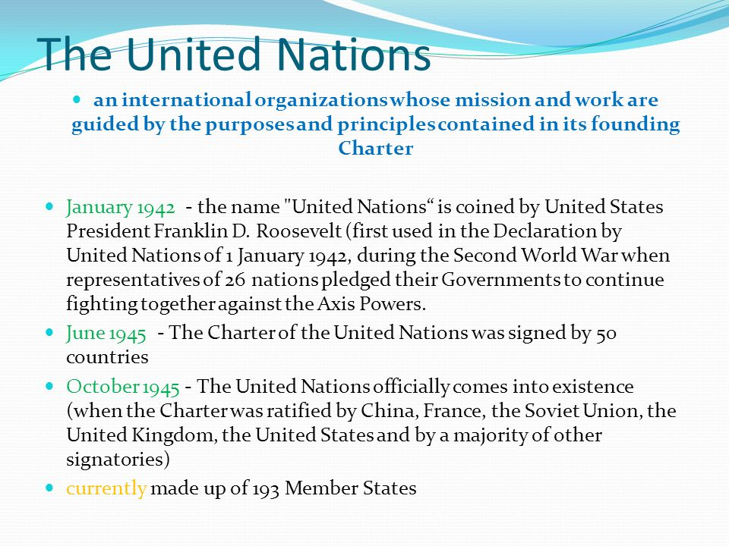
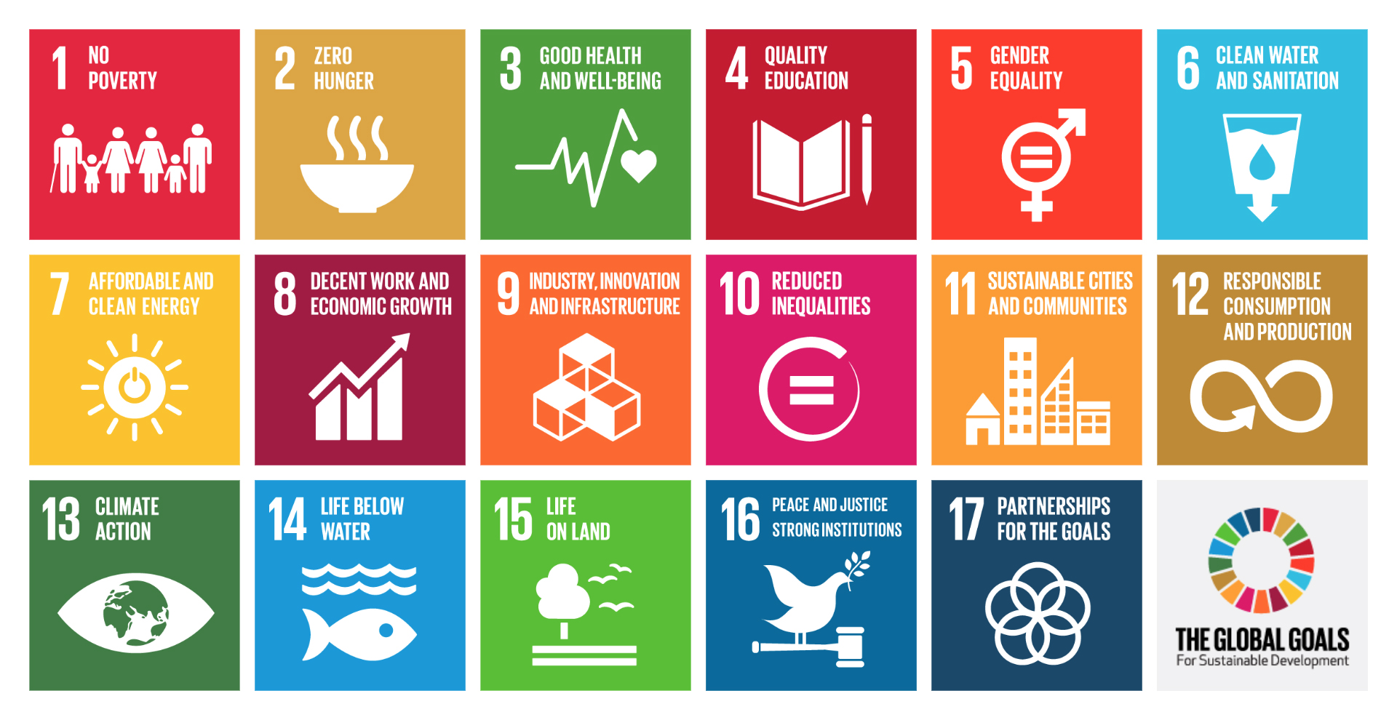

Slide 55
Regional Organizations
Regional Organizations
OSCE - Organization on Security and Cooperation in Europe hemisphere is the world’s largest security oriented intergovernmental organization. Its mandates include issues such as arms control, promotion of human rights, freedom of the press and fair elections. 57 countries are members including the US and Canada
OAS - Organization of American States- every state in the western hemisphere is the premier regional forum for political discussion, policy analysis and decision-making in Western Hemisphere affairs.
OAU – Organization off African Union promotes African states working together to improve their economies, overcome colonial rule and to rid Africa of minority white governments
Economic Alliances - OPEC
  The Organization of Petroleum Exporting Countries is an intergovernmental organization There are 12 member countries and together they control over 40% of the world's oil supply - this allows the group to set prices internationally
Commonwealth - United Kingdom and 52 other states that were former British colonies
EU: CNN http://money.cnn.com/video/news/2016/02/17/european-union-explained.cnnmoney/index.html
Brexit: https://www.youtube.com/watch?v=czWhVBmrNPQ
The Commonwealth Realm: Explained: https://www.youtube.com/watch?v=rkypkxYQs5A

Slide 56
Economic Cooperation / World power today:
Economic Cooperation / World power today:
Economy is more important today in determining world powers (China, Germany Japan all have Strong Economies)
Leading superpower is not a single state but an economic union of European states aka. The European Union
Economic Alliances – European Union
  Since the last world war international power has shifted from solely military powers to include economic power as well
The European Union (EU) promotes development through economic cooperation with the 28 member states (built from the Benelux)
Establishing free trade protocols (reduced taxes and tariffs), open borders, and the euro (single official currency of 19 countries)
  Members were originally simply western and wealthy (France, UK, etc) and there have been some repercussions for letting in weaker Eastern European nations
  One of the strongest nations is Germany, who switched to an economic focus after losing both world wars
  In 2017 the UK voted to leave the EU (the UK never adopted the euro as its official currency)
  OPEC
The EU: https://www.youtube.com/watch?v=ywJS7swbqeE&sns=em
Brexit: 12 min: https://www.youtube.com/watch?v=NgVhRVrANhA

Slide 57
What is NAFTA?
The North American Free Trade Agreement, or NAFTA, is a trade pact signed by the U.S., Canada and Mexico, which made it easier for companies in those three countries to move goods and supplies across North America’s borders. The agreement took effect on Jan. 1, 1994, and essentially eliminated tariffs on most goods traded among the three nations.
NAFTA took effect under President Bill Clinton, who ushered it through Congress, but the framework for the deal was laid years earlier. Ronald Reagan made a North American free trade zone part of his 1980 presidential campaign platform. And President George H.W. Bush signed NAFTA on Oct. 7, 1992, setting the stage for congressional approval of the agreement.
NAFTA shoes and avocados 5 min: https://www.youtube.com/watch?v=DwKR08t5BGA
What is NAFTA Corn and cars: https://www.youtube.com/watch?v=zct3aDb2Rd8

Slide 58
Supranational Organizations
Organization | Members | Mission | Headquarters
United Nations (UN) 1945 | 193 countries | Taking on issues facing humanity such as peace and security | New York City United States
North Atlantic Treaty Organization (NATO) 1949 | United Sates, Canada, Iceland, Western and Central Europe, and Turkey | The mutual defense of member states | Brussels, Belgium
European Union (EU) 1993 | 28 members mostly in Western and Central Europe | The political and economic integration of member states | Brussels, Belgium
North American Free Trade Agreement (NAFTA) 1994) | United States, Canada and Mexico | Free grade among members | Washington D.C. and Mexico City

Slide 59
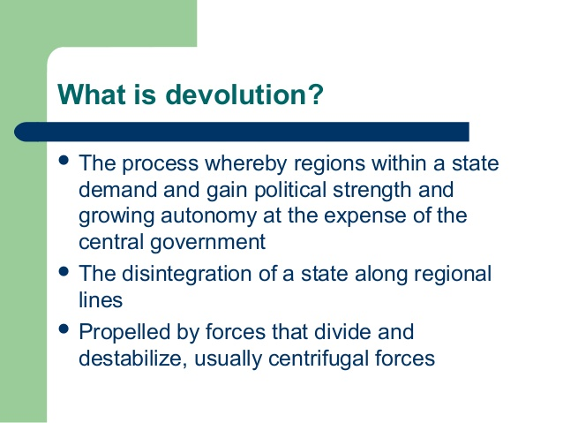

Devolution

Slide 60
Devolution
Devolution is when a central government transfers powers to a local government.
The process whereby regions within a state demand and gain political strength and growing autonomy at the expense of the federal government
The disintegration of a state along regional lines
Factors that lead to the devolution of states
The division of groups by
Physical geography:
Ethnic separatism
Ethnic Cleansing
Terrorism
Economic and social problems
Irredentism

Slide 61
Forces leading to devolution
Physical Geography: of a region can cause isolation and increase the likelihood of devolution: such as deserts, plateaus and large, mountains and large bodies of water
Ethnic separatism: Many ethnic separatist movements through the world take place with specific regional lines within states. Ethnic groups and minorities are often concentrated in specific regions, and can lead o independence movements. In order to maintain unity, the central government will grant more authority to these ethnic regions. Example: Spain with the Basques and Catalans, two culturally and linguistically distinct groups within Spain. If the national government imposes more restrictions throughout the country then the Basques and Catalans may intensify their desire for independence and if it allows more local autonomy, it hopes the desire for independence will subside
Terrorism is organized violence aimed at government and civilian targets intended to create fear in furtherance of political aims. It is most commonly used by non-governmental groups that do not have an army. Ethnic separatist groups employ terrorist tactics in hopes of achieving devolution.. Example The Basque or ETA in Spain. On a global scale, terrorism often has its roots in specific regions or countries. Terrorist groups seeking power and recognition within a country can expand their operations across international boarders and even on a global scale. Example Al Qaeda has its roots among Sunni Muslim's fighting against the Soviet occupation of Afghanistan in the 1980’s, However, in 1996 Al Qaeda directed its aggression towards the United States to protest US support of Saudi Arabia and Israel A series of attacks in eastern Africa and Arabian Peninsula in the 1990’s culminated in the attacks on the World Trade Center and Pentagon on September 11, 2001

Slide 62
Forces leading to devolution
Economics:
Control of natural resources such as mineral deposits can promote regions and countries to advocate for devolution. People in one region might want to use locally produced wealth for local benefits, such as better schools, infrastructure and health care – or simply to lower taxes. The central government might argue that these resources should benefit the entire country
Example: Many tribal groups in the Amazon River basin of Brazil object to the extraction of resources and the development of the rainforest without local communities benefiting and being part of the decision-making process,
Example: In Scotland, revenues from the North Sea oil helped to fuel talk of independence from the United Kingdom. In 2014 Scotland narrowly voted to remain part of the United Kingdom
Social Issues:
Social Devolution often follow geographic divisions between religious, linguistic, and historical regions. Countries experiencing social devolution usually have concentrated pockets of a specific religion or distinct spoken language by the local inhabitants' Federal systems, as in the U.S and Canada, allow local governments to maintain their distinct languages and religions.
Example:: Belgium where the country is split into the Flemish speaking north called Flanders and the French. speaking south called Wallonia. As a result of linguistic, cultural and economic differences the country is sharply divided. Each region has its won institutions and many people identify themselves as Flemish or Walloon, rather than Belgian. The future of Belgium as a single country may be in doubt

Slide 63
Devolution and Fragmentation
Autonomous Regions: have their own local and legislative bodies to govern a region with a population that is an ethnic minority within the entire country. These regions handle their own day to day governance, they are not fully independent from the state in which they are located. EX: the Navajo Nation in the United States based on their heritage, The Jewish Autonomous Oblast in eastern Russia based or religion, Both Federal states, such as India and unitary states such as China include autonomous states
Sub nationalism: People in autonomous regions usually have a great deal of local power but give their primary allegiance to the national state. In contrast, sub nationalism describes people who have a primary allegiance to a traditional group or ethnic. Many French speaking people in Quebec Canada are subnationalist, They feel a stronger loyalty to Quebec than to Canada. Many countries include several subnational groups as a result of wars, shifting borders, and movement of people. These groups have varied types of goals
Equality: In France, citizens of North African ancestry have fought for changes in the law that they are discriminates against them
Independence: In far western China, some members of the Uyghur ethnic group have advocated seceding from China to form a new country, East Turkestan
Changing Countries: In eastern Ukraine, many Russian speaking citizens felt closer ties to Russia than to the rest of Ukraine, Russia invaded and claimed control of this region in 2014. Several thousand died in the fighting

Slide 64
Impact of Technology on devolution & fragmentation
The internet, social media, and the ease of jet travel have had varied effects on how people relate to each other around the world they have
Promoted globalization by connecting people across boundaries
Weakened globalization by helping subnational groups to organize
Supported democratization, the transition from autocratic to more representative forms of politics, by helping reform movements to communicate in China, Iran, Egypt, and other countries were the government had tried to limit the spread of information
Created a digital divide between counties with and without access to information for either political or infrastructure reasons
Increase time space compression, the social and psychological; effects of faster movement of information over space in a shorter period of time
Global communications technology may bring in new ideas that act as centrifugal forces, whereas state-controlled media is utilized as a centripetal force to present a common message.

Slide 65

Why devolution Occurs

Slide 66


Why Devolution Occurs

Slide 67
Centripetal vs Centrifugal
Centripetal Forces are forces that UNITE a nation’s people
Sports Teams (soccer, cricket)
Shared religion / language
Strong charismatic leader
Shared History
Shape of the state (compact)
Centrifugal Forces are forces that DISUNITE a nations’ people
Remember centriFugal is for Fight
Separatists movements
Differing religions / languages
External threat
Shape of state (prorupt / perforated)

Slide 68
Centrifugal forces work to weaken central authority and cohesiveness
Regionalism the belief of practice of regional administrative systems rather than central systems. Often a minority population is concentrated in various pockets of a states and may feel underrepresented and lacking political power, it might pursue a path of separation from the lager state: Canadas French speaking area of Quebec
Economically: Globalization has widened the gap between the rich and poor within a state. Example: India is an emerging economic power, but it is not a strongly united country. Uneven development within a country may lead to divisions between the “haves” and the “have nots”. Uneven development results in uneven benefits, which may result in the separation and fragmentation of a state. Despite rapid economic growth on a global scale, India still has large segments of its population living in abject poverty. This poverty is divided along regional lines
Centrifugal cultural forces have intensified as a result of globalization. Declining state sovereignty and economic advances have empowered ethno-national groups to demand more autonomy. For Example fragmentation within Syria and Iraq gave rise to Kurdish independence movements in those countries

Slide 69
Centripetal Forces: Governments, religious groups, & other institutions use a combination of methods to promote unity in society
Political Identity: Governments attempt to build political unity in seral ways:
Unifying institutions, such as schools, promote social cohesion by educating students on the historic accomplishments of the state, Unifying institutions may also promote holidays that are historically significant, such as an independent day, or a day to honor veterans
Nationalism: The strong feelings of patriotism and loyalty one feels towards one’s country, promotes a sense of belonging, even if a country’s population is an ethnically diverse one
The acceptance of rules or laws and the promotion of political equality help to reinforce political centripetal forces. Examples of this are governmental administration practices such as a fair legal and judicial system and protection of the populace by the government
Customs and rituals based on citizenship are a common way to promote a sense of common identity. In the US, public school students throughout the country recite the Pledge of Allegiance each day

Slide 70
Centripetal Forces: Governments, religious groups, & other institutions use a combination of methods to promote unity in society
Economic Development:
One of the most effective centripetal forces used by governments throughout history has been building infrastructure. Efficient transportation systems and well constricted roads and railways increase and promote trade, communications, dependence and other forms of connections among the population within a state. These can increase the overall wealth of the country. However, since they can commonly help one region or one group of people more than others, they can lead to greater conflict
Improvements in transportation are one way to promote unity by increasing interaction among different ethno-linguistic groups, In addition, advances in communication and trade help eliminate social barriers within a country thus encouraging solidarity among the citizens. Ex: the EU and how goods, workers, and students flow freely across boarders
Cultural Practices:
States with a population that is homogeneous, on that shares a common trait, likely have cultural practices that function as centripetal forces,
Example, in heavily Islamic countries such as Saudi Arabia and Pakistan, Ramadan is a month-long religious observation that helps to unite the overall population
Example: Japan, which preserves its homogeneous culture by maintaining restrictive immigration polices, has strong cultural centripetal forces such as a common language and a shared sense of history

Slide 71
Centrifugal forces work to weaken central authority and cohesiveness, while centripetal forces work to solidify central authority and bind countries together.
An example of a country experiencing centrifugal forces was the Soviet Union in the late 1980’s. The USSR had a weak central government and a depressed economy and was composed of increasingly defiant constituent republics . Russia, the Union’s central state, could no longer hold the confederacy together and the USSR disbanded in 1991.
During the same period, the USSR’s chief rival, the United States, had a strong central government and a relatively robust economy and was composed of states that were generally deferential to the federal government

Slide 72
Examples of Devolution and Demands for autonomy
United Kingdom, where Scotland, Wales and Northern Ireland exercise authority over their own lands, but remain part of the U.K.
Canada Devolution is the transfer of jurisdiction over territorial lands from the Canadian federal government to the territorial governments. the federal government has been transferring its decision-making powers to northern governments. This means greater local control and accountability by northerners for decisions central to the future of the territories.
Nunavut in Canada pursuant to a land claim agreement reached with Inuit, the indigenous people of Canada’s Eastern Arctic. The offshore islands to the west and north of Quebec remained part of the Northwest Territories until the creation of Nunavut in 1999
Nigeria: After civil wars between regions this country now is ruled as a federation
France: Corsica
India/Pakistan: Hindu and Muslim populations

Slide 73
Examples of Devolution and Demands for autonomy
South Sudan: South Sudan, officially known as the Republic of South Sudan, is a landlocked country in East-Central Africa. It gained independence from the Republic of the Sudan in 2011, The majority of South Sudanese are Christian, Conflict in Darfur: Conflict between pastoralists and sedentary farmers, caused in part by environmental pressures and changing land ownership patterns
East Timor: The violence erupted after a majority of eligible East Timorese voters chose independence from Indonesia. Some 1,400 civilians are believed to have died.
Belgium: Belgium has a government that is classified as a federal, parliamentary, constitutional monarchy. cultural tensions between Wallonia (French speaking) and Flanders (Flemish)
The Break up of the Former Soviet Union: resulted in 15 independent countries
Spain: the Catalan people of the Barcelona area wanting a separate state and the Basques.
Hawaii: separatist movement of the native population
Native Americans in US: autonomous regions within the US

Slide 74

Irredentism
Irredentism is any political or popular movement that seeks to claim or reclaim and occupy a land that the movement's members consider to be a "lost" territory from their nation's past.

Slide 75

Balkanization,
In the Balkans, the former state of Yugoslavia was broken into smaller states. Several of these states experienced ethnic cleansing and genocide
Balkanized: small geographic area that could not successfully be organized into stable countries because it was inhabited by many ethnicities with complex, long-standing animosity
Balkanization, is a geopolitical term for the process of fragmentation or division of a region or state into smaller regions or states that are often hostile or uncooperative with one another.
EXAMPLES: The former Yugoslavia has become five independent countries
Devolution can help lead to balkanization because it can increase the sense that the people in each of the smaller regions are different from one another. It can help to create a greater difference, for example, However, devolution is not always a cause of balkanization.

Slide 76
Colonization and Imperialism
Colonization
A colonizer takes over another place, putting its own government in charge and either moving its own people into the place or bringing in indentured outsiders to gain control or the people and the land
Reasons for Colonization
Economic Motives: To grow cash crops or raw materials and new markets for industries
Religion: Spread of that country’s religion to to natives
Power: The most powerful had the most land and resources
Trade: To protect trade routes and increase their influence
Imperialism: Continuation of a colonial empire even after it is no longer politically official
Nationalism: Pride in one’s own country
Reasons for Imperialism
Economic Motives: Industrial revolution created a great demand for cheap raw materials
Nationalism: European nations wanted to demonstrate their power and prestige to the world
Power: European nations had to get new colonies to balance out power with their neighbors

Slide 77


Enclaves and Exclaves

Slide 78



Slide 79


Slide 80


Slide 81

The Era of Two Superpowers
During the Cold War…
NATO - Anti-Communist military alliance between US, Canada, and 14 European States
post USSR - provides Eastern European states with security against Russian aggression
Warsaw Pact - Military alliance between the Soviet Union and communist Eastern European states. Ended with fall of Soviet Union
Satellite States- countries controlled by and bordering a much more powerful state
Shatter belt - a state or group of states existing within a sphere of competition between two powerful states
this creates cultural, economic, and political fragmentation
Buffer zone - countries separating two warring powers (Soviet satellite states of Eastern Europe)
Cuban Missile Crisis: When the Cold War gets Hot: USSR building missile silos on Cuba
Vietnam War / Korean War: Domino Theory: If one country falls to communism the others will

Slide 82



Slide 83

Changes in the Balance of Power
The collapse of communism and the USSR (thus the end of the
Cold War changed the balance of power in Europe.
Both NATO and the EU (European Union) grew, absorbing many
former Soviet satellites. The E.U. in a nutshell; 2017, 2 minutes
Russia appears to be attempting to return to its former position of strength, in the Caucasus (Georgia, 2008) and in Ukraine (Crimea, 2014).

Slide 84
Colonization Imperialism
A colonizer takes over another place, putting its own government in charge and either moving its own people into the place or bringing in indentured outsiders to gain control or the people and the land
Reasons for Colonization
Economic Motives: To grow cash crops or raw materials and new markets for industries
Religion: Spread of that country’s religion to to natives
Power: The most powerful had the most land and resources
Trade: To protect trade routes and increase their influence
Imperialism: Continuation of a colonial empire even after it is no longer politically official
Nationalism: Pride in one’s own country
Reasons for Imperialism
Economic Motives: Industrial revolution created a great demand for cheap raw materials
Nationalism: European nations wanted to demonstrate their power and prestige to the world
Power: European nations had to get new colonies to balance out power with their neighbors

Slide 85


Slide 86


Effects of Decolonization

Slide 87
Africa Decolonization
Economies based on raw material exports – cash crops and raw materials
Aid dependency
Tension between tradition and modernity
African nations relied on buying manufactured goods and had no industrial base
Incurred debts
Governments focused on maintaining power and preserving order (power hungry leaders, military takeovers, harsh dictators, ethnic, many nations adopt a one party system, Rulers used patronage to maintain power by giving high level jobs in government to supporters
US and European countries selling large amounts of arms to questionable rulers, ones with human rights violations
regional conflicts
Population increases, wide spread hunger
Crash Course Decolonization: https://www.youtube.com/watch?v=T_sGTspaF4Y
Crash Course Congo: https://www.youtube.com/watch?v=4uArRzwKHvE
Slide player http://slideplayer.com/slide/4028653/

Slide 88
Effects:
Created artificial boundaries EX Africa
Racial inequality by the colonizer’s favor of one group over another Ex: Rwanda
Ethnic rivalries between groups pitted against each other by the colonizer to retain power Ex. Greeks and Turks in Cypress
Acculturation of native peoples into the colonizer’s culture lost many folk cultures and languages
Spread of the “western” thinking worldwide in areas like agriculture, education, government etc
Slavery of native peoples continued after the colonizer left Ex: US
Example: Many former colonies are now imperialistic and are still dominated by their former colonizer’s culture like Kenya still retains the British language, religion and administrative system

Slide 89
Consequences of Superimposed Boundaries in Africa
Multinational or multiethnic state | Separate nations within the same territory
Internal struggles | Increased likelihood of religious, ethnic, or tribal conflict
External struggles | Increase likelihood of international, regional, or cross boarder conflict
Loss of Culture | Loss of language, cultural traditions etc
New language | European or regional languages (Swahili) become official languages or lingua franca
Cultural syncretism (synthesis) | Between culture groups of a single country
Migration | May increase number of refuges or internally displaced persons; traditional or seasonal migration patterns disrupted
Government change | Nation-building difficulties, non-viable states, formation of new independent states, relocated capitals
Lost or limited access to natural resources | Economic dependency
Ineffective governance | Governments, antecedent treaties and laws of less effective
Political and economic hubs | Diffusion patterns extend from ports along coasts to points inland

Slide 90
Challenges of Landlocked African Countries face in developing economies
Identify | Explain
No Access to the Sea | Lack of easy access to maritime trade or ocean resources
Increased cost of imports | Due to customs, tariffs, tolls, distance, or transportation costs
Increased costs of goods | Due to customs, tariffs, tolls, distance, or transportation costs
Limited road or rail transportation for imported goods in bulk | More break of bulk points
Economic cooperation | Communications needed between landlocked and bordering states
Vulnerability | Can be cut off from global trade and/or political support by hostile neighbors; economically dependent

Slide 91

Ethnic Cleansing In Africa
In 19th and 20th centuries European nations partitioned Africa into regions without regard for distribution of ethnicities there
decolonization - the action of changing from colonial to independent status
result of decolonization of Africa in 1950s and 1960s was the creation of independent states in which numerous competing ethnicities lived
Crash course decolonization : https://www.youtube.com/watch?v=T_sGTspaF4Y

Slide 92

State-sponsored terrorism: states who do not attack other states, but finance terrorist organizations who carry out attacks on states
State supporters of Terrorism: Yemen, Sudan, Syria, North Korea, Libya, Afghanistan, Iraq, and Iran, Saudi Arabia

Slide 93

Terrorism
Terrorism - the use of violence by non-governmental groups against civilians to achieve a political goal by instilling fear and frightening governments into changing policies
Has changed the roles individual countries play in the modern world
ex: Pakistan became a target of US airstrikes because the Taliban was harboring members of Al-Qaeda
Puts strain on relationships between states

Slide 94



Slide 95

ISIS/ISIL/DAESH
The group began in 2004 as al Qaeda in Iraq, before rebranding as ISIS two years later. It was an ally of -- and had similarities with -- Osama bin Laden's al Qaeda: both were radical anti-Western militant groups devoted to establishing an independent Islamic state in the region.
But ISIS -- unlike al Qaeda, which disowned the group in early 2014 -- has proven to be more brutal and more effective at controlling territory it has seized.
ISIS stands for the Islamic State in Iraq and Syria. ISIL means basically the same thing - the Islamic State in Iraq and the Levant.
There is another name that the group rejects, but which many officials use: Daesh. t's an Arabic acronym that means the same thing as ISIL, but sounds like an Arabic word meaning "stomp on." And ISIS hates it so much they have threatened to cut out the tongue of anyone who uses it.
They aim to create an Islamic state in SW Asia united under fundamentalist religious laws
Funded through donations, theft, and black market goods
Recruits through propaganda on social media
What is ISIS 2:30: https://www.youtube.com/watch?v=vOGLesXQ4Tc
What does Jihad mean 3 min: https://www.youtube.com/watch?v=CZP1nAoajh0

Slide 96
Genocide and Ethnic Cleansing in Africa
Darfur: Not a state, but a region in Sudan
A complex history of social inequalities, an environmental crisis and competition over natural resources, conflicting notions of identity, the militarization of rural societies, and, above all, a chronic problem of bad governance that has plagued the Sudan since its independence from British colonial rule in 1956.
These conflicts can be attributed to the deeply rooted regional, political, and economic inequalities that have persisted throughout Sudan's colonial and post-colonial history. These inequalities are exemplified by the political, economic, and cultural hegemony of a small group of Arabic-speaking Sudanese elites who have held power and systematically marginalized the non-Arab and non-Muslim groups in the country's peripheries.
Conflict between pastoralists and sedentary farmers, caused in part by environmental pressures and changing land ownership patterns, was an important cause of the Darfur violence.
The current Darfur conflict is a product of an explosive combination of environmental, political, and economic factors. It is well known that environmental degradation and competition over shrinking resources
Janjaweed, Arab nomads, with the support of Sudan’s government, committed genocide against 450,000 Darfur residents
2.5 million victims of Ethnic Cleansing
South Sudan - war between 1983 until 2005 between Sudan’s northern and southern ethnicities
resulted in est. 1.9 million Sudanese deaths
ethnic cleansing of est. 700,000
South Sudan, composed of Dinka (Christian) and Nuer (ethnic religion) became independent state in 2011
Supporters of Sudanese government continue fighting with newly created South Sudanese
Dangerous potential for genocide

Slide 97
Genocide and Ethnic Cleansing in Africa
South Sudan - war between 1983 until 2005 between Sudan’s northern and southern ethnicities
resulted in est. 1.9 million Sudanese deaths
ethnic cleansing of est. 700,000
South Sudan, composed of Dinka (Christian) and Nuer (ethnic religion) became independent state in 2011
Supporters of Sudanese government continue fighting with newly created South Sudanese
Dangerous potential for genocide
Rwanda 1994
Though Rwanda gained its independence from Belgium,
the result was conflict between the Hutus and the Tutsis, which led to almost violent 1,000,000 deaths.
The Hutus killed the Tutsis and moderate Hutus on a vast scale.
This was Genocide – organized killing in which people are targeted because of their race, religion, ethnicity or1994 - Hutus launched a genocide campaign killed 800,000 Tutsis in Rwanda and 300,000 in Burundi
How did it happen?
Rwanda is an example of the problems that occur in a multi-national state. (One state, more than one nation. Recall, too, that generally one nation tries to dominate.)

