Slide 2

Unit 6: Industrialization and Economic Development

Slide 3
Unit 6 Essential Questions
What is the difference between development and industry?
How did the Industrial Revolution change the world?
How are theories of locational interdependence applied throughout the world?
How do levels of development and industrialization differ around the world?
What are the unintended side effects of development and industrialization?
How does the development of opportunities for women differ from that of men?
Crash Course the Industrial revolution https://www.youtube.com/watch?v=zhL5DCizj5c

Slide 4
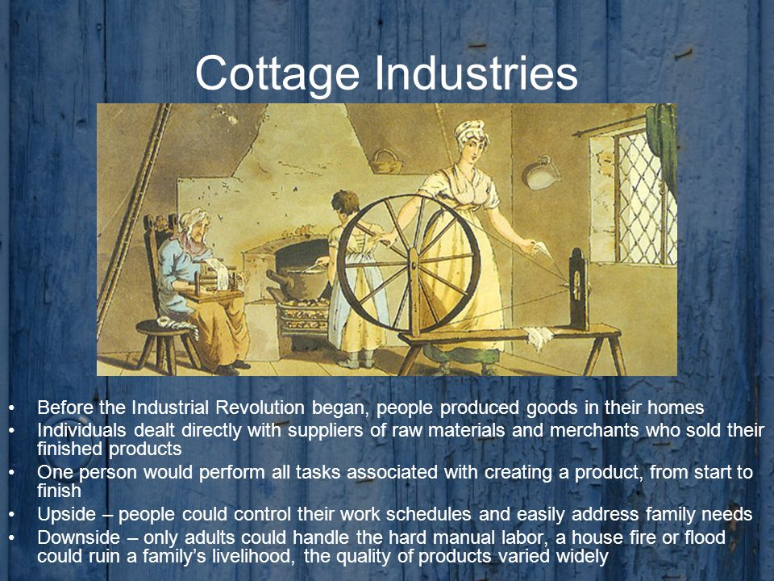
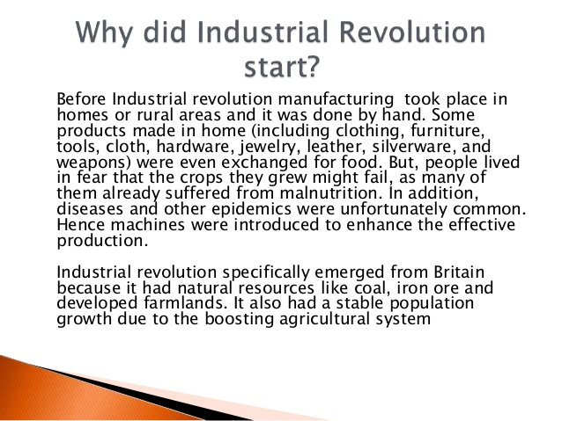
Industry refers to the manufacturing of goods in a factory

Slide 5
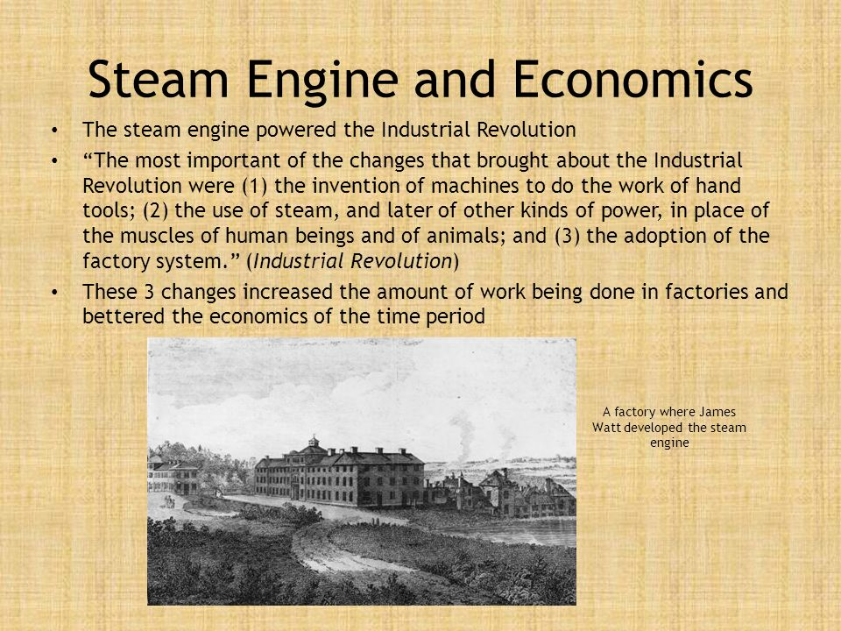
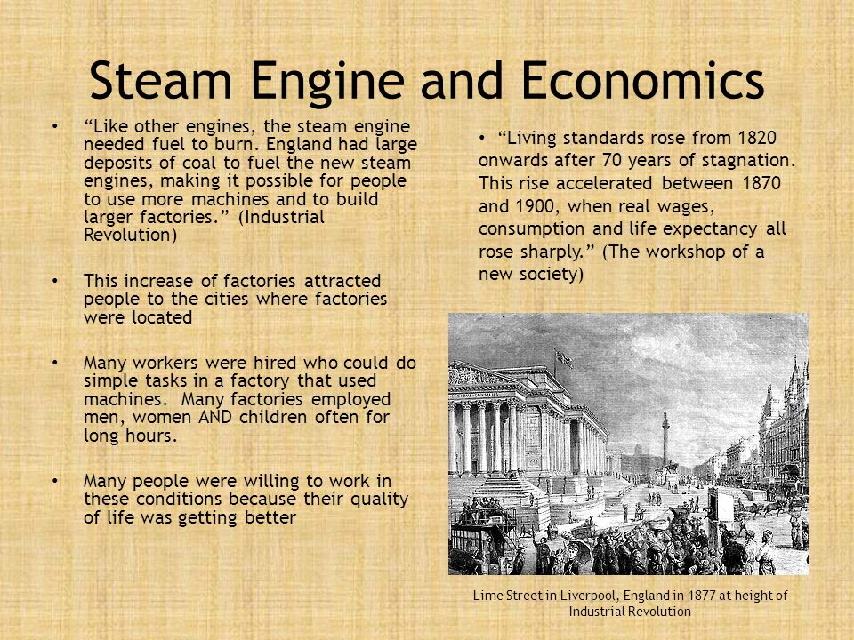
The catalyst for the Industrial Revolution was technology and several inventions that transformed manufacturing with the most important being James Watt’s Steam Engine in 1769

Slide 6
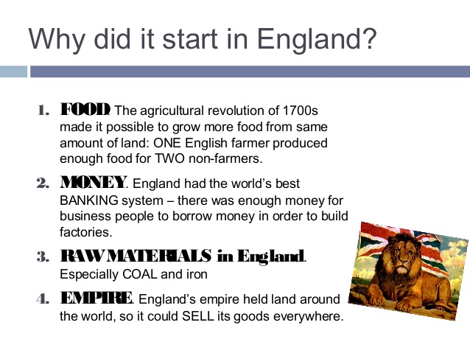
Great Britain: Why Here? Why Now?

Slide 7
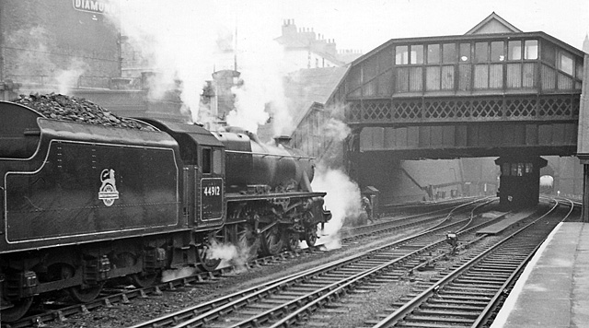
Industries affected by the Industrial Revolution
Iron: Iron had been known for centuries but was difficult to produce because ovens had to be constantly heated which was difficult before steam engines
Transportation: First canals and then railroads(iron horses) enabled factories to attract large numbers of workers, bring in bulky raw material such as iron ore and coal and ship finished goods to consumers
Textiles: production was transformed from a cottage industry to a concentrated factory system which began with Richard Arkwright who invented machines to untangle cotton prior to spinning
Chemicals: were created to bleach and dye cloth using sulfuric acid combined with various metals
Food processing: in 1810 Nicolas Appert started canning food in glass bottles which was essential to feed the factory workers
The assembly line perfected by Henry Ford where one person does one thing as the cars move through the factory
Finance: capitalism

Slide 8
Industrial Revolution: 1750’s until the late 1800’s
Before Industrial Revolution
Hand made products
Cottage Industry
Rural society
Agricultural society
Wood structures
Transport – wagons, river
Water and wind power
After the Industrial Revolution
Products made by Machines
Factory System
Urban Society
Industrial Society
Iron and Steel Structures
Transport – canals Railroads
Steam Power

Slide 9
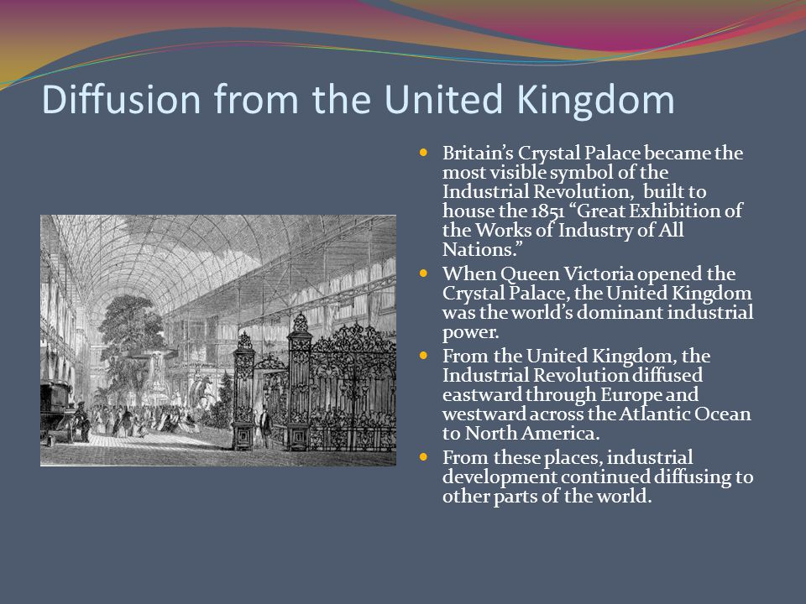
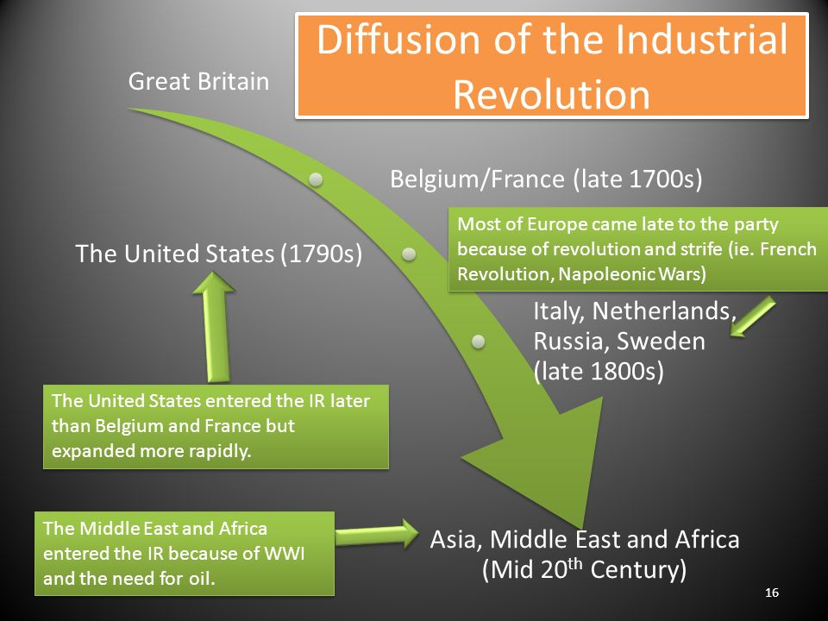
Diffusion of Industrial Revolution

Slide 10
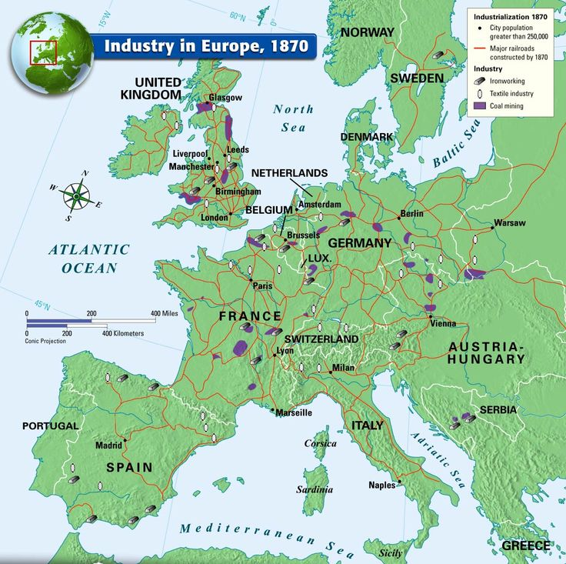
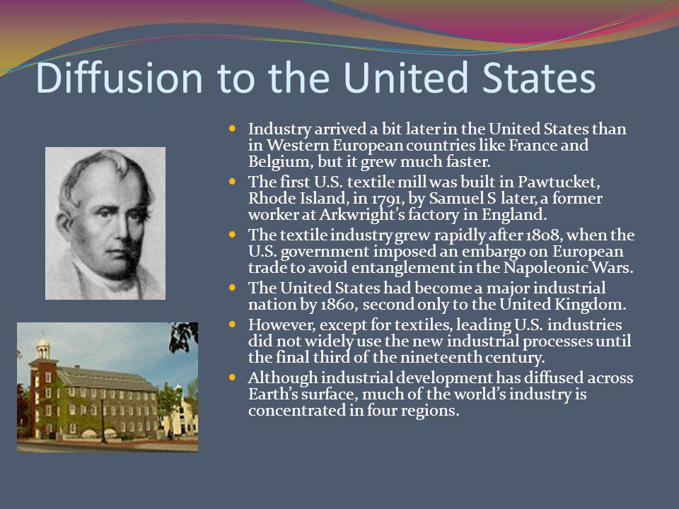
Diffusion of Industrial Revolution

Slide 11
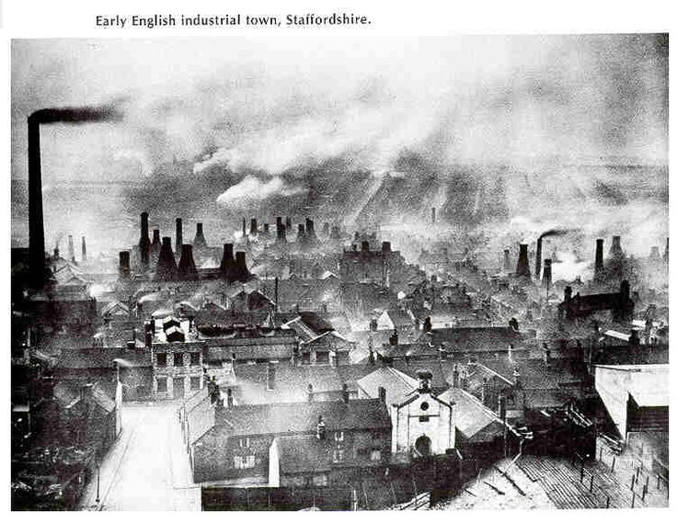
Growth and Population and Cities
As the number of industries in factory cities increased and rural urban migration continued, cities grew rapidly. (London grew from 1 million in 1800 to 6 million in 1900)
Old systems of handling human waste, burying the dead, cleaning up hose manure were over whelmed. Since people burned wood and coal to heat their homes and run factories, air pollution increased to harmful levels, Over time people supported stronger action to build sewers, regulate cemeteries etc. to protect public health
Public health measures became increasingly important as cities became more dense and grew vertically
The development of stronger and more affordable steel (Bessemer Process) and techniques to construct stronger taller buildings
Cities also expanded horizontally with improvements in transportation such as trains, cars and trucks allowing cities to spread out farther from the downtown core

Slide 12
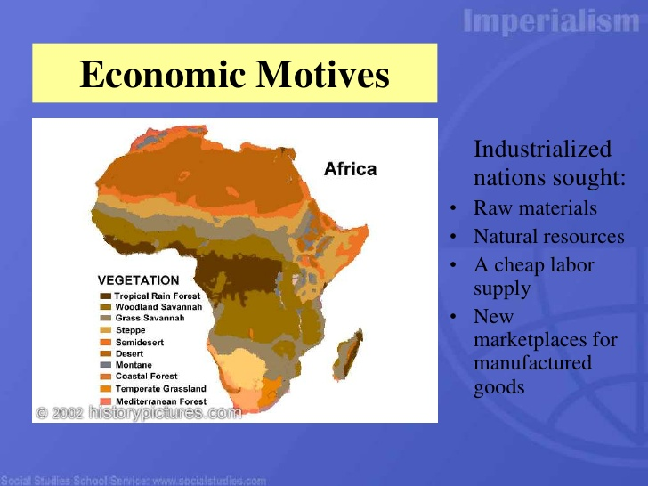
Effects of Imperialism on the Industrial Revolution
As countries such as Great Britain and France industrialized they recognized the value of controlling trading posts and colonies around the world. Colonies provide several resources and other contributions to the economy
Raw materials such as sugar, cotton, foodstuffs, lumber, and minerals for use I mills and factories
Labor to extract raw materials
Markets where manufacturers could sell finished products
Ports where trading ships could stop and get resupplied profits to use from investing in new factories, canals and railroads

Slide 13
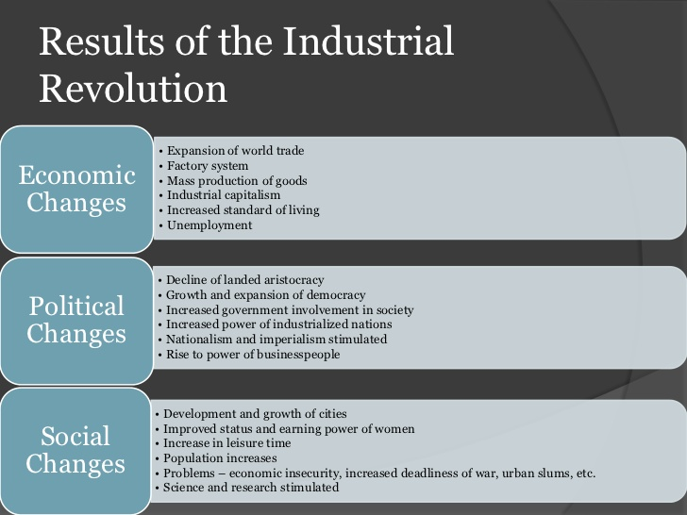

Slide 14
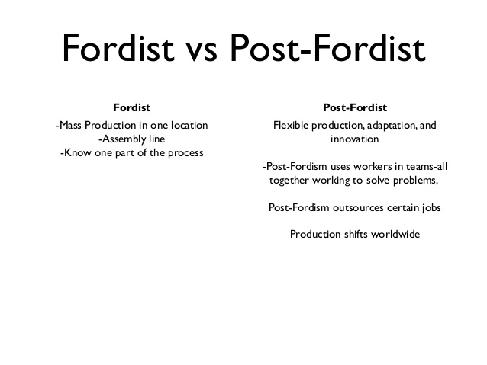
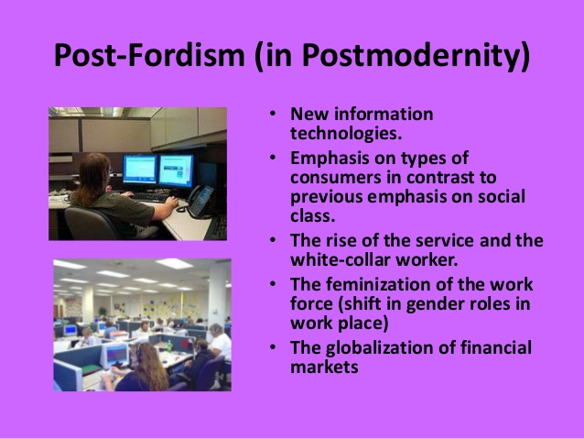
Fordism and Post Fordism

Slide 15
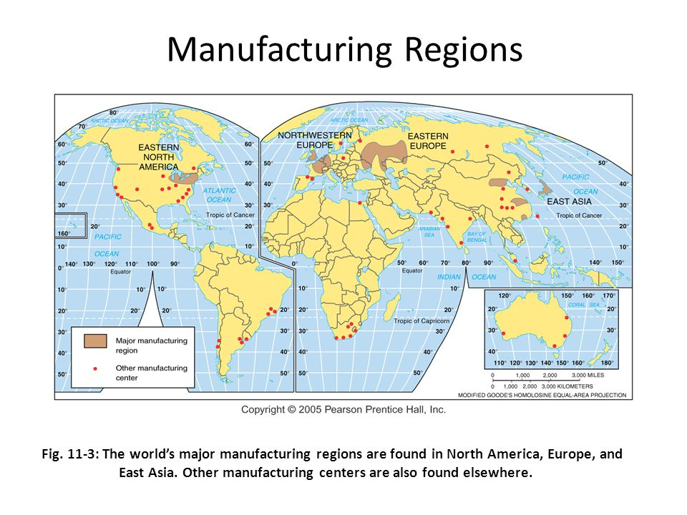
Industrial Regions:
The Industrial Revolution involved a series of improvements that transformed manufacturing. Most of the improvements occurred first in the United Kingdom
Industry depends on access to abundant and affordable suppliers of fossil fuels
The world’s three principal industrial regions are:
Europe: the first region to industrialize with numerous industrial centers competing with each other for supremacy,
North America: Arriving a bit later than in Europe but grew much faster in the 19th century but highly concentrated in the northeast and southeastern Canada. In recent years moving to the south because of lower wages and the difficulty for unions to organize
East Asia: becomes an important industrial region in the second half of the 20th century with China leading the world in manufacturing
Four countries account for ½ of the world’s industrial output: China, United States, Japan and Germany

Slide 16
Other Industrial regions
Rhine Ruhr Valley: Iron and steel manufacturing due to its proximity to coal fields
Mid Rhine – Frankfurt is an financial and commercial center and transportation network. Stuttgart specializes in high value goods like synthetic fibers, dyes and pharmaceuticals
Po Basin: textile industry due to low wage workers and access to inexpensive hydroelectric power
Northeastern Spain Catalonia in Spain’s textile industry and motor vehicle paint
Moscow: huge industrial region in the capital city
St Petersburg specializes in ship building
Urals: proximity minerals attracts steel, machinery and metal fabrication plants
Volga: largest petroleum and natural gas fields and tons of minerals in the Ural mountain range
Kusnetsk: large reserves of coal and iron ore supply the important manufacturing districts
Dontesk one of the worlds largest coal reserves in Ukraine
Silesia: growing industrial region due to skilled labor but low wage workforce and proximity to wealthy markets

Slide 17
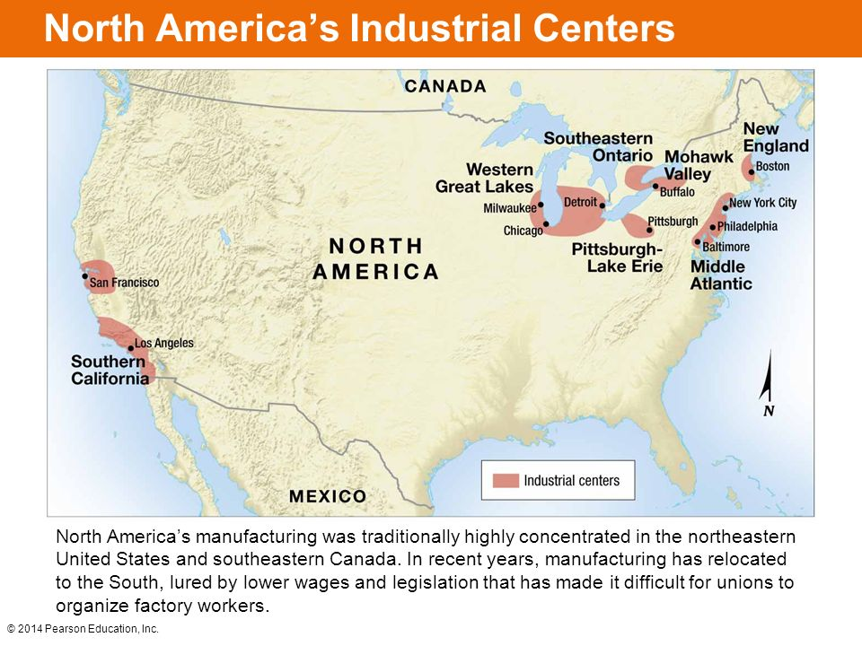
North America’s Industrial Regions
New England Cotton textile center early 19th century
Middle Atlantic larges US market attracts industry that needs to be close to the consumer
Mohawk Valley: industrial center takes advantage of inexpensive electricity for Niagara Falls
Pittsburg/Lake Erie leading steel production in the 19th century to do proximity to Appalachian coal and iron ore
Western Great lakes hub of transportation networks and now center of steel production
Southern California clothing, textile, furniture, food processing
Southeastern Ontario Canadas largest industrial area because its close to US markets. Great Lakes, Niagara falls

Slide 18
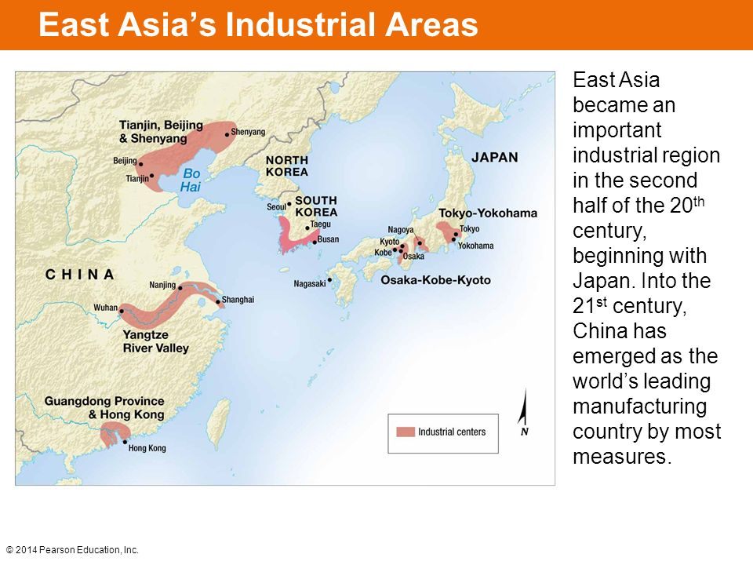
Asia’s Industrial Regions
Japan became an industrial power in 1950’s and 60’s by producing goods sold in large quantities at cut rate prices to other countries
China: worlds largest supply of low cost labor, largest market for consumer products manufacturing on the east coast
South Korea focused on export oriented manufacturing, leading producer of ships

Slide 19
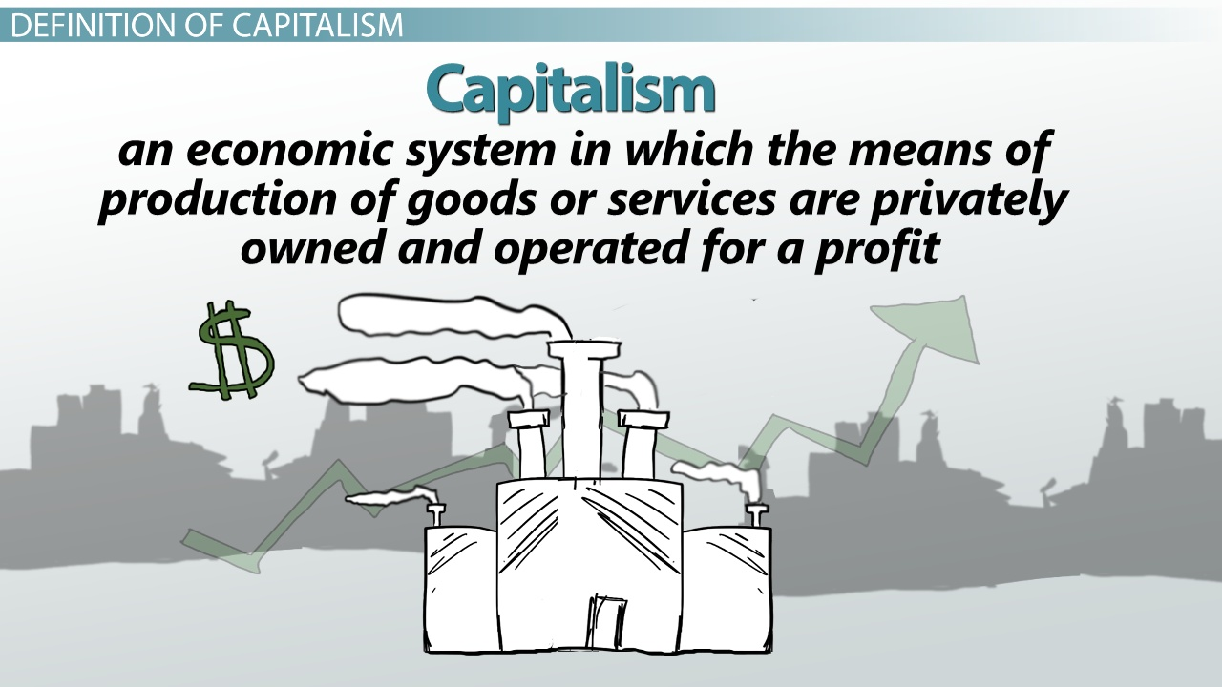
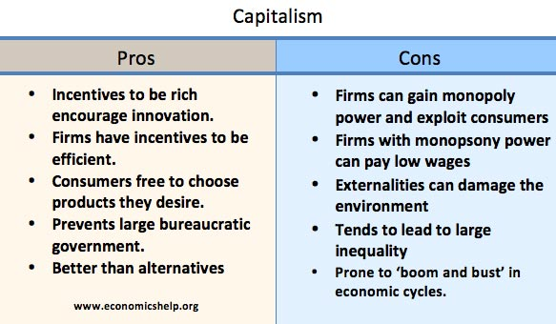
Capitalism crash course Crash Course Capitalism: https://www.youtube.com/watch?v=B3u4EFTwprM

Slide 20
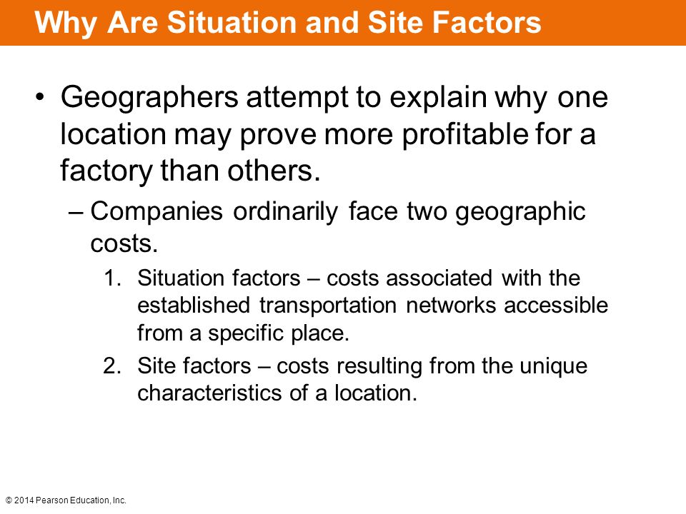

Why are Industries located where they are?

Slide 21
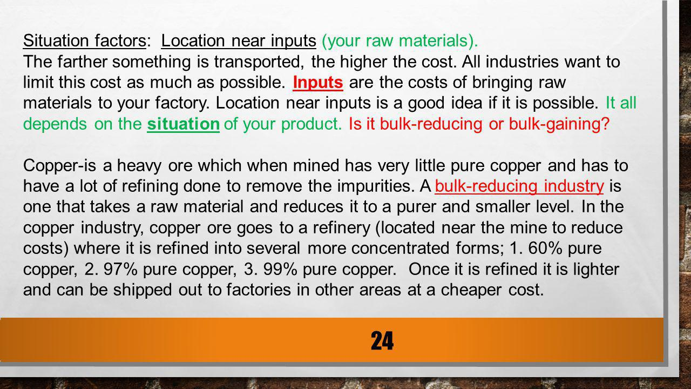
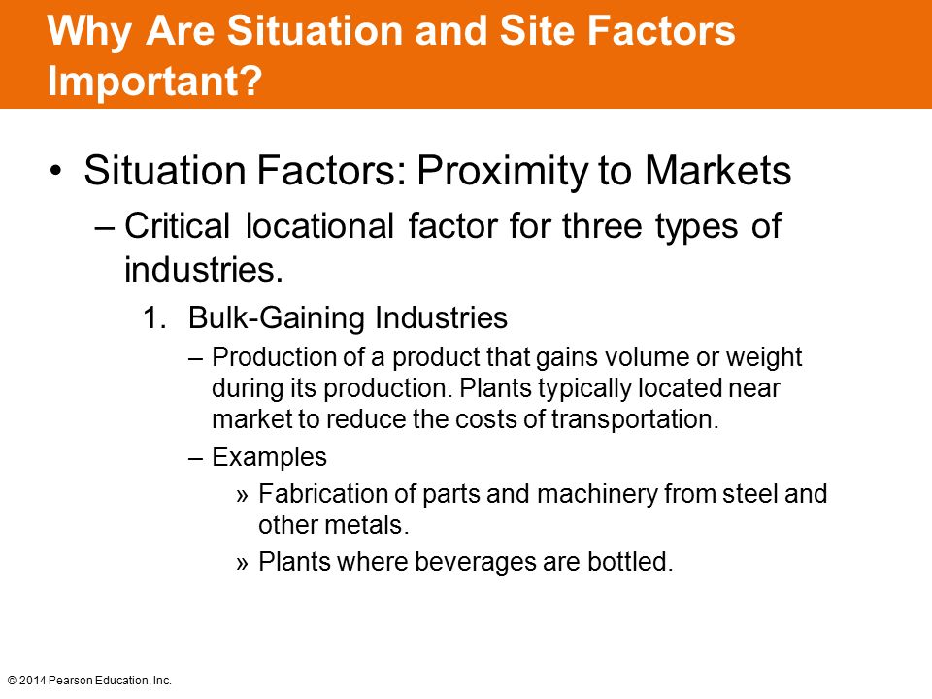
Situation Factors

Slide 22
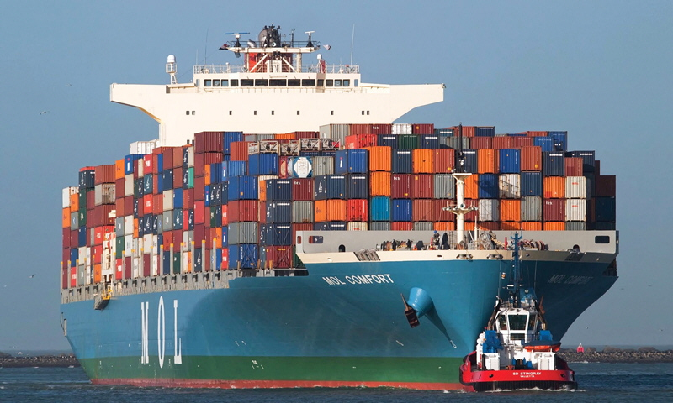
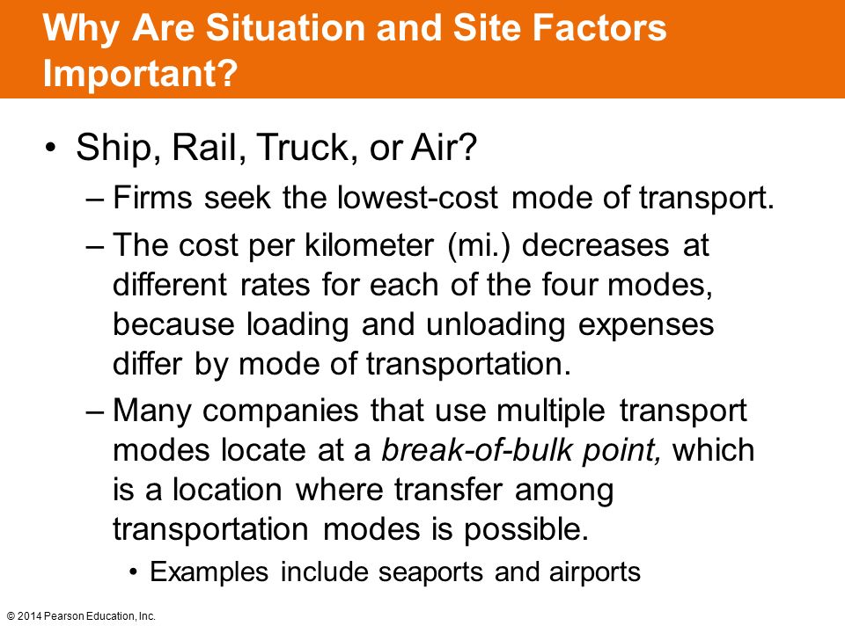

Slide 23
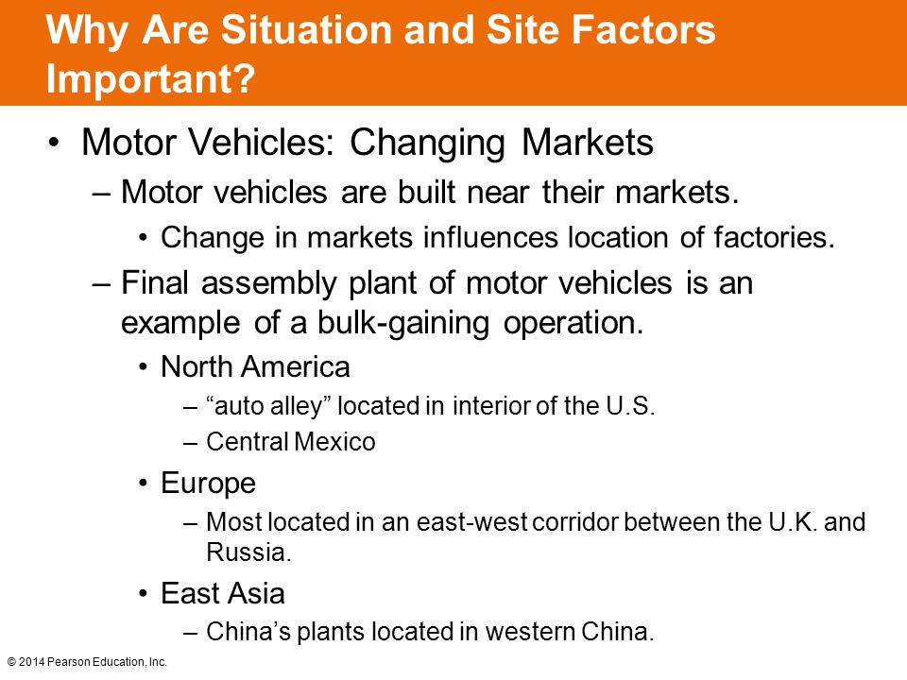
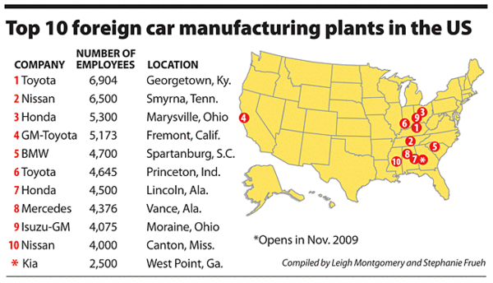

Slide 24
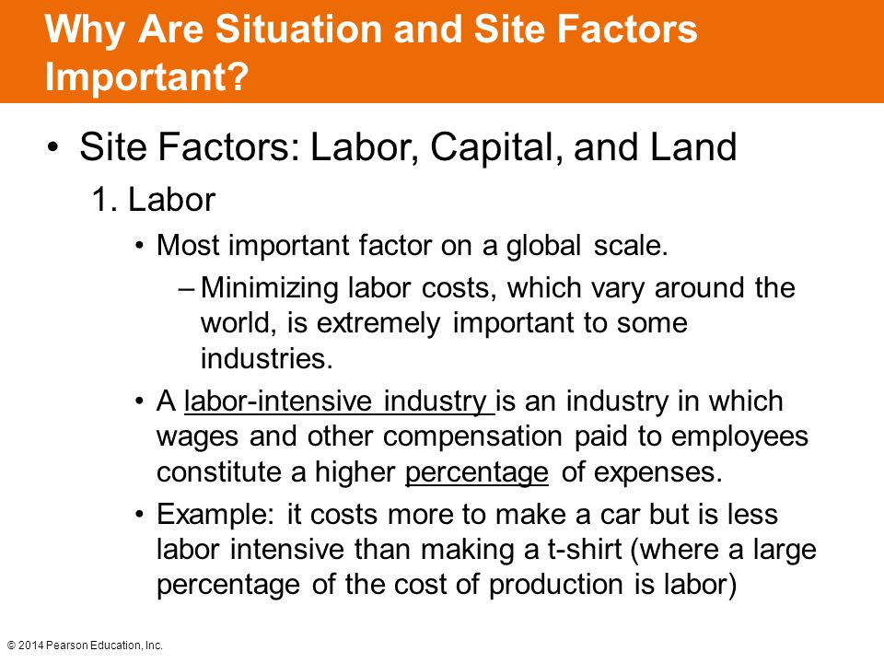
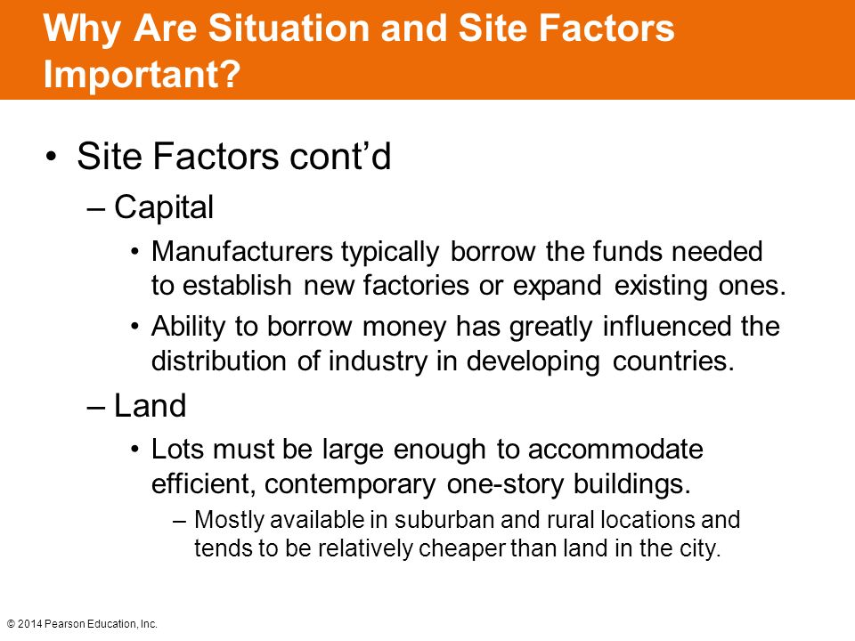

Slide 25
Economic Activities Classification
Economic Activity | Definition | Examples
Primary | Extraction of natural resources Dominated the economy until the Civil War | Farming, mining, forestry, fishing
Secondary | Processing of raw materials into finished goods by manufacturing Significant labor growth in 1840’s to 1960’s | Steel manufacturing, furniture production, food processing, building
Tertiary | Provision of services Most people in the US labor force today | Retail, restaurants, tourism, police, and fire provision. sanitation, advertising
Quaternary | Information and knowledge processing | Education, data processing, research and development, banking and finance, medical, entertainment
Quinary | Highest-level decision making | Top-level government officials and business executives, research scientists, financial consultants

Slide 26
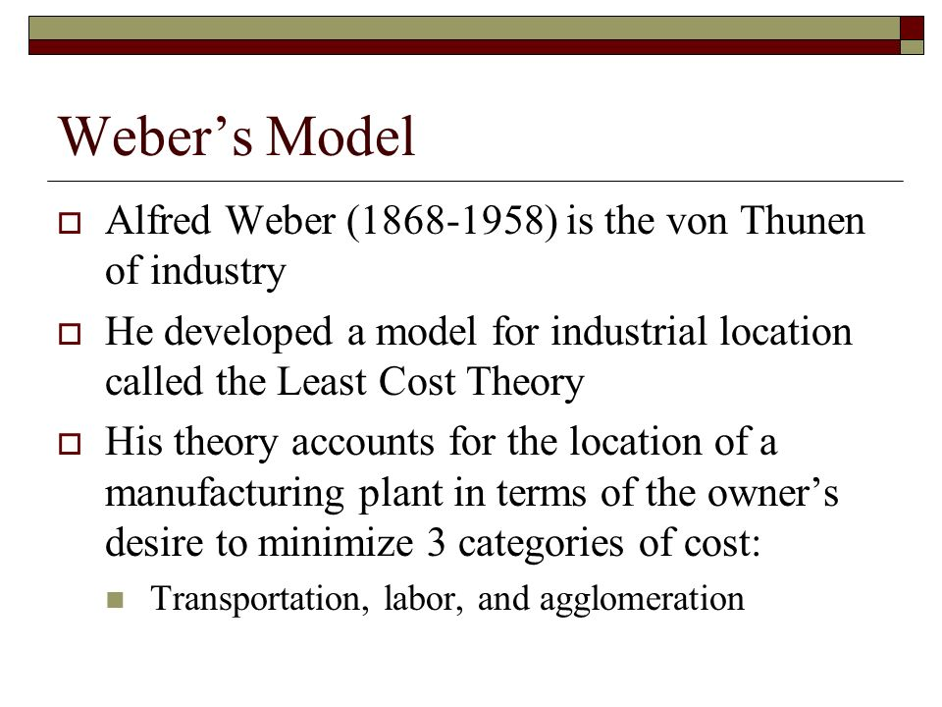
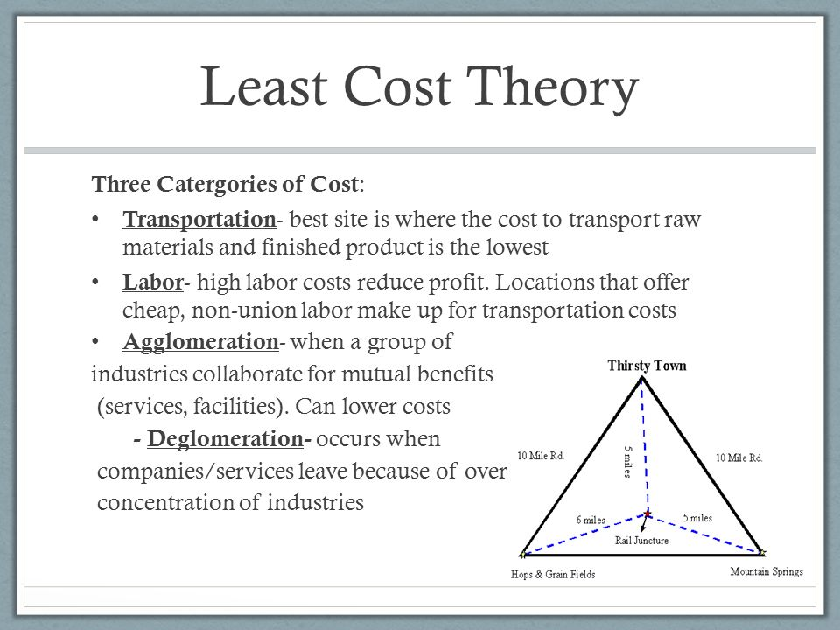
Weber’s Least Cost Model video 3 min https://www.youtube.com/watch?v=wylWDa-gUbg

Slide 27
Weber’s Model Information
Weight gain processing (bulk gaining) in this case you have resources that are lighter than the finished product so they would locate by the market
There are some industries that have spatially fixed costs that stay the same no matter where they are located, normally lightweight expensive products. These are known as Footloose industries because they are not tied to location. Generally do not pollute. (diamonds, computer chips, call centers, online companies, credit card processing companies
Brick and Bunny industries: have one very heavy resource and one very light, so the plan would be to locate closer to the heavier resource. (bricks and feathers)
Labor: high labor costs reduce profits so a factory might do better farther from raw materials and markets if cheap labor is available
Includes availability of industrial capital (money) to buy machinery, technology and labor
In the long run the lower cost of labor will balance the high cost of transportation or land capital.
Agglomeration: when a large number of enterprise cluster (agglomerate) in the same area for mutual advantage, they can provide assistance to each other through shared talents, services and facilities. Costs can be shared (power, resources, infrastructure. Can benefit the industry and customers too. (malls, Dalton, Georgia where All but 1 of the top 20 U.S. carpet makers, Wall Street with its Banking Industries are located near the Stock Market, Silicon Valley, California and High-Tech Companies / Computers, or the Research Triangle and pharmaceutical companies

Slide 28

Benefits of Agglomerations
Similar or interrelated companies nearby
Pools of Skilled & Ordinary Labor
Capital
Infrastructure
Localization Economy - when businesses group in an area in order to share the labor force
Urbanization economy - businesses group in cities to take advantage of infrastructure… ex: subway, power grid, fiber optics
Multiplier Effect – each new firm added will lead to the further development of infrastructure & linkages

Slide 29
Disadvantages of Agglomeration
Congestion
High Land Values
Pollution
Increased Government Regulation
Deglomeration – when it’s more profitable for a company to move to an isolated location.
Deglomeration occurs when businesses in the same industry attempt to locate far away from similar businesses
why?
avoiding traffic congestion
avoiding competition
avoiding increasing costs

Slide 30

Footloose Firms
For some products, the location of a production facility can determine the cost of products
Some have spatially Fixed Costs which do not change despite where the product is assembled, while others have Spatially Variable Costs, which change depending on where he products are produced
Footloose products are an exception to Weber’s theory.
A Footloose industry is a general term for an industry that can be placed and located at any location without effect from factors such as resources, services or transport. These industries often have spatially fixed costs, which means that the costs of the products do not change despite where the product is assembled.
Examples of Footloose industries: computer chips, diamonds

Slide 31
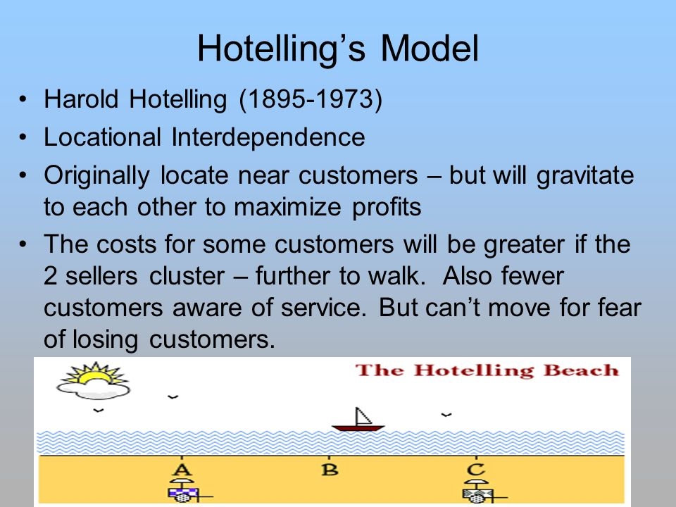
Location Models
Harold Hotelling - Location Interdependence
businesses will locate where they have the most access to the market and where they will take a maximum amount of their competitor’s access to the market.
Video: https://www.youtube.com/watch?v=u4cKzGj58q4

Slide 32
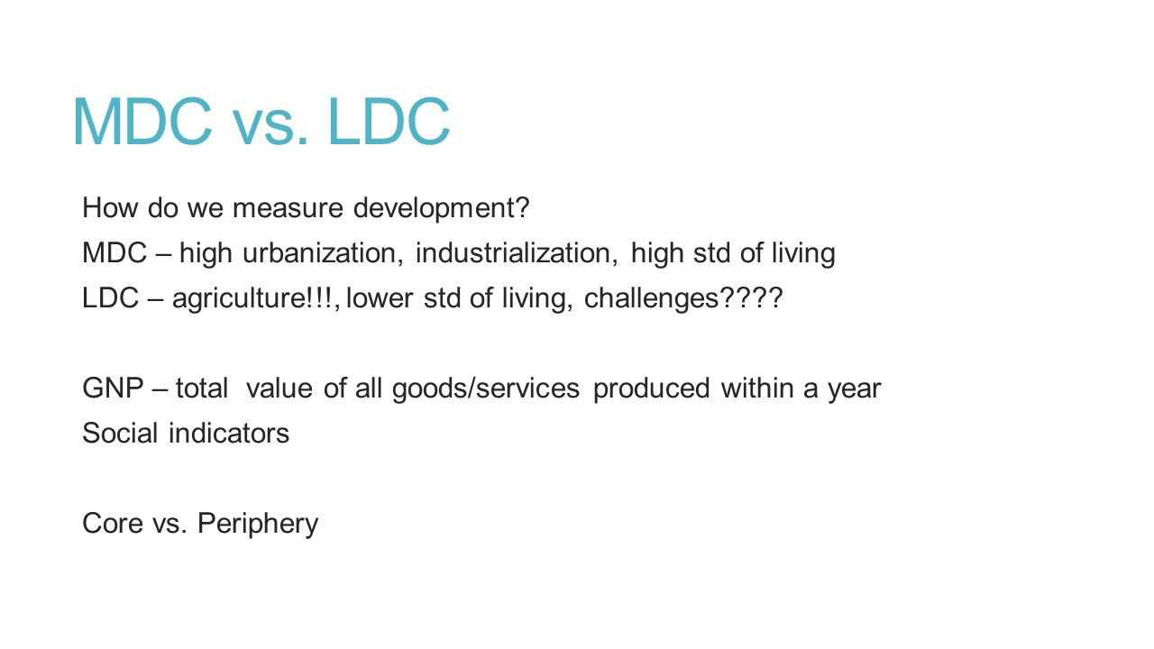
Development is the process of improving the conditions of people through diffusion of knowledge and technology. Every place lies at some point along a continuum of development, it is continuous, and never ending actions to improve.
Developed Country is also known as More Developed Country MDC and referred to by the UN as a very high developed country, has progressed further along the development continuum
Developing Country is also called a Less Developed Country LDC, has made some progress toward development, through less than the developed
Recognizing that progress has varied widely among developing countries, the UN divides them into high, medium and low developing.
Patterson Video Development varies among countries: https://www.youtube.com/watch?v=HbZMXdADBWM

Slide 33

Human Development Index
Human Development Index
To measure the level of development of every country, the UN created the Human Development Index (HDI) and reevaluates the countries yearly with the highest possible score being 1.0 or 100%
The U.N.’s HDI considers development to be a function of three factors with each country getting an overall HDI score based on these three factors
1. a decent standard of living
2. A long and healthy life
3. access to knowledge
Development is a process of enlarging people’s ability to lead a long and healthy life, to acquire knowledge and to have access to resources needed for a decent standard of living

Slide 34

Productivity: the value of a particular product compared to the amount of labor needed to make it.
Value Added in manufacturing is the gross value of a product minus the costs of raw materials and energy
The value added per capita is round $67 per hour in the United States compared to around $16 in Mexico
Workers in developed countries are more productive and produce more with less effort than developing countries because they have access to more machines, tools, and equipment to perform much of the work.
Production in developing countries relies more oh human and animal power

Slide 35
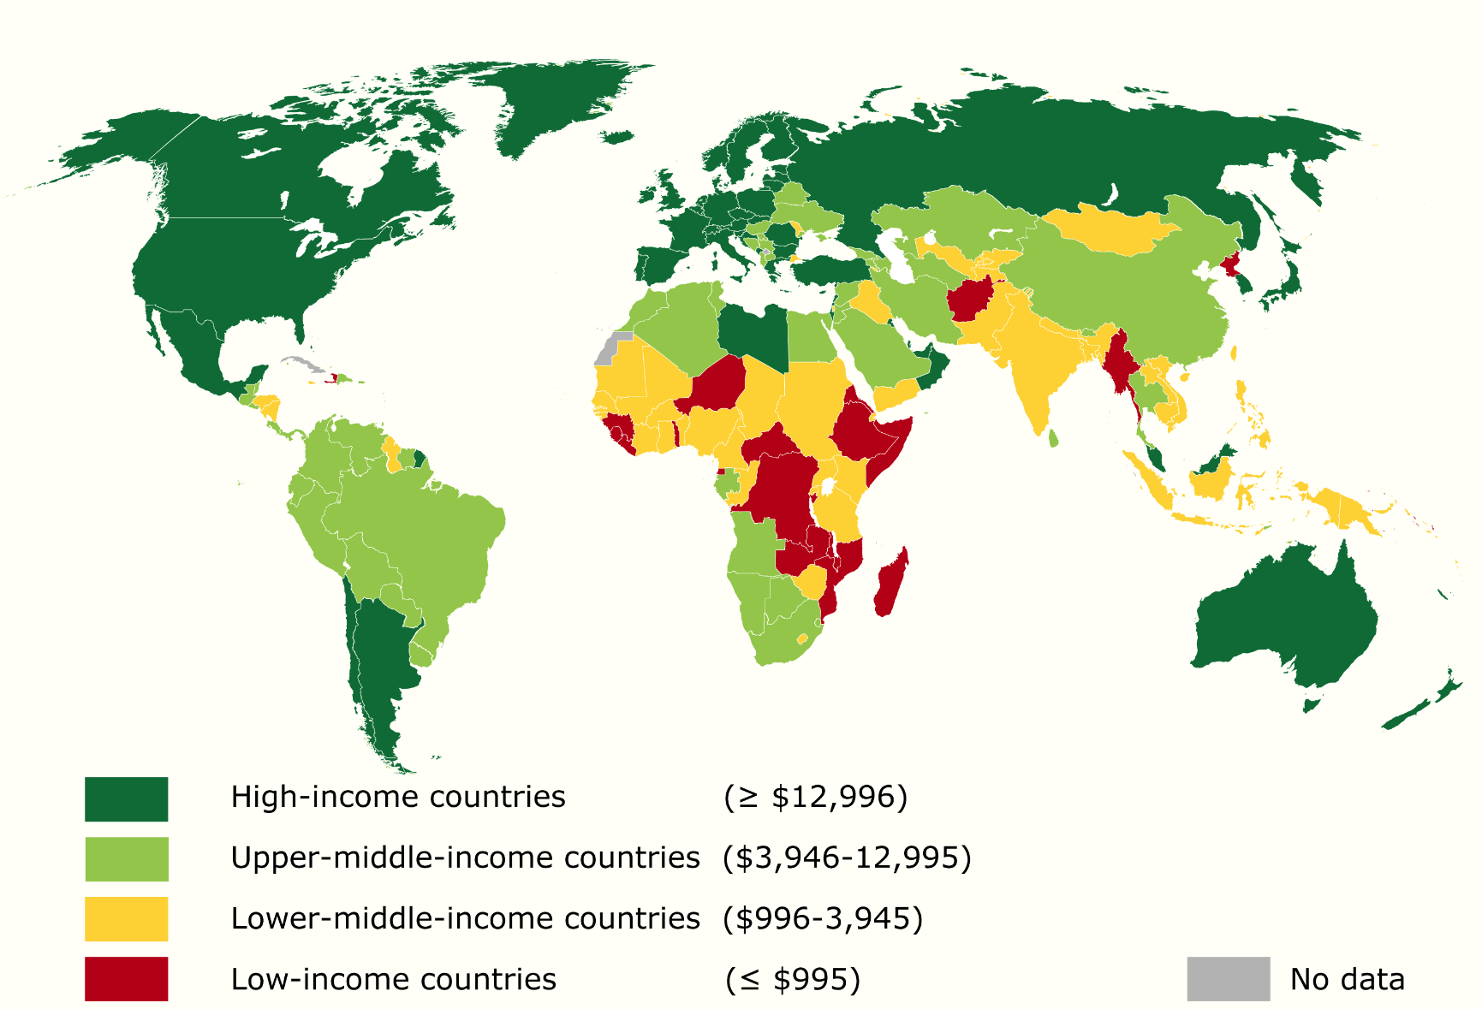
Decent Standard of Living: having enough wealth for a decent standard of living is key to development
The UN measures the standard of living in countries through a complex index called annual gross national income per capita(per person) at purchasing power
Gross National Income: (GNI) is the value of the output of goods and services produced in a country in al year, including money that leaves and enters the country
Purchasing Power Parity:(PPP) is an adjustment made to GNI to account that differences among countries in cost of goods. For example if a resident of country A has the same income as a resident of country B but must pay more for a Big Mac, or a Starbucks latte, the resident of country B is better off.
Gross Domestic Product (GDP) the value of the output of goods and services produced in a country in a year but does not account for money leaving or entering the US
Gross Domestic Product (GDP) and Gross National Product (GNP) both try to measure the market value of all goods and services produced for final sale in an economy. ... GDP refers to and measures the domestic levels of production, whereas GNP measures the levels of production of any person or corporation of a country
Crash course econ: https://www.youtube.com/watch?v=UHiUYj5EA0w

Slide 36
Access to knowledge: U.N. considers years of schooling to be the most critical measure of the ability of an individual to gain access to knowledge needed for development
To form the access to knowledge component of HDI, the U.N. combines two measures of years of schooling
1. Years of schooling for today’s adults: this measures the number of years that the average person aged 25 or older in a country has spent in school. Adults have spent an average of 11.5 years in school in developed countries compared to only 4.7 years in South Asia and sub Saharan Africa
2. Expected years of schooling for today’s youth: this measures the number of years that the U.N. forecasts average 5 year old will spend in school.. The U.N. expects that 5 year old’s in developed countries will spend an average of 16.3 years in school. Meaning roughly half of today’s 5 year old’s will graduate from college in developed countries. The expected average in sub Saharan Africa is 9.3 and 10.2 in South Asia
Other indicators can measure regional variations in access to knowledge such as
1. Pupil / teacher ratio: The number of enrolled students divided by the number of teachers. The fewer pupils a teacher has the more likely that each student will receive effective instruction
2. Literacy rate: the percentage of a country’s people who can read and write. Improved education is a major goal of many developing countries but funds are scarce
In addition in developing countries, most books, newspapers, and magazines are published in developed countries, in part because more of their citizens read and write but also can afford to buy them. Developed countries dominate scientific and non fiction publishing world wide including text books. Students in developing countries must learn technical information from books that usually are not in the native language

Slide 37
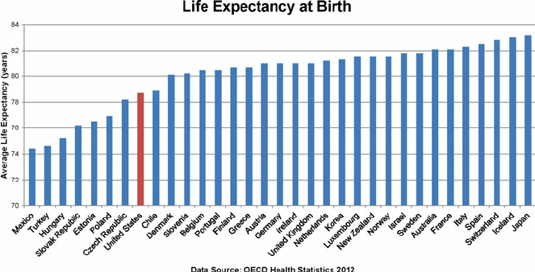
Health and Wealth: U.N. considers good health to be very important so a goal is to provide the nutrition and medical services needed for people to lead long healthy lives
U.N. selected life expectancy at birth as the contributor to HDI
People are healthier in developed countries. When people get sick these countries possess the resources to care for them. Developed countries use part of their wealth to protect people who are unable to work. Such as the sick . Elderly poor disabled, orphaned, veterans of war, widows, unemployed or single parents. Better health and welfare allow people to live longer. Better developed countries allow babies to survive infancy.
Infant mortality is rate is greater in developing countries because babies may die from malnutrition, lack of medicine needed to survive illness and also they may die from poor medical practices dud to lack of education
Part of Wealth generated in developed countries is used to purchase goods and services such as motor vehicles, telephones and computers
Wealth inequality in America utube 6: https://www.youtube.com/watch?v=JTj9AcwkaKM
Income and Wealth Inequality: Crash Course Economics https://www.youtube.com/watch?v=0xMCWr0O3Hs

Slide 38
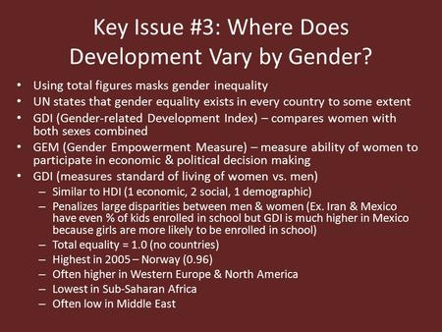
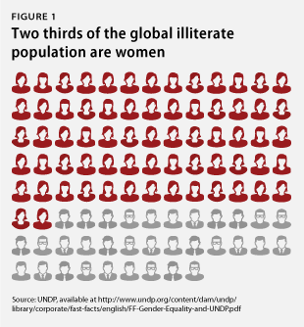
Gender related Development Index (GDI) measures the gender gap in the level of achievement for the 3 dimensions of HDI and ranks countries based on their deviation from gender parity.
Gender Inequality Index (GII) measures the gender gap in the level of achievement in 3 dimensions, reproductive health, empowerment and labor market. The higher the GII the greater the inequality. A score of zero would mean equal. Reproductive health is the largest contributor to gender inequality.

Slide 39
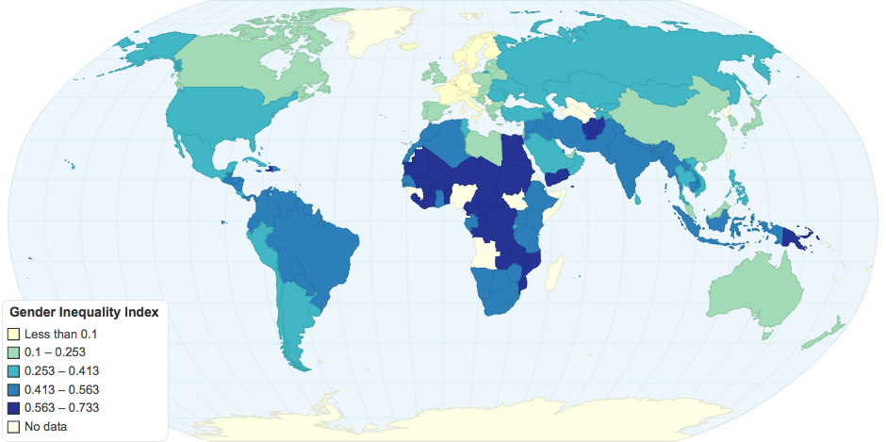
Gender Inequality Over Time
The U.N. have found that the gender inequality has declined since the 1990’s in all but 4 of the 138 countries with the greatest improvement being in Southwest Asia and North Africa
The improvement in gender inequity as been relatively modest in the US. It has a GII score of only 47, although it ranks fifth in the world on HDI. The U.N points to two factors:
1. Compared with other very high HDI countries, the US has a much higher birth rate among teenage women and a higher mortality rate among women during childbirth
2. The percentage of women in the national legislature is lower in the US than in other high HDI countries
Patterson video why does development vary by gender?: https://www.youtube.com/watch?v=7vOnhtFedKg

Slide 40

Microloans and opportunities for Women
In recent years NGO’s nongovernmental organizations have initiated microcredit or microfinance programs
These programs provide small loans to start or expand a business to entrepreneurs who would not normally qualify for credit from traditional sources
These loans have been particularly active in South Asia and South America
The vast majority of the entrepreneurs taking advantage of micro credit loans are women, many of whom are quite poor. And has a repayment rate of more than 98%
The success of microcredit programs has resulted in increased financial clout of women giving them more influence in their homes and communities and working women have more voice in child bearing decision, more money to pay for contraceptives, less time to raise children and less need for additional children, birth rates have decreased. Also, women’s increased wealth also allows for children to be better nourished reducing child mortality

Slide 41
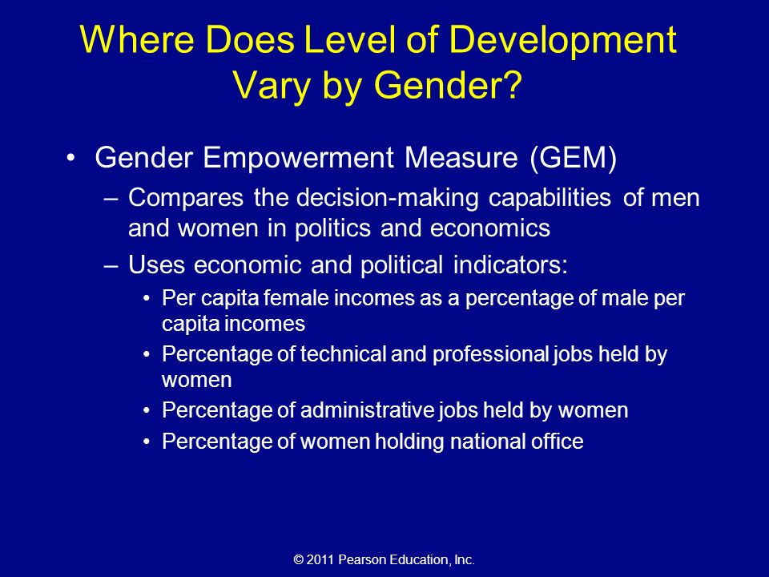
Gender Empowerment and Employment
Employment
Female Labor Force Participation Rate is the percentage of women holding full time mobs outside the home.
Worldwide, 51% of women work outside the home, compare to 77% percent of men.
In general women in developed countries are more likely than women in developing countries to hold full time jobs outside the home.

Slide 42

UN Millennium Development Goals

Slide 43
UN Millennium Development Goals and Progress
Goal | Example of Progress
1. Eradicate extreme poverty and hunger | The number of people in extreme poverty fell from 1.7 billion to 0.8 billion
2. Achieve universal primary education | The number of children not in school fell from 100 million in 2000 to 57 million in 2015
3. Promote gender equality and empower women | Gender disparity in education was eliminated in developing regions overall
4. Reduce child mortality | The global mortality rate for children under the age of five dropped from 90 per 1,000 to 43 per 1,000 between 1990 and 2015
5. Improve maternal health | Maternal mortality was reduced by 45% since 1945
6. Combat HIV/AIDS, malaria and other diseases | The number of projected new HIV cases was cut by 1.4 million between 2000 and 2o13
7.Ensure environmental sustainability | Ozone depleting chemicals have been almost totally eliminated since 1990
8. Develop a global partnership for development | Developed countries increased their development assistance by 66% up to $135.2 billion since 2000

Slide 44
Development through Self Sufficiency (Balanced Growth)
The Self Sufficiency approach was used by China, India, Eastern Europe and African Countries
This model suggests that money should be spent evenly in all sectors so that all people and industries fee valued
Development through International Trade: The growth may not be dramatic, but it will be equitable
Urban and rural areas will grow at the same speed and poverty will be diminished rather than a small percentage of the population becoming wealthy
Businesses are kept national or even local to protect them from international competition
Limits or quotas on imports and increased tariffs to stop international trade (to make imports more expensive than domestic products)
India used self-sufficiency by requiring complicated licensing for imports, limiting exports increasing tariffs and supporting Indian products made for the Indian people (government incentives for following their guidelines)
Problems with self Sufficiency:
Businesses are inefficient on the global scale and have been protected by government policies that will eventually hurt business
Bureaucracy (government control and red tape) has to be huge and complex – this can lead to corruption and ineffective rules and regulations

Slide 45
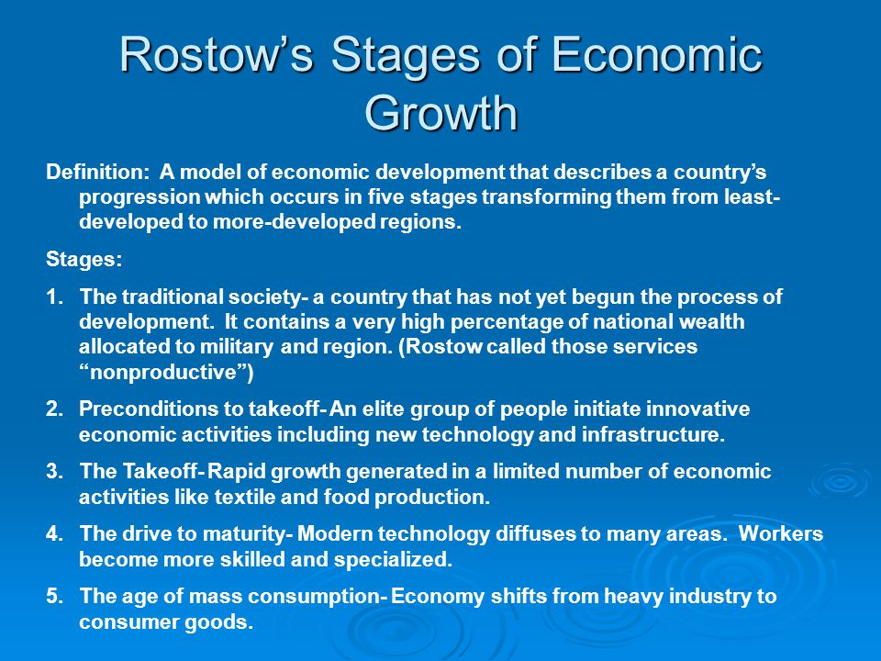

Slide 46
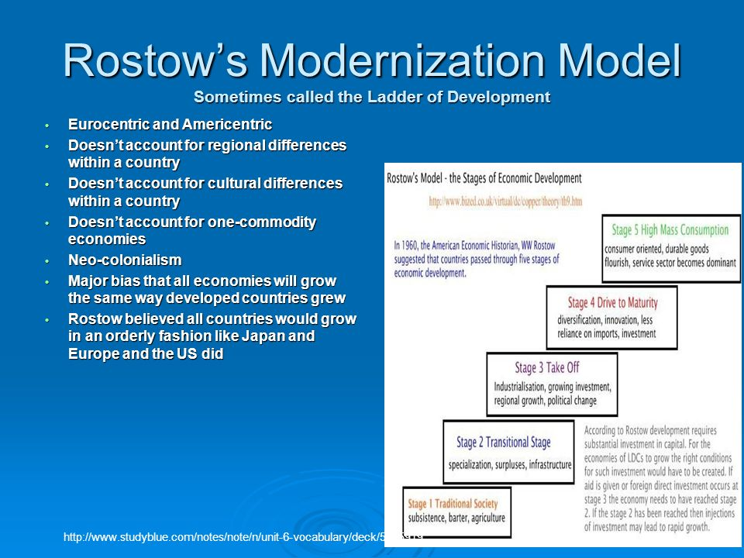

Slide 47
Rostow’s Stages of Economic Growth
Stage | Characteristics | Examples
Traditional Society | Depends upon primary sector activities (farming, fishing, hunting,) subsistence Uses limited technology Carries out local or regional trading Enjoys limited socio-economic mobility | English colonies in North America in 17th century Medieval Europe, Not country is at this state today
2. Pre-Condition for Take off | Improves infrastructure (roads, electrical grid, water systems) etc Improves farming techniques & shifts toward commercial agriculture Exports agricultural and raw materials (international trade) Diffuse technology more widely Starts individual socio-economic mobility | United States in early 19th century Nigeria today Afghanistan today
3. Take Off | Open to major technological innovations Starts industrialization & primary sector begins to shrink Spreads entrepreneurial mentality Begins to urbanize Initiates self sustaining growth | United States mid 19th century Japan, late 19th century Bangladesh today
4. Drive to Maturity | Creates new industries while strengthening existing ones Improves energy, transportation, & communication systems Sees economic growth greater than population growth Invests in social infrastructure (schools, hospitals etc) | U.S. late 19th century, Germany early 20th century Brazil today
5. High Mass Consumption | Spends money on nonessential goods ( consumerism) Purchases of high order goods become common Desires to create an egalitarian society Supports a strong tertiary sector | US early 1920’s to present Japan mid 1950’s to present

Slide 48
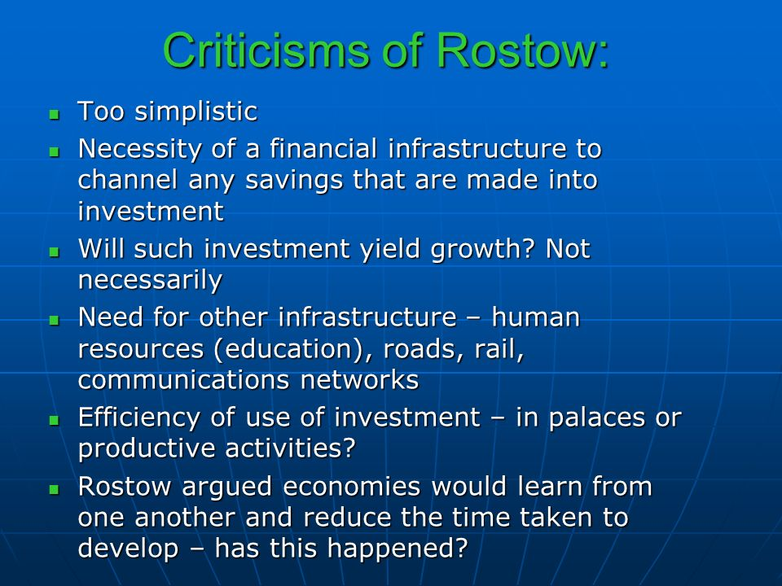

Slide 49
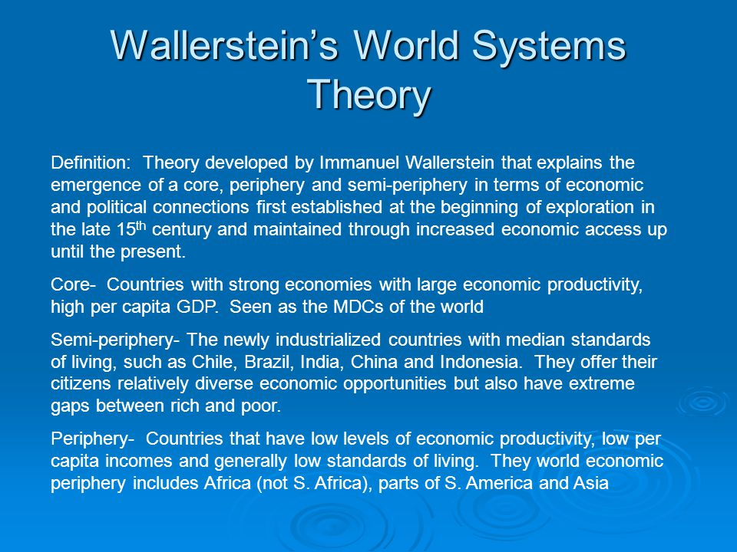
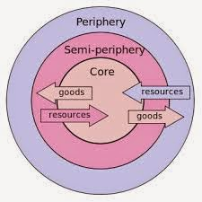
Wallerstein’s World Systems Theory is a dependency model meaning that countries do not exist in isolation but are part of an intertwined world system in which all countries are dependent on each other.

Slide 50
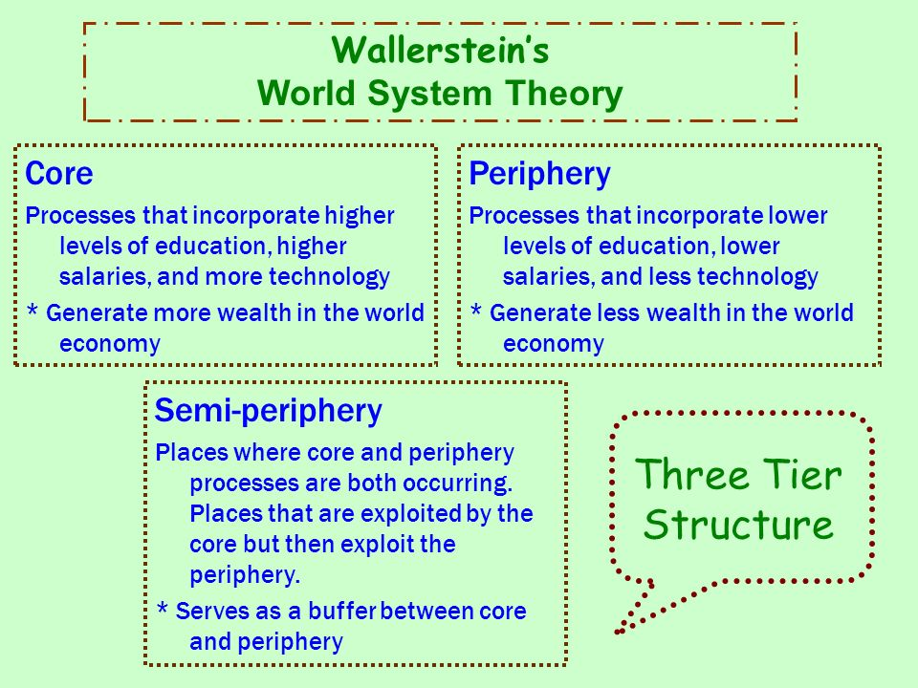
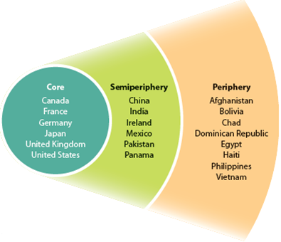

Slide 51
Wallerstein’s World Systems Theory
Category | Characteristics | Examples
Core | Includes the economically advantaged area of the world & the center of world businesses & finances; headquarters of most large multinational companies are located in core countries Focuses on higher skill, capital intensive production Promotes capital accumulation Dominates periphery and semi-periphery economically ad politically, & by paying low wages & exploiting weak environmental laws Benefits greatly from international trade | United States, United Kingdom Japan Australia Germany
Semi-Periphery | Includes the middle income countries Sometimes known as the emerging economics Provides the core with manufactured goods and services that the core once provided for itself, but no longer does | India Mexico South Africa Brazil, China
Periphery | Includes the least developed countries Has a high percentage of jobs in low skill, labor intensive production and extraction of raw materials Provides the core and semi-periphery with inexpensive raw materials, labor, & agricultural production Receives jobs but few profits from manufacturing Often have weak laws protecting workers and the environment | Afghanistan Zimbabwe Peru Kenya

Slide 52
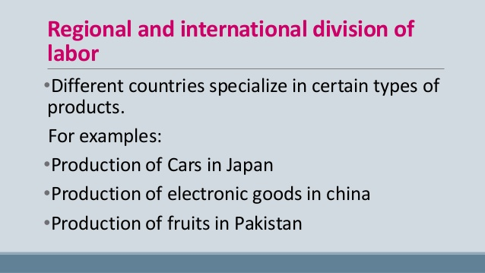
International Division of Labor
Throughout the 20th century, demand for cheaper consumer goods in the consumer economy led many manufacturers to search for cheaper wages (why?)
As industry diffused from core countries to those in the semi-periphery (ex: Mexico, China), an international division of labor* developed
transfer of some types of jobs, especially those requiring low-paid less skilled workers, from more developed to less developed countries
International trade crash course econ: https://www.youtube.com/watch?v=geoe-6NBy10

Slide 53
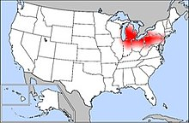
deindustrialization
deindustrialization: process by which companies move industrial jobs to other regions with cheaper labor, leaving the newly deindustrialized region to switch to a service economy and to work through a period of high unemployment
Industry had been concentrated around Pennsylvania to Michigan and Great lakes regions
Industry has been declining in this region
Brown belts: the stereotyped image of a postindustrial landscape is one of deteriorating buildings surrounded by weeds and marked by broken or boarded up window and rusting metal
Called the Rust Belt because the factories were left to rust

Slide 54

Outsourcing
Outsourcing: Turning over much of the responsibility for production to independent suppliers
Cons: Outsourcing and economic restructuring have led to a decline in jobs in manufacturing regions and to relocation of segments of the workforce to other areas.
Pros: Cheaper goods and services, people can spend more on services if they spend less on manufactured goods. Provides LDCs with jobs.
Indian outsourcing 5 min: https://www.youtube.com/watch?v=i5zg1fG7m88

Slide 55

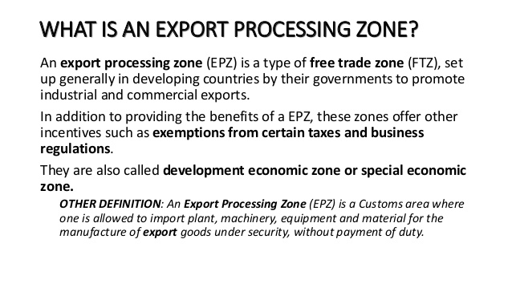
Export-processing zones (EPZs) Region of a less-developed country that offer tax breaks and loosened labor restrictions to companies who export goods to foreign markets

Slide 56

Special Economic Zones
special economic zones: an area in a country that is selected by the government for development
This area has economical laws made in such a manner so that they are business friendly to attract people to set up manufacturing, trading or service establishments.

Slide 57
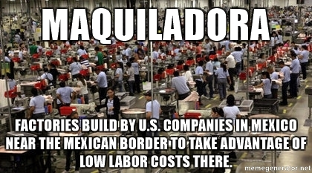
Maquiladoras
Foreign-owned assembly companies located south of the US – Mexico border region
Cheaper labor
Favorable tax breaks
Lax environmental regulations
Close to markets at minimal cost
Maquiladora women https://www.youtube.com/watch?v=yK2KzIGb44I

Slide 58



Slide 59

Why states trade with one another
Complementary comparative advantage create a basis for trade between different regions of the world
Each developed country excels at producing some products, and struggles to produce others.
So… countries produce and sell what they’re good at…
and import products they cannot make well/ cheaply from other countries.
Why do countries trade 2 min: https://www.youtube.com/watch?v=-IW8ZzY3xt8

Slide 60
Advantage to International Trade
The exploitation of a country's comparative advantage which means that trade encourages a country to specialize in producing only those goods and services which it can produce more effectively and efficiently, and at the lowest opportunity cost
Producing a narrow range of goods and services for the domestic and export market means that a country can produce it at higher volumes, which provides further cost benefits in terms of economic scale.
Trade increases competition and lowers world prices, which provides benefits to consumers by raising the purchasing power of their own income, and leads a rise In consumer surplus.
Trade also breaks down domestic monopolies which face competition from more efficient foreign firms.
The quality of goods and services is likely to increases as competition encourages innovation, design and the application of new technologies. Trade will also encourage the transfer of technology between countries.
Trade is also likely to increase employment, given that employment is closely related to production. Trade means that more will be employed in the export sector and, through the multiplier process, more jobs will be created across the whole economy.

Slide 61
Disadvantage to Trade
Trade can lead to over-specialization, with workers at risk of losing their jobs should world demand fall or when goods for domestic consumption can be produced more cheaply abroad. Jobs lost through such changes cause severe structural unemployment. The recent credit crunch has exposed the inherent dangers in over-specialization for the UK, with its reliance on its financial services sector.
Certain industries do not get a chance to grow because they face competition from more established foreign firms, such as new infant industries which may find it difficult to establish themselves.
Local producers, who may supply a unique product tailored to meet the needs of the domestic market, may suffer because cheaper imports may destroy their market. Over time, the diversity of output in an economy may diminish as local producers leave the market.

Slide 62
International Trade/Trade Blocs
International trade & trade blocs (EU, NAFTA, TPP) have become increasingly important because of globalization
WTO: World Trade Organization to promote the international trade countries representing 97% of the world trade established he WTO in 1995
It works to reduce barriers to international trade in two principal ways
1. through the WTO countries negotiate reduction or elimination of international trade restrictions on manufactured goods such as government subsidies for exports, quotas for imports and tariffs on both imports and exports. Also reduce or eliminate restrictions on international movement of money by banks, corporations and wealthy individuals
2. the WTO promotes international trade by enforcing agreements. One country can bring to the WTO an accusation that another country has violated the WTO agreement. And the WTO can rule on the charges and order remedies.
The WTO also protects intellectual property
Critics have attacked the WTO charging anti democratic because decision amade behind closed doors promote the interest of large corporations rather than poor people
Conservative change that it compromises the power and sovereignty of individual courtiers because it can order changes in taxes and laws considered unfair trading practices
Free trade - only market forces (supply and demand) influence trade - not tariffs or other regulations
Fair trade - higher prices are paid to producers (products like coffee, sugar) in developing states if they meet certain labor and environmental criteria

Slide 63



Slide 64

Price of oil dropping in 2014 had consumers everywhere enjoying lower gas prices and lower prices for manufactured goods, however, economies in oil producing regions suffered
Oil companies lost revenue, Like Royal Dutch Shell, based in the Netherlands, saw its earning drop 80%
Worldwide, about 250,000 workers lost jobs. These included people in the field of extracting oil but also workers for tanker firms, or in ports who are no longer needed
Governments in oil dependent countries, such as Venezuela, lost tax revenue, forcing them to lay off public employees and reduce public services
Coal companies that could not compete with lower cost oil reduced production leading them to lay off workers
Energy industry investors saw significant losses as well, Share prices of energy companies plummeted along with oil prices.

Slide 65


Globalization

Slide 66
United States economy today
The US economy is no longer based on the secondary sector
It is now a service economy (tertiary sector) based around services and high tech industries
Silicon Valley, Research Triangle
The US economy has transitioned from manufacturing to service-based
service economies focus on research and development, marketing, tourism, sales, and telecommunications.
The services sector accounts for 80% of the US economy

Slide 67
Changing Employment Sectors and Economic Development
As countries industrialized, the primary sector shrank and the secondary sector grew. As part of this shift, countries became wealthier because wages in the secondary sector were higher than those in the primary sector
In addition to higher wages, the secondary sector jobs also had a greater Multiplier Effect, a term for the potential of a job to produce additional job ls.
For example: when a tire manufacturer expanded a plant and created 100 new jobs in a community, the new workers would have more money to spend on food, clothes, movies, and other items from nearby businesses. These businesses would prosper and sometimes add more staff
Multiplier Effect in Reverse: when there is a shrinkage of the secondary sector workforce in the US and other developed countries causing many other businesses to suffer as well. Also, when a large retail store opens in a community that may employ hundreds but smaller stores near by might close or lay off employees.
Governments in developed countries often attempt to replace manufacturing jobs lost because of deindustrialization and automation with new quaternary jobs that would have higher than average waged jobs, and can generate additional jobs
Examples: Cities like Denver, Pittsburgh and Austin bringing in high tech jobs which benefit other sectors of the economy like entertainment, tourism, etc.
One challenge of shifting from manufacturing to quaternary jobs is that many displaced workers do not possess the skills required for new jobs

Slide 68
United States economy today
The US economy is no longer based on the secondary sector
It is now a service economy (tertiary sector) US economy has transitioned from manufacturing to service-based
service economies focus on research and development, marketing, tourism, sales, and telecommunications.
The services sector accounts for 80% of the US economy
based around services and high tech industries
Because of economic growth from the technopoles, Growth Poles or growth centers are concentration of high value economic development in the growth pole attracts even more development. Once the process starts, if feeds on its self becoming a magnet for more businesses
Spin-off Benefits are the positive outcomes in addition to the main outcome. For example a farmer 100 miles away from the pole should be able to increase his sales
Technopoles:
Just as agglomeration economics can encourage spatial groupings of manufacturing plants the same can apply to technology companies
Technopole as a hub for information based industry and high tech manufacturing. It allows for benefits such as certain services and attracts highly skilled workers to the area and are often located near universities well known for their computer, mathematics, engineering, science and entrepreneurial business faculties: They also have a concentration of high value economic development
Silicon Valley with UC Berkeley and Stanford campuses, famous for technology
Research Triangle developed because of three universities, Duke, UNC and NC State
Unwanted side effect is the “Backwash Effect: the loss of the highly educated from distant communities migrate to the techopoles or growth poles while small communities suffer depopulation

Slide 69
Government Efforts to Promote Economic Growth
Type of Incentive | What Businesses Receive
Tax Breaks | A tax holiday (a temporary exemption from some taxes) A tax break for money invested in research and development
Loans | Forgivable loans Money to borrow at below normal interest rates
Direct Assistances | The Use of land or buildings free of charge Infrastructure such as roads and sewers paid for by the government A subsidy for each full time job created
Changes in Regulations | Legislation that weakens unions Legislation that reduces environmental rules

Slide 70


Right To Work States State right to work laws essentially requires unionized workplaces to become "open shops". Open shops must allow employees to work, whether or not they join the associated unions or pay regular dues.

Slide 71

Transnational Corporations (TNC’s)
Transnational Corporations are companies that have offices or divisions across the globe. The purpose behind them is to reduce transportation costs of products and people
They have unusually large workforces, necessary because of their global reach and volume, The majority of these employees are well educated
As they receive promotions they may be forced to move across the planet
Honda is a transnational corporation. You can go almost anywhere in the world and buy a Honda product
General Electric is one of the largest TNC”s

Slide 72

Sustainability Issues
sustainable development is development that meets the needs of the present without compromising the ability of future generations to meet their own needs
Sustainability addresses issues of…
natural resource depletion, mass consumption costs, pollution, climate change, human health, and social & economic equity
In industry and agriculture, more women are taking on responsibilities in the workforce.
the challenge = laws that protect them and treat them equally
■ Ecotourism - A form of tourism pursued by many ecologically concerned people, who visit regions with pristine ecosystems without damaging the economic system, intended as a low-impact and often small scale alternative to standard commercial mass tourism

Slide 73


Slide 74

Fossil fuels aren’t distributed evenly. Coal, Petroleum an natural gas all formed millions of years ago

Slide 75

Industries depend on available and abundant low cost energy. Demand for energy comes from four principal types of consumption in the US
Industries: Factories use about 40% natural gas and 30% coal and petroleum. Most natural gas and petroleum burned directly while coal is consumed through electricity
Transportation: almost all transportation systems run on petroleum products
Homes: natural gas and coal provide roughly equal shares of home needs. Natural gas is the principal source of home heating and air conditioning whereas electracy generated primarily from coal is the principal source of electricity
Commercial: Stores and offices have uses and sources similar to those for homes

Slide 76
Fossil fuels: Manufacturing depends on the availability to abundant low cost energy.
Developed countries use large quantities of energy to run factories,
Historically, people relied primarily on animate power which is power supplied by animals or by people this was supplemented by biomass fuel (wood, plant materiel, and animal wasted) burned directly or converted to charcoal
During the pas 200 years developed countries have concerted primarily to energy from fossil fuels or energy formed from residue of plants and animals buried millions of years ago.
Coal: coal supplanted wood as the lead source in North America and Europe
Petroleum: first pumped in 1859, petroleum did not become an important source of energy until the diffusion of motor vehicles in the 20th century
Natural Gas: Originally burned off as a waste product of petroleum drilling, but is now used to heat homes and produce electricity
Renewable resources: those produced in nature more rapidly than they are consumed by humans
Non renewable resources are those produced in nature more slowly than they are consumed by humans like fossil fuels

Slide 77

Developing countries accounted for more energy usage than developed countries for the first time in 2006. US had long led demand for energy but China now leads. The highest per capita consumption of energy is in developing countries

Slide 78



Slide 79



Slide 80


Slide 81


Slide 82

Nat geo https://www.youtube.com/watch?v=oJAbATJCugs

Slide 83
Video
Patterson Video Key Issue 1 where is industry distributed: https://www.youtube.com/watch?v=eZuVzQs97ng
Patterson video Key Issue 2 site an situation: https://www.youtube.com/watch?v=Jo3z-9qm0kI
Patterson Key Issue 3 Energy https://www.youtube.com/watch?v=eZuVzQs97ng
Patterson Key Issue 4 why are industry and site situations changing: https://www.youtube.com/watch?v=c4AsEy4UZCQ
Crash Course the Industrial revolution https://www.youtube.com/watch?v=zhL5DCizj5c
Keith Hughes I.R. 27 min: https://www.youtube.com/watch?v=Wrmax07bxyQ
Crash Course Capitalism: https://www.youtube.com/watch?v=B3u4EFTwprM
Five interesting facts about capitalism : https://www.youtube.com/watch?v=IMPvD1wDEi0
Patterson Video Development varies among countries: https://www.youtube.com/watch?v=HbZMXdADBWM
Patterson video why does development vary by gender?: https://www.youtube.com/watch?v=7vOnhtFedKg
Crash Course Economics on Productivity: https://www.youtube.com/watch?v=UHiUYj5EA0w
Income and Wealth Inequality: Crash Course Economics https://www.youtube.com/watch?v=0xMCWr0O3Hs
Crash course macro econ, GDP: https://www.youtube.com/watch?v=d8uTB5XorBw
Why does development vary among countries: https://www.youtube.com/watch?v=ZAyJX1PK-BY
Crash Course International Trade: https://www.youtube.com/watch?v=geoe-6NBy10
Nat geo global warming https://www.youtube.com/watch?v=oJAbATJCugs

