Slide 1
Unit 7 Urban Development part 2 Note power point

Slide 2
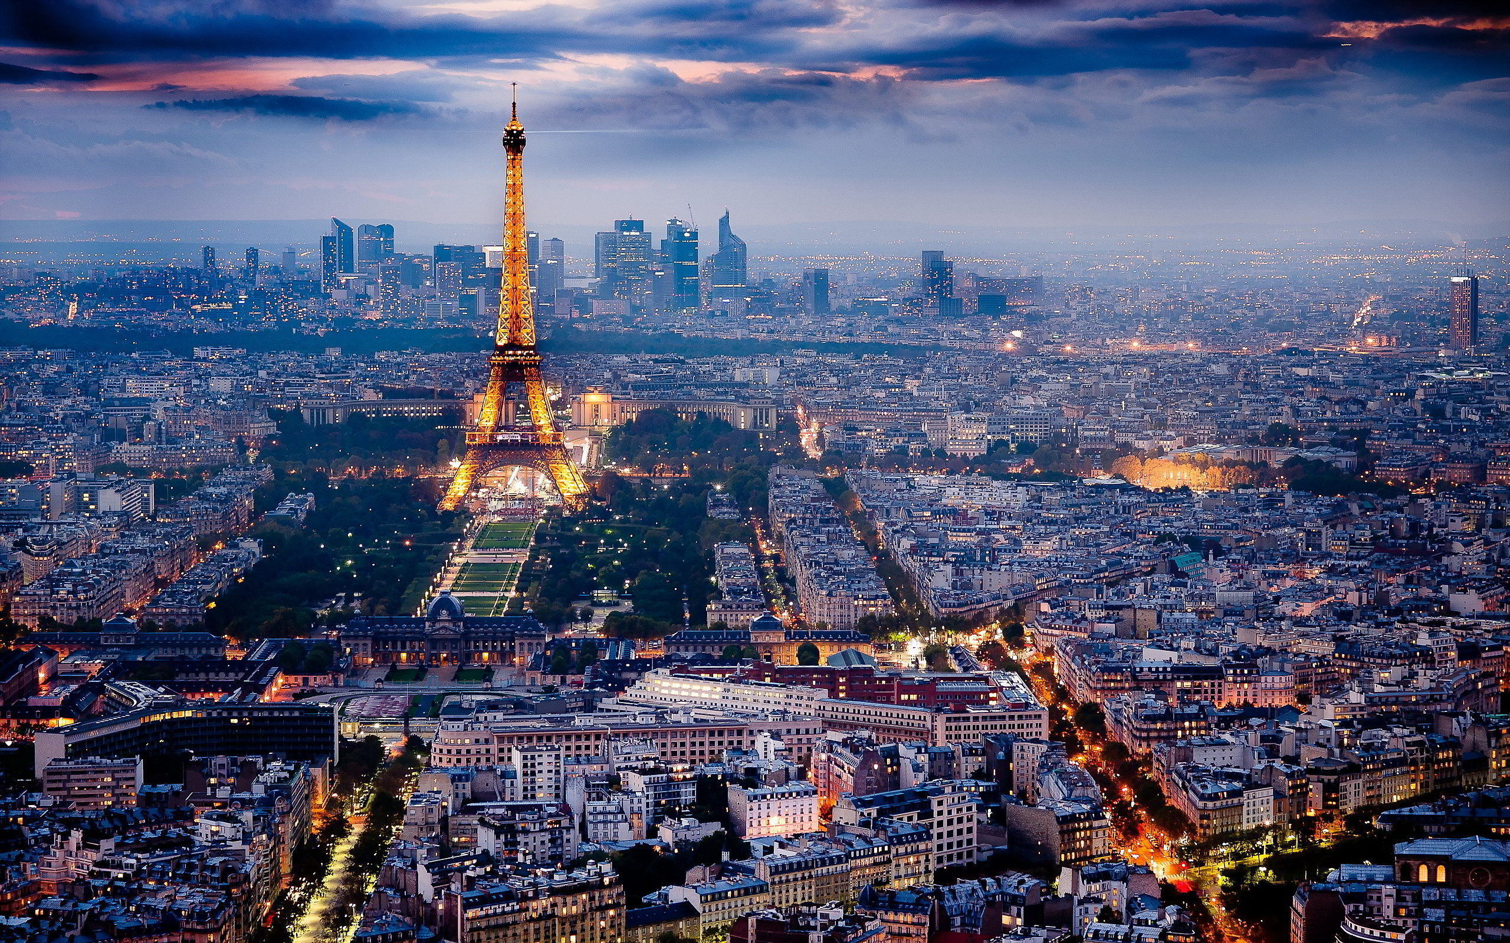
World Cities or Global Cities: are ones that exert influence far beyond their national boundaries
World Cities are communication hubs, financial and banking centers with influential stock exchanges, transportation centers, and corporate headquarters.
Many are headquarters of international organizations. (United nations in NYC)
Top 10 per Forbes are
1. London 6. Hong Kong
2. New York 7. Dubai
3. Paris 8. Beijing
4. Singapore 9. Sydney
5. Tokyo 10. Los Angeles

Slide 3
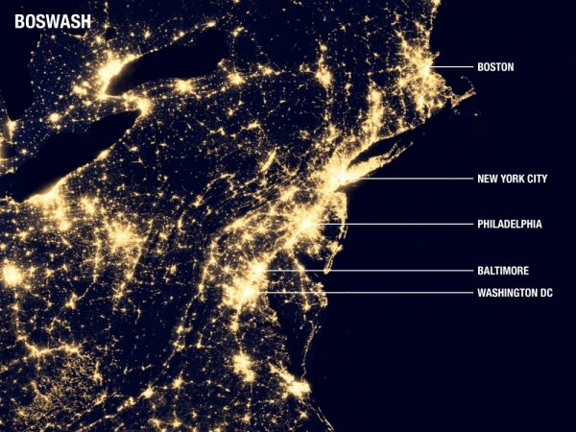
Megalopolis are a chain of connected cities
The term came about when geographer Jean Gottman used it to describe the continuously developed string of cities from Boston through New York and Philadelphia through Baltimore and Washington D.C. The “Bos-Wash Corridor” now includes nearly 50 million
These cities have formed a single conurbantion, they had essentially merged into a single uninterrupted urban area, Cities crossed state boundaries and exceeded the definition of a metropolitan area, which is focused on a single urban center.
While legally the major cities remained separate, they and their suburbs had become a single region
Other Examples: the corridor in California from San Diego through Los Angeles to San Francisco, Tokyo- Yokohama in Japan

Slide 4
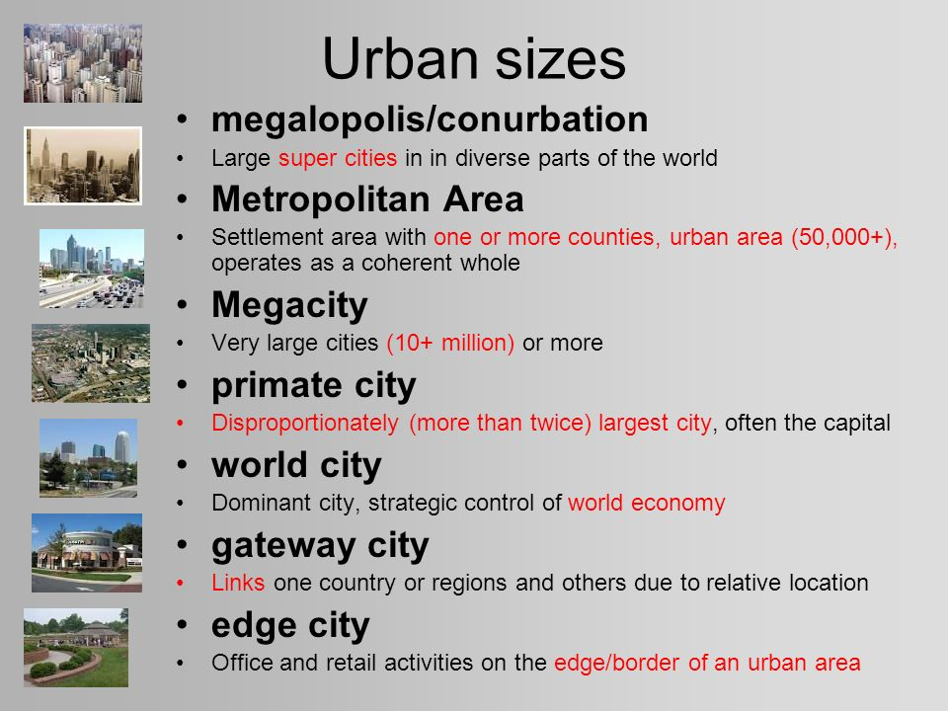
Urban Sizes

Slide 5
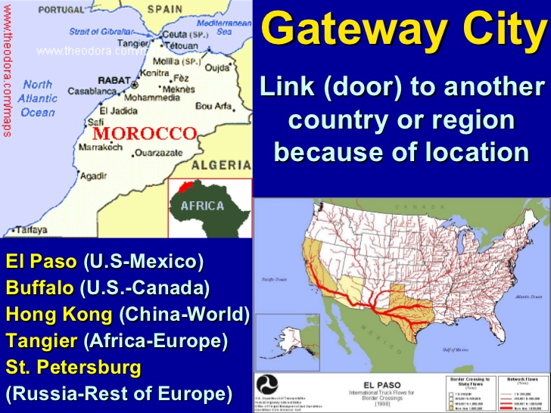
Gateway Cities
Gateway City: Airport or seaport that serves as the entry point to a country by being the primary arrival and departure point
The examples of gateway cities in the U.S. are New York, Miami, San Francisco, Honolulu, Los Angeles, Boston, Chicago, and Washington, D.C.
Other World Gateway Cites include: Toronto, Vancouver, Europe: Amsterdam, London, Paris, Berlin, Frankfurt, Madrid, Milan, Beijing, Hong Kong, Seoul, Shanghai, Singapore, Sydney, Tokyo. Mexico City, Johannesburg, Istanbul, Kuala Lumpur, Jakarta, Amsterdam, Brussels, Mumbai

Slide 6
World Cities or Global Cities: are ones that exert influence far beyond their national boundaries
All World Cities are currently communication hubs, financial and banking centers with influential stock exchanges, transportation centers, and corporate headquarters.
Many are headquarters of international organizations. (United nations in NYC)
Top 10 per Forbes are
1. London 6. Hong Kong
2. New York 7. Dubai
3. Paris 8. Beijing
4. Singapore 9. Sydney
5. Tokyo 10. Los Angeles

Slide 7
Megalopolis are a chain of connected cities
The term came about when geographer Jean Gottman used it to describe the continuously developed string of cities from Boston through New York and Philadelphia through Baltimore and Washington D.C. The “Bos-Wash Corridor” now includes nearly 50 million
These cities have formed a single conurbantion, they had essentially merged into a single uninterrupted urban area, Cities crossed state boundaries and exceeded the definition of a metropolitan area, which is focused on a single urban center.
While legally the major cities remained separate, they and their suburbs had become a single region
Other Examples: the corridor in California from San Diego through Los Angeles to San Francisco, Tokyo- Yokohama in Japan

Slide 8
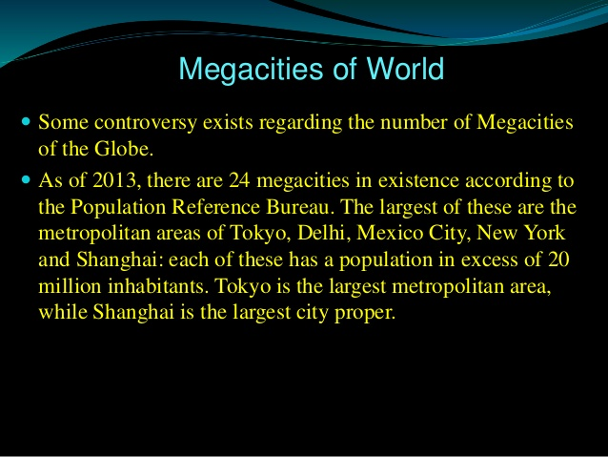
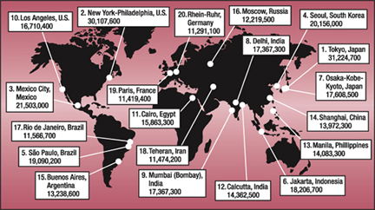
Megacities

Slide 9
Why do inner cities have distinctive problems
The process of deterioration
1. Filtering: the process of change in the use of a house from singe family owner occupancy to rented apartments and ultimately abandonment. Many homes are subdivide houses and occupancy by successive waves of lower income people
2. Redlining: drawing lines on a map to identify areas in which banks will refuse to loan money
Brownfields: as manufacturing moved away, cities were left with unemployed residents and abandoned factories. These are visual reminders on the landscape
-------------------------------------------------------
Inner cities frequently surround the central business districts. During much of the 20th century the trend in the US and Europe was toward the ghettoization of inner cities. Many inner cities became dilapidated centers of poverty as affluent whites moved out to the suburbs and immigrants and people of color vied for scare jobs and resources . This process has often been called white flight was exacerbated by a proactive known as blockbusting when real estate agents and developers encouraged affluent white property owners to sell their homes and businesses at a loss by stoking fears that their neighborhoods were being overtake by racial or ethnic minorities such as blacks, Hispanics and Jews
Urban Renewal
Cities identify blighted inner city neighborhoods, acquire the properties from private owners, relocate the residents and businesses, clear the site, and build new roads and utilities
The land is then turned over to private developers or to public agencies such as the board of education or the parks department, to construct new buildings or services. Effectively developing it so well that the property value is too high for the original tenants to stay and they are forced to move to another area
Can be considered the same as:
Urban Revitalization which usually includes the construction of new shopping districts, entertainment venues and cultural attractions, has enticed young urban professionals back into the cities where nightlife and culture are more accessible
Federal government grants help cities pay for urban renewal
Eminent Domain: laws allow the government to seize land for public use after paying owners the market value for their property. Cities often use these laws to enable them to build new roads or schools but they can also sell the land to private businesses or groups to build hotels, hospitals or other developments
Urban renewal 2 min: https://www.youtube.com/watch?v=WQm6kLWfLwc

Slide 10
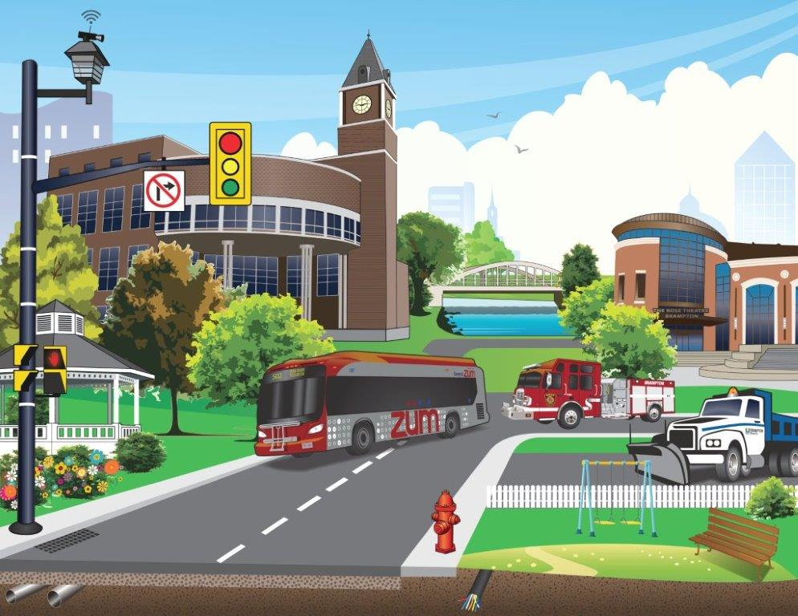
Infrastructure
Transportation features, such as roads, bridges, parking lots and signs and signals, snow removal
Buildings, such as police stations, courthouses, government buildings, police & fire stations
Distribution systems for water, gas and electricity
Collection systems for sewage and garbage
Open spaces, such as public parks and town squares
Entertainment venues, such a museums, theaters, and sports facilities

Slide 11
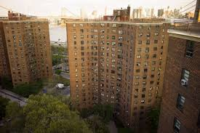
Public Housing
Government supported housing in which the low income tenants must pay 30% of their income for rent with the government covering the other costs not paid for by rent.
Accounts for 2% of all dwellings in the US
The US government has provided subsidies to private developers to build. Frequently concentrated in a small part of the city
One reason for the shortage of affordable housing in urban neighborhoods is the cost of the building and managing it can be greater than the profits a business can make so charitable organizations and the government provide assistance. Many fall into decline
Some cities have another approach called scattered site was employed to alleviate the problems of public housing, Public housing was dispersed throughout areas of the city. Children this had access to better local schools and amenities available in wealthier neighborhoods. But faced
“not in my backyard” (NIMBYISM) response
You can see this with: industries, power
plants, group homes, sewage facilities etc moving
into an area

Slide 12
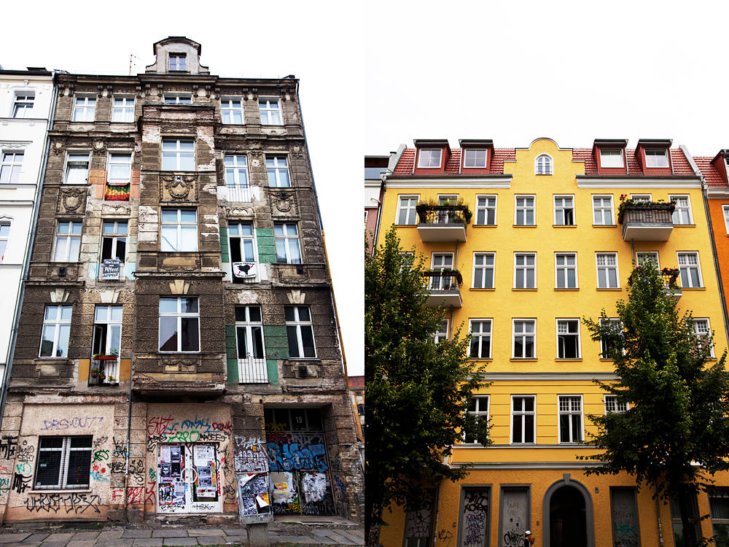
Renovated Housing: an alternative to demolishing deteriorated inner city houses is to renovate them. In some cases nonprofit organizations renovate housing and sell or rent them to low income people
Often renovated housing attracts middle class people
Gentrification: the process by which middle class people move into deteriorated inner city neighborhoods and renovate the housing. These people are often attracted by the cheap housing, proximity to CBD, and availability of city amenities.
This process also results in the raising of property values beyond the range of many of the low income residents who are required or forced to move out and can result in segregation
Deteriorated inner city neighborhoods are attractive for several reasons:
Houses may be larger and more substantially constructed yet less expensive than houses in the suburbs
Houses may posses attractive architectural details such an ornate fireplace, high ceilings, wood trim
For people who work downtown, inner city living eliminates the strain of commuting
Neighborhoods are near theaters, bars, restaurants, stadiums and other cultural recreational faculties

Slide 13
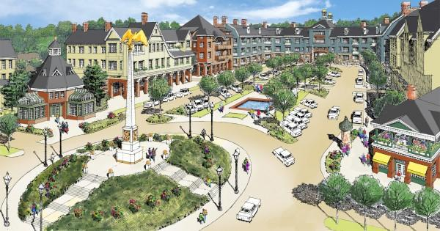
New Urbanism: a movement in urban planning emerged in the 1990’s aimed at reducing sprawl, increasing affordable housing and creating vibrant livable neighborhoods
New urbanism is aimed at livable neighborhoods that are largely walkable, mixed use neighborhoods.
Unlike the clear separation between residential and commercial uses created by zoning in most cities, these neighborhoods would have a mix of homes and businesses. Homes would include a variety of sizes and price ranges in order to create a socially diverse community.
Two obstacles:
1. The existing system of zoning: a system had created segregated areas by land use and turs contributed to sprawl
2. Public opinion: some people were accustomed to traditional land use patterns in cities were not convinced that new urbanism was an improvement
However in communities that changed their zoning laws and where people changed t heir attitudes toward mixed use neighborhoods, new urbanism took hold

Slide 14
Inner City Social Problems
Underclass: a term referring to inner city residents because they are trapped in an unending cycle of economic and social problems; They suffer from relatively high rates of unemployment, alcoholism, drug addiction, illiteracy, juvenile delinquency
Homeless: while accurate numbers are difficult to obtain, it is estimated that on any given night nearly 1 million Americans sleep in doorways, on heated street grates, in bus and subway station or in parks. Over the course of a year, the number of Americans who are homeless is estimated at more than 3 million
Crime: trapped in a hopeless environment, some inner city residents turn to drugs. Some drug users obtain money through criminal activities. Gangs from in inner city neighborhoods to control the lucrative drug distribution. Violence erupts when two gangs fight over the boundaries between their areas
Ethnic and Racial Segregation: many neighborhoods in the US are segregated by ethnicity, African Americans and Hispanics concentrate in one or two large continuous areas of the inner city, whereas whites tend to live in the suburbs
Lack of Job Skills: the underclass is increasingly unable to compete for jobs, many inner-city residents lack the technical skills needed for most jobs because fewer than half completed high school.
Culture of Poverty: many inner city residents are trapped as permanent underclass because they live in a culture of poverty. Unwed mothers, about 90% of children in inner cities live with only one parent, because of inadequate and expensive child care services, single mothers may be forced to choose between working to generate income and staying home to take care of their children

Slide 15
Informal Economy
The Informal Economy is the portion of the economy that is not taxed, regulated, or managed by the government. In the slums and squatter settlements of cities in the less developed world, the informal economy is important, effective,, and vibrant. The majority of the population may be part of it. Where governments have been ineffective at promoting the growth of businesses, individuals have taken on that role. Economists estimate that nearly 50% of people in Latin America work in the informal economy
Shadow Economy: In more developed countries, the informal economy operates as a showdown economy. the part of an economy involving goods and services which are paid for in cash, and therefore not declared for tax.
Local governments are concerned not just because of their lost tax revenue but also because these shadow enterprises are not regulated for safety and undercut businesses that do operate openly and follow regulations

Slide 16
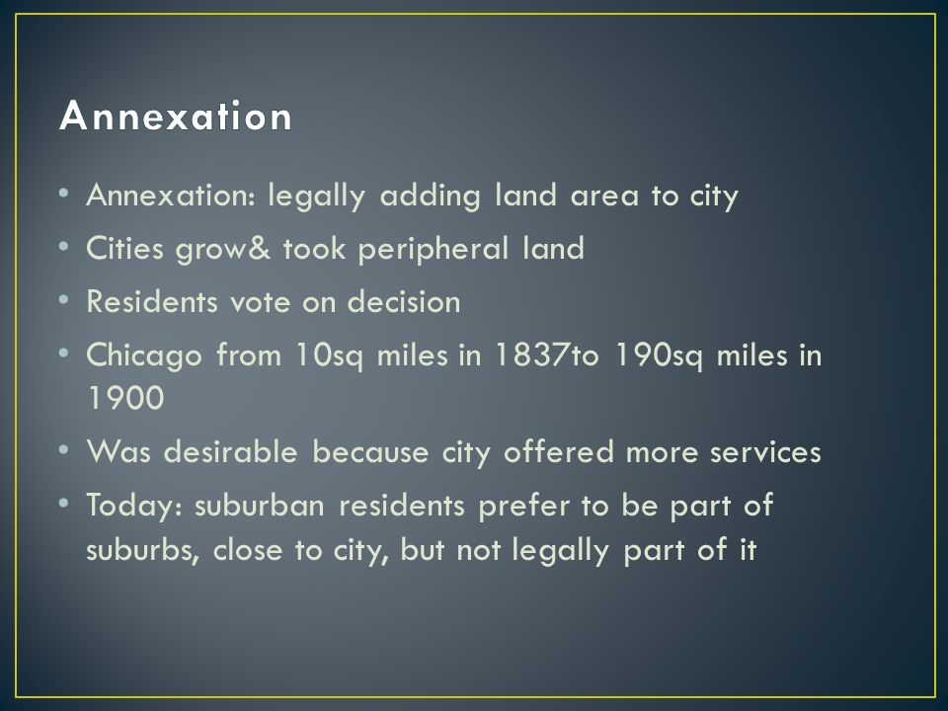
Annexation
Annexation: the process of legally adding land are to a city.
Until recently the US, as cities grew they expanded by annexing peripheral land, Rules concerning annexation very among states. Normally land can be annexed into a city only if the majority of residents in the affected are vote in favor of doing so.
In the 1900’s peripheral residents generally desired annexation because they offered better water supply, sewage disposal, trash pick up, paved streets, public transportation and police and fire protection
for many cities, economic problems are exacerbated by their inability to annex peripheral land

Slide 17
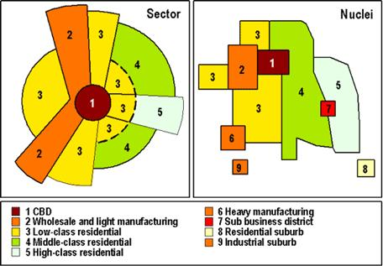
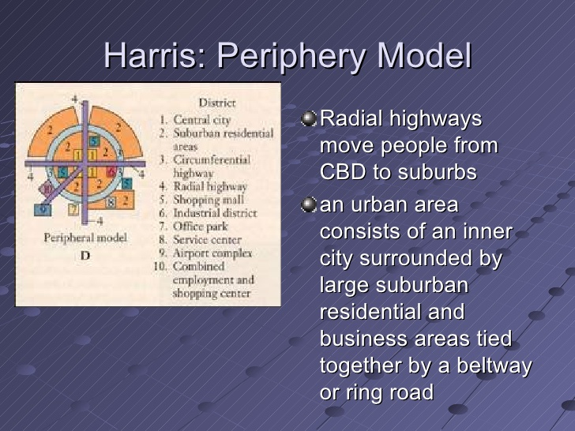
Peripheral Model is a variant of the multiple nuclei model, describes suburban neighborhoods surrounding an inner city and served by nodes of commercial activity along a ring road or beltway. This model’s name comes from the role of the service nodes with their related suburbs that develop on the periphery of the original city

Slide 18
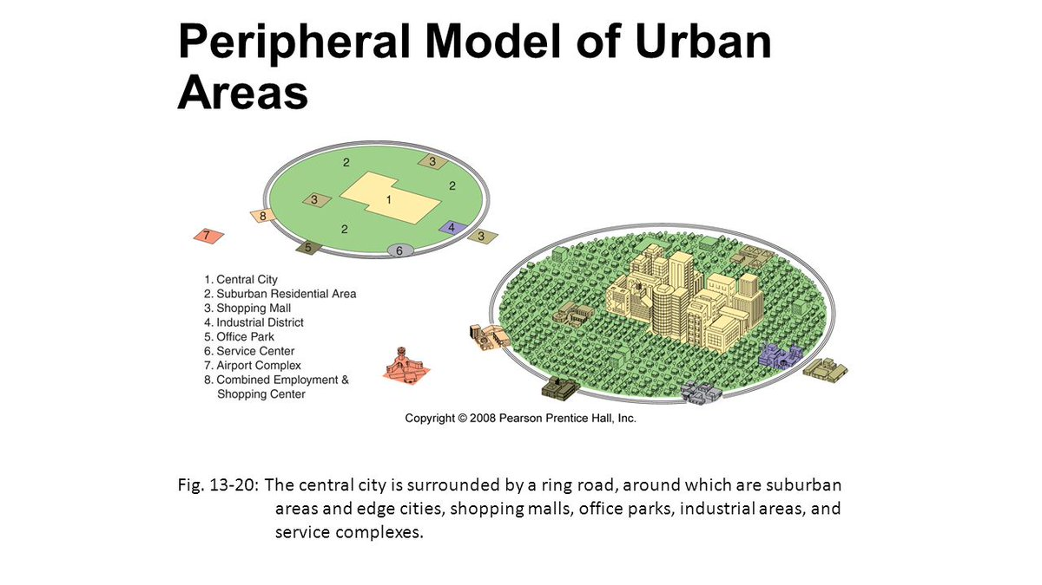
Peripheral Model

Slide 19
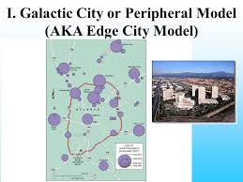
Chauncy Harris created the Galactic City Model (peripheral model) describing the spread of U.S. cities outward from the CBD to the suburbs leaving a declining inner city. As suburbs grew. Some of the functions of the CBD began to appear in them. At key locations along transportation routes, mini downtowns of hotels, malls, restaurants, and office complexes emerged, Modern geographers call these Edge Cities.
Edge Cities are nodes of economic activity that have developed in the periphery of large cities. They usually have tall office buildings, a concentration of retail ships, relatively few residences, and are located at the junction of major transportation routes.
Area | Nearest city
2. | Walnut Creek, Calif. | San Francisco
3. | Coral Gables, Fla. | Miami
4. | Southpark Area, N.C. | Charlotte
5. | San Antonio Airport Area, Tex. | San Antonio

Slide 20
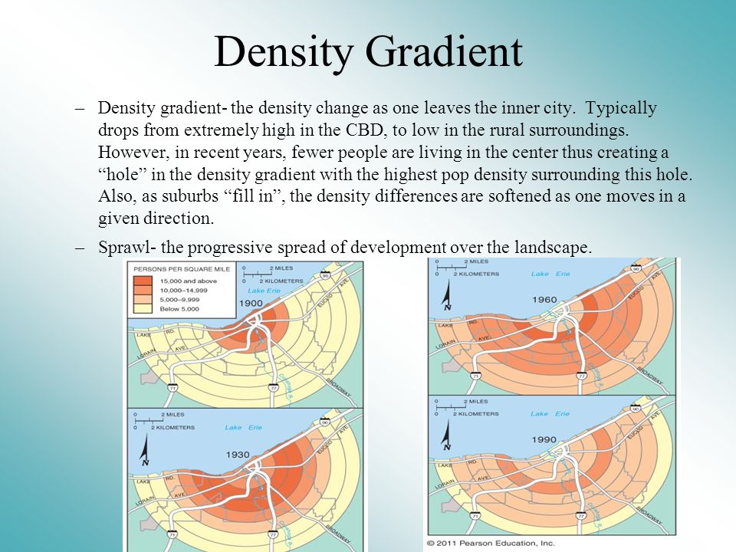
Density Gradient: the change in density in an urban area from the center to the periphery
As you travel outward from the center of the city you can see a decline in the density at which people live. Inner city apartments can have as many 250 dwellings per hector or 100 per acre. And that number decreases the further you get away from the center.
Changes in Density Gradient in recent years are caused by
1. the number of people living in the center has decreased so the density gradient has decreased in the center
2. fewer differences in density within urban areas. The density has increased on the periphery through construction of apartments and row house projects and diffusion of suburbs across a larger area
These two changes have reduced the extremes of density between inner and outer areas traditionally found within cities. As long as demand for single family detached houses remains high, land on the fringe of urban areas will be converted from open space to residential land use.. The peripheries of US cities look lie Swiss cheese with pockets of development and gaps of open space

Slide 21
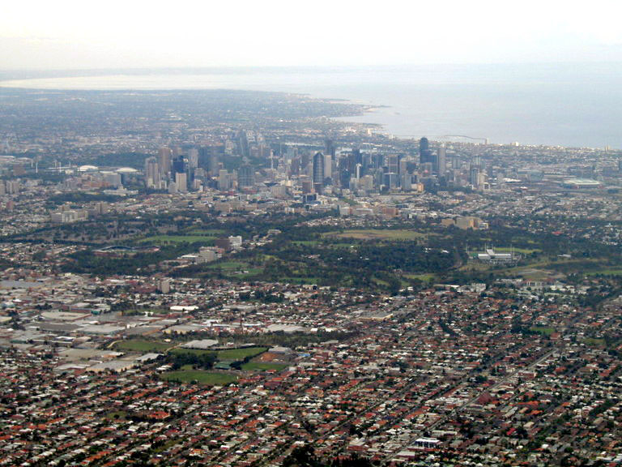
Sprawl: the progressive spread of development over the land scape
Building better cities sprawl ted talk 14 min: https://www.youtube.com/watch?v=IFjD3NMv6Kw
When private developers select new housing sites, they seek cheap land that can easily be prepared for construction – land often not contiguous to the existing built up area,
Sprawl frequently occurs when affluent individuals leave older downtown areas causing both segregation and inner city decay.
Sprawl is also fostered by the desire of many families to own large tracts of land and made easy because of the car, interstates, highways and the presence of inexpensive land outside the urban areas
Undesirable traits from sprawl are roads and utilities must be extended to connect isolated new developments to nearby built up areas, These costs are funded by taxes or the services are provided by the developer who passes on the cost to new residents through higher home process
Sprawl also wastes land, Some prime agricultural land may be lost through construction of isolated housing developments and it reduces the ability of city dwellers to get to the country for recreation and can affect the supply of local dairy products and vegetables.
Low density suburb also wastes more energy, especially because of cars required for most trips.
Officials attack sprawl by designation areas of mandatory open space or greenbelts or rings of open space
When developers purchase land beyond the periphery of the city’s built up area in a process called Leapfrogging. Neighborhoods built there may be farther from the central business district in actual distance but the presence of highways make them relatively close in time

Slide 22
Suburban Segregation
Modern residential suburb is segregated in two ways
1. Segregation of social classes: housing in a given suburban community is usually built for people of a single social class, with others excluded by virtue of the cost, size or location of the housing. Segregation by race and ethnicity also persists in some suburbs
2. Segregation of land uses: residents are separated from commercial and manufacturing activities that are confined to compact, distinct areas
Zoning Ordinance is a law that limits the permitted uses of land and maximum density of development in a community. Zoning ordinances typically identify districts designed only for single family houses, apartments, industry or commerce.
Low income families may have difficulty finding affordable housing through provisions such as requiring each house to sit on a large lot and prohibiting apartments.
Gated Communities Fences are built around some suburban housing districts and visitors must check in at a garage house to ender. The growth of gated communities can reinforce separation in terms of not just economic but also social status, ethnicity and even political views
Low income people and minorities are unable to live in many US suburbs because of the high cost of housing and unwelcoming attitudes of established residents. Suburban communities discourage entry of these with lower incomes and minorities for fear property values will decline if the high status composition of the neighborhood is altered

Slide 23
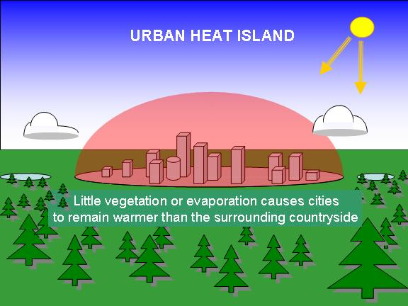
Environmental Problems in Cities: Cities have environmental impacts because of the city structure itself- buildings and streets, being human modifications of the natural environment. And the concentration of so many people in one location can dramatically affect the lands scape
Urban Canyons: streets lined with tall buildings, can channel and intensify wind, Tall buildings can also prevent natural sunlight from reaching the ground. Soils are compacted and replaced with buildings streets and parking lots as a result rainwater runs off instead of soaking into the ground and can cause flooding
Urban Heat Island: the concentration of buildings in the core of a city creates an urban heat island, a portion of a city warmer than surrounding regions.
Urban wildlife: such as rats, raccoons, and pigeons can thrive in cities but can spread diseases and be a nuisance to people. There are also feral (wild) dogs, cants, snakes, and other former pets that have escaped or been abandoned.
Pollution: sometimes untreated industrial and human waste, car emissions, poorer inhabitants burning charcoal, wood and kerosene

Slide 24
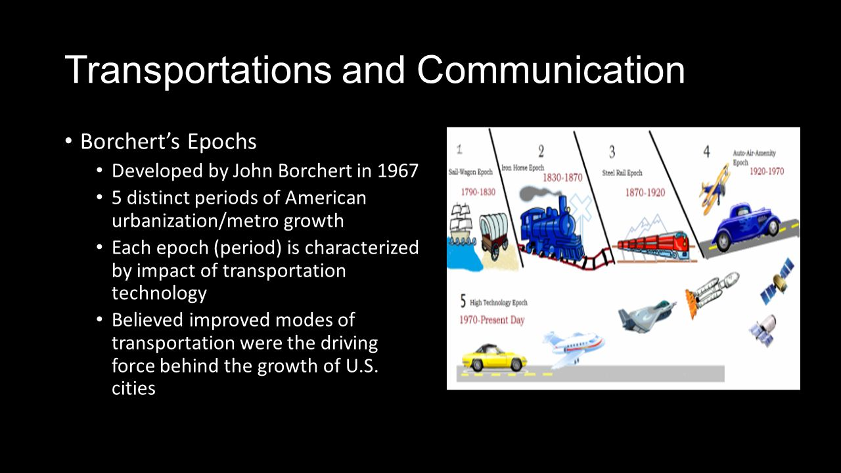
Geographer John Borchert described urban growth based on transportation technology. Each new form of technology produced a new system that changed how people moved themselves and goods.

Slide 25
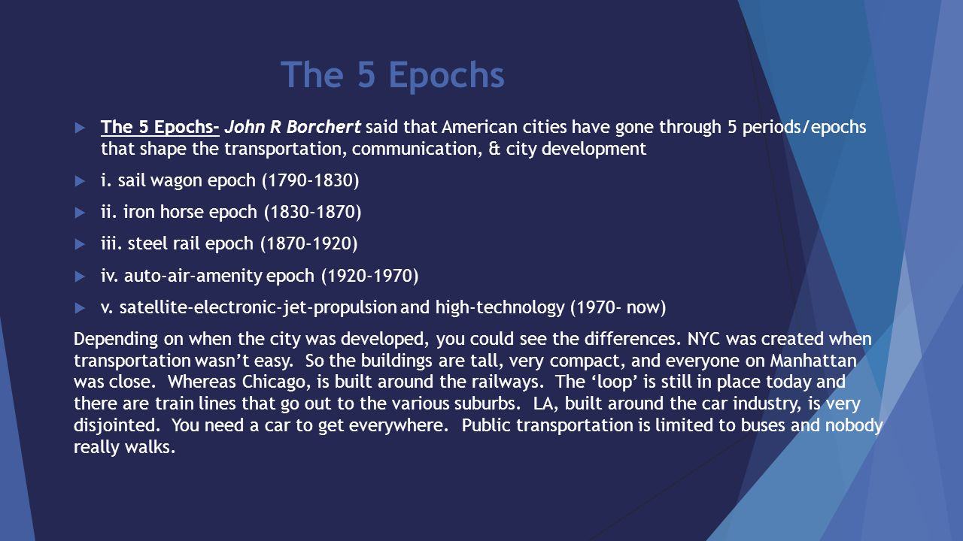

Slide 26
Contribution of Transportation to Suburbanization
Urban Sprawl makes people more dependent on transportation for access to work, shopping and leisure activities whit more than half of all trips being work related
Historically growth of suburb s was constrained by transportation problems, people lived in cities because they were within walking distance of shops and jobs. With the invention of the railroad and later cars people could live in the suburbs and working in the central city.
Cars and trucks have permitted the large scale development of suburbs at greater distances from the center and gave drivers much greater flexibility in their choice of residence. More than 95% of all trips within the Us are made by car
The US government encourages the use of cars and trucks by paying 90% of the cost of interstate highways
The heaviest flow of commuters is into the CBD in the morning and out of it in the evening. Rush Hour or peak hour is the four consecutive 15 minutes periods that have the heaviest traffic because a large number of people must reach a small area of land at the same time in the morning and disperse at the same time in the afternoon
Benefits and costs of motor vehicles: comfort, choice and flexibility. You have comfortable seats, can listen to music, travel whenever you wish, not constrained by timetables and isolated from unpleasant people
Perceived costs of using vehicles is less that the cost of public transportation. Many looking at just each time they pay for that compared to fuel but many don’t thing about costs of insurance and licenses
Cars use a large amount of land and many Americans wasted 18 gallons of gas and lose 42 hours per year sitting in traffic jams but most Americans still prefer to commute by vehicle valuing privacy and flexibility of schedule offered by a car

Slide 27
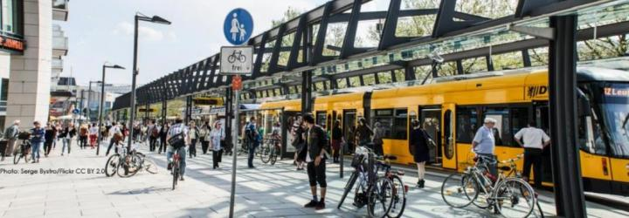
Public Transportation
Public Transportation in the US
Public Transportation in the US is used primarily for commuting by workers into and out of the CBD but is used by only about 5% of commuting trips in some large cities it is minimal or nonexistent is most others. Motorists driving alone account for 76% of commuters and carpooling for another 10%
Rail lines in Chicago Boston, Atlanta, Baltimore, Los Angeles, Miami, San Francisco and Washington, NYC
Public Transportation in other countries
Hundreds of cities around the world have extensive networks of bus, trams, subways, light rail systems that have been maintained and funded and makes movement easy
The greater importance placed on public transportation outside the US can be seen
Light Rail comes to Triangle: https://www.youtube.com/watch?v=XK3B2UjPrs4

Slide 28
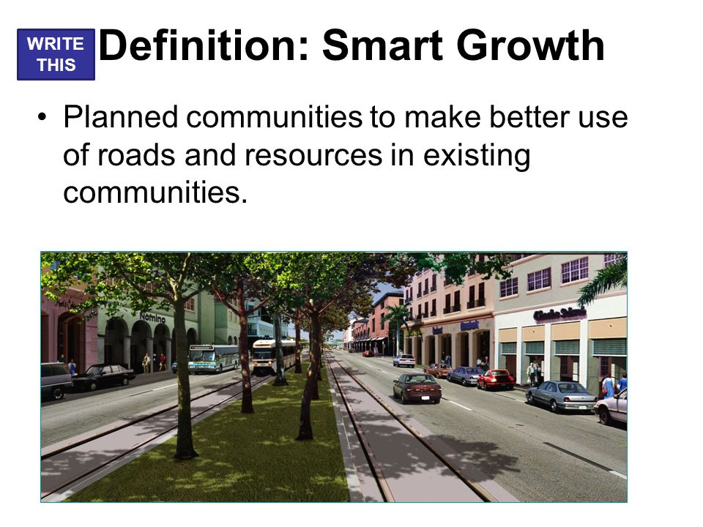
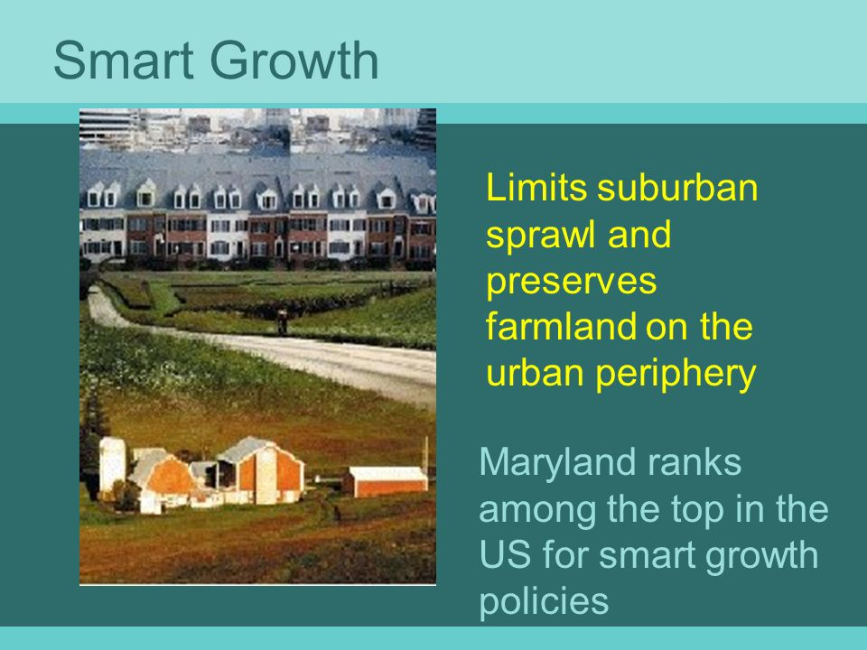
Smart Growth Legislation and regulations to limit suburban sprawl and preserve farmland

Slide 29
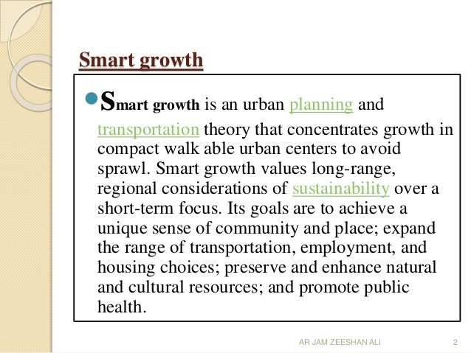

Slide 30
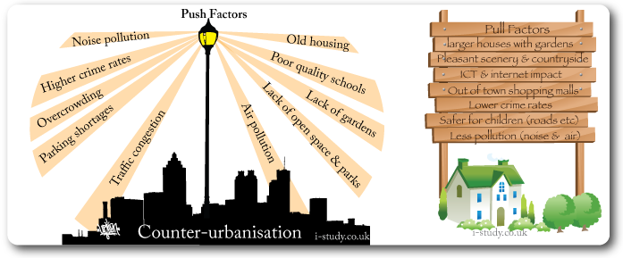
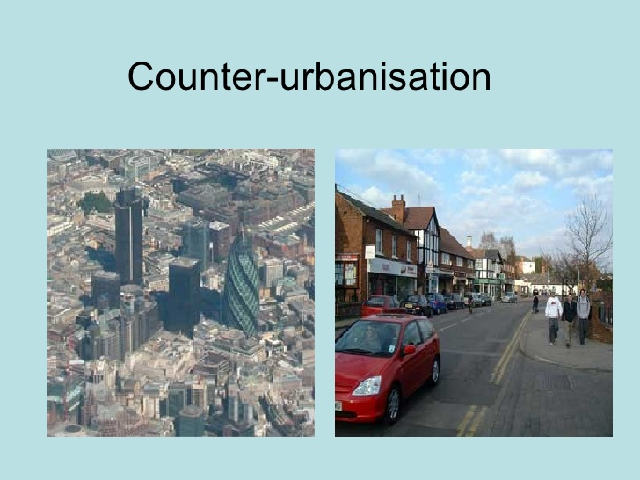
Counter Urbanization or deurbanization, residents leaving cities with many relocating to exurbs, the prosperous residential districts beyond the suburbs. Contributing to this is the ability of people to work remotely vie technology. The attraction being mountains, streams, and prefer a calmer, smaller more isolated community

Slide 31
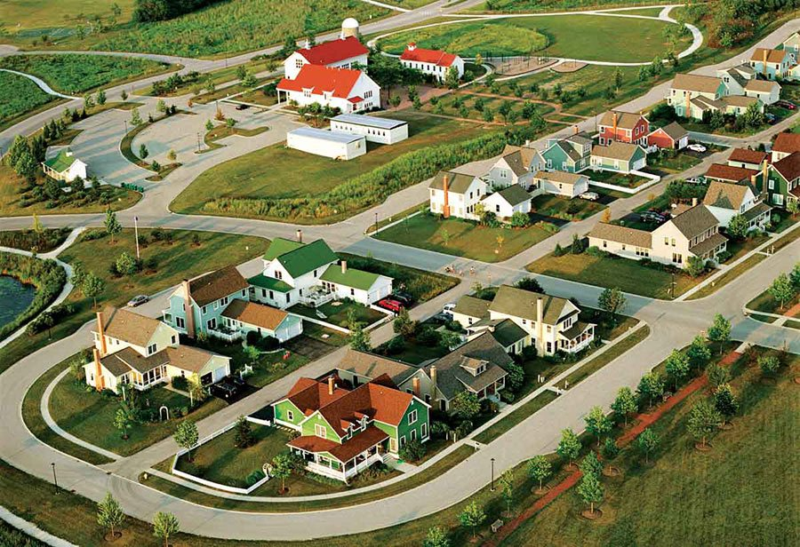
Agrihoods
A new type of housing community known as an "agrihood" is popping up around the US.
Agrihoods are built around working farms and are replacing the golf communities once favored by baby boomers.
NBC: https://www.nbcnews.com/nightly-news/video/agrihoods-the-newest-trend-in-millennial-living-1118578243751
Detroit agrihoods https://detroit.curbed.com/neighborhood/579/north-end

