Slide 1
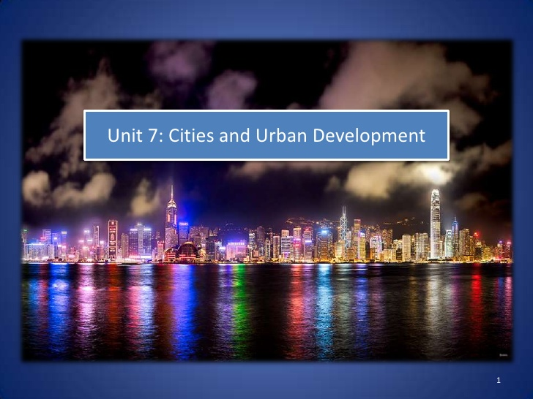

Slide 2
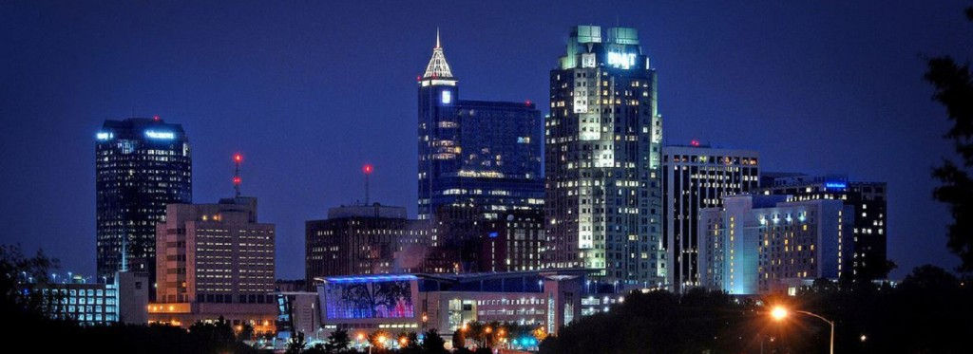
Urbanization by the Numbers
There are over 500 cities with populations over 1 million
Since 2008 50% of the world's population have lived in cities
The majority of growth is occurring in Africa and Asia
Seven of the fasting growing cities (based on population) are in emerging and developing countries.
What are the Top 10 Cities
(by population):

Slide 3
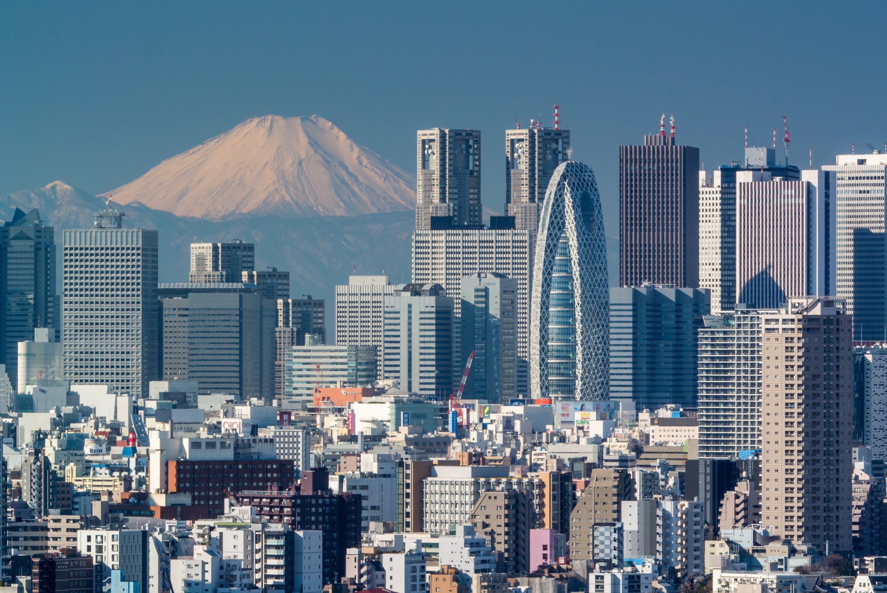
Top 10 Cities (by population)
  Tokyo
  Jakarta (Indonesia)
  Delhi (India)
  Seoul (South Korea)
  Manila (Philippines)
  Mumbai (India)
  Karachi (Pakistan)
  Shanghai (China)
  New York (US)
  Sao Paolo (Brazil)
  What are their populations?
  What is the population of North Carolina?
  Of Raleigh
  How many are LDC’s (Less developed countries) How many are MDC’s (more developed countries)

Slide 4
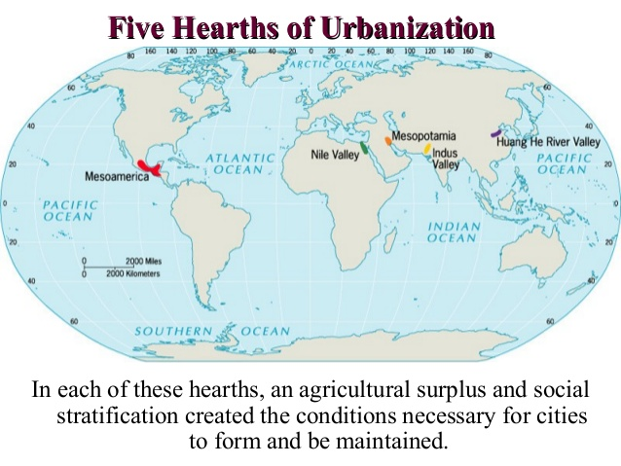
5Hearths of Urbanization
Urban hearth areas began around 3500 BCE near reliable water sources
  Tigris and Euphrates Rivers (Fertile Crescent)
  Indus River Valley (India)
  Nile River (Egypt)
  Huang He River or Yellow River: (China)
  Mesoamerica: Settlements in Mexico and Peru
Urbanism grew because of trade marketplaces
  West to the Mediterranean and East through Persia to the Far East
Cities were sometimes built on planned grid patterns around administrative buildings or around religious centers or holy sites
Ted talk history of cities 4 min https://www.youtube.com/watch?v=fKnAJCSGSdk

Slide 5
Cities in History
Preindustrial cities had rural areas (provided food and agriculture) around urban centers (economic functions).
After the Neolithic Revolution humans began to grow crops and domesticate animals , ) ancient settlements that were the most successful were city-states.
  City states consisted of an urban center (the city) and its surrounding territory and agriculture villages. Each had its own political system and functioned independently from other city states. The population in the surrounding villages and territory received services and protection from urban center.
  Early city states emerged in several locations around the globe in urban hearths, generally associated with river valleys:
  Ancient cities in Greece and Rome used the city-state model (market area surrounded by land to farm and live
  After the fall of the Roman Empire in the 5th century these cities faded
Feudal cities (Medieval cities) emerged during the Dark Ages 6th -13th centuries (Middle Ages or Medieval) in Europe and were based around wealthy people exchanging land for the labor of the poor, Many European cities characterized by narrow winding streets and an ornate church
With the Age of Exploration in the 15th - 17th centuries and mercantilism (European powers claiming status by taking raw materials from their colonies) new colonial cities were created as copies of the original European cities, Wide boulevards and classical architecture
By the beginning of the 16th century cities in the world existed in a crescent shape "urban banana"
  London, Paris, Constantinople, Venice, Cairo, Nanking, Hanchow and Osaka
These cites had both favorable site (arable land, resources, layout) and situation factors (proximity to trade routes)
Many early cities had shops, markets, home and offices mixed together in urban space, but by the medieval period certain jobs were located together (builders, artists, etc.)
  There was always economic segregation with the wealthiest living in the city center

Slide 6
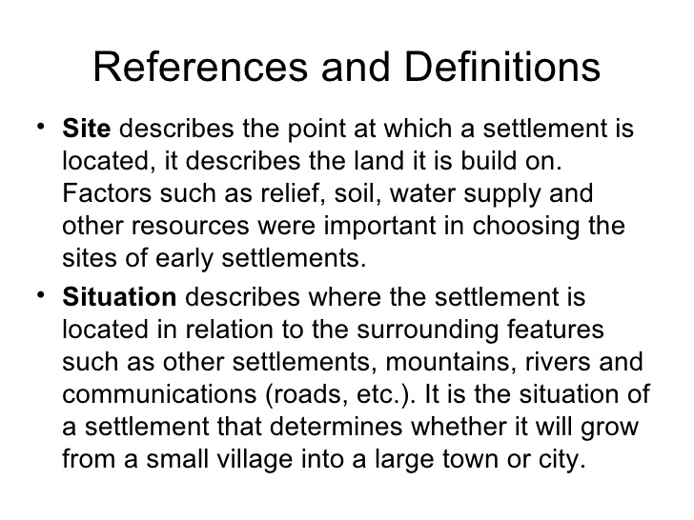
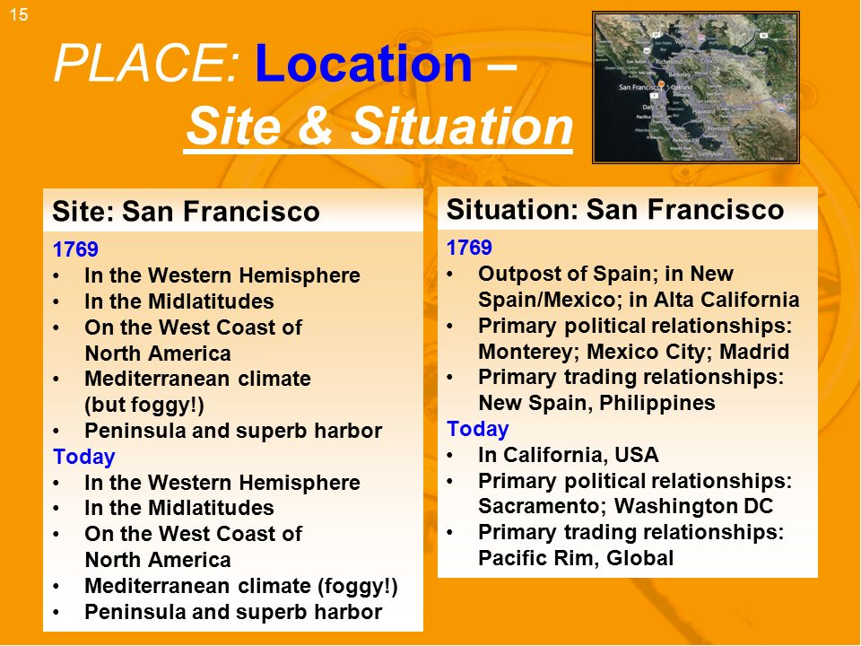

Slide 7
Geographers are interested in the global distribution of urban settlements. Having a high percentage of people living in urban areas living in urban areas is a distinctive feature for MDC’s. They are also interested in where people and activities are distributed within urban spaces
Urbanization: is the process by which a population of cities grows.
It has two dimensions
1. an increase in the number of people living
in cities
2. increase in the percentage of people living
in cities.
What is a settlement?
It is a permanent collection of buildings where people reside, work, and obtain services.
They occupy a very small percentage of Earths surface, under 1% but are home to nearly all humans

Slide 8
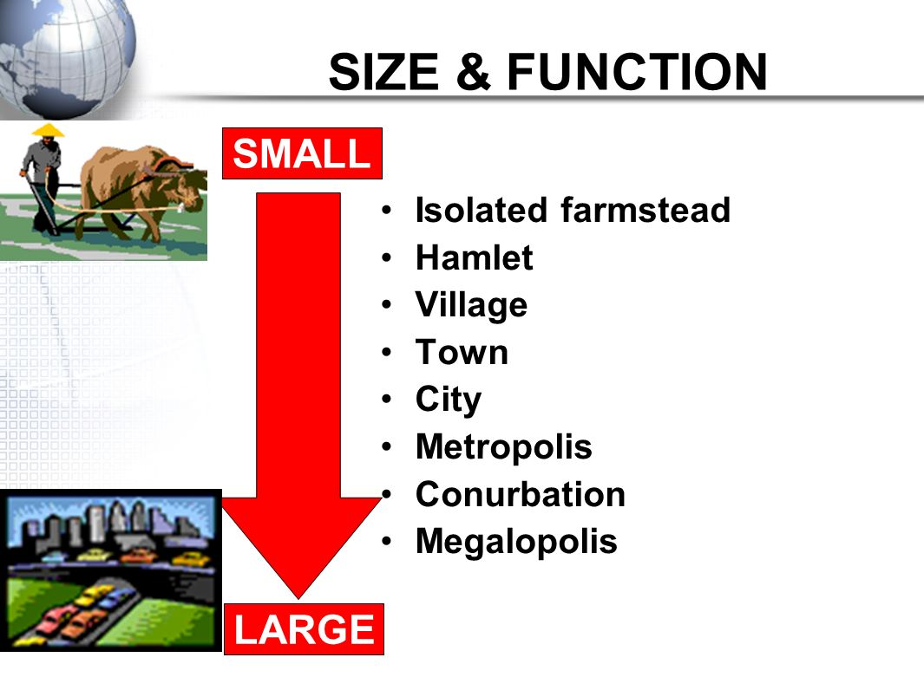
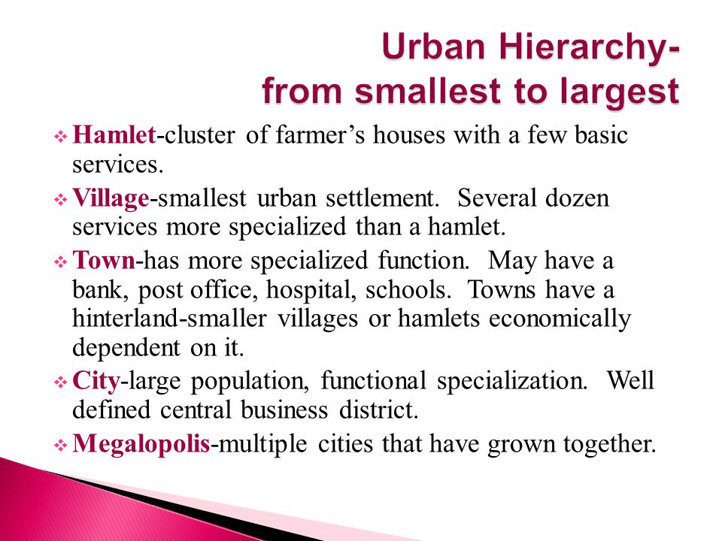
Urban Hierarchy: ranking of settlements according to their size and economic functions.

Slide 9
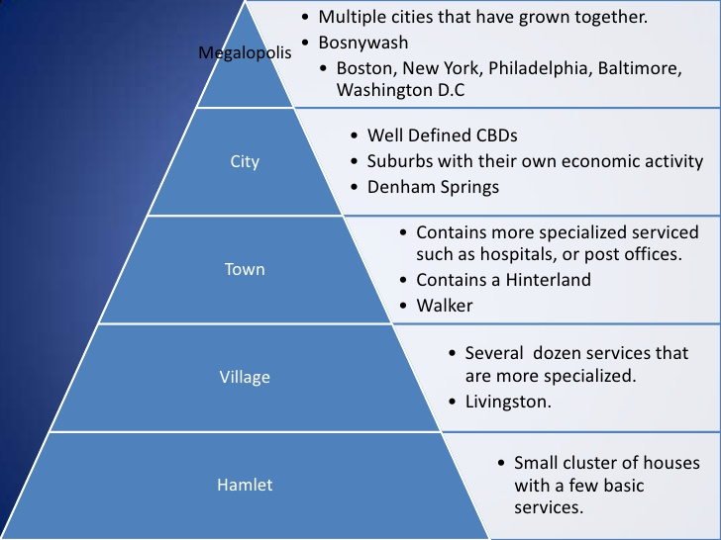
Settlement Sizes

Slide 10
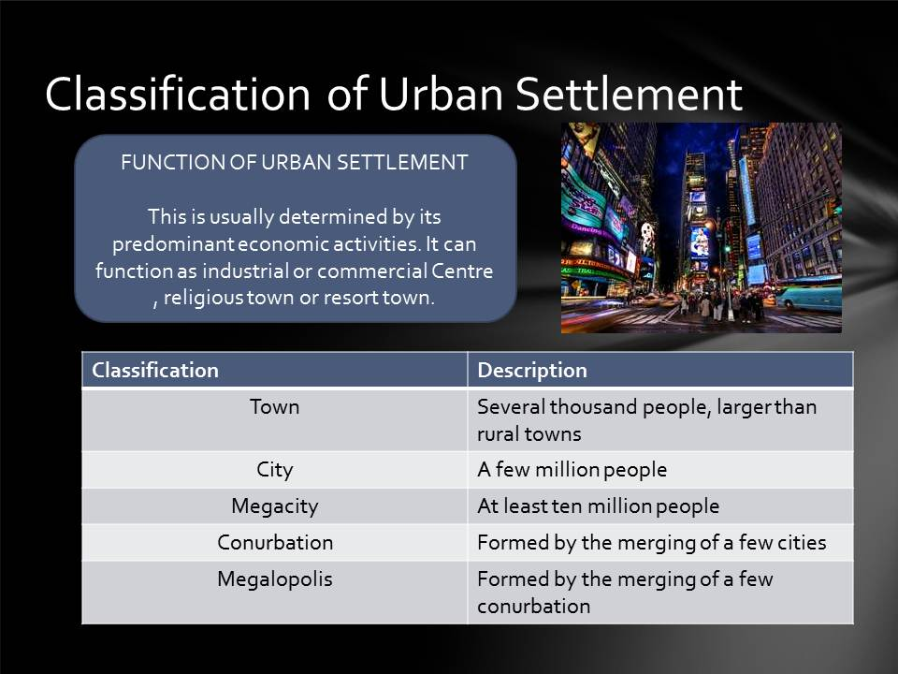

Slide 11
Increasing Parentage of People in Cities
The higher percentage of urban residents in MDC’s is a consequence of changes in Economic structure during the past two centuries – first the Industrial Revolution in the 19 century and then the growth of services in the 20th.
The percentage of urban dwellers is high in MDC”s because in the past 200 years rural residents have migrated from the country ide to work in the factories and services that are concentrated in the cities, plus the need for fewer farmworkers has pushed many people out of rural area s along with the rising employment opportunities in the cities
The percentage living in cities has risen rapidly in recent years in LDC’s because of the migration of rural residents to the cities in search of jobs in manufacturing of services. Like in MDC”s people in LDC’s are pushed off farms by declining opportunities.
The percentage of people living in cities increased from 3% in 1800 to 6% in 1850, 14% in 1900, 30% in 1950 and in 2000 47%
A large percentage of people living in urban areas is a measure of a country’s level of development. In MDC’s about ¾ of people live in urban area compared to abut 2/5 in LDC’s. EXCPET in Latin America where the urban percentage is comparable to the level of MDC”6+
America has grown even more urban. According to new numbers from the U.S. Census Bureau, 80.7 percent of the U.S. population lived in urban areas as of the 2010 Census, a boost from the 79 percent counted in 2000.

Slide 12
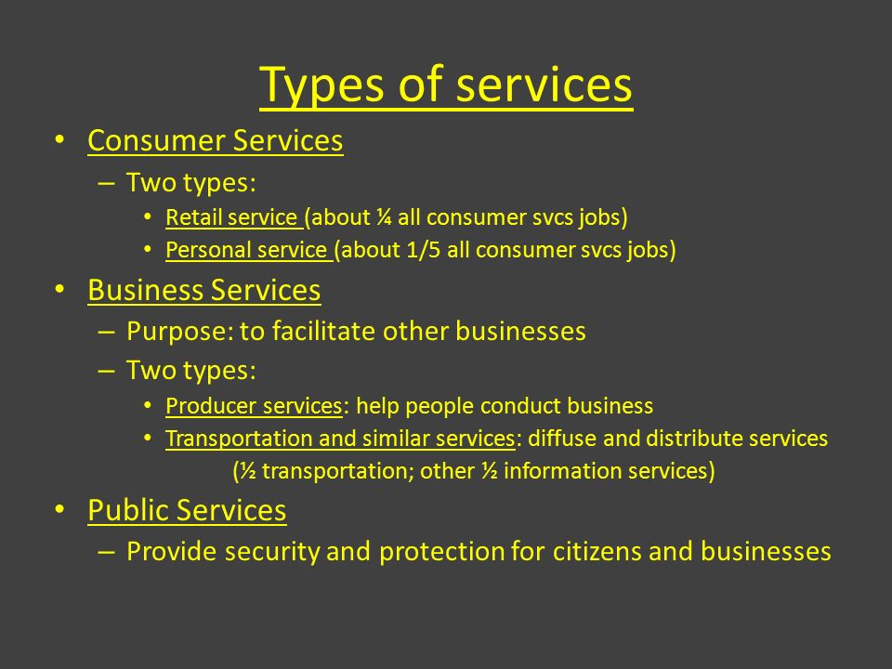
Centers for Services
As cities grew, more people developed specialized skills other than producing food. This changed the relationship between cities and the areas around them. City residents depended on farmers for food and in return people in cities focused on supplying services for their inhabitants and the inhabitants of surrounding regions.

Slide 13
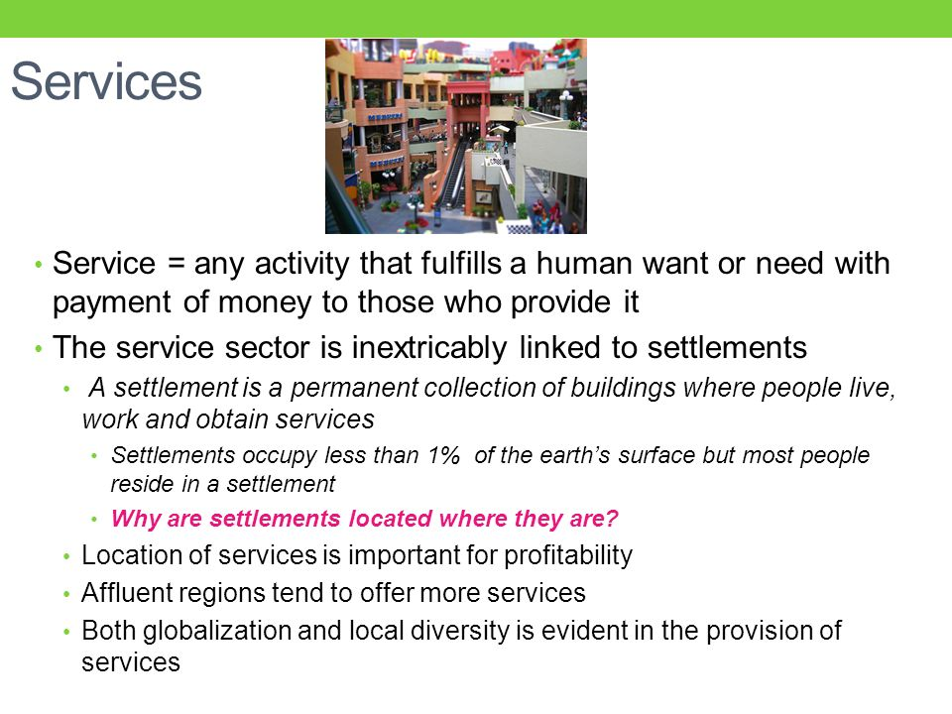
Intro to Services and Settlements

Slide 14
Defining Cities: a place in which there is a relative concentration of people. Cities are places where people come together to build a nucleated or clustered, settlement
Population Characteristics of cities is social heterogeneity the population of cities, as compared to other areas, contains a great variety of people,
One reason cities are diverse is because they are centers of immigration. They have a higher population density and urban residents are generally more accustomed to diversity. The large size of the population of a city means that it is easier for individuals with less common cultures, interests, or ways of life to find others who share them
Transportation: trains, buses and cars have enabled people to move farther from the center of the city but still visit or work in the city.
This is an example of Time-Space compression in the form of transportation improvements, has led to urban growth.
The development of the internet, to transport ideas allow more people to work from home which has further increased the distance people can live from the center of the city
Legal definition of a City:
a city is the territory inside officially recognized boundaries.
This is useful for determining the precise population, for taxing residents and for establishing and enforcing governing rules.
Most large cities today are defined legally, share boundaries with adjacent cities.
Metropolitan areas, sometimes called Metro Areas, are a series of legally defined cities but they are referred to using only the name of the larges city.
For example the metro area of Denver, Colorado consists of the cities of Denver, Aurora, Lakewood, Englewood, Greenwood Village and other neighboring legally defined cities

Slide 15
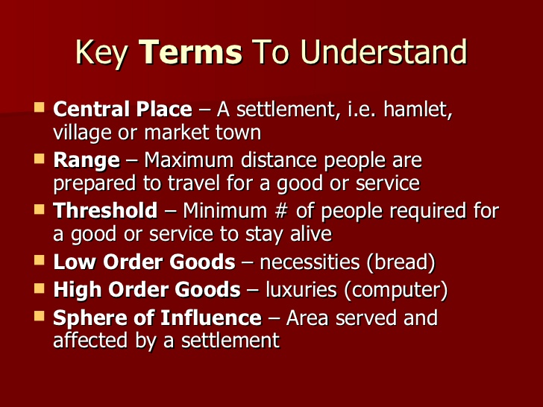
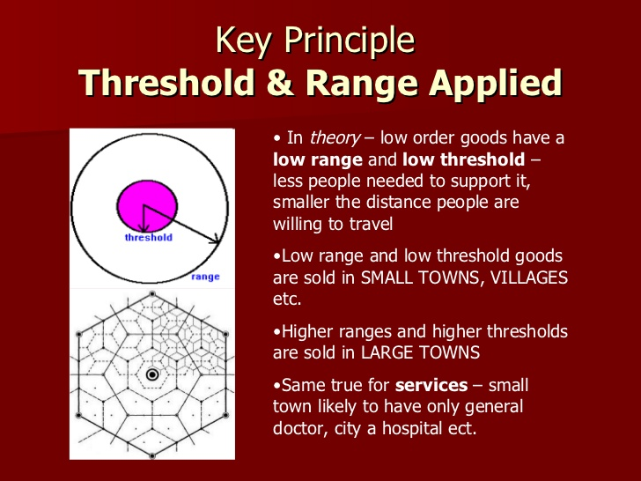
Central Place Theory (Walter Christaller 1933) was developed to explain the distribution of cities of different sizes across a region. Central Place is a location where people go to receive goods and services.

Slide 16
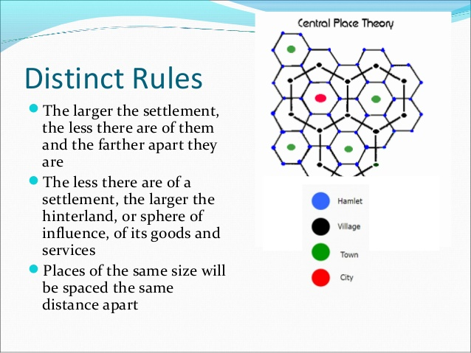
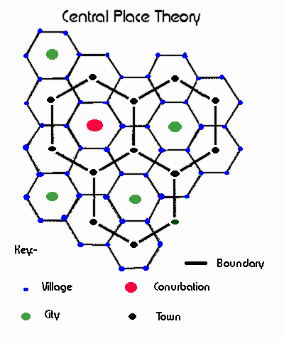
Central Place Theory: 14 min https://www.youtube.com/watch?v=59K1pcw-oJk

Slide 17
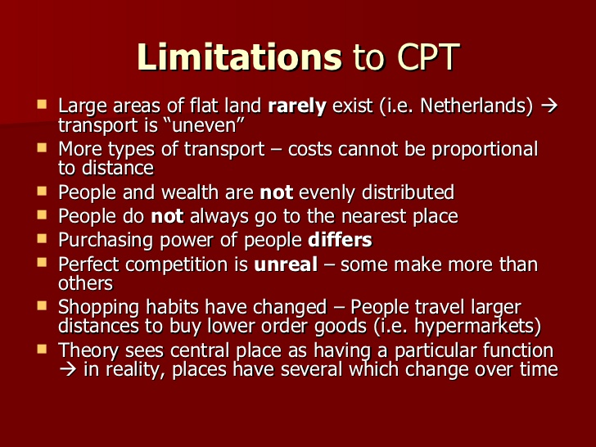
Central Place Theory

Slide 18
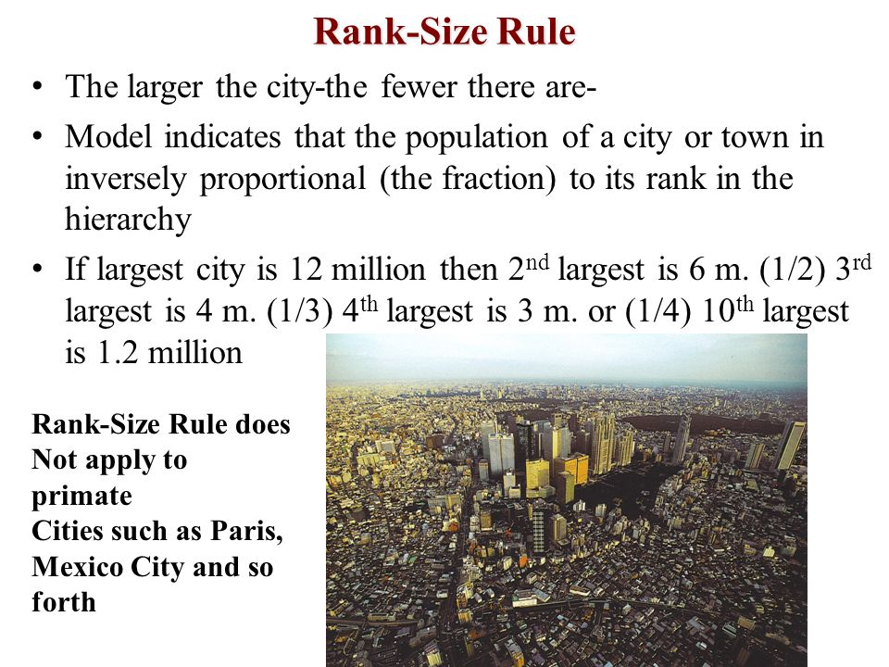
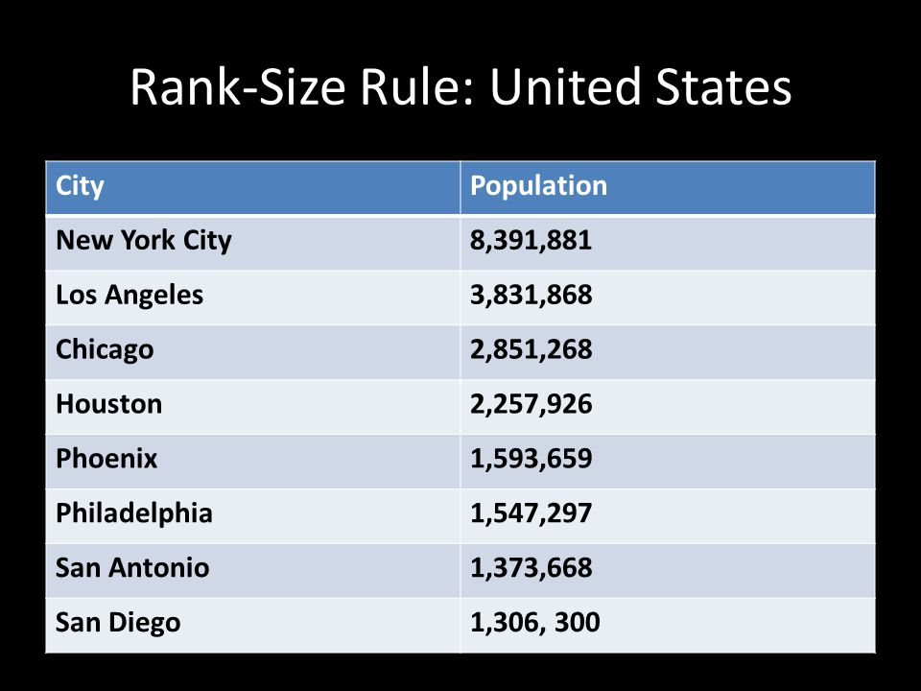
Rank Size Distribution: in many countries, ranking settlements from largest to smallest (population) produces a regular pattern.

Slide 19
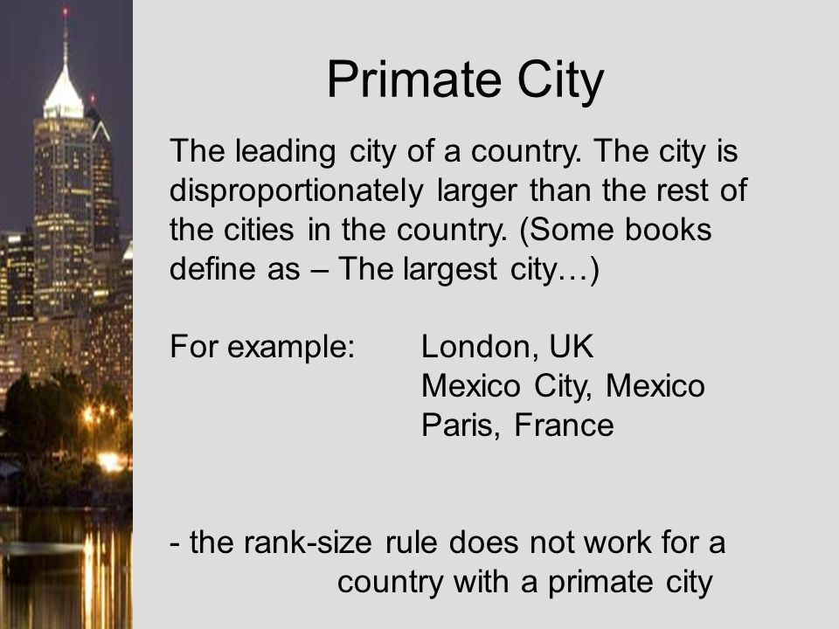
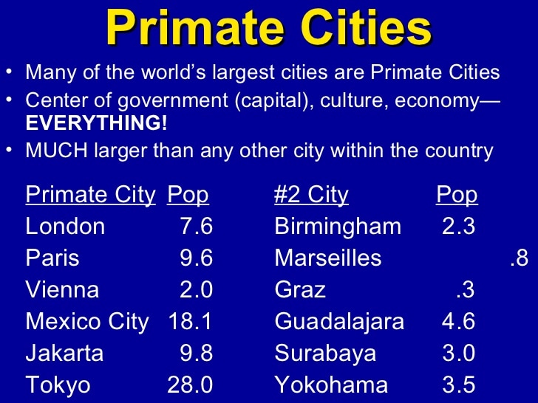
Primate City Rule, the largest settlement has more than twice as many people and the second ranking settlement. The larges city is called the Primate City

Slide 20
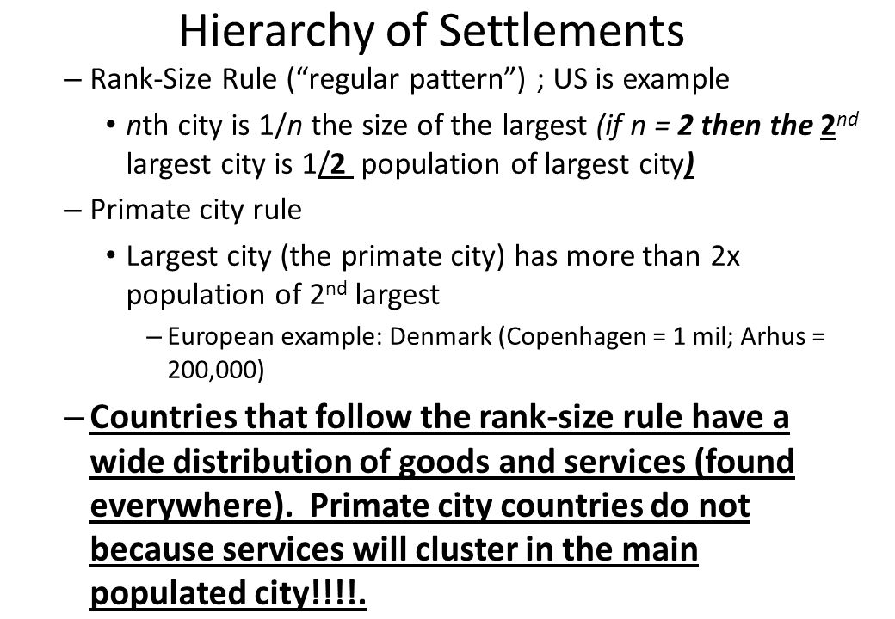
Rank – Size Distribution
The existence of a rank size distribution of settlements is not merely an mathematical curiosity, It has real impact on the quality of life for a country’s inhabitants. A regular hierarchy – as the United States – indicates that the goods and services to consumers throughout the country.
Conversely, the absence of the rank size distribution in a developing country indicates that there is not enough wealth in the society to pay for a full variety of series.
The absence of a rank size distribution constitutes a hardship for the people who must travel long distances to reach an urban settlement that offers services such as shops and hospitals

Slide 21
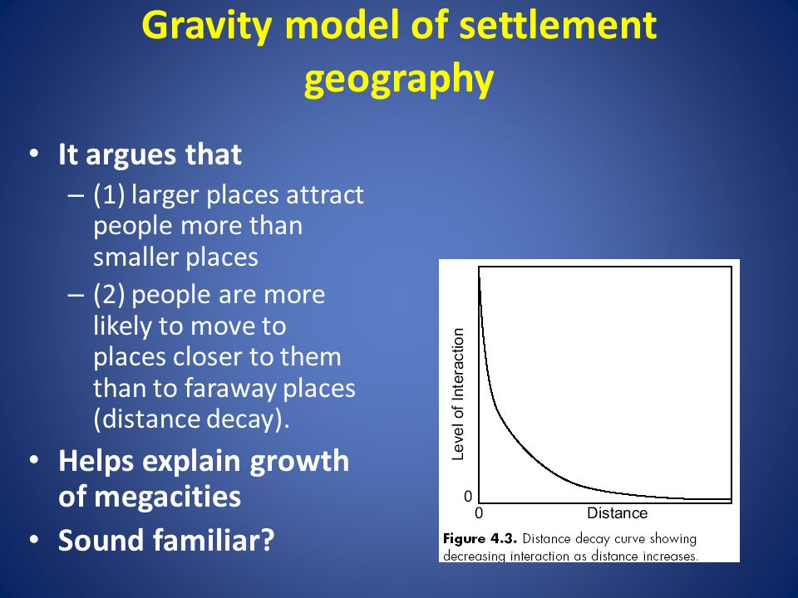
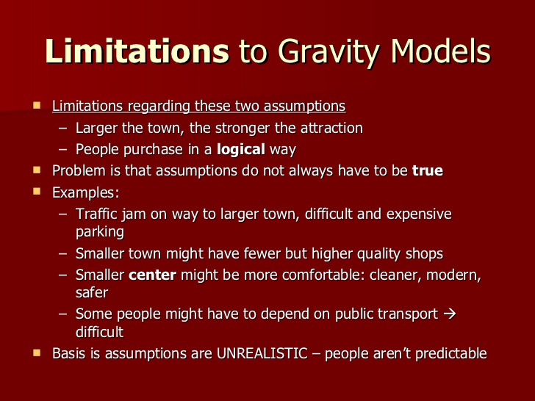
Gravity Model: States that larger places attract people, ideas, and goods more strongly than smaller places. Also , places closer together have a greater attraction

Slide 22
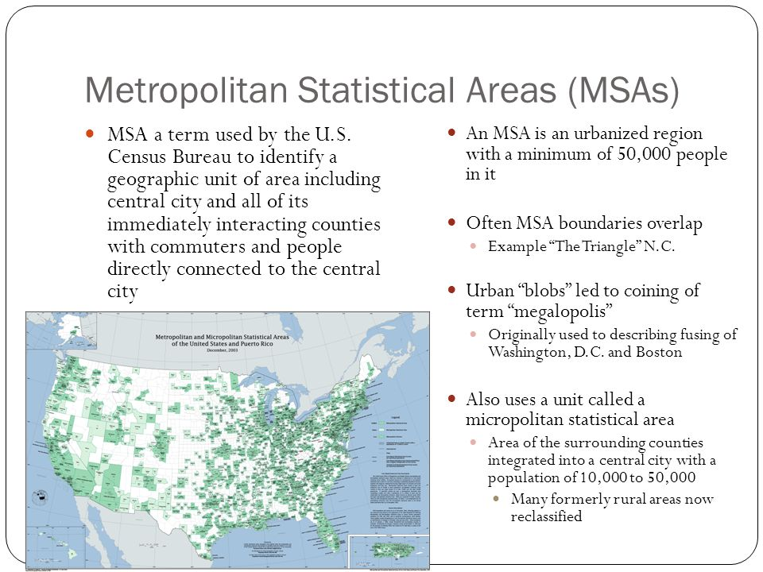
Metropolitan Area
The US Bureau of Census has created a method of measuring the larger functional area of a settlement known as the Metropolitan Statistical area (MSA) which includes:
An urbanized area with a population of at least 50,000
The country within which the city is located. In New England, towns are sometimes used instead of counties
Adjacent counties with a high population density and a large percentage of residents working in the central city’s county

Slide 23
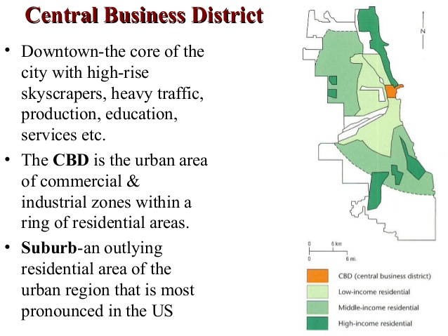
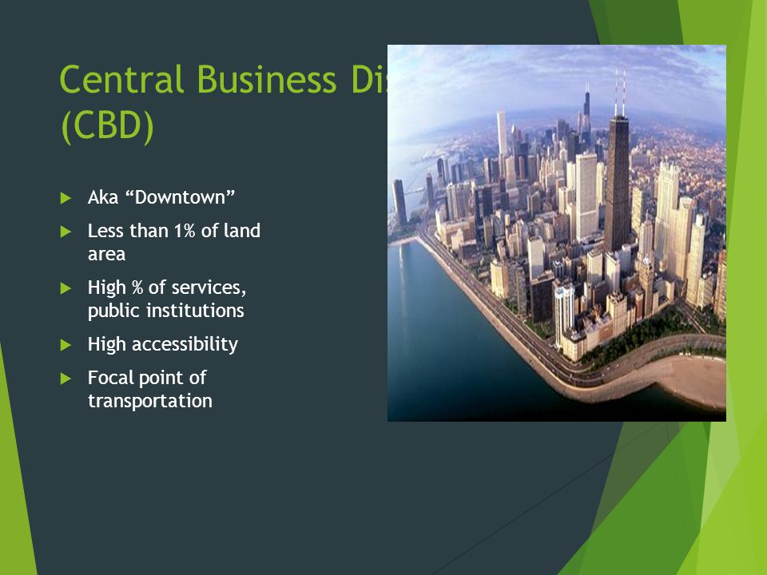

Slide 24
Central Business District (CBD) is compact but contains a large percentage of the public, business and consumer services. Services are attracted to the CBD because of its accessibility. CBD is one of the oldest districts in a city, usually at or near the original site of the settlement, often situated along a body of water, for transportation. CBD’s are often too high for uses other than commerce
Public Services: are typically located in a CBD such as city hall, courts, county and state agencies, and libraries. . Semi public services such as places of worship and social service agencies. Sports facilities and convention centers. Cities place these facilities down town in hopes of stimulating more business for downtown restaurants, bars and hotels
Business Services: Offices cluster in a CBD for accessibility such as a advertising, banking, finance, journalism and law. Lawyers center near courts, and other professional cluster near each other. A central location also helps businesses that employ workers from a variety of neighborhoods but are accessible to all groups.
Consumer Services: In the past 3 types of retail services clustered in a CBD to be accessible to everyone in the region: Retailers with high thresholds (requires a large population to make the economic endeavor profitable), those with high range (draws people from far away to purchase goods and services) and those that served people working in the CBD. Retailers such as department stores would cluster near one intersection known as the 100 percent corner where rents were highest because that location had the highest accessibility for most customers. Changing shopping habits have reduced the importance of retail services with many closing and /or moving to suburban malls
Retailers serving CBD Workers: who may shop during lunch or working hours, these retailers sell office supplies, computers, clothing, shoe repair, dry cleaning and so on.. Patrons of downtown shops tend increasingly to be downtown employees so sales have been stable focusing on the needs of the people living there.

Slide 25
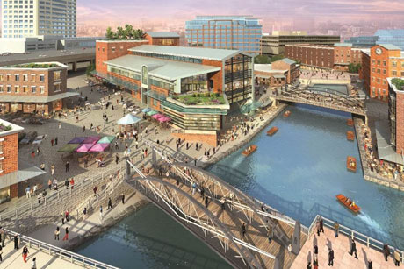
Competition for Space in CBD’s: A CBD’s accessibility produces extreme competition for the limited available land, as a result land values are very high. As a result the CBD has a 3 dimensional character with more space used below and above ground level that elsewhere in urban areas
Activities Excluded from the CBD
Lack of Manufacturing in the CBD: Modern factories require large parcels of land to spread operations among one story buildings. In the past inner city factories and retail establishments relied on waterfronts with access to piers for shipping. Todays large oceangoing vessels are unable to maneuver in shallow waters so port activity has moved to more modern facilities downstream.. Many of these waterfronts have been transformed to commercial and recreational act ivies.
Lack of residents: Many people use to live near the CBD but in the 20th century the push pull of the suburbs had many abandoning the CBD. The Pull was the larger homes, private yards ad modern schools. The Push from the CBD’s were high rents that businesses and retail services were paying, the dirt, crime, congestion and poverty they were experiencing downtown. But new apartments and townhomes, (high density housing) and the construction of abandoned buildings, became more desirable for young professionals, and people without children. Attracted to the entertainment, restaurants, museums and nightlife of the cities as well as improving schools

Slide 26
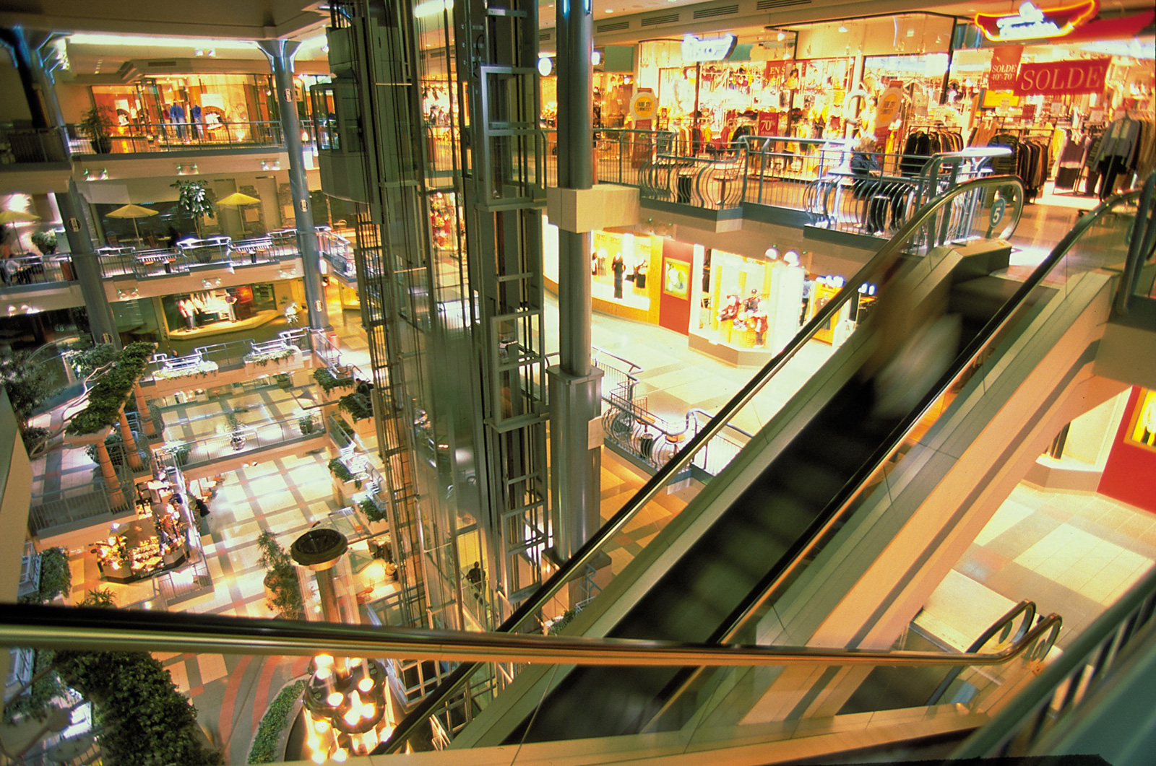
Vertical Features of the CBD: the CBD makes more intensive use of space below and above ground
The Underground CBD: Most CBD’s have a vast underground networks, the Typical underground city includes garages, loading docks for deliveries to offices, ships, pipes for water and sewer series, telephone, electric, TV and cables run beneath the surface. Subway trains run beneath the streets and some cold weather climates have built extensive underground pedestrian passages and shops

Slide 27
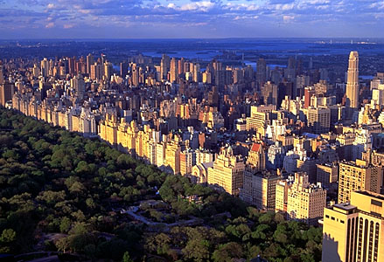
Vertical Features of the CBD
Skyscrapers: Demand for space in the CBD’s has also made high rise strictures a distinctive images and unifying symbols. And are an interesting example of vertical geography
One large US CBD without skyscrapers is Washington DC where no building is allowed to be higher than the US Capital Dome. So no downtown buildings are more than 13 stories

Slide 28
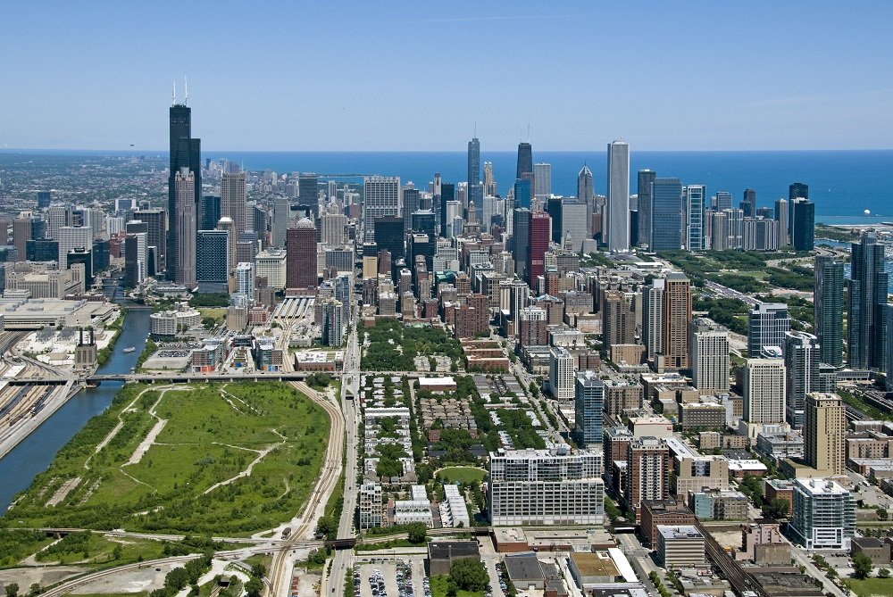
Models of North American Cities
The first three models described in the flowing text are the “classic models” that were based on the city of Chicago.
Located on prairie at the southern end of Lake Michigan, Chicago expanded to the north west and south without physical interruptions. This made the city a good place to examine urban structure without the complications caused by irregular topography
The Three models of Urban Structure help us understand where people with different social characteristics then to live within an urban area. They can also help explain why certain types of people tend to live in particular laces
The study of where people of varying living standards, ethnic background and lifestyle live within an urban area is social area analysis. Social area analysis helps to create an overall picture of where various types of people tend to live, depending on their personal characteristics
Social area analysis depends on the availability of data at the scale of individual neighborhoods. In the US and many other countries, that information comes from the census. Urban areas in the US are divided into Census Tracts that each contain approximately 5,000 residents and correspond to neighborhood boundaries

Slide 29
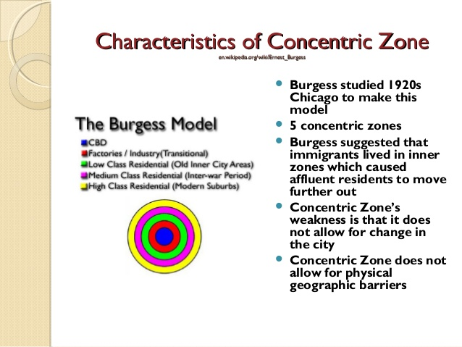
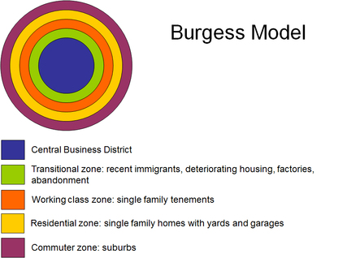
Concentric Zone created in 1923 by F.W. Burgess, a city grows outward from a central area in a series of concentric rings. The first ring surrounding the CBD is a zone of transition that includes industrial uses mixed with poorer quality housing. Manufacturing there can take advantage of proximity to the city center, workers and affordable land. Housing in this zone often consist of older subdivided homes that result in high density. Three additional rings, all residential, as distance from the CBD increased the zone of working class housing followed by a right of higher quality housing and finally a one of large homes and lots in suburban areas on the edge of the city. With greater distance from the CBD land became more plentiful and affordable, residences became larger and higher quality

Slide 30
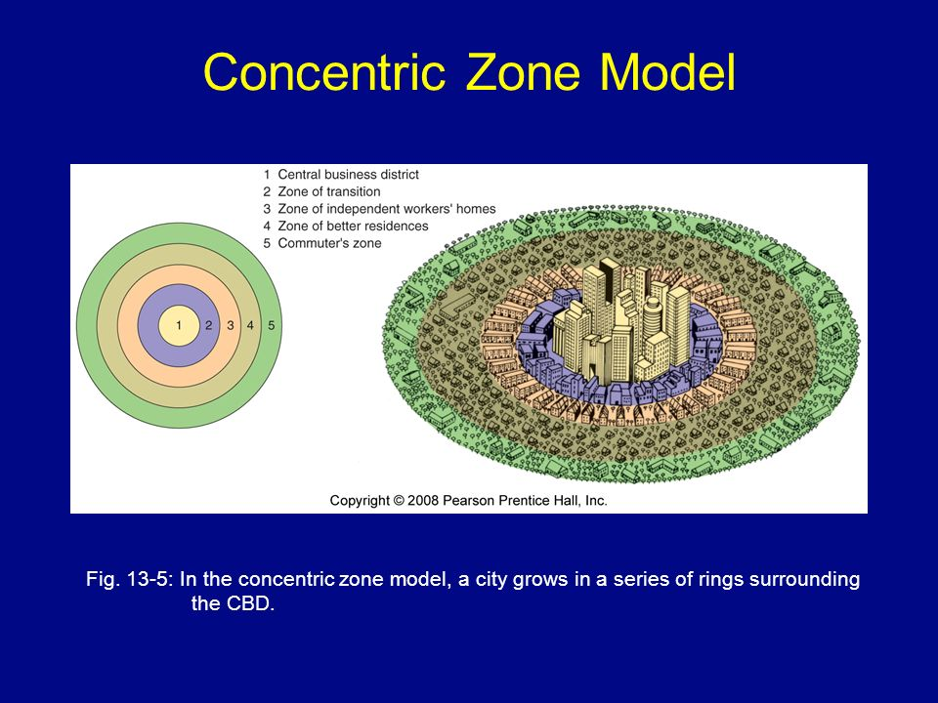

Slide 31
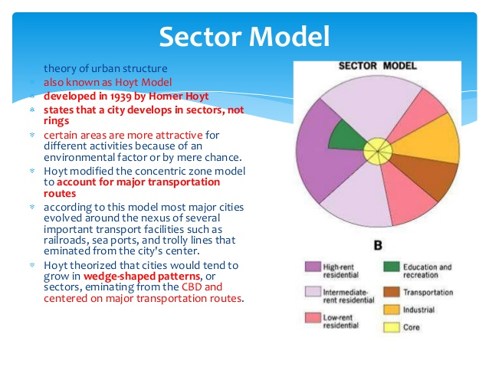
Sector Model, developed in 1939 by Homer Hoyt stating a city develops in a series of sectors. Certain areas of the city are more attractive for various activities, Hoyt described how different types of land use and housing were all located near the CBD early in the city’s history. Each grew outward as the city expanded, creating wedges, or sectors of land use, rather than rings. The model places the sectors for the low-income, lower quality housing next to these industrial and transportation zones, and it places high income residences extending in a wedge away from these zones along wide tree lined boulevards or on higher ground

Slide 32
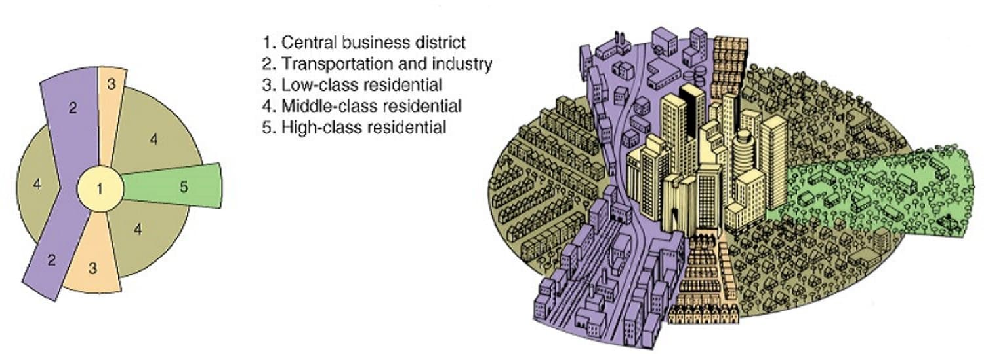
Hoyt Sector Model

Slide 33
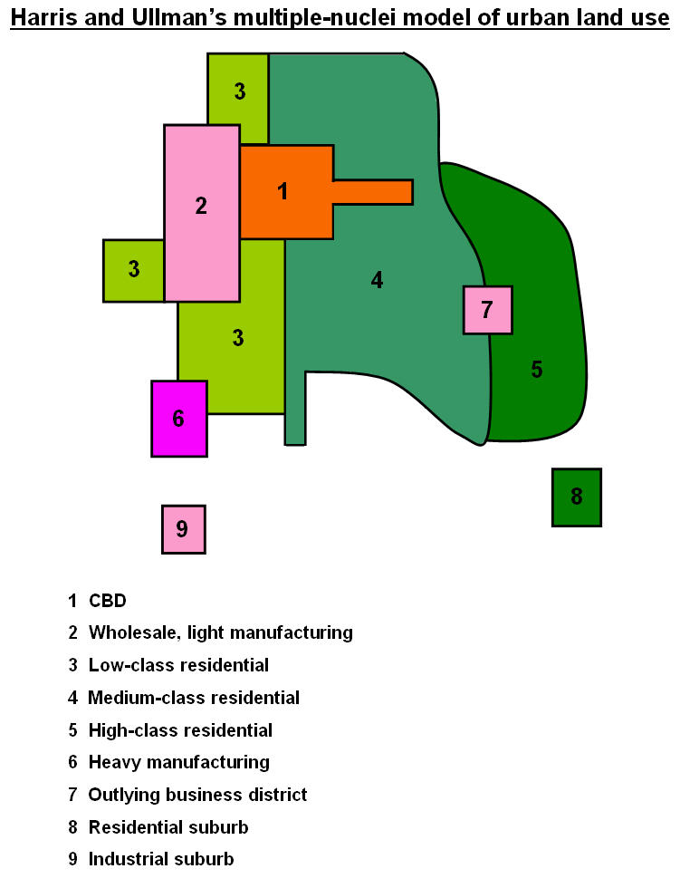
Geographers Chauncy Harris and Edward Ullman developed the Multiple-Nuclei Model by studying changes in cities in the 1940’s. This model suggested that functional zonation occurred around multiple centers, or nodes. The characteristics of each node either attracted or repelled certain types of activities The result was a city that consisted of a patchwork of land uses each with its own center, or nucleus
. In the multiple nuclei model, the CBO and related functions continued to exist but were joined by smaller business districts that emerged in the suburbs.
A zone of industry could be in a variety of locations, including the traditional CBD or port, or it could move to new outlying locations near an airport or other transportation junction.
This industrial zone would attract related industries and an area of higher density housing. A university or a business park might attract nearby restaurants, theaters, and other amenities. As a result people might create a district of student housing or high quality homes nearby by

Slide 34
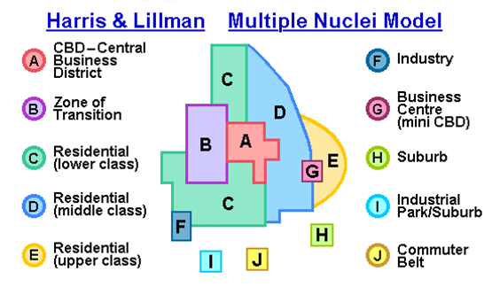
Multiple Nuclei Model

Slide 35
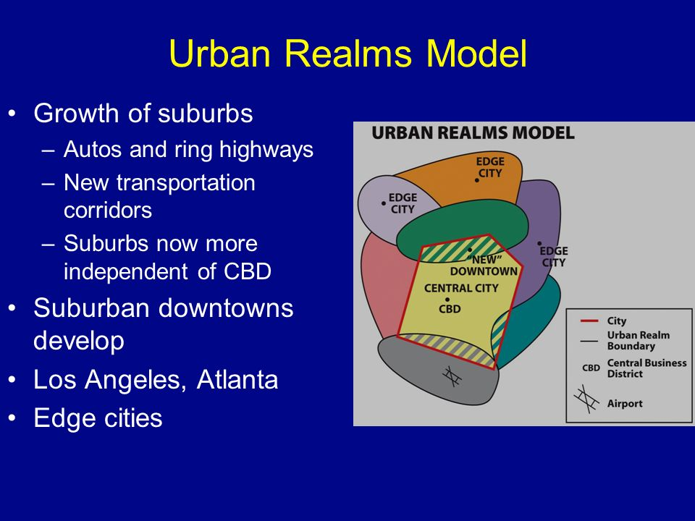
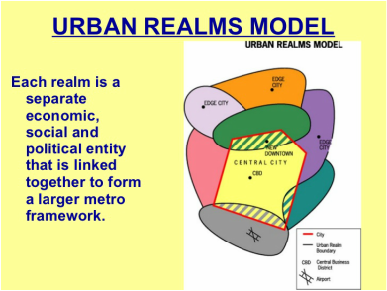
Urban Realm The spatial components of the modern metropolis, where each realm is a separate economic, social, and political entity that is linked together to form the larger metropolitan framework

Slide 36
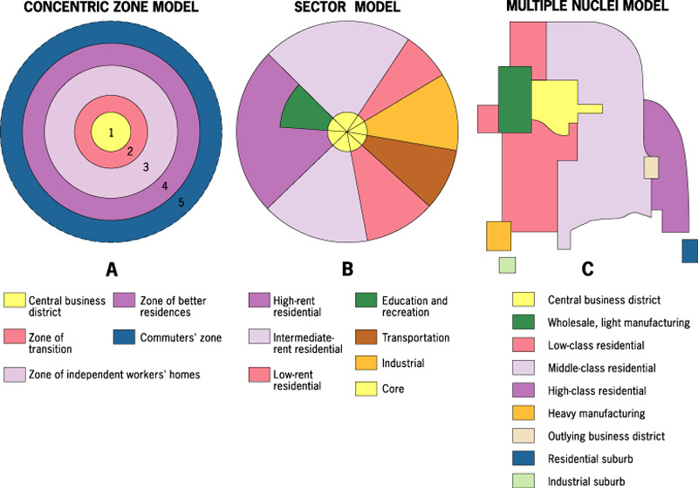
Urbanization and cities, early history of cities, vocab hamlet, town city, concentric, sector, global cities great over view 14 min: https://www.youtube.com/watch?v=RrEUwOyGuZI

Slide 37
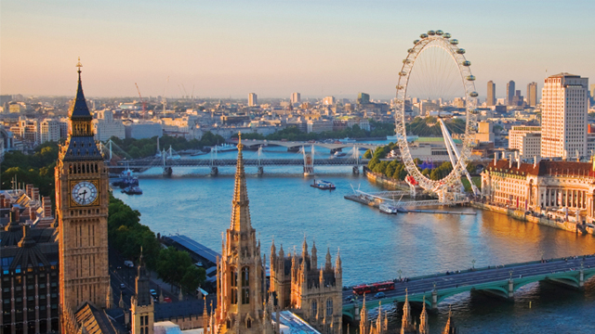
World Regional Models
Geographers have also developed models to describe cities outside of North America. Rings, sectors, and multiple nuclei can be found in these models along with some additional elements. But the models share the same basic characteristic s of North American models, that of functional zonation

Slide 38
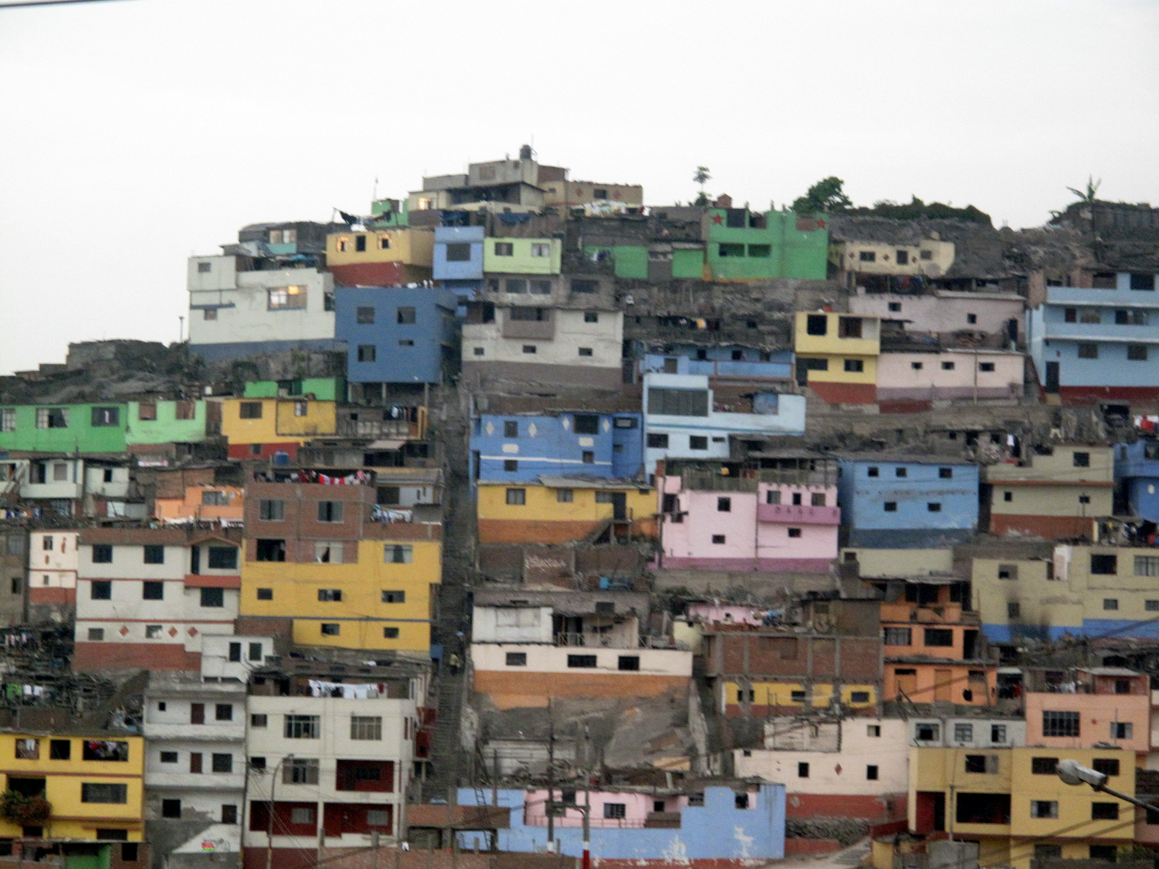
Latin American Cities. The Griffen-Ford Model is often used to describe Latin American Cities. It places a two part CBD at the center of the city; A traditional market center adjacent to a modern high rise center
The most desirable housing in the city is located there, adjacent to the developed center of the city.
This high quality housing extends outward from the urban core, accompanied by a commercial Spine of development.
Theaters, restaurants, parks and other amenities are also located along this spine or corridor, which ends in a growing secondary center,
In the model, this secondary center is identified as a mall
As distance increases from the center of Latin American cities, the quality of housing decreases. Public transportation, the urban water supply and access to electricity all decrease away from the center, sometimes disappearing altogether.
The outer ring of the city, the periferico, is characterized by poverty, lack of infrastructure, and areas of poorly built housing known as Shantytowns. Often residents here are recent migrants to the city.
Many Latin American cities also contain favelas or barrios, which are neighborhoods where extreme poverty, homelessness and lawlessness are common.
Most favelas are in disamenity zones, areas not connected to city services and under the control of drug lords and gangs. Disamenity zones ae often in physically unsafe locations such as on ravines or steep unstable mountain slopes
Tower of David 26 min https://www.youtube.com/watch?v=BipKO8wEuAk

Slide 39
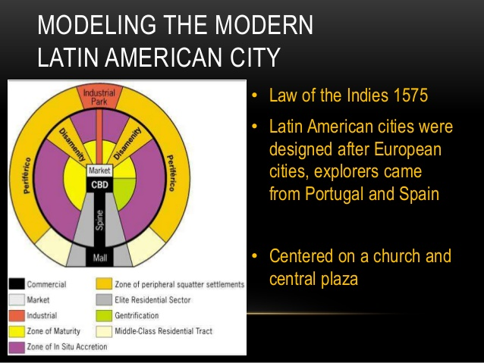
Latin American City

Slide 40
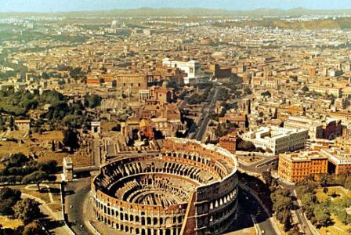
European Cities: Many of todays cities in Europe are descendants of medieval and pre industrial cities, City walls, once build for protection also restrained growth. These cities grew slowly for centuries with little planning.. The result is a dense mix of commercial and residential land use with narrow winding streets. Distinct land use zones are hard to find in core areas. Later urban renovations produced elegant wide boulevards with high quality housing and shops.
Central business districts in Europe differ in important was from NA attempting to preserve the historic character of their urban cores, by limiting construction, and restricted the height of buildings
European CBD’s also have many more residents living in relatively low rise apartment buildings so a larger population living downtown commercial uses ae more than NA by including many more small business such as vegetable gardens, markets, bakeries and butcher shops
European suburbs are likely to have higher percentage of taller buildings. Most are apartment buildings so population densities are higher in Europe
International immigration creates ethnic diversity in the suburbs and this diversity often reflects the colonial heritage of the country

Slide 41
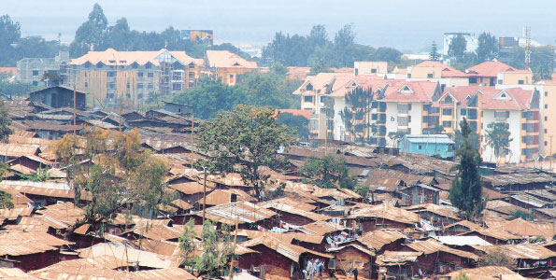
African Cities: large cities were rate in most of Africa until Europeans colonized the continent but in recent decades urban areas began to grow rapidly. These cities include several identifiable regions
Traditional CBD: which existed before European colonization has small shops clustered along narrow, twisting streets. It includes the formal economy: permanent stores that hire workers with full time jobs at set wages and that comply with local regulations
Colonial CBD has broad straight avenues and large home parks and administrative centers
Informal economy zone thrives with curbside, car side and stall based businesses that often hire people temporarily and do not follow all regulations. This zone includes periodic markets where small scale merchants congregate weekly or yearly to see their goods
A zone of mining and manufacturing also exists in many cities
Residential zones are often based on ethnicity. These mirror the multi-ethnic makeup of African countries
The periphery of cities often consist of Informal Settlements, densely populated areas built without coordinated planning and without sufficient public services for electricity, water and sewage
The growth of informal settlements often results from the rapid influx of migrants into cities who simply reside wherever they can find space, creating Squatter settlements.

Slide 42
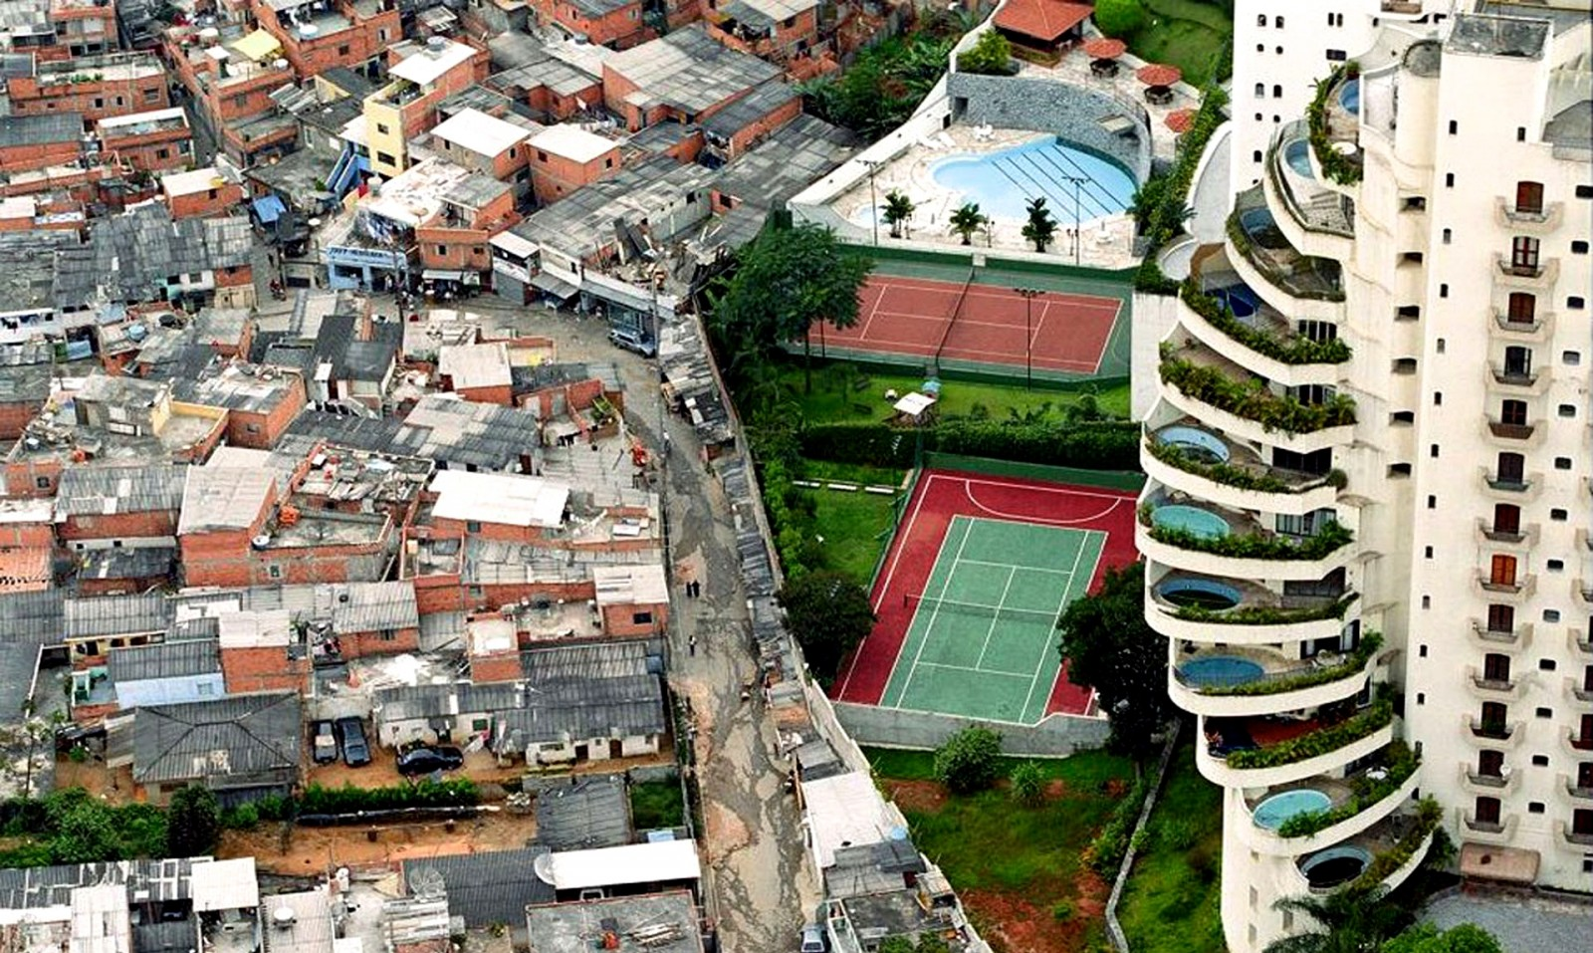
Colonial impact on LDC’s
European and less developed cities typically follow the same models, only the direction of increasing wealth is reversed. The rich cluster downtown and the poor are banished to the outskirts, Many LDC cities show this trend because they were founded by Europeans colonists who simply imposed their urban planning upon whatever city they chose
Squatter settlements – the out skirts of many LDC cities where the poor are clustered. These settlements often lack running water, schools, electricity, mass transit, or any other service that one would expect in a city
Other names of Squatter Settlements include: barrios, barriada and favelas in Latin America, bidonvilles in North Africa, bustees in India. Gecekondu in Turley, kampongs in Malaysia and barung-barong in the Philippines.
The United nations estimated that 175 million people worldwide lived in squatter settlements in 2003,

Slide 43
Middle Eastern and Islamic Cities: Cities shaped by the spread of Islam are common in the Middle East, North Africa, parts of Spain and East Africa and a few locations in Southeast Asia
The dominate feature of these cities is a central mosque with minarets.
The mosque is in the center of the city is usually surrounded by a complex of structures to the public, such as schools, soup kitchens for the poor.
As cities grew additional mosques were added in outlying neighborhoods.
Many cities were built with a defensive citadel (a fort designed to protect the city) with its areas for the palace, barracks for soldiers
A major road runs from the gates to the center and along the roads of traditional outdoor markets of covered bazaars.
These features create shady areas, which might be cultural adaptions to the sun and heat of the Middle East. They also create privacy which suggests that they express an important value within Islam
Residential neighborhoods often reflect the differences in ethnicity, tribe or branch of Islam. The organization and architecture found in the neighborhoods often have 3 features
1. streets and alleys are often twisting and dead end streets are common
2. Homes have central courtyards rather than yards in front or back
3. Window are small and located above eye level
ltural adaptions to the sun and heat of the Middle East. They also create privacy which suggests that they express an important value within Islam

Slide 44
Southeast Asian Cities: follows the MeGee Model where the focus of the modern city is often a former colonial port zone. The export oriented zone shares commercial uses similar to the CBD in North American cities
These cities might include a government zone dominated by foreign merchants and ambassadors.
A belt of market gardening surrounds and supplies the city
They have a history of Chinese immigration and commercial interest that dates back a few centuries. As a result many cities include a secondary commercial zone dominated by Chinese businesses.
As the importance of industry in Southeast Asia has risen, industrial parks and regions of manufacturing have emerged on the peripheries of some cities
1. Tokyo-Yokohama, Japan
Urban area: 37.8 million people
Population density: 4,400 people per square kilometer
Greater Tokyo is the largest urban agglomeration in the world, swallowing up the neighboring cities of Yokohama, Kawasaki, and Chiba. Despite its size, Tokyo has very efficient public transportation, which accounts for almost 80% of all journeys.
Urban Detail: Tokyo Bay has been gradually filled up to create more living space

Slide 45
Urbanization in the Developing World
Megacities were once found only at the centers of large empires or the most powerful countries, however in the past century a combination of high birth rates and rural to urban migration in less developed counties has made megacities more common in LDC’s
Of the 30 largest metropolitan areas in the world in 2015 about half were in semi-periphery or periphery countries
3 were in Africa: Cairo, Lagos, Kinshasa
5 were in South Asia: Mumbai, Delhi, Kolkata, Dhaka, Karachi
5 were in South America: Sao Paulo, Buenos Aires, Rio de Janeiro, Lima, Borgata
Megacities in relatively poor counties face the same challenges as megacities in wealthy countries but without as many resources to respond.. Social problems between ethnic groups, joblessness, lack of infrastructure,, inadequate housing, and environmental problems such as pollution

Slide 46
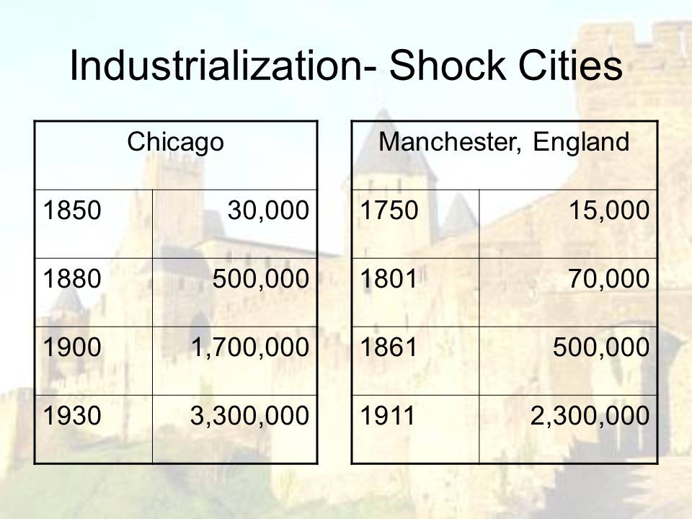
Shock Cities
Urban place experiencing infrastructural challenges related to massive and rapid urbanization.
A shock city is not able to withstand the rapid urbanization.
Examples in the 1900’s Manchester England and Chicago Ill.
Mumbai, India. A city that is industrializing so fast that infrastructure just can't keep pace, creating a society with some of the richest and poorest people in the world.

