Slide 1
UPDATED info from College Board
APHuG Exam – Tuesday, May 12 – 4:00 pm
Students should have responded to their 4/13 College Board email AND RESPONDED!
Teachers will be receiving info. this week on students that have not responded so that Teacher can contact specific students so they can contact College Board.
EXAM will NOT be given in “my ap college board link” …
Students will receive a separate email link prior to the exam.
Each student will have a separate email link that will be secured/monitored by College Board during exam-testing.

Slide 3
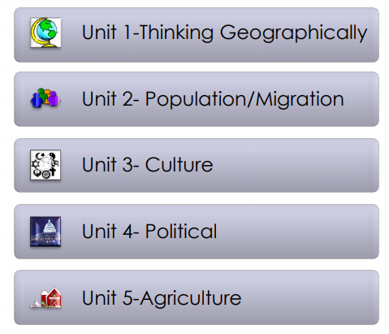

Slide 4
College Board wants you to do well
You have GOT TO BE PREPARED for the 45 minute FRQ writing
You may use materials, but remember, the more you look-up… the less time you’ll have to write
WRITING IN DETAIL is MOST IMPORTANT – PRACTICE, PRACTICE, PRACTICE – Timed writings, and uploading the writing.
“Googling” for information is going to be impossible, so don’t expect being able to go to Google and look for something is going to help!
College Board has stated it is “absolutely possible” to make a “5” on THIS EXAM and not get finished – ALWAYS MAKE SURE YOU’RE AWARE of the TIME
USE A SPLIT SCREEN ON YOUR COMPUTER – have the FRQ up (this will also have the timer) and then have your Google Doc up

Slide 6
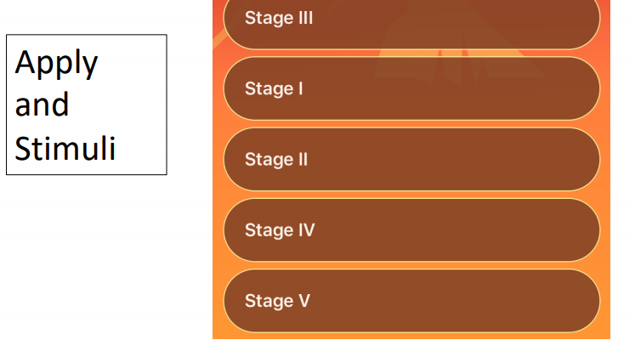
PREPARING for May 12 Exam Day-Practice, Practice, Practice

Slide 7
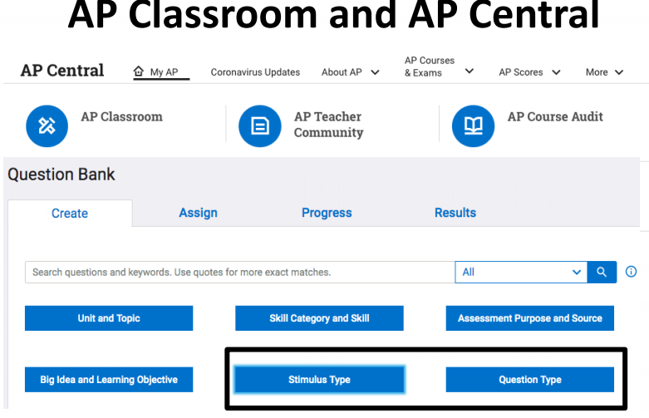
Now – being able to Apply the MCQ to the FRQ
- Compare (Apply)

Slide 8
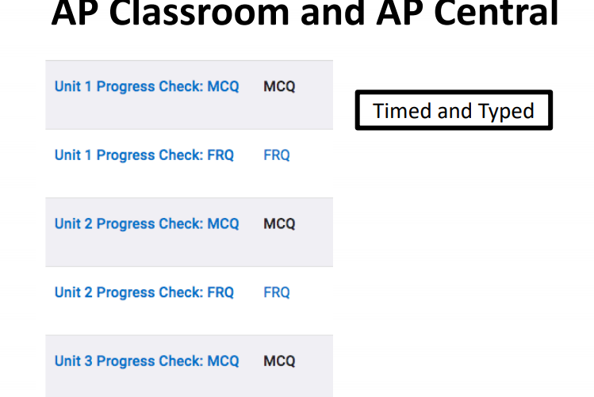

Slide 9
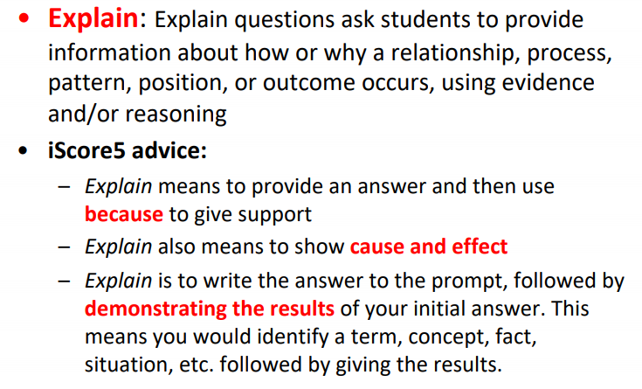
Explain the degree to which a geographic concept, process, model or theory effectively explains geographic effects in
Different contexts and regions of the world.
Explain the degree to which a geographic concept, process, model or theory effectively explains geographic effects
Across various geographic scales.

Slide 10
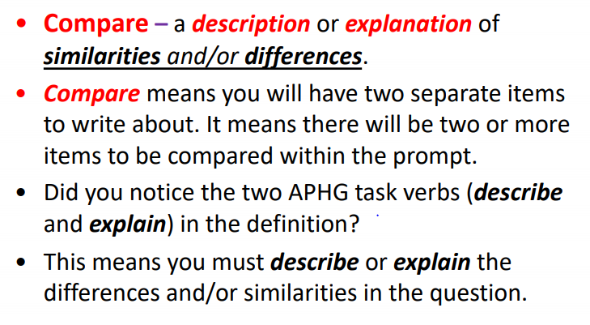
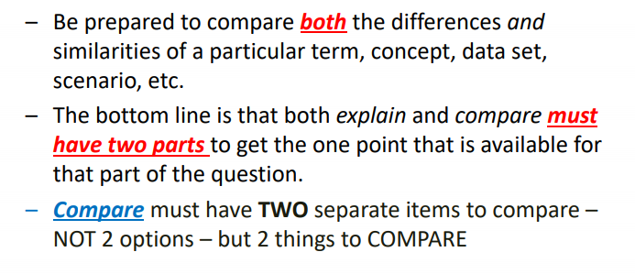
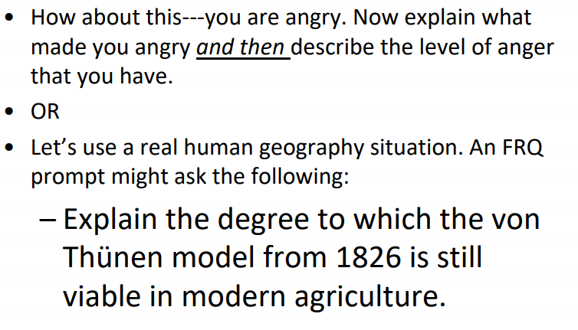
PRACTICE
You are frustrated. Explain what made you frustrated. Describe the level of frustration that you have. Compare your level of frustration at a different time and place in
your life.

Slide 11
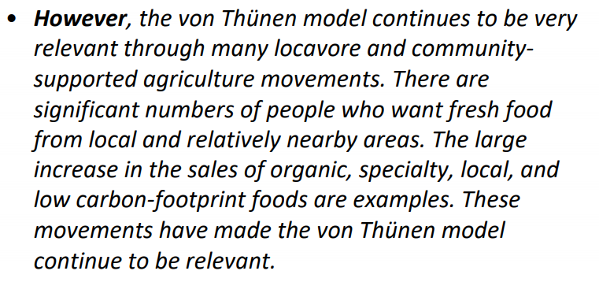
outdated
Those who eat
locally grown goods

Slide 12
REVIEW: Q&A ON EXAM DAY … don’t wait till 2:00 PM to log on …
Students need to log onto the LINK 30 minutes prior to taking the exam
Specific information, questions, pre-exam opening activities will need to be filled out prior to the student starting the exam
If you happen to be sick or there are unforeseen circumstances and you cannot take the exam OR you have computer glitches during your May 12 exam, you can make it up
MAKE UP DATE is Monday, June 1 at 2:00 pm – there is NO OTHER MAKE-UP DATE for the exam.
June 1 EXAM WILL BE A DIFFERENT EXAM than the May 12 Exam.

Slide 13
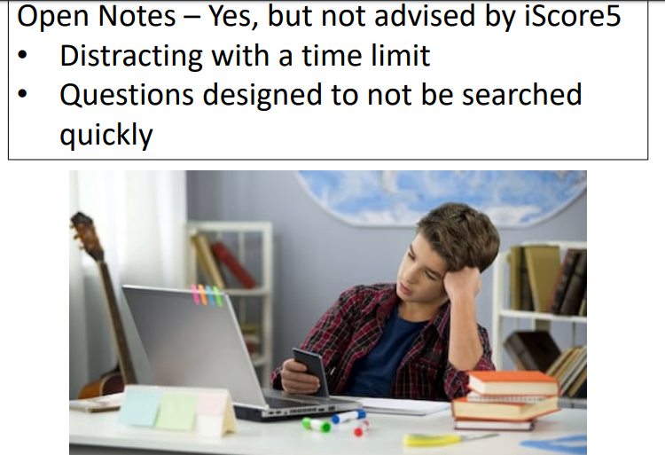

Slide 14
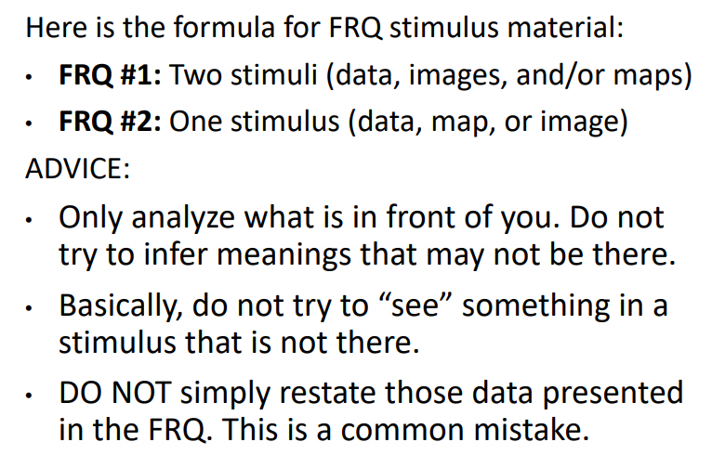

Slide 15
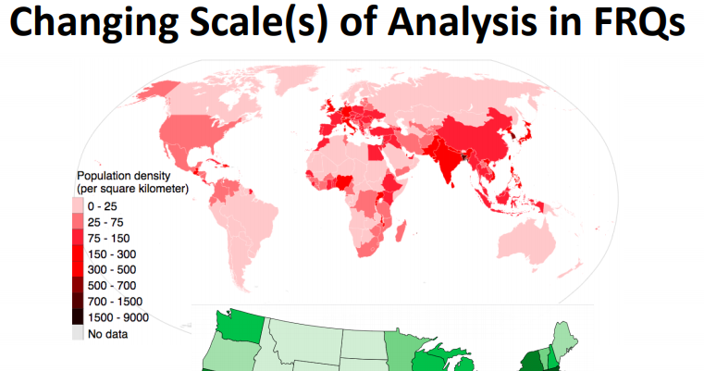
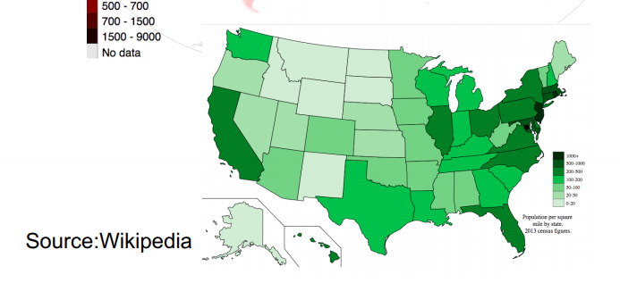

Slide 16
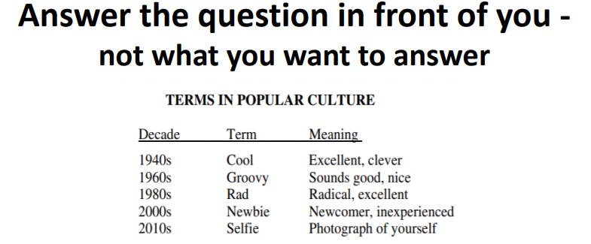

Slide 17
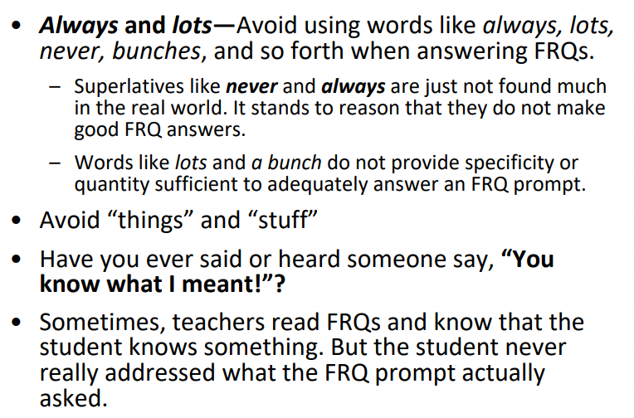

Slide 18
