Slide 1
Chapter 1 Toward Civilization (prehistory – 3000B.C.)
World History/ HS

Slide 2
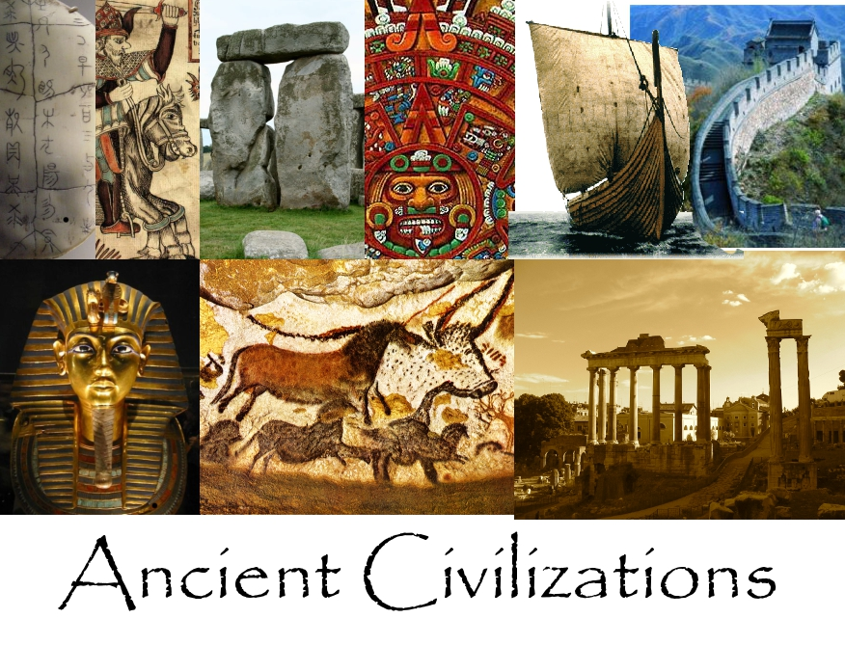
Chapter 1 Toward Civilization (prehistory – 3000B.C.)

Slide 3
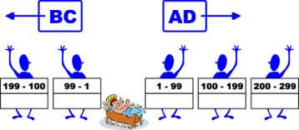
Timelines
B.C. is an abbreviation for “Before Christ.” A.D. is an abbreviation for “anno Domini,” which is Latin for “in the year of our Lord.”
B.C. and A.D. are commonly used to count years in time. Jesus Christ’s birth is used as a starting point to count years that existed before (B.C.) and after (A.D.) He was born. For example, the year 532 B.C. refers to the time 532 years before A.D. 1, when Christ was assumed to have been born.
Some object to time being tied to any kind of religious benchmark. Instead of using the term A.D. they prefer to use the phrase “Common Era,” abbreviated “C.E.” Likewise, in place of B.C., which refers to the time “Before Christ,” they favor labeling that era “B.C.E.,” meaning “Before the Common Era.” Thus, C.E. is generally equivalent to A.D. and B.C.E. is generally equivalent to B.C.
Why Do We Scale Time by BC and AD? - Stuff You've Probably Wondered #22 5 min video: https://www.youtube.com/watch?v=S-1IscRjGvk

Slide 4
Geography and History
GEOGRAPHY is the study of people and their environments and the resources available to them
Geography, in effect, determines the entire course of civilizations. It determines what foods can be grown, what livestock can be raised, whether there is sufficient water, how warm or cold it is, who people trade with, how they travel, availability of minerals metals and spices, the outcomes of war, etc.

Slide 5
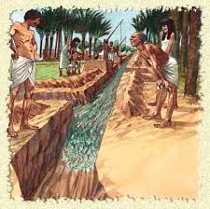
Human-Environment Interaction
  Humans have shaped and been shaped by the places they lived
EXAMPLES: dig irrigation ditches, build dams and bridges, cut trees for farm land, roads, canals,

Slide 6
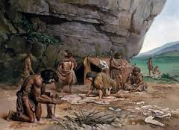
How Do We Know?
  Prehistory refers to the long period of time before people invented system of writing
Prehistoric people had no cities, countries, central government, complex inventions

Slide 7
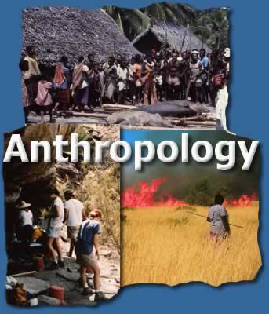
Anthropology
  Anthropology: origins and development of people and societies
  Some anthropologist study human lives while others focus on the variety of cultures
  Culture refers to the way of life of a society that is handed down from one generation to the next by learning and experience
  CNN Amazon tribe
  https://www.cnn.com/2018/08/23/americas/amazon-tribe-drone-intl/index.html

Slide 8
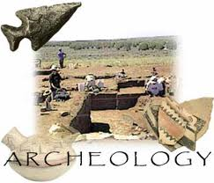
Archeology
  Archaeology is the study of past peoples and cultures
  They find and analyze material remains of human cultures to learn about prehistoric people and to add to the written records of historical times
  They study artifacts or objects made by human beings
  Examples: tools, weapons, pottery, clothing and jewelry

Slide 9
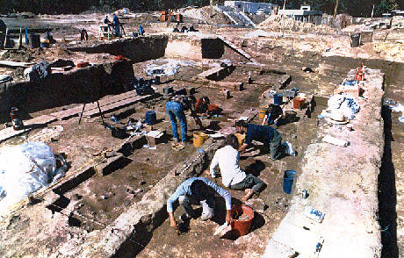
Archaeologist at Work
  By studying artifacts, archaeologists have traced how early people developed new technologies
  Technology refers to the skills and tools people use to meet their basic needs
  They also make detailed maps locating every artifact they find
  By doing this they can tell what went on at different locations in a site

Slide 10
Technology and the Past
  Archaeologist use modern technology to study and interpret their findings
  Computers store data or develop accurate site maps
  Aerial photographs can reveal patterns of how people use the land
  Radio carbon dating can help determine age of objects
  Geologists or experts on earth science can help date artifacts by determining the age of near by rocks
  Botanists and zoologists exerts on plants, animals study diets, bones, bloodstains etc
  Experts in climates can conditions people faced
--Biologists analyze human bones and bloodstains
on weapons or tools

Slide 11

Historical Detection
Historians study written evidence
Historians must evaluate the evidence to determine if its reliable
Do records tell exactly what was said? Who recorded the info, is the writer recording as an eyewitness or rumor, is it a forgery, what about historians cultural background, personal experiences, political opinions

Slide 12
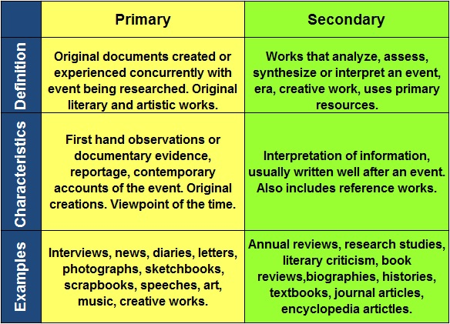
Primary and Secondary Sources

Slide 13
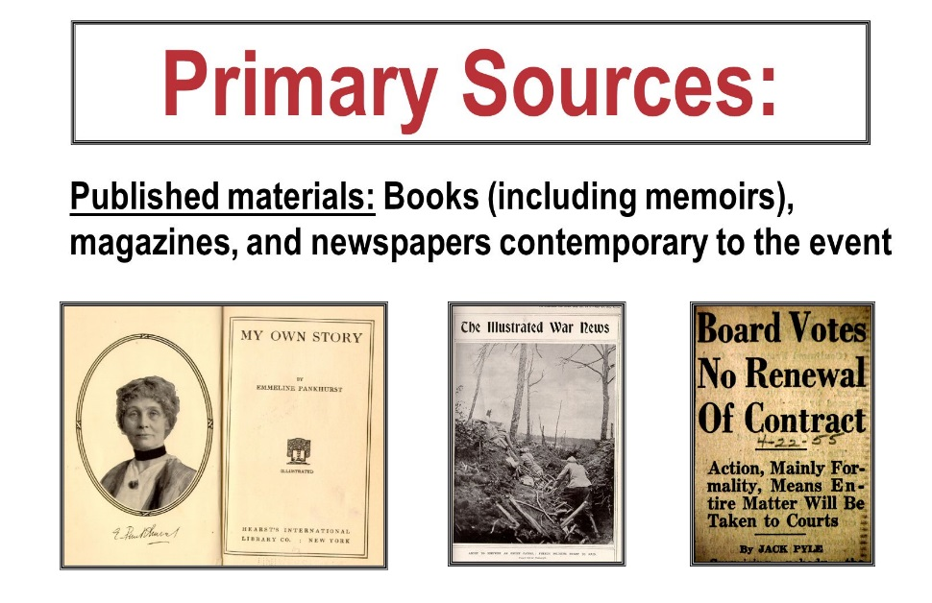
What about Newspapers?
Most articles in newspapers are secondary sources but reporters may be considered as witnesses to and event or phenomenon would treat the newspaper as a primary source

Slide 14
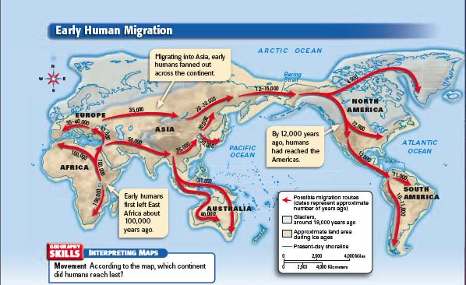
  The movement of people out of Africa

Slide 15
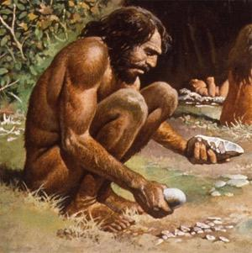
Old Stone Age
  Paleolithic people lived in small hunting and gathering bands numbering about 20 to 30 people
  In general men hunted or fished and women cared for children and gathered fruits, nuts, wild grain, roots and shell fish
  They were nomads moving from place to place as they followed game animals and ripening fruit
  ECONOMIC: Hunting/ Gathering

Slide 16
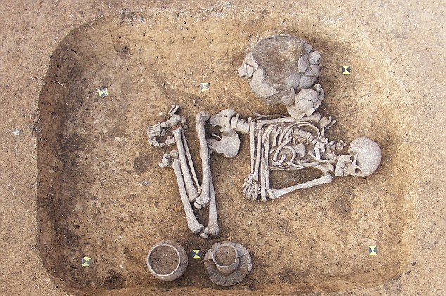
Old Stone Age
Development:
Made simple tools and weapons
Developed spoken language
Invented clothes of animal skins
burying their dead with great care suggesting a belief life after death
Dependent on environment
Built fire for warmth and cooking
Religion was animism
Cave paintings

Slide 17
New Stone Age or Neolithic Era
About 11,000 years ago people began producing their own food and settled into permanent villages and developed tools and skills
**Neolithic or Agricultural Revolution: Man began to plant crops
Economic:
Farming
Domesticated or tamed animals
Some were Pastoralist people who ranged over a wide area keeping herds of livestock
Developments:
Leads to a growth in population (more food more people)
More interactions among human communities
Work divided by gender and age
Increased status of men-Decline in the status of women
Could own property and accumulate wealth
New farming technologies
Created the first calendars to determine when to plant and harvest
Learned to weave cloth
Crash Course Neolithic Revolution : https://www.youtube.com/watch?v=Yocja_N5s1I

Slide 18
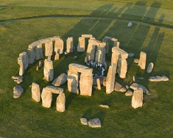
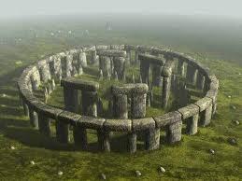
Stonehenge is one of the wonders of the world and the best-known prehistoric monument in Europe and is an example of a megaliths
(huge stones used for burial or religious purposes).

Slide 19
The Rise of Cities
  The rise in cities was the main feature of civilizations
  Civilization is a complex, highly organized social order
  Civilizations emerged after farmers began cultivating fertile lands along river valleys and producing surplus or extra food.
These surpluses (extra) helped
populations to expand and as
populations grew some
villages grew into cities
Cities rose independently in the valleys of
Tigris / Euphrates Rivers in the Middle East
2. Nile River in Egypt
3. Indus River in India
4. Huang He or Yellow River
in China

Slide 20
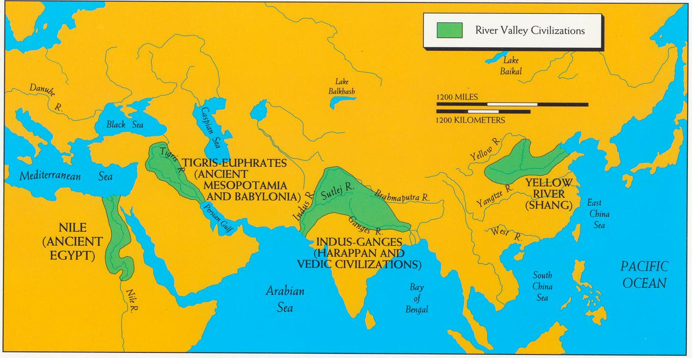
River Valley Civilizations

Slide 21
River Valley Civilizations
  Conditions in these areas favored farming
Flood waters spread silt across the valleys renewing the soil and keeping it fertile
Animals flocked to rivers to during and were another source of food
Rivers provided a regular water supply and transportation
rivers provided a source of food
  Challenges of rivers
to control flooding and channel water to fields
cooperation was need to meet these challenges such as building dykes,(a long wall or embankment built to prevent flooding ) canals, irrigation ditches
large scale projects required leadership
and a well organized government

Slide 22
The Big Eight Features of Civilization
1. cities
2. organized central government
3. complex religion
4. job specialization
5. social classes
6. arts and architecture
7. public works
8. writing

Slide 23
Organized Governments
  As cities grew there was a need for a steady food supply
  To produce large amounts of food and oversee irrigation projects new forms of government arose
  Early governments:
    village council of elders
    Priests
    warrior kings
    Kings set up hereditary rule who passed power from father to son…Most rulers claimed their right to rule came from the gods
  As governments became more complex rulers issued laws, collected taxes, and organized systems of defenses, had royal officials to enforce laws and later a number of duties were taken over by government departments

Slide 24
Complex Religions
Most ancient people were Polytheistic or believed in many gods
They believed these gods, goddesses and spirits controlled the forces of nature & human activity
Priests and worshipers sought to gain the favor of gods through complex rituals such as ceremonies, dances, prayers and hymns
To ensure divine help, people built temples, sacrificed animals, crops or other humans to the gods

Slide 25
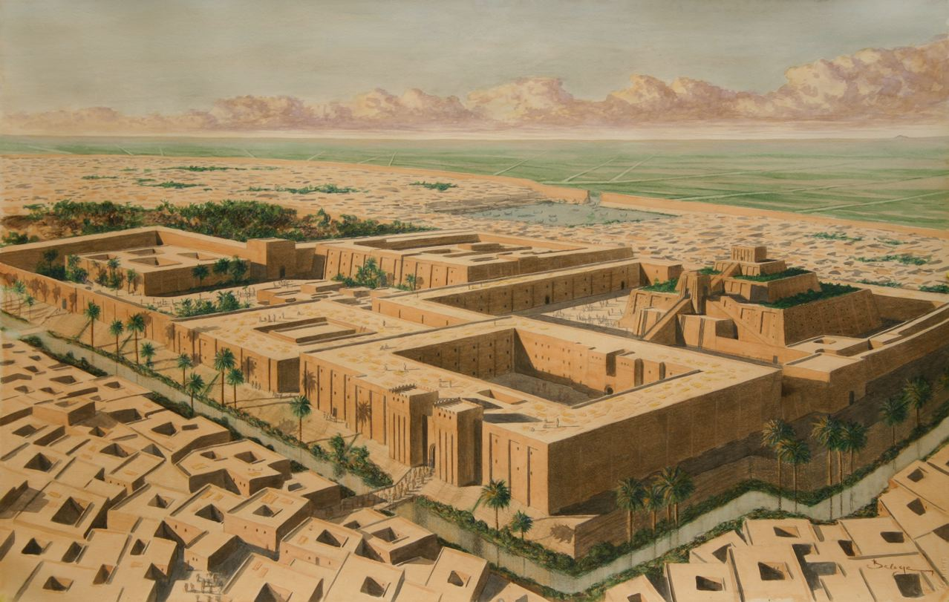
Job Specialization
Job specialization: to train in or devote oneself to a particular area of study, occupation, or activity
Urban people developed many new crafts which required individuals to specialize in certain jobs resulting in Division of Labor
Some became artisans or skilled craft workers
People learned to make tools and weapons first out of copper then bronze then more durable mixture of copper and tin (metal workings was particularly important)
Cities had specialists like bricklayers, soldiers, merchants, singers, dancers, and storytellers

Slide 26
Social Classes
In cities social organization became more complex
People were ranked according to their jobs which led to the growth of social classes
Levels of early social classes (top to bottom)
1. Ruler/ priests / nobles
2. wealthy merchants
3. artisans
4. peasant farmers (the majority)
5. Slaves (some sold to cover debts, prisoners of war)

Slide 27
Arts / Architecture / Public Works
Arts and Architecture
Temples and Palaces dominated the city
Buildings show the strength and power of their government and gods
Public Works
Public Works: Projects carried out by the government that are meant to benefit the city: the work of building such things as roads, schools, bridges, walls, and reservoirs, ensuring a food supply, protecting the city

Slide 28
Writing / First Empires
Important skill development was writing
May have began with in temples to keep records, to record amounts of grain collected, info on seasons and precise rituals and prayers
Earliest writing was made up of pictograms or simple drawings that looked like of objects they represented
As writing became more complex only specially trained people called scribes learned to read and write
Rival leaders often battled for power some conquering many cities and villages creating the first city states
a group of states or territories controlled by one ruler is an Empire

Slide 29
Factors that cause a civilization to change:
Environmental Influences such as the forces of nature like storms, floods, droughts, earthquakes, volcanoes,
Need for Resources such as metals, stone, trees, water
Cultural Diffusion: The spread of ideas, customs and technologies from one people to another, through trade, migration, missionaries
Expansion and Warfare: as civilizations grow they need more land and resources. Warfare may be waged for the control of land, people and resources. Victors force their way of life over conquered

Slide 30
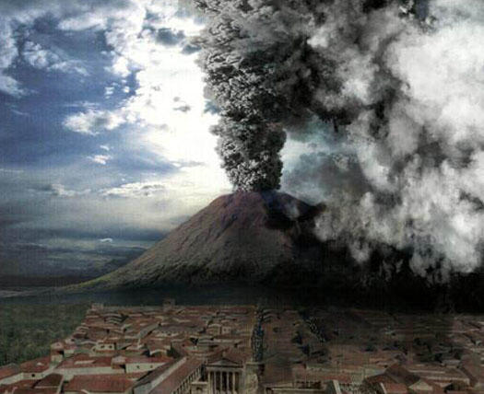
Environmental Changes
Civilizations depended heavily on the physical environment such as rain, fertile soil, stone, timber, or, metals
Drastic events can devastate a community, such as volcanoes, earth quakes, over farming and flooding

Slide 31
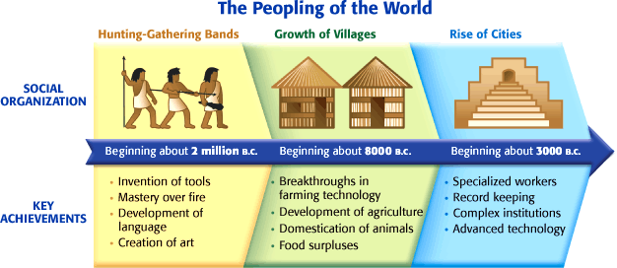
Review

Slide 32
Early River Valleys
Long Term Causes
Silt deposits create fertile soil in river valleys
Neolithic people learn to farm
Hunters and gatherers settle into farming communities
Immediate Causes
New technologies improve farming
Food surpluses support rising populations
First cities built in fertile valleys
Farmers cooperate to control flooding and channel water

Slide 33
RISE OF RIVER VALLEY CIVILZATIONS
Immediate Effects
Complex forms of government develop
Arts become more elaborate
Job specialization leads to social classes
Writing is invented
Long Term Effects
Government bureaucracies emerge
Early civilizations conquer neighboring lands
Civilizations clash with nomadic peoples

Slide 34
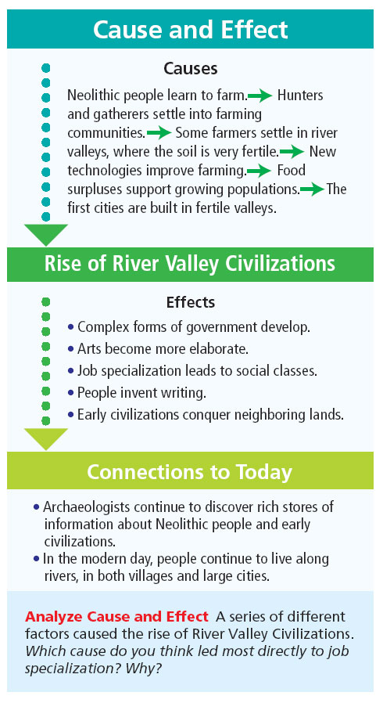
.

Slide 35
FYI / Videos
Mr. Betts Summary: 3:42: https://www.youtube.com/watch?v=q-bCNQd2Cvw
(Ethnocentrism: having or based on the idea that your own group or culture is better or more important than others.
HipHughes Neolithic Revolution 10 min: https://www.youtube.com/watch?v=d8AN7n2sQOg
Crash Course Agricultural Revolution 11 min: https://www.youtube.com/watch?v=Yocja_N5s1I
Seven Brain Hacks to improve productivity: https://www.youtube.com/watch?v=jsFAxAIJmN0

