Slide 1
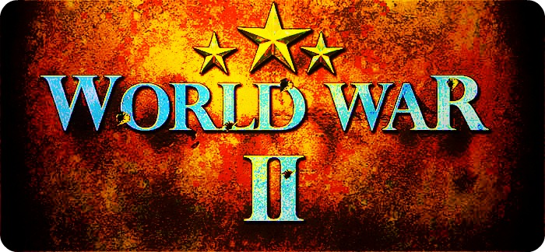

Slide 2
AGGRESSION, APPEASEMENT, AND WAR
In the 1930’s aggressive dictators in Spain, Germany, and Italy along with the militarist in Japan pursued ambitious goals for empire
Leaders of the western democracies were haunted by memories of the Great War tried to avoid conflict through diplomacy.
Both sides tested the other’s commitment and will

Slide 3
Dictators Challenge World Peace/
Japan on the Move
Dictators took aggressive action and met only with verbal protests and please for peace
This was viewed as weakness and they responded with new acts of aggression
Japan’s military leaders wanted an empire equal to those of western powers so in pursuit of this Japan seized Manchuria in 1931
The League of Nations condemned the aggression so Japan withdrew from the League of Nations
The easy success strengthened militarists so they overran much of eastern China which again was protested but had no effect

Slide 4
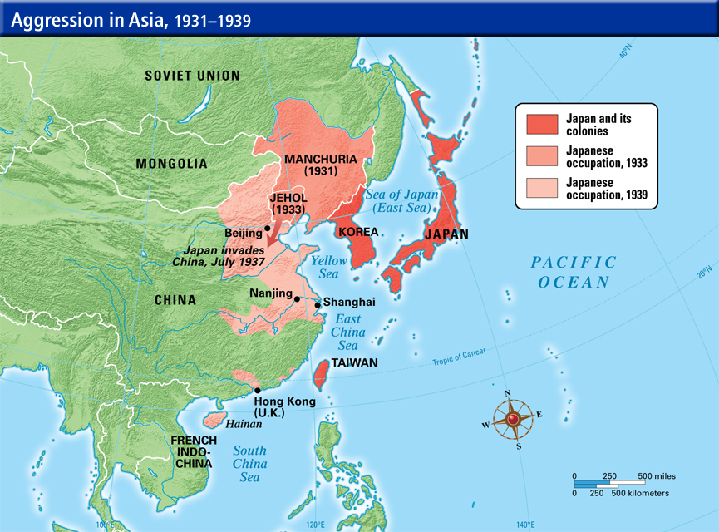
Japan on the Move
Japan’s military leaders wanted an empire equal to those of western powers so in pursuit of this Japan seized Manchuria in 1931
The League of Nations condemned the aggression so Japan withdrew from the League of Nations
The easy success strengthened militarists so they overran much of eastern China which again was protested but had no effect

Slide 5
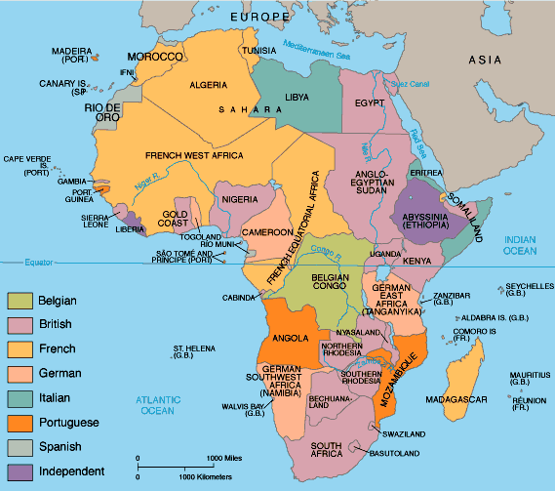
Italy Invades Ethiopia
Italy’s Mussolini used his new modern military to invade Ethiopia in 1935
Ethiopian king Haile Selassie appealed to the League of Nations (L&N) for help and they voted sanctions or penalties against Italy for having violated international laws but they had no power to enforce the sanctions

Slide 6
Hitler’s Challenge
Hitler tests the western democracies and found them weak
He built up the German military in defiance of the Treaty of Versailles
He sent troops into the demilitarized Rhineland bordering France ,another violation
Many Germans hated the Treaty of Versailles so Hitler’s challenges won him popularity at home
Western democracies denounced them but no action was taken, instead they adopted a policy of Appeasement or giving into the demands of an aggressor to keep the peace

Slide 7
Appeasement and Neutrality
Western policy of appeasement developed because
France had suffered from political divisions at home and could not move on Hitler alone
British had no desire to confront Hitler alone with some thinking Hitler was justifiable
Many saw Hitler as a defense against the spread of Soviet communism
The Great Depression
Widespread Pacifism or opposition to all war and disgust with the previous war pushed many governments to seek peace at all costs
The US Congress passed a series of Neutrality Laws
1. Forbade the sale of arms to any nation at war
2. Outlaws loans to warring powers
3. Outlawed Americans from traveling on ships of warring powers
The fundamental goal of America policy was to avoid involvement in European affairs

Slide 8
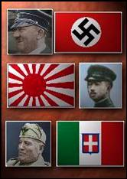
Rome-Berlin, Tokyo Axis
Germany, Italy and Japan formed the Rome-Berlin, Tokyo Axis
The Axis powers agreed to fight Soviet communism and not to interfere with one another’s plans for expansion

Slide 9
From Monarch to Republic
In the 1920’s Spain was a monarchy
Most Spaniards were poor peasants or urban workers
In 1931 popular unrest to the king leaving Spain
A republic was set up with a more liberal constitution
The new government passed a number of controversial laws leaving Spanish public opinion to be divided between those who wanted more reforms and those who wanted less
In 1936 Spain was plunged into a Civil War
Even though it was a local conflict a number of other nations entered into the conflict

Slide 10
Nationalists Verses Loyalists
In 1936 a general named Francisco Franco led a revolt that began a civil war
Fascists and supporters of right wing policies rallied around Franco’s forces and were called Nationalist
Supporters of the republic were called Loyalist and included communists, socialist, and supporters of democracy
Hitler and Mussolini sent aid to Franco
The Soviet Union and western democracies joined the International Brigades and fought alongside with Loyalist against fascism
Britain, France and the US remained neutral

Slide 11
Dress Rehearsal
Both sides committed horrible atrocities taking almost a million lives
In 1937 the Germans bombed a small town called Guernica killing 1,600 innocent people
Nazi leaders said it was an experiment to test their new planes
By 1939 Franco triumphed creating a fascist dictatorship who rolled back reforms and killed or jailed his enemies

Slide 12
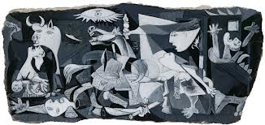
Guernica by Picasso

Slide 13
German Aggression Continues /
Austria Annexed
Hitler purses the goal of bringing all German Speaking people into the Third Reich
He seeks living space for Germans
Hitler believes in the superiority of the German or Aryan race and wants to conquer the inferior Slavs
By 1938 Hitler was ready to engineer the Anschluss or union of Austria and German
He had forced the Austrian chancellor to appoint Nazis to key cabinet posts and they sent the German army to preserve order and him as the new ruler of Austria
This was a violation of the Treaty of Versailles

Slide 14
The Czech Crisis
Germany’s next victim was Czechoslovakia
Hitler insisted that the 3 million Germans in the Sudetenland in western Czechoslovakia was one of the two remaining democracies Britain and France were still not willing to go to war and save, searching for a peaceful solution
At the Munich Conference in 1938 British and French leaders again chose appeasement persuading the Czechs to surrender the Sudetenland without a fight in exchange for Hitler’s assurances that he would not expand his territories

Slide 15
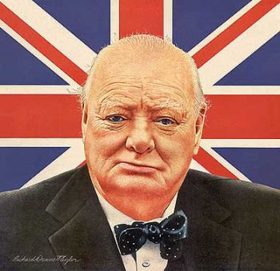
Peace in our Time
British and French leaders return happy that the Munich Pact had saved the Czechs and Europe from war
British Prime Minster Neville Chamberlain signed the Munich Pact
Sec. of the Navy: Winston Churchill warned that “They had to choose between war and dishonor, They chose dishonor, they will have war”

Slide 16
Europe Plunges Toward War /
Nazi Soviet Pact
In 1939 Hitler stunned the world by announcing a non-aggression Pact with Stalin / USSR
Binding Hitler and Stalin to peaceful relations but secretly they agreed to
Not to fight if the other went to war
To divide up Poland and other parts of Eastern Europe
This agreement was based on fear. Hitler feared communism and Stalin feared fascism
Hitler wanted Poland and did not want to fight the western democracies and the USSR at the same time
Since Stalin could not gain allies from the western democracies he knew he needed time to build up Soviet defenses plus he saw a chance to gain important territory

Slide 17
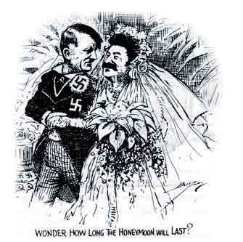
Nazi Soviet Pact Non-Aggression Pact

Slide 18
Invasion of Poland / Why War Came
Reasons Why:
The Treaty of Versailles divided the world into those who were happy with it and those who were not. Those who felt excluded or betrayed were Germany, Italy, Japan and the USSR (Soviet Union/Russia): fear of war and the destructive power of modern technology
In 1939, one week after signing the Nazi-Soviet Pact, German forces invaded Poland
Two days later Britain and France declared war on Germany
World War II had begun

Slide 19
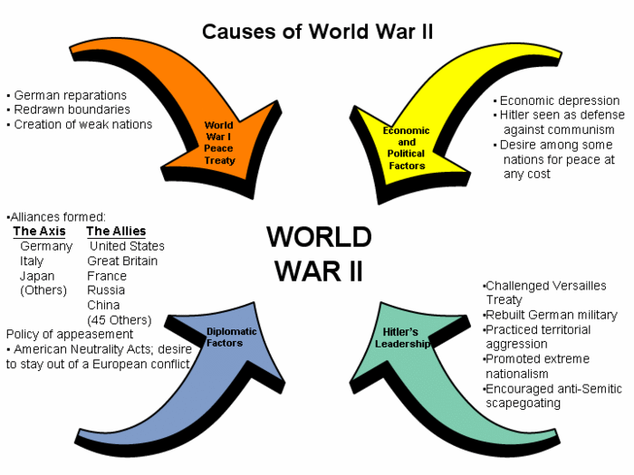
Causes of World War II

Slide 20
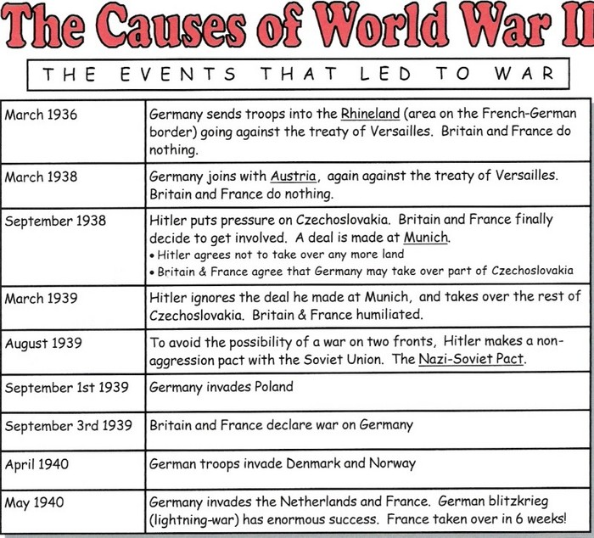
Events Leading To World War II

Slide 21
THE GLOBAL CONFLICT: ASXIS ADVANCE
World War II will be the costliest war in history
Lasted six years from 1939-1945
It pitted the Axis Powers: Germany Italy and Japan against the Allied powers: Britain, France, Soviet Union, China, US and 45 other nations
In Sept. 1939 German forces stormed Poland in a Blitzkrieg or lightening war quickly defeating Poland in a month
While German forces attacked from the west Soviet forces attacked from the East
While Hitler rested afterwards, Stalin’s armies pushed into Estonia, Latvia, Lithuania and part of Finland

Slide 22
The Phony War
During the first winter French and British troops hunkered down behind the Maginot Line to wait, some reporters called this a Phony War
In April 1940 the war exploded with Hitler launching a blitzkrieg against Norway and Denmark which both fell
Next Hitler slammed into the Netherlands and Belgium

Slide 23
Miracle of Dunkirk
By May German forces were pouring into France
Retreating British troops were soon trapped between advancing Nazis and the waters of the English Channel
Desperate the British sent all available naval ships, merchant ships and even fishing and pleasure boats across the channel to rescue the troops off the beaches of Dunkirk and Ostend
Despite German air attacks the armada ferried more than 300,000 British, French and Belgium troops to safety in Britain
This mission was dubbed the Miracle of Dunkirk and raised British moral

Slide 24
France Falls
While German forces head into Paris, Italy declares war on France
On June 22, 1940 Frances surrendered Hitler had avenged the defeat of 1918 forcing the French to sign surrender documents on the same railroad care in which Germany had signed the armistice ending WWI
In the south Germans set up a Puppet with the capital in Vichy. Some French officers escaped to England setting up a government in in exile led by Charles de Gaulle and they worked to liberate France
Within France resistance fighters use guerrilla against German forces

Slide 25
Africa and The Balkans
Axis armies also pushed into North Africa
In Sept 1940 Mussolini ordered forces from Italy’s colony of Libya into Egypt
When British forces stopped the invaders Hitler sent General Rommel nicknamed the Desert Fox to North Africa and pushed back British forces
October 1940 Italian forces invaded Greece and were met with stiff resistance and in 1941 German troops provided reinforcements with both Greece and Yugoslavia being added to the Axis empire however guerilla still would plague the occupying forces
Meanwhile both Bulgaria and Hungary joined the Axis powers

Slide 26
The Technology of Modern Warfare
Technology created a war machine with great destructive power
Planes or the German Luftwaffe bombed civilian and military targets
Armored tanks and troop carriers and parachute troops stormed into Europe
Improved designs for submarines, planes and bombs
Radar was used to detect air planes and Sonar was used to detect submarines
Medical advances treated the wounded
New synthetic goods replaced scare strategic goods

Slide 27
The Battle of Britain and the Blitz
With the fall of France Britain stood alone and Hitler was sure the British would surrender but Churchill rallied the British promising never to surrender
The Luftwaffe began bombing on August 1940 on England’s southern coast
In Sept. Of 1940 the Luftwaffe began bombing London and bombed it continuously for 57 nights
Defiantly Parliament continued to meet, citizens carried on with their daily affairs and the king and queen chose to join the people in the shelters rather than fell to the countryside
Century Series Civilians at war start with London Blitz 15: https://www.youtube.com/watch?v=njLPltxkmhE&list=PLC8D9DC28C3EC5223&index=16

Slide 28
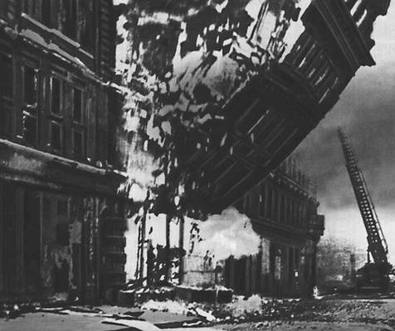
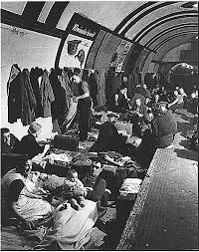
Bombing of London

Slide 29
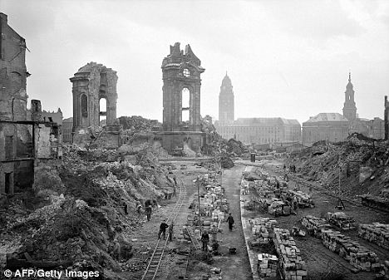
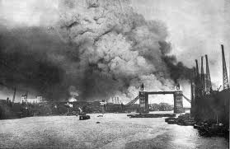
Bombing of London

Slide 30
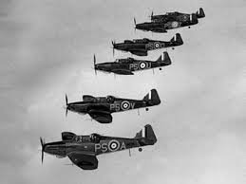
Failure of the Blitz
German planes continued to bomb London until June 1914 which only made the British more determined to turn back the enemy which was made possible by the RAF or Royal Air Force
Churchill (the wise and wonderful)said “Never in the field of human conflict was so much owed by so many to so few”

Slide 31
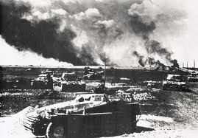
Operation Barbarossa
June 1941 Hitler embarked on Operation Barbarossa or the conquest of the Soviet Union
Hitler wanted the raw materials in the Ural mountains (oil) plus the many other raw materials throughout the USSR
Hitler also wanted to crush communism and defeat Stalin

Slide 32
German Advances
Hitler unleashes a new blitzkrieg with about 3 million German’s pouring into the Soviet Union
Still suffering from the purges and the loss of many top officers Stalin was unprepared
Russia lost 2 ½ million trying to fend off the Germans
As they retreated the Russian troops destroyed factories and farm equipment and burned crops to keep them out of enemy hands (scorched earth)
By fall the Germans were not prepared for the fury of Russia’s General Winter and by Dec. thousands of German soldiers froze to death

Slide 33
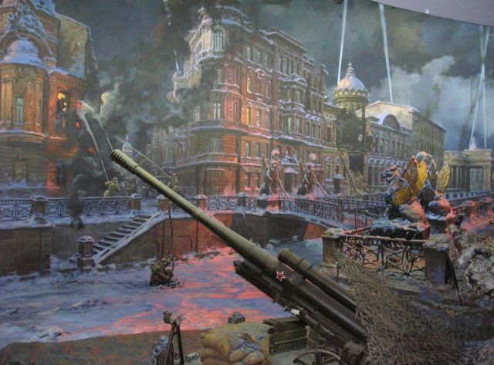
Siege of Leningrad
In Sept 1941 a 2 ½ year siege of Leningrad began
Over a million Leningraders died and the survivors suffered appalling hardships
Stalin urges Britain to open a second front but Britain cannot, they do start working together

Slide 34
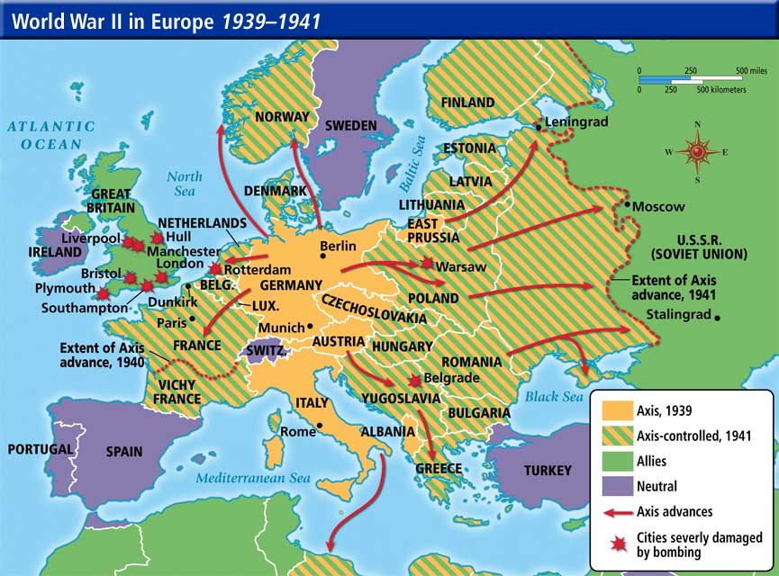
World war II in Europe

Slide 35
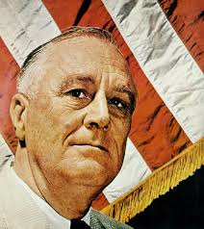
American Involvement Grows
While many in the US did want to remain out of the war many did sympathize with the Allies
Roosevelt found ways around the Neutrality Acts acts providing aid like warships

Slide 36
The Arsenal of Democacy/Atlantic Charter
In 1941 Roosevelt and Churchill meet on a warship in the Atlantic and issued the Atlantic Charter
This stated a set of War Goals for the “final destruction of the Nazi tyranny” and for the Post War world
They pledged to support the right of all people to choose the form of government under which they will live and they called for a permanent system of general security
In 1941 Roosevelt persuades Congress to pass the Lend Lease Act to allow him to sell or lend war materials to any country whose defense the president deems vital to the defense of the US
Century Series over the edge start at 830: http://static1.squarespace.com/static/509296e8e4b08a6452e71191/t/51351ef0e4b055d8b6176c8e/1362435824326/Literacy+Groups.pdf

Slide 37
Japan Attacks / Growing Tensions
From the 1930’3 on Japan had been trying to occupy China and with the outbreak of the war they saw their chance to grab European possessions in Southeast Asia
Resources in this area such as oil, rubber and tin would make fighting the Chinese valuable
In the 1940’s after Japan advanced in to French Indochina and Dutch East Indies the US banned the sale to Japan of war materials such as iron, steel, and oil greatly angering Japan
Militarists such as General Tojo felt that the US was interfering with their plans

Slide 38
Attack on Pearl Harbor
With talks at a stand still Gen. Tojo orders a surprise attack on the American fleet at Pearl Harbor Hawaii
On Dec. 7th 1941 the Japanese airplanes damaged or destroyed 19 ships and destroyed American planes on the ground and killed more than 2400 people
The next day Pres. Roosevelt told the nation that Dec. 7th was “a date which would live in infamy”
He then asked Congress to declare war on Japan and on Dec. 11th Germany, Japan and Italy declared war on the US
"I fear all we have done is to awaken a sleeping giant and fill him with a terrible resolve." Admiral Yamamoto
History Channel 2 min: http://www.history.com/topics/world-war-ii/pearl-harbor/videos/attack-pearl-harbor?m=528e394da93ae&s=undefined&f=1&free=false
USS Arizona: http://www.history.com/topics/world-war-ii/pearl-harbor/videos/uss-arizona-under-attack-at-pearl-harbor?m=528e394da93ae&s=undefined&f=1&free=false

Slide 39
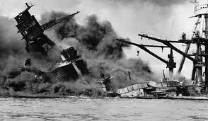
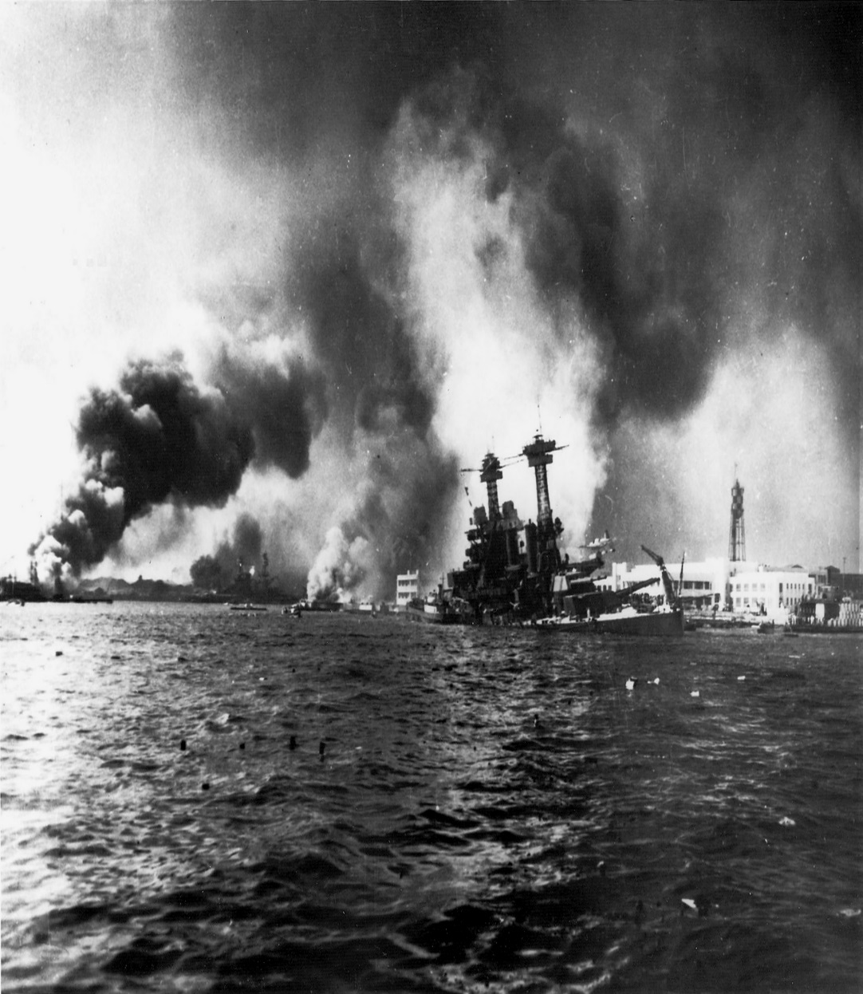
Attack on Pearl Harbor

Slide 40
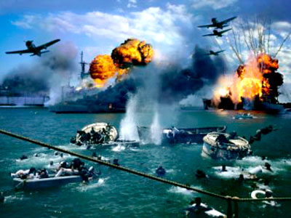
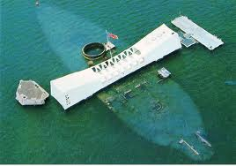
Pearl Harbor

Slide 41
Japanese Victories
In the months after Pearl Harbor the Japanese were successful in capturing the Philippines and other American islands across the Pacific
They overran the British colonies of Hong Kong, Burma and Malay as well as French Indochina
By 1942 Japan’s empire reached from Southeast Asia to the western Pacific Ocean
Axis powers were at their height

Slide 42
THE GLOBAL CONFLICT: ALLIED SUCCESSES
World War II was fought on a larger scale and in more places than any other conflict in history
It was also more costly in lives of both soldiers and civilians
From 1939 to mid 1942 the Axis had a string of successes however, slowly the tide began to turn
Both German and Japan were seeking to conquer more territory and to build a “New Order

Slide 43
Nazi Europe
Hitler’s new order grew out of the racial obsessions that Europe be populated by Aryans or related races so the Slavs should be shoved aside to make room for Aryans or the Germans who Hitler considered the ideal race
The Nazis saw occupied lands as economic resources to be plundered and looted
They stropped conquered nations of the works of art, factories, and other resources
Nazis enslaved, tortured and killed prisoners
Century Series Civilians at war Part 2 Holocaust: https://www.youtube.com/watch?v=00q5jVLm5R8&index=17&list=PLC8D9DC28C3EC5223

Slide 44
Nazi Genocide
At first Hitler forced Jews in Poland and other countries to live in Ghettos and concentration camps
By 1941 he devised plans for his Final Solution or the Jewish problem and that was Genocide or the deliberate murder of an entire religious or ethnic groups
He accomplished this by building special Death Camps in Poland like Auschwitz, Sobibor and Treblinka which killed millions of who Hitler deemed racially inferior like the Slavs, Gypsies, mentally ill and particularly the Jews
Many were herded into “shower rooms” and gassed, used for medical experiments, shot, tortured etc.
There were people and governments who did try to protect the Jews but there were also many who were collaborators or people who helped the enemy in hunting down the Jews including the Vichy Government in France
About 12 million people were murdered with about half being Jewish (killed for their religious and ethnic heritage) and the other half being other “undesirable” peoples

Slide 45
Genocide is the deliberate killing of an entire people. The Nazis’ “Final Solution” was aimed at eliminating Jews and other enemies of the state
Groups that the Nazis targeted for slavery or death:
1. All non-Aryans 9. Mentally challenged
2. Jews 10. Insane
3. Communalists 11. Disabled
4. Socialists 12. Incurably ill
5 Gypsies 13. Homosexuals
6. Liberals 14. Ukrainians
7. Freemasons 15. Russians
8. Jehovah’s Witnesses 16. Poles

Slide 46
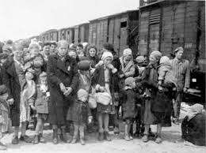
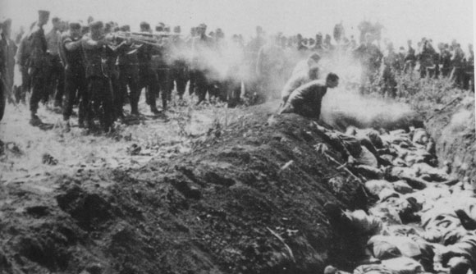
The Holocaust

Slide 47
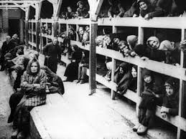
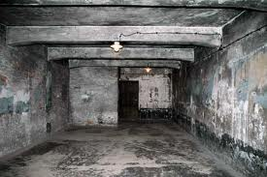
The Holocaust

Slide 48
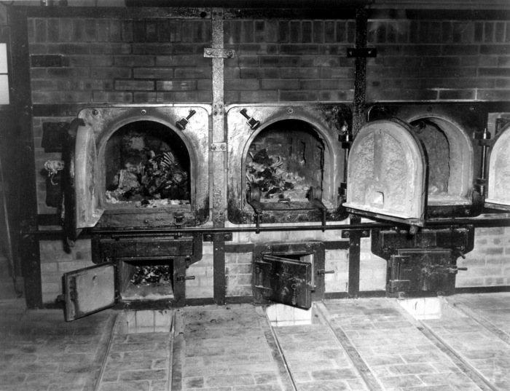
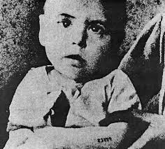
The Holocaust

Slide 49
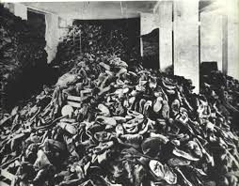
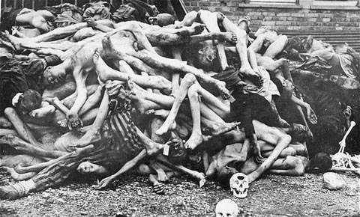
The Holocaust

Slide 50
The Co-Prosperity Sphere
Japan claimed it was anti-imperialism and had a slogan “Asia for Asians”
It created the Greater East Asia Co-Prosperity Sphere and said its mission was to help Asians escape western colonial rule but in fact its real goal was a Japanese empire
The Japanese tested its conquered peoples with great brutality
It seized food crops, destroyed cities and towns and made local people into slave labor
Many groups waged guerrilla warfare against the Japanese invaders
Century Series War in Asia https://www.youtube.com/watch?v=Aq1ORDjttp4&index=18&list=PLC8D9DC28C3EC5223

Slide 51
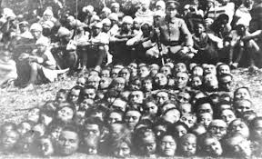
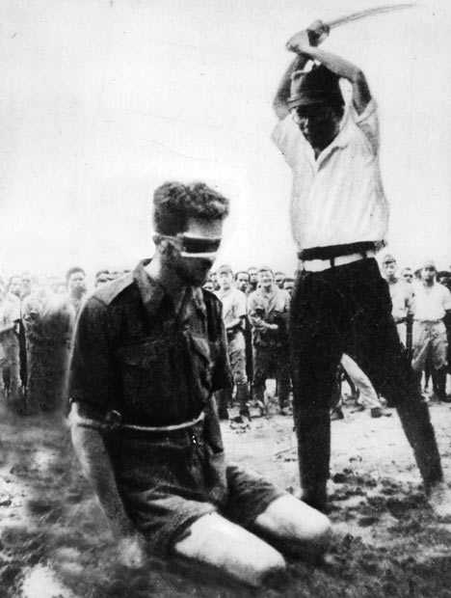
Japanese War Atrocities

Slide 52
The Allied War Effort
After the US entered the war the Allied leaders would meet to hammer out strategies
The BIG THREE Roosevelt, Churchill and Stalin met in 1942 to agree on how to finish the war in Europe before turning their attention to Japan
All three distrusted each other
Stalin urged Roosevelt and Churchill to open a second front in Western Europe to relieve pressure on Russia but that didn’t happen until 1944
British and Americans clamed they didn’t have the resources but Stalin saw the delay as a deliberate attempt to weaken the Soviet Union

Slide 53
Total War
The Allies also commit to Total War
They directed economic resources to the war effort by stopping factories from producing consumer goods to producing war goods
While the government did ration consumer goods and regulate prices and wages it also ended the unemployment of the depression era
Governments also limited the rights of citizens censored the press and used propaganda to win public support for the war
Many citizens of Japanese descent in the US and Canada lost jobs, property and civil rights. Many lost their freedom being forced into internment camps Similar actions were taken by the British to people of German descent
40 years later the US and Canada apologized for their war time policy and paid reparations or payments for damages caused by imprisonment

Slide 54
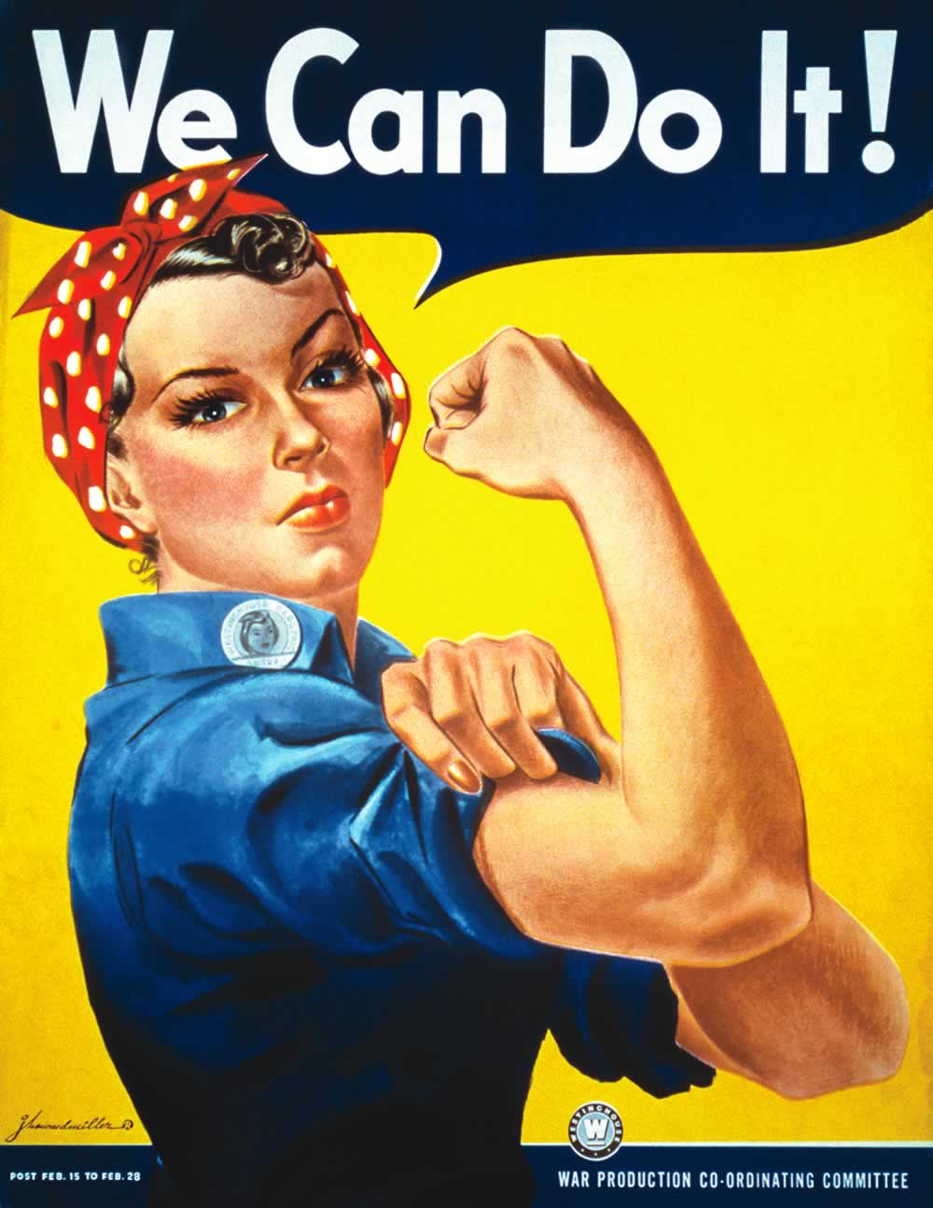
Women Help Win the War
As men joined the military the war industries expanded and millions of women around the world replaced them in essential jobs
British and American women also served in the armed forces

Slide 55
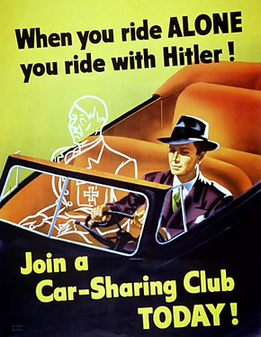
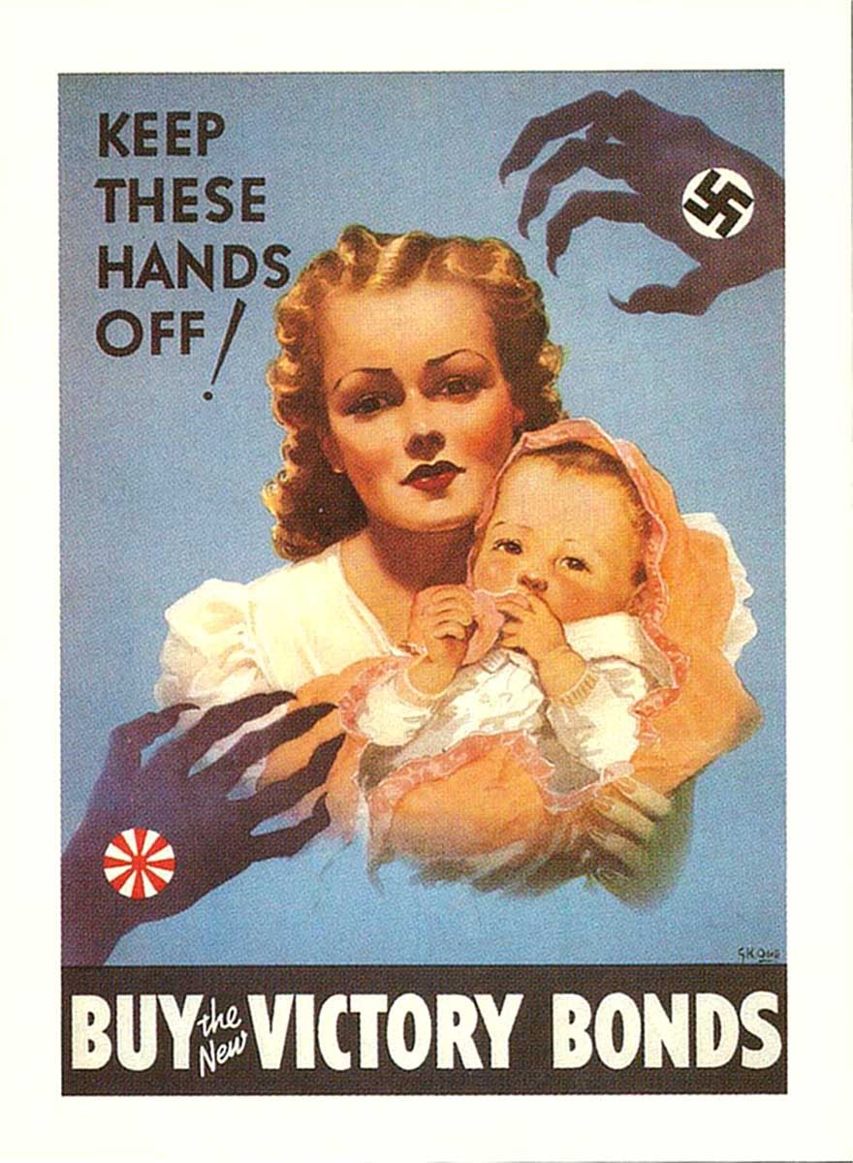
US Propaganda Posters

Slide 56
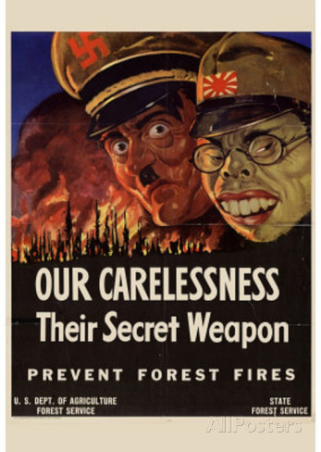
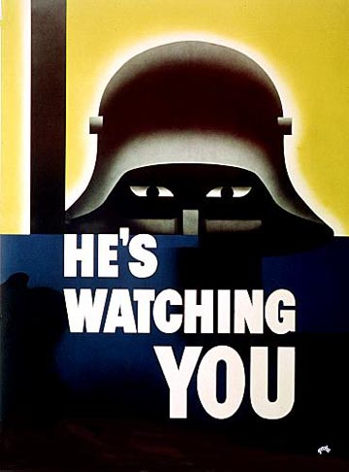
Be Afraid!!!

Slide 57
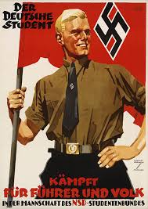
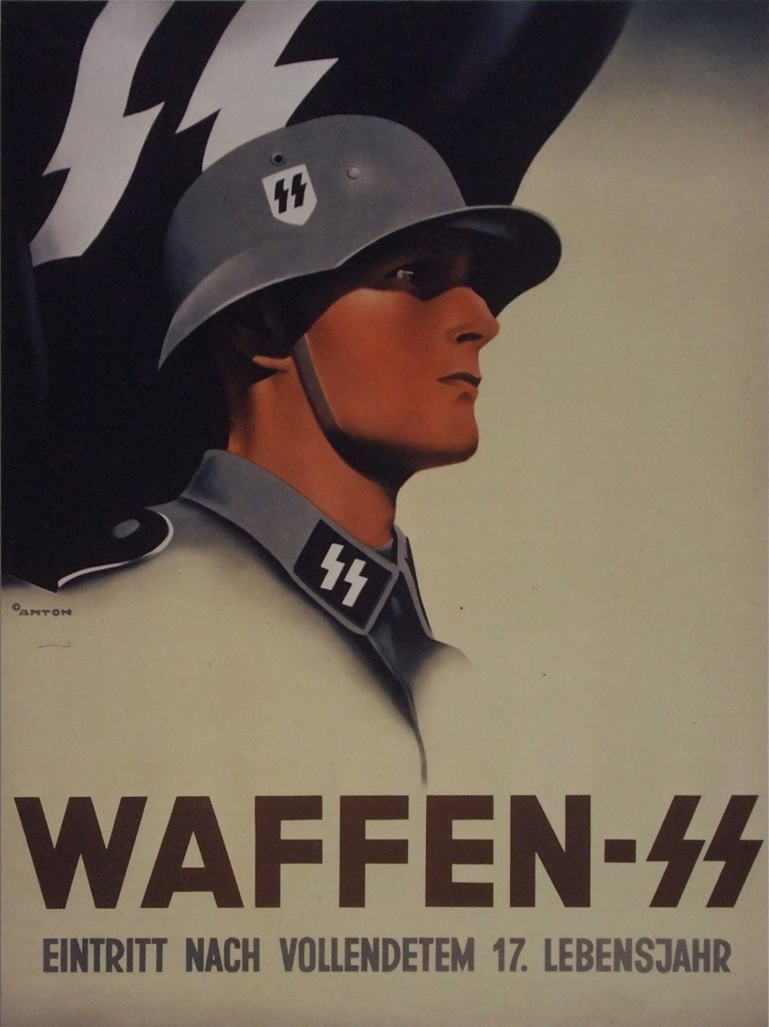
German Propaganda

Slide 58
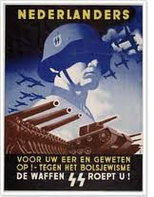
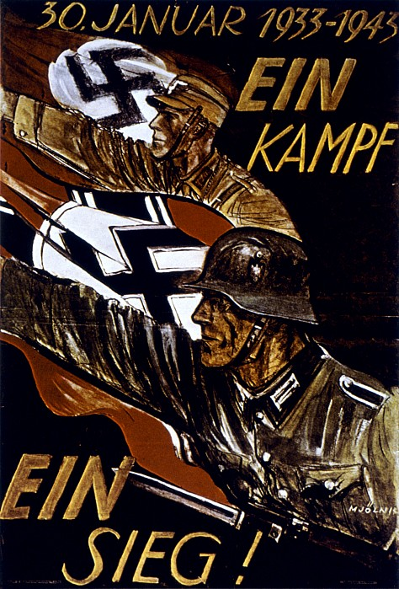
German Propaganda

Slide 59
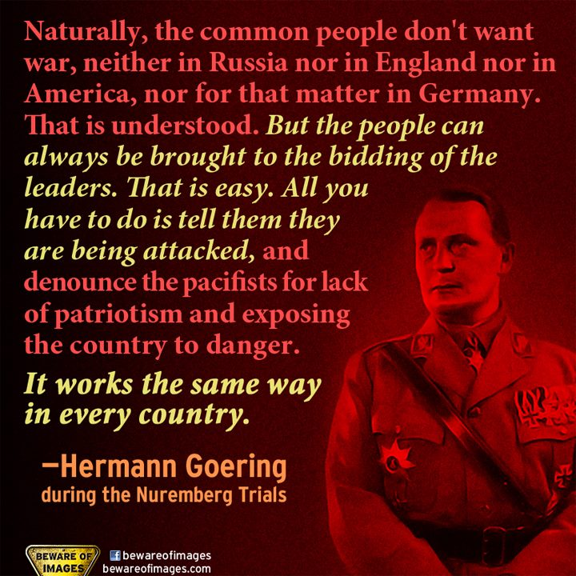

Slide 60
Turning Points / El Alamein
Between 1942 and 1943 the Allies won several victories that would turn the tide of the war
These early victories came in North Africa and Italy
In Egypt, British General Montgomery finally stopped Rommel’s advancement at the Battle of El Alamein driving the Desert Fox back across Libya and Tunisia
Later in 1942 US General Eisenhower took control of forces in Morocco and Algeria and advanced on Tunisia and combining with the British forces to trap Rommel. He surrendered in May 1942

Slide 61
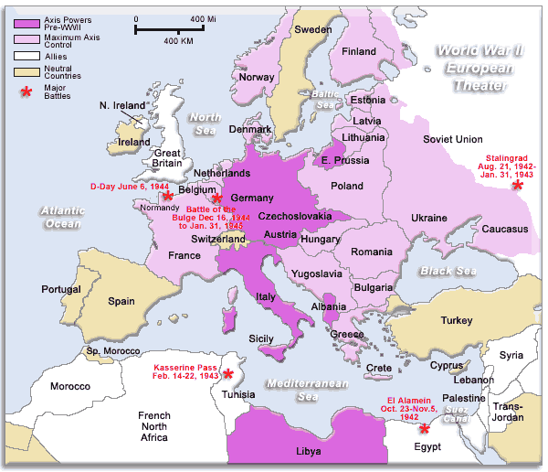
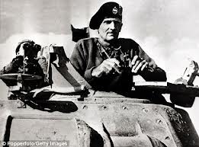
The Desert Fox / WW2 Map

Slide 62
Invasion of Italy
Victory in North Africa allowed the Allies to leap across to Italy in July 1943 and defeating them in about a month
Angry Italians overthrew Mussolini and put a new Italian government in place
Fighting did not end since Hitler sent German troops into rescue Mussolini which stiffened the sill of the Italian fighters
For 18 months Allied forces slowly pushed up Italy suffering heavy losses but did invade and weaken Hitler by forcing him to fight on

Slide 63
The Red Army Resists / Stalingrad
The Germans stalled outside Moscow and Leningrad but in 1942 launched a new offense aimed at the oil fields in the south
He got as far as Stalingrad
The Battle of Stalingrad was one of he costliest in the war
Hitler was determined to capture it and Stalin was determined to defend it
It began when the Germans surrounded the city then the Russians surrounded them
The battle was waged street by street, house by house until the Germans we trapped without food or ammunition and with no hope of rescue
The surrender was in early 1943 and cost the Germans 300,000 killed/wounded

Slide 64
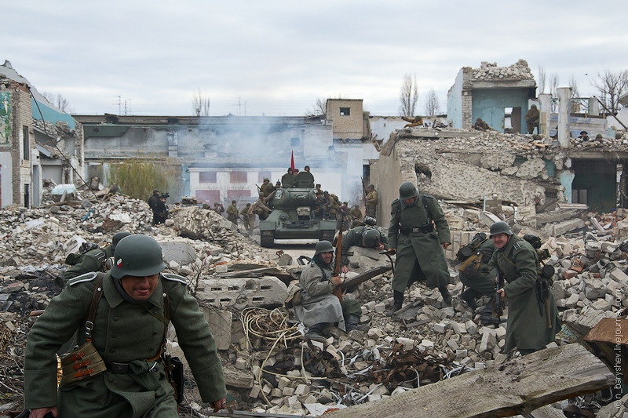
Battle of Stalingrad

Slide 65
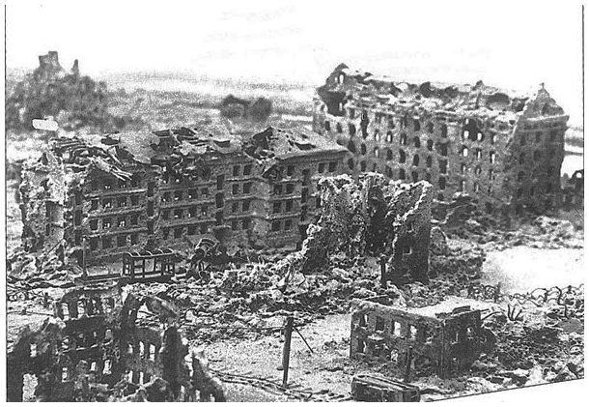
Counterattack
After Stalingrad the Red Army took the offensive and drove the invaders out to the Soviet Union and continued advancing into Eastern Europe

Slide 66
Invasion of France
By 1945 the Allies were ready to open a second front in Europe with the invasion of France
Eisenhower was the Allied supreme commander
To prepare Allied bombers flew constant missions over Germany destroying factories, aircraft and cities
The Allies chose June 6, 1944 as D-Day for the invasion of France
The invasion was a massive landing of thousands of men on the shores of Normandy France finally breaking through German defenses and advancing toward Paris
Under pressure from all sides Germans retreated from Paris and on Augusts 25th the Allies entered Paris and within a month all of France was free
Now attention could be focused on conquering Germany and defeating Japan

Slide 67
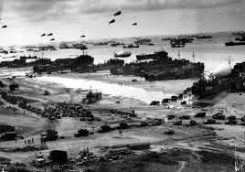
D-Day is the day on which a combat attack or operation is to be initiated. The best known D-Day is June 6, 1944 — the day of the

Slide 68
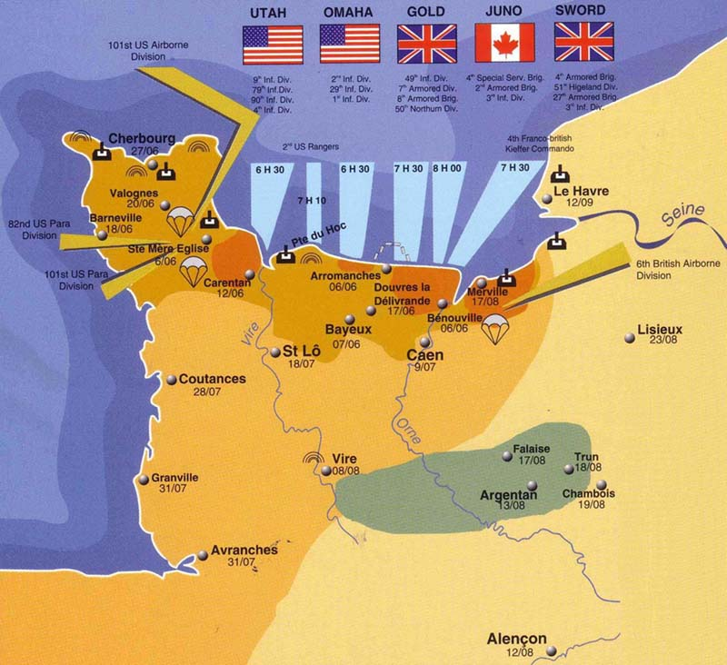
Operation Overlord

Slide 69
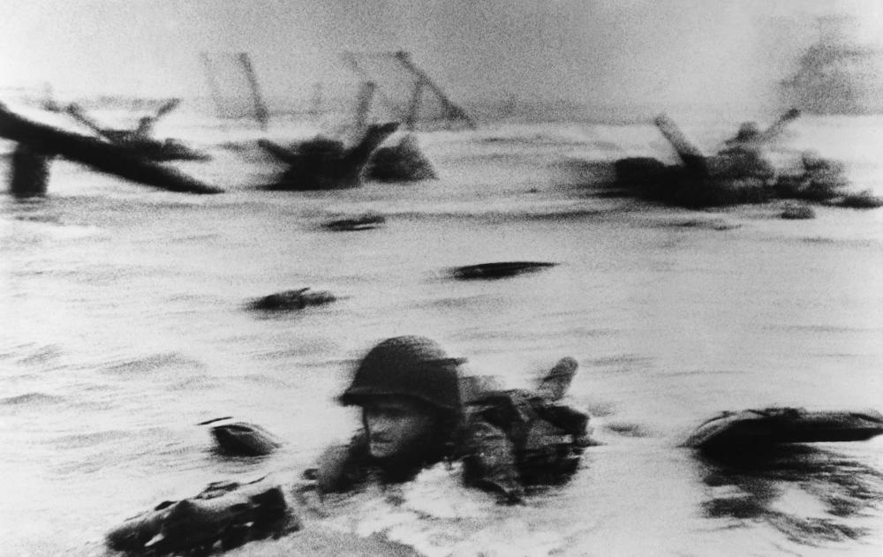
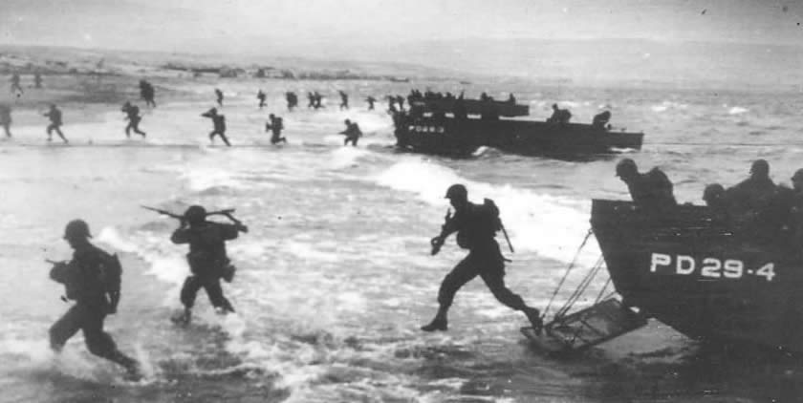
Beaches of Normandy

Slide 70


D-Day

Slide 71

TOWARD VICTORY
War in the Pacific was led by Gen. Douglas MacArthur and was very different from war in Europe
Most battles were fought at sea, on tiny islands or in jungles

Slide 72
War in the Pacific
At first the Japanese won a series of victories and controlled much of the South Sea and by May 1942 they had gained control of the Philippines killing hundreds of US soldiers and 10,000 Filipino
The tide soon turned in May 1942 when the US was victories at Midway in the Solomon islands
This victory marked the beginning of the US campaign of island hopping or capturing some Japanese islands while bypassing others
The objectives was to use captured islands as to the next and gradually move toward Japan as stepping stones
By 1944 Admiral Nimitz was blockading Japan and the US bombers pounded Japanese cities and industries
In Oct. 1944 MacArthur began to retake the Philippines and British were pushing Japanese forces back in the jungles of Burma and Malaya
Despite the setbacks the Japanese government rejected suggestions of surrender

Slide 73

Island Hopping

Slide 74

On Iwo Jima over 6,000 Americans died in the effort to bring US forces within striking distance of Japan

Slide 75

Navajo code talkers

Slide 76
The Nazis Defeated / The Allies Advance
Hitler also rejected the idea of surrender so the allies had to use devastating force
After freeing France the Allies battle toward Germany
In Belgium in Dec. 1944 German launched a massive counter attack attack at the Battle of the Bulge both sides suffered terrible losses with the Germans unable to break through
Hitler had less and less support within Germany
Germany was suffering from round the clock bombing devastating the country and killing hundreds of thousands of people
In march 1945 Allied and Soviet troops closed in on Berlin meeting and shaking hands at the Elba River and everywhere Axis soldiers were surrendering

Slide 77

Battle of the Bulge: last German counter attack

Slide 78

The End in Europe
Italian partisans captured and executed
Hitler knew the end was near and committed suicide in his underground bunker
He killed himself by gun shot on 30 April 1945. His wife Eva committed suicide with him by taking cyanide
The war ended officially in Europe on V-E Day known as Victory in Europe Day

Slide 79

Defeat in Japan
With the war won in Europe the Allies could pour their resources into defeating Japan
By mid 1945 most of the Japanese navy and air force had been defeated yet the army still had an army of 2 million so the road to victory could be a log and costly one

Slide 80
Invasion Versus the Bomb
Some worried that an invasion of Japan could cost 1 million or more casualties
Battles at Iwo Jima and Okinawa demonstrated that the Japanese would fight to the death rather than surrender
In 1944 some young Japanese chose to become Kamikaze pilots who undertook suicide missions crashing their planes into US war ships
Scientist offered another way to end the war
By splitting the atom scientists discovered they could create an explosion far more powerful than ever known
In 1945 scientist successfully tested the first Atomic Bomb at Alamogordo New Mexico
Name of the first two bombs dropped were Fat Man and Little Boy
Roosevelt had died on April 1945 and the new president was Harry Truman and he was just learning of the bomb
After meeting with advisors Truman decided to use the bomb again Japan
While meeting with other Allied leaders in Potsdam Germany, they issued a warning to Japan to surrender or face utter and complete destruction
The Japanese ignored the deadline

Slide 81


Oppenheimer The Manhattan Project: “ Now I am become Death, the destroyer of worlds”

Slide 82


The Gadget / Detonated at Trinity(5:30 am) on July 16. 1945

Slide 83


Early Atomic tests

Slide 84
Hiroshima
On August 6, 1945 an American plane named the Enola Gay dropped an atomic bomb on the city of Hiroshima
The bomb flatten 4 miles miles instantly and killed more than 70,000
Many more died from radiation sickness afterwards and the exposure to radioactive materials.
The next day the USSR declared war on Japan and still no response
The following day the US dropped a second atomic bomb on the city of Nagasaki
Finally on August 10th emperor Hirohito signed a formal peace treaty on the battleship

Slide 85


Hiroshima

Slide 86


Fat Man and the Enola Gay

Slide 87


USS Indianapolis https://www.youtube.com/watch?v=5nrvMNf-HEg

Slide 88
An Ongoing Controversy
Dropping the Atomic Bomb brought a quick end to the war
It unleashed a terrifying force of destruction
Debated ever since
Why did Truman drop the bomb?
1. He was convinced that Japan would not
surrender and their would be heavy loss of life
on both sides
2. To impress the USSR
3. To see what it could do

Slide 89

Hirohito signing surrender papers on the USS Missouri

Slide 90
Reasons for Allied Victory
1. Location of Germany – surrounded by enemies
2. Location of Japan – dependent on imported
goods
3. Poor military decisions by Axis leaders
4. Huge productive capability of the United States
5. Better technology developed and used by Allies
Century Series End of the War: https://www.youtube.com/watch?v=HFe7BZSoGMs&list=PLC8D9DC28C3EC5223&index=19

Slide 91
FROM WORLD WAR TO COLD WAR / Aftermath of War
At the end of the war many countries lay in ruins
Millions of refuges, displaced by fighting for , those liberated from prison camps wandered the land
The devastation, hunger and disease took a large too for years afterwards
Keith Hughes WWII in 10 min: https://www.youtube.com/watch?v=p7fCsXjCW1M
As many as 75 million people were killed around the world 38 million in Europe were killed many were civilians
The Soviet Union lost 22 million the MOST of any nation
Investigation after the war brought horrible atrocities to light.
Crash Course WWII
https://www.youtube.com/watch?v=Q78COTwT7nE&list=PLBDA2E52FB1EF80C9&index=38

Slide 92

Horrors of the Holocaust
While the Allies did know about the Nazi concentration camps they did not know the real horror until they saw them
Walking skeletons to stories of mass murder

Slide 93
War Crimes Trials
The Allies agreed in meetings after the war that the Axis leaders should be tried for crimes against humanity
The war trials were held in Nuremberg Germany
177 Germans and Austrians were tried and 142 were guilty
Similar war crimes trials were held in Japan and Italy
This showed that political and military leaders could be held accountable for actions in wartimes

Slide 94
Allied Occupation
The war crimes also exposed the savagery of the Axis regimes further discrediting the Nazis, Fascist and the militarist ideologies that led to the war
Haunting Questions:
What made the Nazi horrors possible
Why would ordinary people in Germany, Poland and France accept or collaborate in Hitler’s Final Solution
How could the world prevent the rise of future dictators
Allies felt that strengthening democracies would ensure tolerance and peace

Slide 95
The United Nations
The Allies wanted to set up an international organization to ensure PEACE
In April 1945 delegates from 50 counties met in San Francisco and drafted the charter for the United Nations
Under the UN Charter, each of the member nations had ONE vote in the General Assembly
In the smaller Security Council each of its 5 permanent member nations, the US, the Soviet Union, Britain, France and China had the right to veto any council decision
The goal was to give these great powers the authority to ensure the Peace
Often differences among these nations have kept the UN from taking action

Slide 96
Other things the UN does
1. Prevent outbreaks of disease
2. Improve education
3. Protect refugees
4. Give Aid to developing economies

Slide 97

The Alliance Breaks Apart
Two new powers would emerge from this war
The United States
The Soviet Union
These two countries would become Super Powers with the economic resources and military might that would dominate the globe
They would also become intense rivals and would come to divide the world

Slide 98

Growing Differences
Conflicting Ideologies and mutual distrust soon led to the conflict know as the Cold War
It was a state of tensions and hostilities among nations without armed conflict between the major rivals

Slide 99
Origins of the Cold War
Stalin’s goals in Eastern Europe:
Spread of communism into the area
Create a Buffer Zone of friendly governments as a defense against Germany
As the Red Army (Soviets) pushed out the Germans from Eastern Europe it left behind occupying forces
The US and British did not approve of this
Stalin pointed out that the US did not consult with the USSR about peace terms for Italy or Japan both defeated and occupied by US/British forces, The same was true for USSR. It would determine the fate of the Eastern European lands overrun by the Red Army on the way to Berlin
Truman and Churchill rejected this idea and made Stalin promised “Free Elections” but Stalin ignored the pledge destroying rival government parties and installing pro Soviet communist governments throughout Eastern Europe

Slide 100

A Divided Europe
Churchill describes the Soviet control of Eastern Europe as an Iron Curtain dividing the continent
The Iron Curtin became a symbol of the Cold War along with fear
Europe would be described as Eastern and Western blocks
East was Soviet dominated communist countries and the West were democracies led by the United States

Slide 101

New Conflicts Develop
Churchill and Truman both saw communism as an evil force creeping across Europe and threatening countries around the world
The US abandoned its traditional Isolation (withdrawing from global affairs) but instead taking a leading role in the world
Soviets soon began backing communist rivals fighting in Greece
Stalin was also menacing Turkey in the Dead Sea linking the USSR to the Russian Black Sea coast to the

Slide 102
Truman Doctrine
Truman takes actions with the Truman Doctrine
US would resist Soviet expansion in Europe or the world
The military and economic aid and advisors were sent to Greece and Turkey to help them withstand the communist threat
It was rooted in the idea of containment or limiting communism to the areas already under Soviet control
Stalin saw it as being encircled by capitalist wanting to isolate the Soviet Union

Slide 103
The Marshal Plan
To help strengthen democratic governments the US offered a massive aid package called the
The US would funnel food and economic assistance to Europe to help countries _
Truman also offered aid to the USSR and its satellites or dependent states
Stalin saw it as a trick to win Eastern Europe over to capitalism and democracy and he forbade the Eastern European countries to accept US aid promising it from the USSR

Slide 104
Divisions in Germany
Germany had been divided into 4 zones of occupation by the US, France, Britain and USSR
The US France, and Great Britain decided to join their zones and encouraged Germans to rebuild
The USSR dismantled factories and took other resources back to help rebuild the USSR (Russia)
Germany thus became a divided nation
Western Germany was democratic and allowed the people to write their own constitution and regain self government
East Germany was communist and tied to Moscow

Slide 105

Looking Ahead
After surrender the US occupied a ruined Japan
Germany had been divided into 4 zones of occupation
Problem: how to build a foundation for a stable peace

Slide 106

Post World War Germany

Slide 107
Berlin Airlift
Stalin’s resentment a the west to rebuild Germany triggered a crisis
The former capital of Berlin was also divided in to 4 zones and was deep within the Soviet zone.
In 1948 Stalin tried to force western Allies out of Berlin and sealed off every part of the city
Western powers responded to the blockade by mounting around the clock airlift
For more than a year cargo planes supplied West Berliners with food and fuel forcing the Soviets to end the blockade
Although the West won a victory it only deepened hostilities

Slide 108


Berlin Wall

Slide 109
Military Alliances
As tensions grew in 1949 the US Canada, and Nine other nations formed a new military alliance called the North Atlantic Treaty Organization or NATO
Members pledged to help one another if any one of them was attacked
In 1955 the USSR responded by forming its own military alliance called the Warsaw Pact and included the USSR and Seven satellites in Eastern Europe
Soviets used the military alliance to keep its satellites in order

Slide 110
NATO – Warsaw pact
North Atlantic Treaty Org. Members
Belgium
Canada
Denmark
France
Iceland
Italy
Luxembourg
Netherlands
Norway
Portugal
United Kingdom
United States
Greece
Turkey
West Germany
Spain
Warsaw Pact Member Nations
Albania
Bulgaria
Czechoslovakia
East Germany
Hungary
Poland
Romania
Soviet Union

Slide 111
The Arms Race
Each side in the Cold War armed itself to withstand an attack by the other
At first the US was ahead because it had atomic bombs but the USSR quickly developed them too and so the race was on
For the next 4 decades both sides spent fantastic sums to develop new, more deadly nuclear and conventional weapons and delivery systems
Timeline of nuclear bombs 10 min: https://www.youtube.com/watch?v=I9lquok4Pdk
Largest bomb tsar https://www.youtube.com/watch?v=RNYe_UaWZ3U

Slide 112

The Propaganda War
Both sides participated in a propaganda war
US defending capitalism and democracy against communism and totalitarianism
The USSR clamed to struggle against western imperialism
Cold War: https://www.youtube.com/watch?v=y9HjvHZfCUI&list=PLBDA2E52FB1EF80C9&index=39

Slide 113


Cold War Propaganda/ Duck and Cover

Slide 114
Looking Ahead
The Cold War would last more than 40 years
It would divide Europe and fuel crisis around the world
It would strain the resources of the US and exhaust those of the Soviet Union
Though no large scale war broke out between the super powers they both championed opposite sides in numerous smaller wars
Meanwhile new weapons would raise the specter of global destruction
Crash Course Cold War: https://www.youtube.com/watch?v=y9HjvHZfCUI&index=39&list=PLBDA2E52FB1EF80C9
Keith Hughes Cold War: https://www.youtube.com/watch?v=bTk3dFC7t00

