Slide 1
Indus River Valley

Slide 2
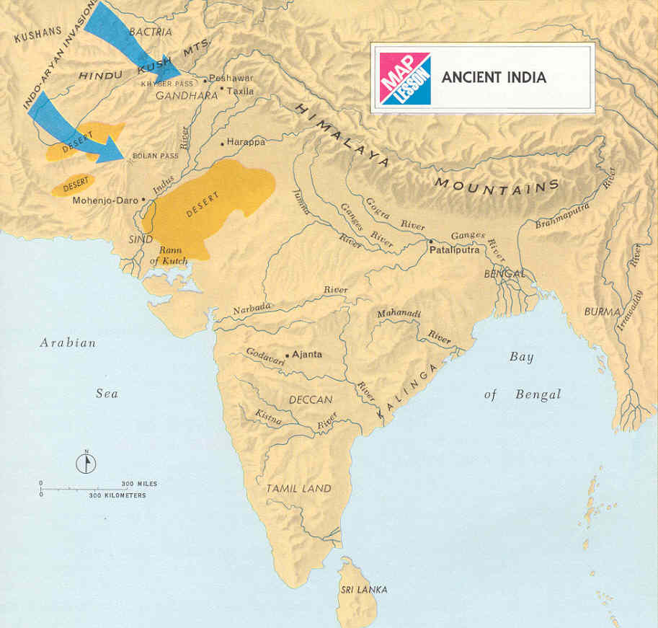
Geography of the Indian Subcontinent / Cultural Diversity
India is a large landmass that is part of a content called a Subcontinent and includes three major geographic regions
Includes today’s countries of India, Pakistan, Bangladesh, Sir Lanka, Nepal, Bhutan
It has three major rivers: Indus, Ganges and Brahmaputra
Heavy rains add to its fertility with seasonal winds called Monsoon bringing rain
Mountain ranges include:
Himalayas and Hindu Kush

Slide 3
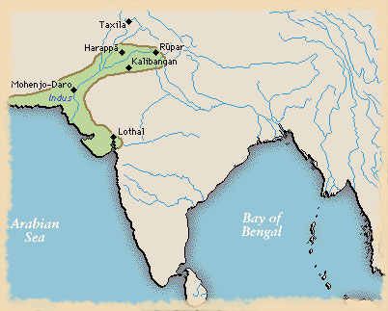
Cities of the Indus Valley

Slide 4
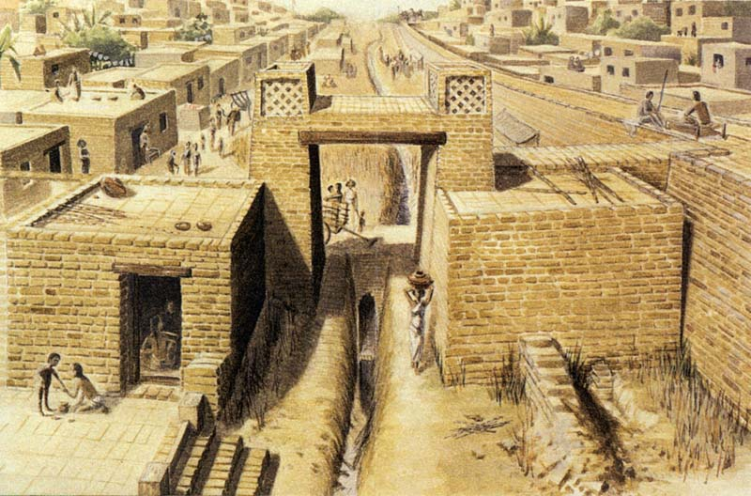
Indus Valley Civilization
Earliest civilization a mystery/emerging in Pakistan about 2500BC
This civilization flourished for about 1,000 years then vanished without a trace
We know little about this large civilization

Slide 5
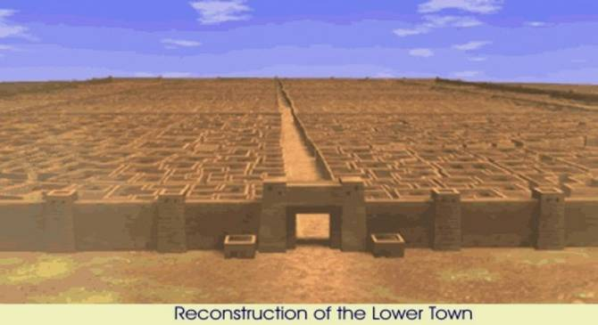
Welled Planned Cities
Two main cities of Harappa & Mohenjo-Daro may have been twin capitals
The most striking feature was it was so well planned
Houses even had modern plumbing with baths, drains and water chutes that led into sewers
They had a well organized government
Powerful leaders, perhaps priest –kings and tens of thousands of city dwellers

Slide 6
Farming and Trading/Relegion
Most people are farmers and they grew a wide variety of crops
Some people were merchants/traders with ships carrying things like cotton, cloth, grain copper etc.
Contact with Sumer may have stimulated them to develop their own system of writing
Religious Beliefs
Polytheistic
Mother earth goddess
They showed veneration or special regard for cattle

Slide 7
Decline and Disappearance
In 1750 BC we see a decline in the quality of life in this region…Why?
1. damage to local environment
2. volcanic eruption
3. earth quake
4. Invaders

Slide 8
The Aryan Civilization
Aryans (term meaning noble) were among many Indo-Europeans (refers to a related family of languages in Europe and Asia) to migrate here seeking water and pastures
Most of what we know comes from the Vedas
The Vedas are a collection of prayers, hymns, and other religious teachings
Aryan priests memorized and recited the Vedas for a 1,000 years before they were written down
Aryan warriors were nomadic herders who valued cattle and even when they settled into farming wealth was still measured in cows and bulls

Slide 9
Aryan Society
Divided people by occupation / Three basic groups were
1. The Brahmins or priests
2. Kshatriyas or warriors
3.Vaisyas or herders, farmers, merchants
As their power grew priests claimed that they alone could conduct the ceremonies needed to win favor from the gods
Aryans felt superior to the Dravidians
A later social division was added the
4, Sudras who were Dravidians
Later class divisions reflected the social and economic roles more than ethnic differences between Aryans and not Aryans
As these changes occurred they gave rise to a more complex system of castes or social groups into which people are born and which they cannot change

Slide 10
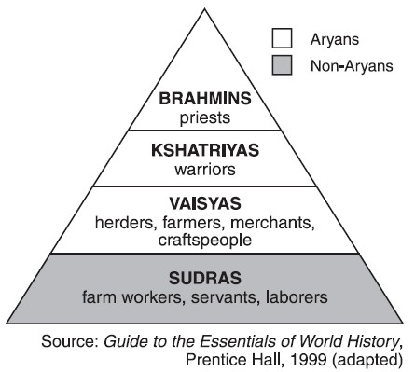
Ancient Indian Caste System

Slide 11
Aryan Religious Beliefs
Polytheistic worshiping gods and goddesses that embodied natural forces such as sky, sun, storm, and fire
The chief god was Indra, the god of war
Honored animals were monkeys and snakes
Sacrifices of food and drink were offered
Over time some began believing in a single god called Brahman that resided in all things

Slide 12
Expansion & Change
Aryan tribes were led by chiefs called rajahs
They were the most skilled war leaders and elected by an assembly of warriors
He ruled with the advice of a council of elders

Slide 13
From Nomads to Farmers
Aryans mingled with the people they conquered
They gradually gave up their nomadic ways and settled into farming
By 500 BC a new Indian civilization emerged consisting of many rival kingdoms
Because of the blending of the cultures the people shared a common culture rooted with both Aryan and Dravidian traditions
Their written language was called Sanskrit
Epic Literature: Aryans preserved a strong oral tradition, memorizing and reciting hymns and epic poems

Slide 14
The Beliefs of Hinduism
Hinduism, which claims about 800,000 million practitioners worldwide, is unique among humanity’s major religions in that it cannot be traced to any specific individual or historical event
Scholars believe that Hinduism arose about 3,5000 years ago out of interactions between Aryans and Indus Valley people
Hindu means Indian
Because Hinduism arose from no single person or institution, it is seen an eternal & unchanging in its essence. Believers regard it as having existed forever

Slide 15
Many Gods – or One?
Key feature: all the universe is part of the unchanging, all powerful spiritual force called Brahman
Because brahman is too complex and powerful a concept for most to understand they worship a variety of gods that give concrete form to brahman
Most important gods are
1. Brahma: The Creator
2. Vishnu: The Preserver
3. Shiva The Destroyer
Each represents aspects of Brahman each god may take on many forms & has its own family

Slide 16
Sacred Texts
Over several Thousand years Hindu teachings have been recorded in sacred texts such as the Vedas and Upanishads

Slide 17
The Goal of Life
To Hindus, every person has an essential self or atman which is another name for Brahman
The ultimate goal of existence is to achieve Moksha or union with Brahman
To do this one must free themselves from selfish desires that separate them from brahma.
Usually it takes many life times to achieve Moksha
The Hindus believe in reincarnation or the rebirth of the soul in another bodily form which allows people to continue working toward moksha through several lifetimes

Slide 18
Karma and Dharma
In each existence Hindus believe a person can come closer to achieving moksha by obeying the law of Karma which refers to all actions of a person's life that affect their fate in the next life
All existences is ranked
Humans come closest to the Brahman animals, plants and objects
If you live a virtuous life you can be reborn at a higher existence but if you do evil then you will acquire bad karma and be reborn into suffering
Hinduism stresses the importance of Dharma or ones religious and moral duties and they vary according to class, occupation, gender or age. By obeying ones dharma a person acquires merit for the next life.
To Hindus, all people and things are aspects of Brahman and should therefore be respected. And try to follow a path of ahimsa or nonviolence

Slide 19
Opposition to the Brahmins
A new religion called Janism grew out of Hindu traditions
It rejected the idea that Brahmin priests alone could perform certain scared rites
It’s teachings emphasized meditation, self denial and extreme form of ahimsa (avoidance of killing any living thing)
Crash Course Hinduism: https://www.youtube.com/watch?v=0tpVZrsvK-k
Keith Hughes 9 min: https://www.youtube.com/watch?v=IGV6M4wQ8Os

Slide 20
Gautama Buddha: The Enlightened One
Siddhartha Gautama founder of Buddhism
Early Life
He was born about 566 BC to a high cast family.
A prophet predicted he would become a wandering holy man
To prevent this, his father his father kept him in the palace walls surrounded by comfort and luxury. Gautama would marry and have a son and enjoyed a happy life until

Slide 21
The Search
One day Gautama rode outside the palace walls and for the first time saw a sick person, an old person & a dead person
For the first time he became aware of human suffering
Disturbed, he left the palace forever
He set out to discover the realm of life where there is neither suffering nor death
He wondered for years, seeking answers, fasting and meditating
One day under a tree determined to stay until he understood the mystery of life
After 48 days Gautama rose and was now the Buddha or The Enlightened One

Slide 22
The Four Noble Truths
The Four Noble Truths Stand at the heart of Buddhism
1. All life is full of suffering and sorrow
2. The cause of suffering is the desire for that are illusions and negative deeds and mindsets such as hatred and desire
3. The only cure for suffering is to overcome desire
4. The way to overcome desire is to follow the Eightfold Path
You must understand the Four Noble Truths and follow the Eight Fold Path along with living a moral life, avoiding evil words and actions
Through meditation a person may achieve “enlightenment”
One’s final goal is Nirvana or union with the universe and release from the cycle of rebirth

Slide 23
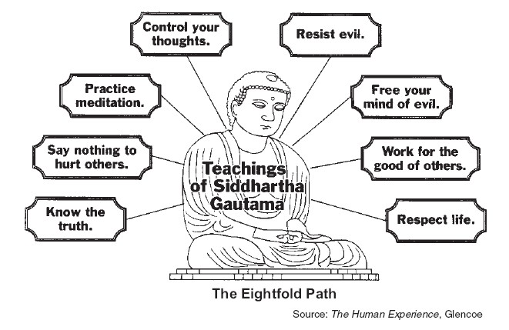
The Eight Fold Path

Slide 24
Buddhism & Hinduism Shared Traditions
Similarities:
Both grew out of the traditions as Hinduism
Both stressed non violence
Both accepted the laws of Karma, dharma and the cycle of rebirth
Differences:
Buddhism rejected priests, formal rituals and the many gods of Hinduism. Buddha urged each person to seek enlightenment through meditation
Buddhism rejects the caste system offering hope of nirvana to all

Slide 25
Sacred Texts / Spread of Buddhism
After Buddha's death his followers collected his teachings into a sacred text called the Tripitaka or The Three Baskets of Wisdom
Buddha attracted many disciples who set up monasteries to study meditation and centers of learning
Crash Course Hinduism and Buddhism: http://www.watchknowlearn.org/Video.aspx?VideoID=55664
Keith Hughes: https://www.youtube.com/watch?v=kGUwKscC0tw

Slide 26
Two Sects
Theravada Buddhism: closely followed the Buddha’s original teachings, see Buddha as a teacher it required a life devoted to hard spiritual work with only the most dedicated able to maybe reach Nirvana
Mahayana sect made Buddhism easier for ordinary people to follow. They pictured him and other holy beings as gods. People turned to these gods for solving daily problems and achieving salvation
The afterlife as a filled
with many heavens and
hells

Slide 27
Decline of India
Buddhism took hold across India but slowly declined in India
Hinduism eventually absorbed some Buddhist ideas and made room for Buddha as another Hindu god
Quieting the Monkey Brain 2 min:
https://www.youtube.com/watch?v=4PkrhH-bkpk
Creating a mandala 2:30: https://www.youtube.com/watch?v=IYVcjFhpsHc

Slide 28
The Maurya Empire / Chandragupta
Chandragupta first gained power in the Ganges Valley
He then conquered northern India
The dynasty maintained order through a well-organized bureaucracy building roads and harbors and collected taxes and manage factories
Chandragupta's rule was effective but harsh with secret police who reported crimes and dissent any differing or opposing ideas
Had specially trained women to guard his palace

Slide 29
Asoka
The most honored Maurya emperor was Chandragupta's grandson Asoka
After a bloody war, horrified by the slaughter, over 100,000_ dead, he turned his back on further conquests and converted to Buddhism and rejected violence and resolved to rule by moral example
He became a vegetarian and sent out missionaries or people sent on a religious mission to spread Buddhism
His rule brought peace and prosperity to the land and helped to unite the diverse people of the empire

Slide 30
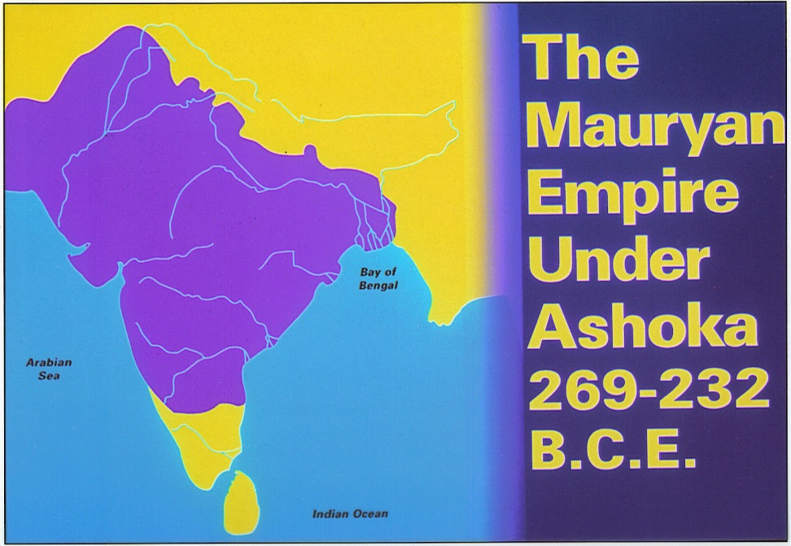
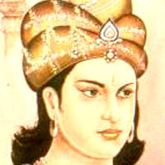
Ashoka

Slide 31
Golden Age of the Guptas
The most powerful Indian state was the Gupta Dynasty who united much of India
They organized strong central government that promoted peace and prosperity
They ruled from 320 AC to 550 AD
This was considered the Golden Age or period of great cultural achievements and was a time of peace and prosperity

Slide 32
Advances in Learning
Students were educated in religious schools but learning was not limited to religion
Advances mathematics with devising a simple system of writing numbers we still use today called Arabic Numerals because it was Arabs who carried them from India to the Middle East and Europe
Originated the concept of Zero and developed the decimal system with numbers based on 10
They performed simple surgeries and vaccinating people against smallpox

Slide 33
Complex Caste System
Society was dived into four occupational classes with Non-Aryan's considered outcasts and held the lowest jobs
Many additional castes and sub castes evolved as invaders were absorbed into the society
By modern times there were hundreds of major castes and thousands of subcastes

Slide 34
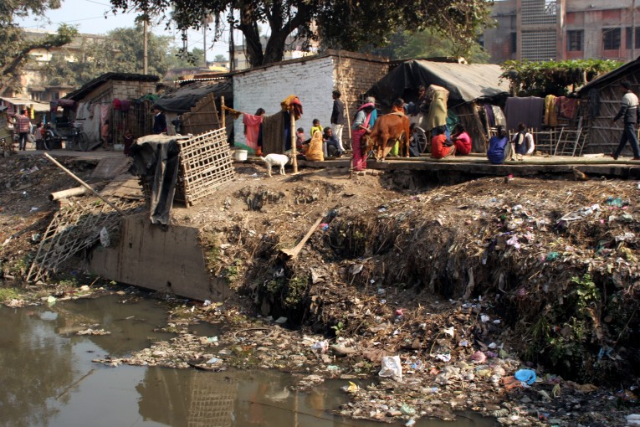
Complex Rules
Castes were closely linked to the Hindu beliefs with people in different castes were different species of beings
The high caste brahmin were purer and closer to moksha
To ensure purity there were rules to govern every aspect of life and one may not marry outside ones caste or eating with other outside the caste
The lowest rank was the Untouchables who were restricted the impure jobs and were forced to live apart from everyone else

Slide 35
Effects / Family Life
Despite inequalities the caste ensured a stable social order
People knew they could not change their status in life but could reach a higher state in a future life by fulfilling the duties of their present caste
Purpose of Hindu caste system is to ensure spiritual purity.

Slide 36
Structure
The idea family was the joint family in which parents, children, grandparents, uncles and their kids share a common dwelling, this usually happen only in wealthy families
In poor families were seldom large since they died early
Families were patriarchal meaning the father or oldest male in the family headed the household
His power was limited by sacred laws and tradition and usually consulted his wife or others
Property belonged to the whole family

Slide 37
Children and Parents
Children learn from their family about their caste and obeying caste rules
Family interests come before individual interests
Parents have the important duty of arranging good marriage for their children
Custom says a brides family should provide a Dowry or payment to the bridegroom and finance the wedding
After marriage the daughter leaves and becomes part of the husbands family

Slide 38
Videos
Keith Hughes Indus River Civ. 10:25: https://www.youtube.com/watch?v=zulZTaK9u3M
Keith Hughes Buddhism 10 min: https://www.youtube.com/watch?v=eYKdEnEqfQQ
Keith Hughes Hinduism 9 min: https://www.youtube.com/watch?v=IGV6M4wQ8Os
Crash Course 10 in Ancient Indus Valley: https://www.youtube.com/watch?v=n7ndRwqJYDM
Crash Course Ancient China 12 min: https://www.youtube.com/watch?v=ylWORyToTo4
Buddha and Ashoka: Crash Course World History 12 min: https://www.youtube.com/watch?v=8Nn5uqE3C9w
Silk Road and Ancient Trade: Crash Course World History 11 min: https://www.youtube.com/watch?v=vfe-eNq-Qyg
Five major Religions Ted Talk 11 min. https://www.youtube.com/watch?v=m6dCxo7t_aE

