Slide 1
Globalization /Decolonization/ the Middle East/ Climate Change and the Modern World
World History
Crash Course Globalization: https://www.youtube.com/watch?v=T_sGTspaF4Y

Slide 2

Chiang Kai-shek
Chiang Kai-shek, Chiang oversaw a modest program of reform in China but the government's resources were focused on fighting internal opponents, including the Communists. From 1931, Chiang also had to contend with a Japanese invasion in Manchuria, in the north-east of China.
In 1946, civil war broke out between the KMT and the Communists. In 1949, the Communists were victorious, establishing the People's Republic of China. Chiang and the remaining KMT forces fled to the island of Taiwan

Slide 3
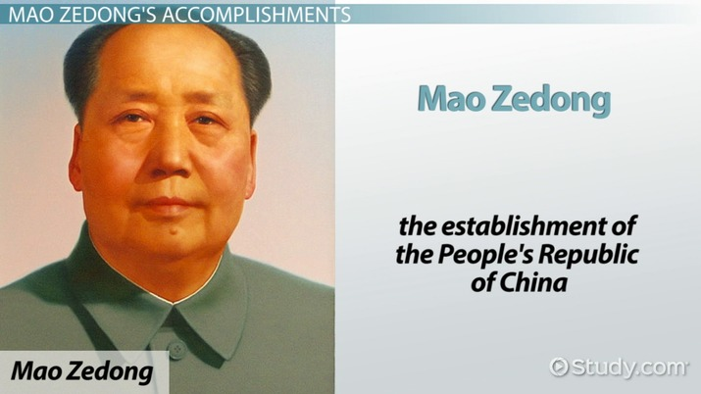
Mao Zedong
Mao Zedong, also known as Chairman Mao, was a Chinese communist revolutionary who became the founding father of the People's Republic of China, which he ruled as the Chairman of the Communist Party of China from its establishment in 1949 until his death in 1976

Slide 4
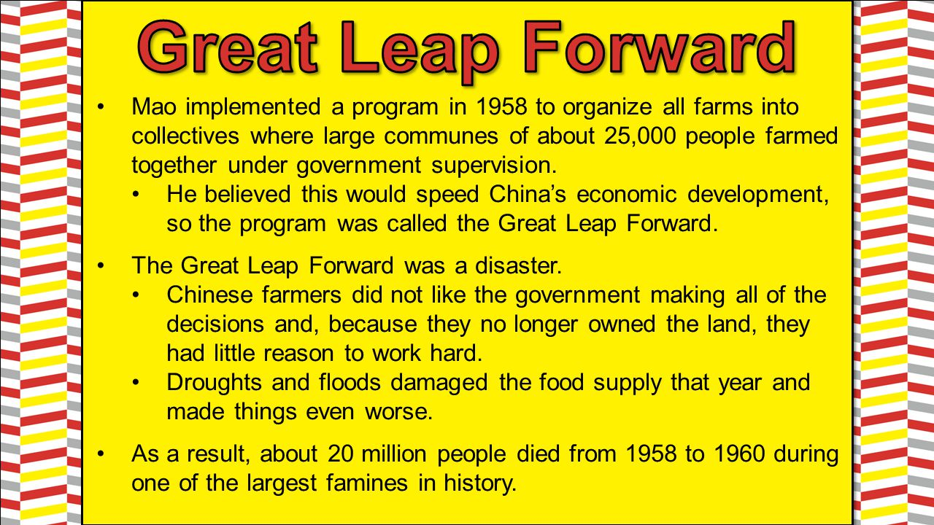
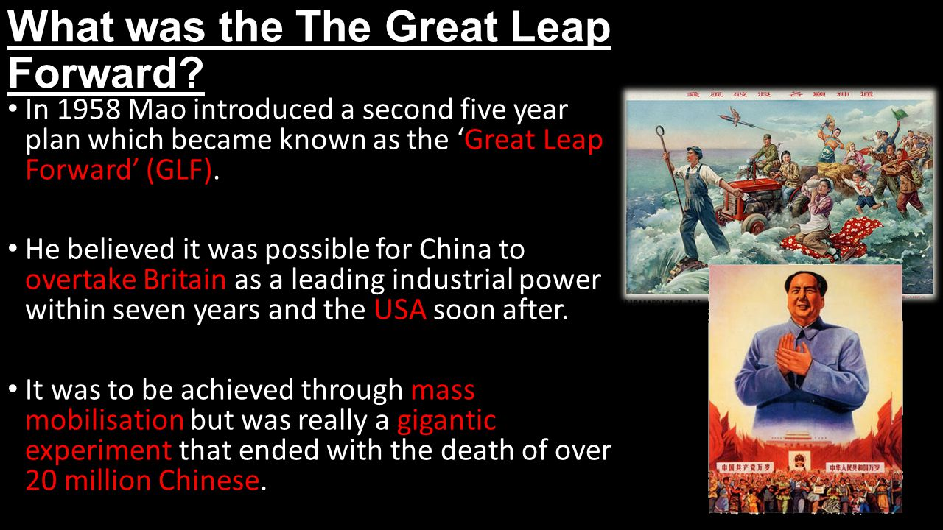
Mao’s Great Leap Forward

Slide 5
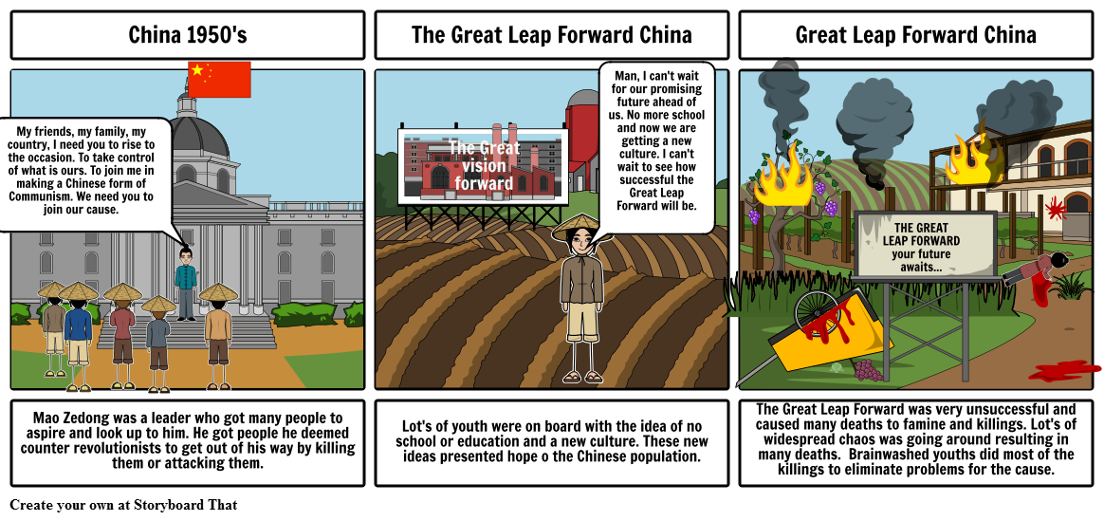
Great Leap Forward

Slide 6
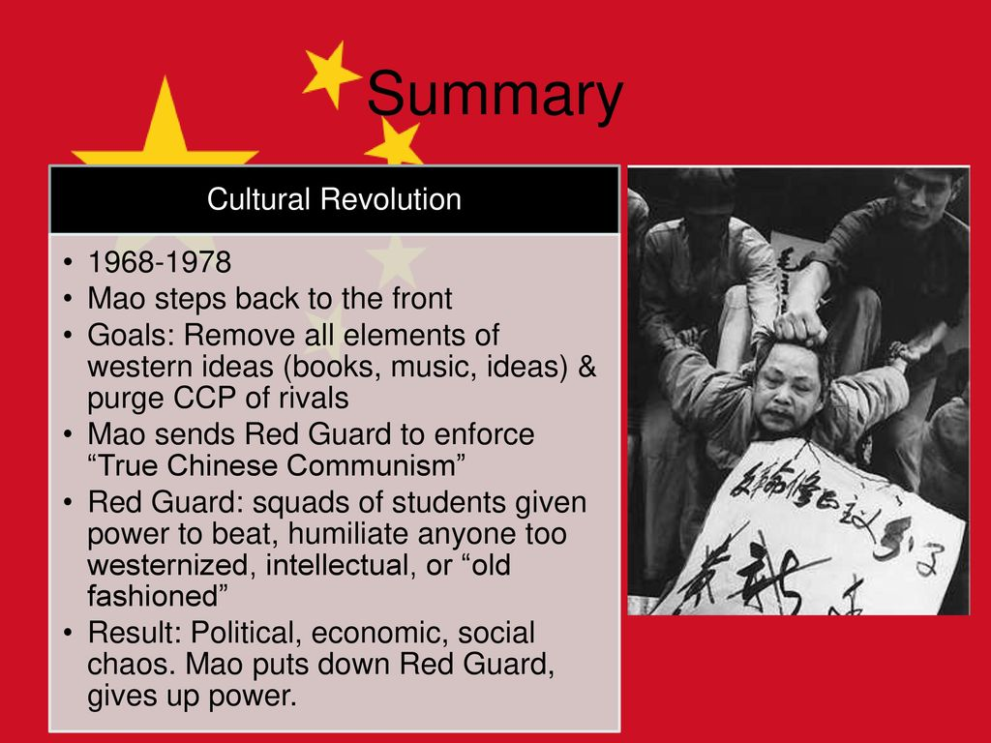
China’s Cultural Revolution
Mao launched the so-called Cultural Revolution (known in full as the Great Proletarian Cultural Revolution) in August 1966, He shut down the nation’s schools, calling for a massive youth mobilization to take current party leaders to task for their embrace of bourgeois values and lack of revolutionary spirit. The movement escalated quickly as the students formed paramilitary groups called the Red Guards & attacked & harassed members of China’s elderly & intellectual population. A personality cult quickly sprang up around Mao. 1.5 million people were killed during the Cultural Revolution, and millions of others suffered imprisonment, seizure of property, torture or general humiliation

Slide 7
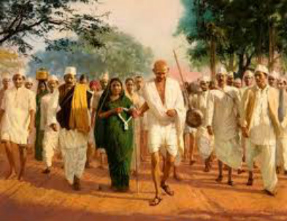
Gandhi’s Salt March
The Salt March, which took place from March to April 1930 in India, was an act of civil disobedience led by Mohandas Gandhi (1869-1948) to protest British rule in India. During the march, thousands of Indians followed Gandhi from his religious retreat near Ahmedabad to the Arabian Sea coast, a distance of some 240 miles. The march resulted in the arrest of nearly 60,000 people, including Gandhi himself. India finally was granted its independence in 1947.
The march prompted an international outcry against British policy in India.
Civil disobedience is the active, professed refusal to obey certain laws, demands, and commands of a government, or of an occupying international power. Civil disobedience is a symbolic or ritualistic violation of the law, rather than a rejection of the system as a whole.
Gandhi and British Rule: http://education-portal.com/academy/lesson/mohandas-gandhi-and-the-british-invasion.html

Slide 8
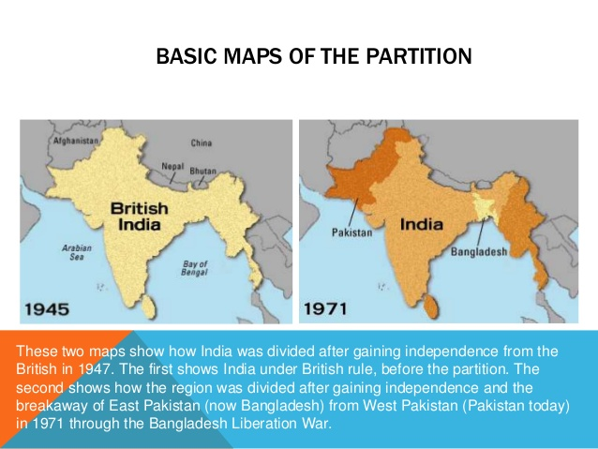
Partitioning of India/Pakistan https://www.youtube.com/watch?v=yReaR1p-PV0

Slide 9
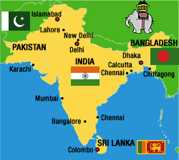
India – Pakistan – Bangladesh
Why do they hate each other 3:34: https://www.youtube.com/watch?v=YHfz_U-cXxI

Slide 10
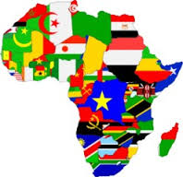
Effects of Colonization Today
Imperialist policies promoted ethnic rivalry by favoring one group above the others, distributed resources in an unequal manner, changing of boundaries, disallowed democratic governments, and prohibited local participation in governmental decisions and actions.

Slide 11
Decolonization in Africa
Political Trends in Post-Colonial Africa
Since gaining independence, many African counties have struggled to build stable governments
One Party Rule and Military dictatorships After many African countries gained independence following World War II, strong leaders seized power and set up one-[party rule or military dictatorships. Although some of these regimes lasted for many years, others were toppled and replaced in military coups, which were common
Ethnic Conflicts and Civil War Africa’s ethic diversity and rivalries, combined with country borders that were drawn without consideration of ethnic homelands, led to conflicts and civil wars in many countries
Struggles with Democracy Beginning in the early 1990’s many African countries began to make progress toward democracy and overcome their history of dictatorship and conflict. However, most countries still struggle to hold free and fair elections and maintain stability

Slide 12
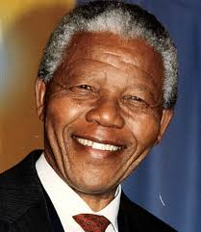
South Africa
Apartheid: a policy of rigid segregation of non-white people in the Republic of South Africa. This insures white economic, political and social supremacy.
A resistance political party known as the African National Congress worked to protest unfair laws.
Peaceful marches were met with tear gas and bullets and prompted worldwide commendation, sanctions and boycotts of goods
Nelson Mandela was an ANC leader who was jailed for 27 years
In 1994 President de Klerk freed Mandela and Africans of every race could vote and they elected Mandela.
Apartheid Explained 3 min: https://www.youtube.com/watch?v=S7yvnUz2PLE

Slide 13

Globalization
Globalization: the process by which national economies, politics, culture, and societies become integrated with those other nations around the world
Interdependence: dependence of countries on each other for goods, resources, knowledge, and labor from other parts of the world
This spread of goods and ideas had led to the development of a global economy
Globalization 1 Crash course: https://www.youtube.com/watch?v=5SnR-e0S6Ic
Globalization 2 Crash course: https://www.youtube.com/watch?v=s_iwrt7D5OA
Globalization Economics Crash Course: https://www.youtube.com/watch?v=9MpVjxxpExM

Slide 14
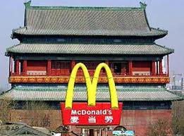
Globalization: Trade
Globalization encouraged:
Outsourcing : practice of sending work to the developing world in order to save money or increase efficiency.
EX: Many jobs today are outsourced to India, Russia, China and the Philippines.
Multi-nationals: Corporations that have branches and assets in many counties and sell their goods and services throughout the world
http://coronado.maps.arcgis.com/apps/MapTour/?appid=902e6acb7ddb4170ae5b86e22251416a
Schools around the world: http://www.theguardian.com/education/gallery/2012/sep/14/schools-around-the-world-children

Slide 15



Slide 16



Slide 17
Weaknesses of Globalization
A Financial Crisis in a country or region can have a global impact
Ex: 1997 Financial crisis struck Thailand and quickly spread to other Asian countries from Singapore to South Korea
The World is dependent on oil
Ex. All nations need oil for transportation and for products like plastics and fertilizer. In 1973 OPEC (Organization of Petroleum Exporting Countries)
What would happen if OPEC would limit oil production?
limited oil exports and raised prices, sending economic shock waves around the world, transportation prices raise, prices for products rise because of increased transportation costs and oil used in products like plastics, fertilizer etc. gasoline prices go up, shortages, rationing, overall prices increases
Globalization Explained in One Minute: https://www.youtube.com/watch?v=Xc0bR9tiDyU
Globalization explained 4 min: https://www.youtube.com/watch?v=JJ0nFD19eT8

Slide 18
1973 Oil Crisis
In October 1973, the members of Organization of Arab Petroleum Exporting Countries or the OAPEC (consisting of the Arab members of OPEC) proclaimed an oil embargo "in response to the U.S. decision to re-supply the Israeli military" during the Yom Kippur war; it lasted until March 1974.
The embargo caused an oil crisis, or "shock", with many short- and long-term effects on global politics and the global economy
Control of oil became known as the "oil weapon." It came in the form of an embargo and production cutbacks from the Arab states. The weapon was aimed at the United States, Great Britain, Canada, Japan and the Netherlands. These target governments perceived that the intent was to push them towards a more pro-Arab position. Production was eventually cut by 25%. However, the affected countries did not undertake dramatic policy changes.

Slide 19
Free Trade
Free Trade is a key part of global trade today. The UN is an international organization with many responsibilities including promoting international monetary cooperation and encourage global economic growth
To ensure this balance, treaties, and organizations guide global trade:
(WTO) World Trade Organization: sets up global rules to ensure that trade flows as smoothly as possible. It is Made up of more than 100 nations
The Group of (G8) When the 8 global leaders of the world together to meets yearly to discuss a wide range of economic and international issues. It consists of Great Britain, Canada, France, Germany, Italy, Japan the United States and Russia
The World Bank is an international financial institution that provides loans to countries for the purpose of pursuing capital projects. It comprises two institutions: the International Bank for Reconstruction and Development, and the International Development Association

Slide 20
Trading BLOCS
Many nations have formed Blocs or regional groups to promote trade and meet common needs
NAFTA: North Atlantic Free Trade Association: Facilitates trade among US Canada and Mexico.
APEC: Asia Pacific Economic Cooperation: Promotes trade along the Pacific rim
European Union: a political and economic union of 28 member states that are located primarily in Europe. Trading partners generally do not go to war
OPEC: Organization of Petroleum Exporting Countries: Represents oil producing countries and regulates the production of oil to stabilize the market. (founded in Baghdad, Iraq, with the signing of an agreement in September 1960 by five countries namely Iran, Iraq, Kuwait, Saudi Arabia and Venezuela. They were to become the Founder Members of the Organization. )

Slide 21
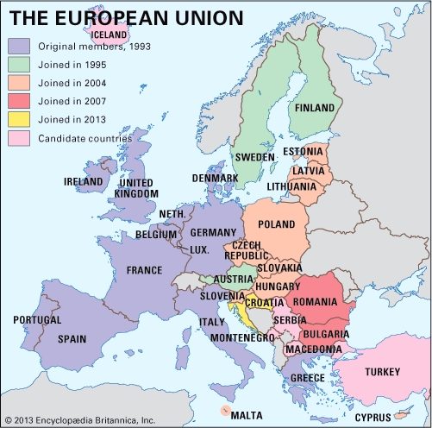
The European Union
The European Union is a group of 28 countries that operates as a cohesive economic and political block. Nineteen of the countries use the euro as their official currency
The fundamental purposes of the European Union are to promote greater social, political and economic harmony among the nations of Western Europe. The EU reasons that nations whose economies are interdependent are less likely to engage in conflict.

Slide 22
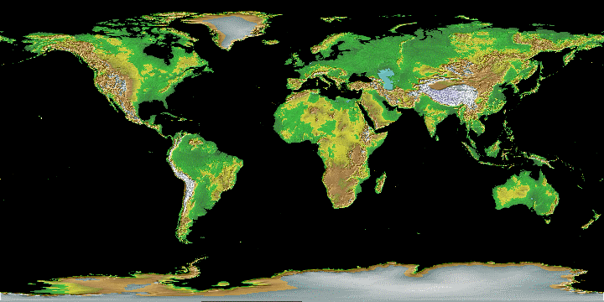
Globalization: Social and Environmental Issues
Social Problems
1. Poverty
2. Natural Disasters
3. Disease
4. Famine
Crash Course Globalization I : https://www.youtube.com/watch?v=5SnR-e0S6Ic&list=PLBDA2E52FB1EF80C9&index=41
Crash Course IIhttps://www.youtube.com/watch?v=s_iwrt7D5OA&index=42&list=PLBDA2E52FB1EF80C9

Slide 23
Negative effects of Globalization on the Environment
1. Acid Rain
2. Pollution
3. Deforestation
4. Erosion
5. Global Warming
The Kyoto Protocol International agreement with the goal of reducing the causes of global warming and stabilizing greenhouse gas concentrations
Paris Climate Agreement: On April 1st 2016, the United States and China, which together represent almost 40% of global emissions, issued a joint statement confirming that both countries would sign the Paris Climate Agreement. 195 countries have signed this agreement, however, recently the United States has pulled out of this agreement

Slide 24
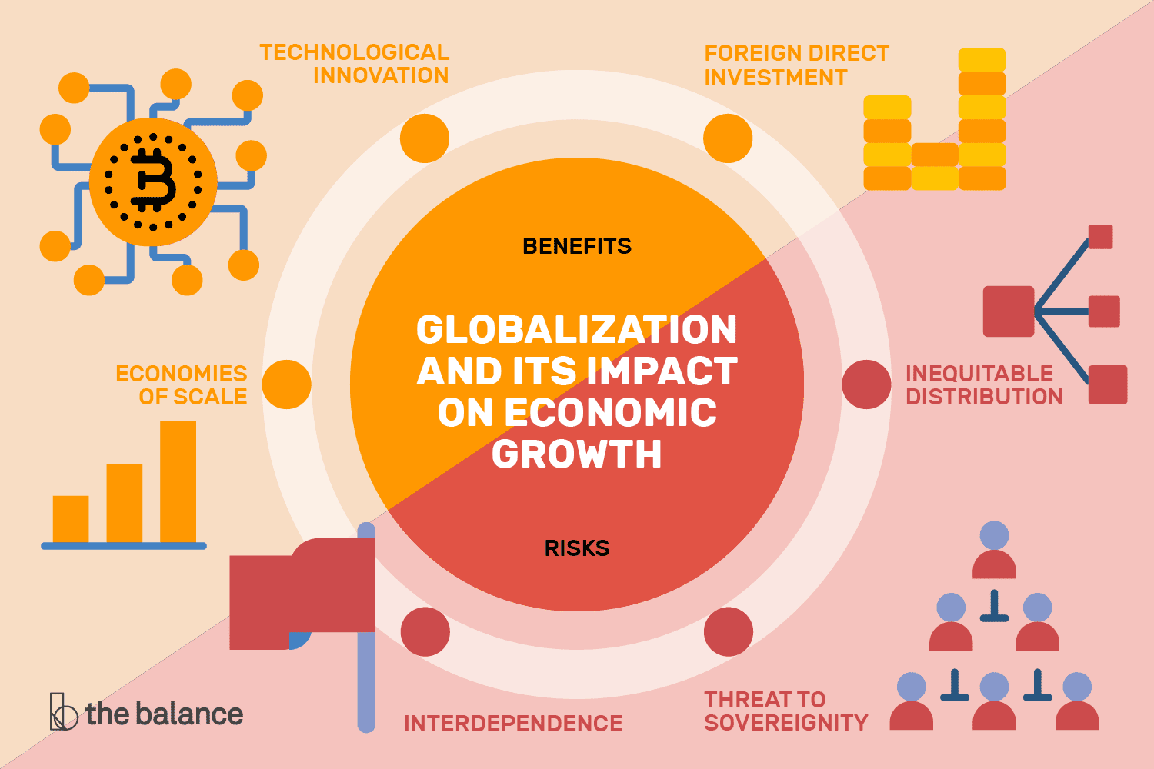
The Impact of Globalization

Slide 25
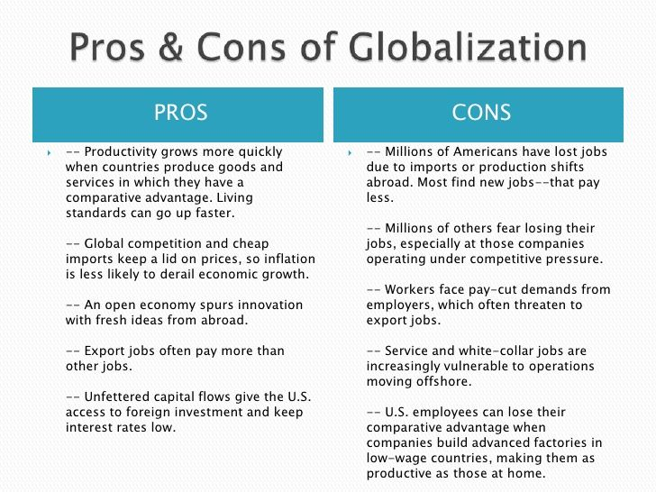
Pros and Cons of Globalization

Slide 26
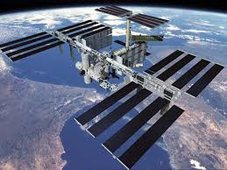
Globalization and Technology: The Space Race
By the second half of the 20th century there were few places on Earth that had not been explored, Space was seen as the “next frontier”
1957 The USSR launched the 1st satellite Sputnik and later the 1st man in space
1969 US NASA Program landed the 1st man on the moon
1998 Russia, US Canada, Japan, and many European countries worked on the International Space Station

Slide 27
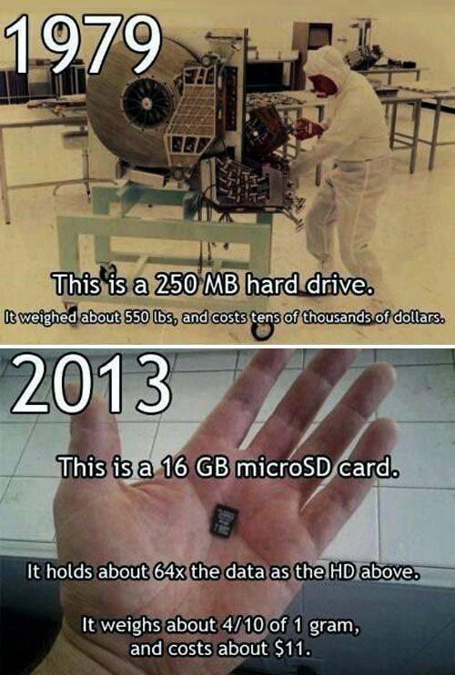
Computers and the internet
1940’s First computers were huge and slow
1970’s Personal Computers (PC’s) became widely available to the public. Due to the silicon ship the computer was reduced in size.
1990’s The internet or World Wide Web (www) was established via cable and satellites
Examples of how various types media has been used to expose human rights violations across the globe. Apartheid, Abu Ghraib, My Lai, and Tiananmen Square, were all violations of human rights that were broadcast through print, visual or Internet media and resulted in significant domestic or global response.

Slide 28
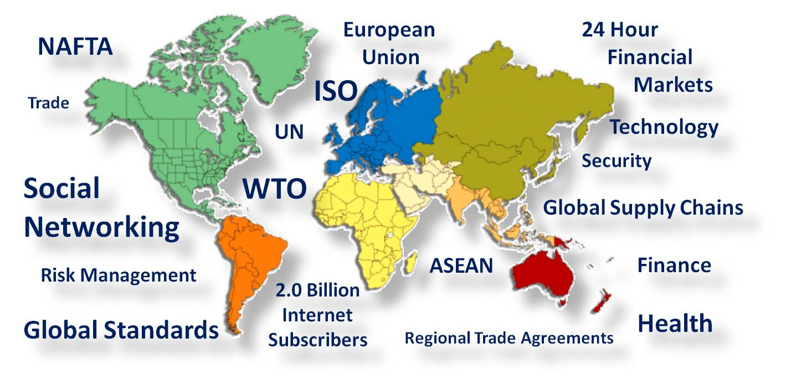
Globalization

Slide 29
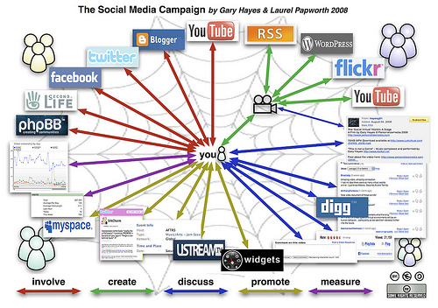
The Use of Social Media in World Events

Slide 30
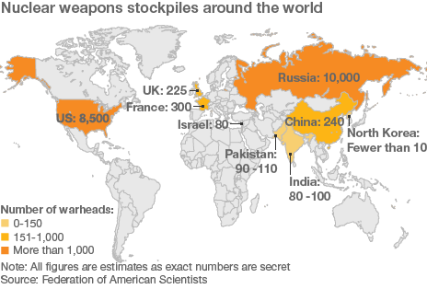
Nuclear Weapons World Wide history of nuclear bombs: https://www.youtube.com/watch?v=xLRSmzGRLUk

Slide 31
Globalization and Security
Security in a dangerous world
In 1968, the Nuclear Non-Proliferation Treaty (NPT) was signed by Russia, the United States, and 60 other countries. By 2000, 187 nations had signed the treaty.
The purpose of this treaty was to ensure that nuclear weapons did not proliferate or spread to nations that had no nuclear weapons
Today, the NPT is the most globally accepted arms control agreement, India, Pakistan, Israel, and Cuba have not signed
The (IAEA) International Atomic Energy Agency monitors nations regularly to check that they comply with the treaty
Comparing bombs: https://www.youtube.com/watch?v=xLRSmzGRLUk
What happens when a nuclear bomb is detonated: https://www.youtube.com/watch?v=JL4Kqfxg2KU

Slide 32
Human Rights
In 1948 the UN approved the declaration of Human Rights. It stated that all people are entitled to basic human rights “without distinction of any kind such as race, color, sec, language, religion, political or other opinion, national or social origin, property, birth or other status”
However, human rights abuses ranging from arbitrary arrest to torture and slavery occur daily around the world. The UN and human rights groups monitor and report human eights violations from Afghanistan to Bosnia to Congo.

Slide 33
Terrorism
Terrorism is the use of violence, especially against civilizations, by groups of extremists to achieve political goals. Sometimes terrorists are funded and protected by governments.
In the last two centuries terrorist have:
Bombed buildings
Slaughtered civilians, police, soldiers
Assassinated political leaders

Slide 34
Regional Terrorist Groups
Particular regional terrorist groups have operated for decades:
1. Irish Republican Army (IRA) forced British to give up northern Ireland
2. The ETA a Basque terrorist group seeks to compel the Spanish government to seceded part of their territory
3. Tamil Tigers in Sri Lanka uses guerrilla warfare to gain territory
4. The Shining Path in Peru uses violence to attempt to overthrow the government

Slide 35
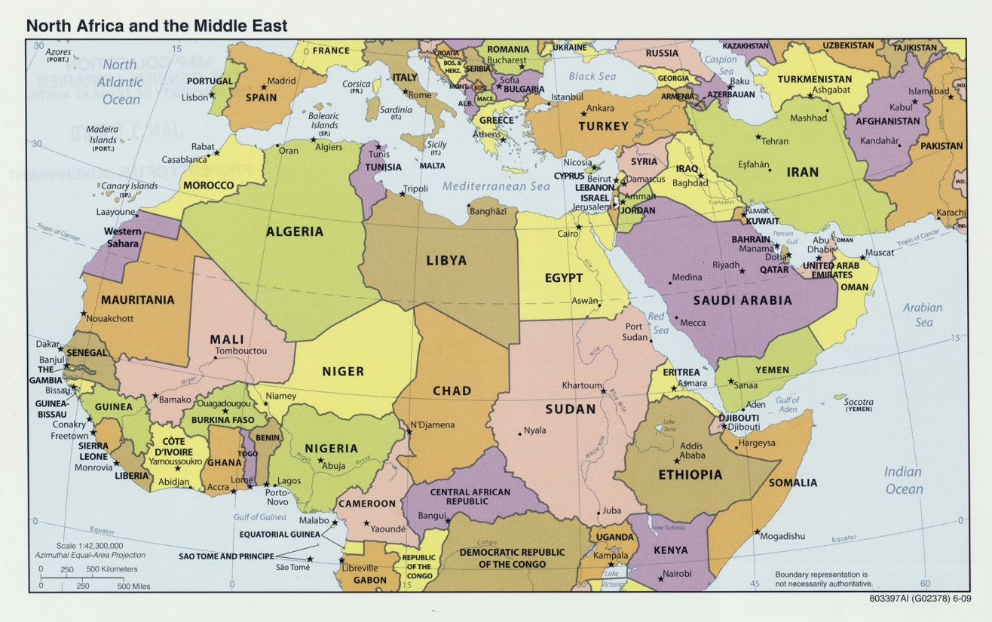
North Africa and the Middle East

Slide 36
Israel
Going back to 1850's Jews had already started moving into the Israeli area, buying up arid land & developing it, and joining the Jewish communities that were already there due to anti Semitism throughout the world. That was the start of the creation of Israel. It kept going from there. There was more land buying, more people moving there
Balfour Declaration: the statement made by Arthur Balfour in 1917 of British support for the setting up of a national home for the Jews in Palestine, provided that the rights of "existing non-Jewish communities" in Palestine could be safeguarded
After World War I, Palestine was administered by the United Kingdom under a Mandate received in 1922 from the League of Nations
So when the opportunity arose as the Ottoman empire disassembled, the Jewish community petition the international and current owners, the Brits, for a country for themselves and to no longer be 2nd class minority to everyone else and a state was declared.
In 1948, under the UN, the modern history of Palestine begins with the termination of the British Mandate , the Partition of Palestine and the creation of Israel, and the ensuing Israeli-Palestinian conflict
Jewish leadership accepted the Partition Plan, but Arab leaders rejected it. The Arab League threatened to take military measures to prevent the partition of Palestine and to ensure the national rights of the Palestinian Arab population
Numerous wars have been waged on Israel from neighboring Arab countries throughout its history.
Best Solution? One or Two State Solution. One country of Israel or an Israel and Palestine State
10 min summary: https://www.youtube.com/watch?v=4r1EmEni2Rw
Why no Palestinian state 5 min https://www.youtube.com/watch?v=Dyqx7CDGrTA
History of Israel Palestine war 10 min: https://www.youtube.com/watch?v=iRYZjOuUnlU

Slide 37
Nuts and Bolts of Israel
Zionism is the nationalist movement of the Jewish people that supports the re-establishment of a Jewish homeland in the territory defined as the historic Land of Israel
In 1948, under the UN, the modern history of Palestine begins with the termination of the British Mandate , the Partition of Palestine and the creation of Israel, and the ensuing Israeli-Palestinian conflict
The Six-Day War was a brief but bloody conflict fought in June 1967 between Israel and the Arab states of Egypt, Syria and Jordan
The Oslo Accords are a set of agreements between the Government of Israel and the Palestine Liberation Organization: the Oslo I Accord, signed in Washington, D.C., in 1993; and the Oslo II Accord, signed in Taba, Egypt, in 1995
Best Solution? One or Two State Solution. One country of Israel or an Israel and Palestine State

Slide 38
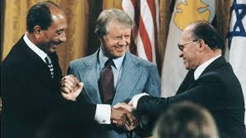
Camp David Accords
Camp David Accords: Hosted by President Carter and signed in 1978 by Egyptian President Anwar el-Sadat and Israeli Prime Minister Menachem Begin. Laid the groundwork for a permanent peace agreement between Egypt and Israel

Slide 39
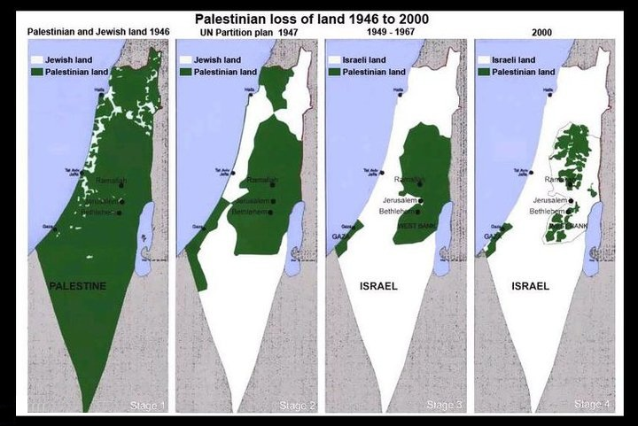
The Growth of Israel

Slide 40
Terrorism in the Middle East
1. The PLO Palestine Liberation Organization renounced terrorism in 1988 however other Palestinian groups practice terror to achieve their goals including the establishment of a Palestinian state with Jerusalem as its capital. The leader was Yasser Arafat
2. Hamas: Palestinian Islamic Resistance Movement whose goal is to liberate Palestine,
3. Hezbollah is a Shiite Muslim political group in Lebanon with a militant wing that the United States and the European Union define as a terrorist v(a Lebanese terrorist organization ) the goal of driving Israel from Lebanon land and establishing an Islamic state there.
Al Qaeda is a powerful terrorist that was led by a Saudi Arabian named Osama Bin Laden. It is an Islamic Fundamentalist group, standing for the Base in Arabia.
Bin Laden helped warlords in Afghanistan drive out the Soviets in the 1980’s
His Goal to expel American business interests, political influence, and military power from Saudi Arabia and Middle East.
By 2000, he was providing aid, training and money to scattered terrorist groups from Morocco to Indonesia.
Al-Qaeda terrorists blew up two American embassies in East Africa in 1981

Slide 41
Persian Gulf War/ 1st War with Iraq
Iraqi leader Saddam Hussein ordered the invasion and occupation of neighboring Kuwait in early August 1990. Alarmed by these actions, fellow Arab powers such as Saudi Arabia and Egypt called on the United States and other Western nations to intervene. Hussein defied United Nations Security Council demands to withdraw from Kuwait by mid-January 1991, and the Persian Gulf War began with a massive U.S.-led air offensive known as Operation Desert Storm. After 42 days of relentless attacks by the allied coalition in the air and on the ground, U.S. President George H.W. Bush declared a cease-fire on February 28; by that time, most Iraqi forces in Kuwait had either surrendered or fled

Slide 42
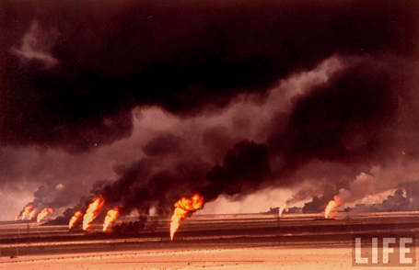
Burning of Kuwait oil fields

Slide 43
9/11
On September 11th 2001, Teams of Al Qaeda terrorists hijacked four airplanes on the east coast of the US
1. Two planes slammed into the twin towers of the World Trade Centers in New York
2. One plane plunged into the Pentagon in Virginia
3. One plane’s passengers challenged the hijackers which led the plane off its target and it plunged into the ground
4. The attackers killed 2,977 people
The attackers were Islamic terrorists from Saudi Arabia and several other Arab nations. Reportedly financed by Osama bin Laden’s al-Qaeda terrorist organization, they were allegedly acting in retaliation for America’s support of Israel, its involvement in the Persian Gulf War and its continued military presence in the Middle East
5 min summary: http://www.history.com/topics/9-11-attacks/videos/911-timeline
FOX 20 min: http://video.foxnews.com/v/1151859712001/flashback-911-as-it-happened/?#sp=show-clips
CNN 9 min: https://www.cnn.com/videos/us/2011/09/07/natpkg-911-aircheck-timeline.cnn/video/playlists/remembering-9-11/
https://www.youtube.com/watch?v=AQPlREDW-Ro

Slide 44
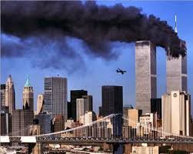
9/11: Led to War with Afghanistan and Iraq

Slide 45
Second War In Iraq
On March 20, 2003, citing Saddam Hussein’s failure to adhere to United Nations Security Council Resolutions, a US-led coalition of 49 countries launched a "shock and awe” invasion of Iraq. Within three weeks, the Iraqi government was overthrown and its military disbanded.
While the primary reason given for the invasion was to remove the threat of Saddam Hussein and his weapons of mass destruction (WMDs), no such weapons were found.
In the absence of WMDs, supporters of the war argued that regime change, spreading democracy in the region, and making the United States safer were the primary objectives.
Opponents of the war, before and after the invasion, argued that the US oil interests and a pre-existing motivation to topple Saddam were the real reasons for the attack.
After six years in Iraq, with the coalition reduced to five countries, the US has spent billions of dollars on the conflict and has lost over 4,000 American lives in the war.

Slide 46
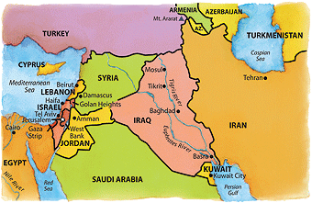
Middle East Map

Slide 47
Nations in the Middle East
Egypt
Largest in population of Arab countries
Strategically important because it boarders Israel and controls the Suez Canal
In 1952 Nasser seized power and took control of Canal in 1956 from British and French
1979 Sadat was 1st Arab leader to make peace with Israel.
In 1981 he was assassinated and Mubarak took control.
He was forced out of power during the Arab Spring
Iran
Because of its large oil reserves Iran was of interest to the west.
1951 the elected prime minister Mosaddeq nationalized the western owned oil industry.
1953 the US helped to oust him and put Shah Pahlavi in place outraging many Iranians.
The shah returned Iran’s oil industry to Western control and for 25 years stayed in power with US support
In 1979 protesters drove the shah into exile and the US embassy was taken over. The Ayatollah Khomeini came to power and proclaimed Iran an Islamic republic or theocracy
Iran is believed to building an atomic bomb so the US and other countries have imposed economic sanctions against it. Recently 5 countries (US, UK, France, China, Russia and Germany.) have made a nuclear treaty with Iran with it agreeing not to pursue nuclear weapons for at least 15 years. Even more recently the US has pulled out of this treaty
Iran 10 min: https://www.youtube.com/watch?v=Q_AHJQiMxIw
https://www.youtube.com/watch?v=_6RGeqNFaQM
ARGO:

Slide 48
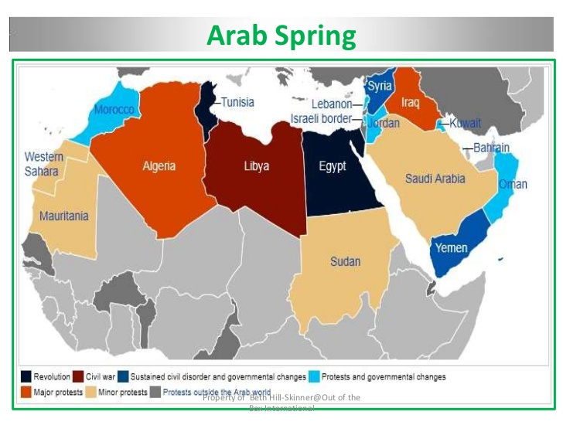
Arab Spring
The Arab Spring was a series of anti-government protests, uprisings and armed rebellions that spread across the Middle East in early 2011.
Countries involved: Tunisia, Egypt, Libya, Yemen, Bahrain, Algeria and Syria
Arab Spring explained Seeker 5 min: https://www.youtube.com/watch?v=lGGDfmhKoyk

Slide 49
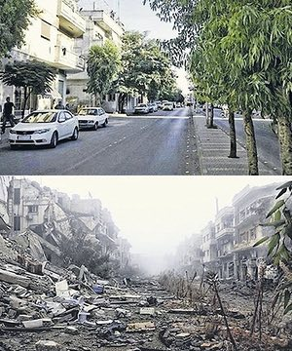
Syria, before & after: ISIS Explained in a nutshell: https://www.youtube.com/watch?v=AQPlREDW-Ro

Slide 50
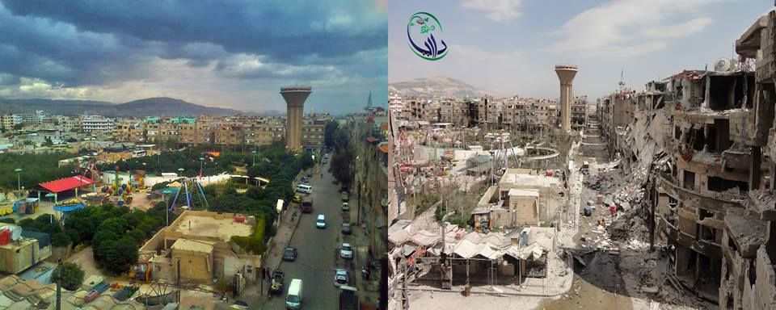
Syria Before and After: Syrian refugees explained in a nutshell 6 min: https://www.youtube.com/watch?v=RvOnXh3NN9w

Slide 51
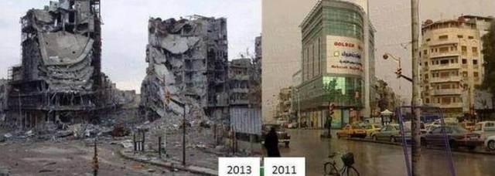
Syria Before and After

Slide 52
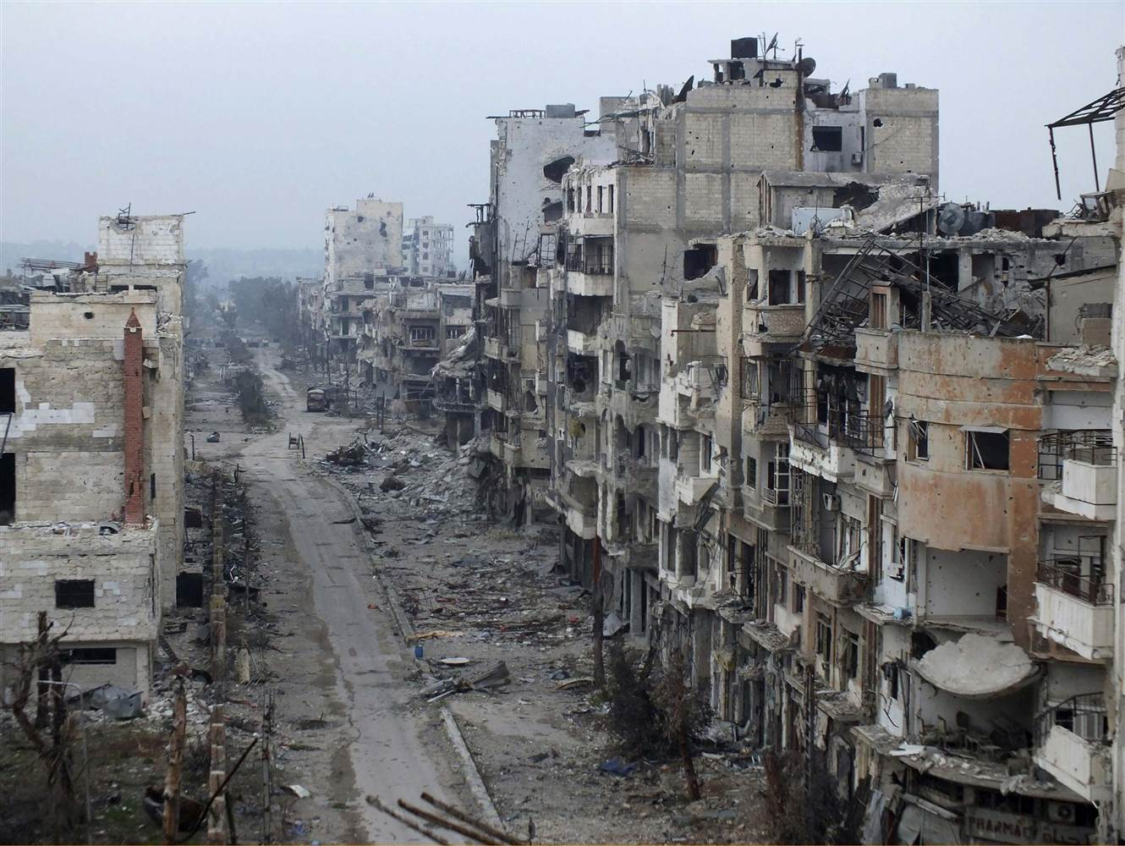
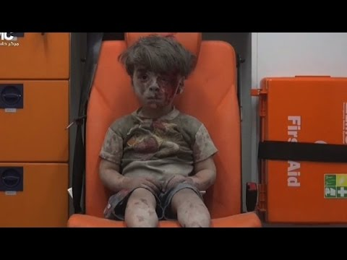
Syria today: Day in the life of a Syrian girl: https://www.youtube.com/watch?v=RBQ-IoHfimQ

Slide 53
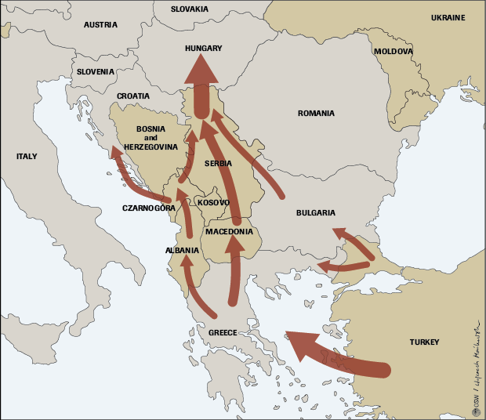
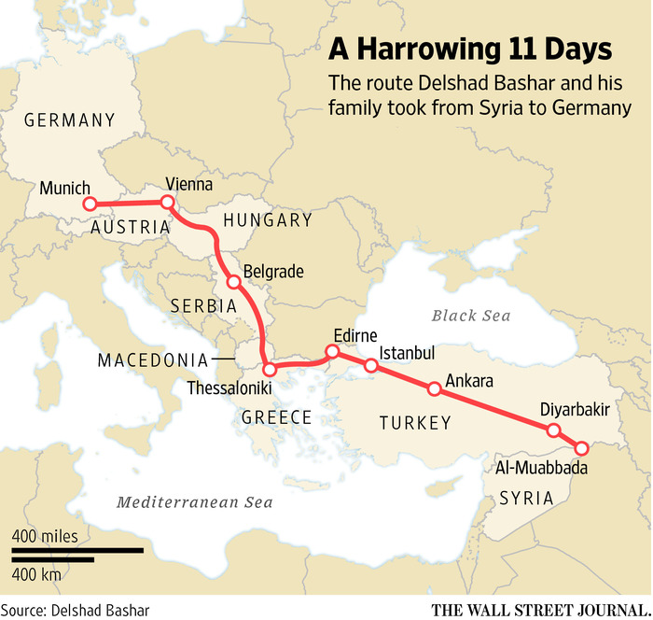
The Route of Many Refugees

Slide 54
Climate Change: is the catch-all term for the shift in worldwide weather phenomena associated with an increase in global average temperatures.
Global warming is a long-term rise in the average temperature of the Earth's climate system, an aspect of climate change shown by temperature measurements and by multiple effects of the warming
Greenhouse gases trap heat radiating from Earth to space. This heat, in the form of infrared radiation, gets absorbed and emitted by these gases in the planet’s atmosphere warming the lower atmosphere and the surface.

Slide 55
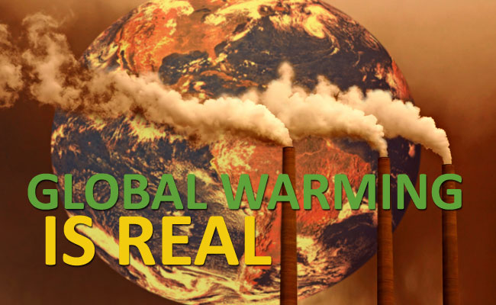
Climate Change: Per NASA
Most climate scientists agree the main cause of the current global warming trend is human expansion of the "greenhouse effect"— warming that results when the atmosphere traps heat radiating from Earth toward space.
Certain gases in the atmosphere block heat from escaping. Long-lived gases that remain semi-permanently in the atmosphere and do not respond physically or chemically to changes in temperature are described as "forcing" climate change. Gases, such as water vapor, which respond physically or chemically to changes in temperature are seen as "feedbacks."

Slide 56
Climate Change
Climate change is the catch-all term for the shift in worldwide weather phenomena associated with an increase in global average temperatures.
On Earth, human activities are changing the natural greenhouse. Over the last century the burning of fossil fuels like coal and oil has increased the concentration of atmospheric carbon dioxide (CO₂). This happens because the coal or oil burning process combines carbon with oxygen in the air to make CO₂.
To a lesser extent, the clearing of land for agriculture, industry, and other human activities has increased concentrations of greenhouse gases.
The consequences of changing the natural atmospheric greenhouse are difficult to predict, but certain effects seem likely:
On average, Earth will become warmer. Some regions may welcome warmer temperatures, but others may not
A stronger greenhouse effect will warm the oceans and partially melt glaciers and other ice, increasing sea level. Ocean water also will expand if it warms, contributing further to sea level rise.
Meanwhile, some crops and other plants may respond favorably to increased atmospheric CO₂, growing more vigorously and using water more efficiently. At the same time, higher temperatures and shifting climate patterns may change the areas where crops grow best and affect the makeup of natural plant communities.

Slide 57
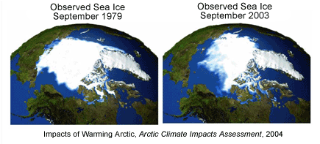
Global Warming Effects
Did you know?
The Earth's average temperature has increased about 2 degrees Fahrenheit during the 20th century. What's the big deal?
Two degrees may sound like a small amount, but it's an unusual event in our planet's recent history. Earth's climate record, preserved in tree rings, ice cores, and coral reefs, shows that the global average temperature is stable over long periods of time. Furthermore, small changes in temperature correspond to enormous changes in the environment.
For example, at the end of the last ice age, when the Northeast United States was covered by more than 3,000 feet of ice, average temperatures were only 5 to 9 degrees cooler than today.

Slide 58
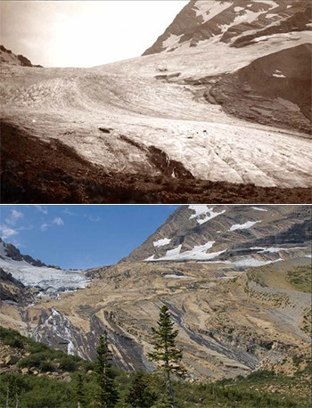
Global Warming Effects
Global climate change has already had observable effects on the environment. Glaciers have shrunk, ice on rivers and lakes is breaking up earlier,
plant and animal ranges have shifted and trees are flowering sooner.
Changes in precipitation patterns,
More droughts and heat waves,
Hurricanes will become stronger and more intense,
Sea level will rise 1-4 feet by 2100, Arctic likely to become ice-free,
plant and animal species will go extinct
Major Costal Cities will be flooded

Slide 59
Climate Change
The Green Revolution refers to a series of research, and development, and technology transfer initiatives, occurring between the 1940s and the late 1960s, that increased agricultural production worldwide, particularly in the developing world, beginning most markedly in the late 1960s.
a large increase in crop production in developing countries achieved by the use of fertilizers, pesticides, and high-yield crop varieties.
Global warming and climate change both refer to the observed century-long rise in the average temperature of the Earth's climate system and its related effects. Multiple lines of scientific evidence show that the climate system is warming
Current Effects: Glaciers have shrunk, ice on rivers and lakes is breaking up earlier, plant and animal ranges have shifted and trees are flowering sooner, sea levels are rising, weather changes, loss of islands due to oceans rising, death of coral reefs, loss of animals, perma frost is melting, Fifteen of the 16 hottest years ever recorded have occurred in the 21st century.
Sustainability the ability to be maintained at a certain rate or level. "the sustainability of economic growth“ The avoidance of the depletion of natural resources in order to maintain an ecological balance. "the pursuit of global environmental sustainability"

Slide 60
Sustainability the ability to be maintained at a certain rate or level. "the sustainability of economic growth“ The avoidance of the depletion of natural resources in order to maintain an ecological balance. "the pursuit of global environmental sustainability"
* Solar Energy The greatest advantages of solar energy are that it is completely free and is available in limitless supply. Both of these factors provide a huge benefit to consumers and help reduce pollution. Replacing non-renewable energy with this type of energy is both environmentally and financially effective.
Wind Energy Wind energy is another readily available energy source. Harnessing the power of wind energy necessitates the use of windmills; however, due to construction cost and finding a suitable location, this kind of energy is meant to service more than just the individual. Wind energy can supplement or even replace the cost of grid power, and therefore may be a good investment and remains a great example of sustainable development.
Crop Rotation Crop rotation is defined as “the successive planting of different crops on the same land to improve soil fertility and help control insects and diseases.” This farming practice is beneficial in several ways, most notably because it is chemical-free. Crop rotation has been proven to maximize the growth potential of land, while also preventing disease and insects in the soil. Not only can this form of development benefit commercial farmers, but it can also aid those who garden at home.
Efficient Water Fixtures Replacing current construction practices and supporting the installation of efficient shower heads, toilets and other water appliances can conserve one of Earth’s most precious resources: water. Examples of efficient fixtures include products from the EPA’s Water Sense program, as well as dual-flush and composting toilets. According to the EPA, it takes a lot of energy to produce and transport water and to process waste water, and since less than one percent of the Earth’s available water supply is fresh water, it is important that sustainable water use is employed at the individual and societal level.
Green Space Green spaces include parks and other areas where plants and wildlife are encouraged to thrive. These spaces also offer the public great opportunities to enjoy outdoor recreation, especially in dense, urban areas. According to the UW-Madison Department of Urban and Regional Planning, advantages of green spaces include, “helping regulate air quality and climate … reducing energy consumption by countering the warming effects of paved surfaces … recharging groundwater supplies and protecting lakes and streams from polluted runoff.” Research conducted in the U.K. by the University of Exeter Medical School also found that moving to a greener area could lead to significant and lasting improvements to an individual’s mental health.

Slide 61
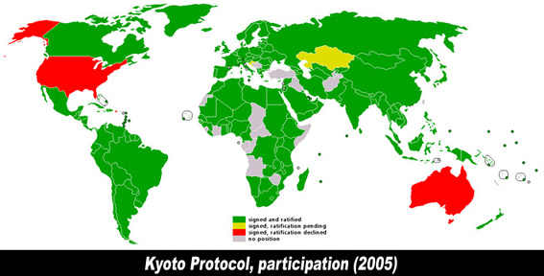
Kyoto Protocol Participation: an international treaty which extends the 1992 UN framework on Climate Change commits state parties to reduce greenhouse gas emissions, based on the scientific consensus that global warming is occurring and it is extremely likely that human-made CO2 emissions have predominantly caused it.

Slide 62
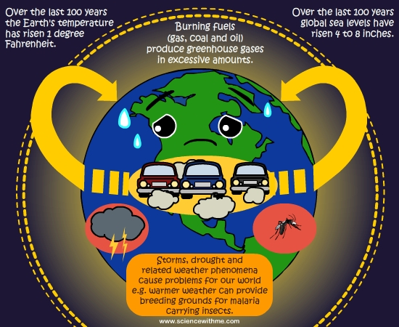
Global Warming

Slide 63
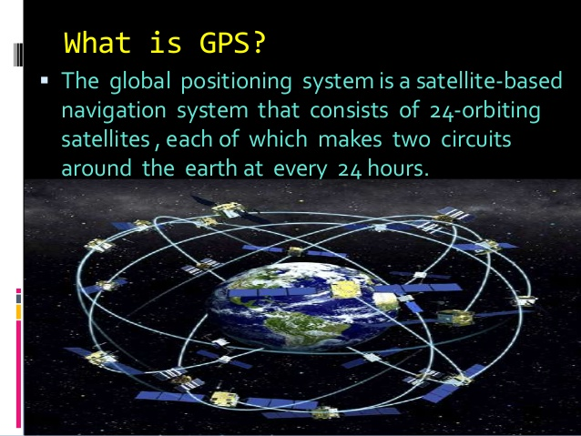
Global Positioning System (GPS)
The Global Positioning System (GPS) is made up of satellites, ground stations, and receivers. GPS is a system. ... The receiver figures out how far away they are from some of them. Once the receiver calculates its distance from four or more satellites, it knows exactly where you are.

Slide 64
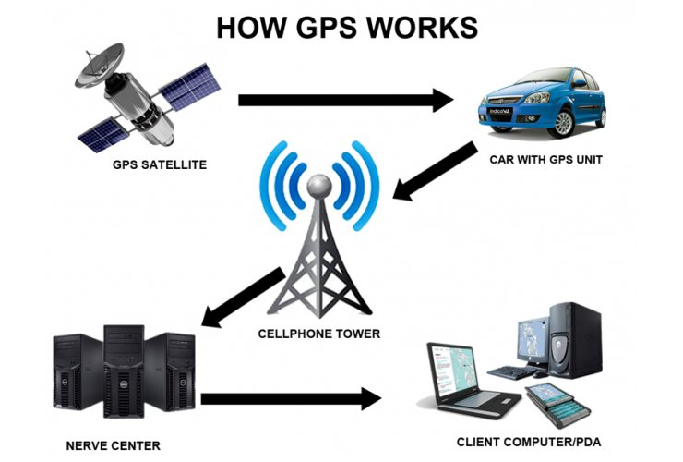
GPS
GPS systems are extremely versatile and can be found in almost any industry sector. They can be used to:
map forests,
help farmers harvest their fields,
navigate airplanes on the ground or in the air.
military applications
for emergency crews to locate people in need of assistance.
Track packages
Monitor the movement of objects and people

Slide 65
Iran, Syria, ISIS, Refugees Explained
Argo: https://www.youtube.com/watch?v=_6RGeqNFaQM
Iran Hostage Crisis Explained Keith Hughes 13 min: https://www.youtube.com/watch?v=Kz6O9L7QBno
Crash Course Arab Israeli conflict: https://www.youtube.com/watch?v=1wo2TLlMhiw
Syrian War explained 7 min: https://www.youtube.com/watch?v=JFpanWNgfQY
Arab Israeli conflict: https://www.youtube.com/watch?v=cMv7_eOb0B4
Palestinian Conflict Explained: Mowing the Grass in Gaza: https://www.youtube.com/watch?v=R9sQ9bedl_g
Iran 10 min: https://www.youtube.com/watch?v=Q_AHJQiMxIw
Arab Spring explained Seeker 5 min: https://www.youtube.com/watch?v=lGGDfmhKoyk
Iran and Iraq, why do they hate each other: https://www.youtube.com/watch?v=G-dMM3HRnhY
ISIS Explained in a nutshell: https://www.youtube.com/watch?v=AQPlREDW-Ro
Day in the life of a Syrian girl: https://www.youtube.com/watch?v=RBQ-IoHfimQ
Syrian refugees explained in a nutshell 6 min: https://www.youtube.com/watch?v=RvOnXh3NN9w
How the US became a Super Power 9 min: https://www.youtube.com/watch?v=BShvYeyMm_Y

Slide 66
Summary Videos
Happiest Countries: http://www.bustle.com/articles/50585-which-country-is-the-happiest-in-the-world-hint-its-not-the-us?utm_source=FBTraffic&utm_medium=fijifrost&utm_campaign=CMfacebook
Human migration 2 min: https://www.youtube.com/watch?v=CJdT6QcSbQ0
3,000 BCE-1,000 CE history 13 min: https://www.youtube.com/watch?v=hXiLMb-OFgY
History of the World in 4 min: https://www.youtube.com/watch?v=ewd4l2rD2_U
Video 50 centuries in 10 min: https://www.youtube.com/watch?v=dp0tqdu7fH4
1,000 years of war 5 min: https://www.youtube.com/watch?v=1hsDn2kNriI
Spread of World Religions in 3 min: https://www.youtube.com/watch?v=AvFl6UBZLv4
History of Europe in 3:30: https://www.youtube.com/watch?v=uxDyJ_6N-6A
Great empires of the world 6 min: https://www.youtube.com/watch?v=MOrD8eOdRxU
AP History of the World start about 4 min in: https://www.youtube.com/watch?v=c-dmjDU7FT4
History of the World Every year 20 min: https://www.youtube.com/watch?v=-6Wu0Q7x5D0

Slide 67
Videos
Video about Israeli Palestinian conflict: Keith Hughes 16.47:
https://www.youtube.com/watch?v=cMv7_eOb0B4&list=PL63FCC94DD9F44C96&index=1
Cold War Hughes Cold War Hughes 11: https://www.youtube.com/watch?v=bTk3dFC7t00&list=PL63FCC94DD9F44C96&index=5
Current Wars around the World: https://screen.yahoo.com/news/countries-currently-war-complete-list-130000267.html
Iraq ISIS explained 435: https://www.youtube.com/watch?v=AQPlREDW-Ro
Stans: 348: https://www.youtube.com/watch?v=yXc3ExJGVYw
Timelapse bombs: https://www.youtube.com/watch?v=_W_lLhBt8Vg
Atomic bombs https://www.youtube.com/watch?v=5gD_TL1BqFg
Top 10 biggest: https://www.youtube.com/watch?v=4rElV_w_DPQ
Most powerful bomb: https://www.youtube.com/watch?v=P2eqNB6zy9k
Desalinization crash course https://www.google.com/search?q=crash+course+deconinzation&oq=crash+course+deconinzation&aqs=chrome..69i57j0l3.6484j0j4&sourceid=chrome&es_sm=122&ie=UTF-8
Decolonization Power Point: https://drive.google.com/viewerng/viewer?a=v&pid=sites&srcid=bGFuaWVyaHMub3JnfGNwd2h8Z3g6N2YyOGJlNDA4Y2U3Zjc4NA
Gandhi and British Rule: http://education-portal.com/academy/lesson/mohandas-gandhi-and-the-british-invasion.html

