Slide 1
WORLD HISTORY
Ancient Greece Notes

Slide 2
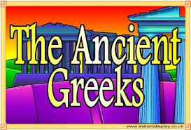
Greece

Slide 3
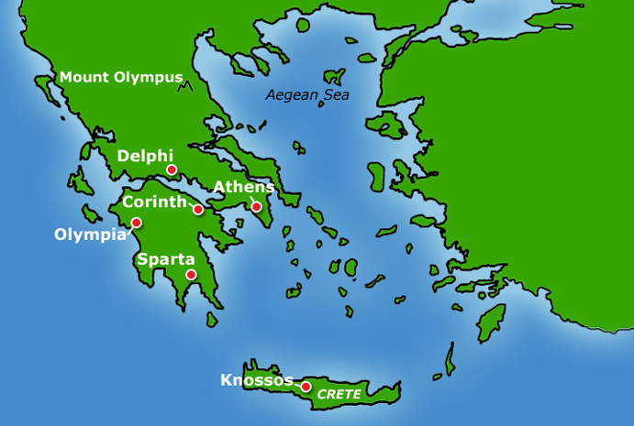
Map of Ancient Greece

Slide 4
Minoan Civilization
Located in Aegean Sea
Island of Crete was home to a brilliant early civilization
Called the Minoans after Minos, a legendary king between 1750-1500BC
They were a peaceful trading community
Rulers lived in a vast palace at Knossos
Palace include religious shrines dedicated to gods and goddess
Walls at Knossos were covered with frescos and tell us much about their civilization

Slide 5
A Civilization Disappears
By 1400 BC Minoan civilization disappeared
What happen?
Earthquake?
Tidal wave ?
Invaders?

Slide 6
Rulers of Mycenae
Mycenaean civilization dominated the Aegean world from 100-1200 BCE
They were sea faring traders
Warrior-kings built thick walled fortresses
Mycenaean’s were best remembered for their part in the Trojan War 1250 BC
For years people regarded the Trojan War was legend but in the 1870's Heinrich Schliemann proved that it existed
They were later conquered by the Dorians which ushered in a “Dark Age” in Greece

Slide 7
Governing the City States
Greeks unique version of a city state was called a polis
City built on two levels
1. Acropolis high city with temples dedicated to different gods
2. Agora on flatter ground is the main walled city with markets, public buildings and homes
Population of city state was were fairly small which helped citizens share in the responsibilities of triumphs and defeats
Daily lives: men spent much time talking in the marketplace, debating and the whole community enjoyed festivals honoring the city’s

Slide 8
Early Greek Government
Between 750 & 500 BC Greeks developed different forms of governments
At first, they were a Monarchy in which a king or queen exercises the central power
Then power shifted to Aristocracy. In which Greece was ruled by a land holding elite
As trade expanded a new class of wealthy merchants, farmers and artisans emerged who challenged the landowning nobles for power and resulted in an Oligarchy where power is in the hands of a small powerful elite class, usually the business class
Later a democracy: a government in the hands of the people

Slide 9
Greek Religion
Greeks were polytheistic
They believed the gods lived on Mt. Olympus in northern Greece
Most powerful god was Zeus who presided over affairs of gods and humans
Aphrodite: daughter of Zeus and goddess of love
Ares: god or war
Athena: goddess of Wisdom, the city of Athens was named for her
Olympics: Began in 776 BCE and were created to honor Zeus. Only free men who spoke Greek could participate. Original events were running but boxing and wrestling, chariot racing, discus and javelin etc were added. Only men could participate and attend

Slide 10
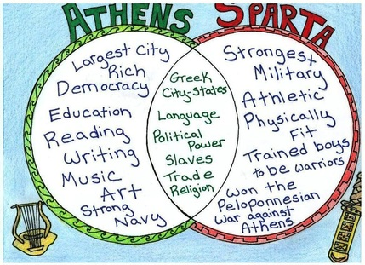
Development of Athens and Sparta
1. Athens: glorified the individual and extended political rights to more citizens
2. Sparta: stressed military virtues and discipline

Slide 11
Sparta: Setting the Stage
Early in its history Spartan invaders conquered people into state owned slaves called Helots. These helots came to outnumber the Spartans and rose up and rebelled. The Spartans quelled the up rise but changed their society so it would never happen again.
Sparta created a military society where the only occupation for men was to be in the military
Spartan government is an Oligarchy that includes 2 kings and a council of elders who advised the kings
At age 7 boys must live in the barracks and prepare for a military life. Boys had to live in the barracks and endure a coarse diet, exercise and rigid discipline
At age 20 men could marry but still live in the barracks for another 10 years

Slide 12
Athens Creates a Limited Democracy
While Athens begins with a monarchy, of rule by a King or Queen but rebellion would set up an aristocracy, or rule by a land holding elite. Later A series of tyrants will take over. Draco, who was know to have very strict laws and harsh punishments (draconian) but others, like Solon will move Athens closer to a democracy, by giving more citizens a say in the government and out lawed debt slavery. Others continued this in addition to new building projects giving jobs to the poor
Athens will move closer by giving more citizens a say in the government and out lawed debt slavery

Slide 13
Greek Achievements
Art: Sculpture and Painting :By 450 BC Greek sculptors developed a new style of art emphasizing natural lifelike poses that were also idealistic poses that is showing individuals in their most perfect and graceful form
Most important Greek contribution to literature was in the field of literature
Theater: First Greek plays evolved out of religious festivals
Dramas were often based on moral and social issues
Tragedy plays that told stories of human suffering that usually ended in disaster
Comedy: were humorous plays that mocked people or customs
Herodotus :the father of history in the western world. cast a critical eye on his sources, noting bias and conflicting accounts
Notes:
m

Slide 14
Greek Philosophy
Greek thinkers challenged the belief that events were caused by the whims of the gods, and were concerned with ethics and morality
Socrates: Socrates engaged in questioning of his students in an unending search for truth. He sought to get to the foundations of his students' views by asking continual questions, called the Socratic Method.
Plato: Felt philosophers were best suited to govern
Aristotle who analyzed all forms of government and favored rule by a single strong and virtuous leader. Pioneered the use of reason and logic to study the natural world
Most Famous Student was Alexander the Great

Slide 15
Advances in Learning
Pythagoras Calculated the relationship between sides of a right triangle!
Euclid developed the basis for modern geometry!! How cool is that!!
Aristarchus Argued the earth rotated on is axis and orbited the sun. this theory was called heliocentric or sun centered solar system
Archimedes applied principle of physics to make use of the lever and pulley
Hippocrates: Studied the causes of illnesses and looked for cures. Father of medicine. Hippocratic oath set ethical standards for doctors

Slide 16
Persian and Peloponnesian Wars
Setting the scene: Persian empire grew to include the Greek city states of Ionia in Asia Minor
499 BC the Ionian Greeks rebelled, and Athens sent ships to help angering the Persians
Battle at Marathon Although Persia crushed the rebellion, Darius was furious at Athens’ role and later sent a huge force to punish Athens
Athenian forces, though greatly outnumbered, broke the Persian line and forced the Persians to retreated to their ships
Athens will defeat the Persians
One lone runner, Phidippides, was sent to announce the victory in Athens and ran 26 miles and upon telling of the victory died

Slide 17
Renewed Attacks!
Darius’ son Xerxes sent a much larger army in 480 BC
This time Athens, Sparta and other Greek city states joined together to fight the Persians
Battle at Thermopylae: (480 BCE)a small Spartan forced guarded a narrow mountain pass and fought the Persians
This battle gave the Greeks time to prepare and defeat the Persians and had victory once again
Crash Course Video / Persians and Greeks: https://www.youtube.com/watch?v=Q-mkVSasZIM

Slide 18
Athens in the Age of Pericles
The years after the Persian Wars were a Golden Age for Athens Known as the Age of Pericles. Athens prospered with many building projects, increasing Athenian’s prosperity and a flourishing of the arts
The economy thrived and government became more democratic
Athens was a Direct Democracy where citizens take direct part in the day to day affairs of the government
All male citizens, regardless of wealth or social class , should take part in government there for they paid a stipend or fixed salary to the men
Athenians also served on juries
A jury is a panel of citizens who have the authority to make a final judgment in a trial
Athenian citizens could vote to banish someone they saw as a threat to their democracy, This was called Ostracism. The person voted out had to live outside the city for 10 years
The Funeral Oration: Speech given by Pericles at a funeral of Athenians slain in battle where he stressed rights and duties of the citizen

Slide 19
The Peloponnesian War
In 431 BCE war broke out between Athens and Sparta and would soon engulf all of Greece,
The Peloponnesian War would continue for 27 years
When Sparta attacked Pericles allowed the people from around the city to move inside Athens
The overcrowded condition led to a terrible plague breaking out and killing at least a third of the population including Pericles
Sparta allied itself with Persia and was able to defeat Athens in 404 BC
The Peloponnesian War ended Athenian domination of the Greek world
The Athenian economy would eventually revived and it remained the cultural center of Greece

Slide 20
Alexander the Great
Came from the mountainous kingdom of Macedonia and became king at age 20 after his father Phillip was assassinated
He would come to conquer Greece through bribes, threats, diplomacy and warfare, and alliances
Alexander the Great sought to expand the Empire and marched from victory to victory through Asia Minor, into Palestine and south to Egypt and on to Babylon and India and twice defeated the Persian army.
One of the world's greatest military generals, he created a vast empire that stretched from Macedonia to Egypt and from Greece to part of India. This allowed for Hellenistic culture to become widespread
Alexander fell victim to a sudden fever and died and his three generals will divide his empire

Slide 21
The Legacy of Alexander the Great
His most lasting achievement was spread of Greek culture
Alexander founded many new cities most named after him
Greek citizens settled in these new cities bring their culture with them
Local people assimilated or absorbed Greek ideas as the Greeks adopted local customs too
The heart of the Hellenistic world was Alexandria in Egypt
It had goods, architecture and ideas from all over the world
The Hellenistic world built grander, larger more elaborate buildings that that of classical Greece (It was a blend of Greek, Indian, Egyptian, Persian)

Slide 22
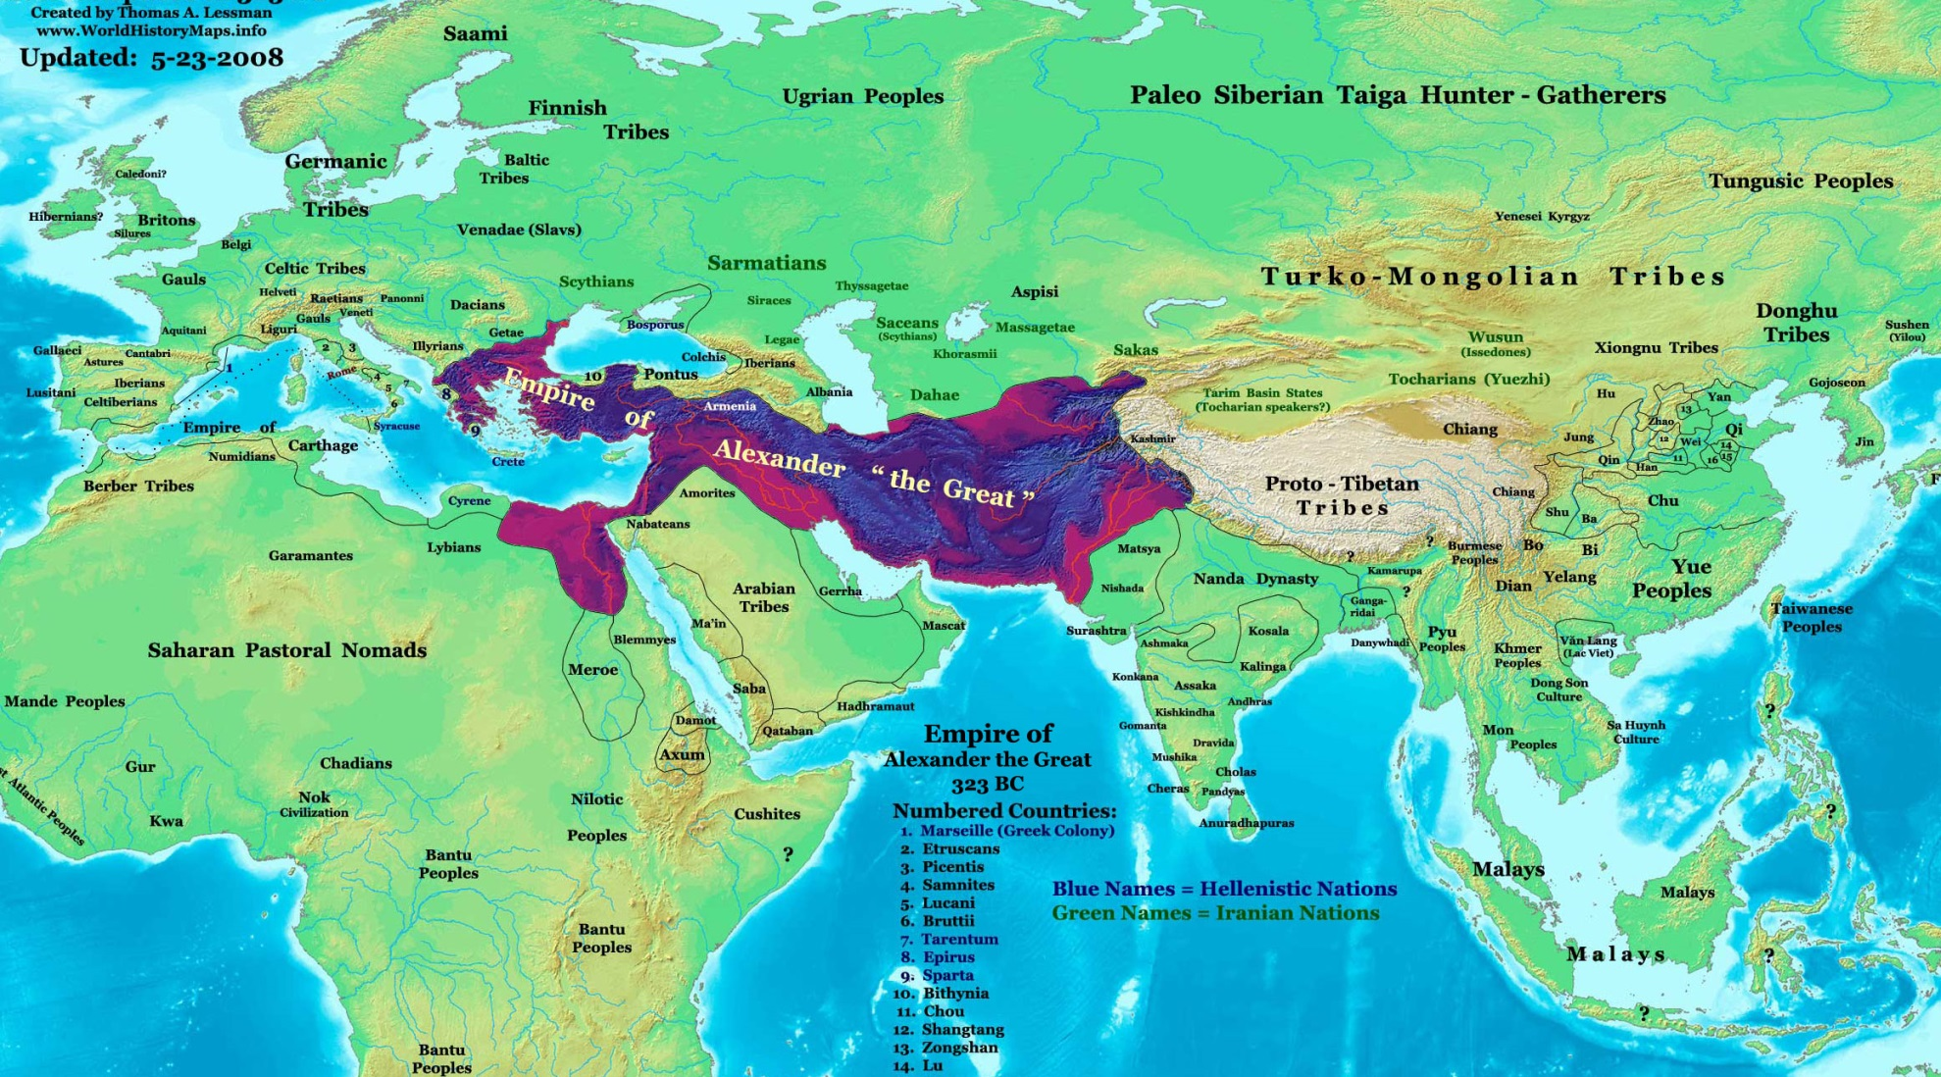
The Empire of Alexander the Great

