Slide 1
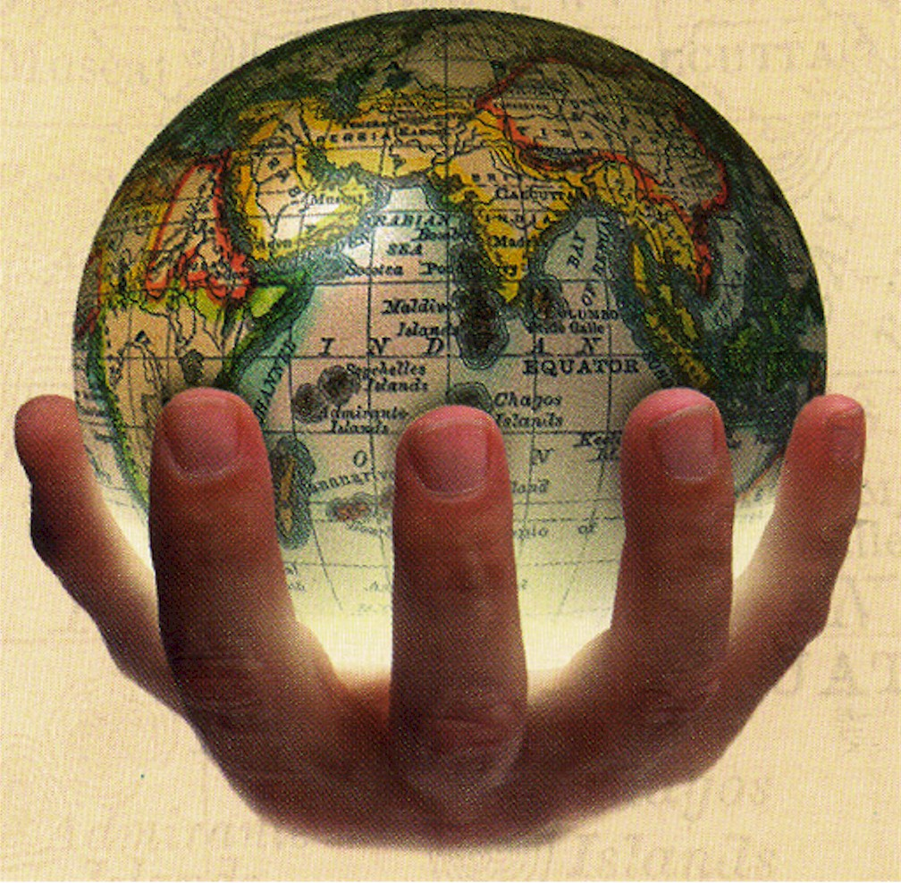
Imperialism

Slide 2
Imperialism
The domination by one country of the political, economic or cultural life of another country or region
is a policy of extending a country's power and influence through colonization, use of military force, or other means

Slide 3
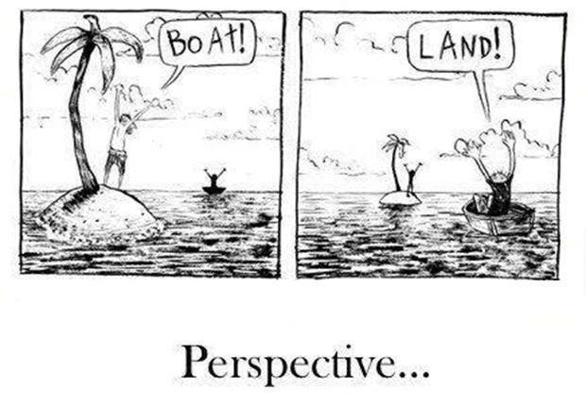
It’s All About Perspective

Slide 4
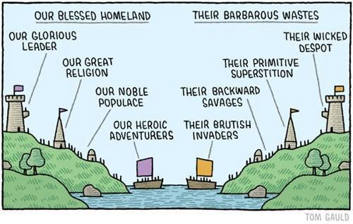
Patriotism Explained

Slide 5
The Unification of Germany or
Second Reich
Napoleon crated the Confederation of the Rhine
Prussia was led by King William I who made Otto von Bismarck the chancellor or highest official of a monarch
Bismarck would become the leader and took the title of Kaiser or emperor in 1871 and unify Prussia with the other German states creating Germany.
Germans celebrated the birth of the Second Reich or empire. They called it that because they considered it heir to the Holy Roman Empire or first Reich.

Slide 6
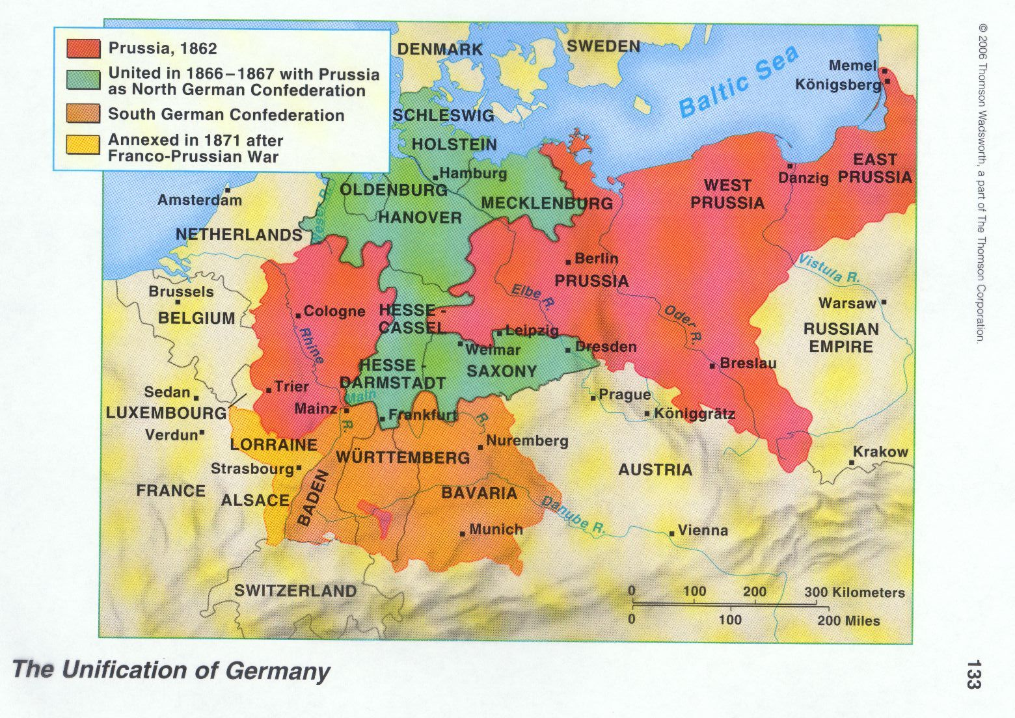
Unification of Germany

Slide 7
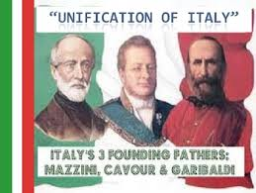
Unification of Italy
The Italian peninsula had been divided into small independent states since the fall of the Roman Empire in 476.
Garibaldi, a nationalist and leader of the Red Shirts, begins unification
Under Mazzini, King Victor Emmanuel II and Prime Minister Cavour Italy will become unified

Slide 8
Elements of Nationalism: In Europe in the 1800’s, devotion to one’s national group, or nationalism, swept through the continent. The elements of nationalism listed below help bond a nation together
Culture: Shared beliefs and a way of life created a common bond
History: A shared past connects people as a group
Religion: Common religion helps unite people
Language: a Common language helps unite people
Territory: A shared land gives land people a sense of unity
Can Nationalism be bad? Sometimes When the belief that nations will benefit from acting independently rather than collectively, emphasizing national rather than international goals, that a country deserves something or feels it is superior

Slide 9
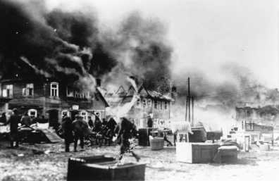
Russian Pogroms
A pogrom is a violent riot aimed at massacre or persecution of an ethnic or religious group, particularly one aimed at Jews.

Slide 10
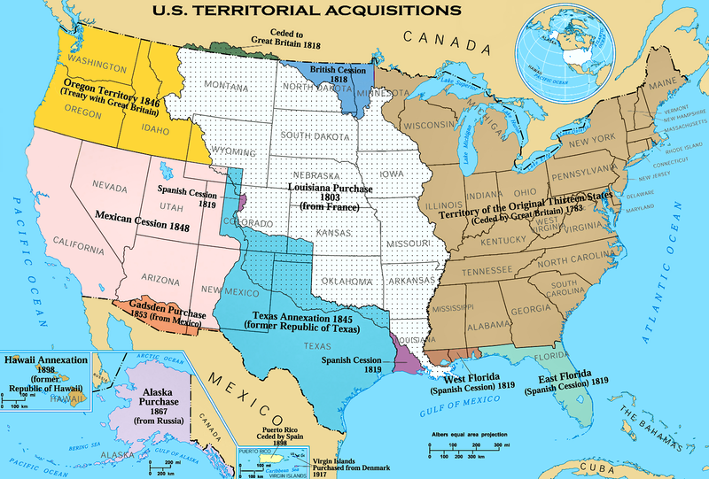
US Territorial Additions/ Manifest Destiny

Slide 11
Levels of Imperialism
The most powerful nations sought to expand for economic, social, political, military and technological reasons. Once conquered, the dominant nation had to decide how to govern. The type of control had to be decided: colonization, a protectorate, or a sphere of influence.
In a colony, the people would be directly managed by the mother country's government. The government could send in its own officials and maintain its laws as the governing laws of the colony .
If a protectorate was chosen, the governing country would retain partial control over the land (Protectorate). Mainly, its job would be to protect the acquired nation and influence the nation's government.
In the case of a sphere of influence, the ruling nation would just require exclusive trading rights or other advantages over its competitors; political control of the conquered nation was usually not sought .

Slide 12
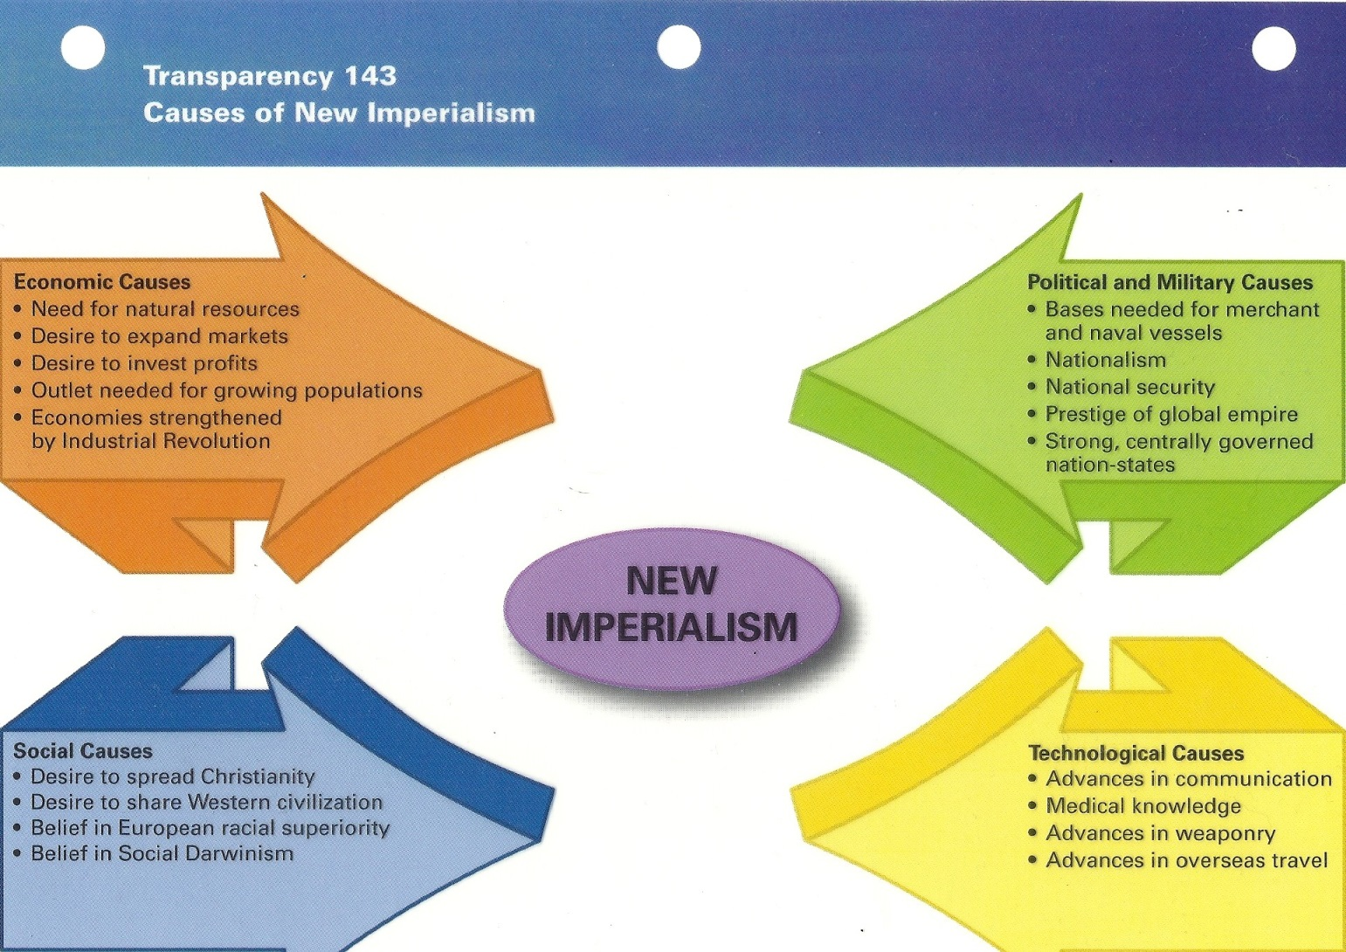
Causes of Imperialism

Slide 13
The Berlin Conference
The Berlin Conference of 1884–85 was a meeting between European nations to create rules on how to peacefully divide Africa among them for colonization. The conference was convened by Portugal but led by Otto von Bismarck, chancellor of the newly united Germany. Though invited, the U.S. declined to participate. The resulting agreement banned the slave trade in name (though not in reality, especially in the Belgian-controlled Congo Free State) but otherwise encouraged European nations to aggressively colonize and exploit Africa's human and natural resources

Slide 14
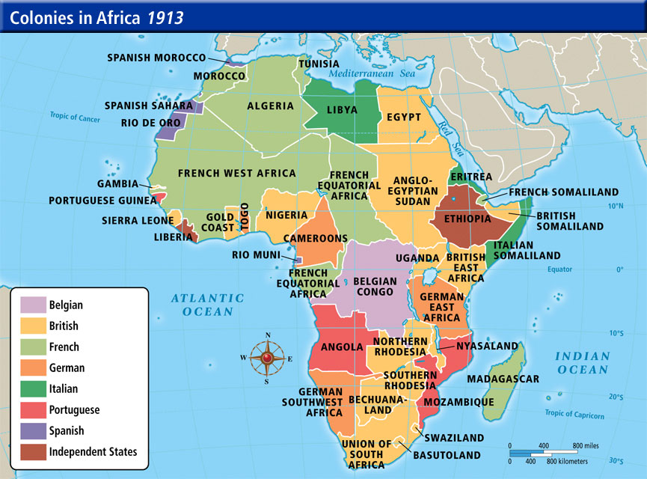
Colonies in Africa

Slide 15
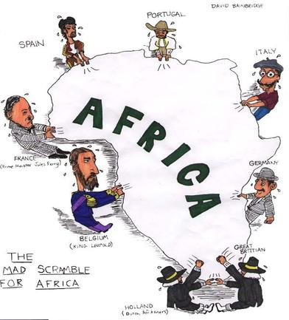
Scramble for Africa

Slide 16
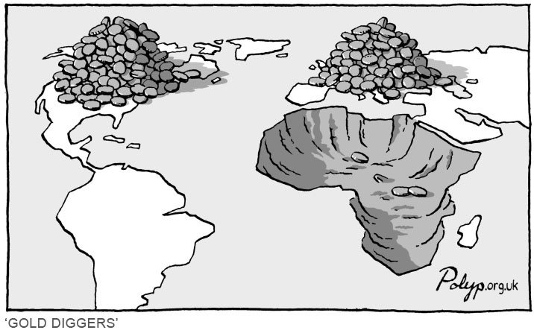
Gold Diggers

Slide 17
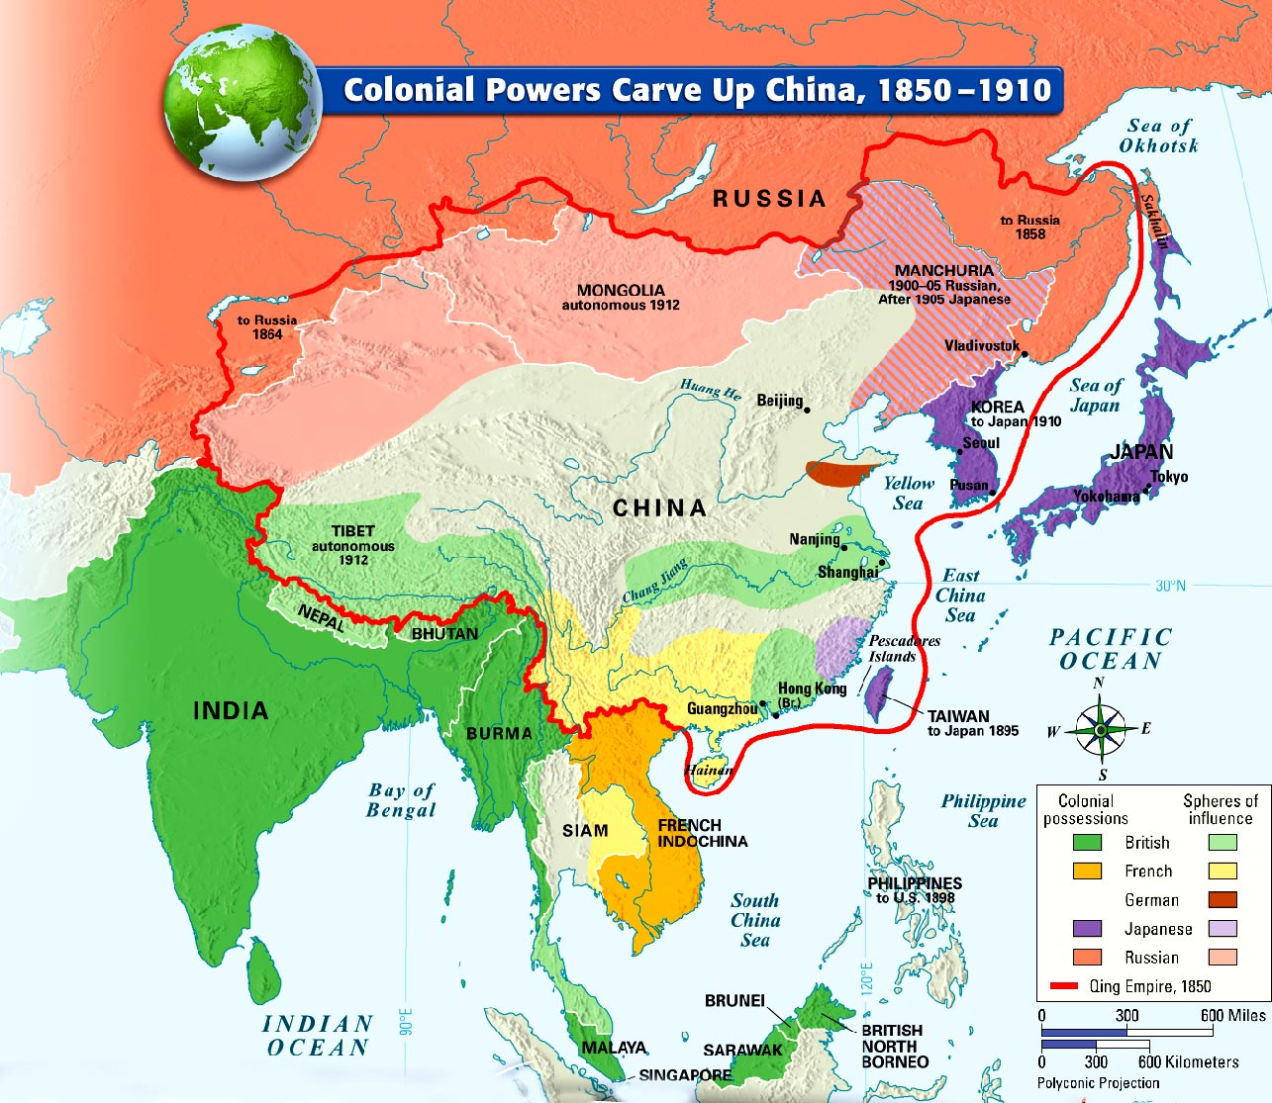
Imperialism of Asia

Slide 18
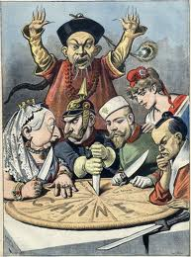
Imperialism of Asia

Slide 19
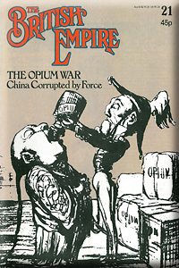
The Opium War
The term Opium War actually refers to a pair of wars fought between Britain and China in the early 1800s.
The first Opium War took place from 1839-1842. British traders were importing opium from India into China, against the wishes of the Chinese government. The Chinese destroyed a warehouse full of opium, and the British responded by sending a fleet of warships. The Treaty of Nanjing brought an end to the conflict. The treaty also ceded Hong Kong to Britain.

Slide 20
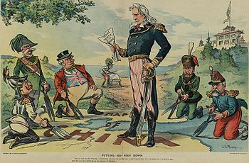
China’s Open Door Policy
By the late 1890’s the US feared that European nations would divide China among themselves so to prevent its loss of profitable trade the US proposed the Open Door Policy which would allow Free Trade in the Chinese ports under European control

Slide 21
Rebellion in China
Taiping Rebellion 1850-1864
The Taiping Rebellion or Taiping Civil War was a massive rebellion or civil war in China that lasted from 1850 to 1864 fought between the established Manchu-led Qing dynasty and the millenarian movement of the Heavenly Kingdom of Peace.
A revolt against the Qing dynasty in China led by Hong Xiuquan, a convert to Christianity; over 20 million died; eventually suppressed with British and French aid
Boxer Rebellion 1900
A siege of a foreign settlement in Neijing by Chinese nationalists who were angry at foreign involvement in China
An anti foreign and anti Christian rebellion
Rebels were called boxers by westerners because they performed physical exercises they believed would make them able to withstand bullets. They killed foreigners and Chinese Christians and destroyed foreign property.

Slide 22
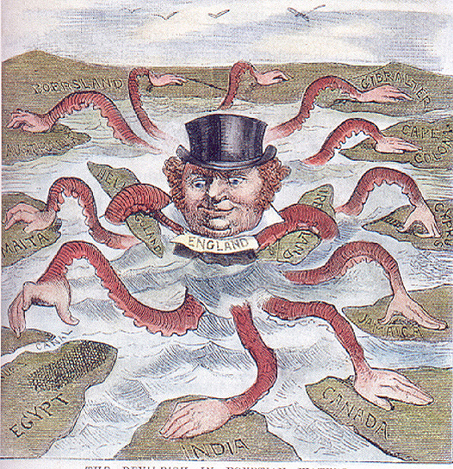
British Imperialisms

Slide 23
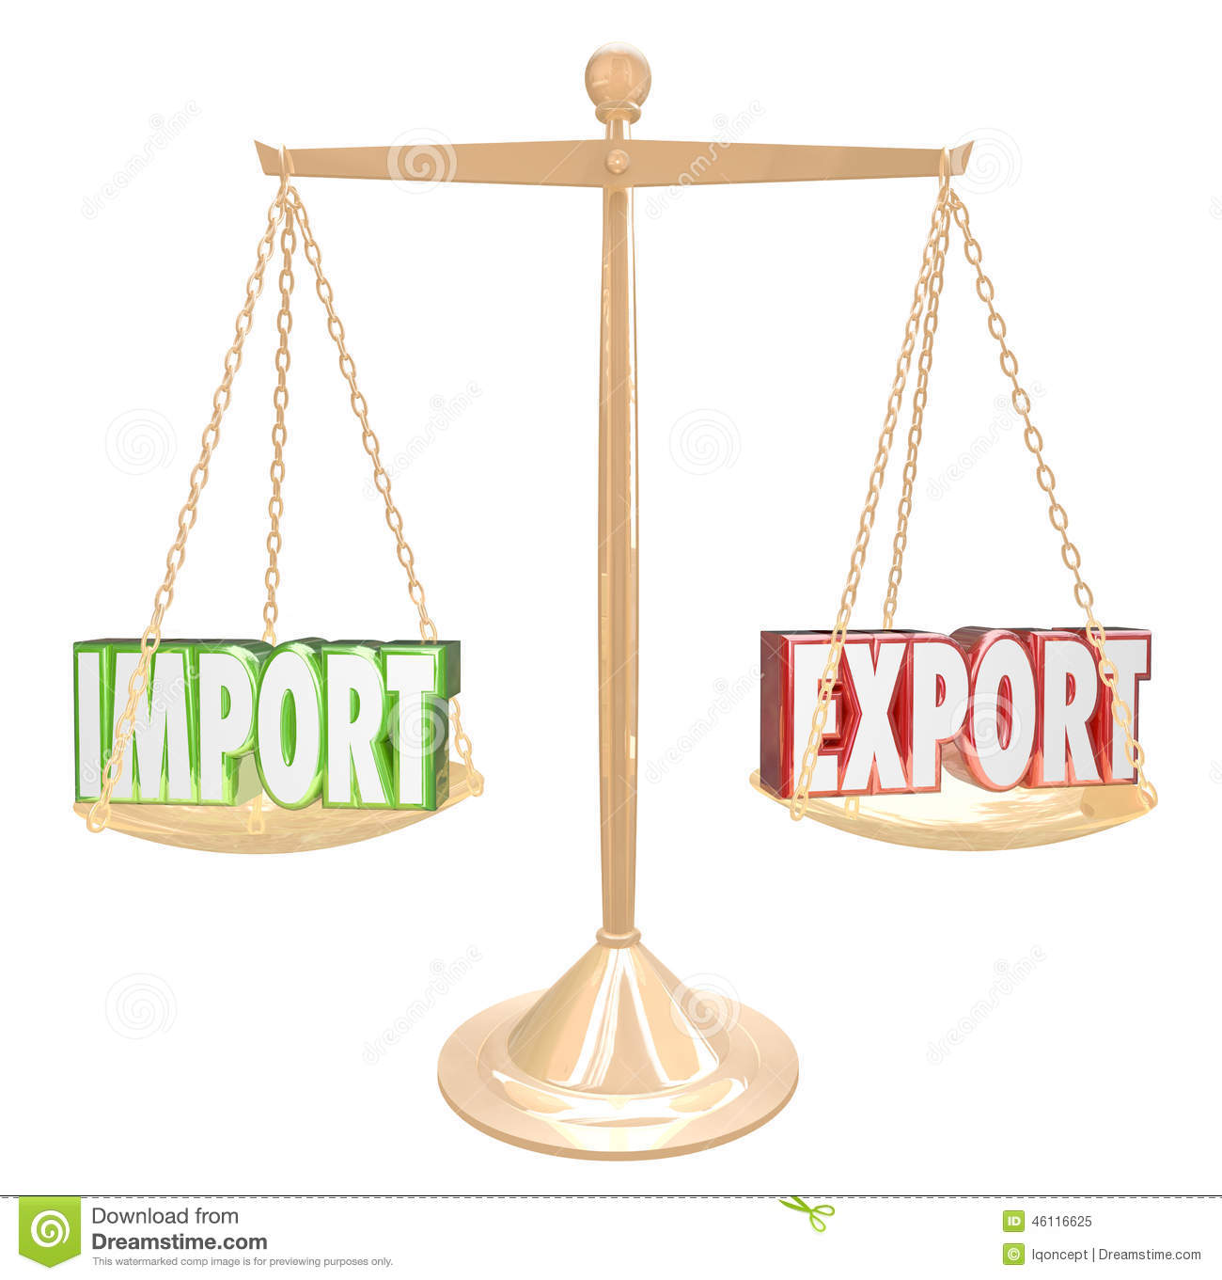
Balance of Trade
Definition of trade surplus/deficit. A trade surplus (a surplus in the balance of trade) occurs when the value of a country's exports exceeds that of its imports. A trade deficit (also called a trade gap) occurs when imports exceed exports.

Slide 24
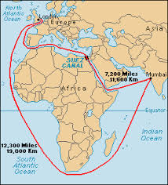
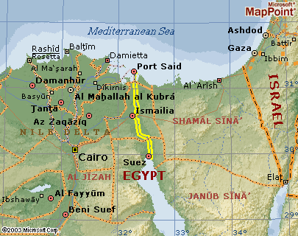
Suez Canal opens in 1869 & stretches over 100 miles
Connecting the Mediterranean Sea and the Red Sea/

Slide 25
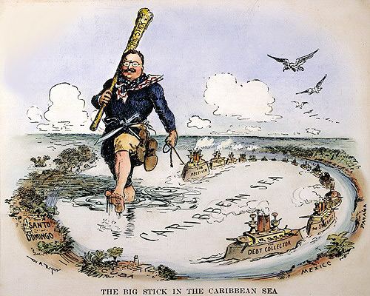
US Imperialism The Monroe Doctrine was a United States policy of opposing European colonialism in the Americas beginning in 1823.

Slide 26
Spanish American War
On April 25, 1898 the United States declared war on Spain following the sinking of the Battleship Maine in Havana Harbor in Cuba on February 15, 1898. The war ended with the signing of the Treaty of Paris (yes, another Treaty of Paris: ) on December 10, 1898. As a result Spain lost its control over the remains of its overseas empire -- Cuba, Puerto Rico, the Philippines Islands, Guam, and other islands.

Slide 27
About the Panama Canal
President Teddy Roosevelt wanted to build a canal through central America but when negotiations broke down with Columbia, who owned Panama, the US helped organize an Panamanian rebellion to win its independence
The US would control the 50 mile length and 5 miles on either side of the canal that runs through Panama
It was one of the world’s greatest engineering feats
Took 10 years to cut 50 miles
5,600 workers died building it
Opened August 15, 1914
Congress would later pay Columbia $25 million
Ships pay a fee, depending on size, to go through the canal.
Panama now owns the canal and is building a second one to handle the new larger ships
Nat Geo Panama Canal 47 min https://www.youtube.com/watch?v=_4F867o_U1w

Slide 28
Imperialism
Imperialism: Asia, Africa, India,
Imperialism Crash Course: https://www.youtube.com/watch?v=alJaltUmrGo&list=PLBDA2E52FB1EF80C9&index=35
Keith Hughes Imperialism 20 min: https://www.youtube.com/watch?v=3Zdnmsf6SXk

Slide 29
3 British Colonies
British Colony | Settled by | Impact on Ingenious People | Gained Self Rule From Britain
Canada | First France then Britain | Native Americans forced to give up land | 1867
Australia | Britain, as a penal colony | Aborigines suffered disastrously | 1901
New Zealand | Britain attracted by climate | Maori fought against settlers, population reduced drastically | 1907

Slide 30
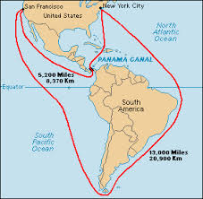
How Panama Canal shortens the trip

Slide 31
About the Panama Canal
President Teddy Roosevelt wanted to build a canal through central America but when negotiations broke down with Columbia, who owned Panama, the US helped organize an Panamanian rebellion to win its independence
The US would control the 50 mile length and 5 miles on either side of the canal that runs through Panama
It was one of the world’s greatest engineering feats
Took 10 years to cut 50 miles
5,600 workers died building it
Opened August 15, 1914
Congress would later pay Columbia $25 million
Ships pay a fee, depending on size, to go through the canal.
Panama now owns the canal and is building a second one to handle the new larger ships
Nat Geo Panama Canal 47 min https://www.youtube.com/watch?v=_4F867o_U1w

Slide 32
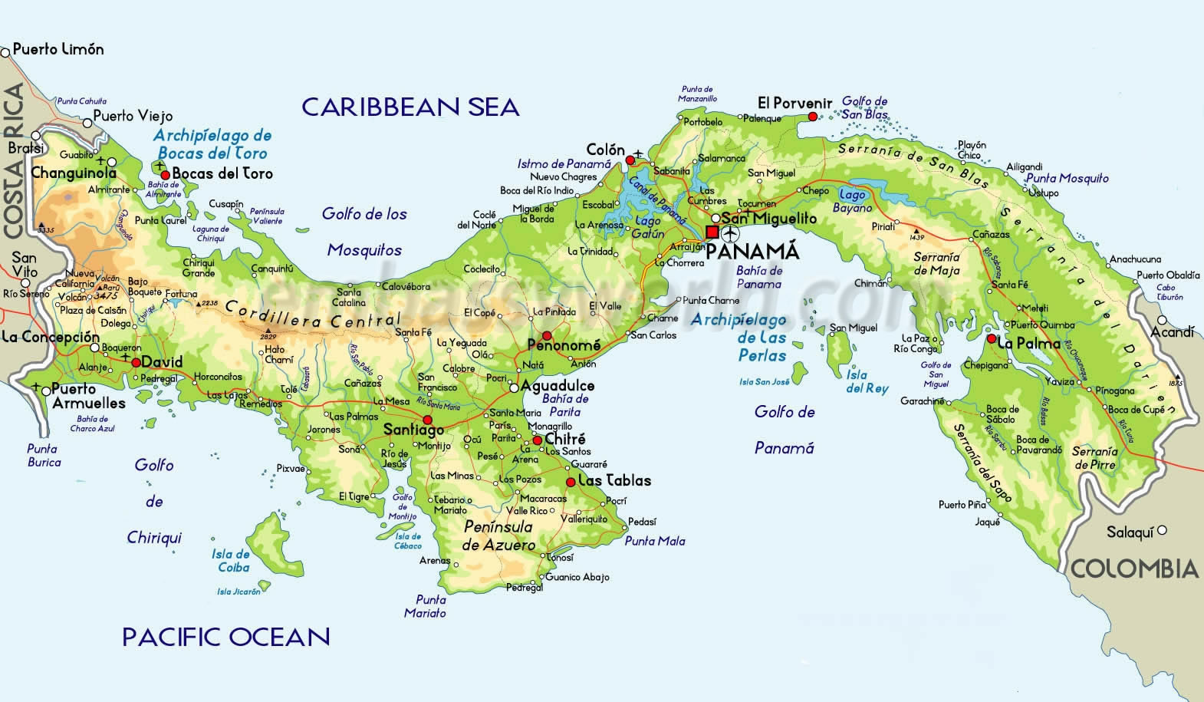
Panama map

Slide 33
US Imperialism in the Caribbean
Speak softly and carry a big stick

Slide 34
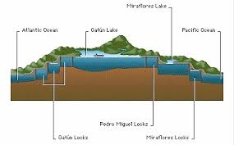
Locks needed to go over the Continental Divide

Slide 35
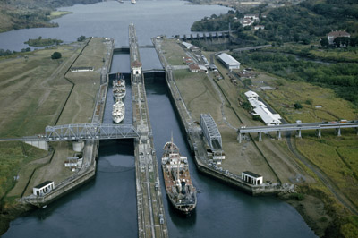
Locks of the Canal

Slide 36
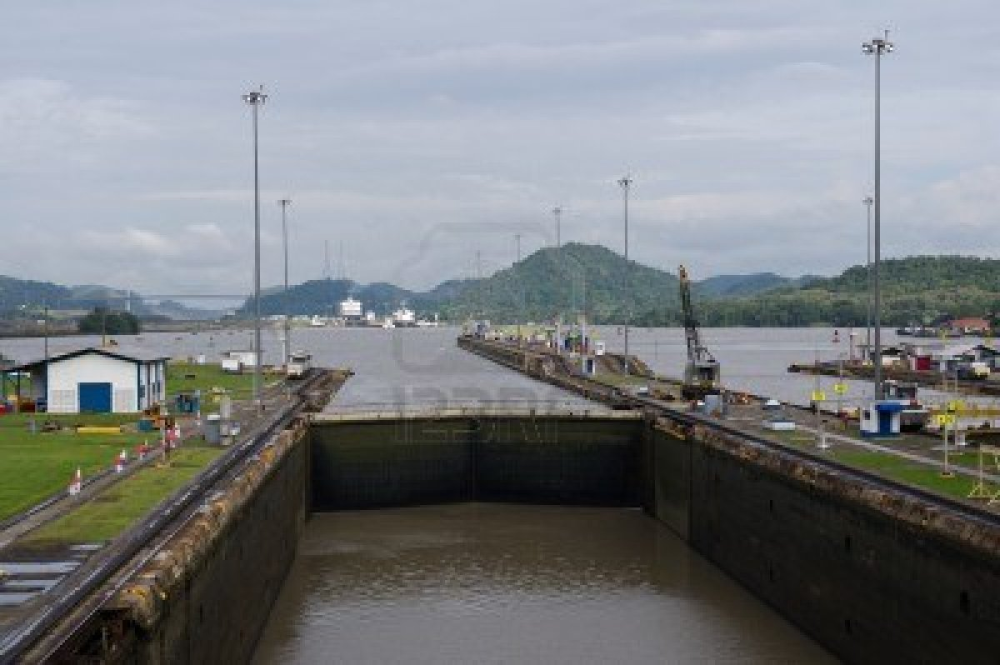
Going Though the Locks

Slide 37
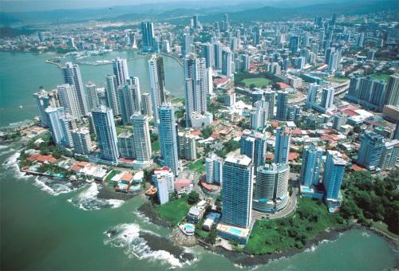
Panama City

Slide 38


Cuna Indians and Molas

