Slide 1

Industrial Revolution
The Industrial Revolution was the transition to new manufacturing processes in the period from about 1760 to sometime between 1820 and 1840
Crash Course: https://www.youtube.com/watch?v=zhL5DCizj5c
Summary in 8 min: https://www.youtube.com/watch?v=nl_-6WPQ4Sg
Causes of the Industrial Revolution: The Agricultural Revolution 5 min https://www.youtube.com/watch?v=6QKIts2_yJ0

Slide 2
Three factors that played a role in the agricultural revolution in Britain in the 1700’s
1. Improved methods of farming like the seed drill
2. Improved livestock breeding methods, wider
varieties of crops
3. The enclosure method or taking over and
fencing off land to gain pastures for sheep
and increase wool production
3. Better educated farmers

Slide 3
The Agricultural Revolution contributes to population growth in Britain
More food was being produced which led to a population explosion also it led to a decline in the death rates and a rise in the birthrates. It reduced the risk of famine and help produce healthier mothers and babies

Slide 4
Five factors that helped Britain take the lead in industrialization
Exploration and Colonialism providing abundant resources from around the world
Sea Power: a large navy and merchant fleet can provide goods from around the globe
3. Political Stability: relative peace allows commerce to
thrive
4. Government Support: Laws passed that favored businesses
allowing it to compete successfully
5. Growth of private investment: funding for research and
development
6. A growing population Society that valued hard work and
worldly achievements

Slide 5
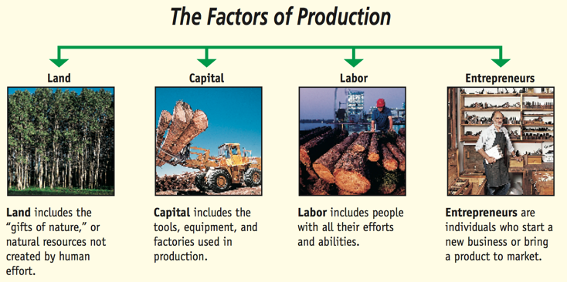
Four Factors of Production

Slide 6
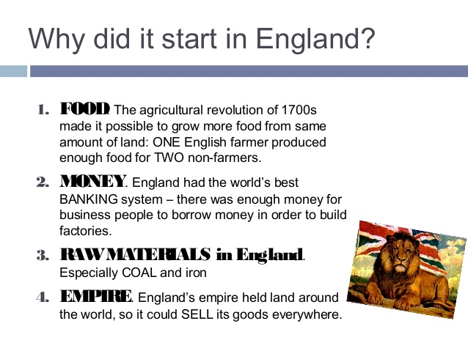
Age of Industry Starts in England

Slide 7
Textile Industry / Cottage Industry
How did the textile business work when it was a cottage industry?
1. Merchant brought wool to cottage
2. Weaver made cloth
3. Merchant took cloth to
market
Advantages and Disadvantages of the Cottage Industry
Advantages: worker could adjust schedule
Disadvantage: fire or floods

Slide 8
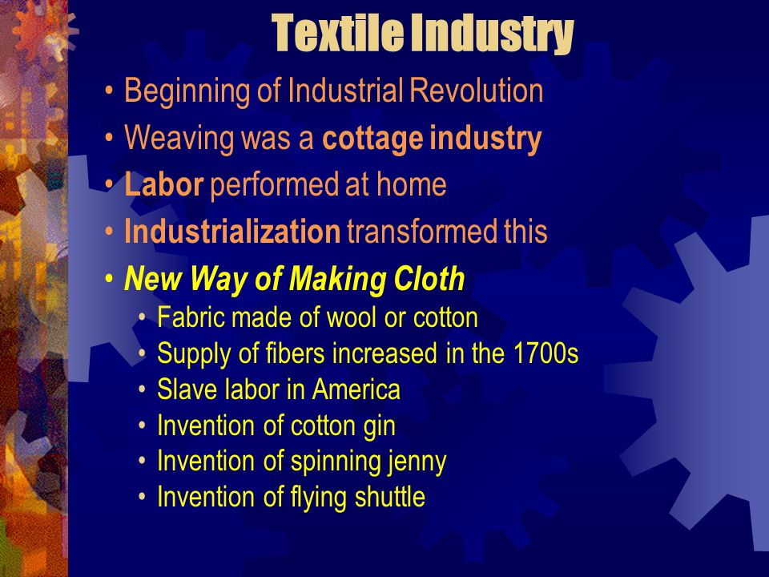
Industry Starts with the Textile Industry (cloth or woven fabric)

Slide 9
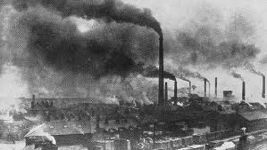
How the factory system changed the nature if work
1. work based on a factory schedule not by the seasons
2. machines with no safety devise caused accidents
3. workers exposed to dangers like coal dust
4. women and children working outside the home

Slide 10
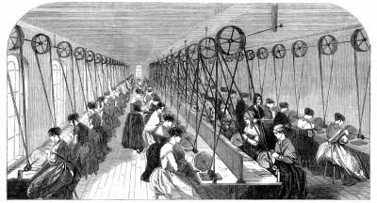
3 reasons why factory owners often preferred women workers to men
They could adapt more
easily to machines
2. Easier to manage
3. Could pay them less for
the same work as men
History Channel spinning wheel 2:50
http://www.history.com/topics/industrial-revolution
Keith Hughes Industrial Rev 27 min: https://www.youtube.com/watch?v=Wrmax07bxyQ

Slide 11
Effects of Factory System
Why were towns unhealthy?
Chemicals,
pollution,
poor sanitation
What kept factory workers wages low?
They had no other way to make a living
Why was factory work especially dangerous for children?
They could be injured while using machines
They could become sick from the fumes, dust, conditions

Slide 12
Advantages and Disadvantages of Factory System
Advantages:
Increased production
Lower prices
Availability of products
Disadvantages:
Harsh working conditions
Ended cottage industries
Bad Factory owners
Pollution
Child Labor

Slide 13
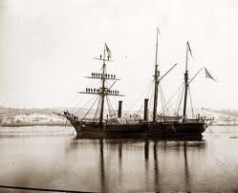
Three examples of the revolution in Transportation
James Watt develops the steam engine!!
Steam engines for trains and ships
2. Iron for railroads
3. Turnpikes and canals

Slide 14
Process of Mass Production
Mass Production is the system of manufacturing large numbers of identical items
Interchangeable parts: identical machine made parts making production and repair of factory made goods more efficient
Assembly line is the product moves from worker to worker as each one performs a step in the manufacturing process. With this division of labor, workers can make many items quickly

Slide 15
Effects on Home Life
When work had been done in the home women often worked along side of their husbands with the introduction of Industry this drew workers away from home and the worlds of work and home began to separate with women and men occupying separate spheres with women at home and men in the workplace to support the home and family

Slide 16
Effects of Industrialization on Countries
For some like Britain it brought great power with rich global economies and ability to mass produce ships and weapons
The ability to control economies other than their own
Populations grew
America has many immigrants both skilled and unskilled that contribute to the nations economic success and cultural variety

Slide 17
Effects of Industrialization on Societies
An increase of wealth
Higher standard of living or level of material comfort
The rise of a middle class
More leisure time to enjoy concerts, sporting events, museums
More are educated
More participate in politics

Slide 18

Adam Smiths’ theory on economics and laissez-faire economics
Smith believed the market was self-regulating and required almost no government involvement. That the unregulated exchange of goods and services would help everyone

Slide 19
Karl Marx’s theory as explained in the Communist Manifesto
Marx believed that economics was the driving force in history and that history was a continuous struggle between the haves and have nots. In the end there would be a class struggle in which the proletariat would triumph and take the means of production and set up a classless society and because wealth and power would be equally shared
Communism: a way of organizing a society in which the government owns the things that are used to make and transport products (such as land, oil, factories, ships, etc.) and there is no privately owned property
Capitalism and Socialism Crash Course : https://www.youtube.com/watch?v=B3u4EFTwprM&list=PLBDA2E52FB1EF80C9&index=33

Slide 20
Capitalism / Socialism
Capitalism:
An economic system in which the means of production are privately owned and operated for profit
Socialism:
A system in which the people as a whole rather than private individuals own all property and operate all businesses

Slide 21
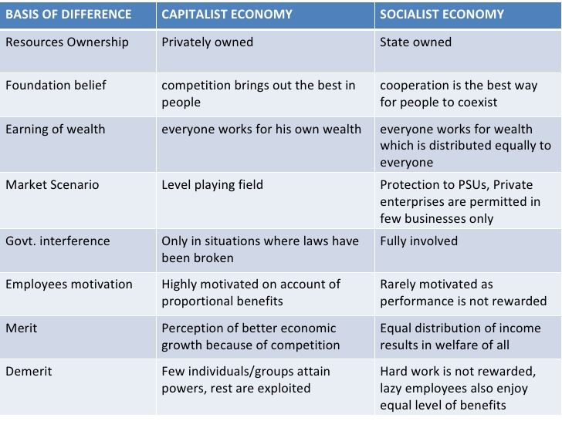
Capitalism and Socialism

Slide 22
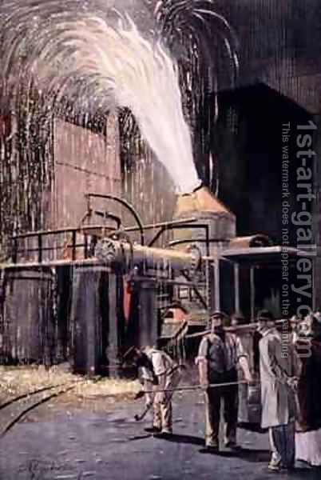
Henry Bessemer develop Steel
The Bessemer Process purified iron ore into a new substance called steel.
Steel was lighter, harder and more durable than iron.
It could be made cheaply and used to make tools, bridges and railroads

Slide 23
Inventors!
Alessandro Volta : battery
Michael Faraday : simple electric motor and dynamo
Thomas Edison : electric light bulb
Nikolaus Otto : internal combustion engine
Karl Benz: automobile
Gottlieb Daimler: first 4 wheeled automobile
Henry Ford : used an assembly line to make cars
Wright Brothers: airplane
Samuel Morse telegraph
Alexander Bell telephone
Guglielmo Marconi radio

Slide 24
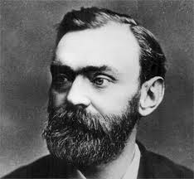
Alfred Nobel
In 1866 a Swedish chemist Alfred Noble invented dynamite.
It was widely used in construction but to Nobel’s dismay also for warfare.
He willed his fortune to fund the famous Noble prizes that are still awarded today

Slide 25

Relativity
German born physicist Albert Einstein advanced theories of relativity which argued that the measurements of space and time are not absolute
E+mc2
theory of special relativity that shows that the increased relativistic mass (m) of a body comes from the energy of motion of the body—that is, its kinetic energy (E)—divided by the speed of light squared (c ²).
(what the heck does that mean?)

Slide 26
Contributions of Louis Pasteur, Robert Koch
Pasture: proved germs and certain disease were linked leading to vaccines and improved sanitation
Koch: identified bacteria that caused tuberculosis

Slide 27
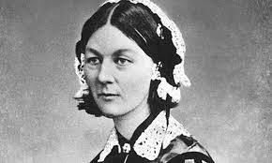
Contributions of Florence Nightingale
Nightingale: founded the first nursing school and introduced hygiene in hospitals

Slide 28

Contributions of Joseph Lister
Lister: discovered antiseptics prevented infection

Slide 29
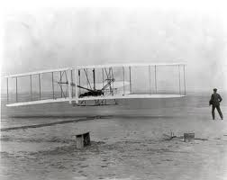
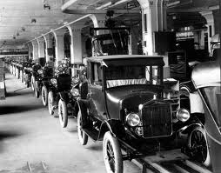
First mass produced cars (Ford)
First Flight (1903) Wright Brothers

Slide 30
New Ideas, Advancements & Developments in Science & Medicine
New Ideas in Science
Natural selection and evolution
Modern atomic theory
Mendeleyev’s periodic Tables
Radioactivity
Atomic nucleus
Theory of relativity
Advancements in Medicine
Pasteurization and vaccination
Anesthetics
Antiseptics
Modern Hospitals
More training for nurses and doctors
Knowledge of germs

Slide 31
Improvements that were made in the early 1900’s
Business advances in offering stock and corporations
Sidewalks, sewers and skyscrapers
Street lights
Unions worked to helped to improve working conditions, improve wages and outlaw child labor
Old age pensions and disability insurance
Rising standards of living
Advances in medicine and life expectancy
Music halls, museums, theaters, libraries

Slide 32
Social Darwinism
Charles Darwin argued that all forms of life had evolved into their present state over millions of years. Process of natural selection or survival of the fittest. Those who adapt to their environment the best survive and pass those traits on to their offspring.
Social Darwinism was not advocated by Darwin. It supported survival of the fittest in humans and societies. It held that wealth and power were a sign of natural superiority, its absence was a sign of unfitness. The theory was used from the late 19th century to support laissez faire capitalism, racism and imperialism
Social Darwinism encouraged racism (the unscientific belief that one racial group is superior to another) Many Americans and Europeans claimed the success of Western civilization was due to the supremacy of the white These ideas will have a lasting impact on world history

Slide 33
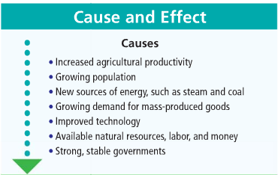
Causes of Industrial Revolution

Slide 34
Effects of the Industrial Revolution
Immediate Effects:
Rise of factories
Changes in transportation and communication
Urbanization
New methods of production
Rise of urban working class
Growth of reform movements
Long Term Effects
Growth of labor of unions
Inexpensive new products
Increased pollution
Rise of big business
Expansion of public education
Expansion of middle class
Competition for world trade
Progress in medical care

Slide 35
Connections to Today
Improvements in world health
Growth in population
Industrialization in developing nations
New energy sources such as oil and nuclear
Environmental pollution
Efforts to regulate world trade
Climate Change / Global Warming
Coal, Steam, and The Industrial Revolution: Crash Course World History
11:04
https://www.youtube.com/watch?v=zhL5DCizj5c
Keith Hughes, Industrialization 27 min: https://www.youtube.com/watch?v=Wrmax07bxyQ
CM in the air 3:02: http://news.yahoo.com/nasa-simulation-shows-a-year-in-the-life-of-earth-s-co2-190708986.html

