Slide 1
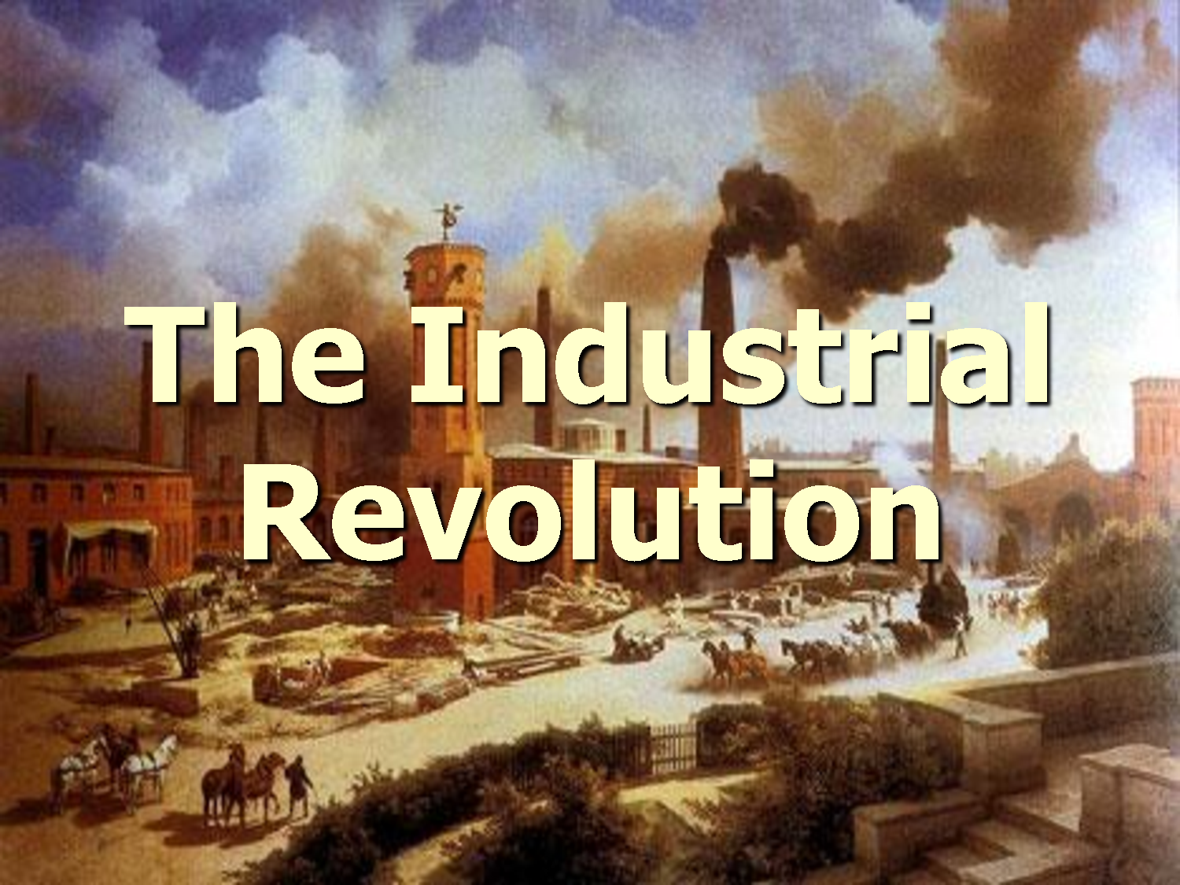
Chapter 20-22

Slide 2

Industrial Revolution
The Industrial Revolution was the transition to new manufacturing processes in the period from about 1760 to sometime between 1820 and 1840

Slide 3
Three factors that played a role in the agricultural revolution in Britain in the 1700’s
1. Improved methods of farming
2. The enclosure method or taking over and
fencing off land to gain pastures for sheep
and increase wool production
3. Better educated farmers

Slide 4
The agricultural revolution contributes to population growth in Britain
More food was being produced which led to a population explosion also it led to a decline in the death rates and a rise in the birthrates. It reduced the risk of famine and help produce healthier mothers and babies

Slide 5
five factors that helped Britain take the lead in industrialization
1. Abundant resources like coal, workers, iron
2. New technologies
3. Improved economic conditions, more capital $$
4. Stable government
5. Society that valued hard work and worldly
achievements

Slide 6
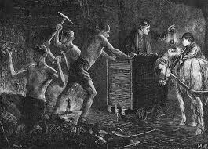
Three sources of energy that helped power the Industrial Revolution
1. water for mills
2. coal for steam
3. human and animal
power

Slide 7
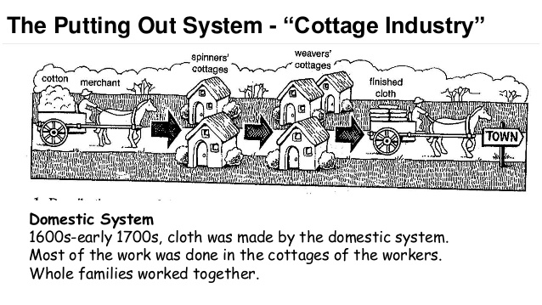
Before the Age of Industry was the Putting Out System https://www.youtube.com/watch?v=jYsU2dv9-CU

Slide 8
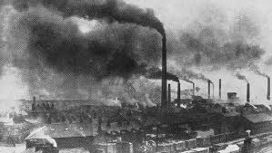
How the factory system changed the nature if work
1. work based on a factory schedule not by the seasons
2. machines with no safety devise caused accidents
3. workers exposed to dangers like coal dust
4. women and children working outside the home

Slide 9
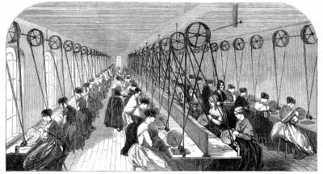
3 reasons why factory owners often preferred women workers to men
They could adapt more
easily to machines
2. Easier to manage
3. Could pay them less for
the same work as men
History Channel spinning wheel 2:50
http://www.history.com/topics/industrial-revolution
Keith Hughes Industrial Rev 27 min: https://www.youtube.com/watch?v=Wrmax07bxyQ

Slide 10
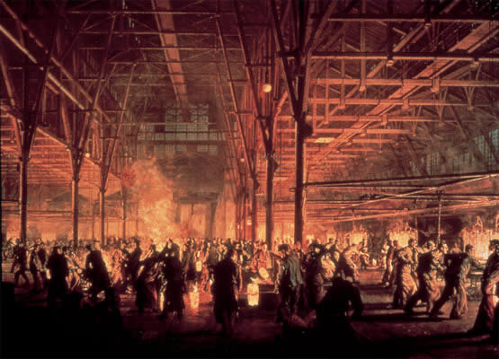
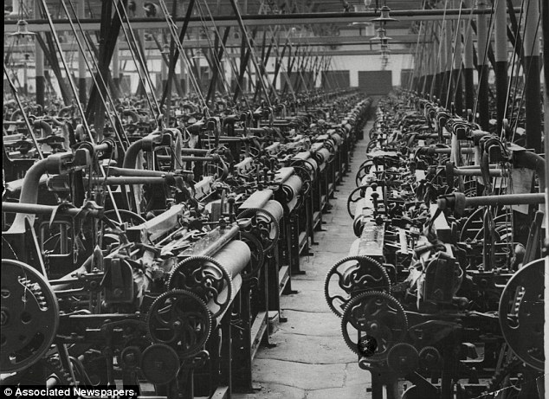
Early Factories

Slide 11
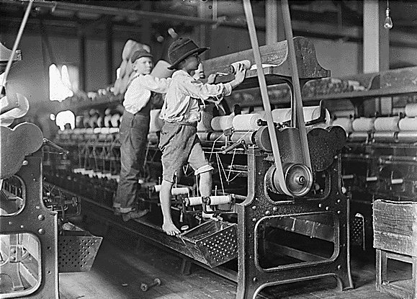
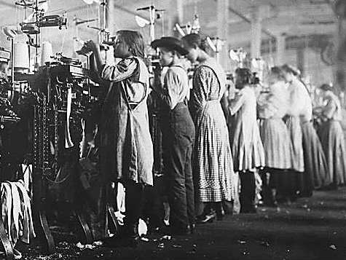
Children Working in the Factories
Child labor 7 min: https://www.opened.com/video/child-labor-in-the-industrial-revolution/113942?isAlreadyAdded=false&isEditMode=false

Slide 12
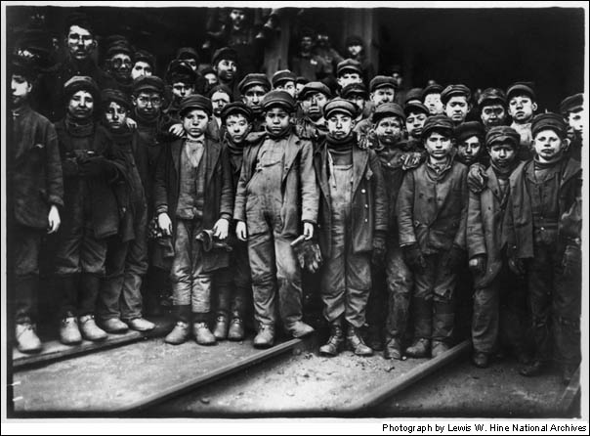
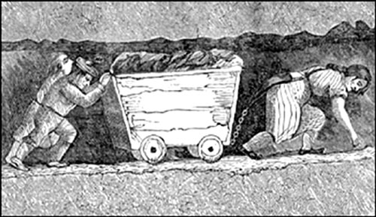
Children in the Coal Mines

Slide 13
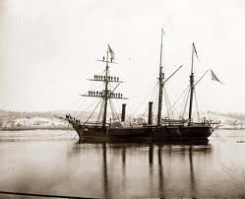
Three examples of the revolution in Transportation
Steam engines for
trains and ships
2. Iron for railroads
3. Turnpikes and canals

Slide 14
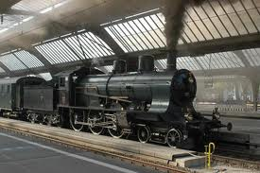
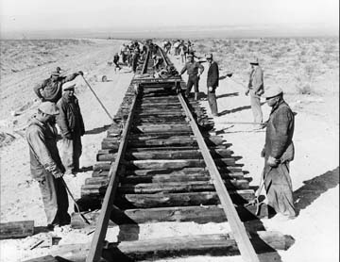
Early Trains http://www.history.com/topics/industrial-revolution/videos/modern-marvels-evolution-of-railroads?m=528e394da93ae&s=undefined&f=1&free=false

Slide 15

Adam Smiths’ theory on economics and laissez-faire economics
Smith believed the market was self-regulating and required almost no government involvement. That the unregulated exchange of goods and services would help everyone

Slide 16
Karl Marx’s theory as explained in the Communist Manifesto
Marx believed that economics was the driving force in history and that history was a continuous struggle between the haves and have nots. In the end there would be a class struggle in which the proletariat would triumph and take the means of production and set up a classless society and because wealth and power would be equally shared
Communism: a way of organizing a society in which the government owns the things that are used to make and transport products (such as land, oil, factories, ships, etc.) and there is no privately owned property
Capitalism and Socialism Crash Course : https://www.youtube.com/watch?v=B3u4EFTwprM&list=PLBDA2E52FB1EF80C9&index=33

Slide 17
Capitalism / Socialism
Capitalism:
An economic system in which the means of production are privately owned and operated for profit
Socialism:
A system in which the people as a whole rather than private individuals own all property and operate all businesses

Slide 18
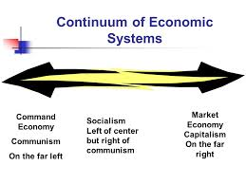
Communism – Socialism - Capitalism

Slide 19
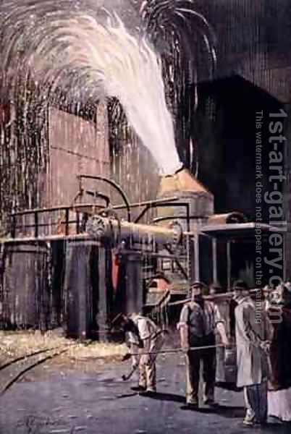
Henry Bessemer develop Steel
The Bessemer process purified iron ore into a new substance called steel.
Steel was lighter, harder and more durable than iron.
It could be made cheaply and used to make tools, bridges and railroads

Slide 20
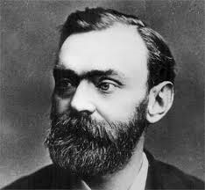
Alfred Nobel
In 1866 a Swedish chemist Alfred Noble invented dynamite.
It was widely used in construction but to Nobel’s dismay also for warfare.
He willed his fortune to fund the famous Noble prizes that are still awarded today

Slide 21
Contributions of Louis Pasteur, Robert Koch
Pasture: proved germs and certain disease were linked leading to vaccines and improved sanitation
Koch: identified bacteria that caused tuberculosis

Slide 22
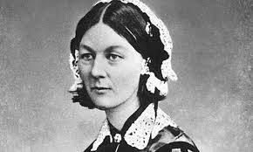
Contributions of Florence Nightingale
Nightingale: founded the first nursing school and introduced hygiene in hospitals

Slide 23

Contributions of Joseph Lister
Lister: discovered antiseptics prevented infection

Slide 24
Inventors!
Alessandro Volta : battery
Michael Faraday : simple electric motor and dynamo
Thomas Edison : electric light bulb
Nikolaus Otto : internal combustion engine
Karl Benz: automobile
Gottlieb Daimler: first 4 wheeled automobile
Henry Ford : used an assembly line to make cars
Wright Brothers: airplane
Samuel Morse telegraph
Alexander Bell telephone
Guglielmo Marconi radio

Slide 25
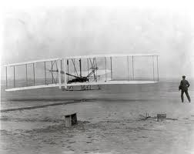
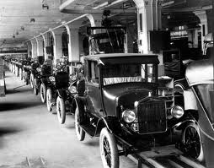
First mass produced cars (Ford)
First Flight (1903)

Slide 26
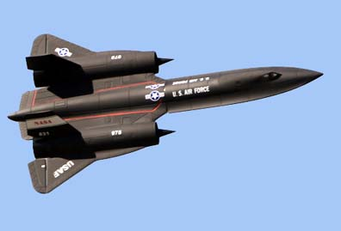
Fastest Plane / SR-71 Blackbird
The Lockheed SR-71 Blackbird holds the official Air Speed Record for a manned air-breathing jet aircraft with a speed of 2,193 mph. It was capable of taking off and landing unassisted on conventional runways.
First supersonic research project built by the Bell Aircraft CO. was conceived during 1944 and designed and built during 1945, it achieved a speed of nearly 1,000 miles per hour during 1948.
Mach one is about 768 MPH

Slide 27
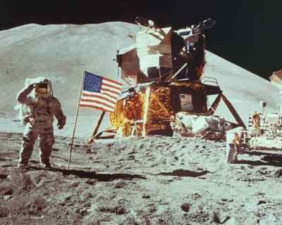
Man Lands on the Moon 1969
Apollo 11 carried the first humans to the moon, Americans Neil Armstrong and Buzz Aldrin on July 2o, 1969. Armstrong became the first to step onto the lunar surface

Slide 28
Improvements that were made in the early 1900’s
Business advances in offering stock and corporations
Sidewalks, sewers and skyscrapers
Street lights
Unions worked to helped to improve working conditions, improve wages and outlaw child labor
Old age pensions and disability insurance
Rising standards of living
Advances in medicine and life expectancy
Music halls, museums, theaters, libraries

Slide 29
Average Life Expectancy
Average Life Expectancy During Industrial Age
Year | Male | Female
1850 | 40.3 | 42.8
1870 | 42.3 | 44.7
1890 | 45.8 | 48.5
1910 | 52.7 | 56.0
2013 | 78.8 | 81

Slide 30
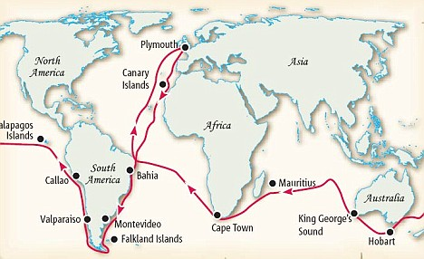
Charles Darwin
In 1831 the HMS Beagle sailed from England on a five year voyage around the world to survey and chart the oceans. Aboard was 22 year old Charles Darwin, whose role was to observe record and collect samples of rocks, plants, animals, insects and fossils. The specimens Darwin collected and studied helped him develop his theory of evolution

Slide 31
Social Darwinism
Charles Darwin argued that all forms of life had evolved into their present state over millions of years. Process of natural selection or survival of the fittest. Those who adapt to their environment the best survive and pass those traits on to their offspring.
Social Darwinism was not advocated by Darwin. It supported survival of the fittest in humans and societies. It held that wealth and power were a sign of natural superiority, its absence was a sign of unfitness. The theory was used from the late 19th century to support laissez faire capitalism, racism and imperialism
Social Darwinism encouraged racism (the unscientific belief that one racial group is superior to another) Many Americans and Europeans claimed the success of Western civilization was due to the supremacy of the white These ideas will have a lasting impact on world history

Slide 32
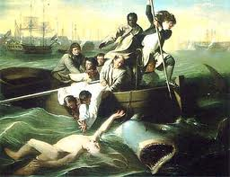
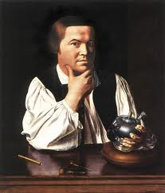
Realism Art/ Copley attempts to represent the world as it was,

Slide 33
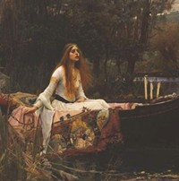
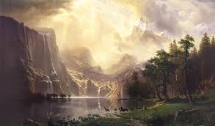
Romanticism ties to capture the beauty and power fo nature.

Slide 34

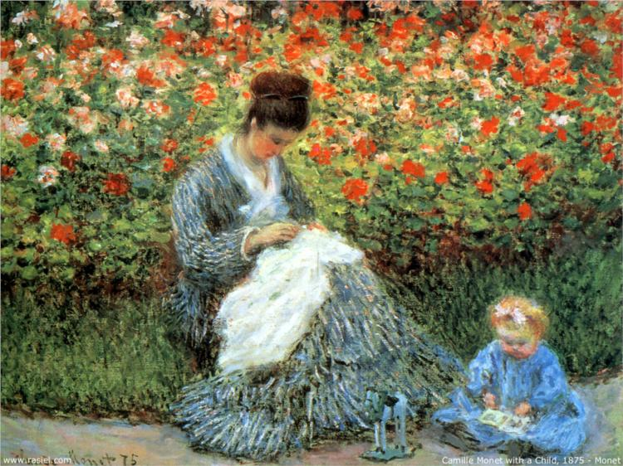
Impressionism / Monet seek to capture the impression made by a scene or object on the viewers eye

Slide 35
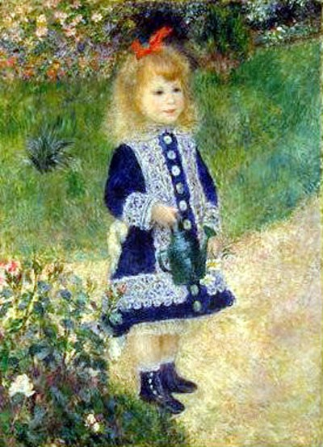
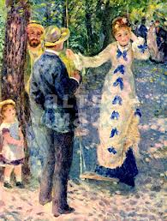
Impressionism / Renoir

Slide 36
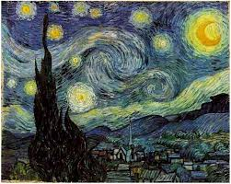
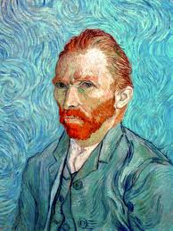
Post Impressionism /Van Gogh
Included many different styles http://www.buzzfeed.com/alanwhite/starry-starry-night
The One Thing You Never Noticed About Vincent Van Gogh's "Starry Night"

Slide 37
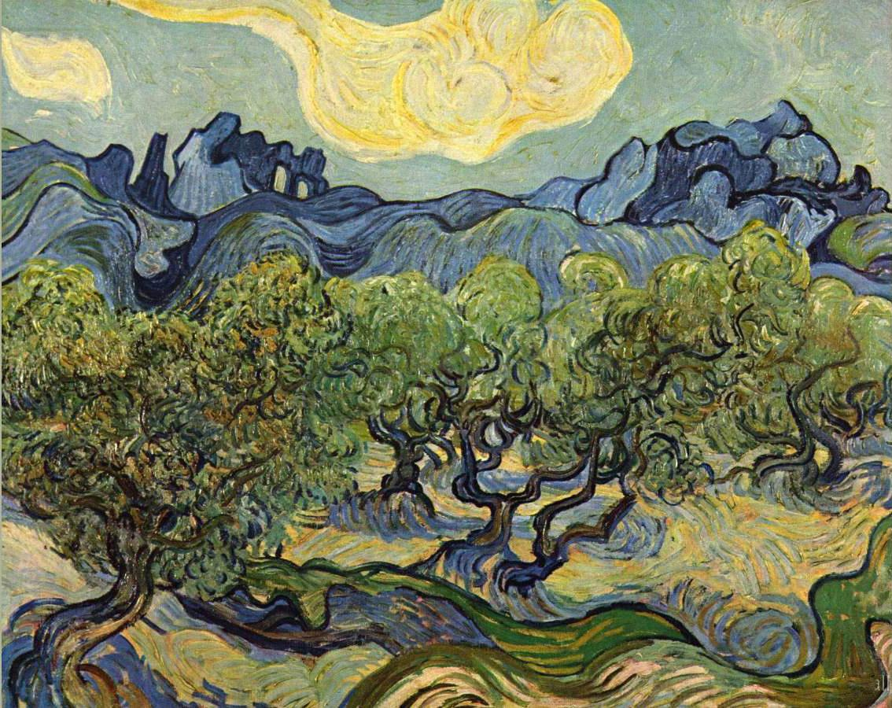
Van Gogh

Slide 38
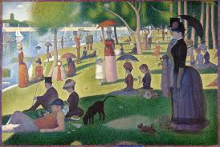
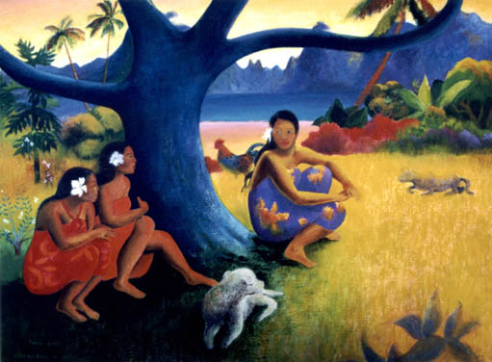
Georges Seurat/ Paul Gauguin

Slide 39
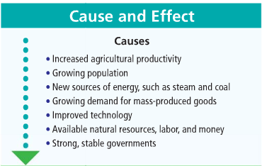
Causes of Industrial Revolution

Slide 40
Effects of the Industrial Revolution
Immediate Effects:
Rise of factories
Changes in transportation and communication
Urbanization
New methods of production
Rise of urban working class
Growth of reform movements
Long Term Effects
Growth of labor of unions
Inexpensive new products
Increased pollution
Rise of big business
Expansion of public education
Expansion of middle class
Competition for world trade
Progress in medical care

Slide 41
Connections to Today
Improvements in world health
Growth in population
Industrialization in developing nations
New energy sources such as oil and nuclear
Environmental pollution
Efforts to regulate world trade
Climate Change / Global Warming
Coal, Steam, and The Industrial Revolution: Crash Course World History
11:04
https://www.youtube.com/watch?v=zhL5DCizj5c
Keith Hughes, Industrialization 27 min: https://www.youtube.com/watch?v=Wrmax07bxyQ
CM in the air 3:02: http://news.yahoo.com/nasa-simulation-shows-a-year-in-the-life-of-earth-s-co2-190708986.html

Slide 42
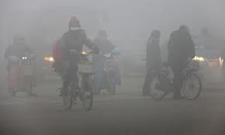
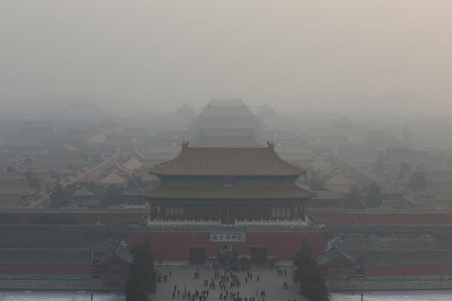
Beijing China in the day time 2013

Slide 43
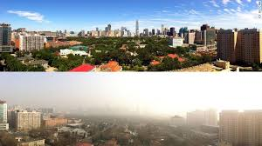
Beijing China / Then and Now

Slide 44
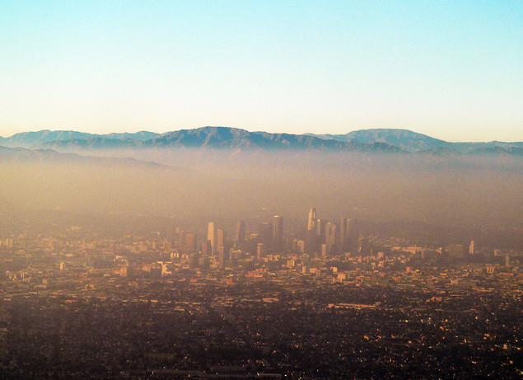
Smog in Los Angeles

