Slide 2
Unit II- Population Condensed

Slide 3
A little information about World Population
80% of pop. Lives within 500 Mi. of an ocean
World inhabitants live on only 10% of the land
90% of pop. Lives North of the Equator
65% lives between 20°N and 60 ° N latitude
Humans are NOT uniformly distributed across the Earth • We can understand the nature of its distribution by studying their concentration and density
• Concentration –
2/3 of Earth’s population is concentrated in 4 regions: • East Asia • South Asia • Europe • Southeast Asia
23 countries = 75% of world population (172)
10 Countries have pops. Greater than 100M
China, India, United States, Indonesia, Brazil

Slide 4
Population Growth

Slide 5
Population
population distributions tells us where individuals or groups live on the Earth’s surface
historically people congregate in places where food can be grown
there are four main areas of population density in the world (five depending on what text you read)
East Asia (Japan parts of China)
South Asia (India)
Southeast Asia (Indonesia)
Europe
* The three Asia population concentrations together comprise more than half of the world’s total population, but together they live on less that 10% of the Earth’s land area (the same held true 2,000 years ago)
Demography is the scientific study of population
Density: numerical measure of the relationship between the number of people and some other unit of interest (typically space)
Concentration: The spread of something over a given area
EX: The area Australia and Continental US is about the same, but the population is radically different (21 million to 300 million). So the density of population in Australia is far lower than the density of population of continental USA. However, the continental USA has almost 60 million people spread throughout rural area. Australia, has its population concentrated in a few urban areas, and a very small percentage spread through very vast rural regions. So Australia may have a higher concentration of people than the USA even though the density is lower

Slide 6
US Population Distribution US Population Distribution Many factors influence population patterns such as: natural environment, economic, development, and cost of living. The majority of population distribution across the U.S. is concentrated on the east coast In many cases, the population will be located near areas of significance, such as capitals.

Slide 7
Ecumene, or portion of the earth’s surface that has permanent human settlement has expanded to cover most of the earth’s land area.

Slide 8
Places that Produce Low Population
Characteristic | Description | Example
Extreme Climate | Too hot, cold, arid (having little or no rain), or wet | Antarctica (too cold, to arid
Extreme relief | Too high or too steep | The Himalaya Mountain peaks
Extreme remoteness | Too hard to access | The Island of Tristan da Cunha (world’s remotest inhabited island)
Infertile land | Unproductive land supports fewer farmers | Amazon River basin (tropical rainforest)

Slide 9
Over Population
When consumption of natural resources by people outstrip the ability of a natural region to replace those natural resources
Problems result when an area exceeds its carrying capacity the number of people an area can support
World pop growth silent 5 min:

Slide 10
Classification of Countries

Slide 11
Comparing Countries

Slide 12
Developed Countries

Slide 13
Developing Countries where MDC and LDC are located 9 min: https://www.youtube.com/watch?v=tktAW8z-VHg

Slide 14
Dependency Ratio
Potential Workforce:
Demographers consider people ages 15 – 64 the Potential Workforce, the group expected to be the society’s labor force.
Everyone else – people under 15 or over 64 – are the dependent population, because they are considered too young or too old to work full time.
Dividing the potential work force by the dependent population results in the dependency ratio. Since many people who are 15 to 64 do not work for pay, and since many people under 15 and over 64 do, this number is only an estimate

Slide 15
Measuring Population: Population increases rapidly in places were more people are born than die, and it declines in places were deaths outnumber births. Populations also increase and decrease when people move in and out
Geographers /
Demographers most frequently measure population change in a country through 3 measures
Crude Birth Rate (CBR)
Crude Death Rate (CDR)
Natural Increase Rate (NIR)
Natural means excluding migration
Crude means looking at society as a whole

Slide 18
Population Replacement level is 2.1
Replacement level fertility is the level of fertility at which a population exactly replaces itself from one generation to the next. In developed countries, replacement level fertility can be taken as requiring an average of 2.1 children per woman.

Slide 19
NIR and Doubling Time
Natural increase rate NIR is the percentage by which the population grows in a year. The Term natural means that a country's birth rate excludes migration. During the twenty first century the world NIR has been 1.2 meaning the population of the world has been growing each year by 1.2 percent
The NIR was essentially zero for most of humanity's several hundred-thousand-year occupancy on earth. The . The number of people added each year has dropped from a historic peak of 88 million in 1989 to current 75 million.
The natural increase rate affects the doubling time which is the number of years to double the population assuming a constant rate of natural increase. At the current rate of 1.2 percent per year, world population would double in about 54 years. If the same NIR continued through the twenty first century,, global population in the year 2100 would reach 24 billion. When the NIR was 2.2 percent in 1963 doubling time was 35 years. had the 2.2% rate continued into the twenty first century earths population would currently exceed 10 billion instead of 7 billion. and the NIR through the 21st century would be more 50 billion in 2100
Regional variations of NIR More that 96% of the NIR is clustered in developing countries. the NIR exceeds 2.0 in most countries of sub Saharan Africa whereas it is negative in Europe meaning that in the absence of immigration, population is actually declining

Slide 20
Demographic Transition Model: Model that shows changes in natural increase, fertility, and mortality rates. This process has several stages

Slide 21
DTM and Why

Slide 22
Gotta Knows about the DTM Stages
Stage 1: Slow population growth, when the birth rate and death rates are both high. Most of the world before the Industrial Revolution was stage 1. Because Pandemics, wars, and weather catastrophes had big effects of population
Stage 2: The population increases greatly as the death rates (especially with children) drops due to improvements in medical care but birth rates stay high so population growth occurs at a fast pace. Many of the least developed countries today are in this stage
Stage 3: The population growth slows because of a falling birth rate due to improvements in economic conditions, status of women and access to contraception. Population continues to grow but at a slower rate. More developed countries (MDC’s) are in this stage today
Stage 4: The rate of natural increase is low or decreasing because of low death rates and low birth rates with a stable population rates. There is a higher levels of education, stronger economies, improved health care, more women in the workforce and a fertility rate of approximately 2 children per women. Mode developed countries are in this stage
Stage 5: There appears to be an emerging 5th state represented by man European countries and Japan. That have achieved this stage of have sub replacement birth rates and the population of elderly is greater than the youthful population.

Slide 23
Causes of Industrial Revolution

Slide 24
Effects of the Industrial Revolution

Slide 25
Characteristics of the DTM Stages
Factor | 1. High Stationary | 2. Early Expanding | 3. Late Expanding | 4. Low Stationary | 5. Declining
Birth Rates | High, but fluctuating as need for farm labor changes | High, but fluctuating to reflect desires for big families | Declining as urbanization decreases the need for child labor | Low but enough to keep the population stable | So low it falls below the death rate
Death Rate | High, but fluctuating to reflect diseases and poor sanitation | Rapidly declining as nutrition, sanitation and medicine improve | Declining but not as fast as in previous stage | Low and stable | Low, sometimes increasing as the population ages
Population Change | Very low growth because births and deaths are both high | Rapid growth as death rates fall faster than birth rates | Rapid but slowing growth as birth rates decline | Very low growth because births and deaths are both low | Very low decline as births fall below deaths
Examples Today | Scattered isolated groups | Mali South Sudan | Mexico Turkey Indonesia | United States China | Japan Germany
Population Structure | Very Young | Very Young | Young, with rising life expectancy | Balanced with more aging | Very old

Slide 27
Population Pyramid Info
Age Distribution
Dependency Ratio: number of people who are too young or too old to work, compared to the number of people in their productive years
Three Age Groupings
0-14 = Dependents
15-64 = Workers
64+ = Dependents
Stage 2 Countries = 1:1
Stage 4 Countries = 1:2
Sex Ratio
Sex Ratio: number of males per hundred females
In general more males are born than females
Males have higher death rates
Europe and North America = 95:100
Rest of World = 102:100

Slide 28
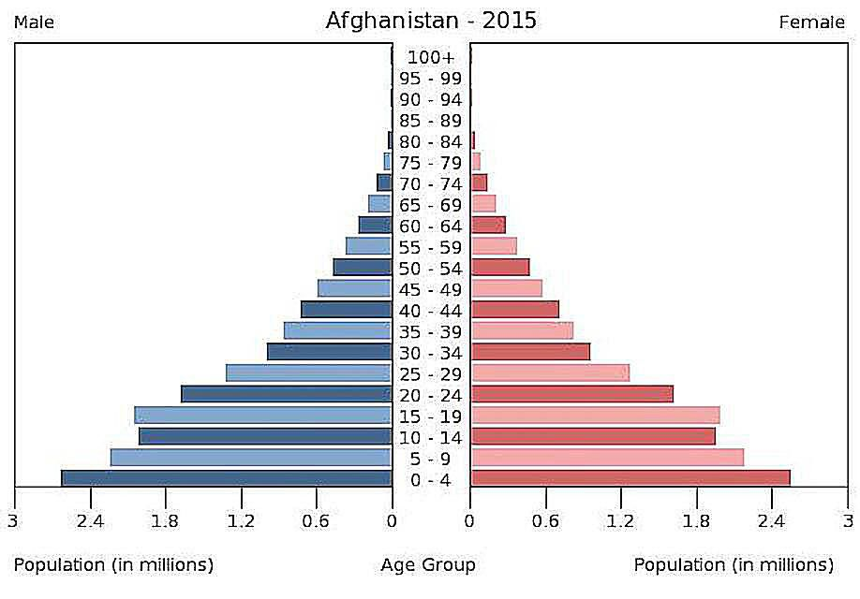
How to read a Population Pyramid
Elder Dependents
Working Population
Youth dependents
Notes:
Take your twizzlers and create the mens side of pyramid on your blank sheet of paper. You should have 21 groups.
Make sure to label the age groups (0-4), (5-9) – etc.
Create the women’s side with twizzlers
Then go over the three areas of the pyramid – youth depends, working population, elder dependents
When you’re done going over the basic components, discuss how population pyramids are meant to change … use the link below to give students a visual of how pyramids change over time
https://www.populationpyramid.net/world/1996/

Slide 29
Aging Populations

Slide 30
Developing vs Developed

Slide 31
Comparing Stages looking at Pyramids

Slide 32
Thomas Malthus: Coined the term over population. In An Essay on the Principle of Population (1798) Stating Earth’s population was growing much more rapidly than the Earth’s food supply. Food shortages and chaos inevitable. Possible checks on population growth: War, poverty, pestilence (epidemics), or famine.

Slide 33
Malthus Critics and Neo Malthusians

Slide 34
Malthus did not foresee
He did not foresee the ability of people to increase food production so dramatically with new technologies
He assumed people had no control over their reproductive behavior, He did not foresee that population growth would slow down over time because of effective contraception, the changing role of women in society and an individual people’s reproductive decisions
He did not recognize that famine is usually related not to a lack of food but to the unequal distribution of food. For example famine struck various parts of Africa repeatedly throughout the 20th century, despite the fact that an abundance of food existed in other parts of the work
While these issues have caused many to discount Malthus’ theories, they have helped bring attention to issues like sustainability and have informed the work of numerous other influential scholars and ecologists

Slide 35
Population Policies: Essentially the stances governments can take on population
These policies determine what is done to influence or control population Growth and Size
Actions these policies induce include
Laws
Free/subsidized daycare or preschool
-Tax or cash incentives
Forced sterilization
-Free contraceptives
-Advertising
Free or increased access to family planning
Taxation
Subsidization of abortion

Slide 36
Role of Women in Society
Role of Women in Society
Culture, economic, political and environmental realities have always shaped decisions about whether to have children.
Since these conditions have varied across tie and cultures so have birth rates,
How people viewed the role of women in society is particularly important
As countries industrialize and move to urban areas women began working, living in smaller apartments and homes, and urban families did not need children to work.
As women gain more education the number of children they have has decreased
Family Planning
Governments influence TFT with concerns of overpopulation, the growth of population beyond what an area can support have led to anti- natalist policies, programs to decrease the number of births
Chinese policy in the 70’s of “later, longer, fewer was introduced to encourage parents to get married later in live, wait longer between children and have fewer children
China’s one Policy
Government Policies to Encourage Births (pro natalist policies, to encourage large families to stimulate economic growth and increased military power, increase the workforce,

Slide 37
Consequences for having an aging population
sub replacement birth rates
the population of elderly is greater than the youthful population.
Increased dependency ratio
Care for the elderly, building nursing homes, health care workers
shortage of qualified workers, making it more difficult for businesses to fill in-demand roles.
The combination of lower tax revenue and higher spending commitments on health care, pension and other benefits
Money needed for aging population health care
Money for families with aging parents at home
Government money for Adult day cares
Not enough younger people paying into social security
Not enough people to buy products
slowdown in productivity growth
more people using pensions than paying into them
Increased dependency ratio
Elderly have fixed incomes, so they pay less taxes which means less revenue for the state

Slide 38
Population policies that encourage large families and raise the rate of natural increase
Ex: Europe: Thanks to falling birth rates and improved healthcare, Europe's population is aging. Thus, its governments are attempting to boost births
through free or subsidized daycare/preschool (Sweden, UK, France),
payments for having children (Poland, Italy),
extended paid maternity leave (Sweden, Norway, Ireland, UK, Germany, France, Spain),
extended parental leave (Germany, France, Spain, Norway, Sweden, UK, Ireland).
Free College tuition
% reduction in fares on all public transport for three child families
Pensions for mothers/housewives who stay home with three children or more
% mortgage and preferential treatment in allocation of three bedroom lfats or apartments ro homes,
Shops offer discounts for large families
Shorter working hours

Slide 39
Population policies that discourage large families and raise the rate of natural increase
Improve standard of living
Build more hospitals and have incentives and investment in schools
Increase number of family planning programs
Encourage the use of contraceptives and limitation of family size
All project villages are of sufficient size to have a health subcenter
Education for all females
Job training for women
Financial incentive for women to choose to be sterilized
Age limits for marriage
Discount housing for two or fewer children
Loss of benefits for families with families with than two children
Free collage for families with few than two children
Free contraceptives
advertisements

Slide 40
Epidemiological Transition Model Stages: The predictable stages in disease and life expectancy that countries experience as they develop. / They correspond with the stages of the DTM
Stage | Description | Effects on Population
1. Pestilence and Famine | Parasitic or infectious diseases, accidents, animal attacks, or human conflicts cause most deaths | A high death rate and low life expectancy
2. Receding Pandemics | The number of pandemics (widespread diseases that affect large populations) declines as a result of improved sanitation, nutrition, and medicine | A decreasing death rate and increasing life expectancy
3. Degenerative and Human Created Diseases | Infectious and parasitic diseases continue to decrease, but diseases associated with aging, such as heart disease and types of cancer – increase as people live | Death rate stabilizes at a low level and life expectancy increases
4. Delayed Degenerative Diseases | Stage 4 is an extension of Stage 3, but the age – related diseases are put off as medical procedures delay the onset of these diseases through advanced procedures. Diseases such as Alzheimer's and dementia increases | Death rate reaches its lowest level and life expectancy reaches a peak
5. Reemerging of Infectious and Parasitic Diseases | Infectious and parasitic diseases increases as some bacteria and parasites become resistant to antibiotics and vaccines | Life expectancy decreases

