Slide 1
Unit 3 / Languages
Churchill

Slide 2
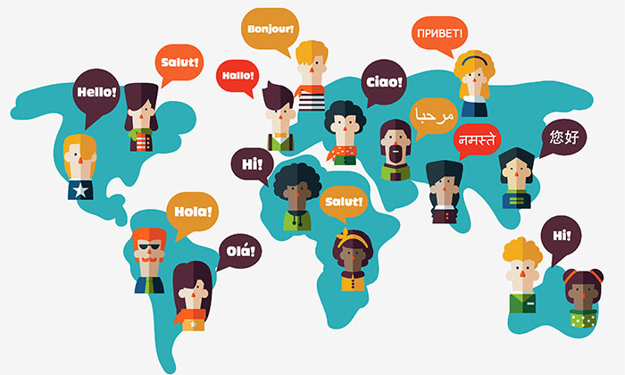
Unit 3 Language

Slide 3
Interesting information on Language
There really are 50 Eskimo words for 'snow‘
The language with the largest alphabet in the world belongs to the Cambodian language Khmer and is 74 characters long. The shortest alphabet is 12 characters long, and belongs to Rotokas. The language with the most words, however, is English, boasting over 250,000 words.
The most widely spoken languages are Chinese, Spanish, English, and Hindi, in that order
Every two weeks, another language dies. Or, perhaps, a dialect. There are over 231 completely extinct languages and 2,400 of the world’s languages are considered to be in danger of dying out.
African clicking language: https://www.youtube.com/watch?v=W6WO5XabD-s
Learning a second language can make you smarter. A number of scientists agree that becoming polyglot can boost your brainpower. Other studies also suggest that speaking more than one language can help to slow down the aging process of the mind.
There are 50,000 characters in the Chinese language. You’ll need to know about 2,000 to read a newspaper
English: The most common letter, and vowel, in the English language is the letter it starts with: E. But the most common consonant in English is R, followed by T. More English words begin with the letter S than any other letter. The English word “alphabet” is made up of two Greek words, which are the first two letters of the Greek alphabet: alpha and beta. The longest word without a true vowel in it is “rhythm”.
The oldest written language was believed to be written in about 4500 BC.
South Africa has 11 official languages – the most for a single country.

Slide 4
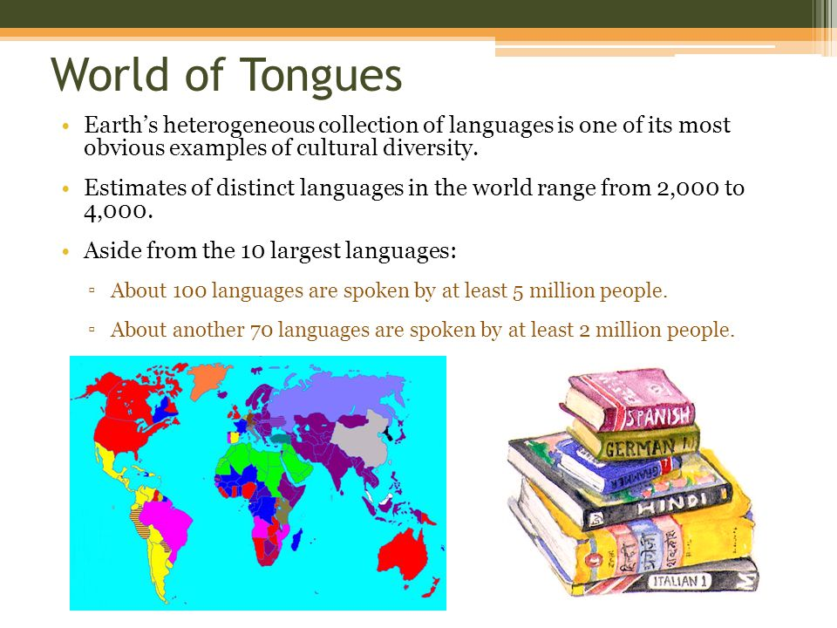

Slide 5
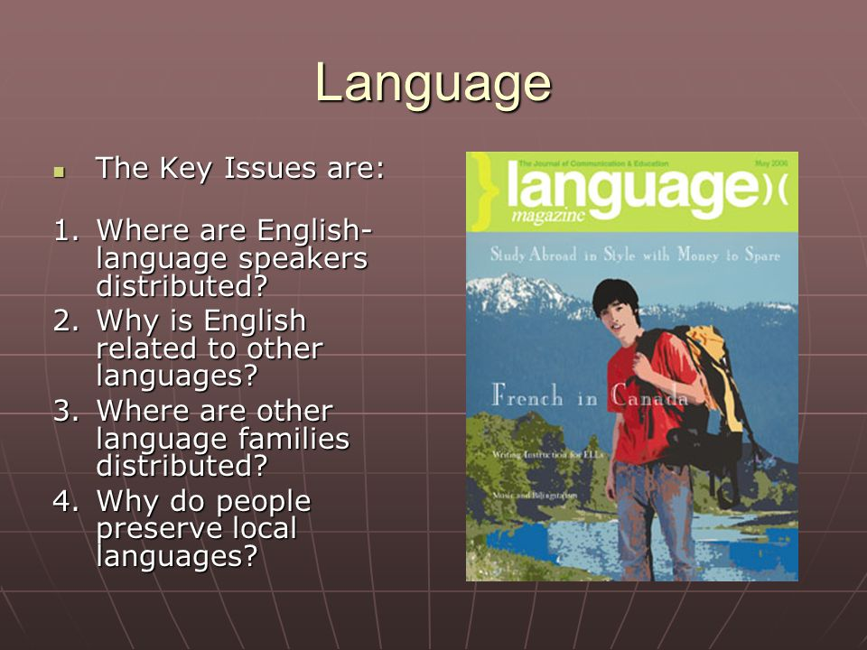
Where did language come from https://www.youtube.com/watch?v=iWDKsHm6gTA

Slide 6
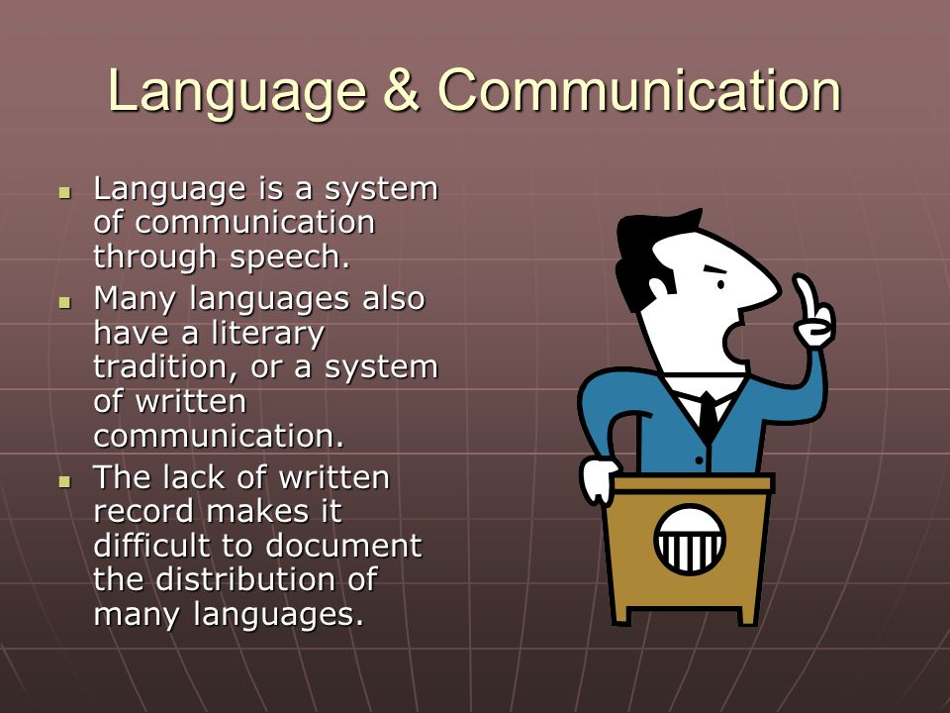

Slide 7
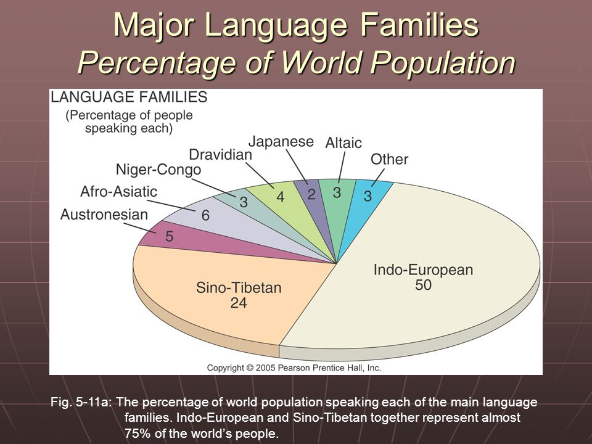

Slide 8
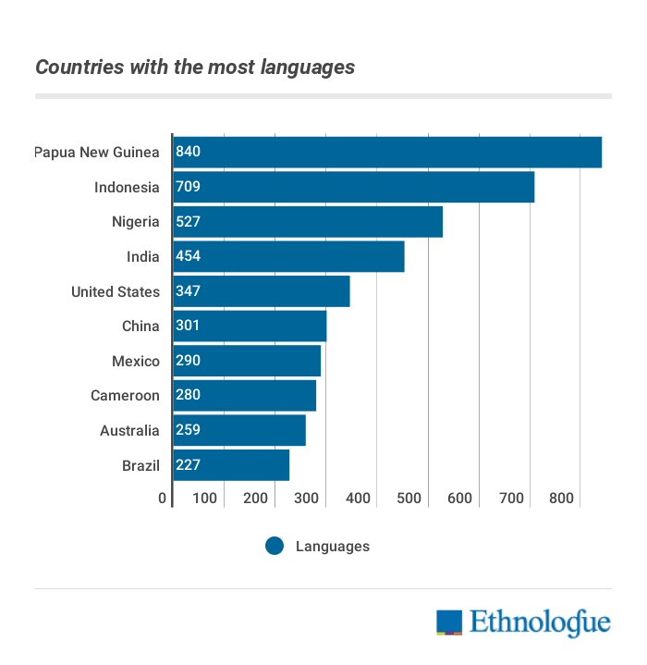

Slide 9
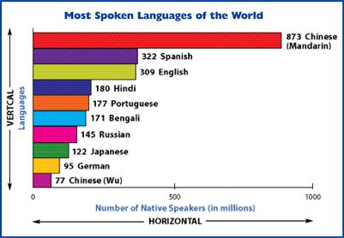

Slide 10
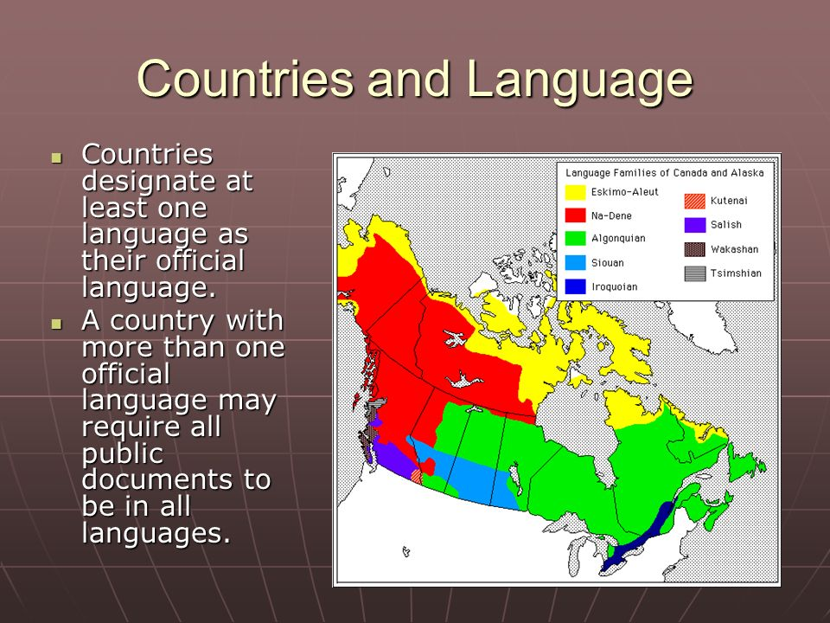

Slide 11
Classifying Languages
Institutional Languages: are used in education, work, mass media, and government
Many countries designate at least one institutional language as an Official Language which is used by government for laws, reports, and public objects, such as road signs, money and stamps. It is a language that would be understood by most of the country’s citizens.
The US has no official language.
Some British colonies designate English as the official language but few of their citizens can speak it. Some countries have more than one official language and require public documents to be in all official languages
EX: Belgium, Albania, Canada, Finland, South Africa has 11 official languages – the most for a single country.
Literary Language means it is written as well as spoken. The system of written communication includes a method of writing and rules of grammar.
Developing Language: is spoken in daily use by people of all ages, from children to elderly . It also has a literary tradition, through literature and the language may not be widely distributed
Vigorous Language: is spoken in daily use by people of all ages, but it lacks a literary tradition. Languages in danger of dying. Or disappearing from use

Slide 12
Should English be the official language of the United States
Make English the Official US Language
58 countries and 28 US states already make English official
Requiring the use of English is a symbol of national unity
Knowledge of English is essential for survival in the United States
Providing services to non-English speakers is expensive
Do not make English the official US Language
A law is unnecessary because English is already the primary language of the United States
The government should not interfere with people’s language rights
Advocating English only attacks immigrants from non English speaking countries

Slide 13
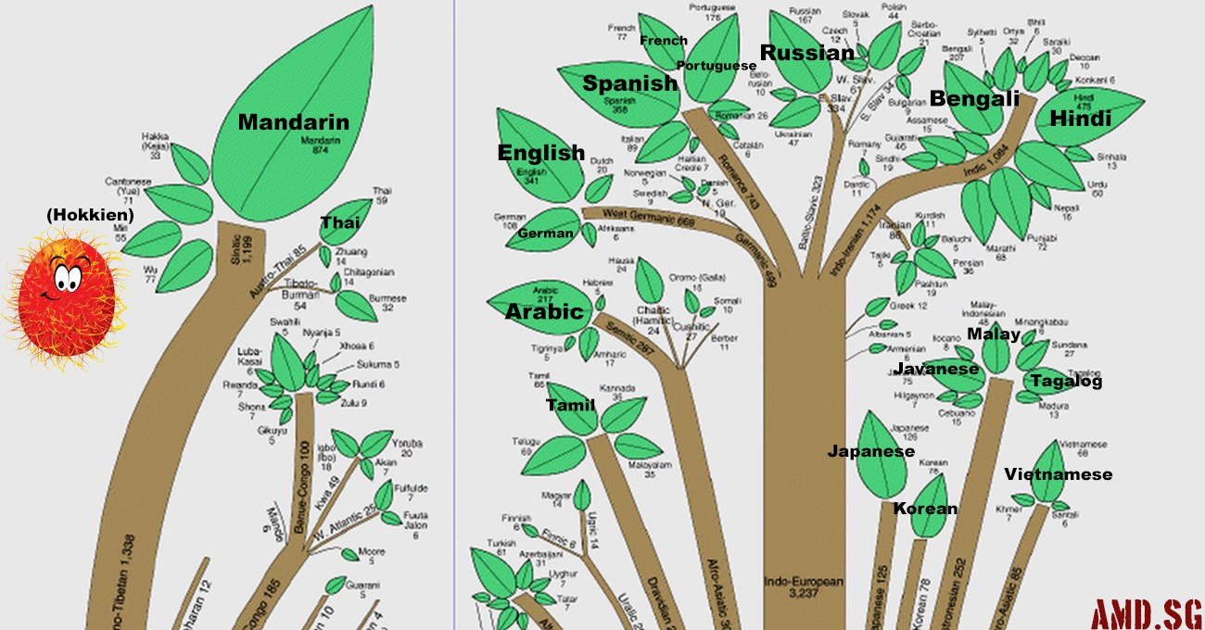
Organizing Language Families
Language Family: is a collection of languages related through a common ancestral language that existed long before recorded history
Language Branch: is a collection of languages within a family related through a common ancestral language that existed several thousand years ago. Differences are not as extensive or as old as between language families and archeological evidence can confirm tat the branches derived from the same family
Language Group: is a collection of languages within a branch that share a common origin in the relatively recent past and display many similarities in grammar and vocabulary
Language families form the trunk of the tree
Individual languages are displayed as leaves
Some trunks divide into several branches, which represent language branches

Slide 14
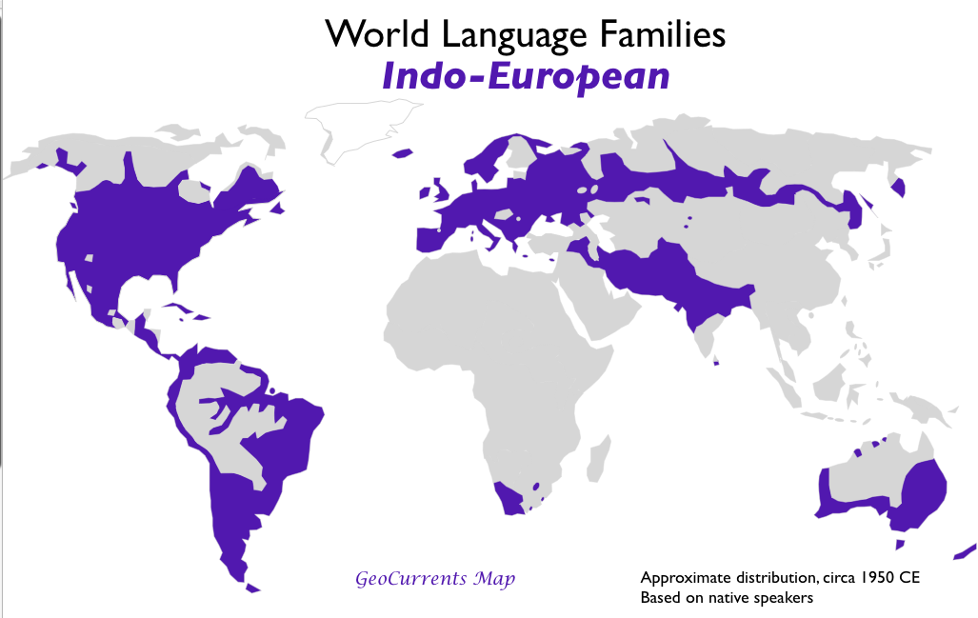
Distribution of Language Families –
The two largest language families are
#1. Indo-European –Is the most widely used language family , it is the Predominate language family in Europe, South Asia, North America and Latin America.

Slide 15
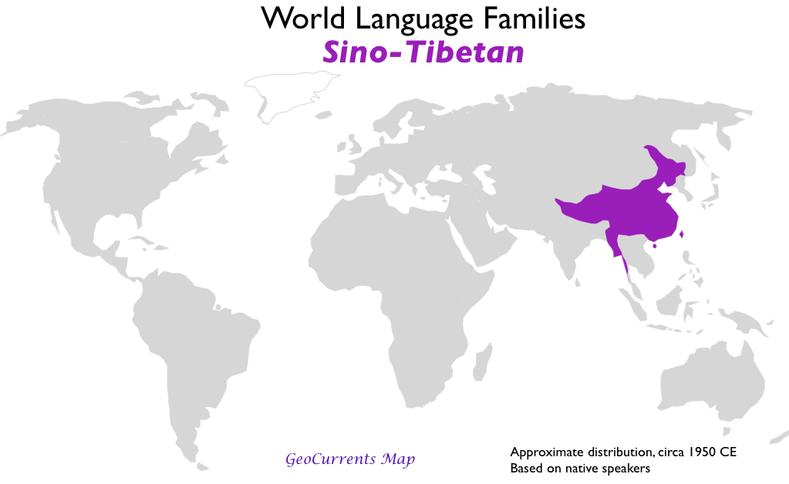
Distribution of Language Families –
The two largest language families are
#2. Sino-Tibetan –relating to or denoting a large language family of eastern Asia whose branches include Sinitic (Chinese), Tibeto-Burman (Burmese and Tibetan), and, in some classifications, Tai (Thai and Lao) Encompasses languages spoken in the People’s Republic of China and several smaller countries in Southeast Asia. » No single Chinese language » Mandarin is the most-used language in the world and the official language of both the People’s Republic of China and Taiwan. There are seven other Sinitic branch languages spoken in China

Slide 16
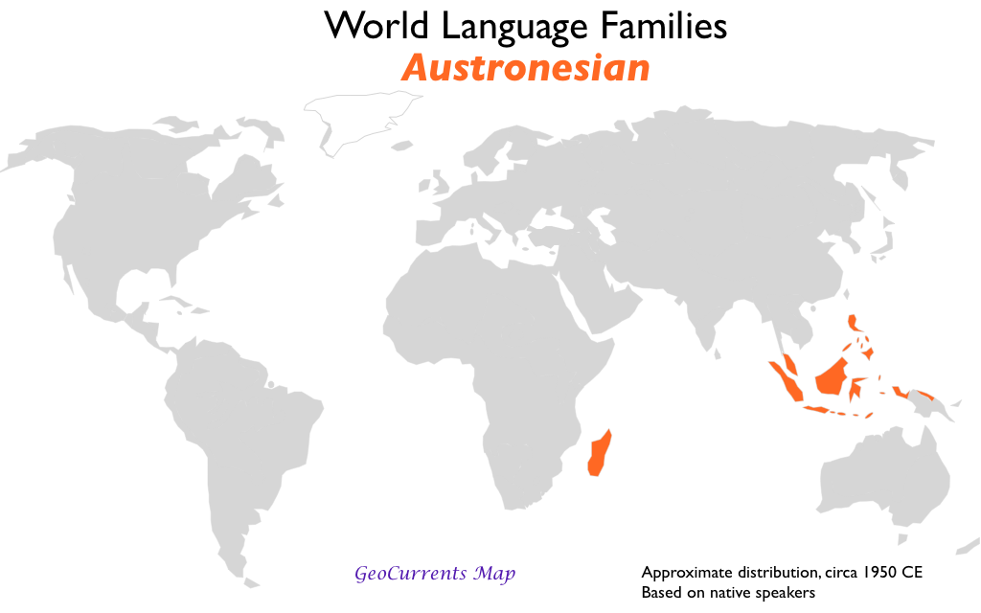
Other Asian Language Families
.
Isolation on islands and peninsulas contributed to overall independent development. –
Austronesian 6% of world. Mostly in Indonesia, the worlds fourth most populous country. With 706 living languages, Predominate language is Javanese

Slide 17
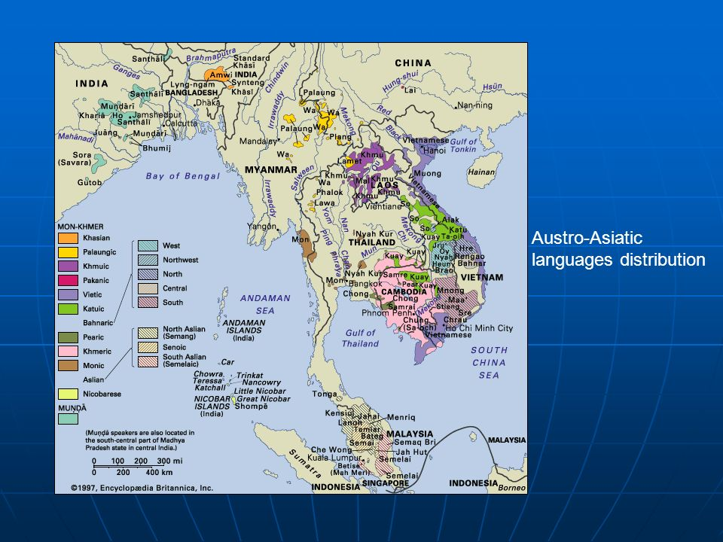
Southeast Asia Language Families
Austro Asiaticis spoken by 2% of population, Vietnamese most spoken. Written with Roman alphabet devised by Roman Catholic missionaries

Slide 18
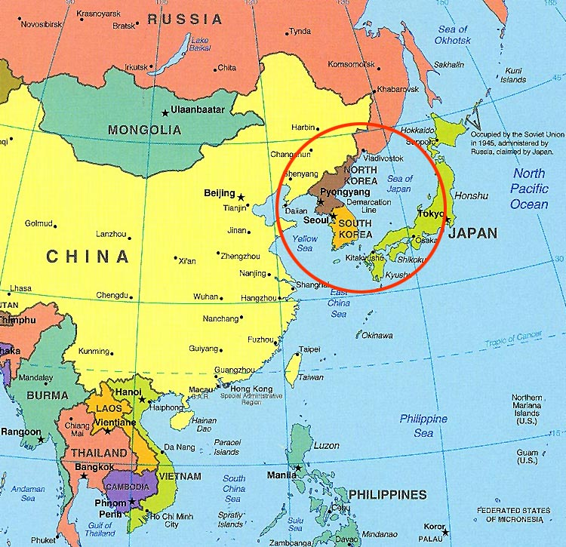
Southeast Asia
Japanese –Written in part with Chinese characters also uses two systems of phonetic symbols phonetic symbols,
Korean: Korean is written in Hankul in which each letter reprecents a sound. More than half of the vocabulary comes from Chinese words

Slide 19
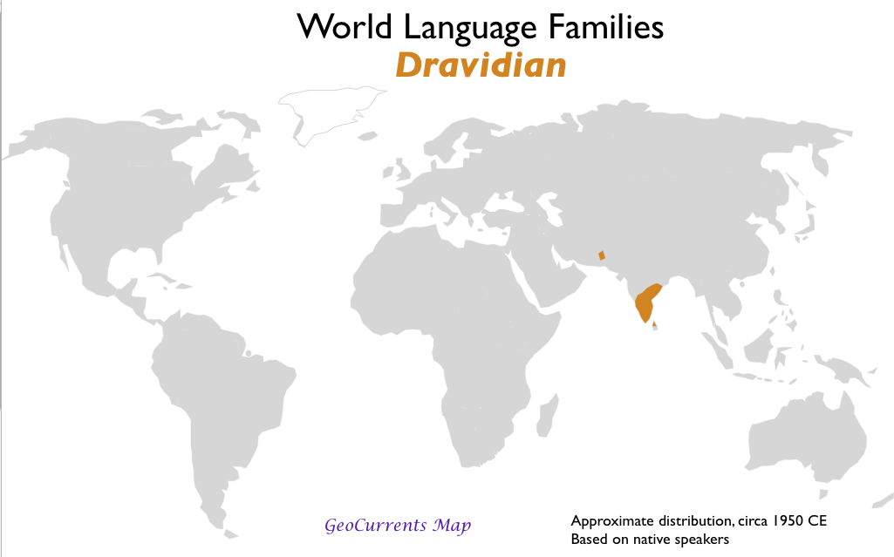
Other Asian Language Families
Dravidian is the principal language family in South Asia. The origin is unknown

Slide 20
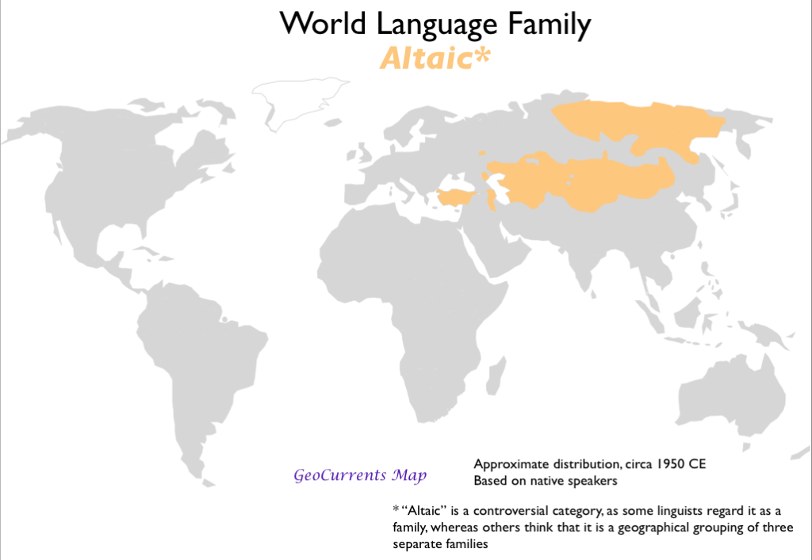
Other Asian Language Families
Altaic it through to have originated in the steppes bordering the Qilian Shan and Altai mountains between Tibet and China
Most spoken by Turkish.
Official language in Azerbaijan. Kazakhstan, Kyrgyzstan, Turkmenistan and Uzbekistan

Slide 21
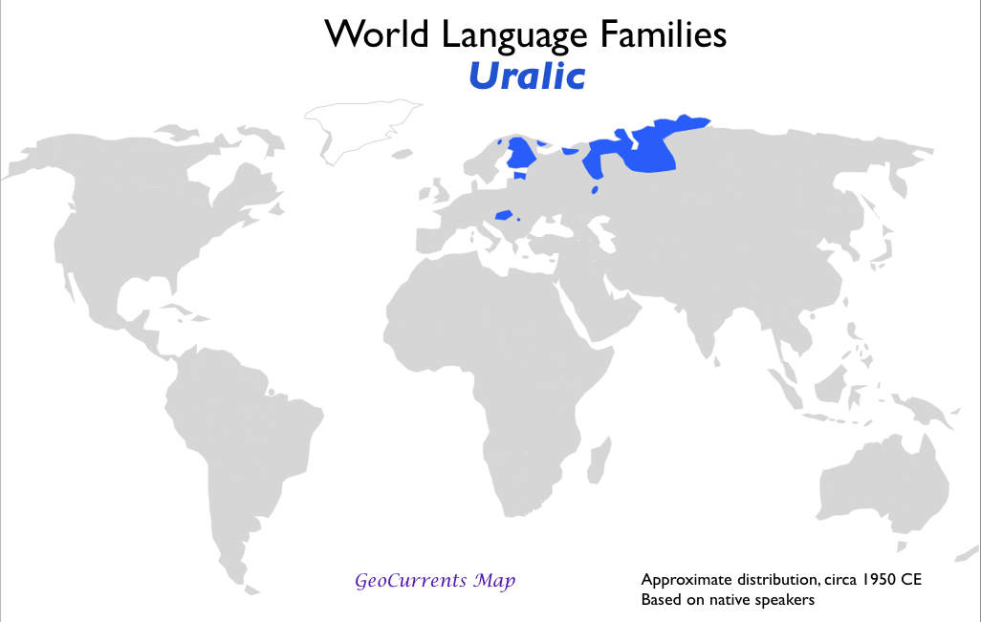
Other Asian Language Families
Uralic languages are traceable back to a common language first used 7,000 years ago by people living in the Ural Mountains in present day Russia, Migrants carry it to Europe. Estonians, Finns and Hungarians speak languages that belong to the family

Slide 22
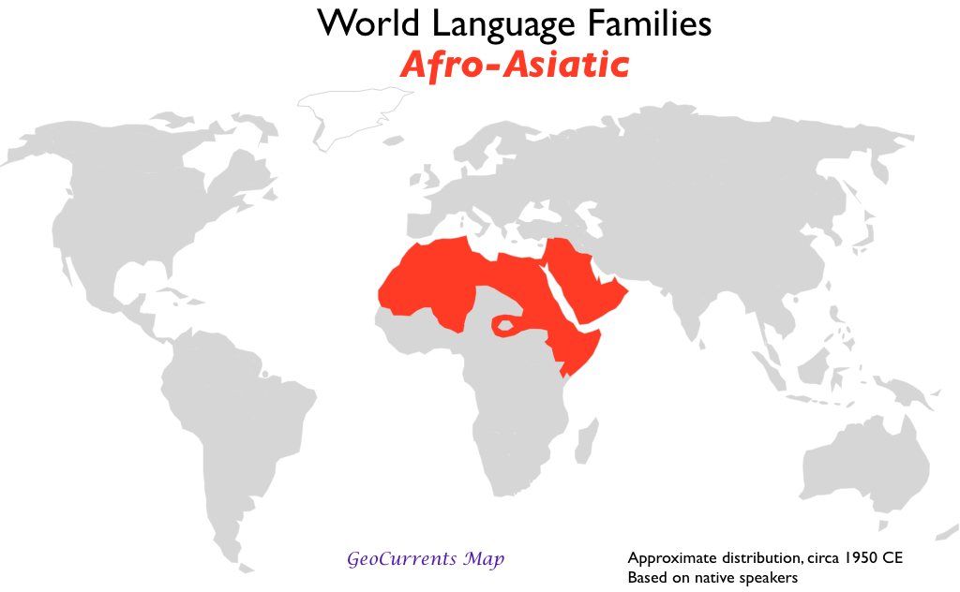
African Language Families
1. Afro-Asiatic – Arabic is major language. » Official language in 24 countries of S.W. Asia and North Africa » 206 million speak the language
One of the six official languages In U.N
Arabic is also spread because it is the language the Quran
It also includes Hebrew

Slide 23
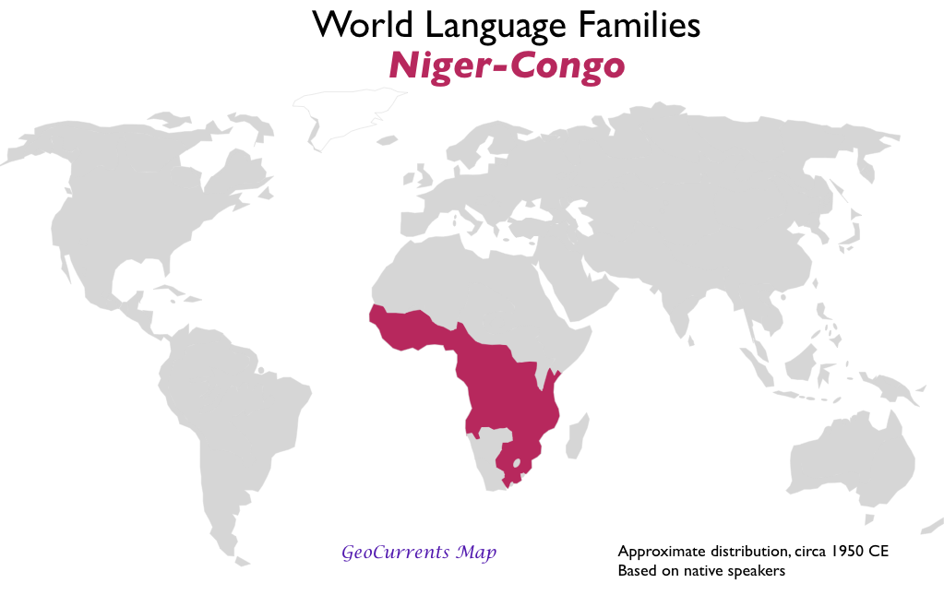
African Language Families
Niger-Congo More than 95% of people in sub Sahara Africa speak languages of this family.
Three most spoken are Yoruba, Igbo and Swahili
Swahili is official language in Tanzania
Swahili is used to communicate with outsiders originating through interaction among African groups and Arab traders so there is a strong Arabi influences.

Slide 24
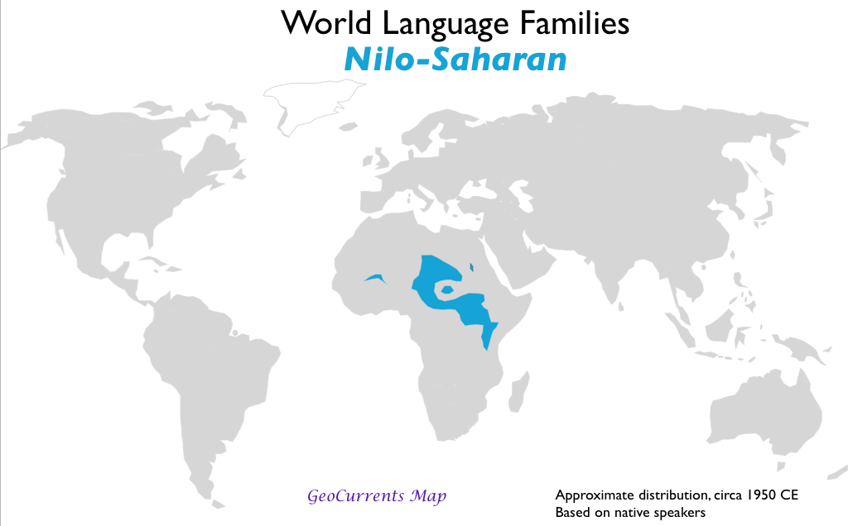
African Language Families
Nilo-Saharan spoken by 43 million in north central Africa.
Divided into six branches

Slide 25
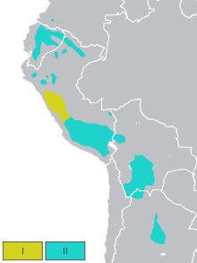
America’s Other Language Family
Quechuan is the most widely used language family in the Western Hemisphere other than Indo European
Speakers live mainly in the Andes Mountains of South America.
Estimated 9 million speakers

Slide 26
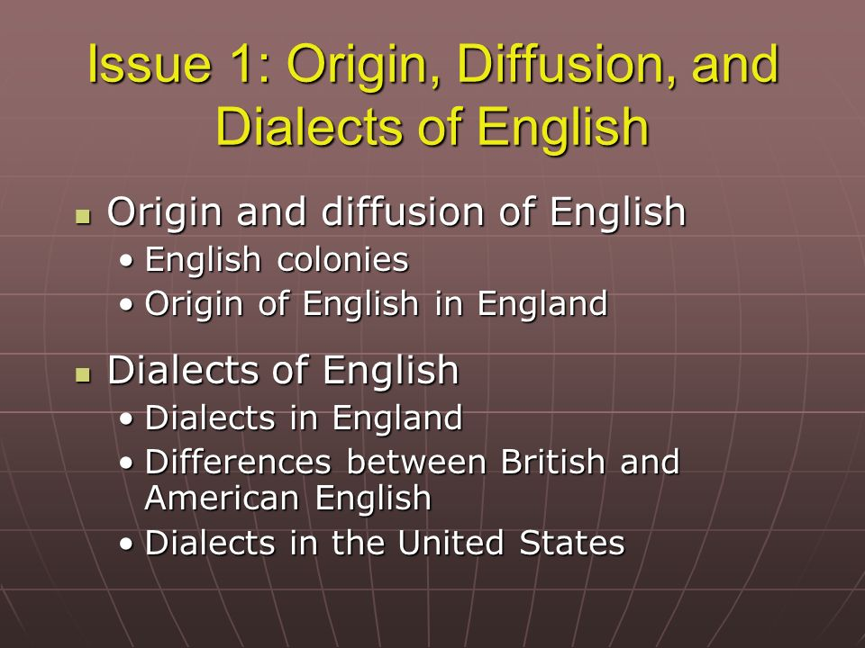

Slide 27
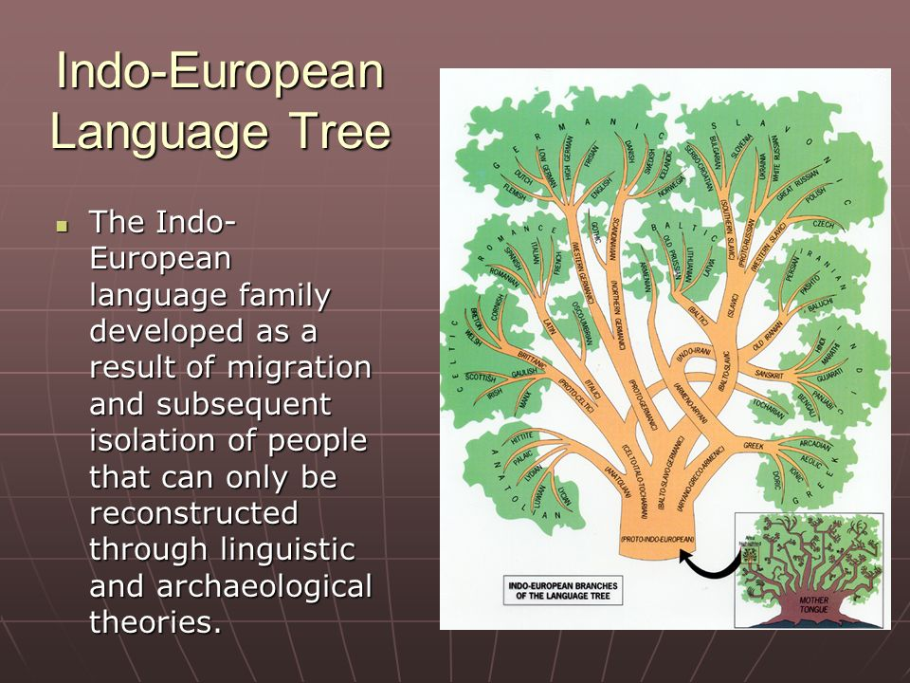

Slide 28
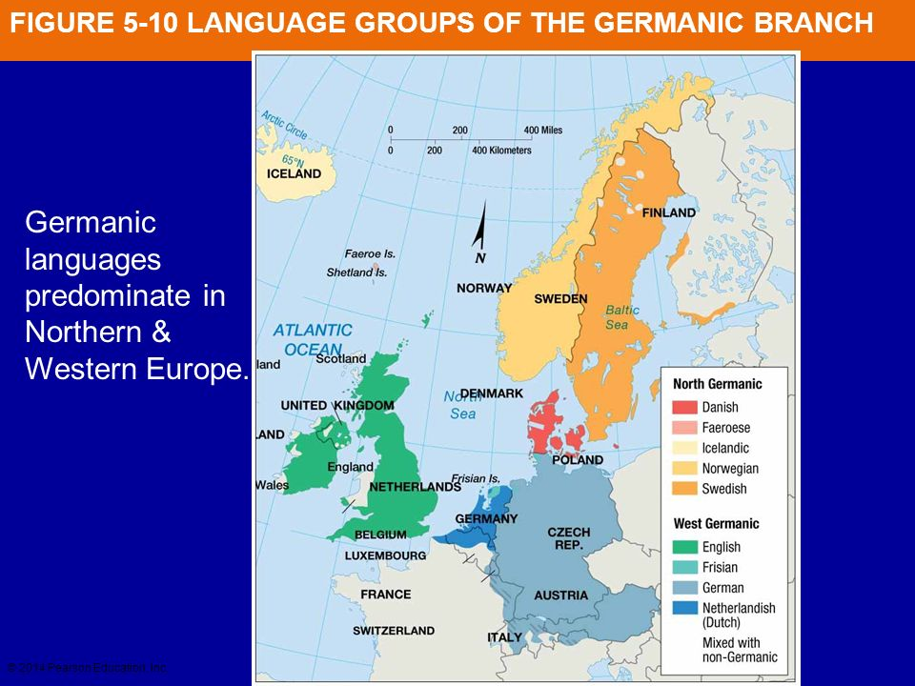
Distribution of Indo European Branches
Germanic: English belongs to the West Germanic branch of the Indo European family. It also includes languages in the Norther Germanic group spoken in Scandinavia, Swedish, Danish, Norwegian and Icelandic, all derive from old Norse

Slide 29
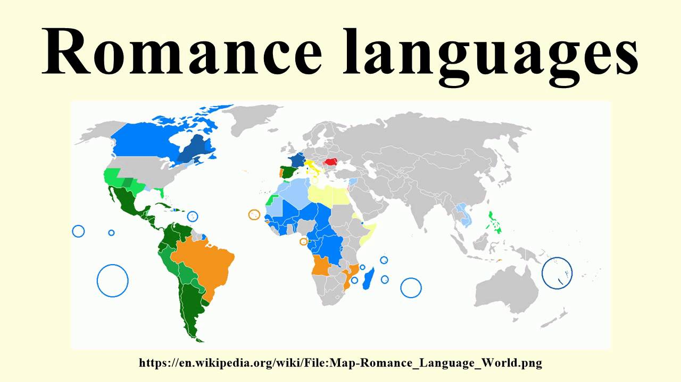
Romance Branch
Romance Languages: four most widely used are Spanish, Portuguese, French and Italian. Mountains serve as boundaries among these countries

Slide 30
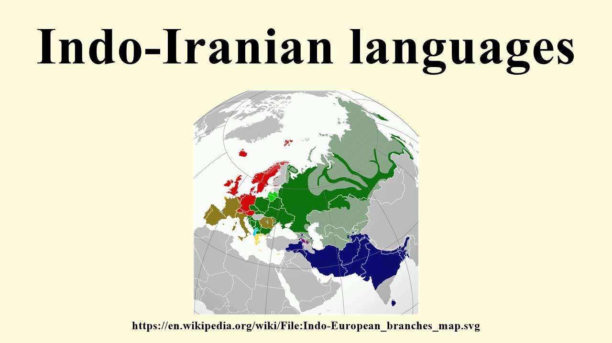
Indo-Iranian Branch
The branch of Indo European language family with the most speakers
It is divided into the Iranian or Western group and the Indic or Eastern group
The major Iranian group includes Persian or Iranian languages in Iran, eastern Afghanistan and western Pakistan and Kurdish
Most widely used languages in South Asia
One very diverse group of the tree is in India. Hindi is the official language of India. India recognizes 22 languages

Slide 31
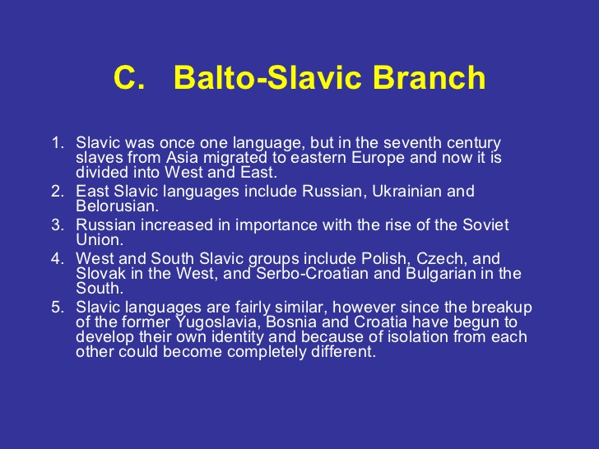
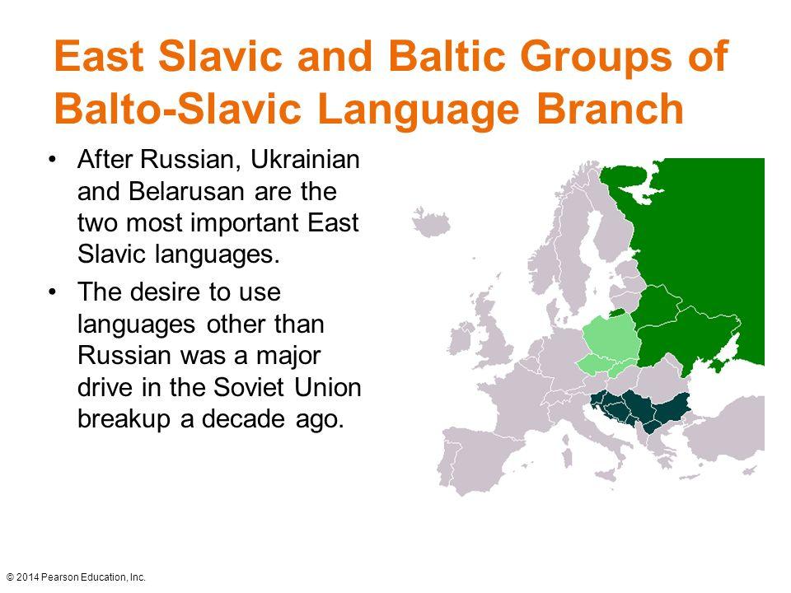
Balto Slavic Branch

Slide 32
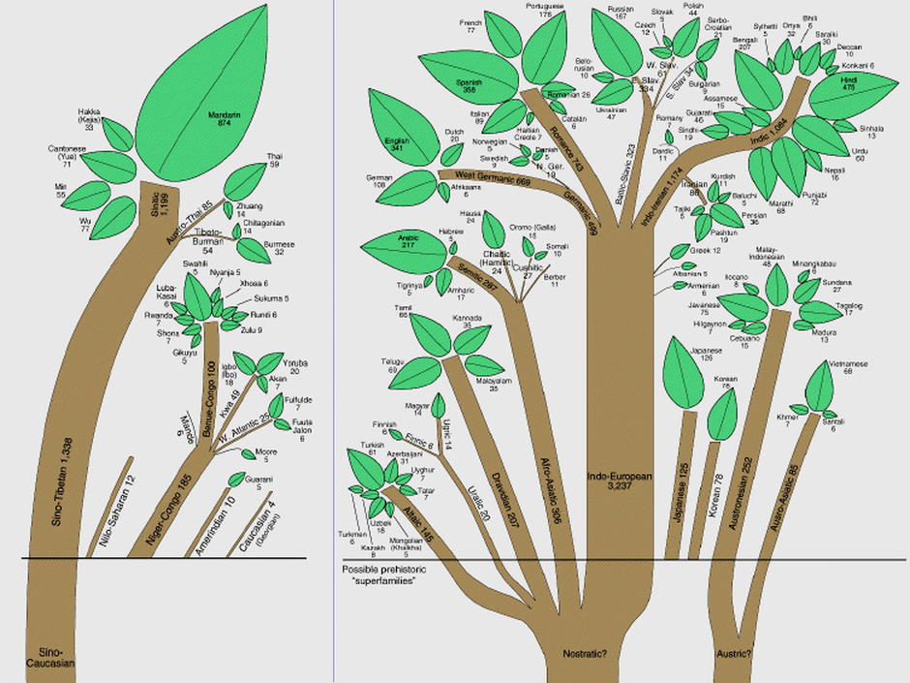
Language Trees

Slide 33
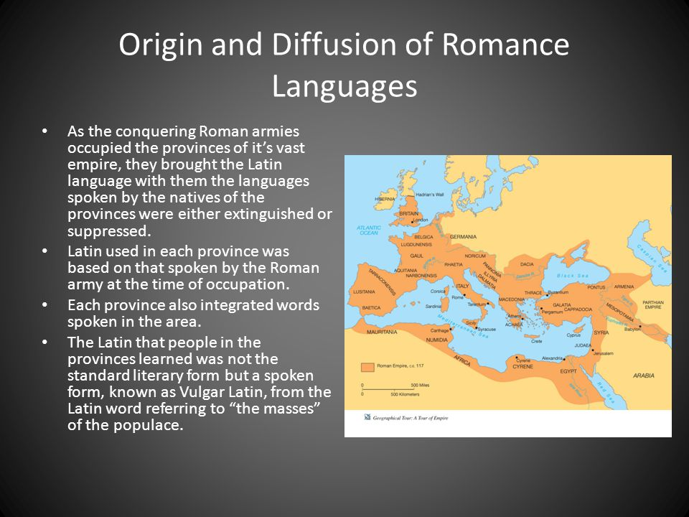
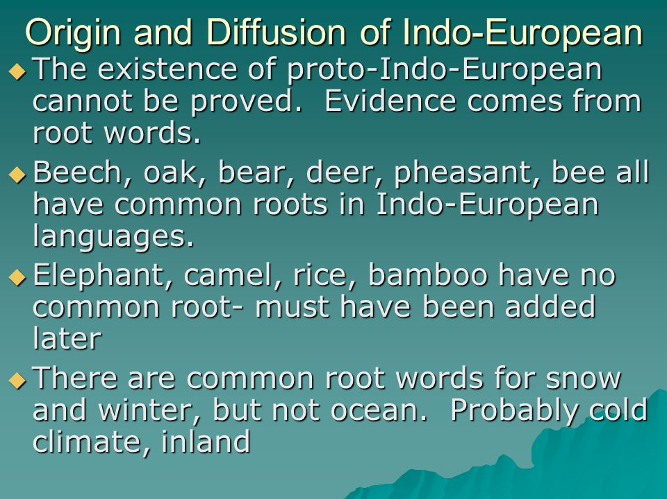

Slide 34
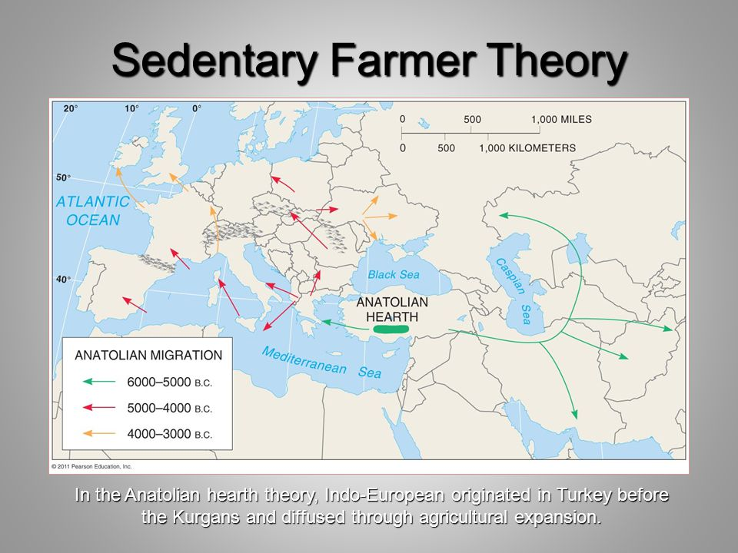

Slide 35
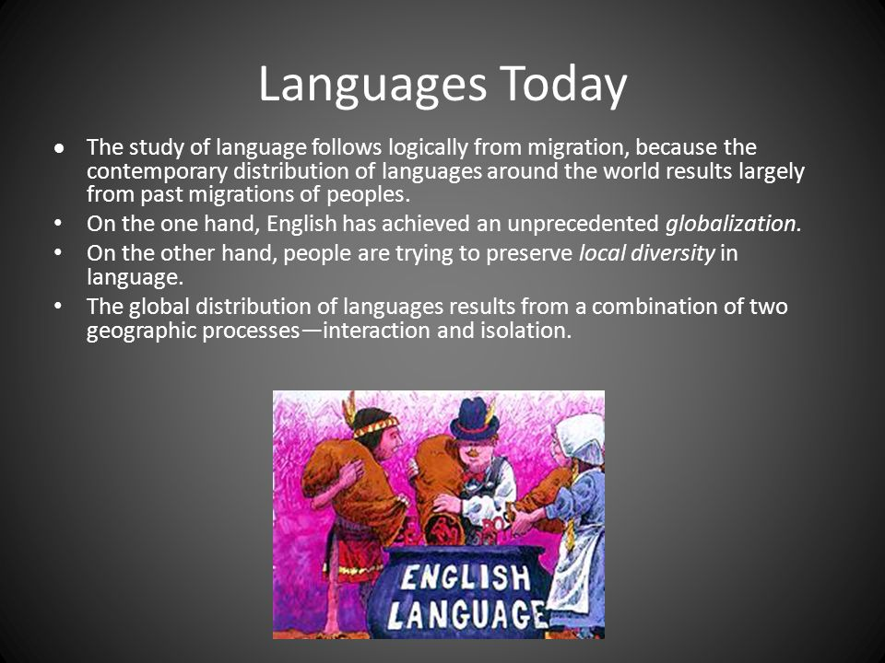

Slide 36
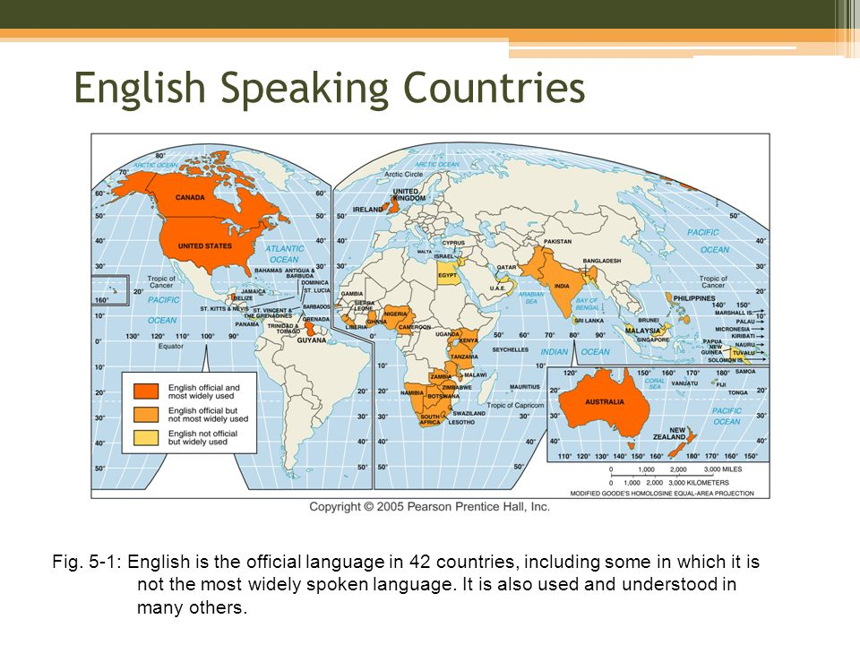

Slide 37
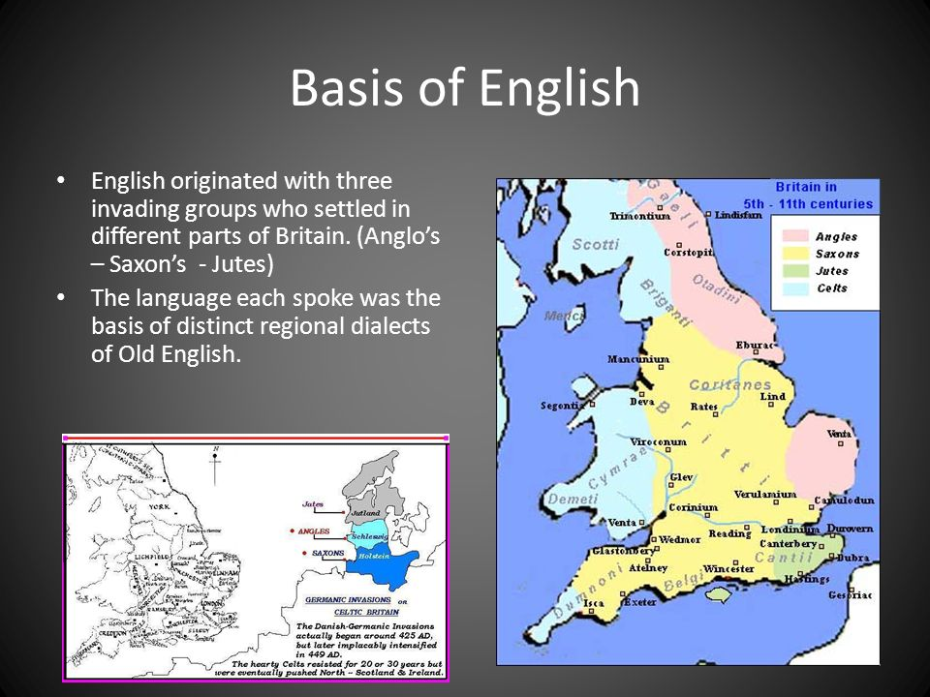

Slide 38
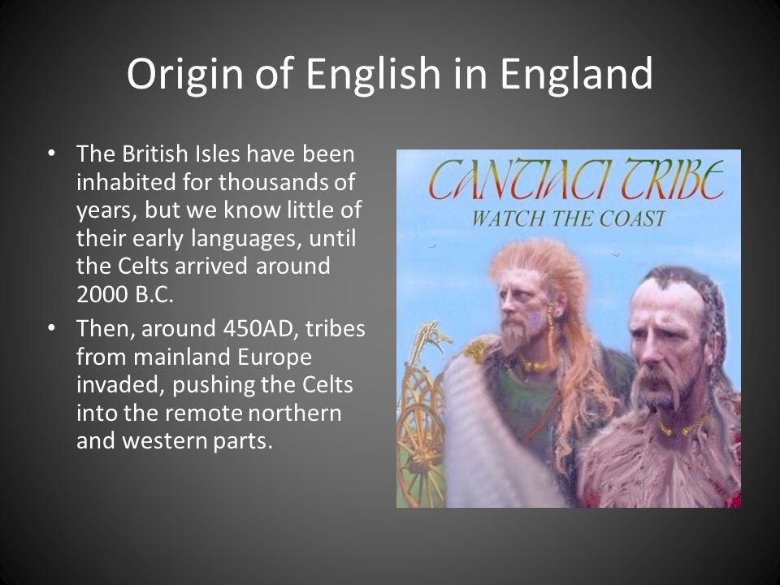
Where did English come from: https://www.youtube.com/watch?v=YEaSxhcns7Y

Slide 39
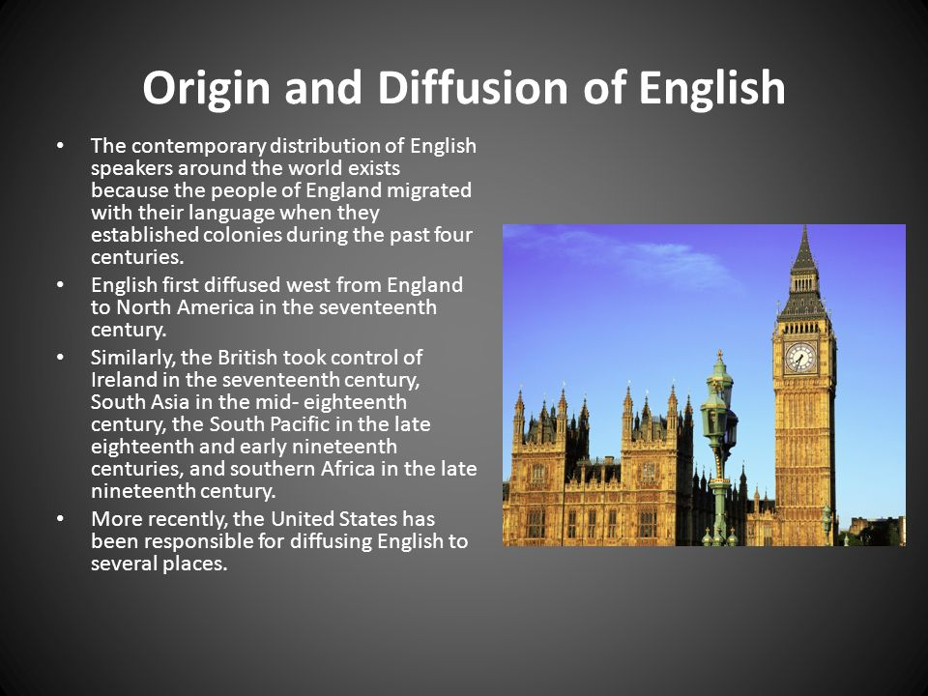

Slide 40
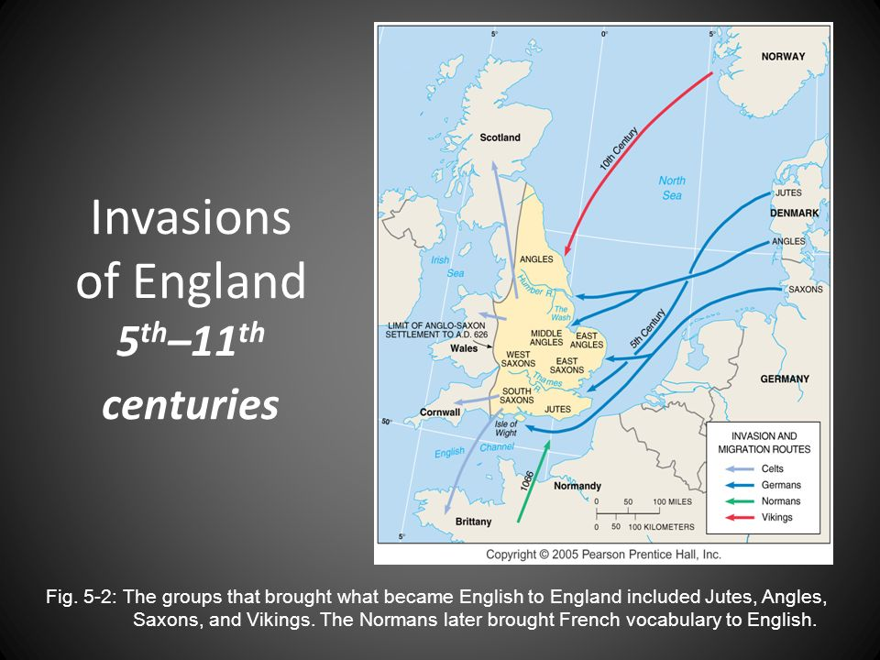

Slide 41
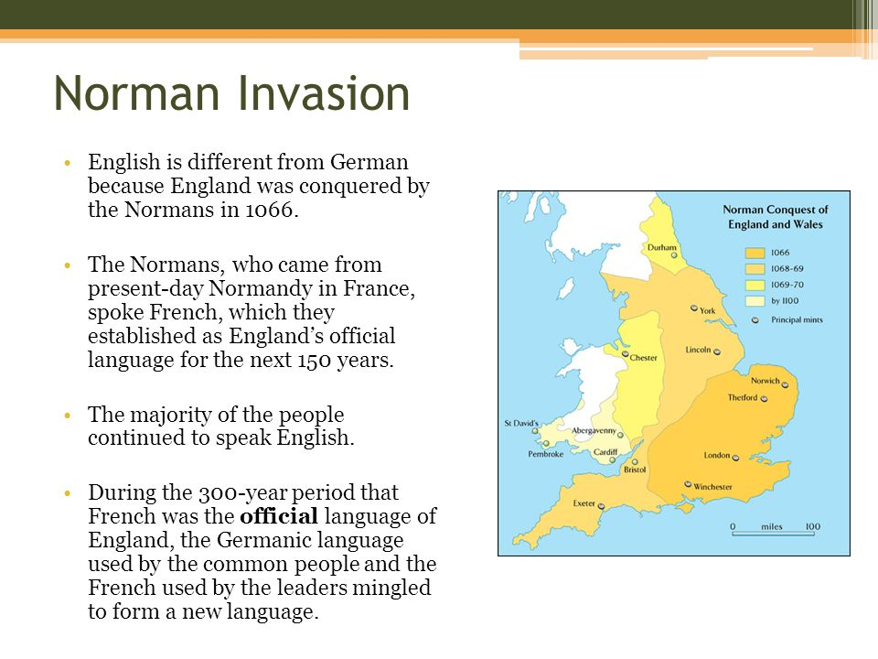

Slide 42
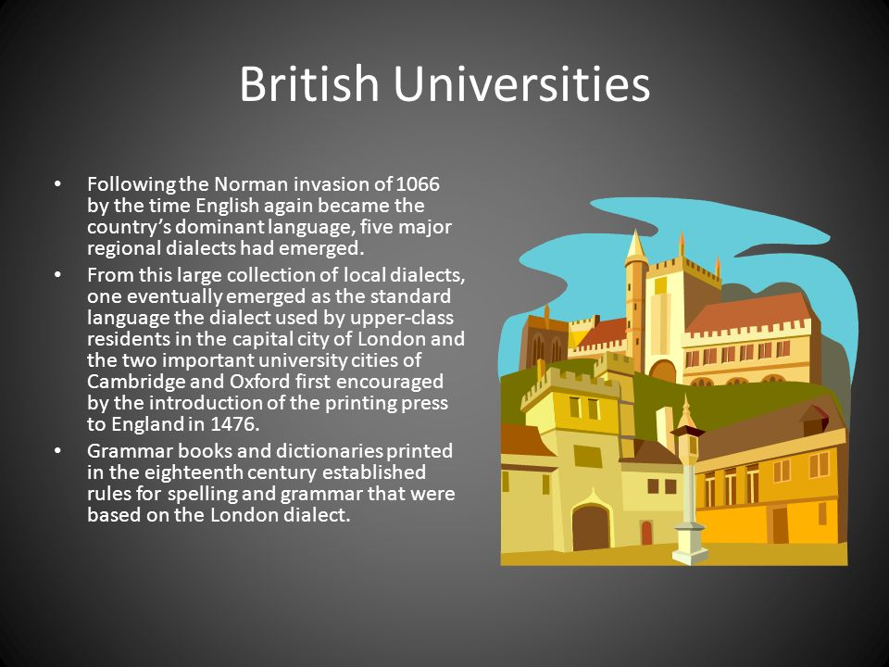
How British and American Spelling Parted Ways https://www.youtube.com/watch?v=vmxHfRCrMCM

Slide 43
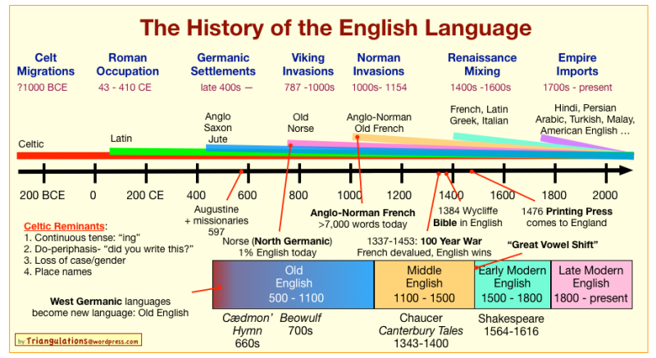

Slide 44
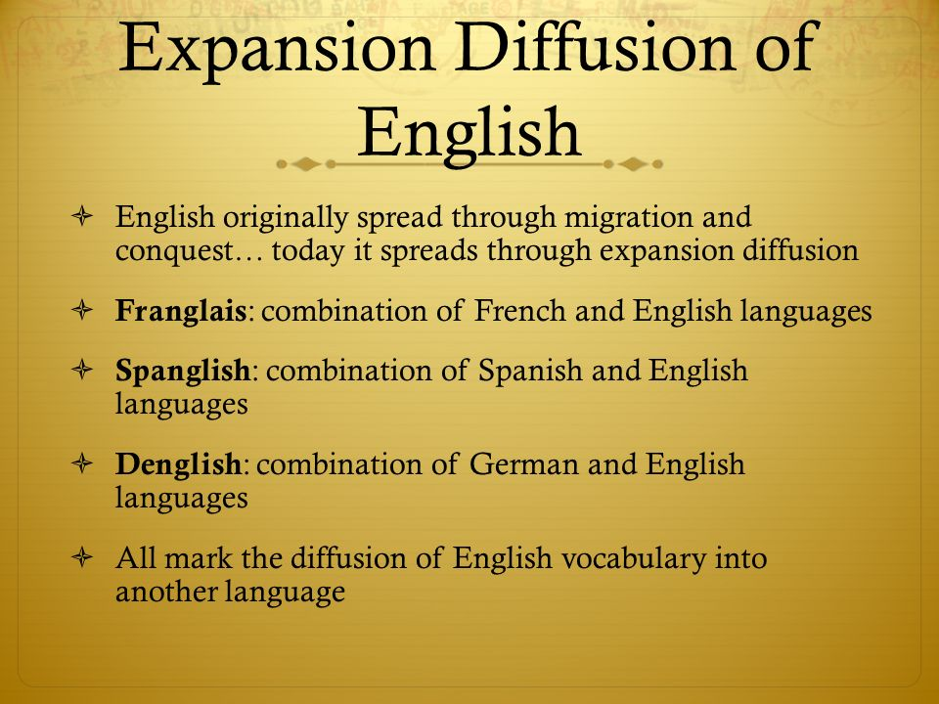

Slide 45
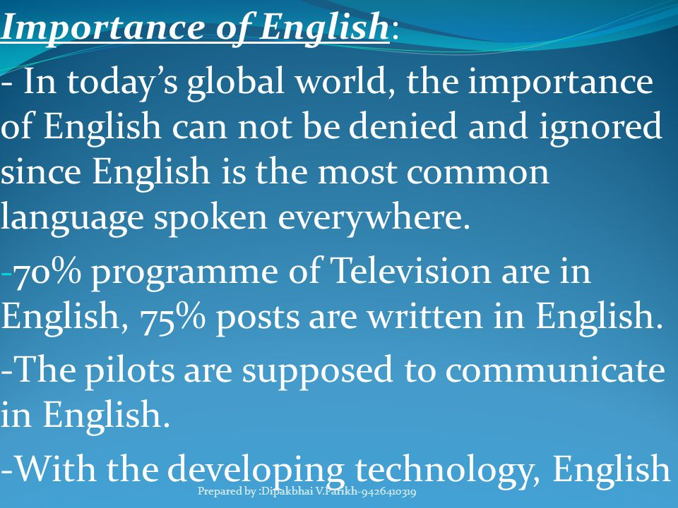

Slide 46
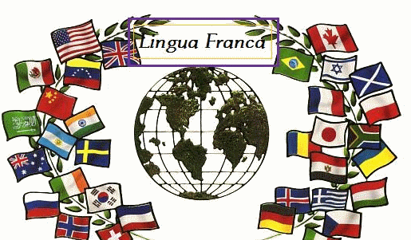
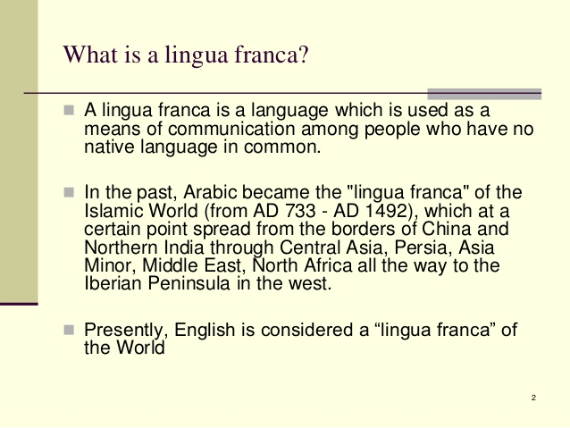

Slide 47
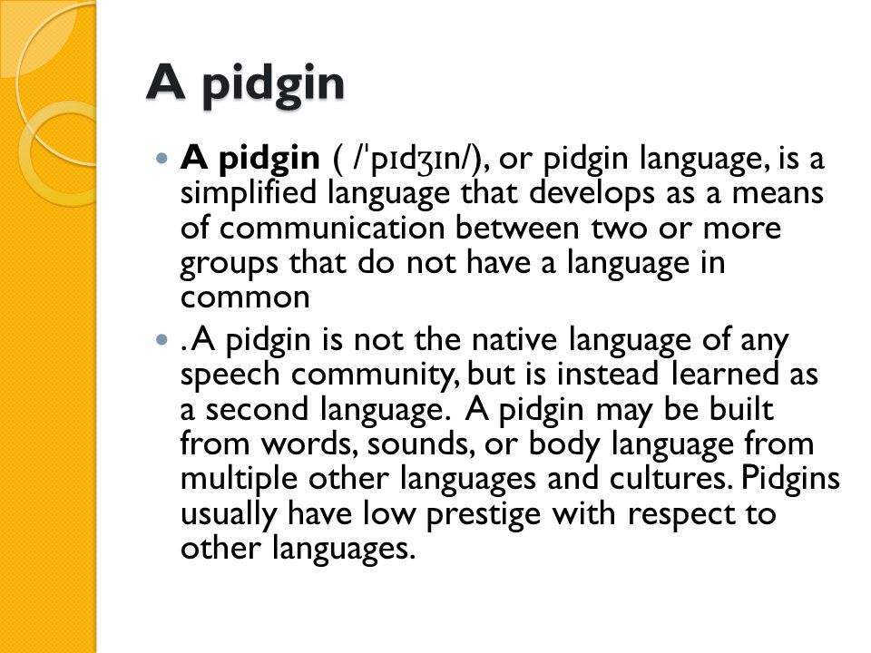

Slide 48
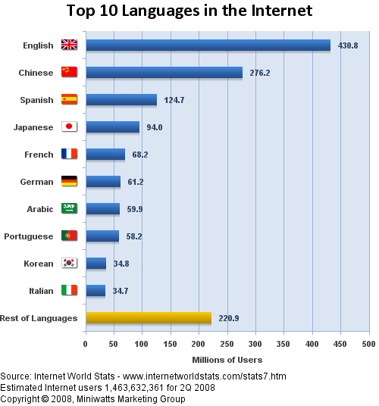

Slide 49
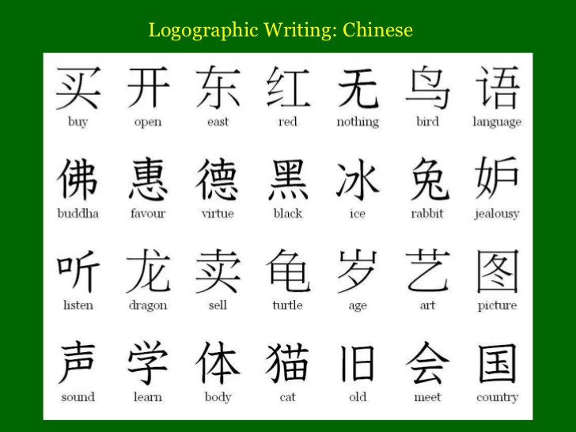
Chinese
Logograms: are symbols that represent towards of meaningful parts of words
Ideogram: a graphic symbol that represents an idea or concept, independent of any particular language, and specific words or phrases.
You would have to know thousands to read a book
Since many symbols represent compound and can write on Twitter with half the number of characters

Slide 50
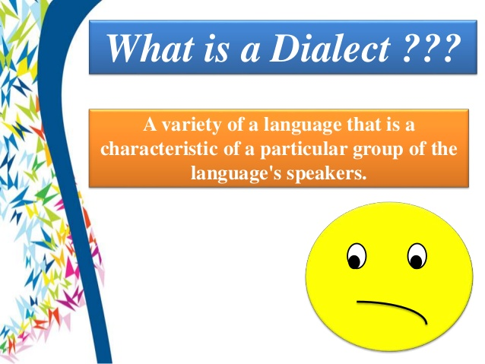

Dialect is a regional variation of a language distinguished by distinctive vocabulary, spelling and pronunciation. Subdialect is a subdivision of a dialect. Two sub-dilects of the same dialect share relatively few differences, primarily in pronunciation and small amounts of vocabulary

Slide 51
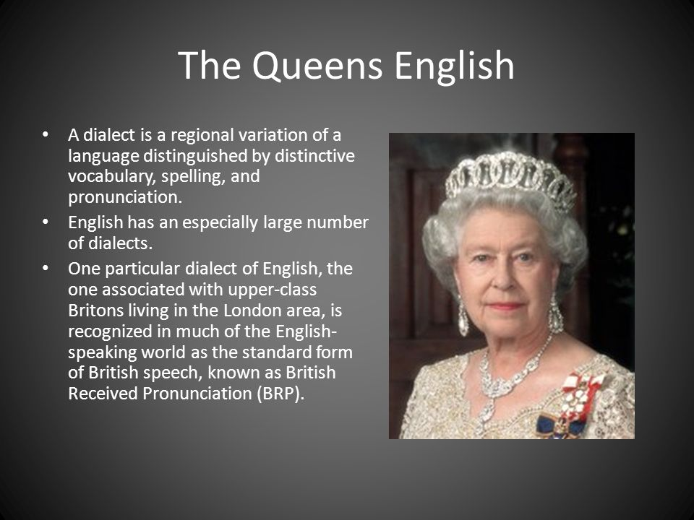
Shakespeare accent: https://pastinthepresent.wordpress.com/2016/03/10/hearing-seventeenth-century-colonists-in-the-witch/
Elllen comparing slang: https://www.youtube.com/watch?v=wYmrg3owTRE
21 accents: https://www.youtube.com/watch?v=3UgpfSp2t6k

Slide 52


Slide 53


Slide 54


Slide 55



Slide 56


Standard Language: in a language with multiple dialects, one dialect may be recognized which is well established and recognized as the most acceptable for government, business, education and mass communication
In England this is known as Received Pronunciation RP: it is well known around the world as the dialect commonly used by politicians, broadcasters and actors

Slide 57

Distribution of Dialects in US
In the US there are four major dialects North Midland, South and West and cam be traced to differences in the origin of the English colonists along the east Coast. Three distinct dialect regions developed
North: 2/3 of the New England colonist were Puritans from southeastern England and had the characteristic of dropping the r sound
South: ½ came from southeastern England with a diverse social class background including deported prisoners, indentured servants and political and religious refugees
Midland: more diverse, predominantly Quakers from north of England, Scots, Irish and Germans, Dutch and Swedish

Slide 58


Slide 59


Dialects in US: quiz: http://www.nytimes.com/interactive/2013/12/20/sunday-review/dialect-quiz-map.html?mcubz=3

Slide 60



Slide 61

Hot Spots were languages are dying out
What is an Extinct Language?
Before a language becomes extinct, it is classified as an endangered language. A language becomes endangered when the native speaker of a minority group chooses to adapt the language of a larger group, such as English, Spanish or French. When they adapt the language of a larger group, they often neglect to teach their native language to children and younger generations in their culture. A language becomes extinct when the last speaker of a native language dies, in turn taking the unique language with them. Many languages in the world only have one living speaker; meaning when they die a language dies with them.
Where are languages becoming extinct?
Language loss is happening throughout the world. According to an article by discovery.com, there are 88 languages in Canada alone that are endangered, or have already become extinct. There are many endangered languages across South America, Europe, as well as Asia. points out hotspots across the world where certain languages are most endangered.

Slide 62
Dying Languages
Gta' (India)
Words have meanings not seen in English words.
Goteh: bring something from an inaccessible place with the help of a long stick
buhno‘: a ladder made from a single bamboo tree
Nosore: to free someone from a tiger
Poh: to kill lice by pressing them under your nails
ruhri‘: to eat flesh from the bone
Ket (Siberia)
Stand can be said in four different ways, depending on what is standing.
keh't dúghìn: a human or animal: person stands
u'y úyba'ut: an object: cradle stands
ohks dúghàta: a tree: tree stands
qu's hávìta: a structure: tent stands
Why does this matter?
Many languages have been developed through oral cultures alone and have not been transcribed into written documents. When we lose a language, it has many cultural and social impacts on society. We lose the ability to understand a cultures way of life and their knowledge and understanding of agriculture, math and religion along with their understanding of the region they once lived. Many words they use describe a situation, and cannot be directly translated into one English word When a language becomes extinct, our entire understanding of a culture does too.
What is being done to prevent language extinction?
Organizations, such as the United Nations Educational, Scientific and Cultural Organization (UNESCO) and Living Tongues Institute for Endangered Languages are attempting to raise awareness of endangered languages as well as document and maintain languages in small communities across the world. By making audio and video recordings as well as detailed linguistic notes, linguists hope to prevent language loss, regardless of whether the language is actively spoken or not.

Slide 63


Maori Language in New Zealand
The haka is a type of ancient Māori war dance traditionally used on the battlefield, as well as when groups came together in peace. Haka are a fierce display of a tribe's pride, strength and unity. Actions include violent foot-stamping, tongue protrusions and rhythmic body slapping to accompany a loud chant. native dance: https://www.youtube.com/watch?v=BI851yJUQQw Rugby players: https://www.youtube.com/watch?v=5chRqRr8iQs

Slide 64
dialect - regional variation of a language
➤ ebonics - A dialect of English that has its roots in West African, Caribbean, and US slave languages,
➤ official language - in multi-lingual states, the language selected for use in affairs within government, and communication between government and citizenry
➤ isogloss - boundary separating language regions preventing diffusion
➤ lingua franca - language mutually understood and commonly used in trade by people who speak other languages
➤ pidgin - form of speech adopting simplified grammar and limited vocab of a lingua franca; used for communication between speakers of different languages
Ideogram: a graphic symbol that represents an idea or concept, independent of any particular language, and specific words or phrases
Literary Language means it is written as well as spoken. The system of written communication includes a method of writing and rules of grammar

Slide 65
Videos
Power of language Ted talk 17 min https://www.ted.com/talks/mark_pagel_how_language_transformed_humanity?utm_source=tedcomshare&utm_medium=email&utm_campaign=tedspread--b
Dialect quiz http://www.nytimes.com/interactive/2013/12/20/sunday-review/dialect-quiz-map.html?mcubz=3
How English differed in England and America: https://www.youtube.com/watch?v=vmxHfRCrMCM
Ted Talk Endangered languages and cultures: 21: https://www.youtube.com/watch?v=vmxHfRCrMCM
The surprising pattern behind color names around the world 7 https://www.youtube.com/watch?v=gMqZR3pqMjg
Where did English come from? - Claire Bowern 5 min: https://www.youtube.com/watch?v=YEaSxhcns7Y
How languages evolve - Alex Gendler 4 min: https://www.youtube.com/watch?v=iWDKsHm6gTA
My Fair Lady "Why Can't The English Learn To Speak?" Music Video 2 min: https://www.youtube.com/watch?v=t8zhp699FXg
6 language trees read: http://eurotalk.com/blog/tag/language-family/
Meet the Last Speaker of a Dying Language 10 min: http://video.nationalgeographic.com/video/short-film-showcase/meet-the-last-speaker-of-a-dying-language
Hugh Laurie: the British slang vs the American 4 min https://www.youtube.com/watch?v=wYmrg3owTRE
21 accents: https://www.youtube.com/watch?v=3UgpfSp2t6k

