Slide 1
World War I
World History

Slide 2
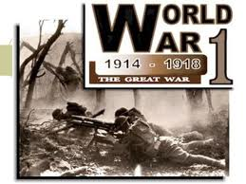
World War I

Slide 3
World War I
By 1914, Europe had enjoyed a century of relative peace
World War I was an extremely bloody war that engulfed Europe from 1914 to 1919, with huge losses of life and little ground lost or won. Fought mostly by soldiers in trenches, World War I saw an estimated 10 million military deaths and 20 million wounded. Many hoped that WW I would be "the war to end all wars," actuality, the peace treaty set the stage for World War II.
Causes of WWI 1:50: https://www.youtube.com/watch?v=24i4ncHuf6A

Slide 4
Events Leading up to the War
In the beginning of the 20th century, Europe was ruled mainly by a family of monarchs who felt many of the loyalties and enmities that figure in all extended families
Bismarck created the German Empire, which upset the delicate balance of power in Europe and resulted in a series of entangling alliances that transformed the continent into tow armed and opposing camps
Nationalism: National pride was a strong factor in motivating the European nations, including German and France, to act aggressively in order to prove their country’s superiority;
Five important wars served as military and political preludes to World War I: the Seven Weeks Wars, War between Prussia and Austria, the Franco-Prussian War, the Russo-Japanese War, and the two Balkan Wars

Slide 5
France and Germany
Nationalistic feelings were strong in these two countries
Germans were proud of their military power and industrial leadership
France longed to gain its position as Europe’s leading power
Frances was bitter about their 1871 defeat in the Franco-Prussian War and the German occupation of the border provinces of Alsace and Lorraine
Patriotic French citizens yearned for revenge against Germany and the recovery of its lost province

Slide 6
Eastern Europe
Russia sponsored a powerful form of nationalism called Pan Slavism
Slavs are the people who live in Eastern and Central Europe, the Balkans, Central Asia and North Asia . They include: Russians, Poles, Czechs, Serbs, Ukrainians, Belarusians, Bulgarians, Slovaks, Slovenes, and Croats
It held that all Slavic people shared a common nationality
Russia was a large Slavic country and felt that it should lead and defend all Slavs
By 1914 Russia decided to support Serbia, a proud young nation
Austria/ Hungary worried that nationalism might foster rebellion among many minority populations within its empire
Ottoman Empire felt threatened by new nations on its borders such as Serbia and Greece
In 1912, several Balkan states attacked Turkey
New Baltic states fought among themselves over the spoils of war
By 1914 the Balkans were the Powered Keg of Europe

Slide 7
Rivalries Among European Powers/Imperialism
Economic rivalries poisoned the international atmosphere
Britain felt threatened by Germany’s rapid economic growth
The Germans thought they didn’t get enough respect from the other great nations
Competition for colonies brought France and Germany to the brink of war
Germany wanted to prevent France from imposing a protectorate on Morocco, but Germany did gain territory in central Africa

Slide 8
Militarism and the Arms Race
The 1800’s saw a rise in militarism the glorification of the military
It grew out of Social Darwinism with the idea of the survival of the fittest
The great powers began to expand their armies and navies
The result was an arms race that increased suspicions and made war more likely
The fiercest competition was the naval rivalry between German and Great Britain who had the world’s most respected navy
Germany began to increase its naval power as it acquired overseas colonies
In return Great Britain increased naval spending
On matters of peace and war governments turned to military leaders for advice

Slide 9
A Tangled of Alliances
Distrust led great powers to sign treaties pledging to defend one another. Gradually two alliances emerged
Bismarck knew that France longed to avenge its defeat in the Franco-Prussian War. He was sure that France wouldn’t attack Germany without help
In 1882 he formed the Triple Alliance with Italy and Austria Hungry. In 1914, when war did break erupt, Germany and Austria Hungary fought on the same side. They became known as the Central Powers
In 1894 a rival block took shape when France and Great Britain formed an alliance
In 1904 France and Great Britain signed an entente, a non binding agreement to follow common policies. Great Britain later signed a similar agreement with Russia.
When war began these powers became known as the Allies
Germany also signed a treaty with the Ottoman Empire while Britain grew close to Japan
The growth of rival alliance systems increased international tensions. The time seemed ripe for war

Slide 10
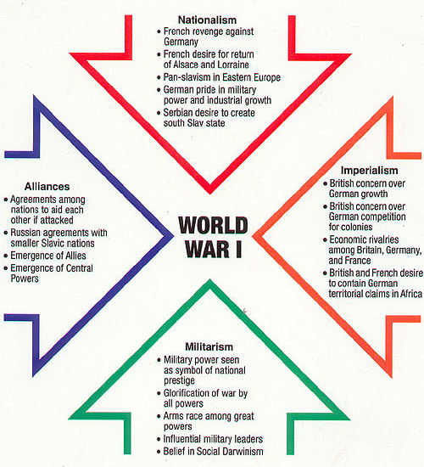
Long Term Causes of World War I

Slide 11
Assassination in Sarajevo/ Serbian Outrage
The crisis began when Archduke Francis Ferdinand of Austria/Hungary, decided he would visit Sarajevo, the capital of Bosnia
Bosnia was under the rule of Austria Hungary
Bosnia was the home of many Serbs and Slavs
Serbian nationalists viewed the Austrians as foreign oppressors. The archdukes’ visit on June 28th was a special date in Serbian history because in 1389 Serbia had been conquered by the Ottoman Empire. One the same date in 1912 Serbia had freed itself from Turkish Rule rule
The Serbian terrorist group commonly known as the Black Hand vowed to take action

Slide 12
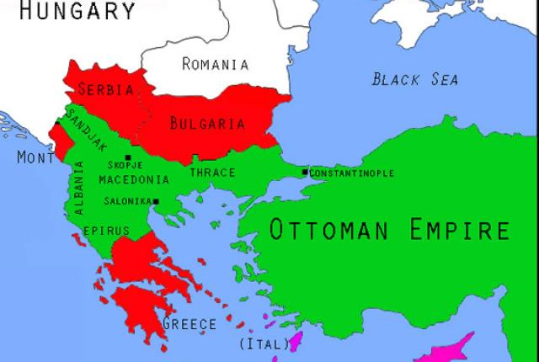
Balkan Region

Slide 13
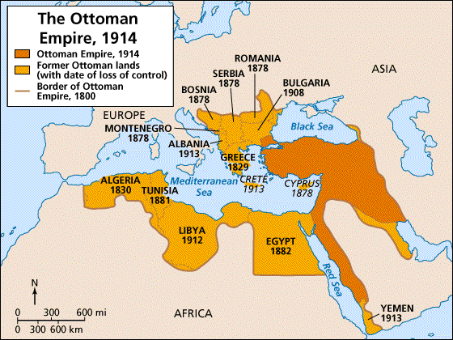
Ottoman Empire 1914

Slide 14
The Fatal Shots/ Conflict Widens
The archduke ignored warnings of anti Austrian unrest in Sarajevo. On June 18, 1914 he and his wife Sophia rode through Sarajevo in an open car. Black Hand conspirators hurled a bomb but did not injure him but an officer in another car.
Later in the ride Gavrilo Princip fired twice into the car killing the archduke and his wife
The news shocked the archduke uncle Francis Joseph of Austria but he did not want to go to war, his government, however wanted to use the incident as an excuse to crush Serbia at last

Slide 15
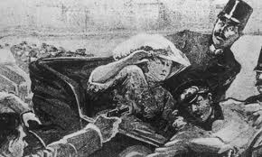
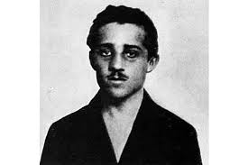
The spark that started World War I

Slide 16
A Harsh Ultimatum
Austria sent Serbia an ultimatum or final set of demands saying Serbia must end all anti Austrian agitation and punish any Serbian involved in the murder plot. AND to let Austria join in the investigation
Because Serbia would NOT agree to all of the terms Austria declared war on Serbia July 28th

Slide 17
Steps to War
Austria-Hungary had the backing of its longtime ally Germany making it easier to declare war on Serbia. In Berlin Germany, Kaiser William II gave Austria his full support against Serbia
Serbia sought help from Russia then Russia began to mobilize or prepare its military forces for war
Russia appealed to its ally, France and Nationalists in Paris saw this as a chance to avenge Frances’ defeat in the Franco Prussian War Frances supported Russian just as Germany supported Austria
Germany then declared war on France. By early August the battle lines were hardening

Slide 18
The Schlieffen Plan
Italy and Great Britain remain uncommitted. Italy remains neutral while Britain was trying to decide whether to supports its ally France or not.
Germany’s war plan made the decision for them
General Alfred von Schlieffen had developed a plan to attack France without entering in to a two front war against France in the west and Russia in the east.
Under the plan Germany had to defeat France quickly and then fight Russia, and depended on Russia being slow to mobilize.
To ensure victory in France the plan required German armies to march through Belgium then go south behind French lines
On Aug.3, Germany invaded Belgium
Britain then declared war on Germany because of Britain’s treaty to keep Belgium neutral

Slide 19
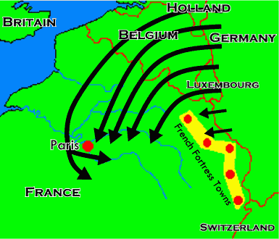
Schlieffen Plan

Slide 20
The Historians View
The Allies were victorious and place all the blame on Germany because it was the first country to invade another country.
Austria Hungry wanted to punish Serbia for encouraging terrorism
Germany wanted to support its one time dependable ally Austria Hungary
Russia thought the Slavic people were going to be oppressed
Frances was afraid it would have to face Germany alone if it did support Russia
Britain wanted to honor its pledge to keep Belgium neutral and feared the powerful German force on the other side of the English Channel
Young men rushed to enlist making war seemed like an exciting adventure

Slide 21
Reasons for Entering the War / July – August 1914
Country | Allied With | Reasons for Entering War
Austria-Hungary | Germany | Wanted to punish Serbia for encouraging terrorism
Germany | Austria/Hungary | Stood by its one dependable ally, Austria-Hungary
Serbia | Russia | Attacked by Austria-Hungary after assassination of Archduke
Russia | Serbia, France, Britain | Wanted to defend Slavic peoples in Serbia,
France | Russia and Britain | Wanted to avoid facing Germany alone at a later date
Belgium | Neutral | Invaded by Germany
Britain | France and Russia | Outraged by invasion of Belgium

Slide 22
Who’s Who
Central Powers
Allies
Germany
Austria-Hungary
Ottoman Empire
(Italy)
France
Britain
Russia
United States
Italy

Slide 23
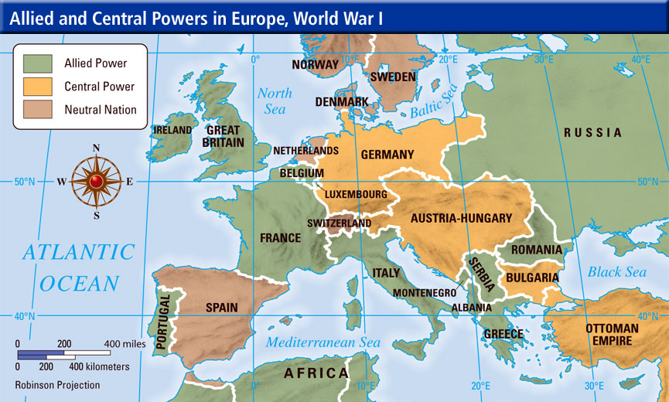
Allies and Central Powers

Slide 24
The Western Front
German forces swept through Belgium
Russia mobilized more quickly than expected and because of early victories caused Germany shift some of its troops to the east weakening German forces in the west
In Sept. of 1914 British troops joined the French troops along the Marne River. This battle destroyed Germany’s hopes for a quick victory on the Western Front
The conflict turned into a long stalemate or deadlock in which neither side is able to defeat the other. Battle lines in France remained unchanged for 4 years
World War I was know as the Great War and was the largest conflict in history up to that time
The early enthusiasm for the war soon faded because this became a far deadlier war than any ever fought before

Slide 25
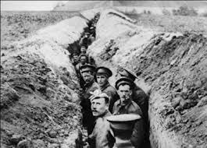
Trench Warfare
The warring armies burrowed into a system of trenches from the Swiss frontier to the English Channel.
The soldiers sweated under the hot sun or froze in the long winters
The land between the opposing trench lines was known as No Man’s Land. This was land that would have to be crossed when the order was given to “go over the top” and charge toward the enemy
The Century Series Shell shock Part1 14 min Beginning, Lusitania: https://www.youtube.com/watch?v=hxZMwv5vqAc&index=4&list=PLC8D9DC28C3EC5223
Part 2 14 min trench warfare: https://www.youtube.com/watch?v=MxV9aXA9EJM&list=PLC8D9DC28C3EC5223&index=5

Slide 26
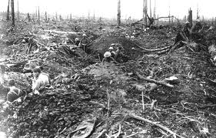
Costly Battles
In 1916 both the Allies and the Central Powers launched offensives to break the stalemate. German forces tried to overwhelm the French at Verdun.
The Battle of Verdun lasted 11 months and had more than a half a million casualties on both sides
The Allied offensive at the Somme River was more costly with more that 60,000 killed or wounded in one day and over 1 million killed over a 5 month period with neither side gaining an advantage
Christmas Time Truce: http://laughingsquid.com/touching-commercial-for-uk-supermarket-sainsburys-dramatizes-the-world-war-i-christmas-truce-of-1914/

Slide 27
Technology of Modern Warfare
Rapid fire machine guns made it nearly impossible to advance across no man’s land
Artillery allowed troops to fight more than 10 mile away
Germany used poison gas that blinded or choked or caused burns or blisters on victims. 2:11 https://www.youtube.com/watch?v=vmir6SxYNII&index=7&list=PLu2xst_eS6dqRn39-oEQFK-b_GqyS89KS
Britain introduced the armored tank
Aircraft were used with pilots known as aces who fought in “dog fights
Germany also used zeppelins or large gas filled balloons to bomb the English coast
Submarines called U boats were used effectively by Germany against the Allies by sinking merchant ships and carried vital supplies to Britain
Germany’s use of submarine warfare would help bring the United States into the war
Red Barron: https://www.youtube.com/watch?v=IEN3A3LmqC0&list=PLu2xst_eS6dqRn39-oEQFK-b_GqyS89KS&index=23

Slide 28
Eastern and Southern Europe
The war became a global conflict
In August 1914 Russian armies pushed into eastern Germany but at the Battle of Tannenburg, armies fought on Russian soil. Russia was poorly equipped to fight a modern war
Italy had signed a secret treaty with the Allies to gain Austrian ruled lands inhabited by Italians
In October 1917 the Austrians and Germans launched a major offensive against Italy at Caporetto and the Italians retreated
British and French forces helped stop the Central Powers advance into Italy

Slide 29
The War Outside Europe
Most of the fighting took place in Europe
Japan allied with Britain and used the war to take German outposts in Japan and islands in the Pacific
The Ottoman Empire joined the Central Powers in 1914 and the Turks closed off allied ships from the Dardanelles a vital strait connecting the Black Sea and the Mediterranean Sea
In 1915 Allies sent British, Indian, Australian and New Zealand troops to open up the strait
At the Battle of Gallipoli Turkish troops tied down the trapped Allies on the beaches forcing the Allies to withdraw from the Dardanelles
The Turks were hard hit in the Middle East
Arab nationalist declared a revolt against the Ottoman Empire and the British sent Col. T.E. Lawrence, known as Lawrence of Arabia to support the Arabs. Eventually the Ottomans lost territory to the Arabs including the city of Bagdad.

Slide 30
Battlefronts of World War I
Western Front
Stalemate
First battle of the Marne prevented a quick German victory
Soldiers fought in the trenches
Battle lines remained unchanged, running from the North Sea coast of Belgium southward through France,
Eastern Front
Battle lines shifted
Casualties were higher than on Western Front
Russia was poorly equipped and forced to retreat
Ottoman Empire
Joined Central Powers
Turks fought on three fronts: Dardanelles, Caucasus and Middle East
Elsewhere in Europe
Bulgaria joined Central Powers helping to defeat Serbia, Romanian joined the Allies but was defeated by Central powers, Italy could not stop Central Powers advance

Slide 31
Armenian Massacre
In 1914 launched an attack in the Caucasus Mountains where a Christian ethic group of Armenians lived inside the territory of the Muslim Ottoman Empire
Ottomans accused the Armenians of helping the Russians and Somme 600,000 died of violence and starvation
Ottomans accused of Genocide (the deliberate destruction of a group of people)

Slide 32
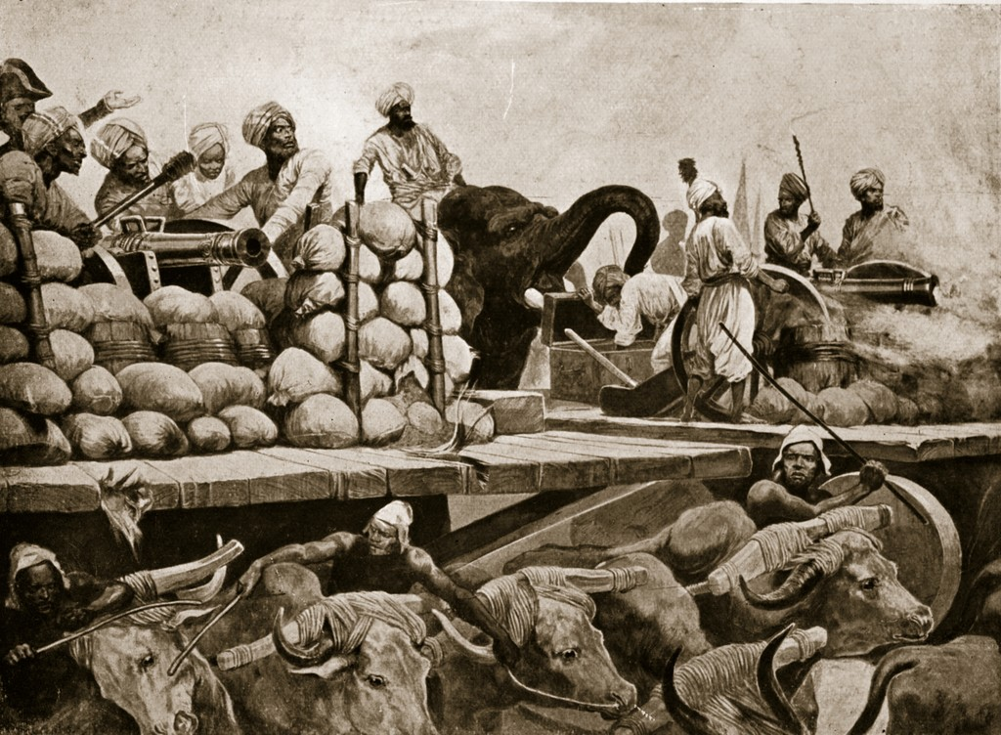
War and the Colonies
European Colonies were drawn into the struggle with some people refusing to serve an imperial power while other volunteered eagerly
Colonies were used for supplies, raw materials and troops

Slide 33
Total War
By 1917 Europe was feeling the strain of war
Three years into the war, a revolution in Russia and the entry of the United States into the war would upset the balance of forces and finally end the long stalemate
Nations began to realize that total commitment of their whole society would be needed. This was called total war or the channeling of a nations entire resources into the war effort

Slide 34
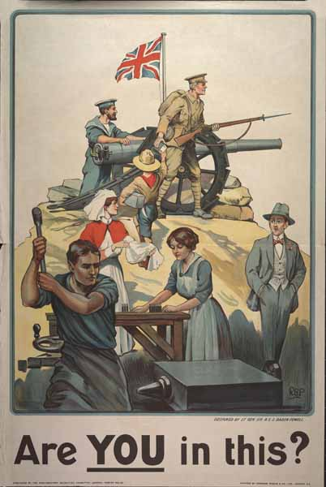
Economic Impact
Both sides set up systems to recruit, arm and transport and supply arms
Each nation except Britain imposed a universal military conscription known as the draft
Taxes were raised, large sums of money were borrowed to pay for the war
Food was rationed, strikes forbidden and prices were set by the government

Slide 35
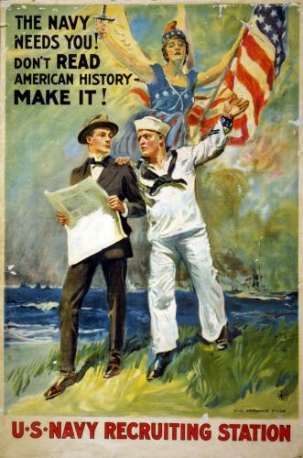
Propaganda War
Total war meant controlling public opinion
Special government boards censored the press to keep complete casualty figures and other discouraging news from reaching the people
Propaganda is the spreading of ideas to promote a cause or damage an opposing cause

Slide 36
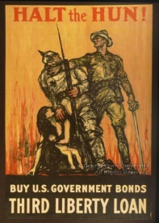
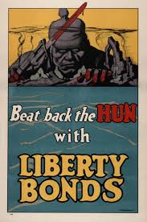
US Propaganda Posters

Slide 37
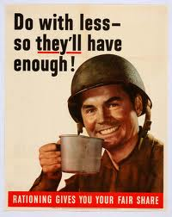
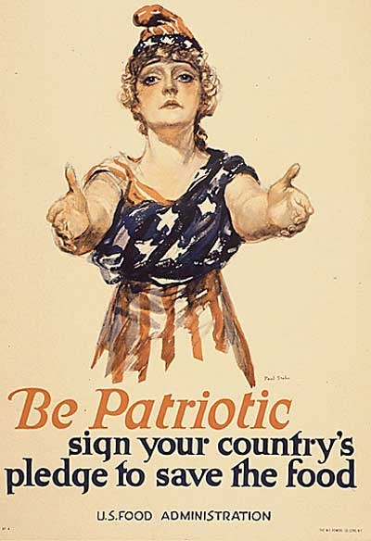
Patriotic Propaganda Posters

Slide 38
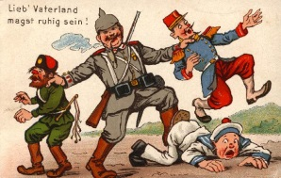
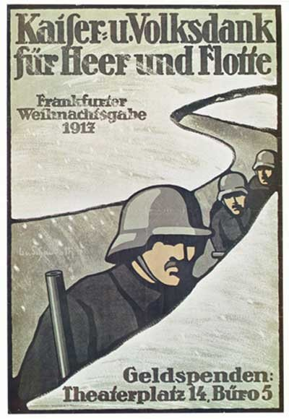
German Propaganda Posters

Slide 39
Impact On Women / Collapsing Morale
Women took over men’s jobs at home, Nurses helped the wounded
Their efforts helped them gain the right to vote after decades of struggle
Morale of both troops and civilians had collapsed by 1917, Boys as young as 15 were being sent to fight
Britain was on the verge of bankruptcy People began calling for an end to the war

Slide 40
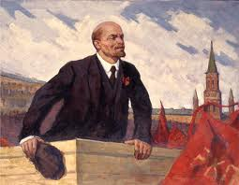
Revolution in Russia Impact on the War
By march 1917 bread riots in Russia had grown into a revolution that bought down the Russian monarchy
The Allies thought this would bring democracy to Russia but when Lenin came into power he signed the Treaty of Brest-Litkovsk with German ending Russian participation in the WWI

Slide 41

Russian Revolution:
Causes of the Russian Revolution:
Massive Russian defeats in the war
Food and fuel shortages
Low confidence in the czar and his government
Lenin promised Peace, Bread and Land
Communism is a form of socialism in which a class struggle was inevitable and would lead to the creation of a classless society in which all wealth and property would be owned by the community as a whole
Creates the USSR: Union of Soviet Socialist Republic s

Slide 42
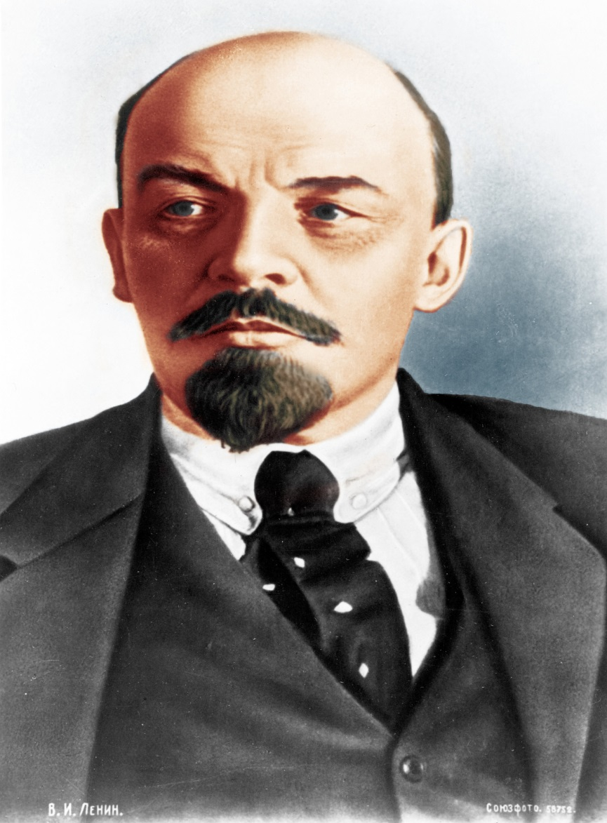
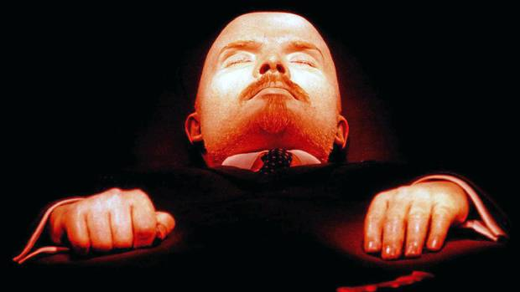
Lenin

Slide 43
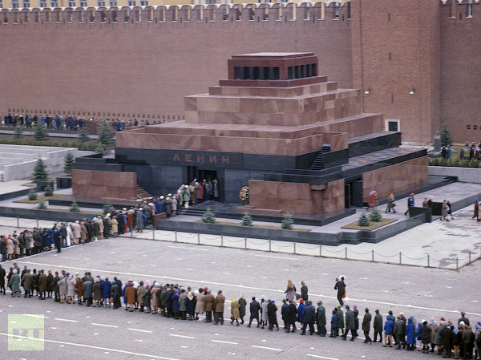
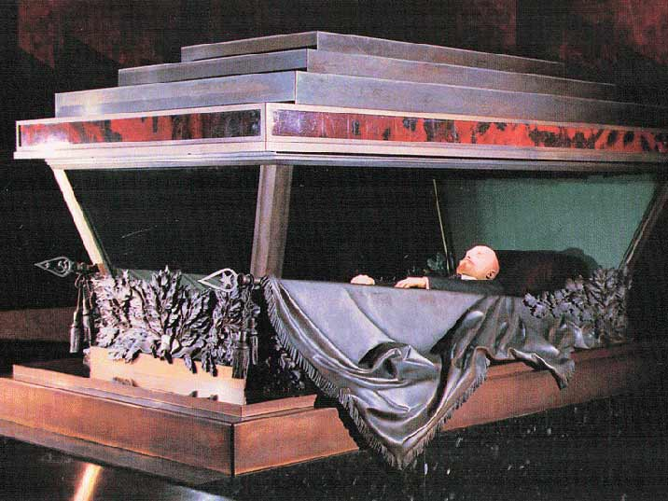
Lenin’s Tomb

Slide 44
Unrestricted Submarine Warfare
After the Russian Revolution began the United States declared war on Germany.
The major reason was the submarine attacks on our merchant and passenger ships carrying American citizens
These ships were transporting supplies to the Allies and President Wilson insisted that Americans had a right to safe travel on the seas since the US was neutral.
In May 1915 the Germans torpedoed the British passenger liner the Lusitania and 1200 passenger s were killed including Americans
Germany said they had the right to do this because the ship was carrying weapons.
Germany agreed to have the subs surface and give warning to allow neutral passengers to escape in lifeboats.
In 1916 Germany resumed unrestricted submarine warfare and Pres. Wilson denounced Germany after they sunk 4 US merchant ships, bring the US into the war

Slide 45
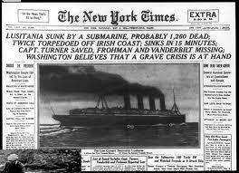
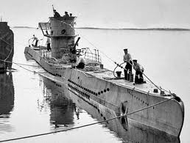
Sinking of the Lusitania

Slide 46
Cultural Ties
Americans supported the Allies because they felt ties of culture and language to Britain and sympathized with France as another democracy
Some German Americans favored the Central Powers
Many Irish Americans resented British rule of Ireland and many Russian and Jewish Americans did not want to be allied with the czar of Russian

Slide 47
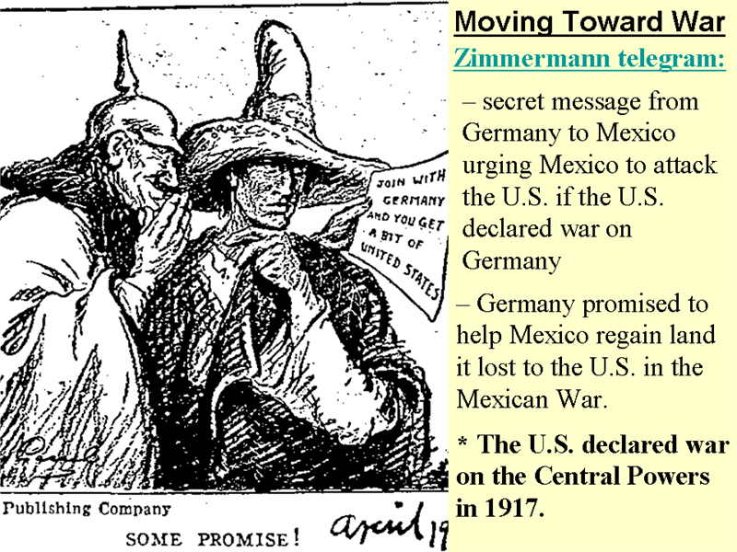
Zimmermann Note
In early 1917 the British intercepted a message from the German Foreign minister Zimmermann to his ambassador in Mexico
Zimmermann promised to Mexico that Germany would help Mexico to “re-conquer the lost territory in New Mexico, Texas and Arizona in exchange for their support of Germany
British revealed the note to the US causing anti-German feelings to intensify in US

Slide 48
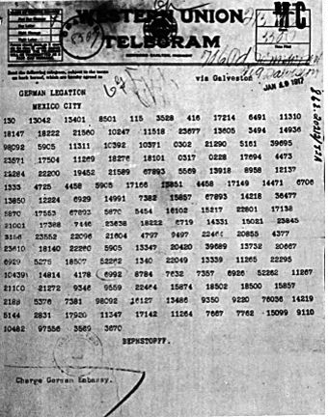
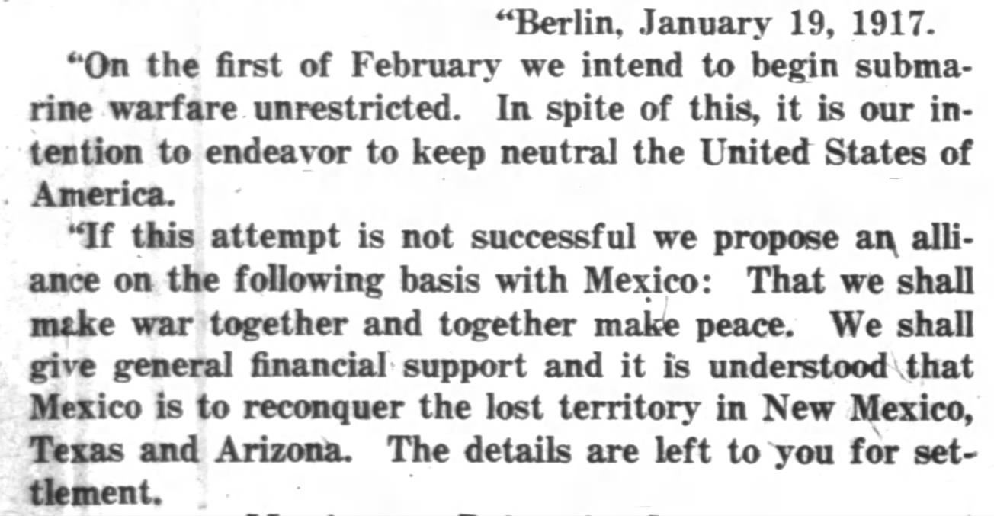
The Zimmerman Telegraph

Slide 49
Causes of America’s Entrance into the war
Cultural ties to England
Sinking of the Lusitanian
The Zimmerman telegram
Sinking of US merchant ships

Slide 50
Declaring War/Wilson’s Fourteen Points
In April of 1917 Wilson asked Congress to declare war on Germany
By 1918 about 2 million recruits joined the war on the Western Front
The US entrance into the war gave the Allies a much needed morale boost and provided financial aid too
In January Pres. Woodrow Wilson issued his Fourteen Points
The 14 Points is a list of terms for resolving this and future wars and include:
freedom of the seas
Free trade
large scale reductions of arms
an end to secret treaties
Wilson favored self determination, the right of people to choose their own from of government
He also urged the creation of a general assembly to keep the peace between nations in the future

Slide 51
Campaign to Victory
In 1918 the German pushed the Allies back 40 miles but the Allies slowly drove the German forces back out of France and Belgium
German generals told the Kaiser that the war could not be won
German people rioted and Kaiser William II fled to the Netherlands
Austria Hungary was collapsing and the Hapsburg Empire was in disarray
The new German government asked for an armistice or agreement to end the fighting with the Allies
On November 11, 1918 at 11:00 AM the Great War at last came to an end.!!!!

Slide 52
The Cost of War / Financial Burdens
Wilson thought he could solve the problems after the war and personally sailed to France
Europe was a shattered continent and making peace was not an easy talk
More than 8.5 million people had been killed
Famine was a problem
Europe was experiencing a pandemic of influenza called the Spanish Flu which killed more than 20 million people
From France to Russian ,homes, farms, factories, roads and churches had been destroyed, which was huge financial burden on the world
The Allies insisted the losers in the war make reparations or payments for war damages

Slide 53
The Big Three/Difficult Issues
President Wilson o the US, David Lloyd George of Great Britain and Georges Clemenceau of France were the strong leaders at the Paris Peace Conference
Britain and France wanted to punish Germany severely. Wilson wanted the Fourteen Points to be the basis of the peace.
Other countries had their own demands and interests
Nationalism was strong and the territories claimed by different groups often overlapped which created problems
Wilson insisted on an international League of Nations, which would be based on collective security a system in which a group of nations acts as one to preserve the peace of all

Slide 54
The Treaty of Versailles
In June 1919 the German representatives of the new German Republic were ordered to the Palace of Versailles outside of Paris
They were ordered to sign the treaty drawn up by the Allies forcing them to assume full blame for causing the war.
The Germans would be forced to pay huge reparations that would further damage their economy. They would also have to pay for the destruction caused by the war but also the pensions for millions of allied soldiers or their widows and families. The total would be over $30 billion
The Treaty also
Weakened Germany.
It limited the size of the German military
It returned Alsace and Lorrain to France
It removed much land from western and eastern Germany
Stripped German of its overseas colonies
The Germans also had to sign a war guilt clause taking blame for the war
The German Government signed the treaty. This resentment helped Spark another war later on

Slide 55
Widespread Dissatisfaction/Self determination
The Allies had separate treaties with the others
Most left widespread dissatisfaction
New nations emerged where the German, Austrian and Russian empires had once ruled. These included Latvia, Lithuania and Estonia
Poland regained independence after more than 100 years of foreign rule.
Three new counties Czechoslovakia, Austria and Hungary rose in the Hapsburg Empire.
In the Balkans a new state Yugoslavia was dominated by Serbia
Eastern Europe remained in turmoil

Slide 56
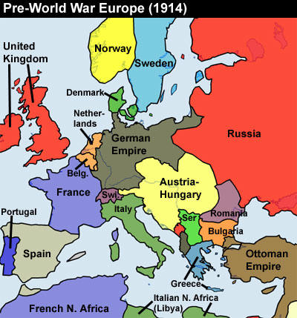
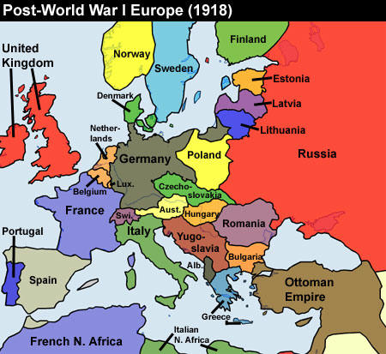
Europe in 1914 and in 1918

Slide 57
Mandate System
European colonies in Africa and Asia and the Pacific expected peace would end imperial rule
Outside of Europe, the allies added to their overseas empires. The treaties created a system of mandates or territories administered by western powers
Britain and France gained mandates of German colonies in Africa and Ottoman lands in the Middle East
Mandates were to be modernized and then stand alone, but they became European colonies
Colonized peoples felt betrayed by the peacemakers

Slide 58
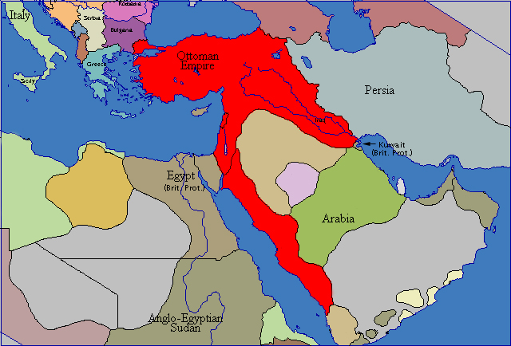
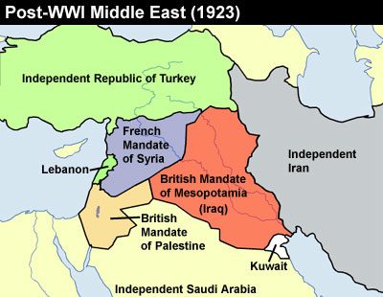
The Middle East Pre and Post War

Slide 59
Unfulfilled Goals / Hopes for Global Peace
The Paris Peace Conference offered one positive thing, Wilson’s League of Nations with more than 40 nations joining the League
Members promised to take common action, economic or military, against any aggressor state
The US Senate refused to ratify the treaty and the US NEVER joined the League. As time soon revealed, the League was powerless to prevent war
Germany was angry it did not get lands promised to them in a secret treaty wit the Allies
Japan was angry over the western nations refusing to recognize its claims in China
Russia resented the formation of a Polish nation and 3 independent Baltic states on former Russian lands
Italy did not receive territory for switching sides

Slide 60
The Major Effects of the Treaty of Versailles
It established 9 new countries and shifted the boundaries of others
It carved out 4 areas from the Ottoman Empire and gave them to France and Great Britain as mandates which would be administered until they were ready for independence
It demilitarized Germany
Germany was required to return Alsace and Lorraine to France
Germany had to pay $33 billion to the Allies
The treaty included a war guilt clause forcing Germany to accept full blame of the war and humiliating Germany
It ignored the claims of colonized people for self-determination
It provoked Russia’s determination to regain former Russian territory
It crated international problems that would eventually lead to World War II
WWI in 6 minutes: https://www.youtube.com/watch?v=-3UjJ5kxiLI&list=UUXito3UI2k0p7U1Jpk4CtAQ
Crash Course WWI 12 minutes: https://www.youtube.com/watch?v=_XPZQ0LAlR4&list=PLBDA2E52FB1EF80C9&index=36

Slide 61
Treaty of Versailles: Major Provisions
Treaty of Versailles: Major Provisions
League of Nations | Territorial Losses | Military Restrictions | War Guilt
International peace organization, enemy and neutral nations originally excluded German and Russia excluded | German returns Alsace and Lorraine to France, French boarder extended to West Bank of the Rhine German surrenders all of its overseas colonies in Africa and the Pacific Russia loses territory to creation of new countries | Limits set on the size of the German army. Germany prohibited from importing or manufacturing weapons or war material | Sole responsibility of the war placed on Germany’s shoulders Germany forced to pay Allies $33 Billion in reparations over 30 years

Slide 62
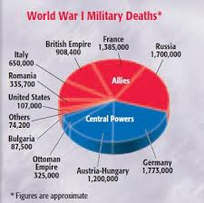
World War 1 Military Deaths

Slide 63
Causes of World War I
Long Term Causes
Rivalries among European powers
European alliance system
Militarism and arms race
Nationalist tensions in the Balkans
Immediate Causes
Austria-Hungary’s annexation of Bosnia and Herzegovina
Fighting in the Balkans
Assassination of Archduke Frances Ferdinand
Russian mobilization
German invasion of Belgium

Slide 64
Effects of World War I
Immediate Effects
Enormous cost in lives and money
Russian Revolution
Creation of new nations in Eastern Europe
Requirement that Germany pay huge reparations
German loss of its overseas colonies
Balfour Declaration
League of Nations
Long Term Effects
Economic impact of war debts on Europe
Stronger central governments
Emergences of United States and japan as important powers
Growth of nationalism in colonies
Increased anti-Semitism in Germany
Rise of fascism
World War II

